Slide 1
AIS 220
Foundational Mathematics for AI
Lecture 16
Review and Matrix Decomposition

Slide 2
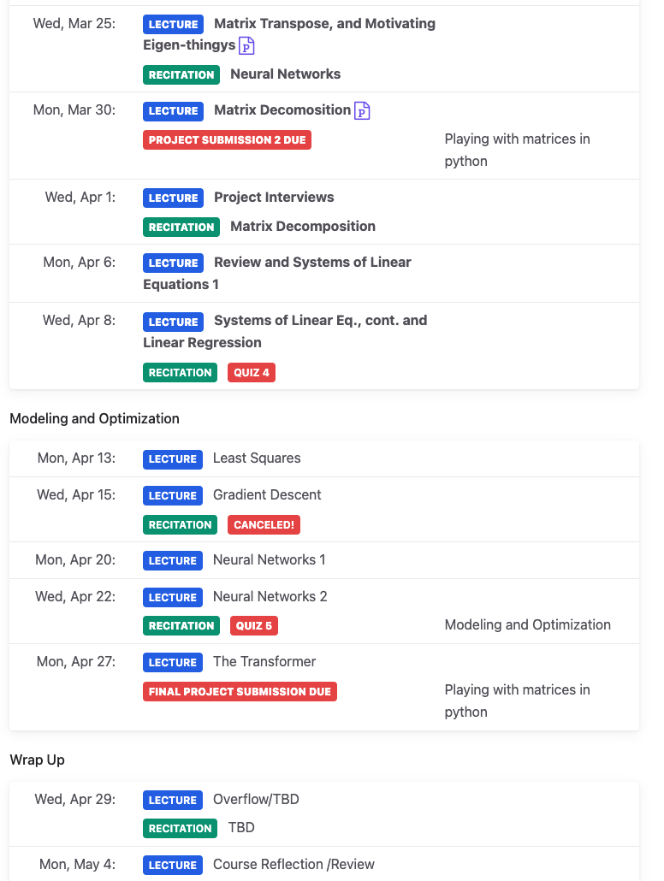
Announcements
Projects due tonight
Project interviews on Weds
Updated schedule!

Slide 3
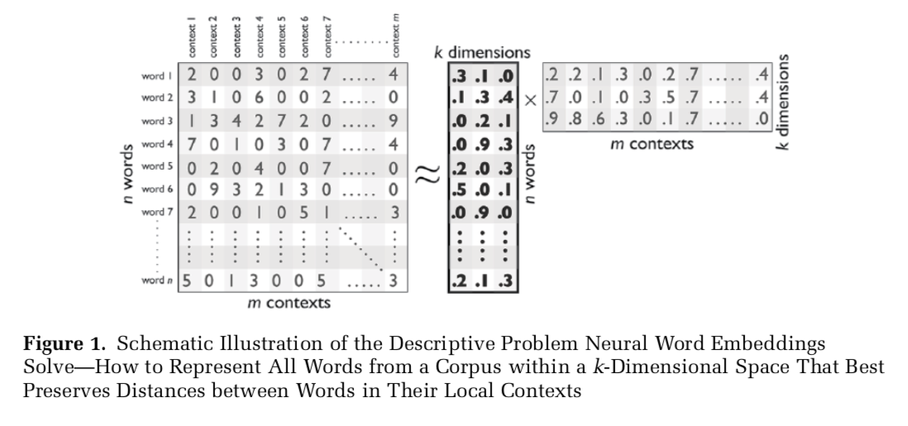

Slide 4
Ways I aimed to talk about decomposition
The word to context matrix contains a lot of redundant information
It would be nice if we had a way to shrink the matrix while still maintaining most of the important information
That’s what word embeddings are really doing!
Enter matrix decomposition
  A starting point for decomposition are eigenthing-ys ☺

Slide 5
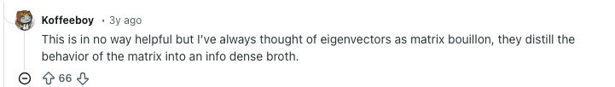
Eigenthingys – Intuition

Slide 6
Today
There are many, many methods for matrix decomposition
We are going to focus on ones that make linearity assumptions
In reverse order, a bit, from how we might teach this in a non-ML-focused course
  Start with Principle Component Analysis (PCA)
  Link that, informally, to eigenvector decomposition
    Introduce determinants, change of basis, and rank to understand this
Next week
  More math-y lectures on PCA and, using very similar concepts, systems of equations

Slide 7
Principle component analysis (PCA)
https://www.youtube.com/watch?v=FgakZw6K1QQ

Slide 8
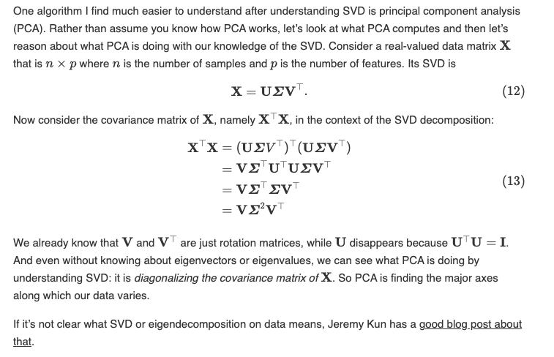
Where’s the linear algebra?
https://gregorygundersen.com/blog/2018/12/10/svd/

Slide 9
A second intuition for PCA
A Tutorial on Change of Basis and Dimensionality Reduction
Based on J. Shlens (2014)
https://arxiv.org/pdf/1404.1100

Slide 10
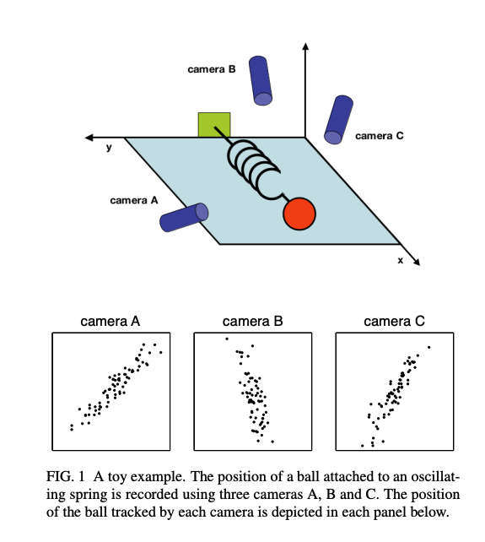
How can we figure out what a better “natural” basis for this data is?

Slide 11
A more formal motivation statement
Data Complexity: Lack of clear 'physics' in high-dim data.
Redundancy: Identifying correlated variables.
Noise: Separating meaningful signal from fluctuations.
Objective: Simplify representation without losing essence.

Slide 12

Philosophy – Change of Basis
Better Coordinate Systems: $Y = PX$.
Principal Components: The rows of the transformation matrix P.
Re-orientation: Aligning axes with maximum variance.

Slide 13
3blue1brown interpretation
https://www.3blue1brown.com/?v=change-of-basis
https://www.3blue1brown.com/?v=eigenvalues

