Slide 1
AIS 220
Foundational Mathematics for AI
Lecture 17
Systems of linear equations

Slide 2
Today
Systems of Linear Equations
Eigenvectors and changing bases
Back, once more, to SVD / PCA
Intermingled: Review
  Basic matrix notation
  Matrix addition, multiplication, transpose, inverse, determinant
  How to build word by context matrices
  Motivations (but not the math) behind PCA

Slide 3
System of Linear Equations
https://www.3blue1brown.com/lessons/inverse-matrices#title
Stops for
  Why are systems of linear equation useful?
    https://www.youtube.com/watch?v=csgNflj69-Y
    https://www.youtube.com/watch?v=pL4PXSXH-R8
    https://www.youtube.com/watch?v=2Bt-mi5rrCI
    Come up with your own example!
  What is the determinant?
    https://www.3blue1brown.com/?v=determinant
  What is rank?
    The “column space” of a matrix.
    Similarly, span of your column vectors
  What is null space?
    The set of vectors that land at the origin (that get “squished” into the origin)

Slide 4
Rank
Sounds a lot like span, right?
The rank of a matrix is the dimension of the span of its columns
The span of a set of vectors = all linear combinations of those vectors
The rank = the number of linearly independent vectors in that set
rank(A)=dim(span of columns of A)

Slide 5
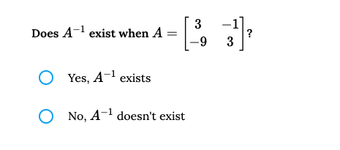
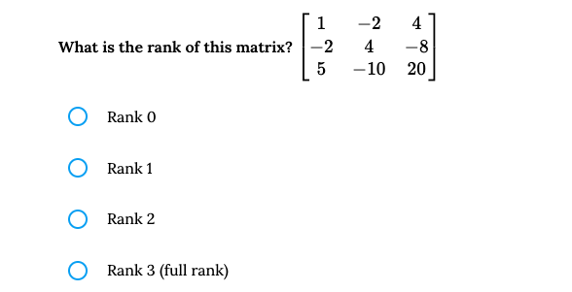
Concept Review
What does A⁻¹A = if A is a 3x3 matrix?
Come up with your own system of linear equations that would be interesting to solve
Computing the determinant, the general formula for 2x2 matrix

Slide 6
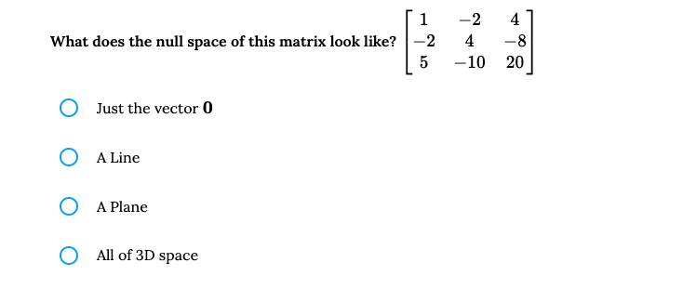
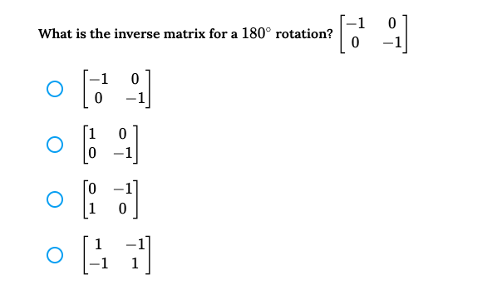

Slide 7
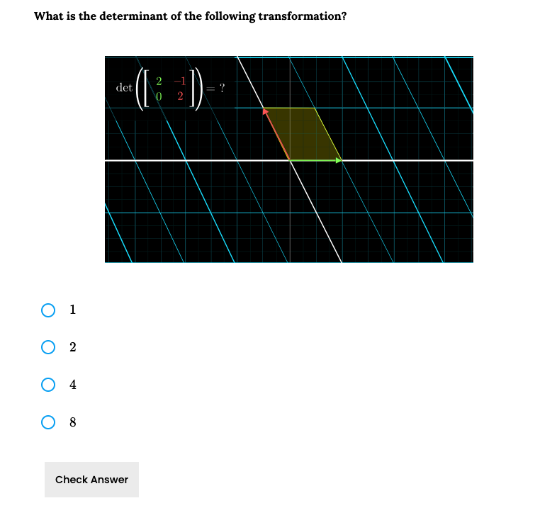

Slide 8
Solving
We will not cover solving systems of linear equations in this class, despite its importance
If you want to know more about this, I think you could do much worse than this reference:
https://e.math.cornell.edu/people/belk/writing/LinearODEs11.pdf

