Slide 1
AIS 220
Foundational Mathematics for AI
Lecture 18
Matrix Decomposition, again, for the last time

Slide 2
Eigenvectors, geometrically
https://www.3blue1brown.com/lessons/eigenvalues#title
Some review points
  “But if you can find an eigenbasis, it can make matrix operations really lovely.”

Slide 3


Slide 4
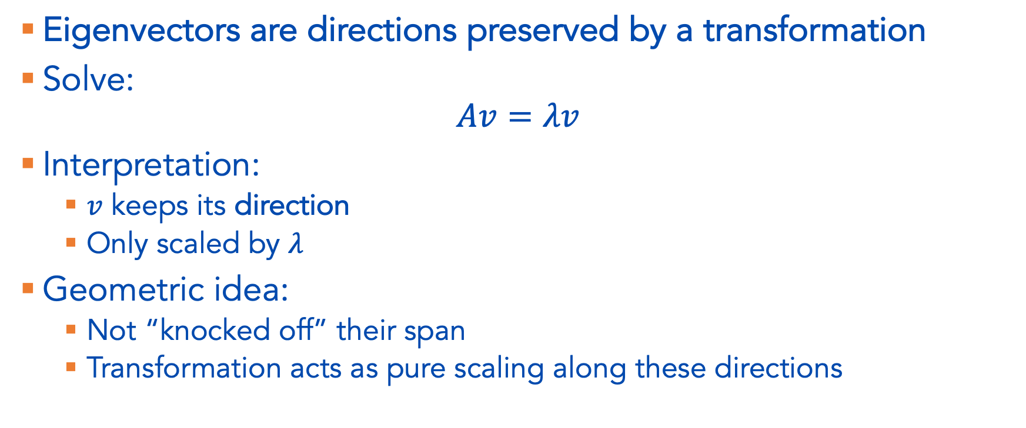
Eigenvectors – (Geometric) Intuition
Eigenvectors are directions preserved by a transformation
Solve:
$$Av=λv$$
Interpretation:
  $v$ keeps its direction
  Only scaled by $λ$
Geometric idea:
  Not “knocked off” their span
  Transformation acts as pure scaling along these directions

Slide 5
Eigenvectors – Who cares, anyway?
Eigenvectors and eigenvalues amount to finding a change of basis that make matrix operations easier (amongst other reasons we won’t cover)
As in 3blue1brown, this utility comes from the fact that we can do Diagonalization. If a matrix A has a full set of linearly independent eigenvectors, we can decompose it as:
A = PDP⁻¹
where D is a diagonal matrix containing the eigenvalues and P contains the eigenvectors. This transformation makes complex operations, like raising a matrix to a high power (as shown in the video), easier

Slide 6

What if $A$ isn’t square or symmetric?
“Same direction” no longer makes sense!
As we will see (and have seen), however, we still find use in these kinds of decompositions
The outline:
  We’re have to define a new notion of what constitutes ”same direction” for non-square matrices
  These are going to be the directions in the column space that “maximally stretch” the data, or in other words, that explain the data “the best” (remember the StatQuest video)
This is going to result in something called the singular value decomposition (SVD) of a non-square matrix

Slide 7
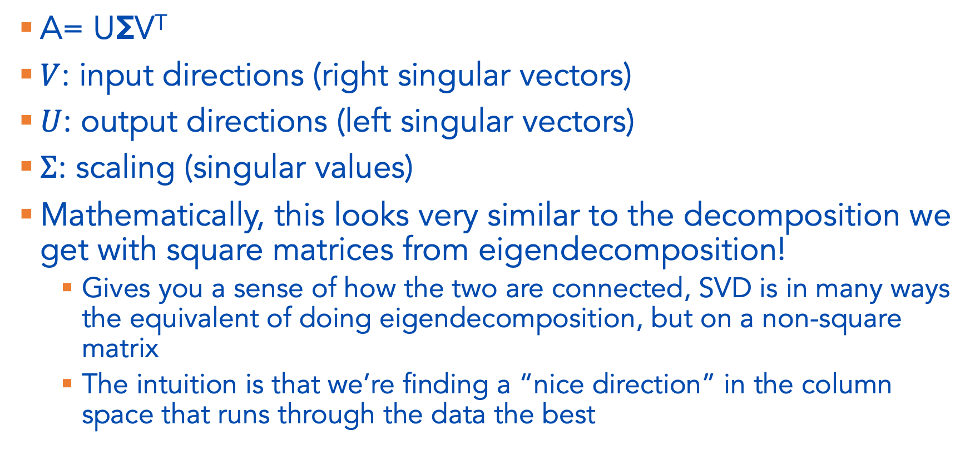
SVD objective, from a linear perspective
A= UΣV^{T}
$V$: input directions (right singular vectors)
$U$: output directions (left singular vectors)
$Σ$: scaling (singular values)
Mathematically, this looks very similar to the decomposition we get with square matrices from eigendecomposition!
  Gives you a sense of how the two are connected, SVD is in many ways the equivalent of doing eigendecomposition, but on a non-square matrix
  The intuition is that we’re finding a “nice direction” in the column space that runs through the data the best

Slide 8
We can, if we want, stop here
Getting the SVD of a non-square matrix again lets us do some nice things with our matrix
But if you recall, I motivated PCA (which is a cousin of SVD) on data matrices
What, exactly, is the relationship between these 3blue1brown videos geometrically, and matrices of data?!!!!

Slide 9
OK, but like, how does this connect to data?
https://gregorygundersen.com/blog/2022/08/28/matrices-as-functions-and-data/
[On the board]

Slide 10
Connecting to SVD
https://www.jeremykun.com/2016/05/16/singular-value-decomposition-part-2-theorem-proof-algorithm/
The SVD is what you get when you iteratively solve the greedy optimization problem of fitting data to a line.
By that I mean, you can compute the SVD by doing the following:
  What’s the best line fitting my data?
  Okay, ignoring that first line, what’s the next best line?
  Okay, ignoring all the lines in the span of those first two lines, what’s the next best line?
  Ignoring all the lines in the span of the first three lines, what’s the next best line?
  (repeat)

Slide 11
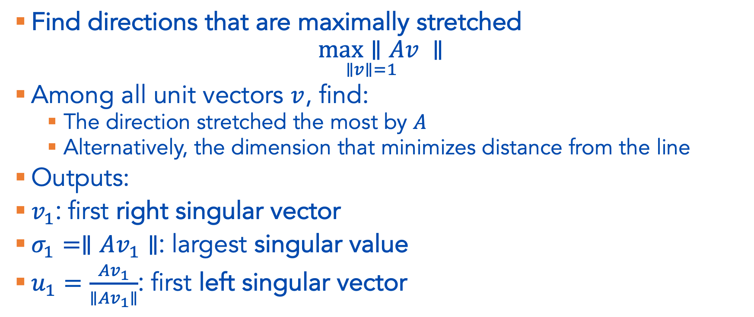
SVD as optimization
Find directions that are maximally stretched
$$\underset{∥v∥=1}{\max{∥Av }}∥$$
Among all unit vectors $v$, find:
  The direction stretched the most by $A$
  Alternatively, the dimension that minimizes distance from the line
Outputs:
$v_{1}$: first right singular vector
$σ_{1}=∥Av_{1}∥$: largest singular value
$u_{1}=\frac{Av_{1}}{∥Av_{1}∥}$: first left singular vector

Slide 12
Questions
We saw in the 3blue1brown how to find the eigenvectors
How do we find U, Σ, and V?
  The iterative, greedy algorithm described above
  This translates to finding orthogonal vectors that maximally explain (or equivalently, “stretch”) our data
And what, exactly, can we use them for?
  Dimensionality reduction
    Projecting onto the first singular dimension gives the best low rank approximation of our data
  Other nice matrix operations that make more sense geometrically

Slide 13
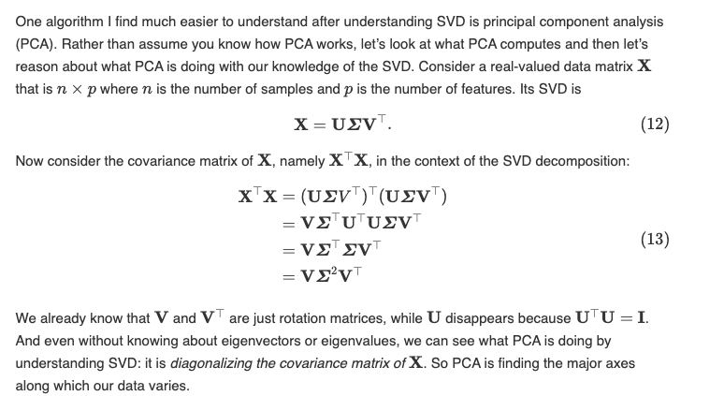
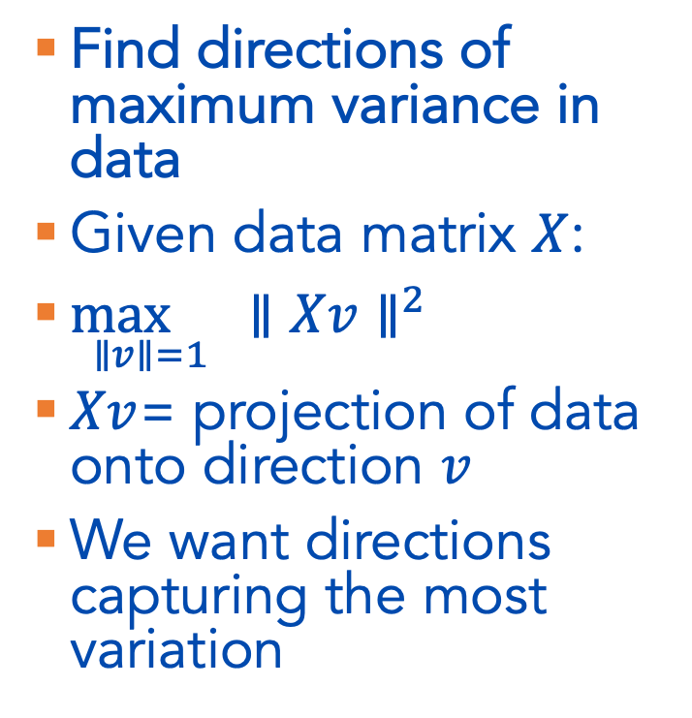
What about PCA?
Find directions of maximum variance in data
Given data matrix $X$:
$\underset{∥v∥=1}{\max{}}∥Xv∥^{2}$
$Xv$= projection of data onto direction $v$
We want directions capturing the most variation
https://gregorygundersen.com/blog/2018/12/10/svd/

Slide 14
