Slide 1
AIS 220
Foundational Mathematics for AI
Lecture 1
Hi!
Kenneth (Kenny) Joseph

Slide 2
Announcements
Hope you all had a nice snow day ☺
  I’ll make up for lost time but will take me a few lectures
I … changed our probability textbook. I’m sorry.
  Bonus points…
Today:
  What is ML
  Where does probability play a role, more concretely
  Why?
    B/c this is, hopefully, the start of many ML classes for you, good to get the big picture view

Slide 3
What is machine learning (ML)?
https://youtu.be/cKxRvEZd3Mw?t=25
Terms to be keying in on:
  Rule-based model
  “Recipe” -> pipeline
  Classifier -> model
  Training data
  Features (“inputs”)
  Labels (“outcome”)

Slide 4
Potential ML questions - Supervised learning
Supervised learning - can I predict an outcome from some inputs
If the outcome is…
  A category/set of discrete outcomes, this is classification
    Given a picture of their brain, does this person have cancer, yes or no?
  A number, this is regression
    How much will the price of this stock change tomorrow, given its prices over the last week?

Slide 5
Potential ML questions (cont.)
Scoring - Determining a score, or rank, for something
Where do we see this?
  Newsfeeds
  Prioritization of, e.g., water mains
How scoring works
  From a classification model
    Represents odds that the thing we’re predicting will happen
  From a regression model
    “Learn to rank” – learn a scoring/preference function directly

Slide 6
Potential ML questions (cont.)
Unsupervised learning – can I identify hidden patterns in a large dataset where there is no outcome

Slide 7
Example of unsupervised learning
https://medium.com/latinxinai/discovering-descriptive-music-genres-using-k-means-clustering-d19bdea5e443
Notes:
Cholera epidemics, what we now know to be caused by a specific pathogen in drinking water, were routine and catastrophic; so common that the population growth of London had flattened out. The likelihood of an infant reaching the age of three was less than one in five. In spite of this terrible scourge, Londoners were helpless to stop it. The germ theory was not yet established, and physicians continued to consider “miasmas,” or toxic vapors, as the source of ,. While Snow was skeptical of the miasma theory, his approach to the 1854 epidemic, was nothing short of brilliant; it was early “Big-data” science, at least to the extent that Snow had no real idea of the causative agent, or a model with which to shape his analysis.

Slide 8
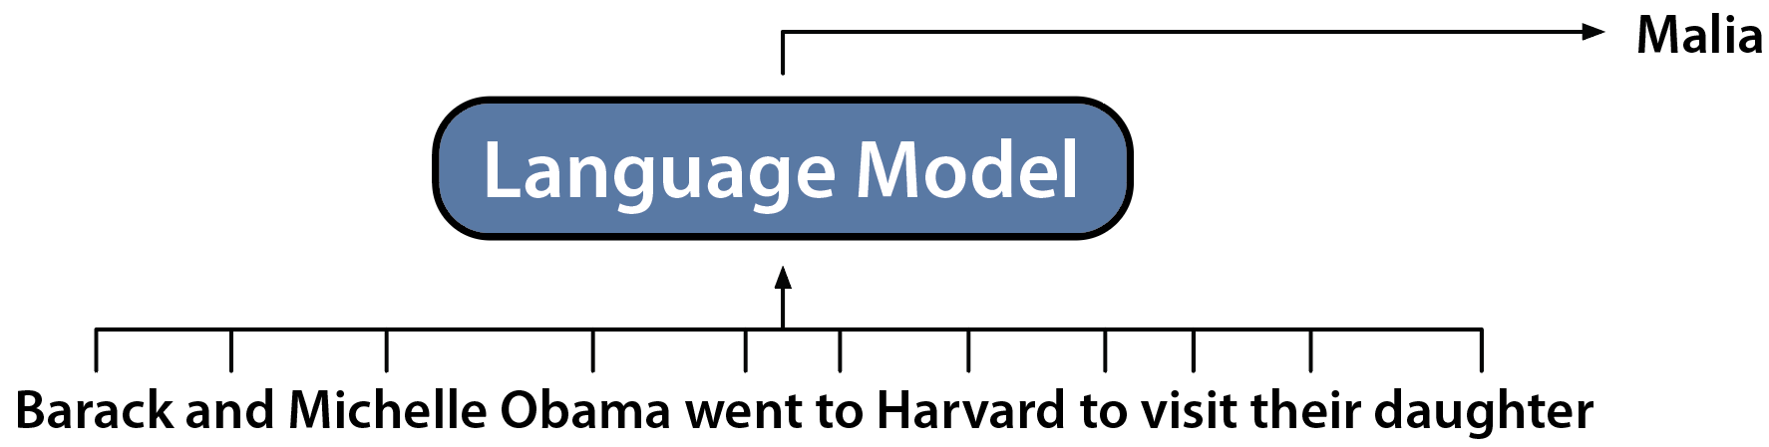
[Many things are in a grey area now]
Generative Language Models: Generate the Next Token
Slide by: Dan Fu

Slide 9

A basic view of the supervised machine learning pipeline
And/or some data
Train the model
?
Start with a question
Engineer the system for production use
Build a model
Evaluate the model

Slide 10
Case Study 1
We are the Buffalo Police Department. We want to predict where crime is going to happen at the neighborhood level.
Our question: Given inputs about a neighborhood today, predict the level of crime in that neighborhood tomorrow

Slide 11
Case Study 2
We are Erie County. We want an algorithm that predicts recidivism, i.e. whether or not a given person, if let out on bail, will or will not commit a crime before their court date

Slide 12

Case Study 3

Slide 13
Weather is explicitly probabilistic
So are the others!
Why? … we’ll discuss in the next few lectures. For now, lean on intuition

Slide 14
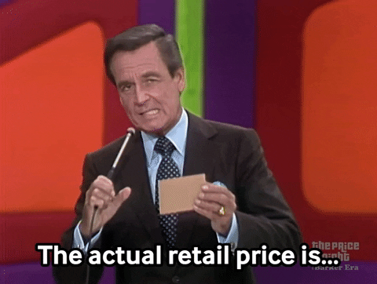
A more fun case study
https://www.youtube.com/watch?v=3WyUpmeg7ro

Slide 15
Building a bidding tool… some starters
Let’s imagine we wanted a probabilistic model to help us make our decision
We’re going to simplify a bit:
  Only two choices: Bid [$1] or Bid [$1 + the highest bid]
Probabilistic models are common in ALL of science
As we’ve seen, this includes ML (to the extent it is a science)

Slide 16
Constructing a (probabilistic) model
Step 1: Define the outcome
Step 2: Write down a probability model
Step 3: Use our model to make predictions

Slide 17
Creating a probabilistic model
Step 1: Define the outcome
  Simple example: Flipping a coin. What is the outcome we are interested in?
  (Much) Harder: TPIR.

Slide 18
Defining our algorithm, cont.
Step 1: Define the outcome
Step 2: Write down the probability model
  Simple example to work with: Flip a coin, then decide whether to bet $1 (heads) or [highest + 1] (tails)
  Some intuitive probability practice with this model

Slide 19
Making a good model
We can build better models by:
Finding more factors to condition on [using more information about our environment]
Gaining more knowledge about how these factors predict our outcome [knowing our environment better]

Slide 20
More factors

Slide 21
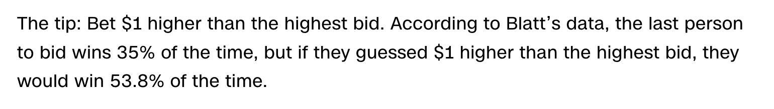
More knowledge
https://www.cnn.com/2013/11/18/showbiz/price-is-right-strategy/index.html

Slide 22
Creating a probabilistic model
Step 1: Define the outcome
Step 2: Write down the probability model
  Flip a coin, then decide whether to bet $1 (heads) or [highest + 1] (tails)
Step 3: Use our model to make predictions
  How do we use our model to predict what to bet?

Slide 23
This is (supervised) machine learning!!
Supervised learning - can I predict an outcome from some inputs
If the outcome is…
  A category/set of discrete outcomes, this is classification
    Given a picture of their brain, does this person have cancer, yes or no?
  A number, this is regression
    How much will the price of this stock change tomorrow, given its prices over the last week?

Slide 24
A basic view of the supervised machine learning pipeline
And/or some data
Train the model
?
Start with a question
Engineer the system for production use
Build a model
Evaluate the model

Slide 25
Case Study 1
Given inputs about a neighborhood today, predict the level of crime in that neighborhood tomorrow
What might we use as inputs/features?
What should our outcome be?

Slide 26
Case Study 3
What might we use as inputs/features?
What should we use as an outcome/label?

Slide 27
A basic view of the machine learning pipeline
And/or some data
Train the model
?
Engineer the system for production use
Start with a question
Build a model
Test the model

Slide 28
What, exactly, is a model?
A model is a thing that simplifies or characterizes your data in some way so as to give you a better understanding of it

Slide 29
Example – Supervised linear regression
Gross Movie Sales (Billions of $s)
Number of tweets of preview links in week before movie

Slide 30
Example – Supervised linear regression
Gross Movie Sales (Billions of $s)
Number of tweets of preview links in week before movie

Slide 31
Is a line the only way?
Gross Movie Sales (Billions of $s)
Can we build a better model?
Number of tweets of preview links in week before movie

Slide 32
Is a line the only way? No!
Gross Movie Sales (Billions of $s)
Number of tweets of preview links in week before movie

Slide 33
Example - classification
Classify all as (-)
Judge lets out on bail
Prior convictions
Judge does not let out on bail
Classify all as (-)
Income

Slide 34
A fancier classification algorithm
Judge lets out on bail
Prior convictions
Judge does not let out on bail
What is good/bad about this relative to the linear model?
Income

Slide 35
Question for you… where does linear algebra fit in?
Hear your thoughts!
https://dododas.github.io/linear-algebra-with-python/posts/16-12-29-2d-transformations.html
Come back to this during the linear algebra portion

Slide 36
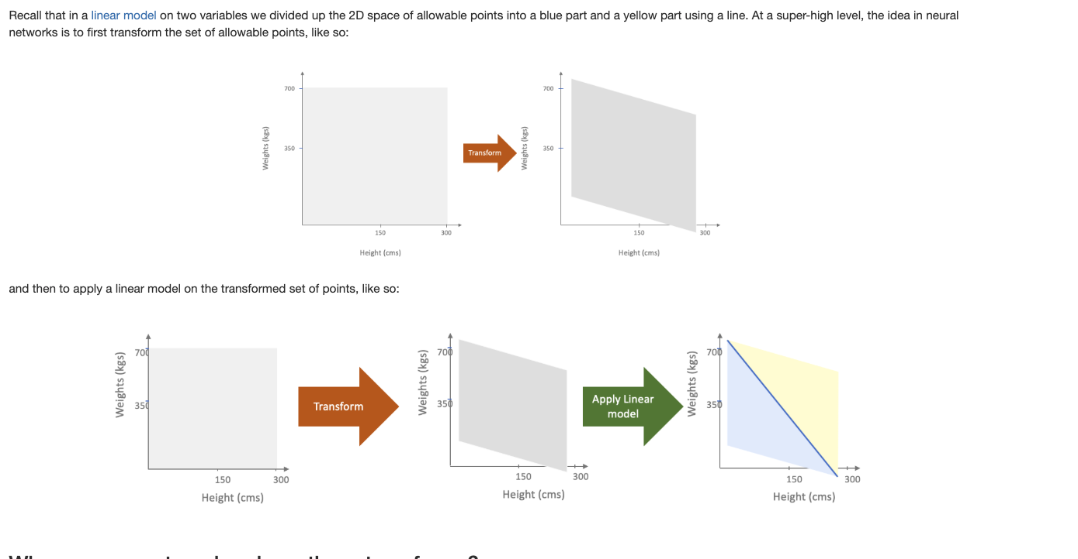

Slide 37
A basic view of the machine learning pipeline
And/or some data
Train the model
?
Engineer the system for production use
Start with a question
Build a model
Test the model

Slide 38
How do we train a model?
That is, how do we find the “best” line?
Number of crimes tomorrow
Number of arrests made today

Slide 39
How do we train a model?
Find the one that minimizes some objective function
Number of crimes tomorrow
SSE – sum of squared errors
Number of arrests made today

Slide 40
Training AND evaluating classification models
Our guess:
8
3
“Truth”
2
7

Slide 41
The Machine Learning Pipeline
And/or some data
Train the model
?
Engineer the system for production use
Start with a question
Build a model
Evaluate the model

Slide 42
Evaluating regression models
1. Make predictions for some text points
Number of crimes tomorrow
Number of arrests made today

Slide 43
Evaluating regression models (cont.)
Make predictions for some text points
Get the error of those predictions
Make some aggregate statement about those errors
… like what?
Number of crimes tomorrow
Number of arrests made today

Slide 44
Evaluating regression models (cont.)
SSE – sum of squared errors
Number of crimes tomorrow
Number of arrests made today

Slide 45
What is this evaluation missing?
SSE – sum of squared errors
Number of crimes tomorrow
Number of arrests made today

Slide 46
What is this evaluation missing?
White, affluent neighborhoods
Number of crimes tomorrow
Black, impoverished neighborhoods
Number of arrests made today

Slide 47
Evaluating classification models
Our guess:
8
3
“Truth”
2
7

Slide 48
Accuracy – how many did we get correct?
Our guess:
8
3
“Truth”
2
7
Accuracy =
(8 + 7) / (8 + 7 + 2 + 3) = .75

Slide 49
Precision - Of + guesses, how many actually +s?
Our guess:
8
3
“Truth”
2
7
Precision =
7 / (7 + 3) = .7

Slide 50
Recall - Of actual +, how many do we guess?
Our guess:
8
3
“Truth”
2
7
Precision =
7 / (7 + 2) = .78

Slide 51
Evaluation Review
Different metrics for different things
Other performance metrics:
  F1 Score
  …
Other considerations
  Class imbalance (accuracy bad)
  …

Slide 52
Summary of learning
We follow a standard pipeline
Our ultimate goal is often probabilistic
To get there, we develop and train models using linear algebra on data that can be represented using linear algebra

Slide 53
What about chat?

Slide 54
1 slide summary: Generative Language Models
Generative Language Models: Generate the Next Token
Slide by: Dan Fu

Slide 55
A not-too-over-simplified definition of LLMs
Find as much data as you can
Find as many computers as you can
Use those computers to build a program that can predict the next word in a document, given all previous words.
If desired, add some additional stuff on top (like what?)
Rinse and repeat until the model is “good”

Slide 56
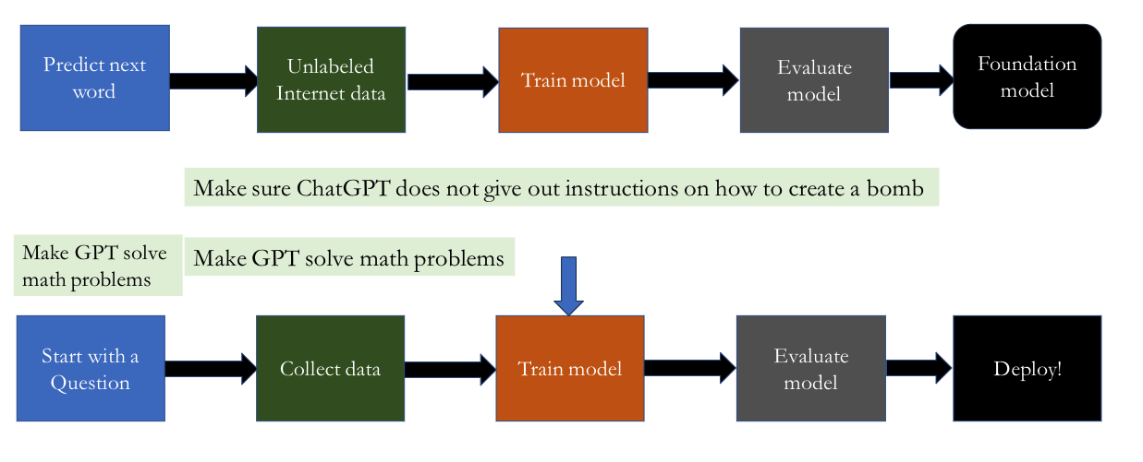
The [new] [simplified] ML pipeline

Slide 57
Great!
Starting next class, we go deep in the weeds of probability
Or really, even, before probability, with set notation!

