Slide 1
Neural Networks
Kenneth (Kenny) Joseph

Slide 2
What I am aiming for
I would like if by the end of this you…
  Understand the basics of these models, and that they are really just very complex matrix algebra
  Appreciate the utility of these models
  Acknowledge their limitations and challenges

Slide 3
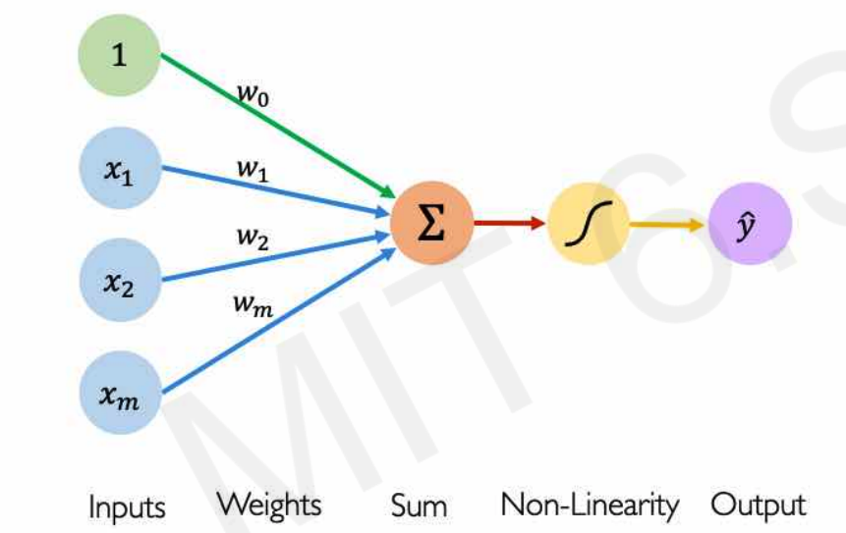
Starting point: the neuron
This is a neuron it consists of:
  Inputs
  A sum
  An activation function
  An output
Quiz
  Can we write this out using linear algebra?
  What is this if there is no non-linearity?
  What if the non-linearity is a sigmoid
http://introtodeeplearning.com/

Slide 4
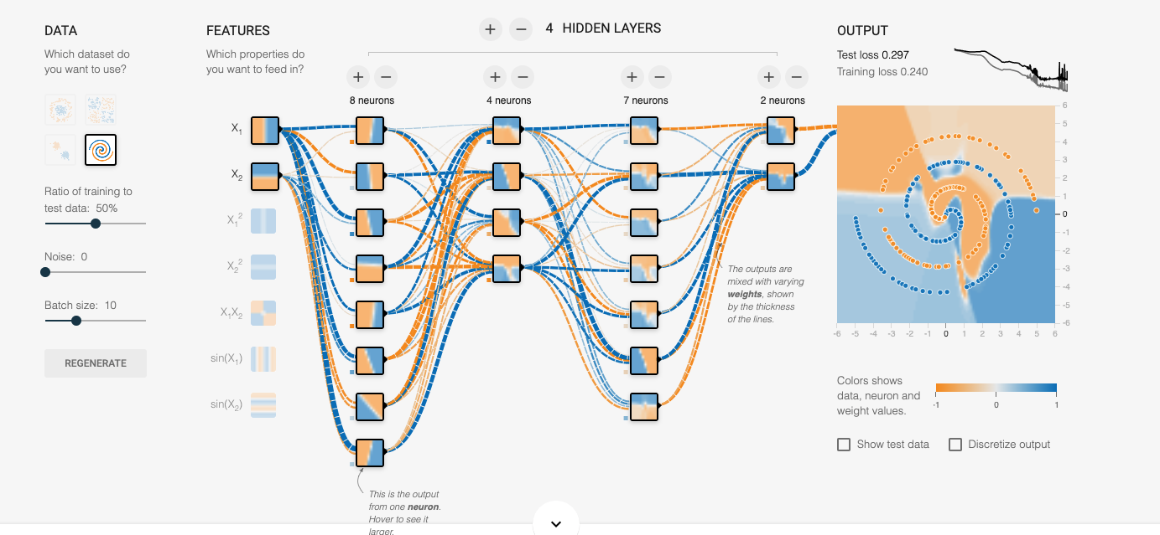
Playing around with Neural Nets
https://playground.tensorflow.org

Slide 5
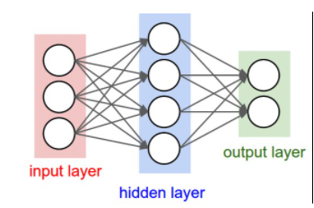
From a neuron to many neurons
Network structure
  Input layer
  Hidden layer
  Output layer
https://cs231n.github.io/neural-networks-1/

Slide 6
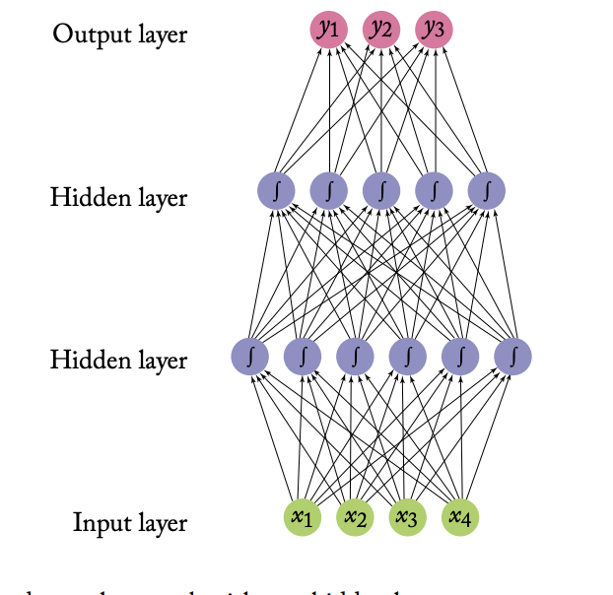
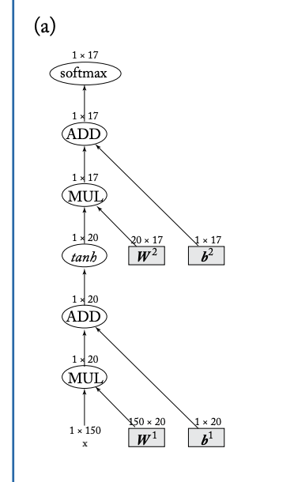
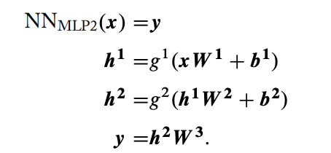
Equivalent Model Representations
https://www.morganclaypool.com/doi/pdf/10.2200/S00762ED1V01Y201703HLT037

Slide 7
Great! Now we know neural networks…?
Not quite. There’s a few details missing
We don’t use the sigmoid activation function anymore, really (next slide)
How do we code this up (recitation and Project 3)
Next week
  How do we actually learn the weights?
  We use other architectures as well, not just these stacks of neurons (multi—layer perceptrons, or MLPs)
    The transformer
  How does this all get used to create a generative language model?

Slide 8
