Slide 1
Quiz Review / Backpropagation
Kenneth (Kenny) Joseph

Slide 2
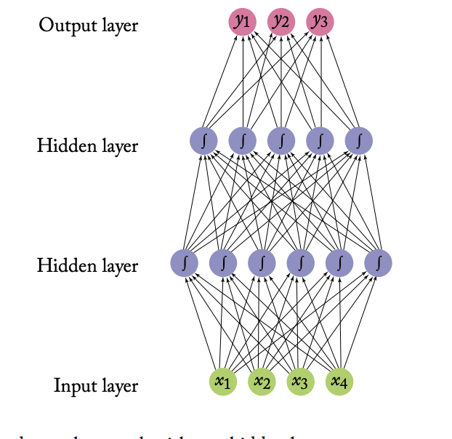
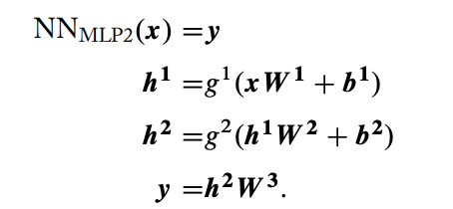
Equivalent Model Representations
https://www.morganclaypool.com/doi/pdf/10.2200/S00762ED1V01Y201703HLT037

Slide 3
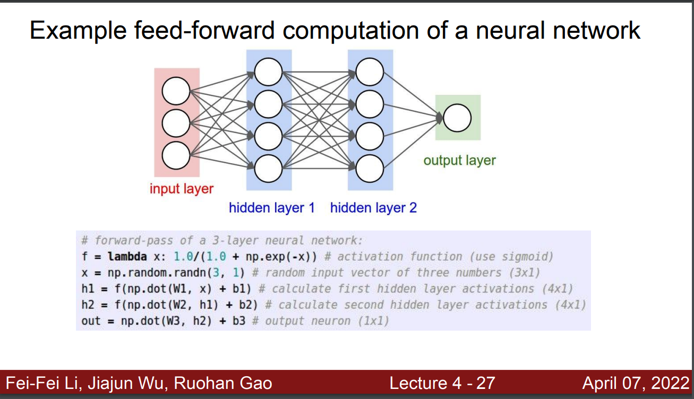

Slide 4
Practice Drawing -> Matrix, Matrix -> Drawing

Slide 5
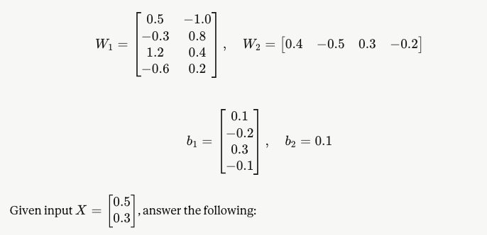
Draw this model
How many parameters does this model have?
Using the sigmoid activation, what is the output of the model?
How would you write f(x)?
What is the output of this model on the given dataset?

Slide 6
Great! Now we know neural networks…?
We don’t use the sigmoid activation function anymore, really (next slide)
How do we code this up (recitation and Project 3)
How do we actually learn the weights?
We use other architectures as well, not just these stacks of neurons (multi—layer perceptrons, or MLPs)
  Wednesday
  [Note – the drawings are different! But the mapping ideas are similar]
How does this all get used to create a generative language model?
  Monday for a bit

Slide 7
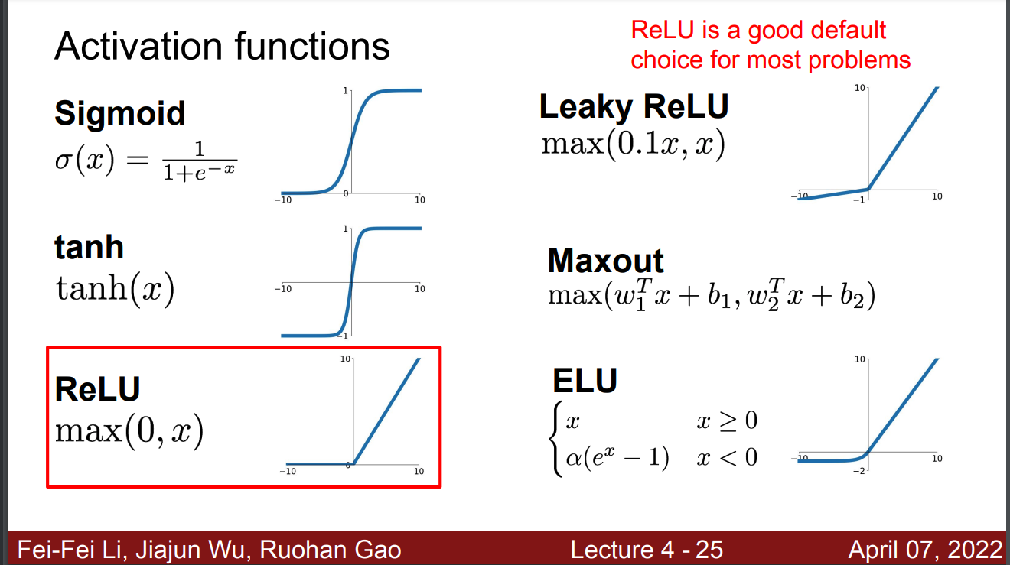

Slide 8
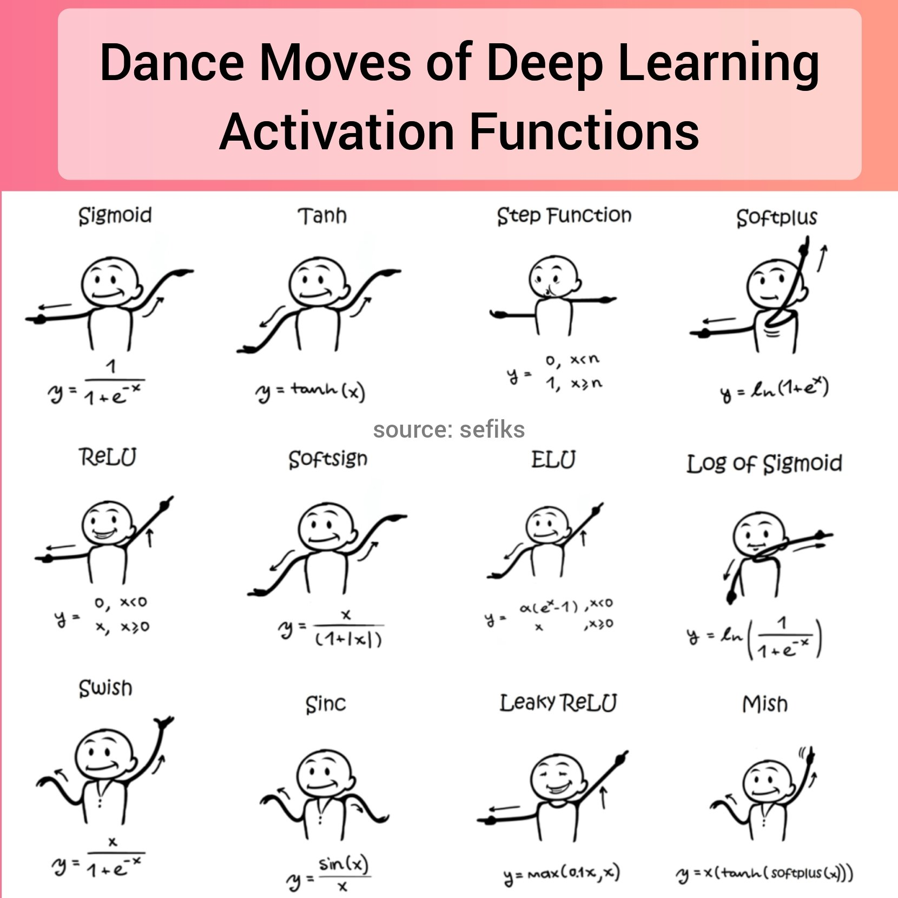
Activation Functions
https://twitter.com/TheInsaneApp/status/1366324846976659461/photo/1

Slide 9
How do we learn the weights?
This is a really hard question

Slide 10
Step 0 – Loss functions as … functions
Understanding loss as a function with the parameters as the parameters of your model class
Let’s draw the loss function for a linear model with no intercept!

Slide 11
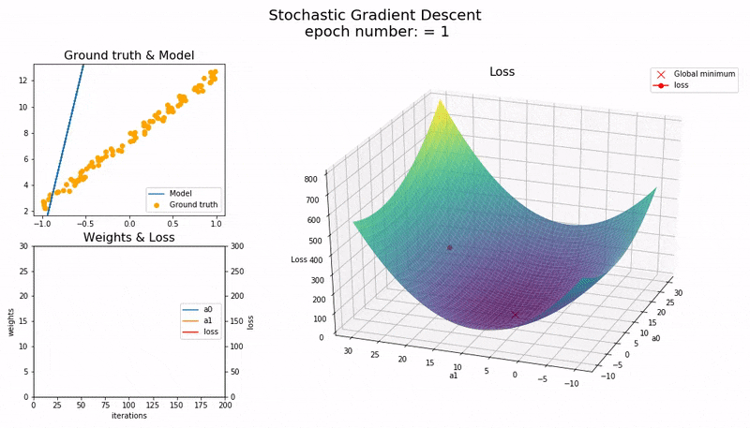
Step 1 – gradient descent
For linear models with an intercept, we have ___ parameters
We can look at the loss function here
It is guaranteed to be convex, which means we can always find a global minimum if we just start somewhere and “descend the gradient”
https://medium.com/@guptamuskaan438/gradient-descent-explained-visually-from-intuition-to-optimization-f20a40798af4

Slide 12
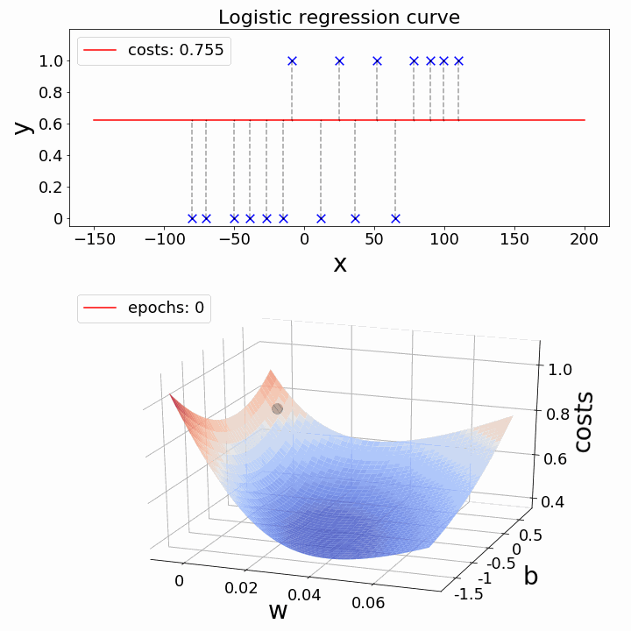
Gradient Descent with a nonlinearity
It looks kind of similar with a single nonlinearity. All good still, just get a weirder shaped line!
https://medium.com/@guptamuskaan438/gradient-descent-explained-visually-from-intuition-to-optimization-f20a40798af4

Slide 13
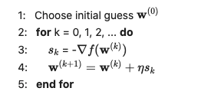
Gradient Descent algorithm

Slide 14
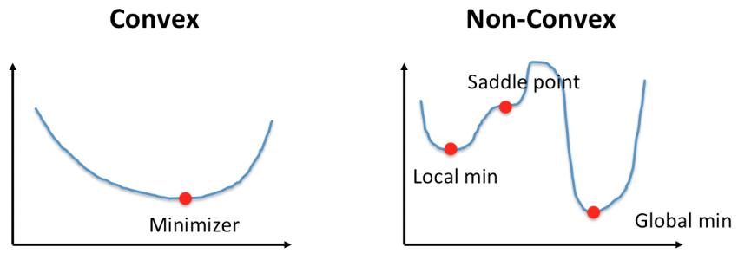
Gradient descent with a non-convex loss
Erg. When we introduce more non-linearities, our loss function becomes non-convex. We can’t just ride our sled to the same bottom, it depends where we start
https://ai.plainenglish.io/navigating-the-terrain-convex-vs-non-convex-functions-in-optimization-86812e9a1989

Slide 15
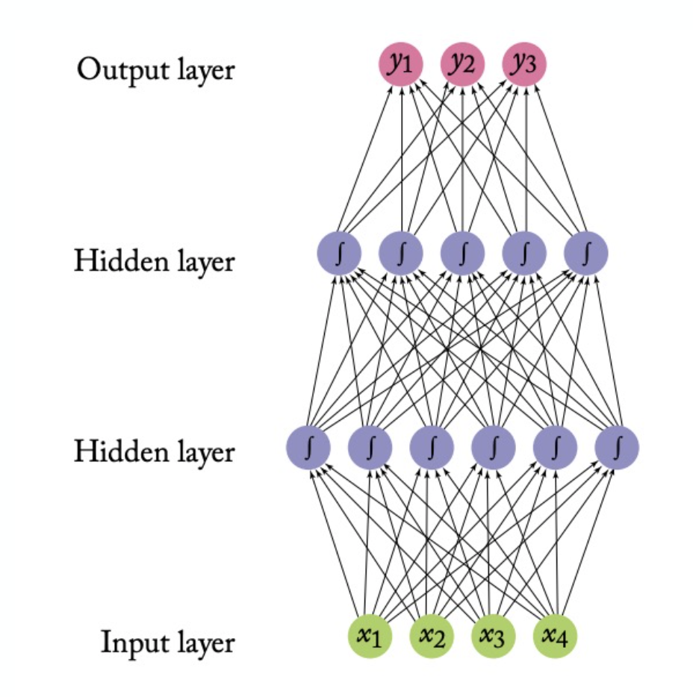
And! We can’t easily compute the gradient now
For neural networks, then:
  We have a non-convex loss… we can’t expect to find the global minimum
  We have to work to even take the gradient, because there’s no closed-form equation for it!

Slide 16
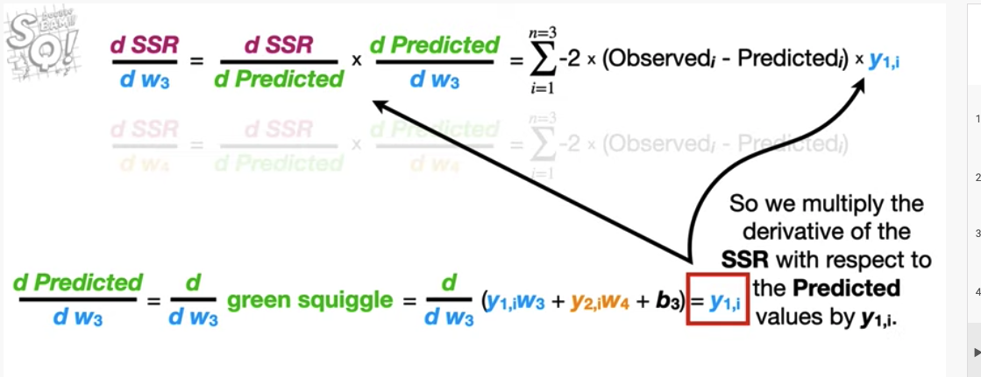
Step 3: Backpropagation (Chain rule)

Slide 17
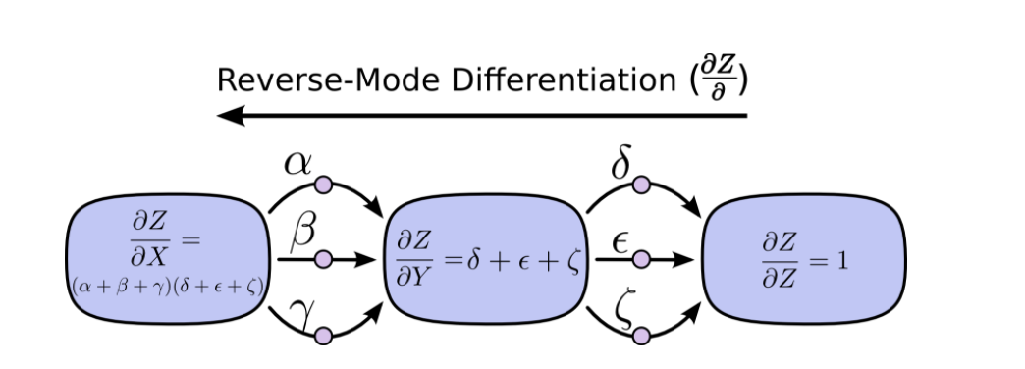
Backprop: Use the chain rule efficiently

Slide 18
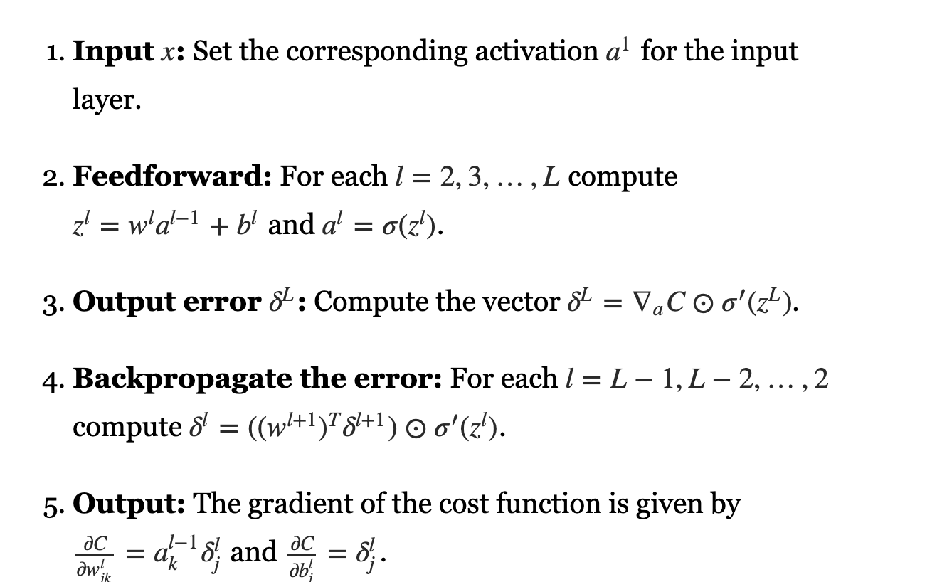
Backprop algorithm

Slide 19
Where we’re at
Backprop helps us take a gradient descent step.
But we still have a non-convex loss
What to do? Lots and lots and lots of ideas that I am not an expert in.
Two high-level things, though:
  Clever optimization
  Clever tweaks to the model class

Slide 20
Optimization tweaks
https://towardsdatascience.com/a-visual-explanation-of-gradient-descent-methods-momentum-adagrad-rmsprop-adam-f898b102325c/

Slide 21
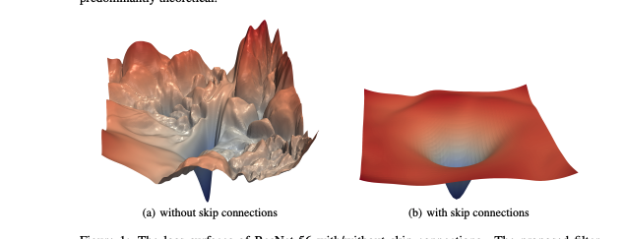
Model tweaks
https://proceedings.neurips.cc/paper/2018/file/a41b3bb3e6b050b6c9067c67f663b915-Paper.pdf

