Slide 1
Neural Networks
Kenneth (Kenny) Joseph

Slide 2
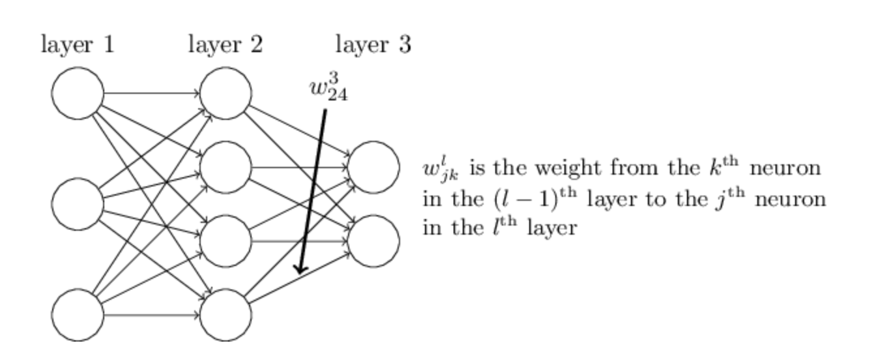
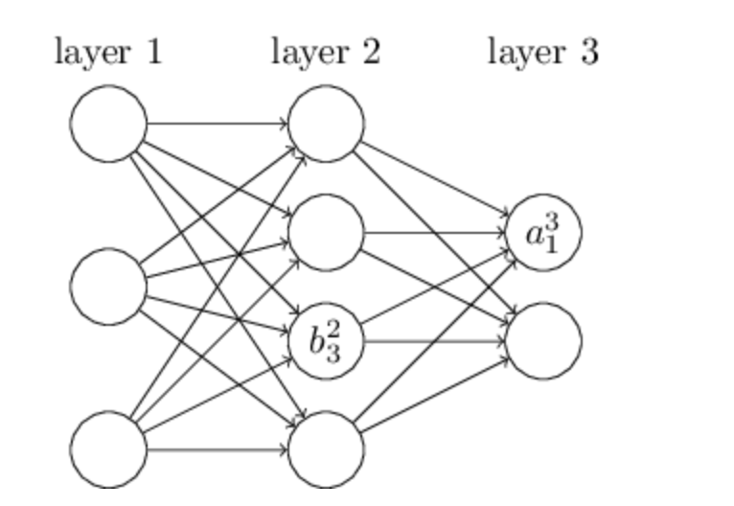
Specifying matrix format
http://neuralnetworksanddeeplearning.com/index.html

Slide 3
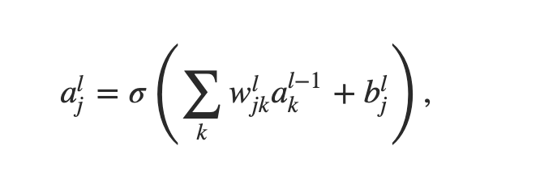
Specifying matrix format
http://neuralnetworksanddeeplearning.com/index.html

Slide 4
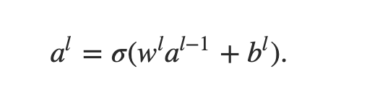
Specifying matrix format
http://neuralnetworksanddeeplearning.com/index.html

Slide 5
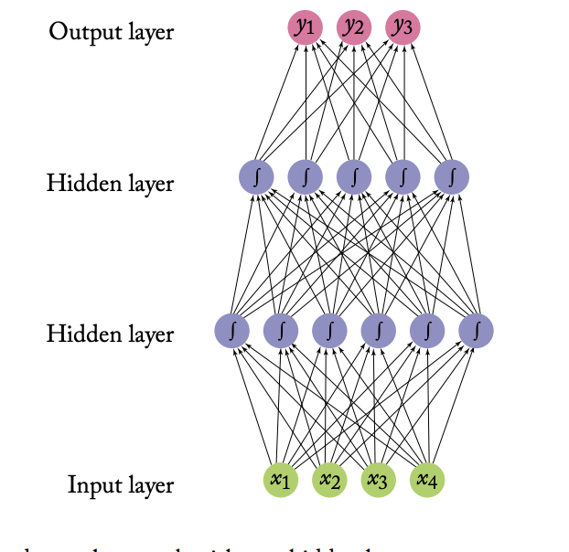
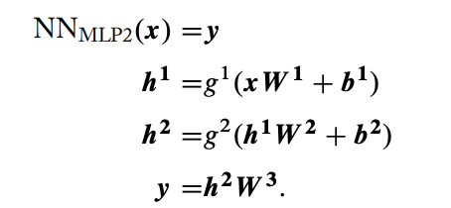
Equivalent Model Representations
https://www.morganclaypool.com/doi/pdf/10.2200/S00762ED1V01Y201703HLT037

Slide 6
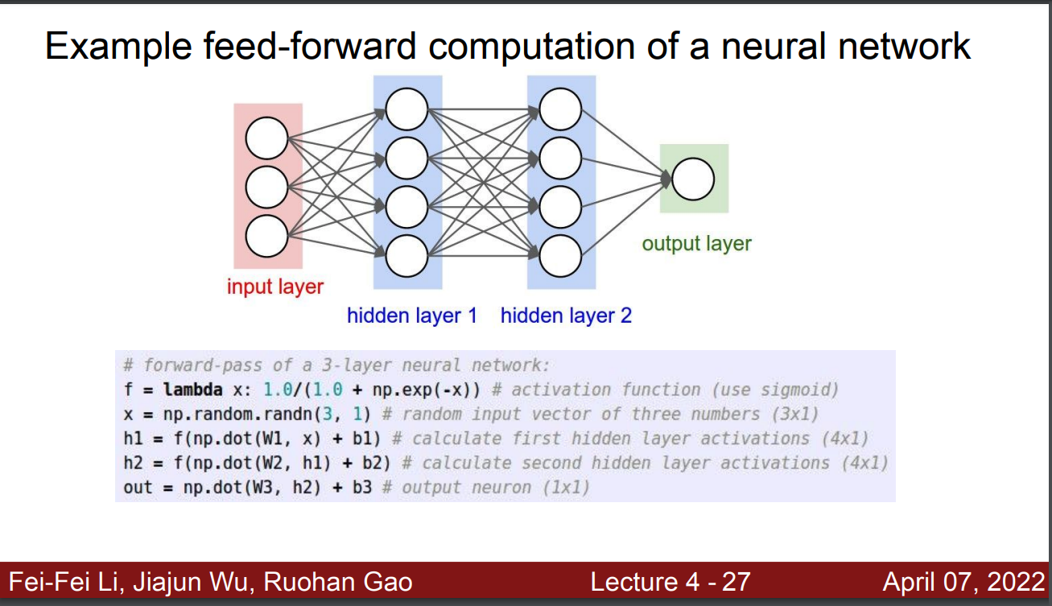

Slide 7
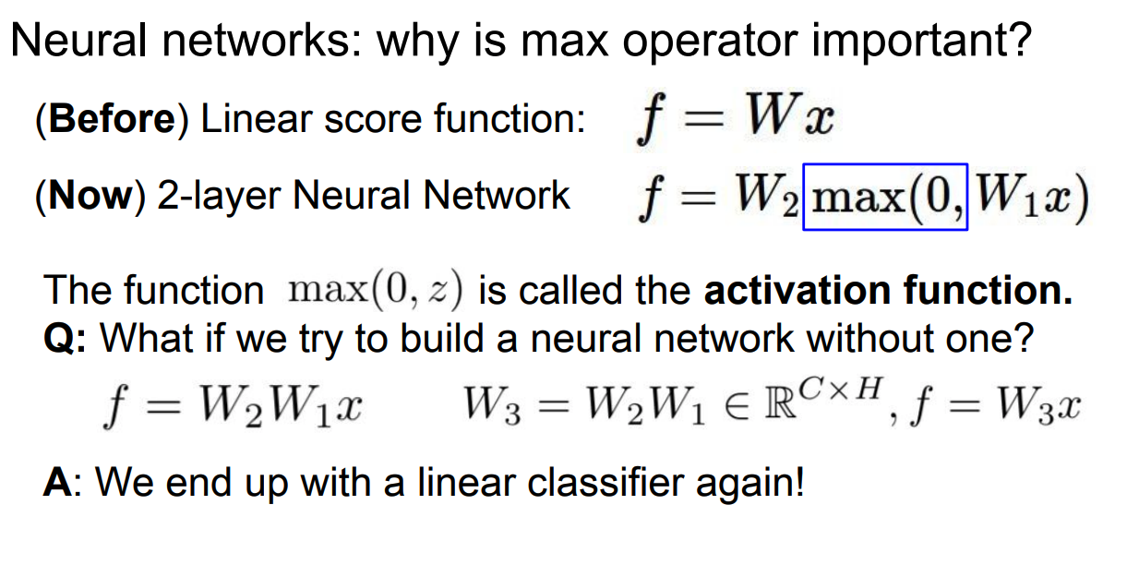

Slide 8
Practice Drawing -> Matrix

Slide 9
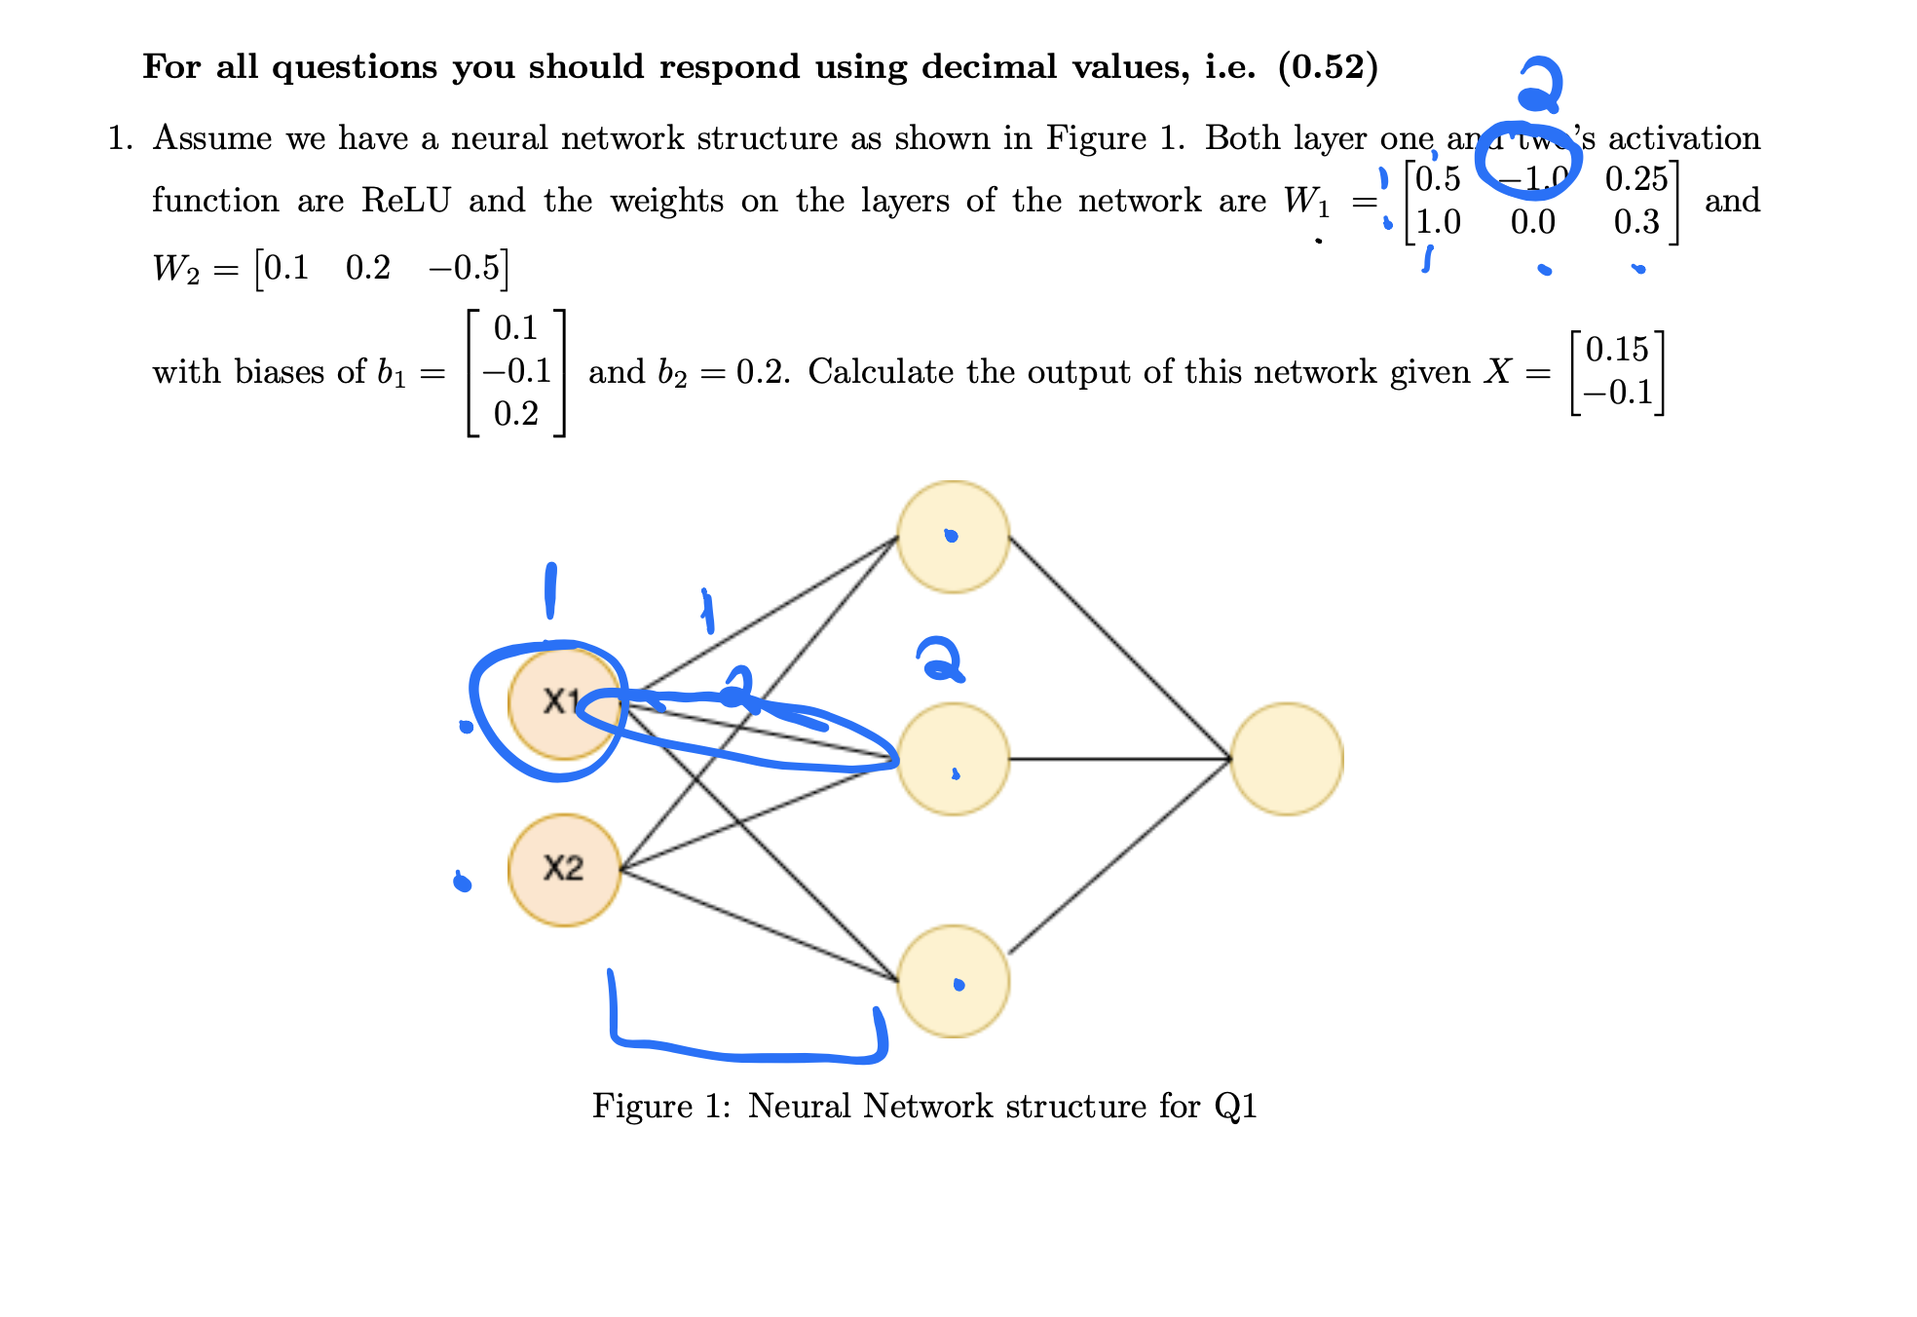

Slide 10
Great! Now we know neural networks…?
We don’t use the sigmoid activation function anymore, really (next slide)
How do we code this up (recitation and Project 3)
How do we actually learn the weights?
We use other architectures as well, not just these stacks of neurons (multi—layer perceptrons, or MLPs)
  The transformer
How does this all get used to create a generative language model?

Slide 11
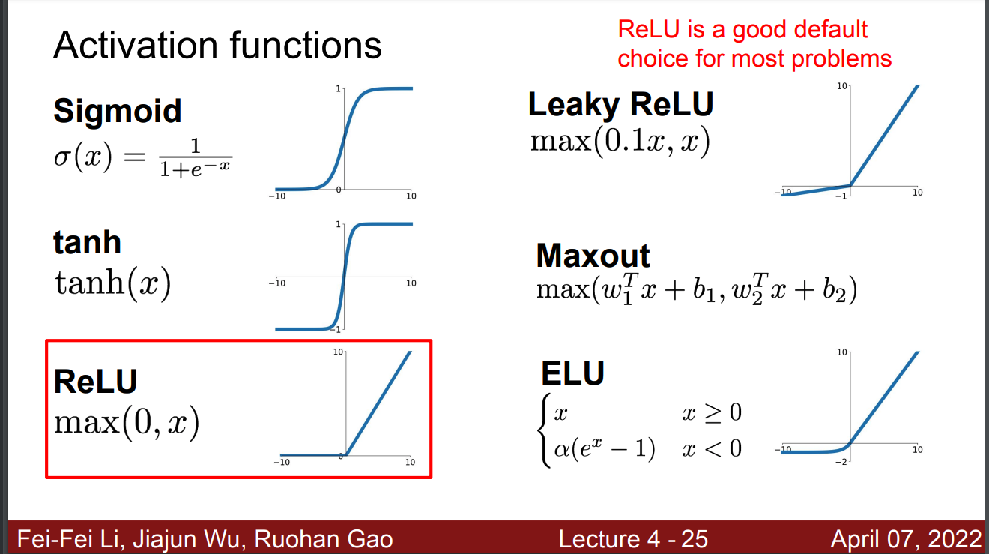

Slide 12
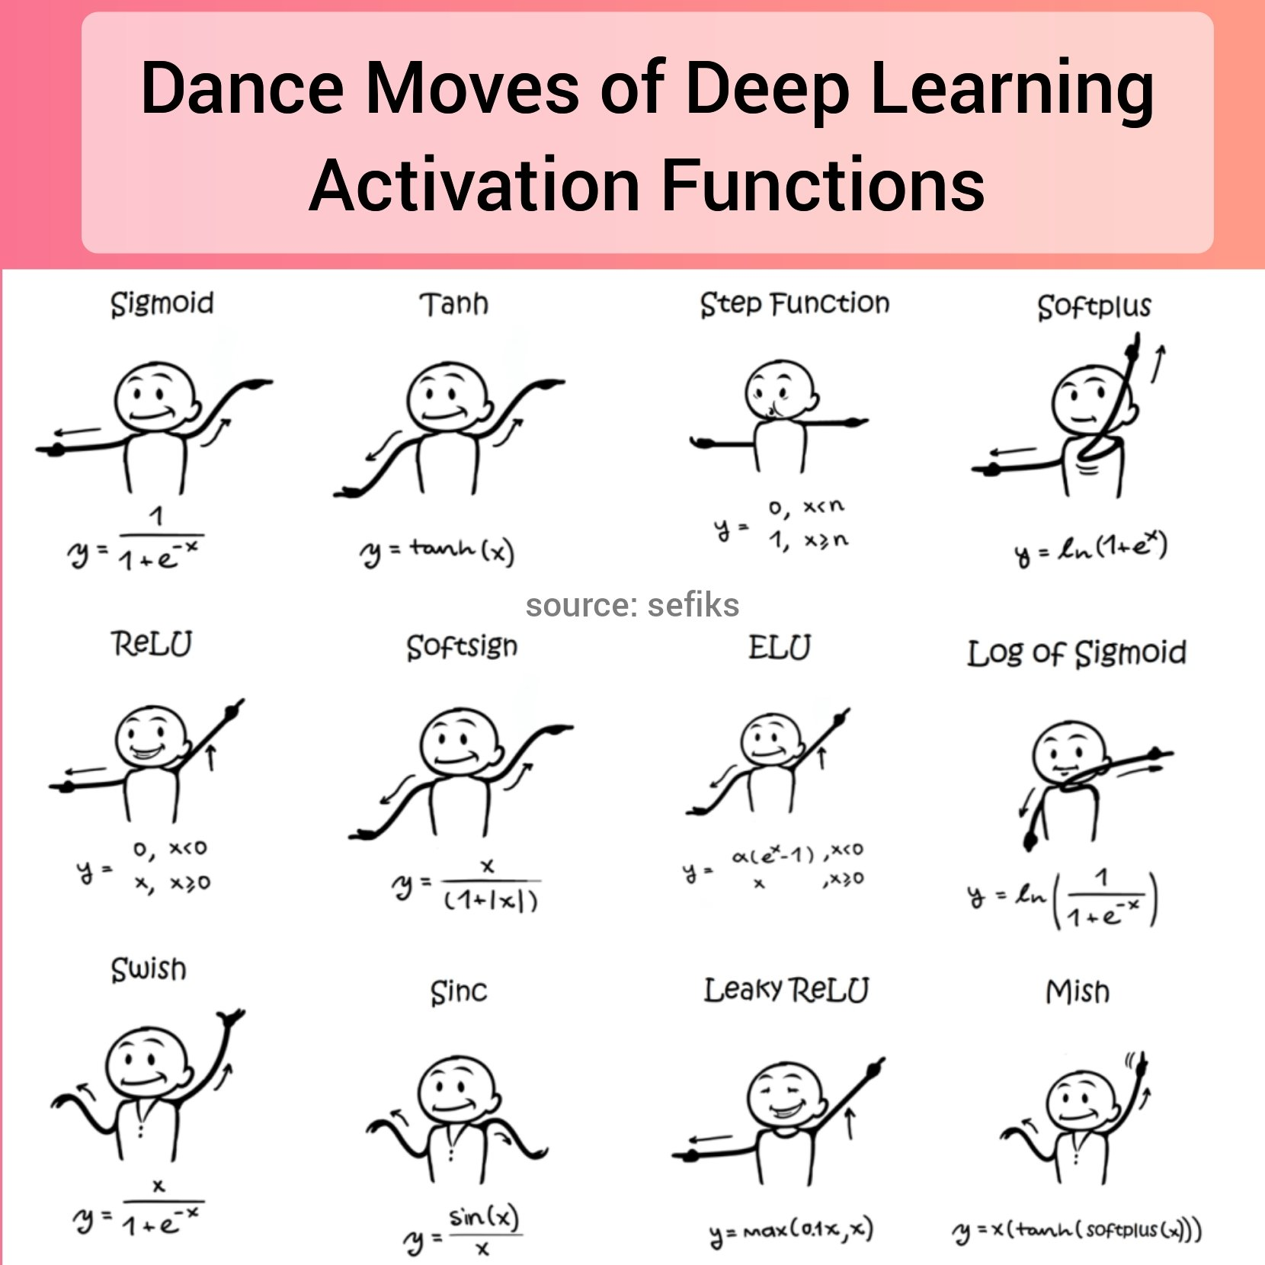
Activation Functions
https://twitter.com/TheInsaneApp/status/1366324846976659461/photo/1

Slide 13
How do we learn the weights?
This is a really hard question

Slide 14
Step 0 – Loss functions as … functions
Understanding loss as a function with the parameters as the parameters of your model class
Let’s draw the loss function for a linear model with no intercept!

Slide 15
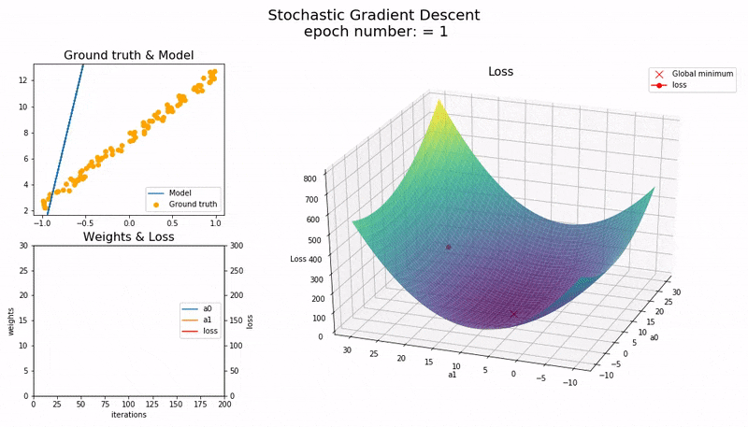
Step 1 – gradient descent
For linear models, we
https://medium.com/@guptamuskaan438/gradient-descent-explained-visually-from-intuition-to-optimization-f20a40798af4

Slide 16
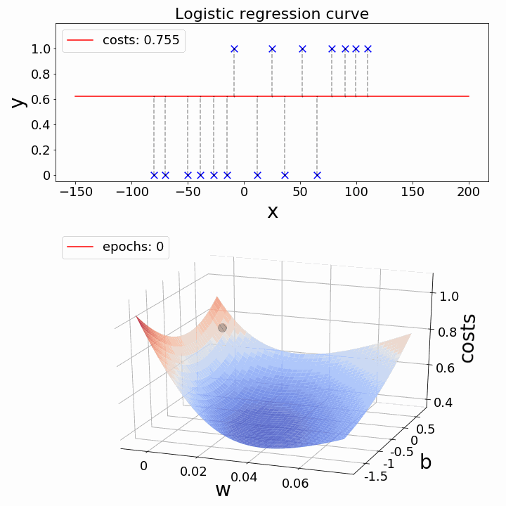
Gradient Descent with a nonlinearity
https://medium.com/@guptamuskaan438/gradient-descent-explained-visually-from-intuition-to-optimization-f20a40798af4

Slide 17
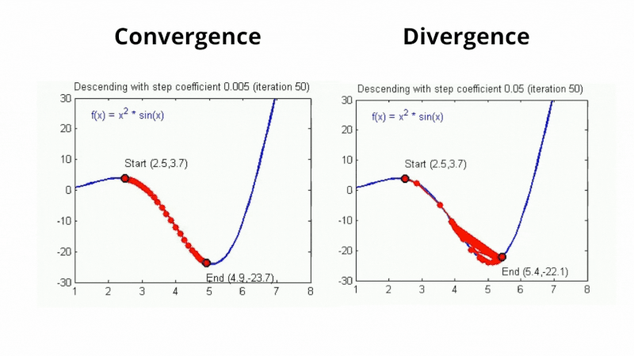
Gradient descent with a non-convex loss
https://medium.com/@guptamuskaan438/gradient-descent-explained-visually-from-intuition-to-optimization-f20a40798af4

Slide 18
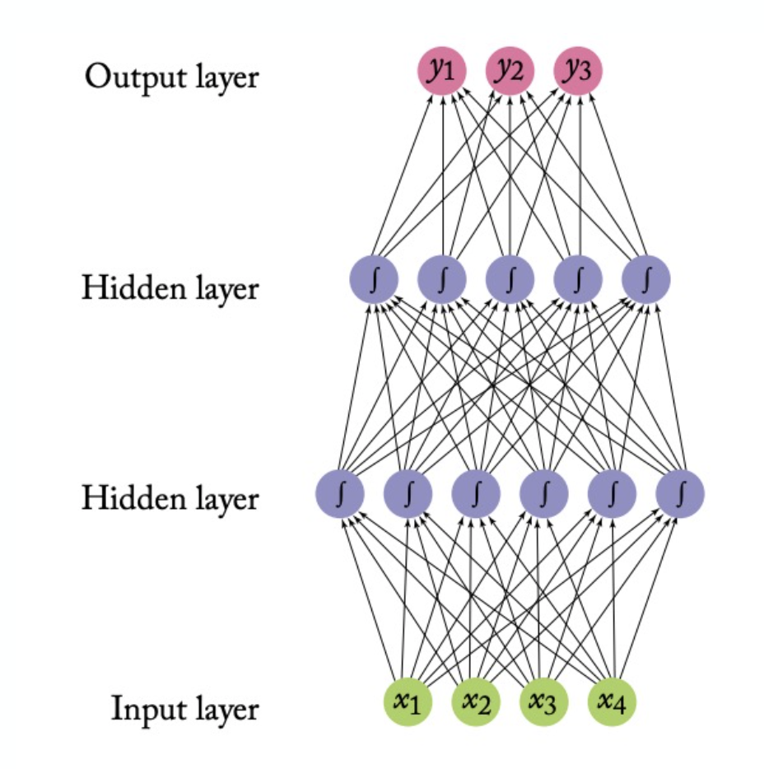
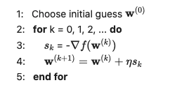
Recall Gradient Descent

Slide 19
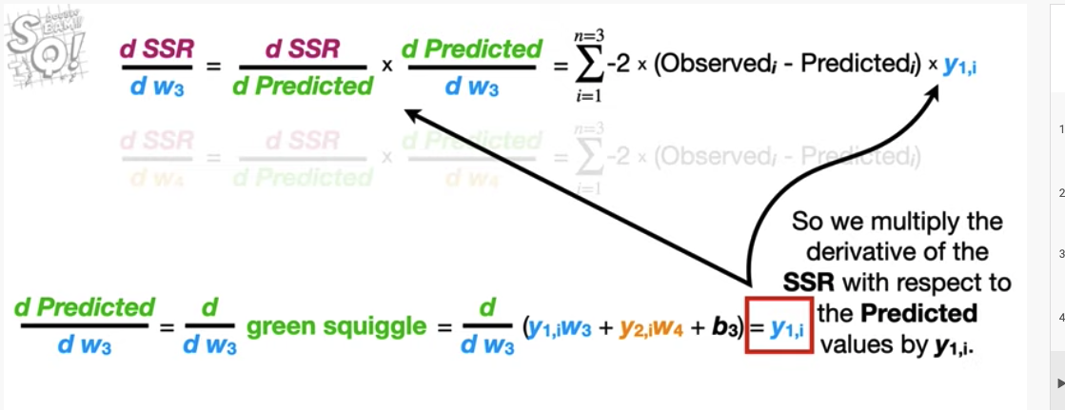
Idea 1: Use the chain rule!

Slide 20
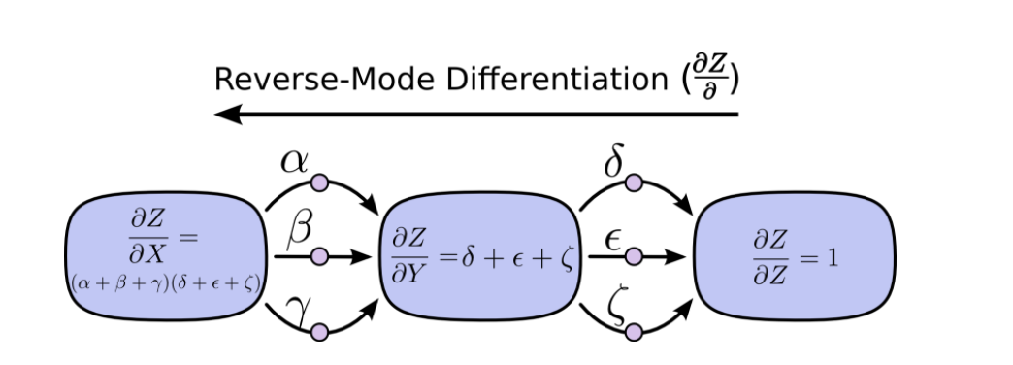
Idea 2: Use the chain rule efficiently

Slide 21
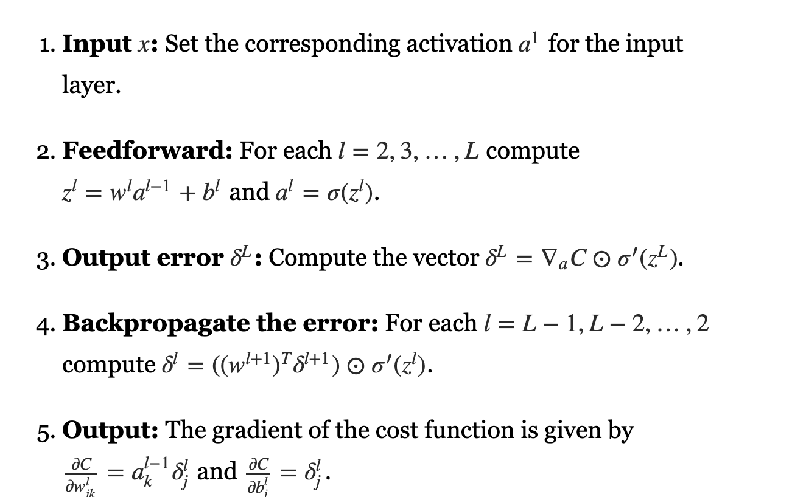
Backprop algorithm

