Slide 1
AIS 220
Foundational Mathematics for AI
Lectures 3-4
Sets, Probability, and Counting
Kenneth (Kenny) Joseph

Slide 2
Announcements
Attendance reminder
Questions?

Slide 3
Outline for today
What is probability (simple version, again)?
What is a set?
Playing with set operations using Seeing Theory
What is a function?
Why sets? Sets -> Probability
What is probability (harder version)
If time… counting…

Slide 4
What is probability?
Probability is math that helps us think about things that can be random… things we can’t be certain of
One way of thinking about "randomness" is that it's a way of expressing what we don't know.
  If we knew more, it might be deterministic, but when we don’t, or can’t, know specific things, we think probabilistically

Slide 5
Two ways of understanding this
“Frequentist” – Relative frequency
  If I do this thing a lot of times, it’ll happen roughly this percent of the time
  Book example: coin flipping
  Another good example?
“Bayesian” – subjective belief
  I think it’s roughly this likely that this thing will happen
  Book example: weather prediction
  Another good example?

Slide 6
What is a set?
A set is an unordered collection of things (elements)
How to write sets and examples of sets [on board]

Slide 7
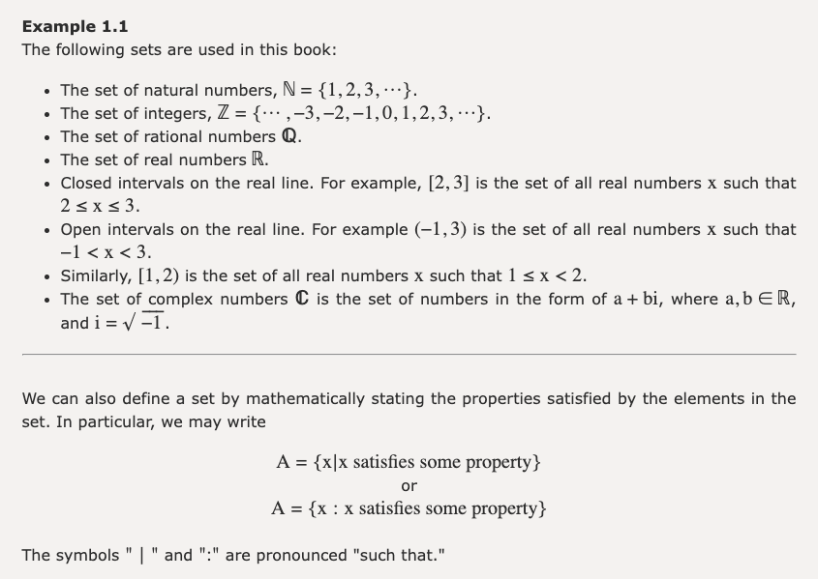

Slide 8
Set Operations and Venn Diagrams
On the board
  Subsets
  Unions
  Intersections
  Compliments
  Difference
  Partitions
  Empty set
https://seeing-theory.brown.edu/compound-probability/index.html#section1

Slide 9
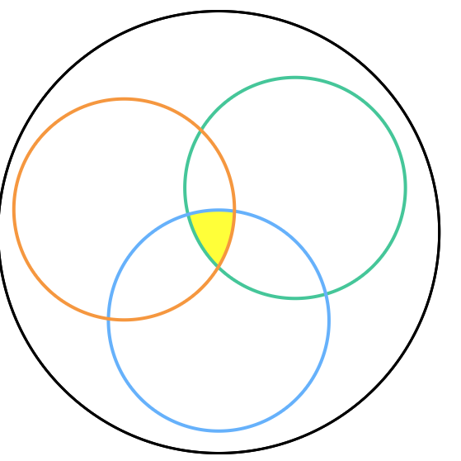
Seeing Theory Exercises

Slide 10
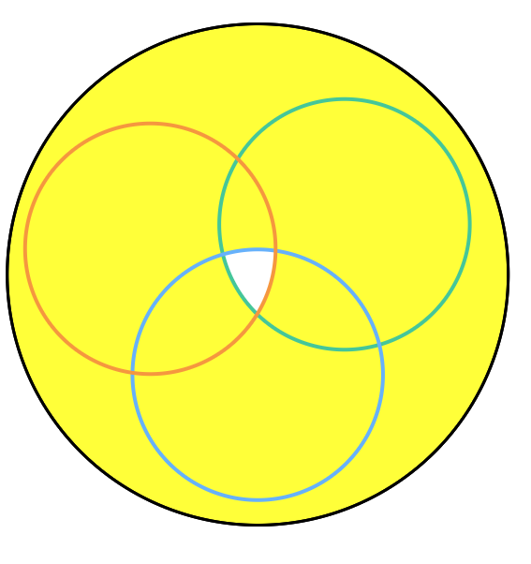

Slide 11
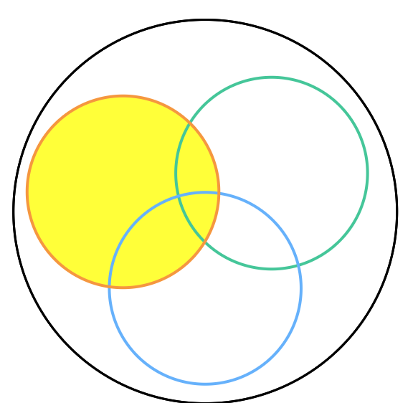
But use the union operator!

Slide 12
Stump your friends!

Slide 13
Set Cardinality
Cardinality – the number of elements in a set
What is the cardinality of the set A = {1,2,3,4}? |A| = ?
Finite Sets
  We can count all the things in them
  Examples?
Infinite sets
  We can’t count everything in them
  Examples?
Related to Greg’s question about discrete vs. continuous, but we’ll get there…

Slide 14
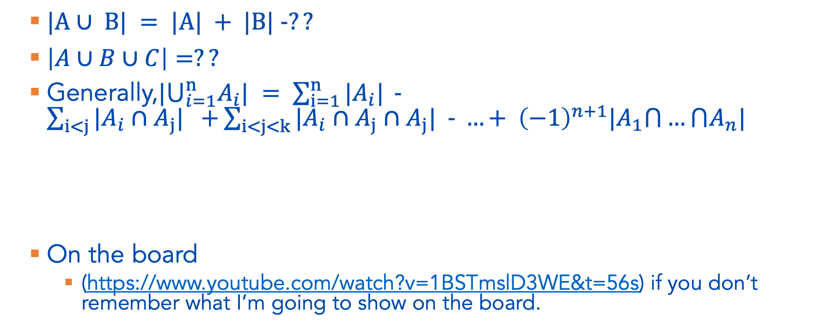
Cardinality of Two sets and the Inclusion-Exclusion Principle
$|A∪ B| = |A| + |B| −??$
$\left|A∪B∪C\right|=??$
Generally,${|⋃}_{i=1}^{n}A_{i}| = \sum_{i=1}^{n}{|A_{i}| }−\sum_{i<j}{|A_{i}∩A_{j}| +}\sum_{i<j<k}{|A_{i}∩A_{j}∩A_{j}| − …+ {\left(−1\right)}^{n+1}|A_{1}⋂…⋂A_{n}|}$
On the board
  (https://www.youtube.com/watch?v=1BSTmslD3WE&t=56s) if you don’t remember what I’m going to show on the board.

Slide 15
Example 1.5 from 1.2.3 on the board…
In a party…
  there are 10 people with white shirts and 8 people with red shirts;
  4 people have black shoes and white shirts;
  3 people have black shoes and red shirts;
  the total number of people with white or red shirts or black shoes is 21.
How many people have black shoes?

Slide 16
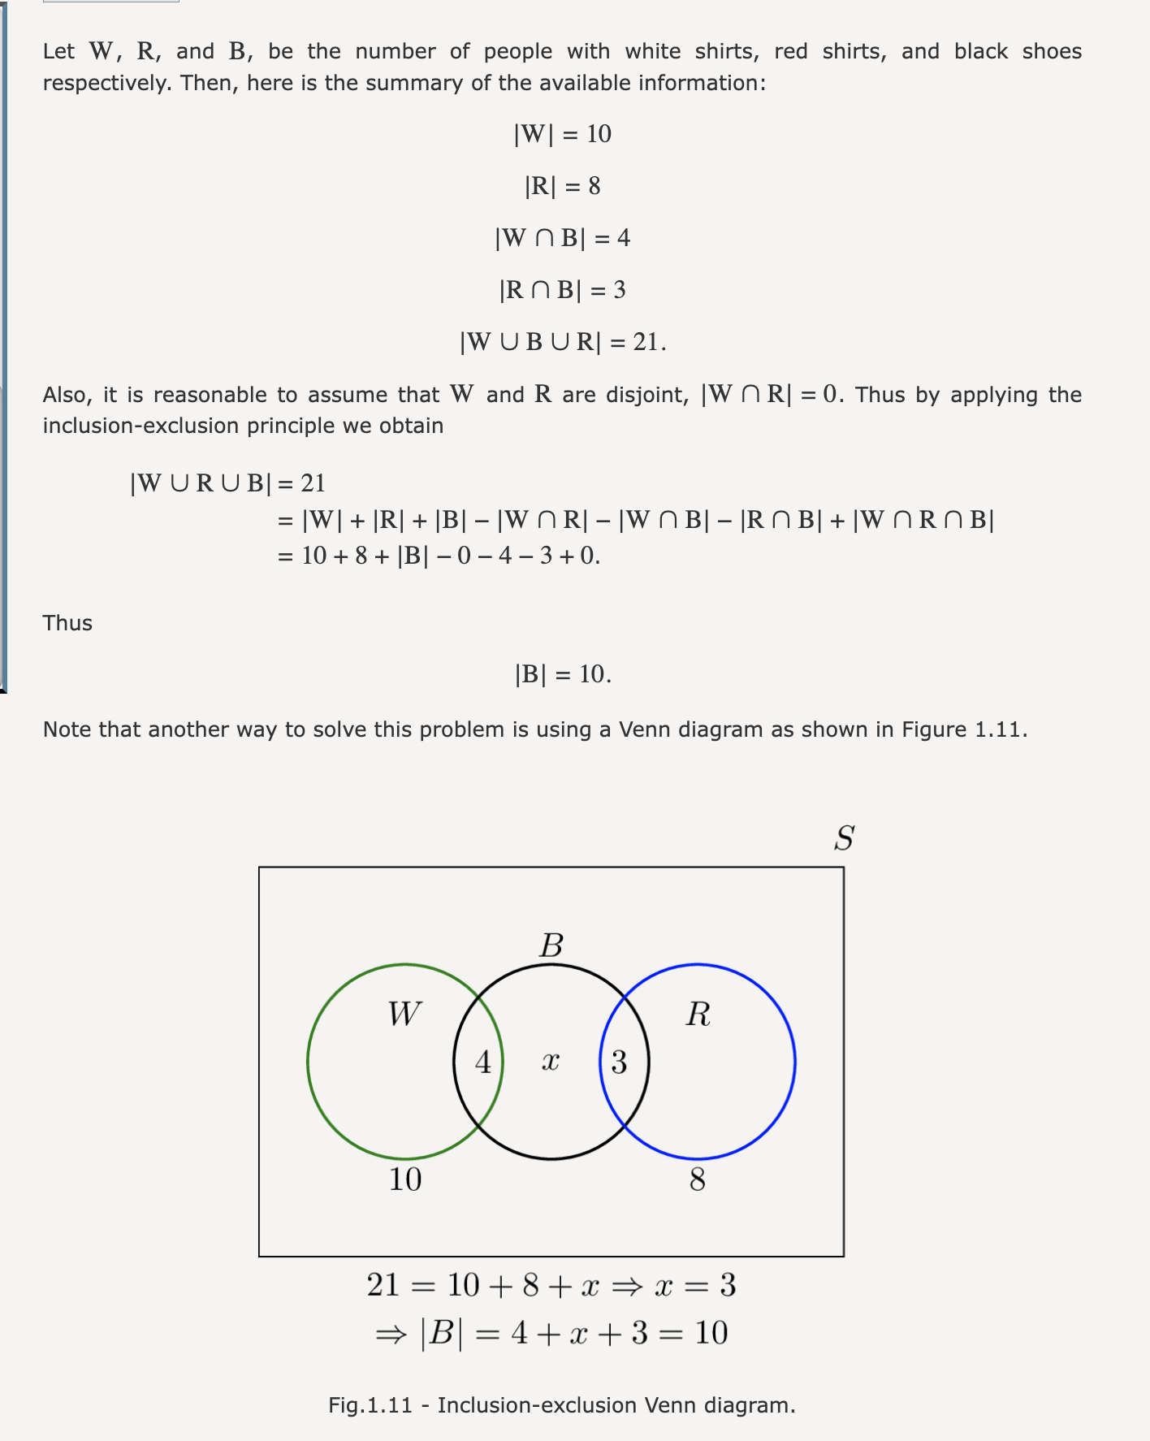

Slide 17
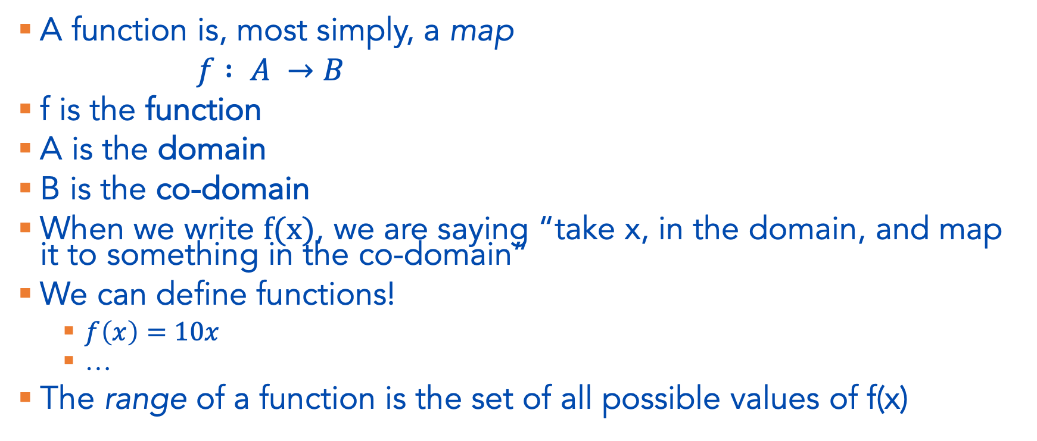
Functions
A function is, most simply, a map
$f : A →B$
f is the function
A is the domain
B is the co-domain
When we write $f(x)$, we are saying “take x, in the domain, and map it to something in the co-domain”
We can define functions!
  $f\left(x\right)=10x$
  …
The range of a function is the set of all possible values of f(x)

Slide 18
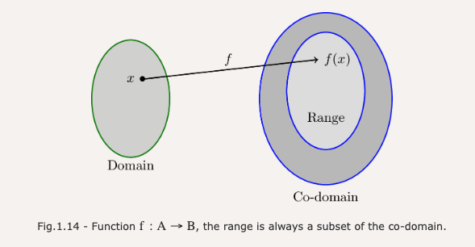


Slide 19
From sets and functions to random events
As a reminder – probability deals with random things
  Before they happen, we’re not sure what the outcome is going to be
One random thing we can think about is a random experiment
  A trial is one run of a random experiment… we can look at outcomes over multiple trials…
In a random experiment, we have an outcome and a sample space. The sample space is the set of all possible outcomes
  What is the sample space of a coin toss?
  A die roll?
  The Sabres’ game?
  Tossing a coin three times?
An event is a subset of the sample space

Slide 20
From random events to probability (pt 1)
The goal of a probability model is to assign a probability to certain events
  If the outcome of an experiment is in an event set (E), we say that event has occurred
The probability of event A occuring is written as…
  P(A)
  NOTE: P(1) is the same as writing P({1})
This must take on a value between?
  [0,1]

Slide 21

Practice
What is the probability of the following events occurring?
  E = {H} when flipping a coin?
  E = { x | x < 3} when rolling a dice?
  E = {W} for the Sabres during their next game?
  E = $\text{\{1,2\}}∪\{3\}$ for a dice roll?

Slide 22
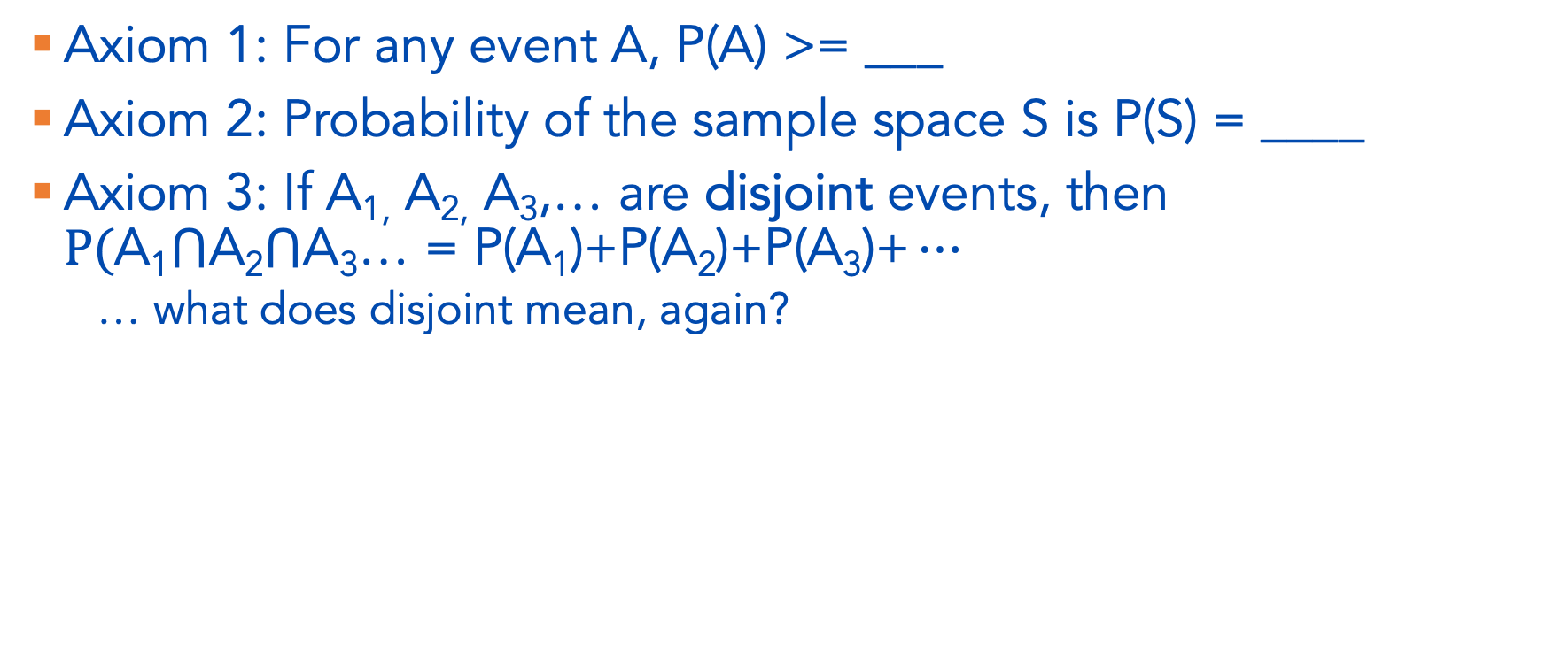
Axioms of Probability
Axiom 1: For any event A, P(A) >= ___
Axiom 2: Probability of the sample space S is P(S) = ____
Axiom 3: If A_{1,} A_{2,} A₃,… are disjoint events, then $P(\text{A}\text{1}⋂\text{A}\text{2}⋂\text{A}\text{3}\text{…}\text{ = }\text{P}\text{(}\text{A}\text{1}\text{)+}\text{P}\text{(}\text{A}\text{2}\text{)+}\text{P}\text{(}\text{A}\text{3}\text{)+}…$
  … what does disjoint mean, again?

Slide 23
More Practice Finding Probabilities
What is the probability of E = {1,5} when rolling a fair die?
  … first … how would we write this as a probability statement?
  … can we use the axioms of probability to help us here?

Slide 24
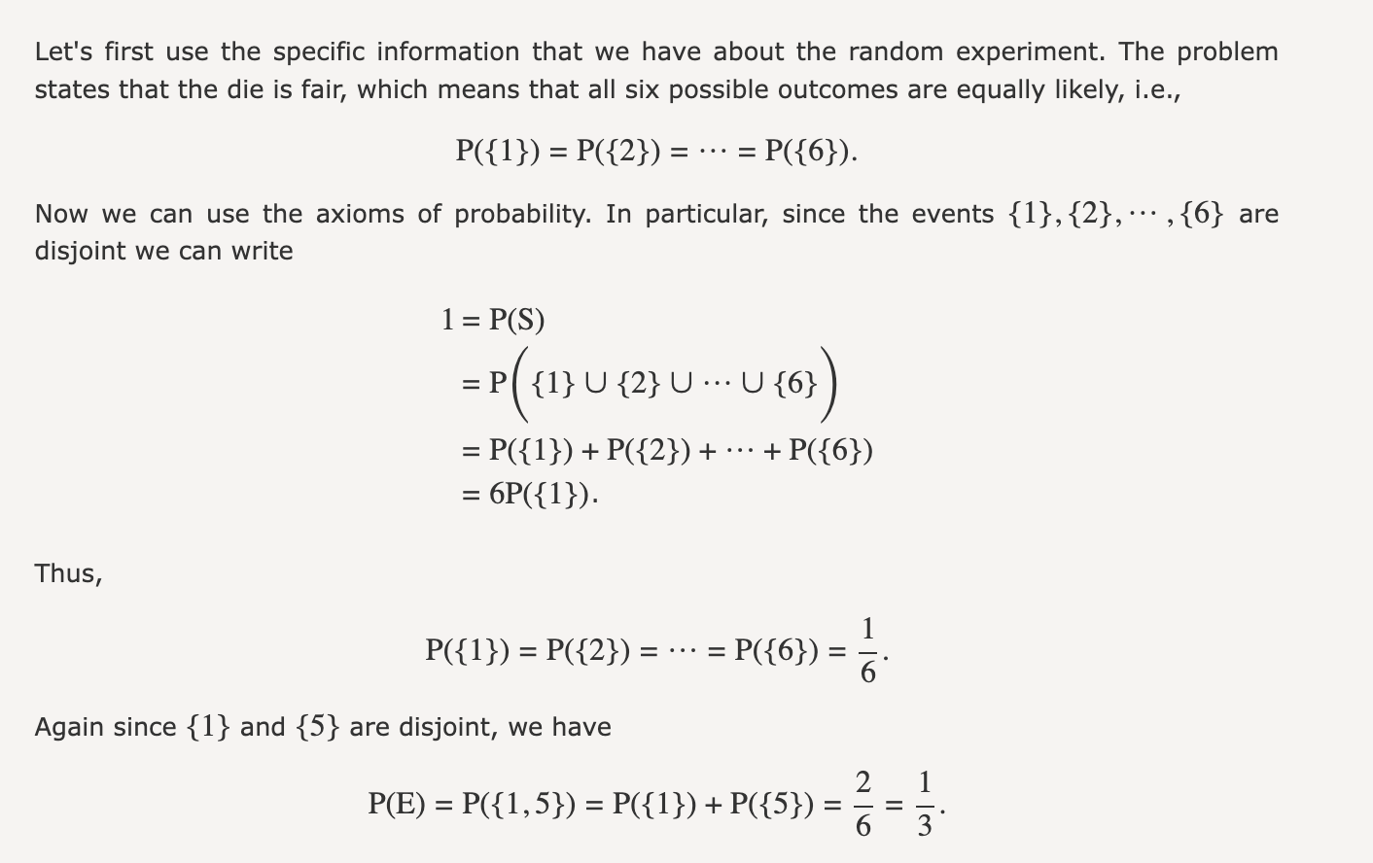

Slide 25
Seeing Theory
https://seeing-theory.brown.edu/probability-distributions/index.html#section1
What are the events here?
What are the trials of the random experiment?
Where can we look for an estimate of the probability?
Generate a grid with P({5}) = 1

Slide 26

One proof (see PN 1.3.3 for others)
For any event, $p\left(A^{c}\right)=1–p\left(A\right)$

Slide 27
Finding Probabilities – 1.3.3 in PN
There is a 60 percent chance that it will rain today.
There is a 50 percent chance that it will rain tomorrow.
There is a 30 percent chance that it does not rain either day.
Find the following probabilities:
  The probability that it will rain today or tomorrow.
  The probability that it will rain today and tomorrow.
  The probability that it will rain today but not tomorrow.
  The probability that it either will rain today or tomorrow, but not both.

Slide 28
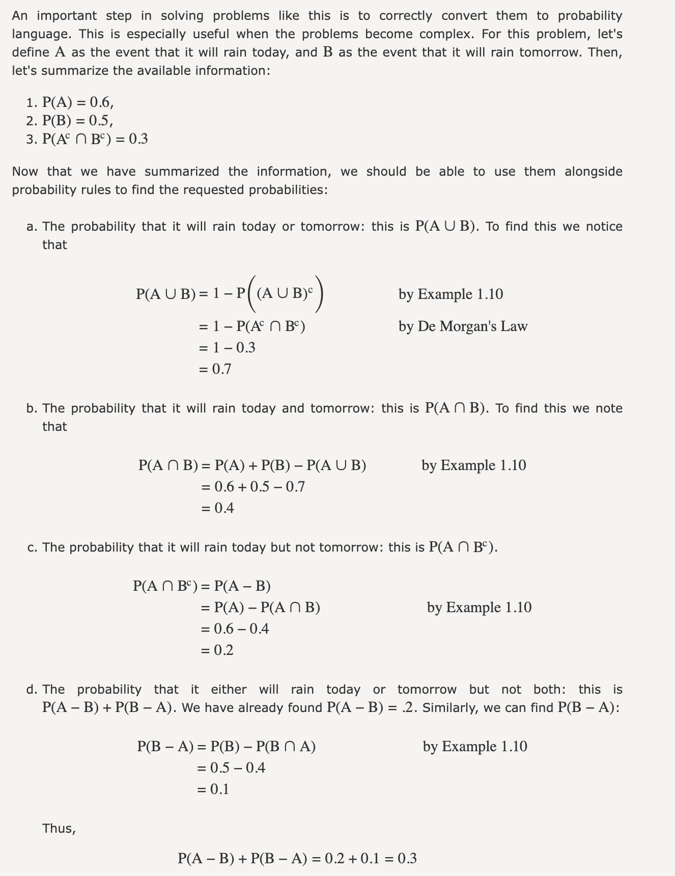

Slide 29
Finding Probabilities – “Real World” Example
Create your own real-world example!
You’ll then ask us and then teach the answer

Slide 30
Discrete vs. Continuous Probability Models
Basic idea:
  We can use summation for discrete probabilities
  We need integration for continuous probabilities
    … I.e. we need some calculus, which this class does not require. So we’ll be pretty hand-wavy here
Discrete models are conducted on countable sets. Note that countable does not mean not infinite
  Example 1.12 is a useful example if you’re curious, but I’m not going to get into this in this class, it’s not overly important for us

Slide 31
Continuous Models, briefly
Continuous models are for when your sample space is uncountable.
Can anyone use notation from Monday to define an uncountable set?
The tricky part about continuous models:
  Let’s say S = [1,50]
  What is P(S)?
  What is P(10)? P(12.3212)?
  ?!
Best intuition: we’re never really interested in P(12.323121213), so we end up with (very large) discrete sets that we treat as continuous
More intuition here requires calculus…

Slide 32
Discrete models (cont.)
A special case that is important to us: we have a discrete model where each outcome is equally likely
Examples?
In such cases, we can say for event A with cardinality M:
Thus, finding probability of reduces to a counting problem in which we need to count how many elements are in and

Slide 33
Example 1.13
I roll a fair die twice and obtain two numbers: M result of the first roll, and N result of the second roll. Write down the sample space S, and assuming that all outcomes are equally likely (because the die is fair), find the probability of the event defined as the event that M+N=8.

Slide 34
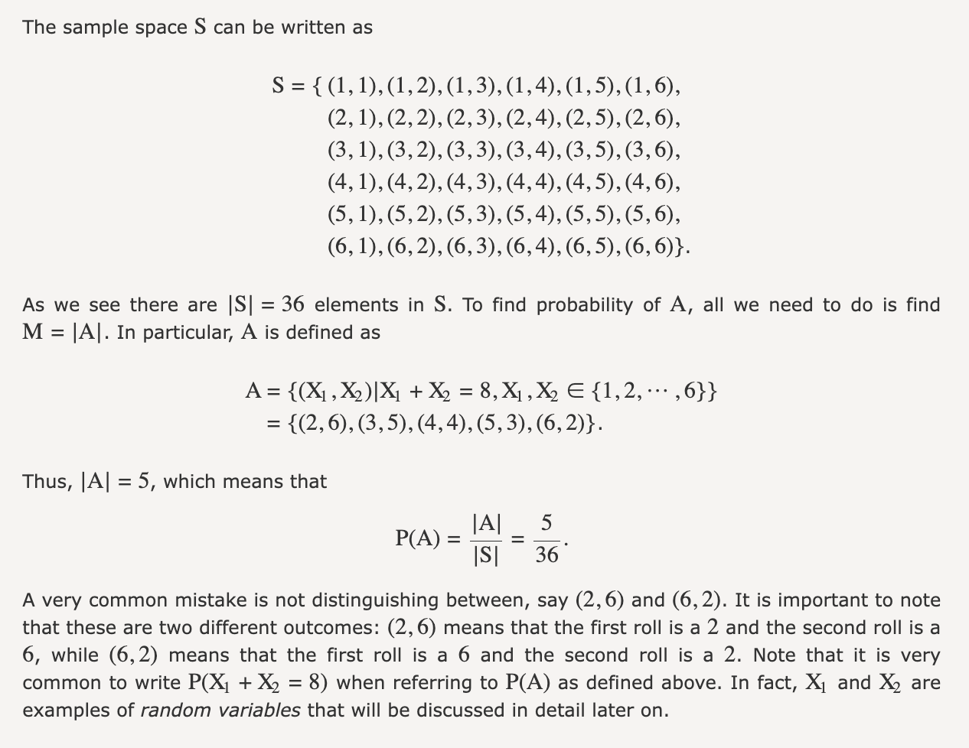

Slide 35
Counting!
As you can see, counting is central to discrete probability distributions! But counting is easier said than done…

