Slide 1
AIS 220
Foundational Mathematics for AI
Lecture 5
(Conditional) Probability and Counting
Kenneth (Kenny) Joseph

Slide 2
Announcements
Project 1 is out
Quiz 1 is Wednesday!
Questions?

Slide 3
Brain warm ups / Quiz 1 topics
More set operations
Cardinality
Basic Probability intuitions
  Basic counting
  Basic implications of axioms
For these, expect questions like those on the board!
Conditional probability (e.g. Example 1.15 in book)

Slide 4
Outline for today
Quick review of most important concepts
What is probability (harder version)
Conditional probability
Bayes Rule
If time… Random variables
We are going to skip counting.

Slide 5
Set Operations and Venn Diagrams
On the board
  Subsets
  Unions
  Intersections
  Compliments
  Difference
  Partitions
  Empty set

Slide 6
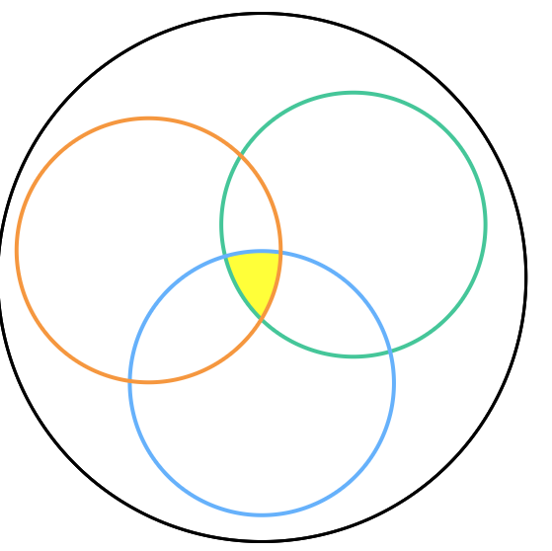
Seeing Theory Exercises

Slide 7
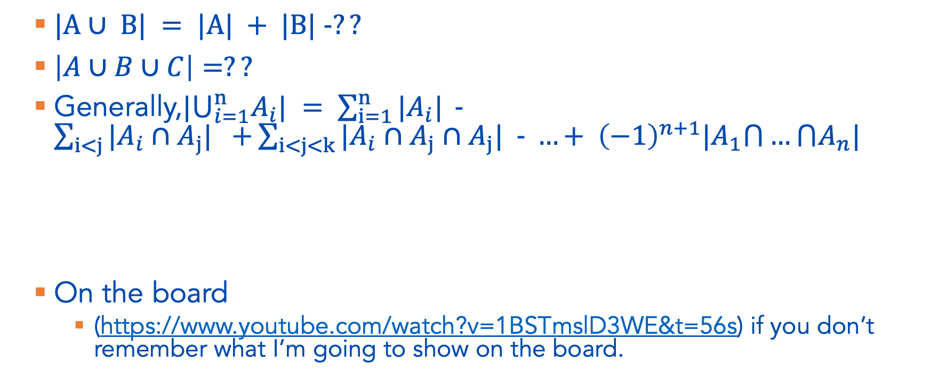
Cardinality of Two sets and the Inclusion-Exclusion Principle
$|A∪ B| = |A| + |B| −??$
$\left|A∪B∪C\right|=??$
Generally,${|⋃}_{i=1}^{n}A_{i}| = \sum_{i=1}^{n}{|A_{i}| }−\sum_{i<j}{|A_{i}∩A_{j}| +}\sum_{i<j<k}{|A_{i}∩A_{j}∩A_{j}| − …+ {\left(−1\right)}^{n+1}|A_{1}⋂…⋂A_{n}|}$
On the board
  (https://www.youtube.com/watch?v=1BSTmslD3WE&t=56s) if you don’t remember what I’m going to show on the board.

Slide 8
Example 1.5 from 1.2.3 on the board…
In a party…
  there are 10 people with white shirts and 8 people with red shirts;
  4 people have black shoes and white shirts;
  3 people have black shoes and red shirts;
  the total number of people with white or red shirts or black shoes is 21.
How many people have black shoes?

Slide 9

Practice
What is the probability of the following events occurring?
  E = {H} when flipping a coin?
  E = { x | x < 3} when rolling a dice?
  E = {W} for the Sabres during their next game?
  E = $\text{\{1,2\}}∪\{3\}$ for a dice roll?

Slide 10
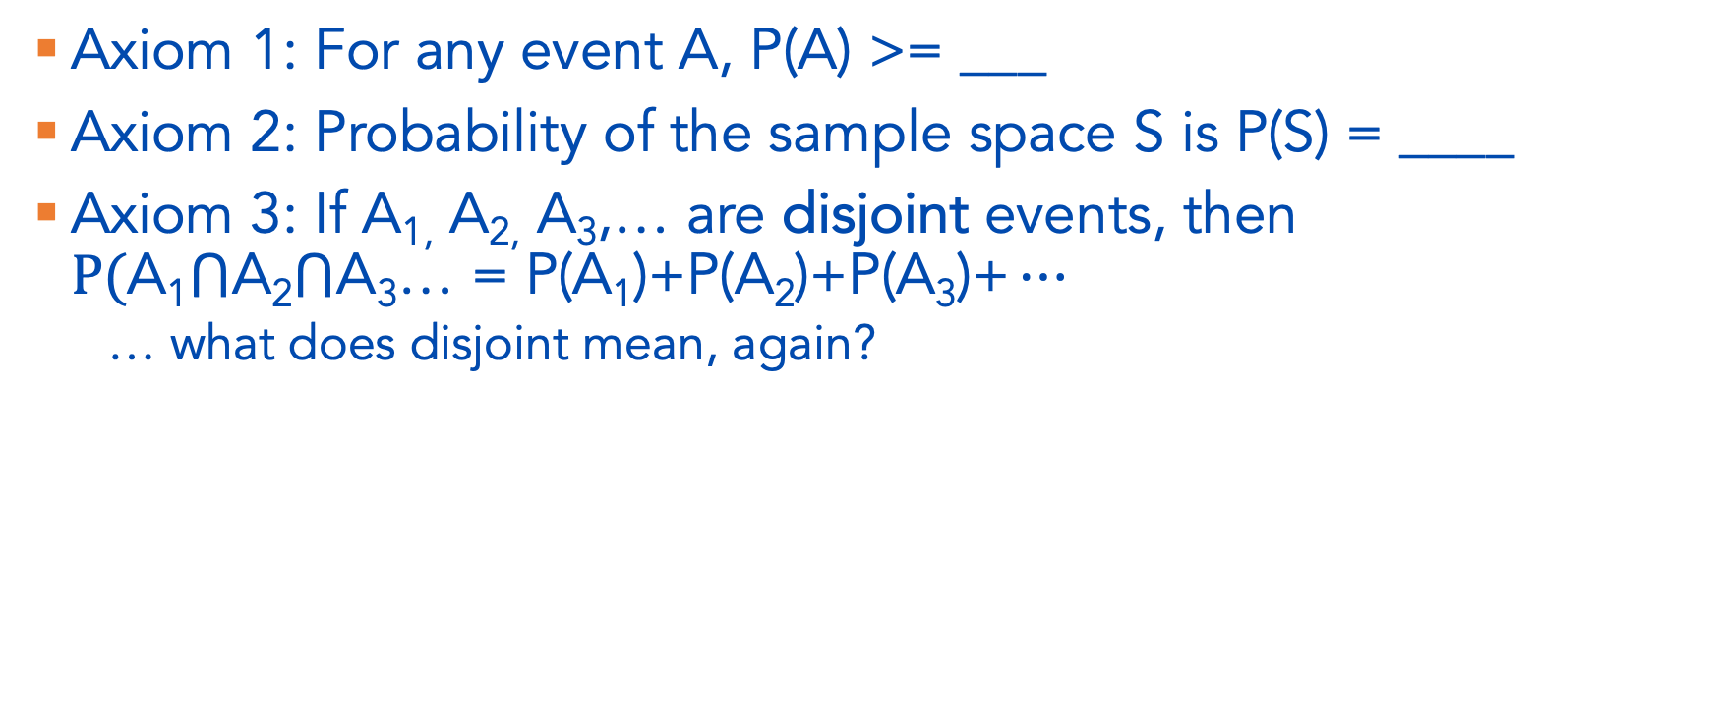
Axioms of Probability
Axiom 1: For any event A, P(A) >= ___
Axiom 2: Probability of the sample space S is P(S) = ____
Axiom 3: If A_{1,} A_{2,} A₃,… are disjoint events, then $P(\text{A}\text{1}⋂\text{A}\text{2}⋂\text{A}\text{3}\text{…}\text{ = }\text{P}\text{(}\text{A}\text{1}\text{)+}\text{P}\text{(}\text{A}\text{2}\text{)+}\text{P}\text{(}\text{A}\text{3}\text{)+}…$
  … what does disjoint mean, again?

Slide 11
More Practice Finding Probabilities
What is the probability of E = {1,5} when rolling a fair die?
  … first … how would we write this as a probability statement?
  … can we use the axioms of probability to help us here?

Slide 12
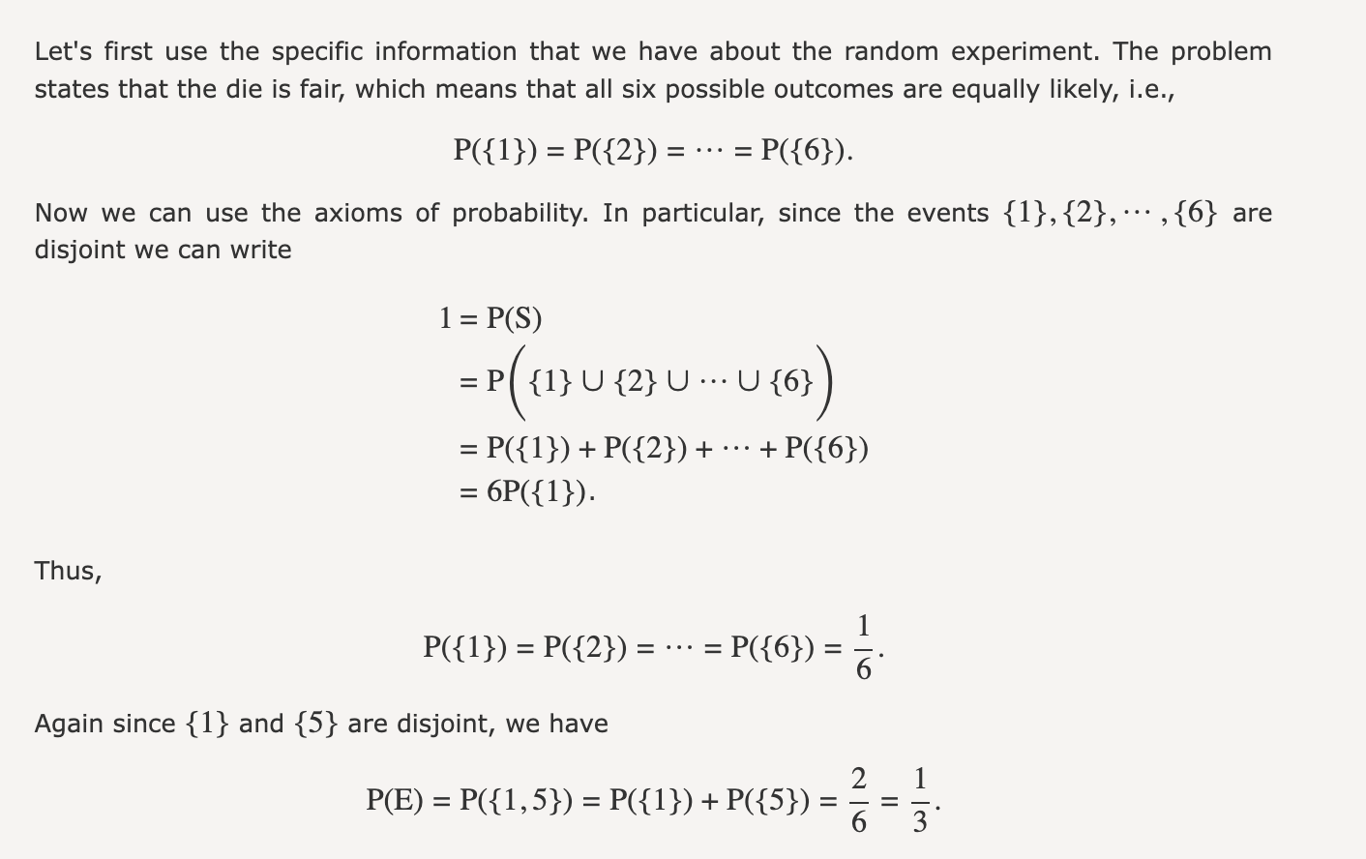

Slide 13
Finding Probabilities – 1.3.3 in PN
There is a 60 percent chance that it will rain today.
There is a 50 percent chance that it will rain tomorrow.
There is a 30 percent chance that it does not rain either day.
Find the following probabilities:
  The probability that it will rain today or tomorrow.
  The probability that it will rain today and tomorrow.
  The probability that it will rain today but not tomorrow.
  The probability that it either will rain today or tomorrow, but not both.

Slide 14
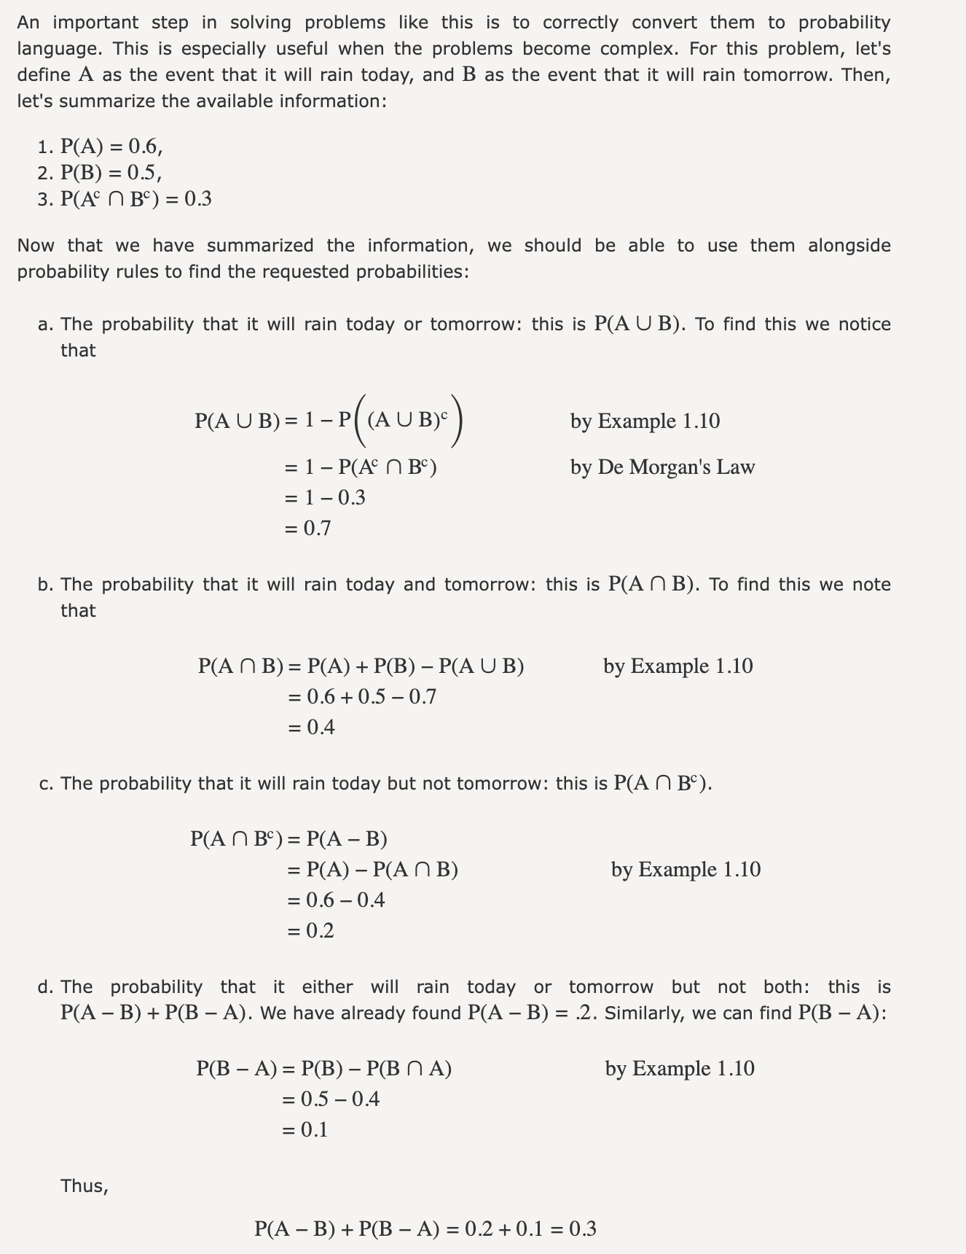
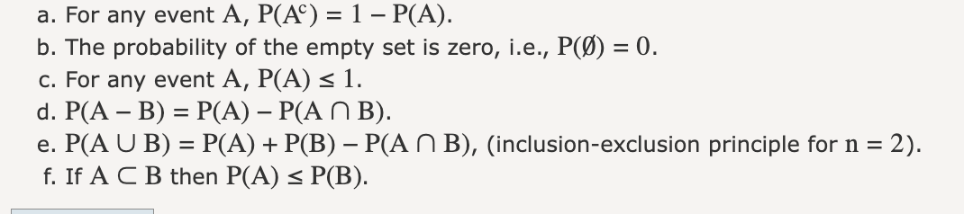

Slide 15
Example 1.13
I roll a fair die twice and obtain two numbers: M result of the first roll, and N result of the second roll. Write down the sample space S, and assuming that all outcomes are equally likely (because the die is fair), find the probability of the event defined as the event that M+N=8.

Slide 16
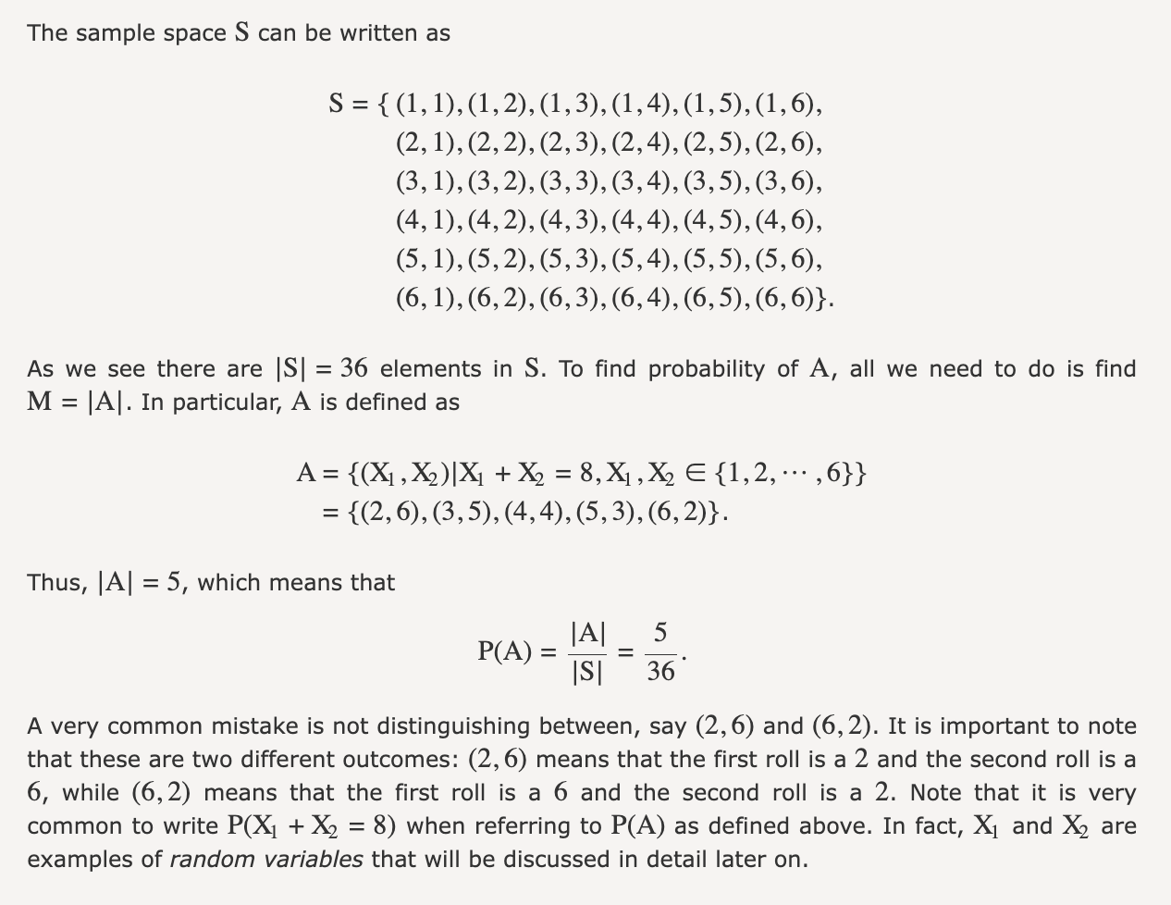

Slide 17
Counting!
As you can see, counting is central to discrete probability distributions! But counting is easier said than done.
We’ll come back to this. But first…

Slide 18
Conditional Probability
High level – how does my probability change when I get more information?
What is the probability that
  it is going to snow on any given day in Buffalo?
  it is going to snow on any given day in Buffalo, given that it cloudy?
  it is going to snow on any given day in Buffalo, given that it is 80 degrees outside?
We write conditional probabilities as p(A | B)
  “The conditional probability of A given that B has occurred”

Slide 19
Example 1.15
A = rolling an odd number on a dice = { ____} ?
B = roll a number 3 or less = { _____}?
What is P(A)?
What is P(A|B)?

Slide 20
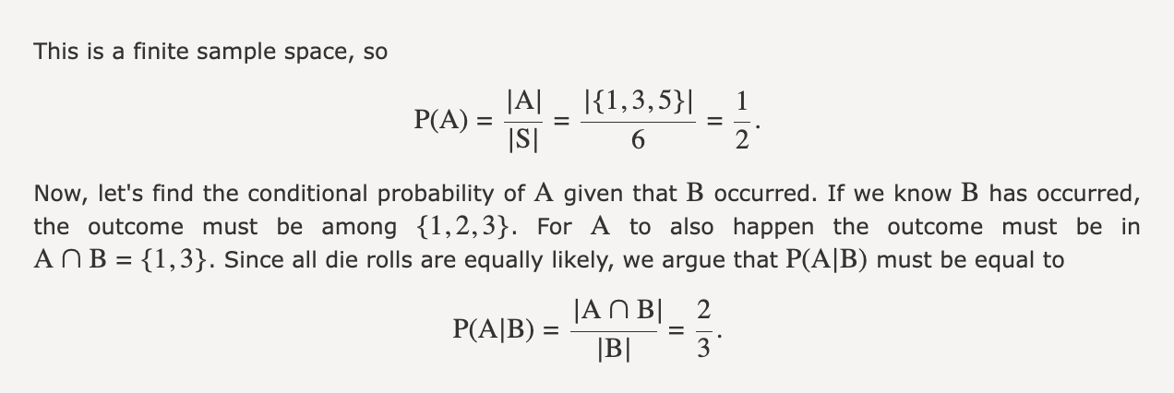

Slide 21
Generally Speaking

Slide 22
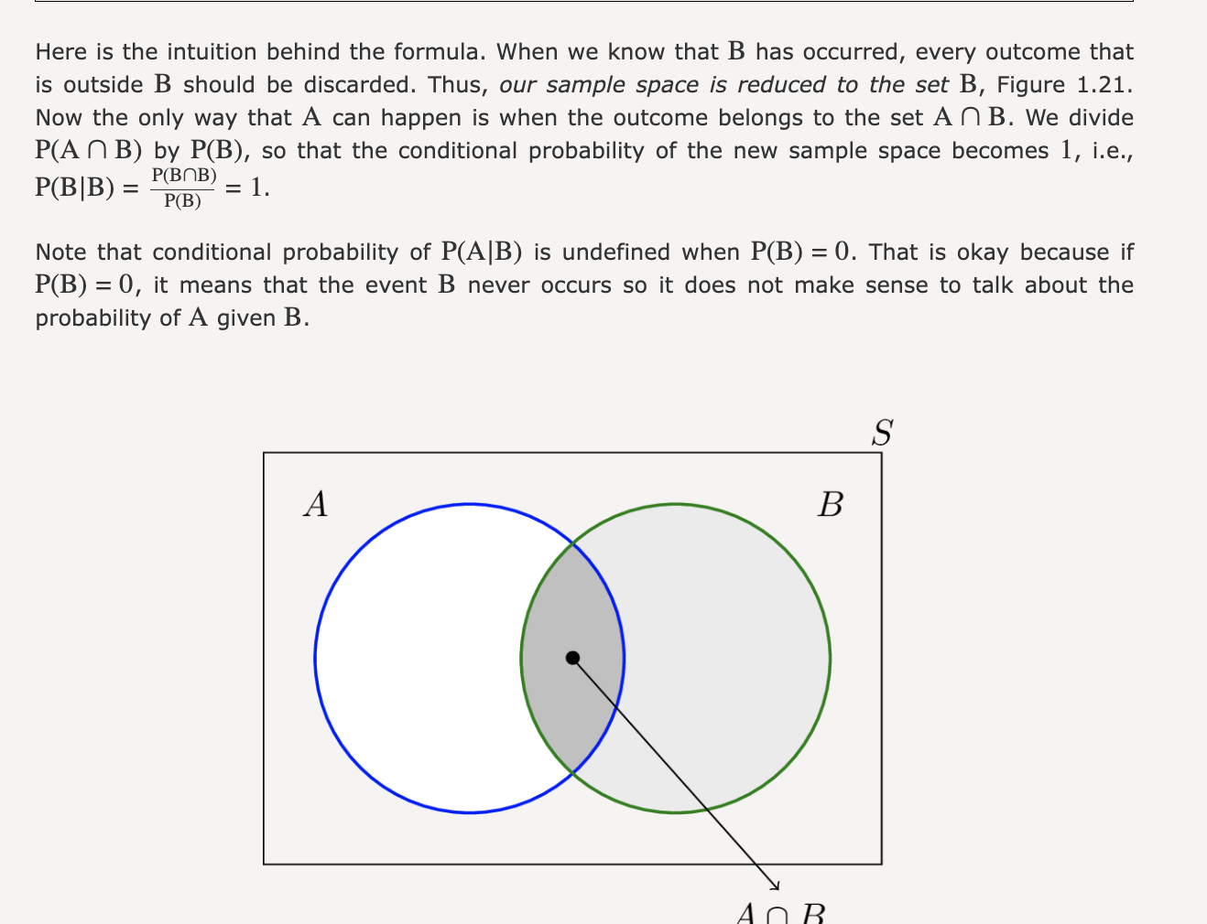

Slide 23
Some intuition questions
What is P(A|B) if A and B are disjoint?
What if B is a subset of A?
https://setosa.io/conditional/
  What happens if P(A and B) = 0?
  What if P(B) = 1?

Slide 24
Consider a family that has two kids…
What is the probability that both kids like trucks, given that the first kid likes trucks?
You ask me, "Do you have at least one kid that likes trucks?”
  I say, yes I do!
  Given this extra information, what is the probability that both kids like trucks?
To solve, we will:
  Draw this out on the board intuitively
  Derive it as in the book

Slide 25
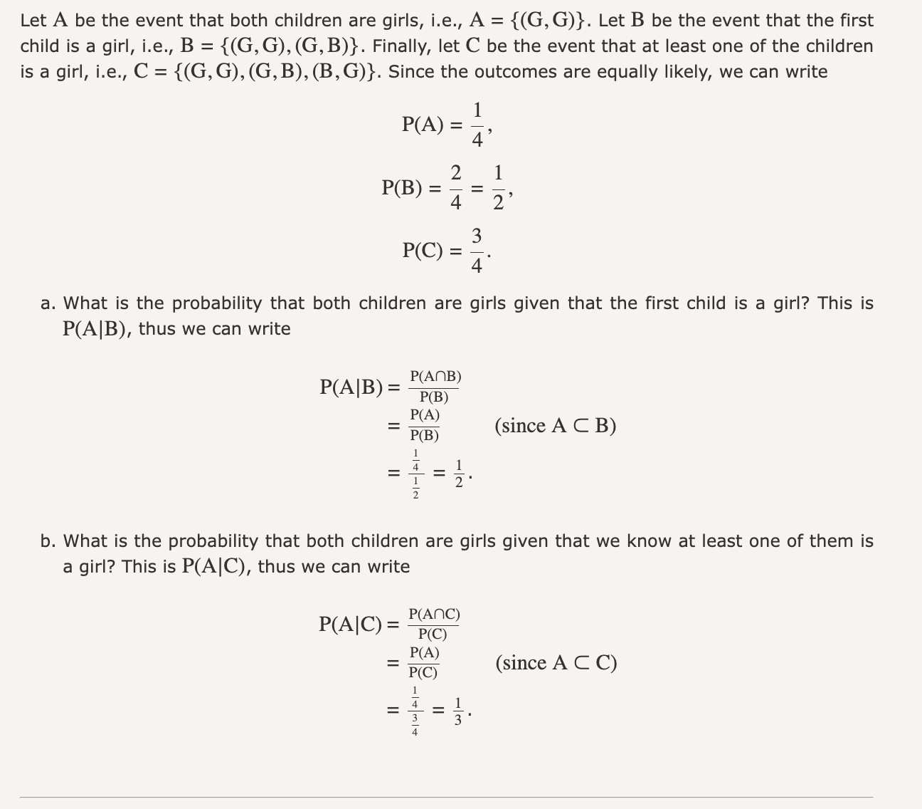

Slide 26
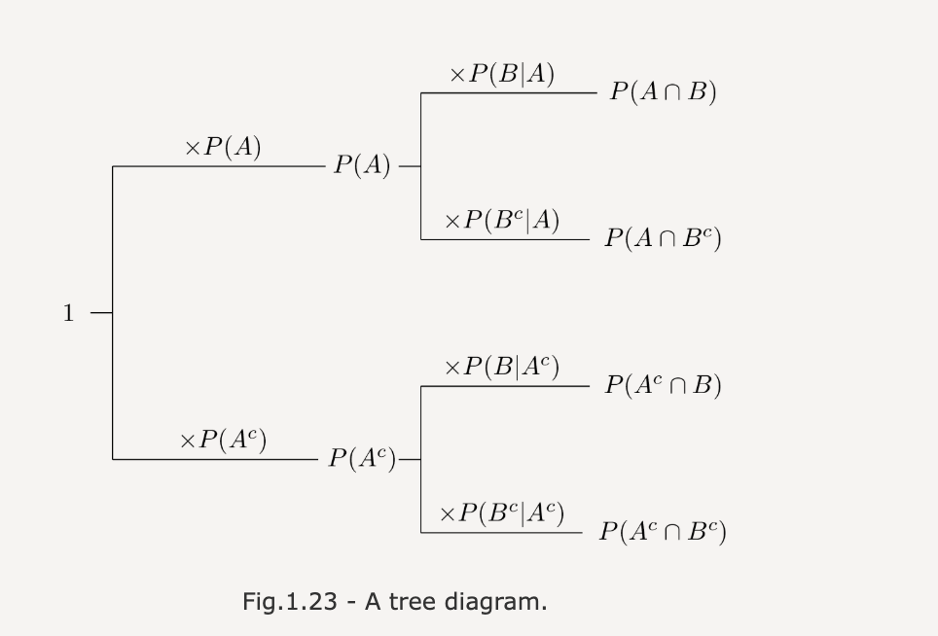
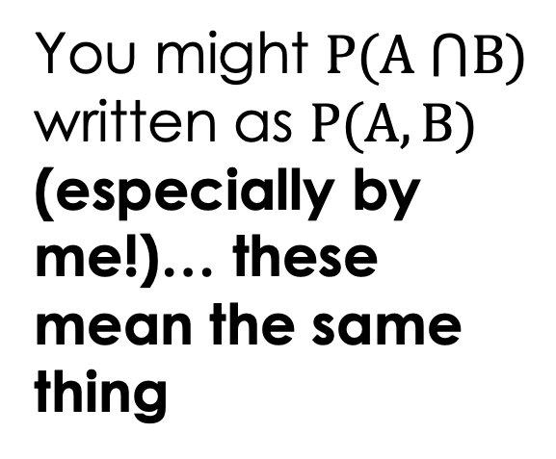
Chain Rule of Probability
You might $P(A ⋂B)$ written as $P(A, B)$ (especially by me!)… these mean the same thing

Slide 27
Extended Chain Rule

Slide 28
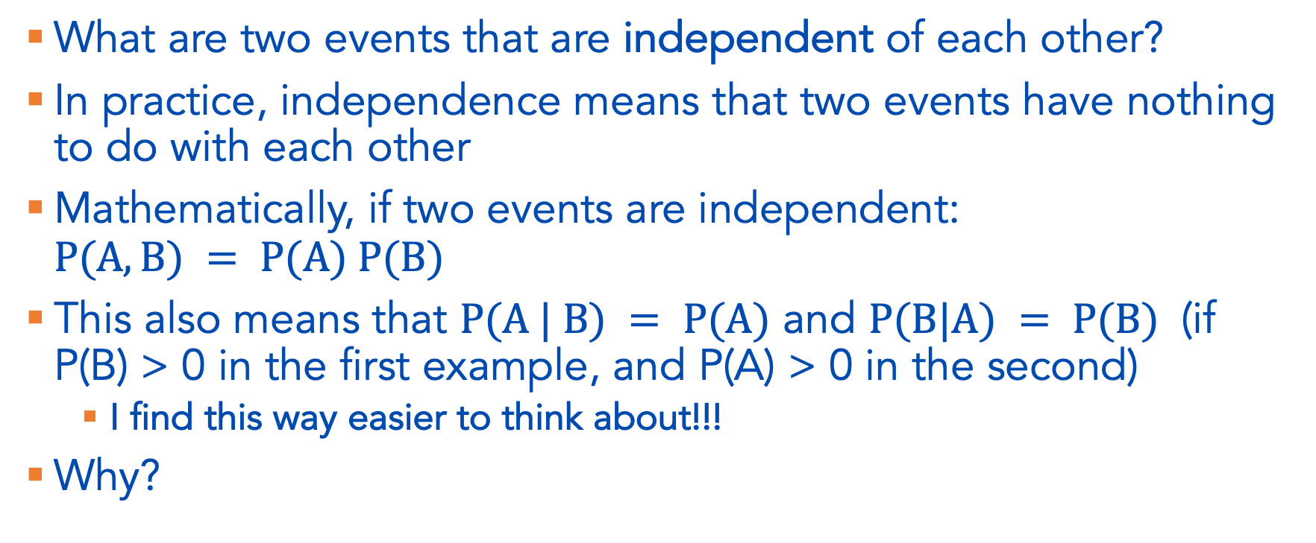
Independence of Two Events
What are two events that are independent of each other?
In practice, independence means that two events have nothing to do with each other
Mathematically, if two events are independent: $P(A,B) = P(A) P(B)$
This also means that $P(A | B) = P(A)$ and $P(B|A) = P(B)$ (if P(B) > 0 in the first example, and P(A) > 0 in the second)
  I find this way easier to think about!!!
Why?

