Slide 1
AIS 220
Foundational Mathematics for AI
Lecture 6
Independence
Kenneth (Kenny) Joseph

Slide 2
Announcements
Project 1 is out
Quiz 1 is Wednesday!
Questions?

Slide 3
Generally Speaking

Slide 4
Chain Rule of Probability

Slide 5
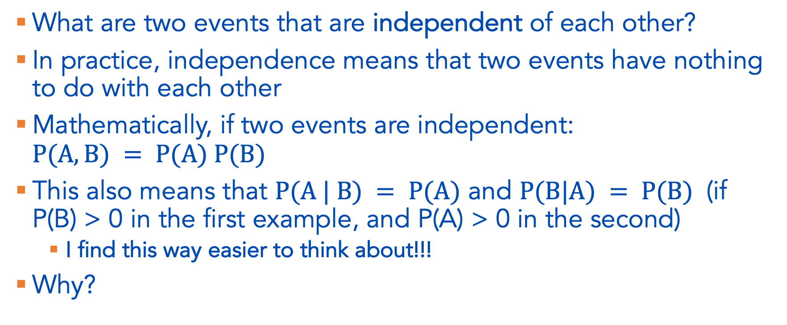
Independence of Two Events
What are two events that are independent of each other?
In practice, independence means that two events have nothing to do with each other
Mathematically, if two events are independent: $P(A,B) = P(A) P(B)$
This also means that $P(A | B) = P(A)$ and $P(B|A) = P(B)$ (if P(B) > 0 in the first example, and P(A) > 0 in the second)
  I find this way easier to think about!!!
Why?

Slide 6

Example 1.20
A random number is selected from the set $\left\{1 , 2 , 3 , … , 10\right\}$, with all outcomes equally likely. Let $N$ denote the selected number. Define event $A$ as the event that $N<7$, and event $B$ as the event that $N$is even. Are events $A$ and $B$independent?

Slide 7

Another example
A random number is selected from the set $\left\{1 , 2 , 3 , … , 10\right\}$, with all outcomes equally likely. Let $N$denote the selected number. Define event $A$as the event that $N<7$, and event $B$ as the event that $N$ is a multiple of 3. Are events $A$ and $B$independent?

Slide 8
Example 1.21
We can extend the independence concept beyond two events (see book for explanation)
I toss a coin repeatedly until I observe the first tails at which point I stop. Let be the total number of coin tosses. Find P(X=5)
First – what does P(X=5) practically mean?
Then, solve

Slide 9
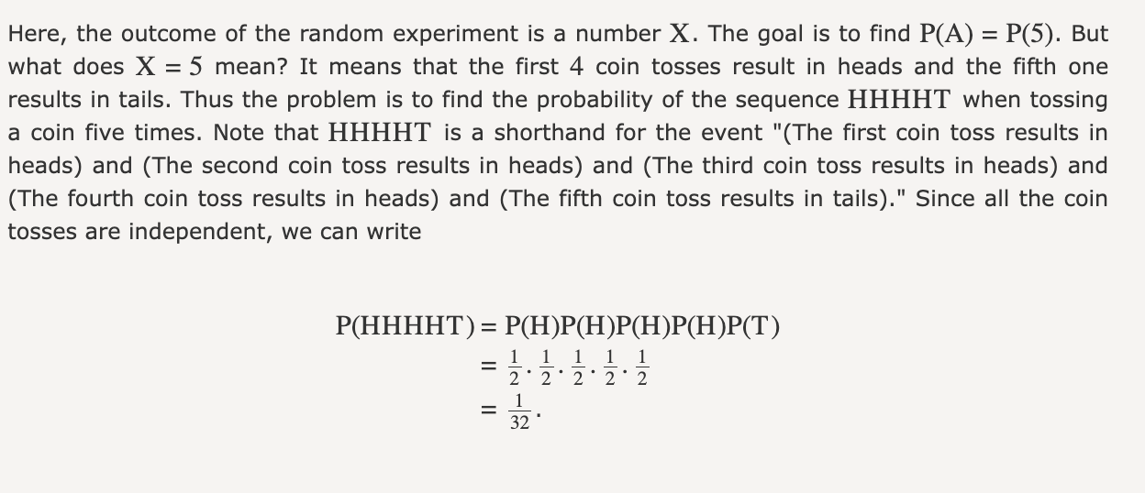

Slide 10
Review and understanding
What does it mean for A and B to be disjoint?
What does it mean for them to be independent?
Do these mean the same thing?

Slide 11
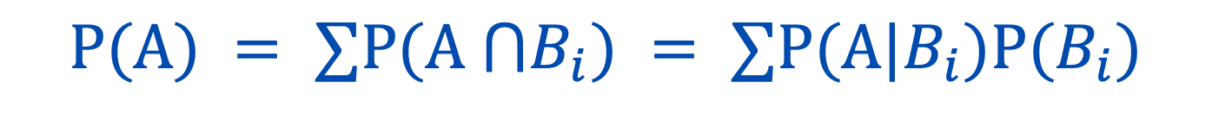
The Law of Total Probability (1.4.2 in book)
$$P(A) = ∑P(A ⋂B_{i}) = ∑P(A|B_{i})P(B_{i})$$
What does this mean in practice?
Example 1.24 in the book!

Slide 12
