Slide 1
AIS 220
Foundational Mathematics for AI
Lecture 7
Bayes and Random Variables
Kenneth (Kenny) Joseph

Slide 2
Announcements
Quiz 1 and Project 1…

Slide 3
Review Problems
Quiz

Slide 4

Bayes Rule!
We know that $P(A|B)P(B) = P(B|A)P(A)$
  Why?
From here, we can derive Bayes Rule
Examples 1.25 and 1.26 in the book

Slide 5
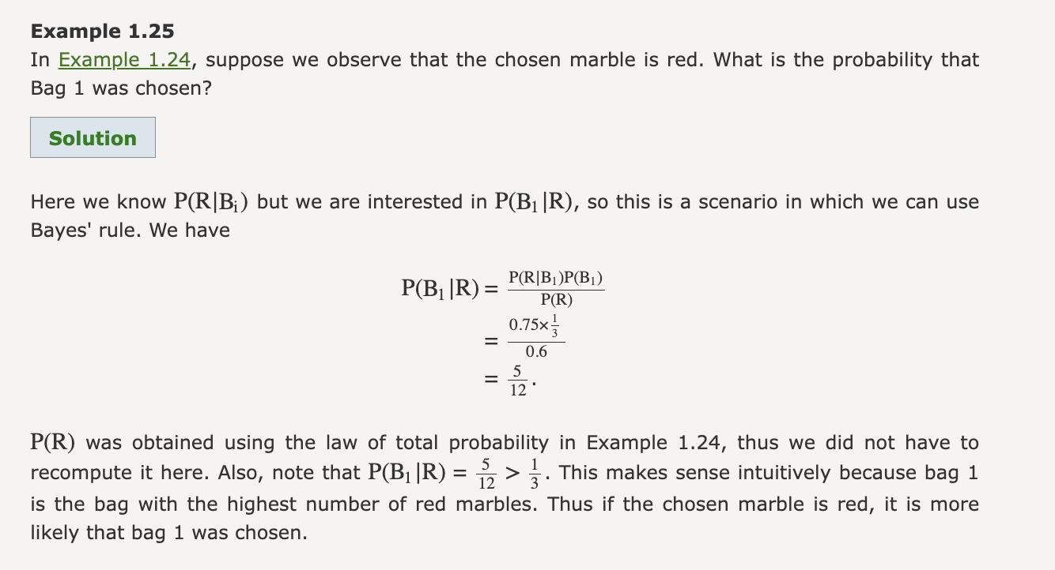

Slide 6
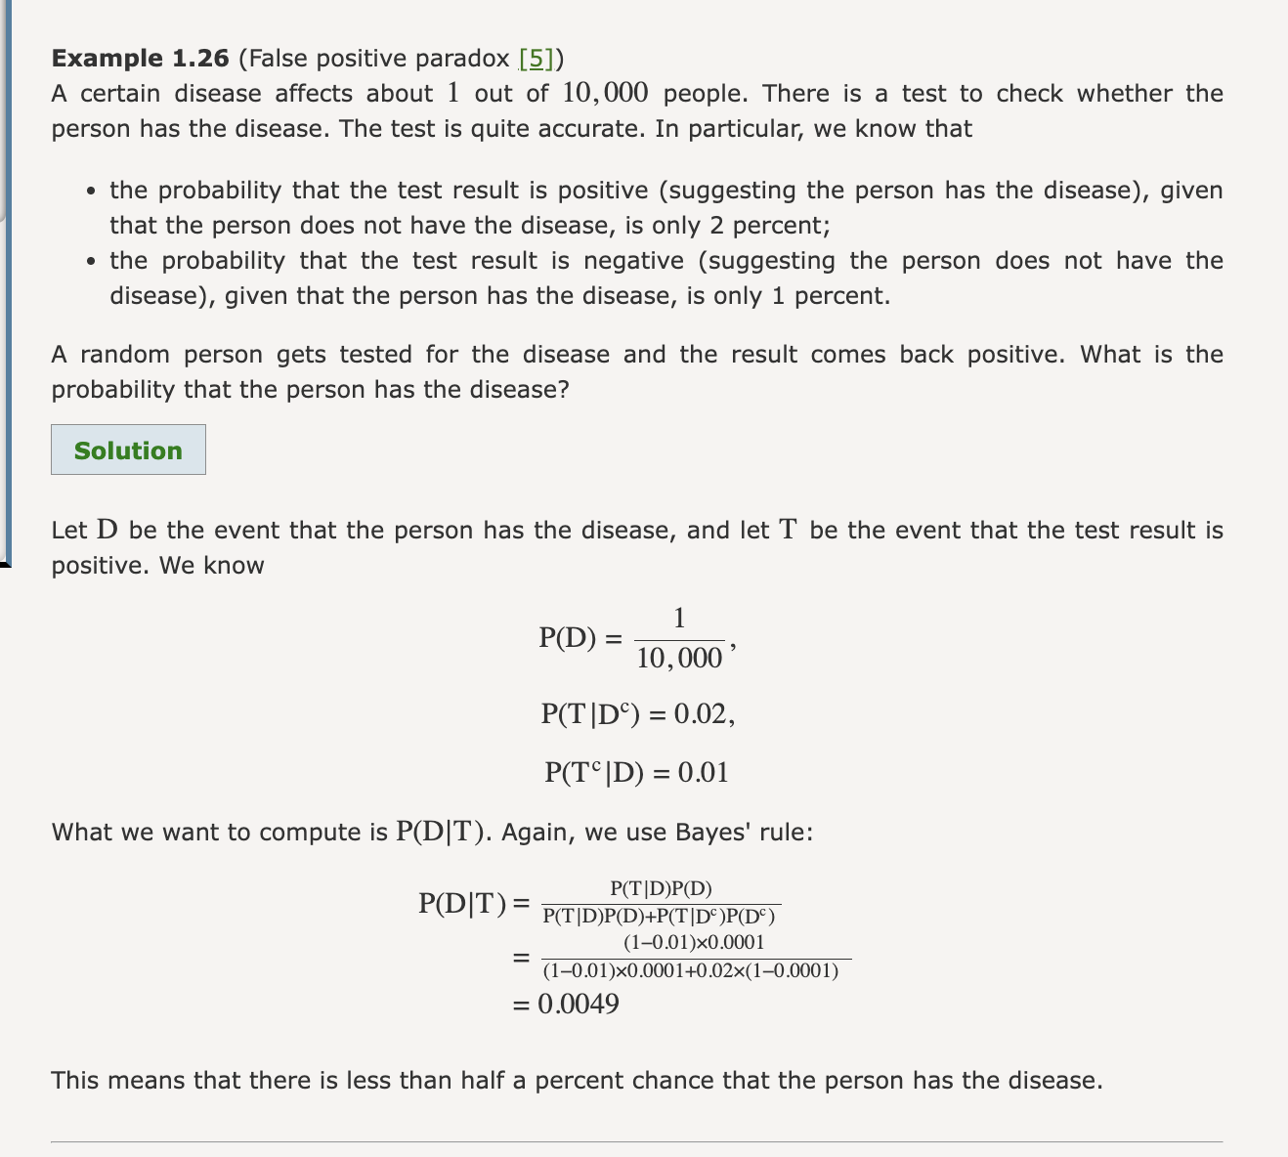

Slide 7
