Slide 1
AIS 220
Foundational Mathematics for AI
Lecture 8
Random Variables and Naïve Bayes
Kenneth (Kenny) Joseph

Slide 2
OK, so like, where are we now?
We learned about sets, which help us to think about
Probability, as the likelihood of outcomes in a set (an event) happen relative to all possible outcomes in a different set (the sample space)
We then turned to think about the probability of multiple events, and what happens when the are conditional on each other, or not (i.e. whether or not they are independent)
Now, we turn to random variables …

Slide 3
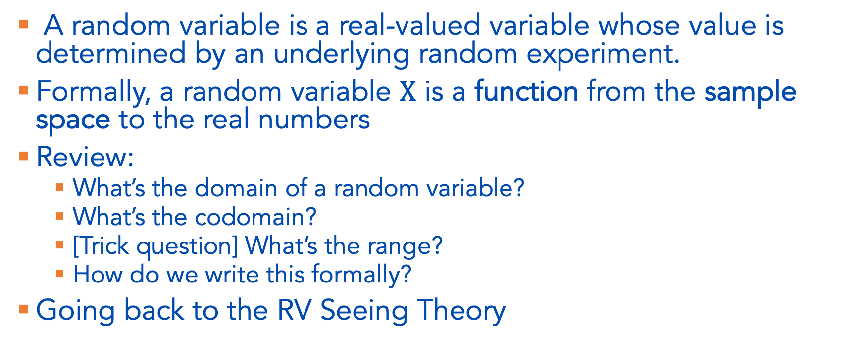
Random Variables
A random variable is a real-valued variable whose value is determined by an underlying random experiment.
Formally, a random variable $X$ is a function from the sample space to the real numbers
Review:
  What’s the domain of a random variable?
  What’s the codomain?
  [Trick question] What’s the range?
  How do we write this formally?
Going back to the RV Seeing Theory

Slide 4
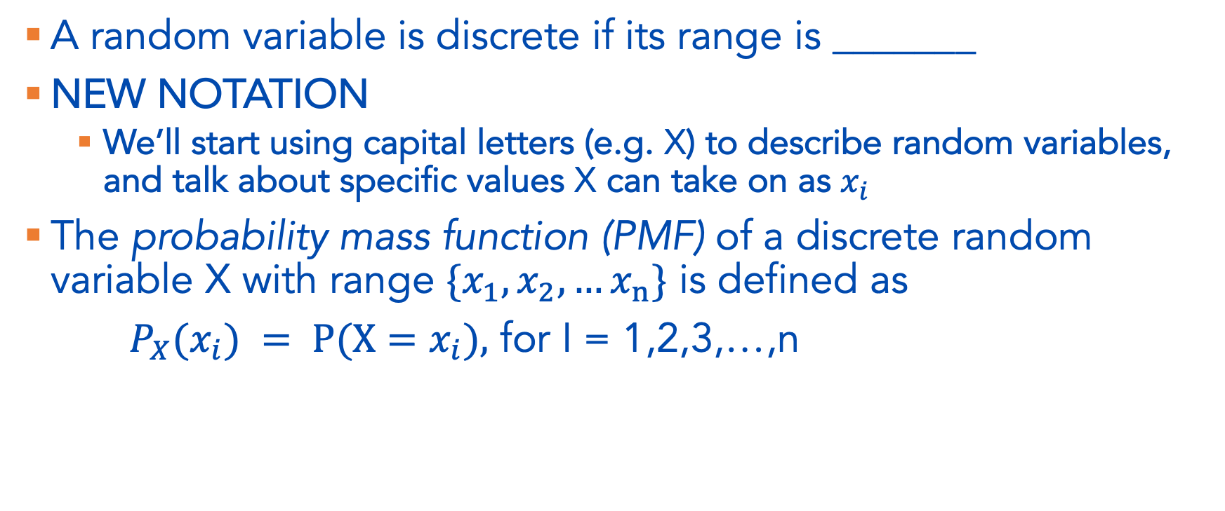
Discrete Random Variables
A random variable is discrete if its range is _______
NEW NOTATION
  We’ll start using capital letters (e.g. X) to describe random variables, and talk about specific values X can take on as $x_{i}$
The probability mass function (PMF) of a discrete random variable X with range ${\{x}_{1},x_{2},…x_{n}\}$ is defined as
$P_{X}(x_{i}) = P(X=x_{i}),$ for I = 1,2,3,…,n

Slide 5

Example 3.3
I toss a fair coin twice, and let X be defined by the number of heads I get. Find the range of X (call it $R_{X}$ as in the book) and the pmf, $P_{X}$

Slide 6
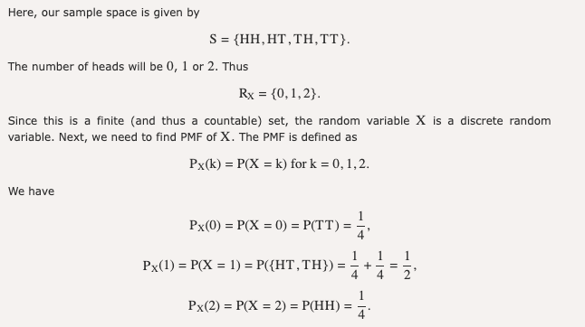

Slide 7
Example 3.4
I have an unfair coin for which P(H) = p, where 0 < p < 1. I toss the coin repeatedly until I observe a head for the first time. Let Y be the total number of coin tosses. Find the distribution of Y.
…sidebar, this kind of scenario comes up a lot. It’s handy to have some pre-defined notation that we can use to think about similar situations!
  https://seeing-theory.brown.edu/probability-distributions/index.html#section1

Slide 8
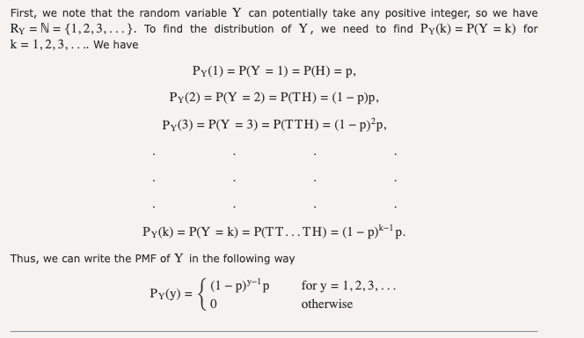

Slide 9
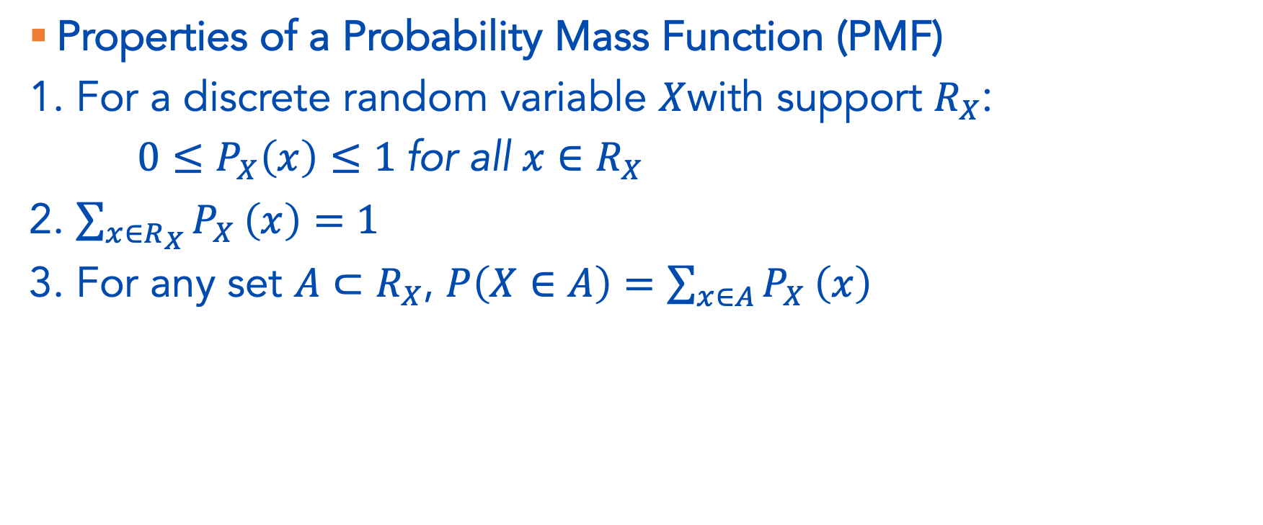
Linking PMFs to axioms of probability
Properties of a Probability Mass Function (PMF)
1. For a discrete random variable $X$with support $R_{X}$:
$0≤P_{X}\left(x\right)≤1 \text{for} \text{all} x∈R_{X}$
2. $\sum_{x∈R_{X}}{P_{X}}\left(x\right)=1$
3. For any set $A⊂R_{X}$, $P\left(X∈A\right)=\sum_{x∈A}{P_{X}}\left(x\right)$

Slide 10
Cumulative Distribution Function (CDF)
The cumulative distribution function (CDF) of a random variable X is defined as
Fₓ(x) = P(X ≤ x), for all x ∈ ℝ.
Example 3.9:
  I toss a coin twice. Let X be the number of observed heads. Find the CDF of X.

Slide 11
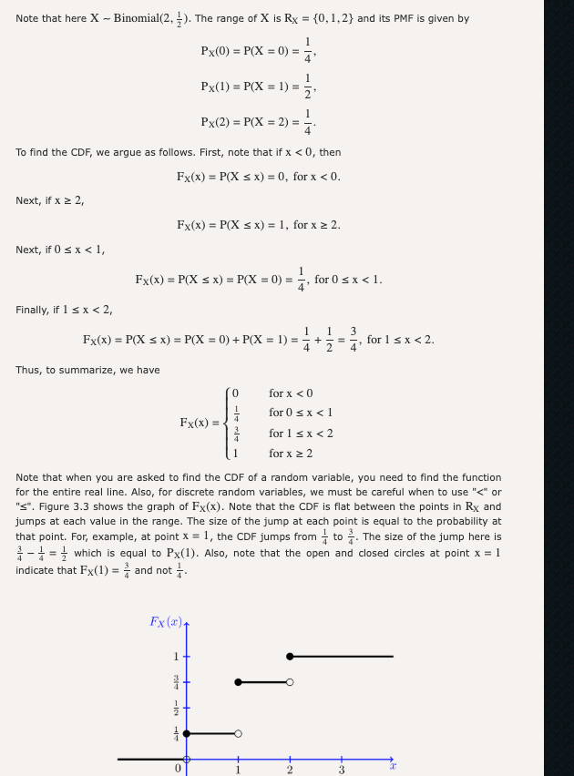

Slide 12
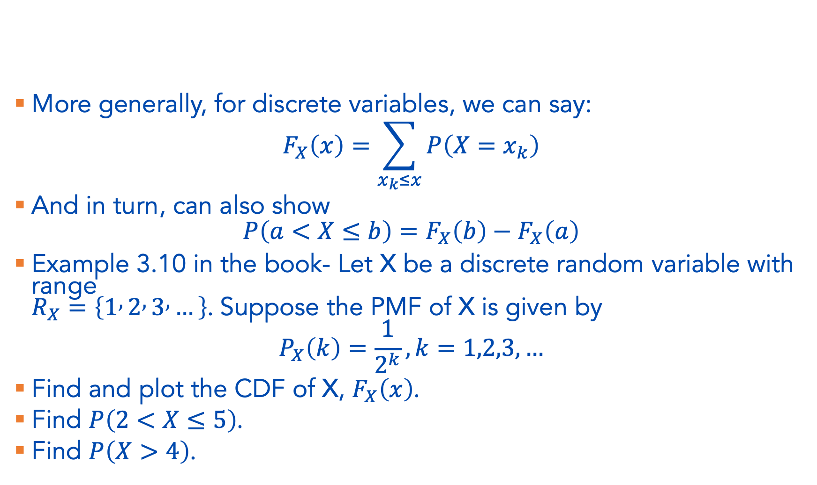
CDF, continued
More generally, for discrete variables, we can say:
$$F_{X}\left(x\right)=\sum_{x_{k}≤x}{P\left(X=x_{k}\right)}$$
And in turn, can also show
$$P\left(a<X≤b\right)=F_{X}\left(b\right)−F_{X}\left(a\right)$$
Example 3.10 in the book- Let X be a discrete random variable with range
$R_{X}=\left\{1 , 2 , 3 , …\right\}$. Suppose the PMF of X is given by
$$P_{X}\left(k\right)=\frac{1}{2^{k}}, k=1,2,3,…$$
Find and plot the CDF of X, $F_{X}\left(x\right)$.
Find $P\left(2<X≤5\right)$.
Find $P\left(X>4\right)$.

Slide 13
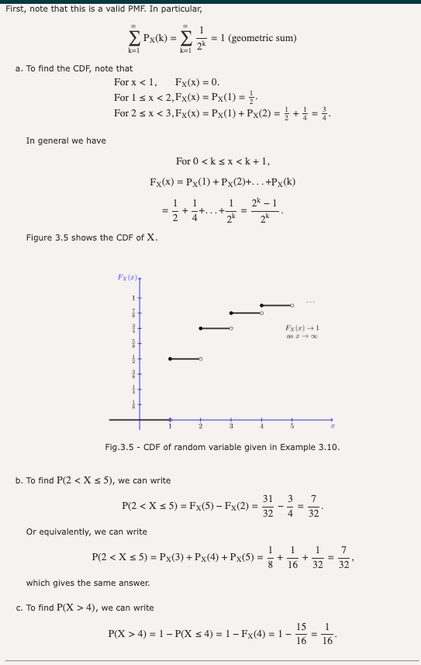

Slide 14
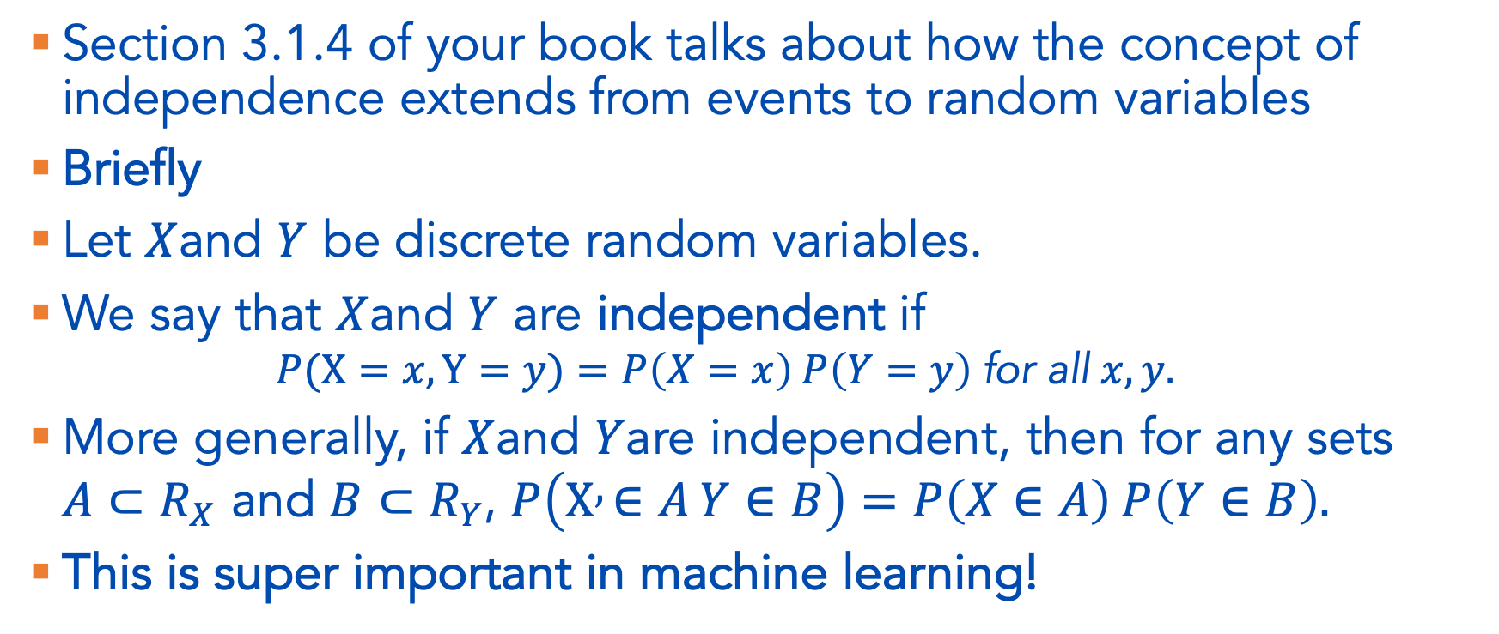
(In)dependence of discrete random variables
Section 3.1.4 of your book talks about how the concept of independence extends from events to random variables
Briefly
Let $X$and $Y$ be discrete random variables.
We say that $X$and $Y$ are independent if
  $$P(X=x, Y=y)=P\left(X=x\right) P\left(Y=y\right) \text{for} \text{all} x,y.$$
More generally, if $X$and $Y$are independent, then for any sets
$A⊂R_{X}$ and $B⊂R_{Y}$, $P\left(X , ∈A Y∈B\right)=P\left(X∈A\right) P\left(Y∈B\right).$
This is super important in machine learning!

Slide 15
Special Distributions
Section 3.1.5 of your book
https://seeing-theory.brown.edu/probability-distributions/index.html
You do not need to memorize these!

Slide 16
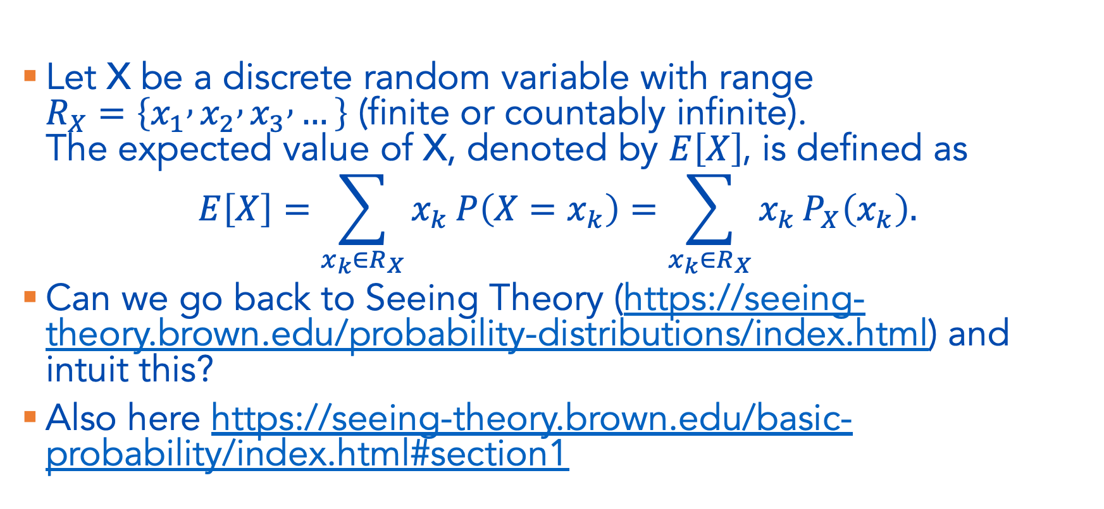
Expectation
Let X be a discrete random variable with range
$R_{X}=\left\{x_{1} , x_{2} , x_{3} , …\right\}$ (finite or countably infinite).
The expected value of X, denoted by $E\left[X\right]$, is defined as
$$E\left[X\right]=\sum_{x_{k}∈R_{X}}{x_{k}}P\left(X=x_{k}\right)=\sum_{x_{k}∈R_{X}}{x_{k}}P_{X}\left(x_{k}\right).$$
Can we go back to Seeing Theory (https://seeing-theory.brown.edu/probability-distributions/index.html) and intuit this?
Also here https://seeing-theory.brown.edu/basic-probability/index.html#section1

Slide 17
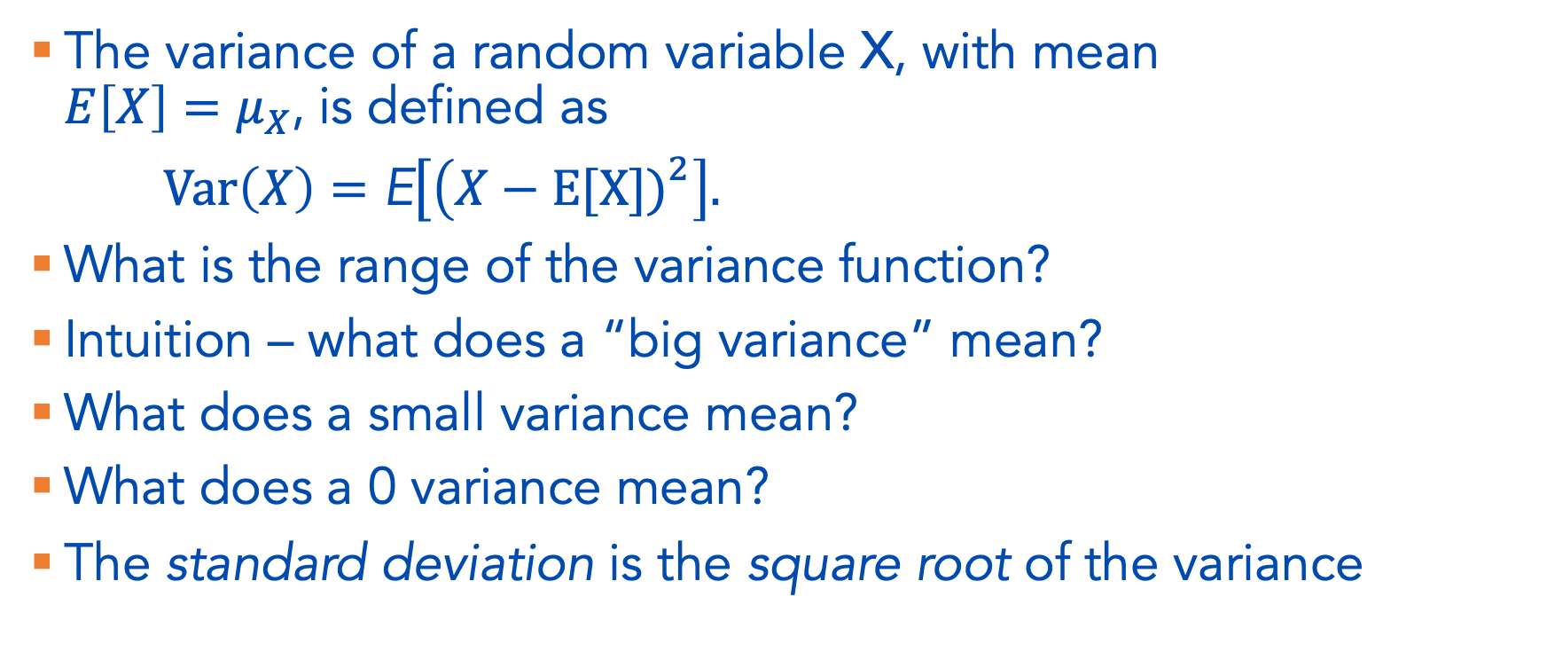
Variance
The variance of a random variable X, with mean
$E\left[X\right]=μ_{X}$, is defined as
$Var⁡\left(X\right)=\text{E}\left[\left(X−E[X]{\left.)\right.}^{2}\right]\right..$
What is the range of the variance function?
Intuition – what does a “big variance” mean?
What does a small variance mean?
What does a 0 variance mean?
The standard deviation is the square root of the variance

