Slide 1
ML&Soc
Lecture 1
Hi!
Kenneth (Kenny) Joseph

Slide 2
Welcome!
Plan:
  Introduce myself
  Tell you a little about what the course is and is not
  Logistics
  Break
  Bit more about the course

Slide 3
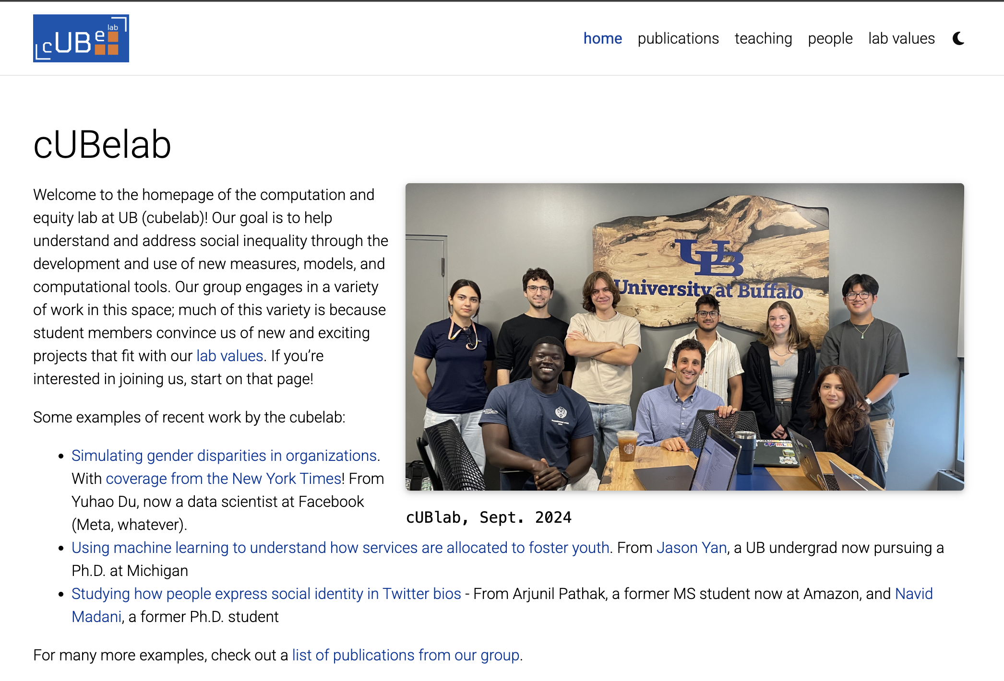

Slide 4
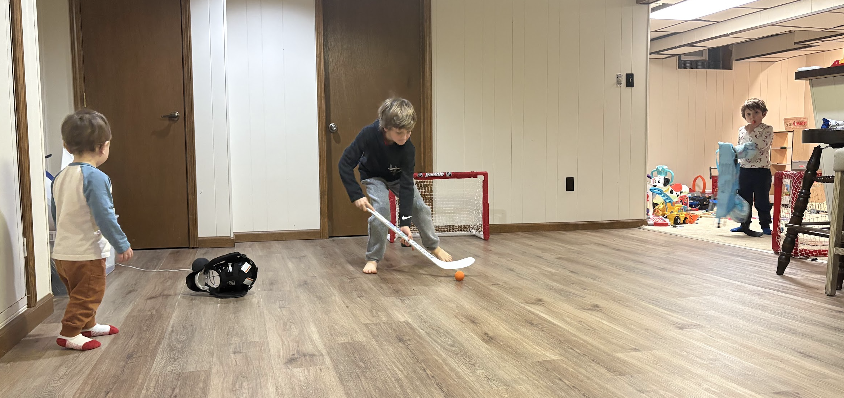
Owen, Micah, and Teddy

Slide 5
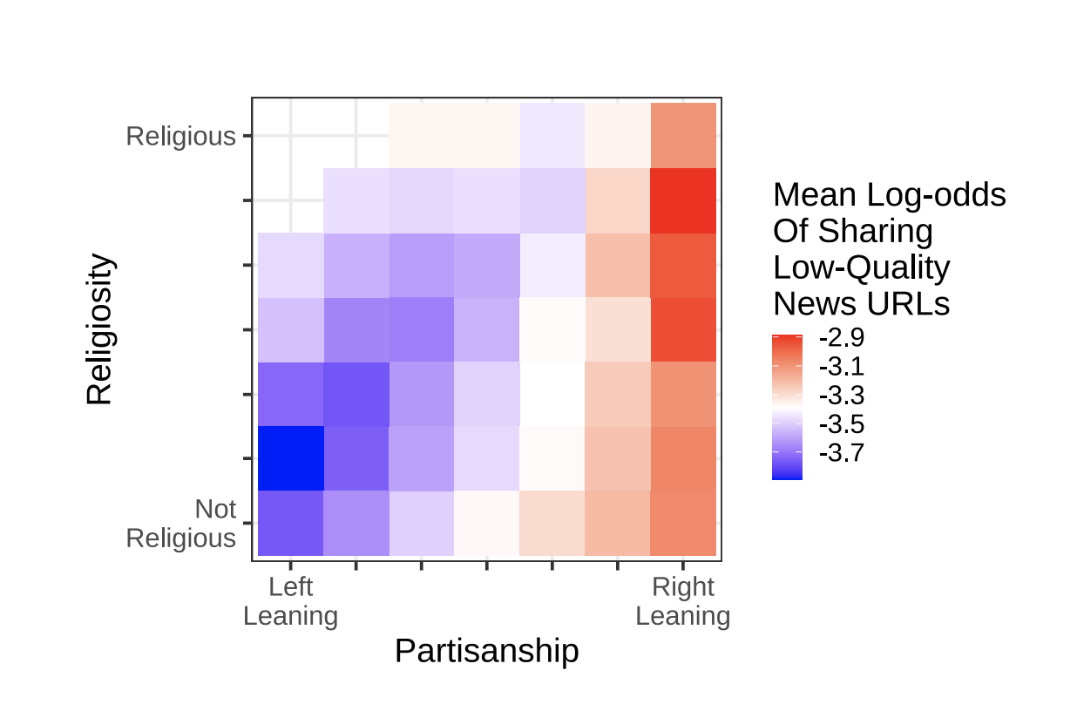
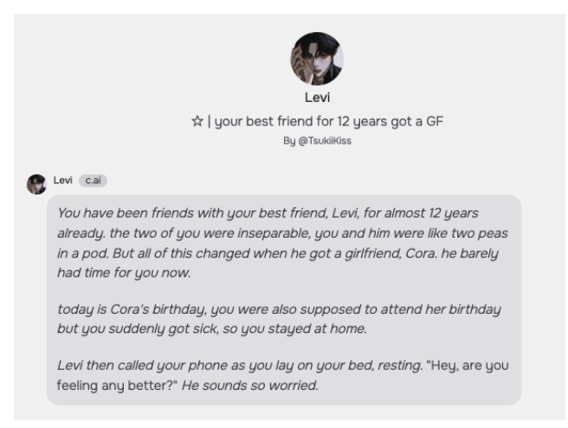

Slide 6
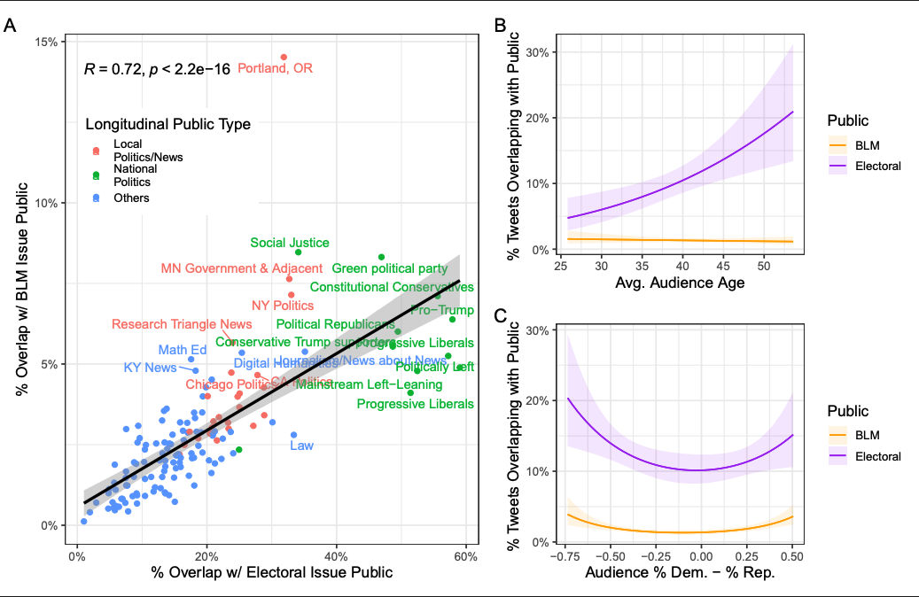

Slide 7
This course
This course is about
  Understanding the societal implications of ML
  Understanding how ML is shaped by … societal implications
  Challenging you with an unconventional project with no right answers (but a lot of wrong ones)
  Deep collaboration
This course is not about
  Telling you how to build “fair ML”
  Chatbots
  Deep technical details about AI
  Deep STS studies of AI

Slide 8
Office Hours
Davis Hall, 335 (for most of the semester)
Fridays, 12:30-1:30

Slide 9
Things to remember
ATTEND, SUBMIT ALL THINGS ON TIME!
DO NOT CHEAT!
READ CAREFULLY!
Take care of yourself!
Be respectful of your classmates!

Slide 10
Academic Dishonesty
All your submissions must be your own work
Penalty:
  Minimum: An grade reduction in course
  Possible: F (or higher penalty) if warranted
YOUR responsibility to know what is cheating, plagiarism etc.
  If not sure, come talk to me
Excuses like “I have a job,” “This was OK earlier/in my country,” “This course is hard,” etc. WON’T WORK
WE DO NOT HAVE ANY PATIENCE WITH ANY CHEATING :
YOU WILL GET A GRADE REDUCTION IN THE COURSE
FOR YOUR FIRST MISTAKE

Slide 11
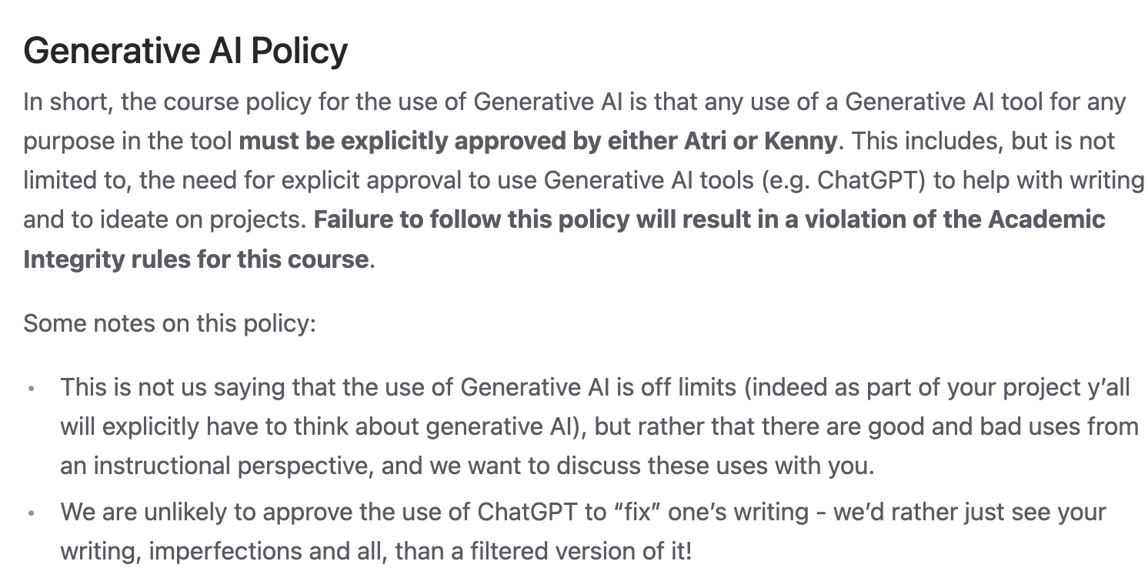
Don’t use it unless we ask you to.

Slide 12
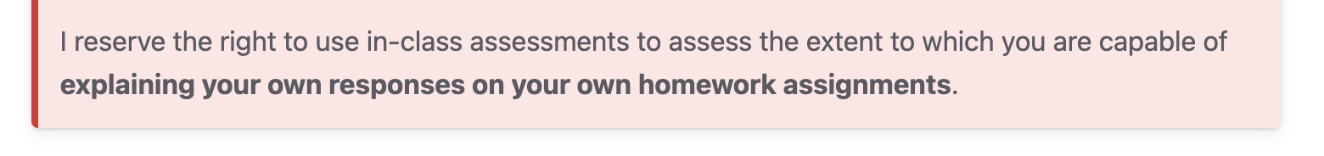
Note the following…

Slide 13
Accessibility Resources
Information included in the syllabus
In short, let us know and consult with Accessibility Resources

Slide 14
Preferred Name
If you prefer using name diff from UB records
Let us know and we’ll make a note of it.

Slide 15

Critical Campus Resources

Slide 16
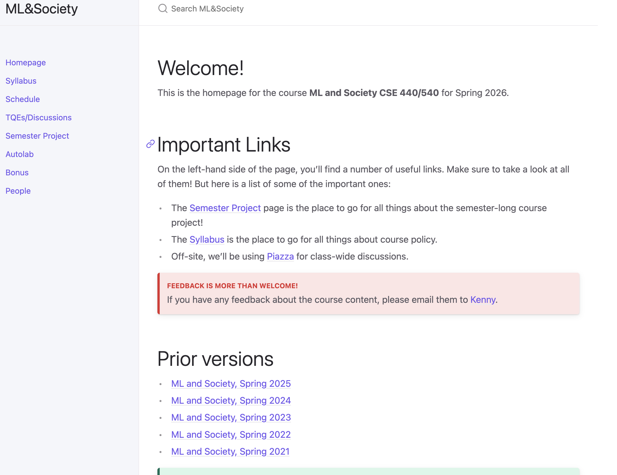
One-ish Stop-shop for the course
cse.buffalo.edu/~kjoseph/mlsoc

Slide 17
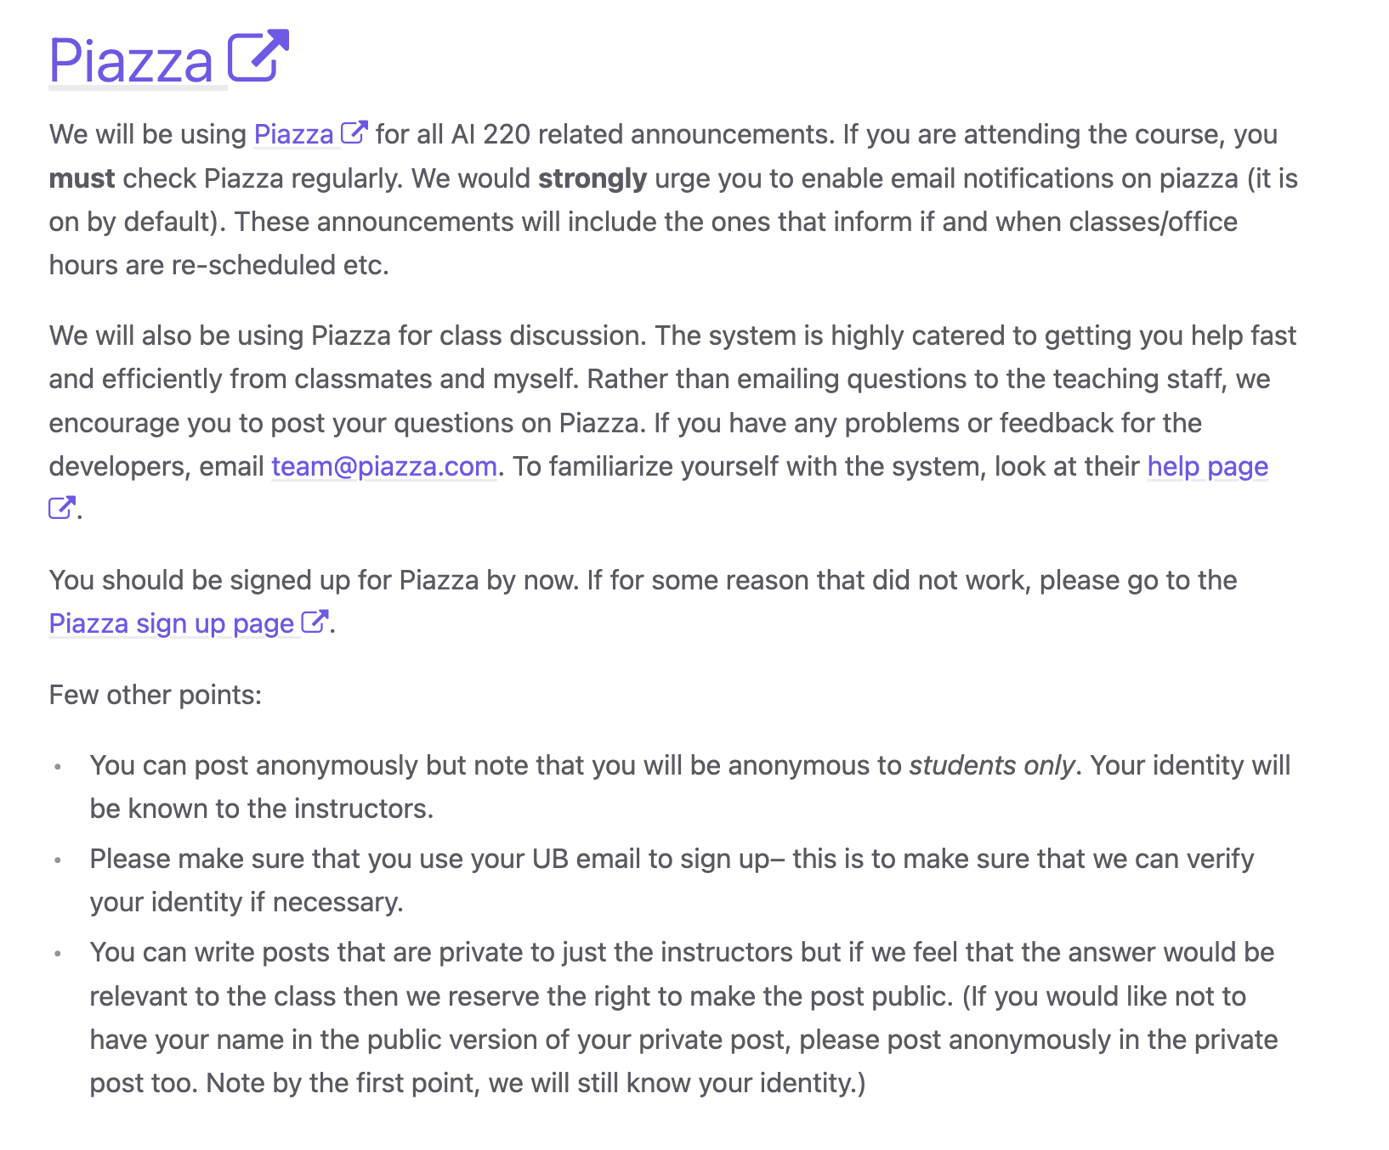
The other stop shop…

Slide 18
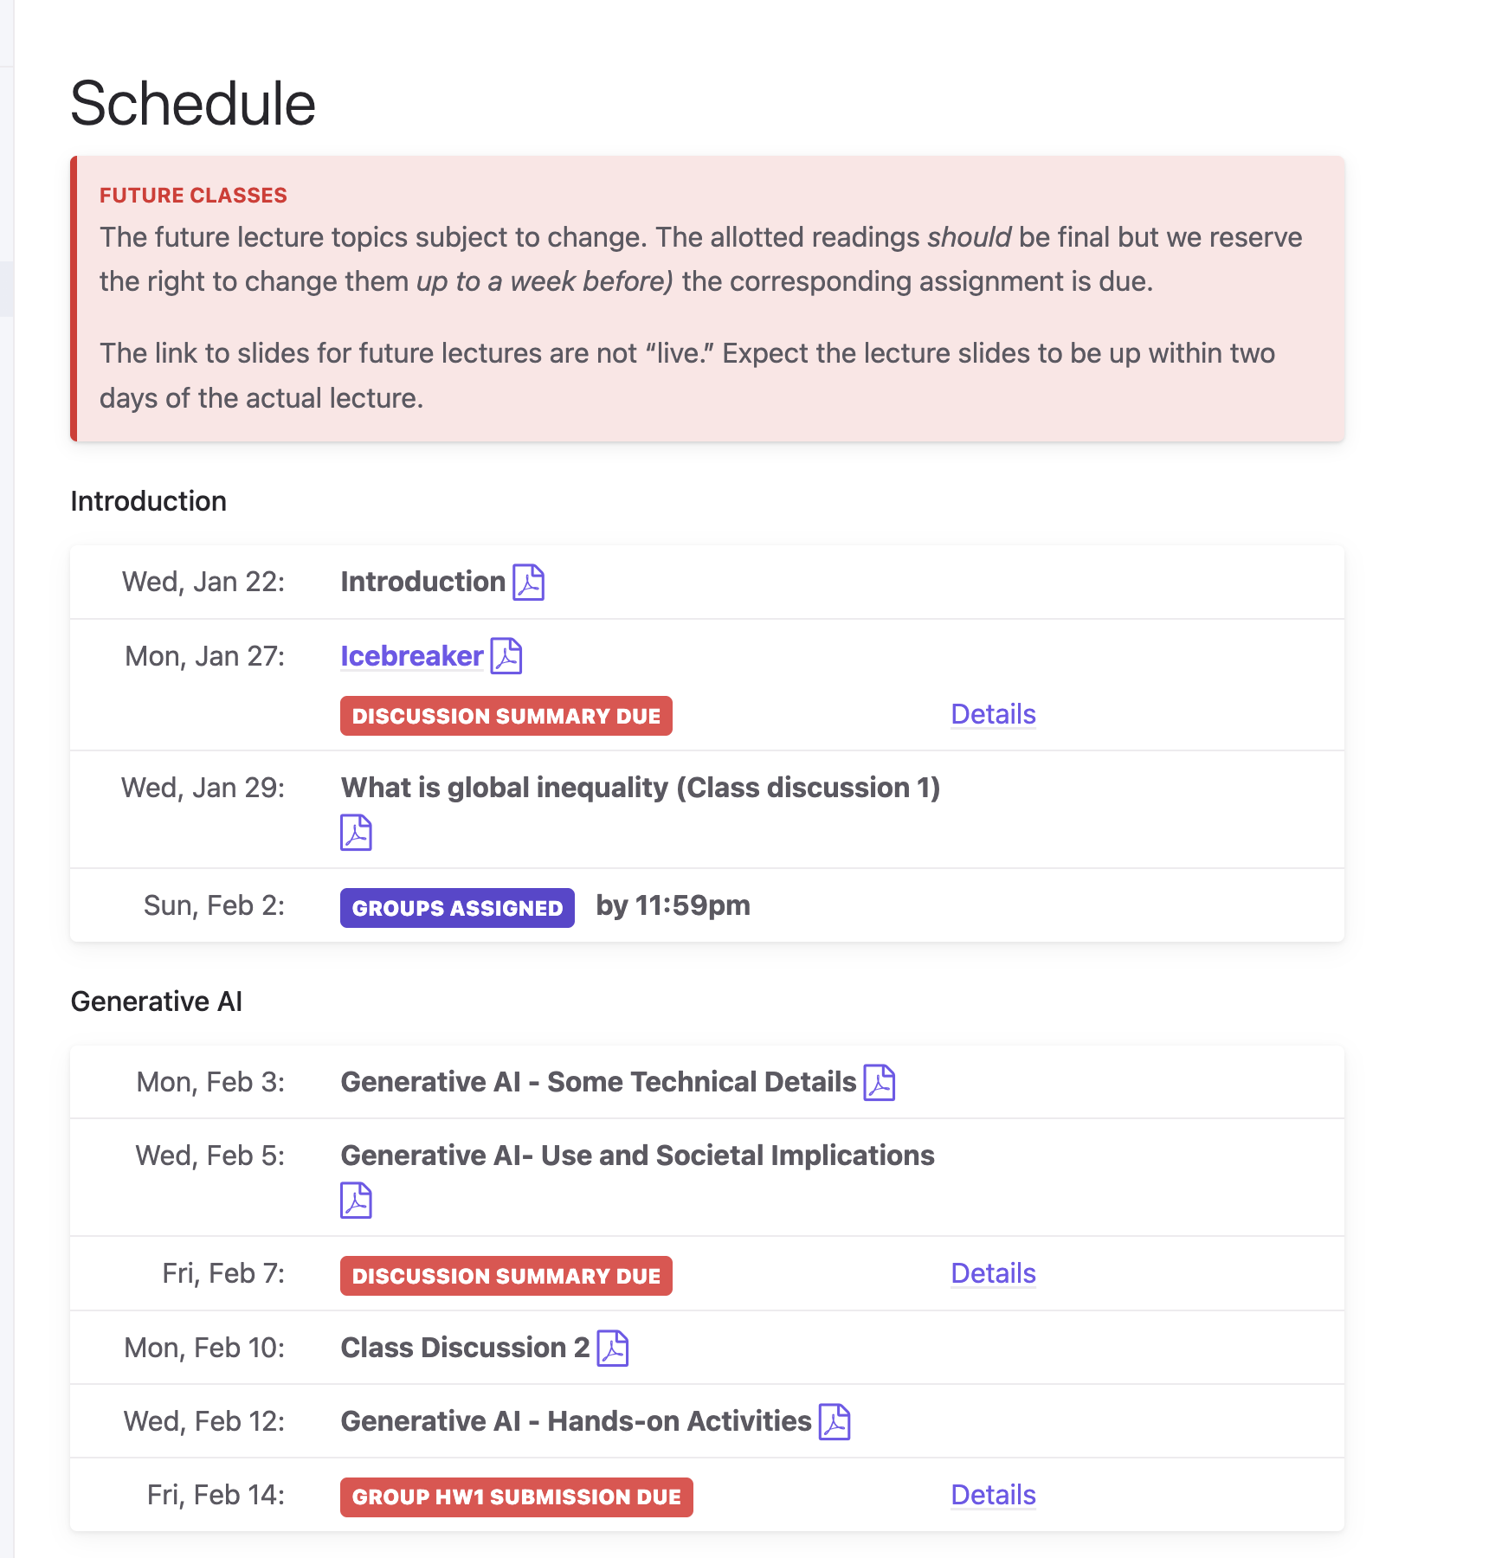

Slide 19
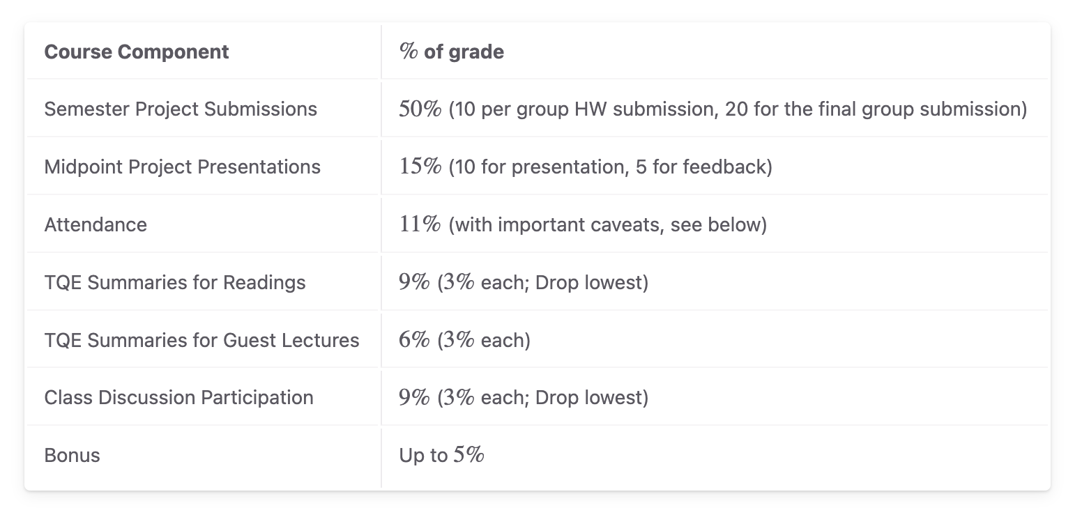
Class outline

Slide 20
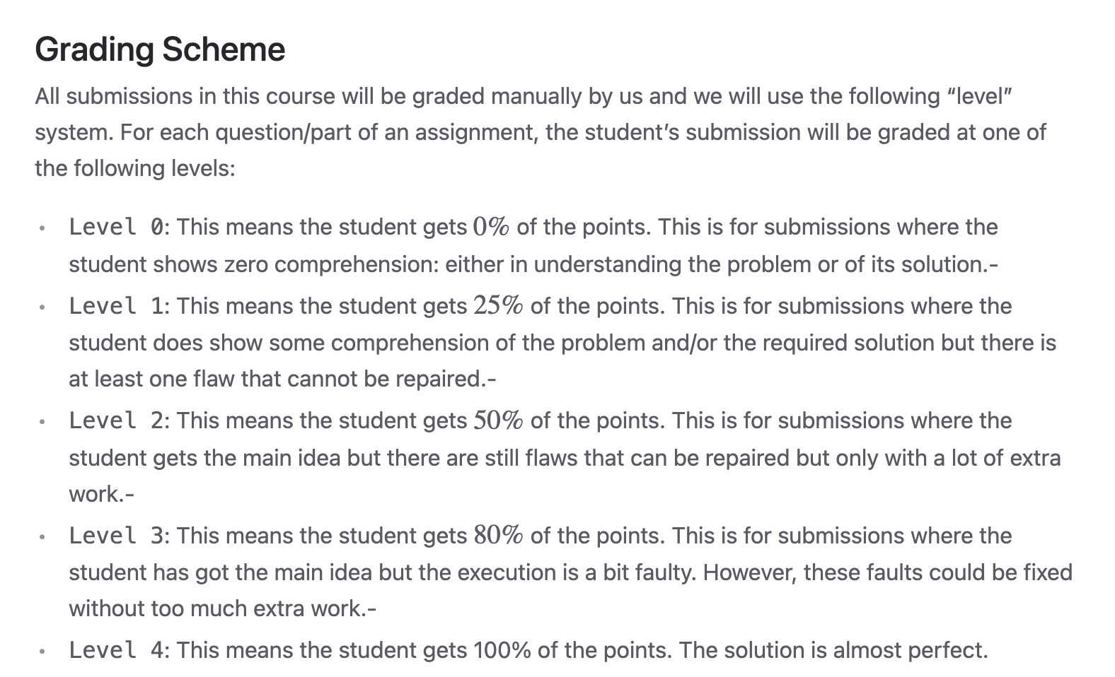
Grading Scheme

Slide 21
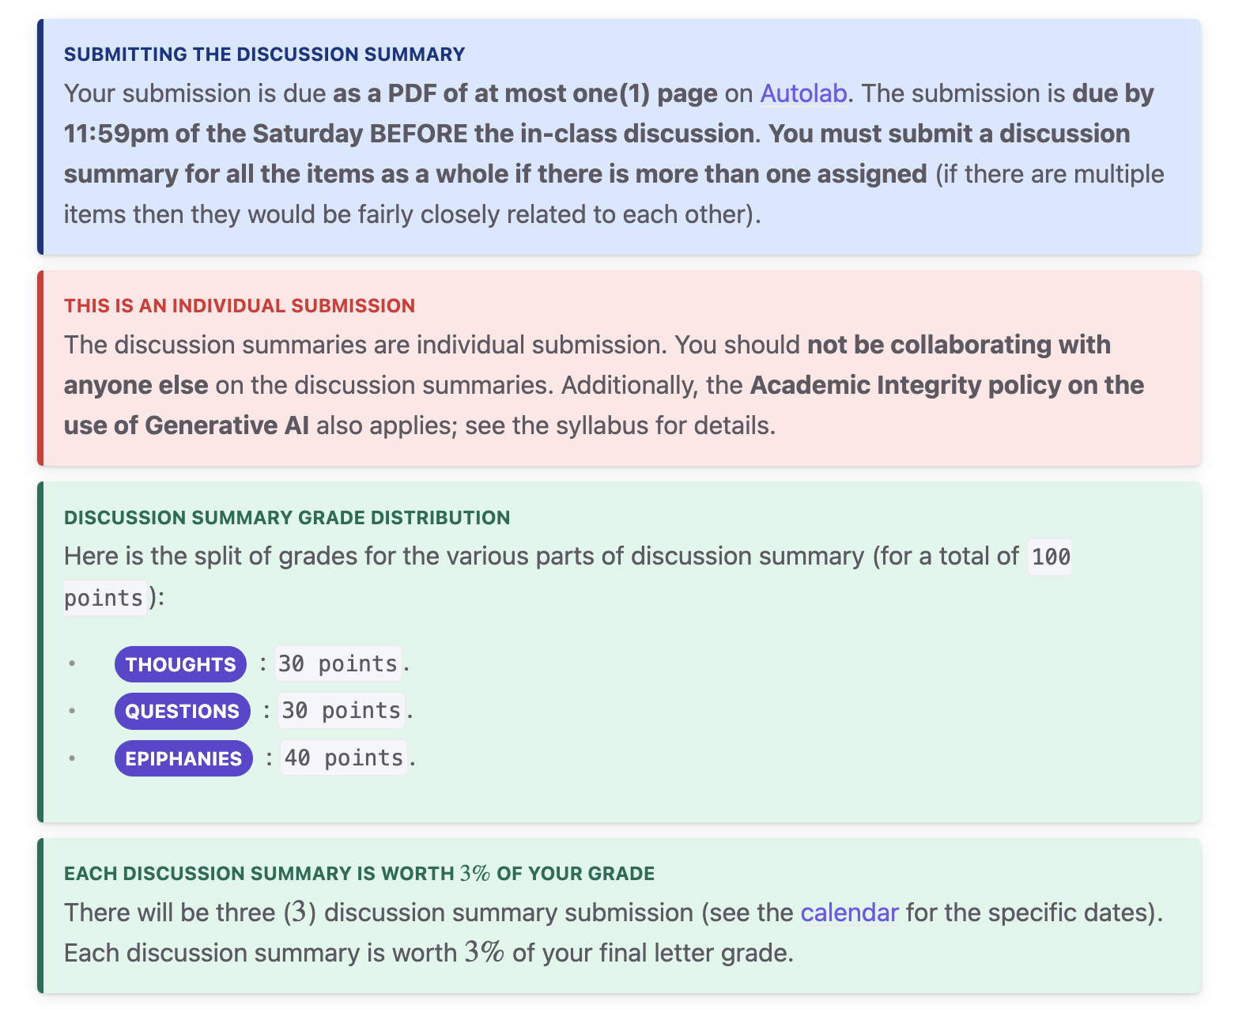
Instructions are not suggestions

Slide 22
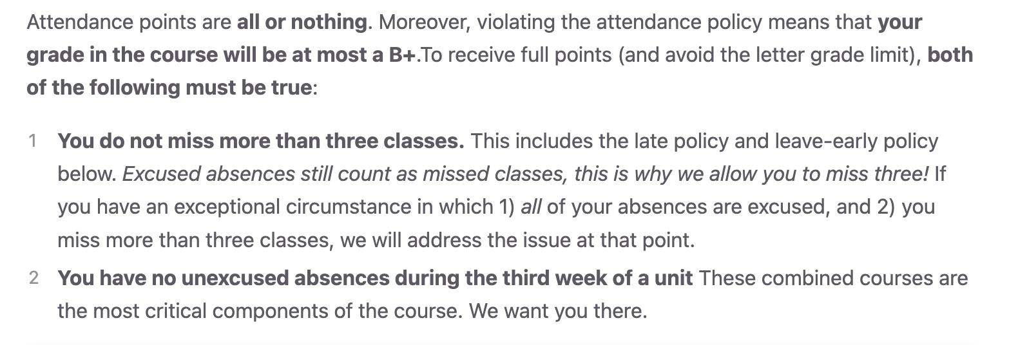
Attendance is critical

Slide 23
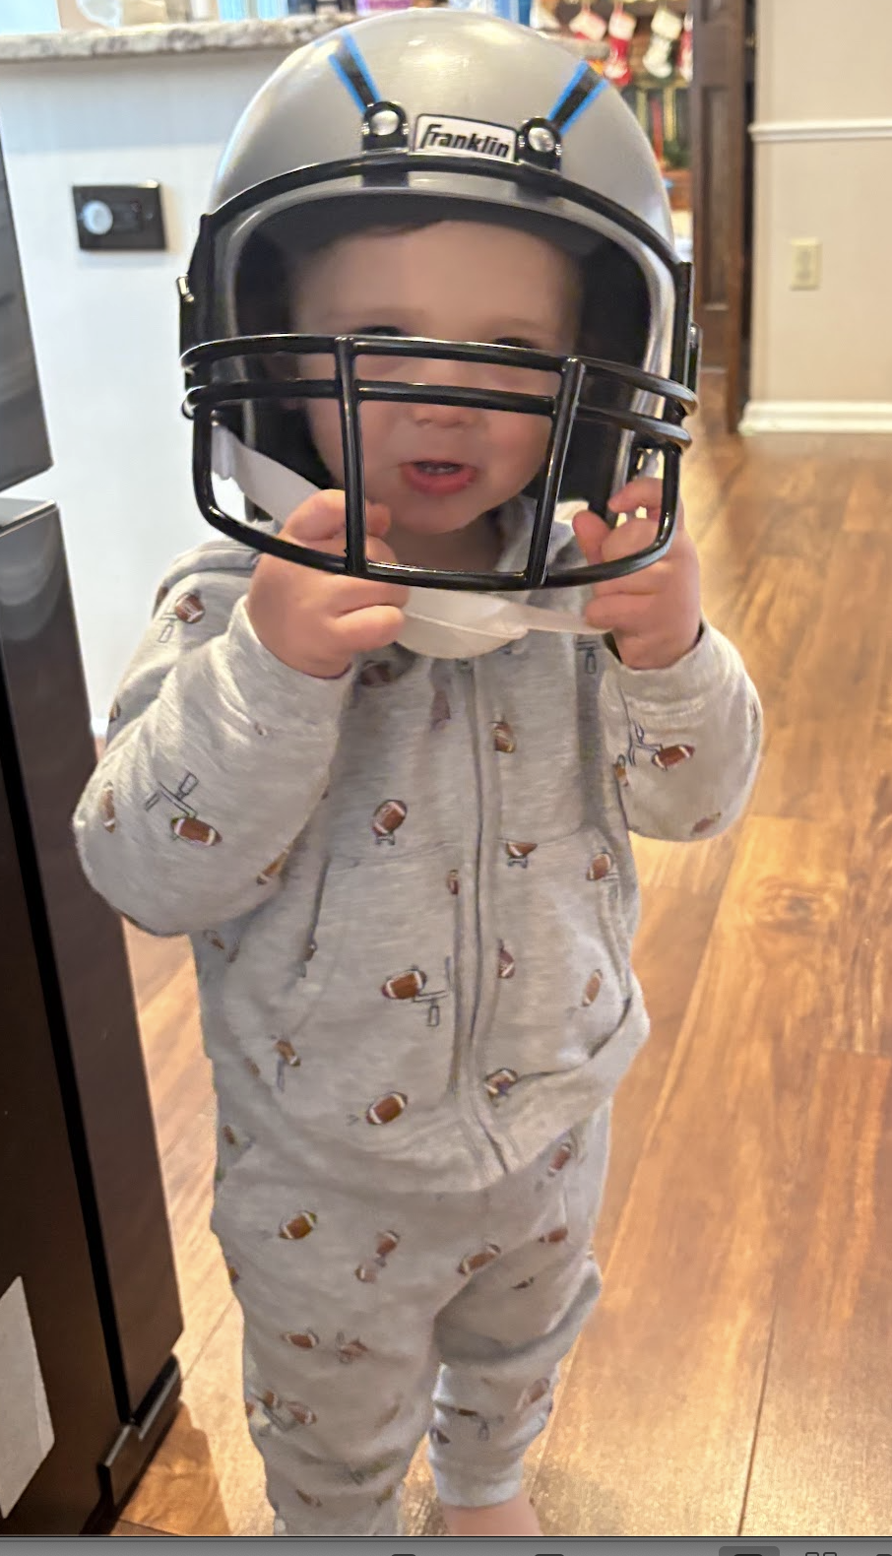
…why?
The workload for this course should be relatively light. There isn’t even homework!
Consequently, you need to be in class, because that is where we will put in the work.
There are no exceptions to the attendance policy.

Slide 24
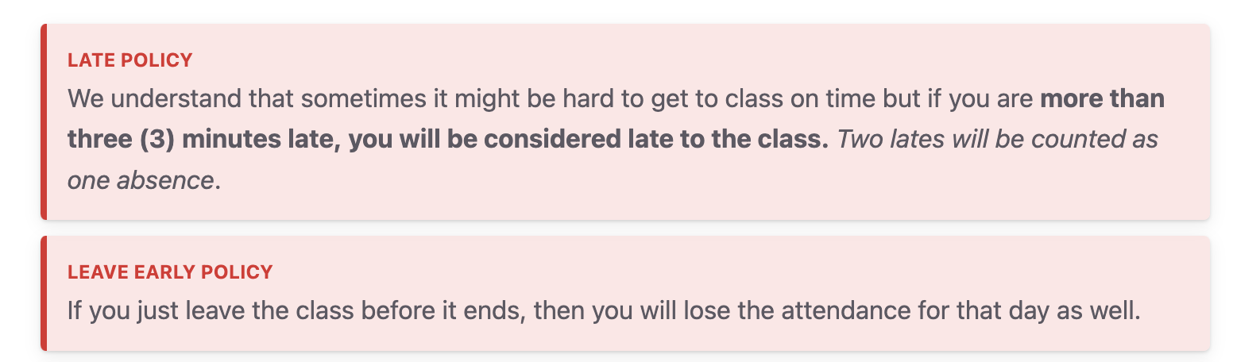
Attendance, additional notes

Slide 25
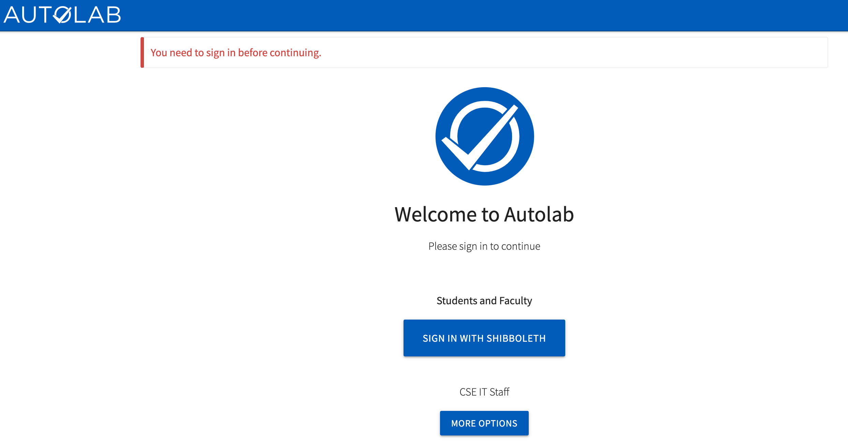
Attendance on Autolab
https://autolab.cse.buffalo.edu/

Slide 26
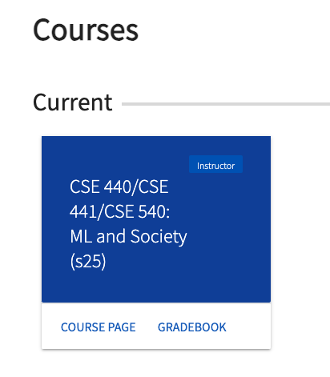
This is what you should see when you login

Slide 27
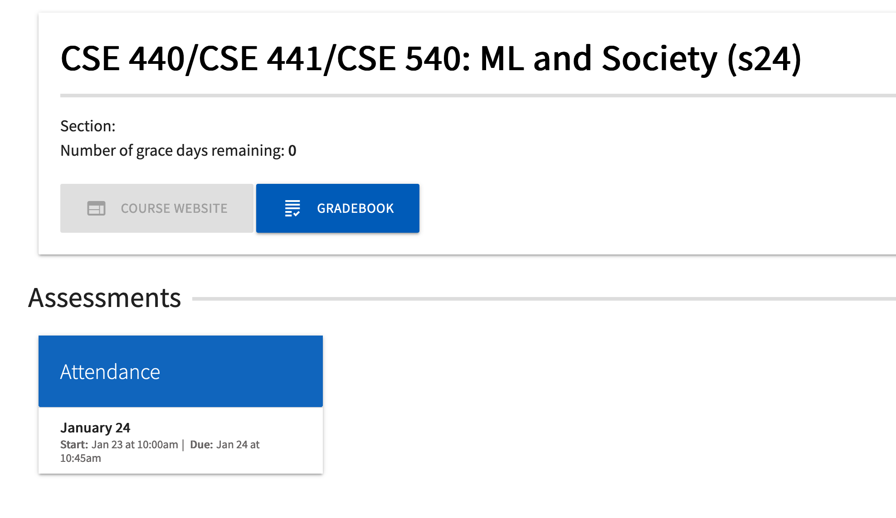
You should see a link for attendance

Slide 28
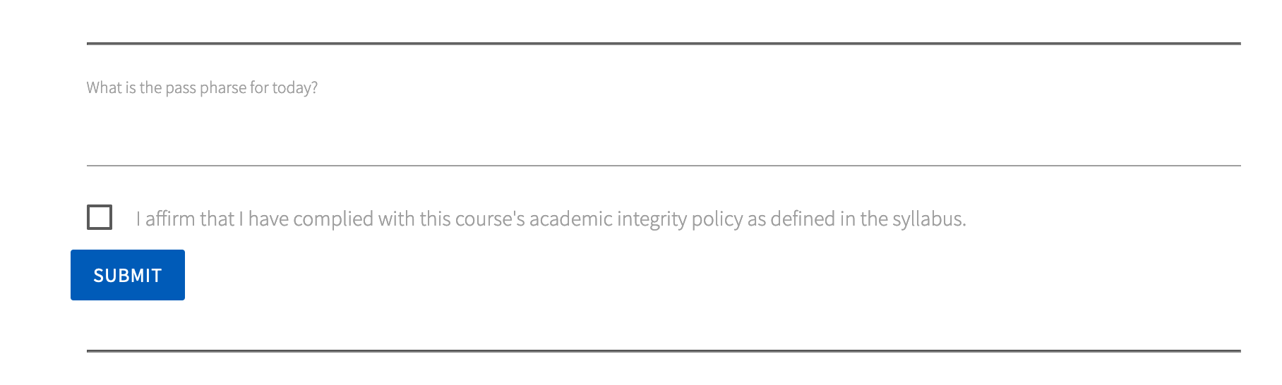
You need to enter a pass-phrase

Slide 29
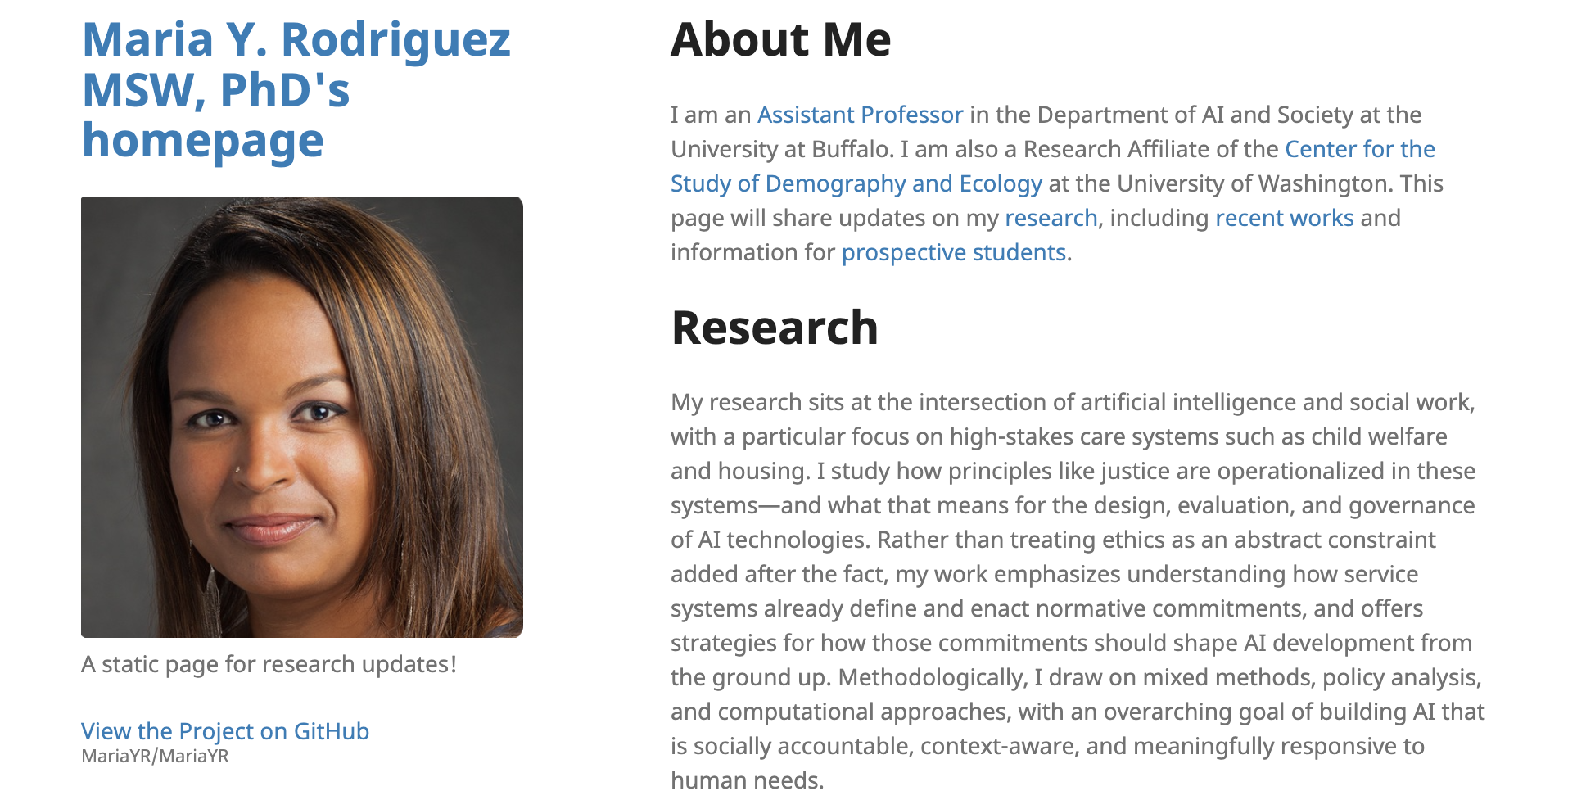
Pass-phrase for today: Maria Rodriguez

Slide 30
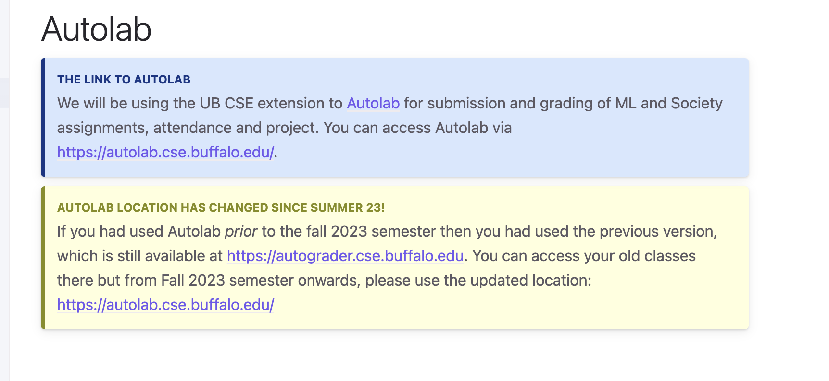
If you need a reminder

Slide 31
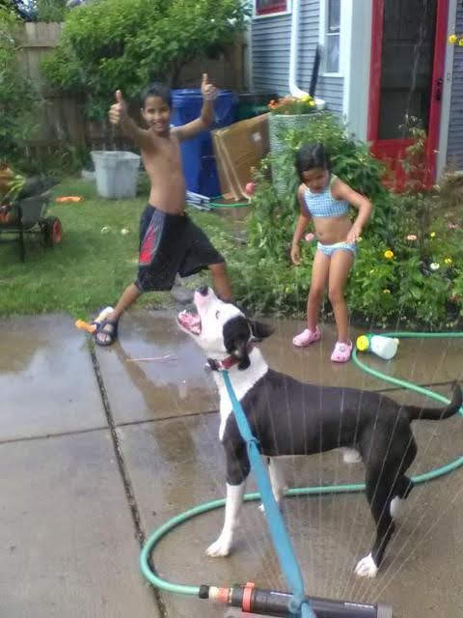
More course logistics in 2nd half of today

Slide 32
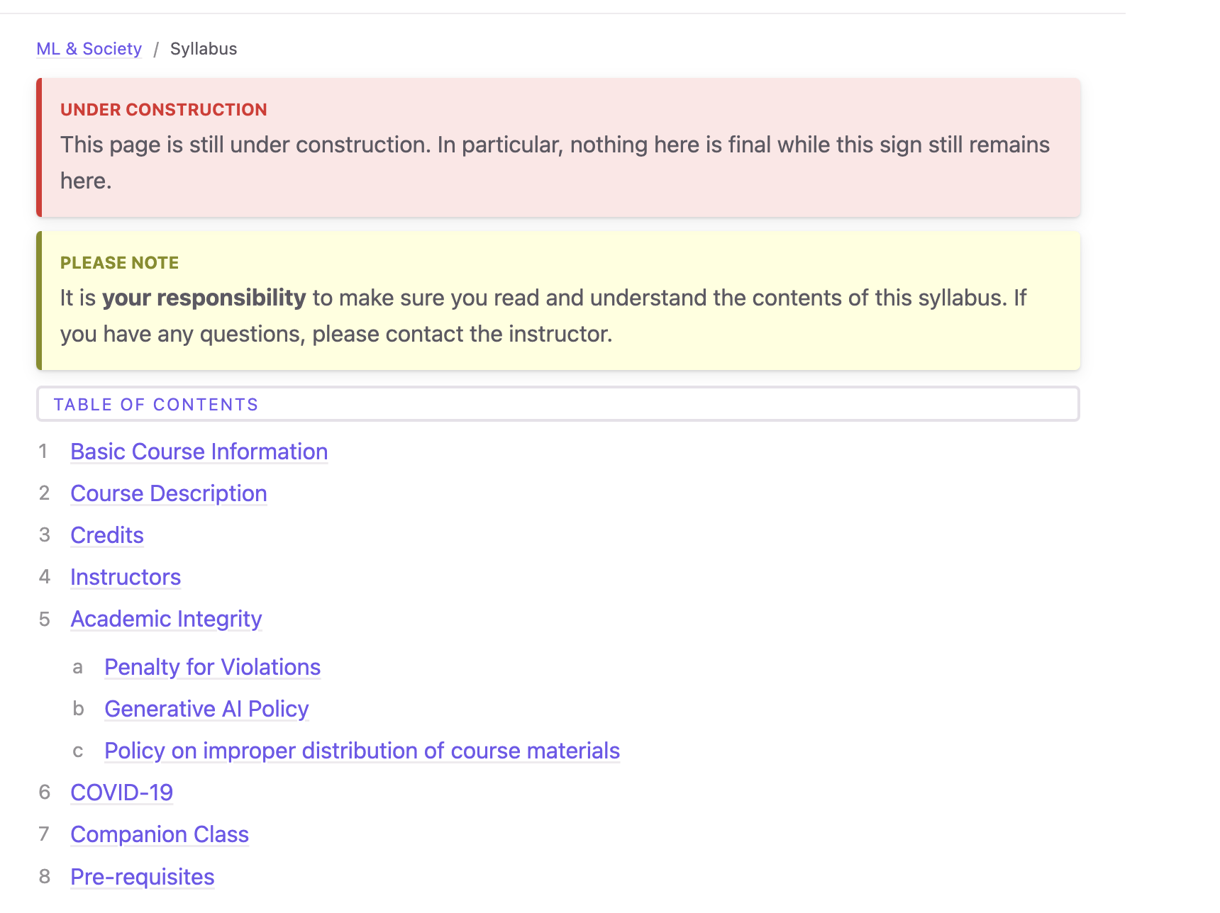
Read the syllabus carefully!

Slide 33
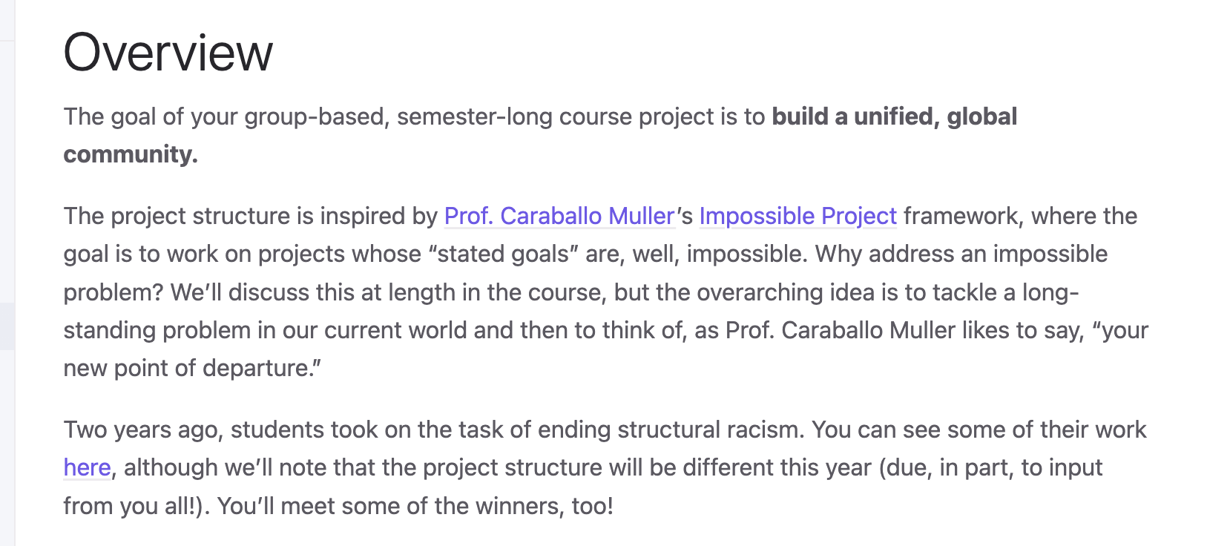
Semester-long Project

Slide 34
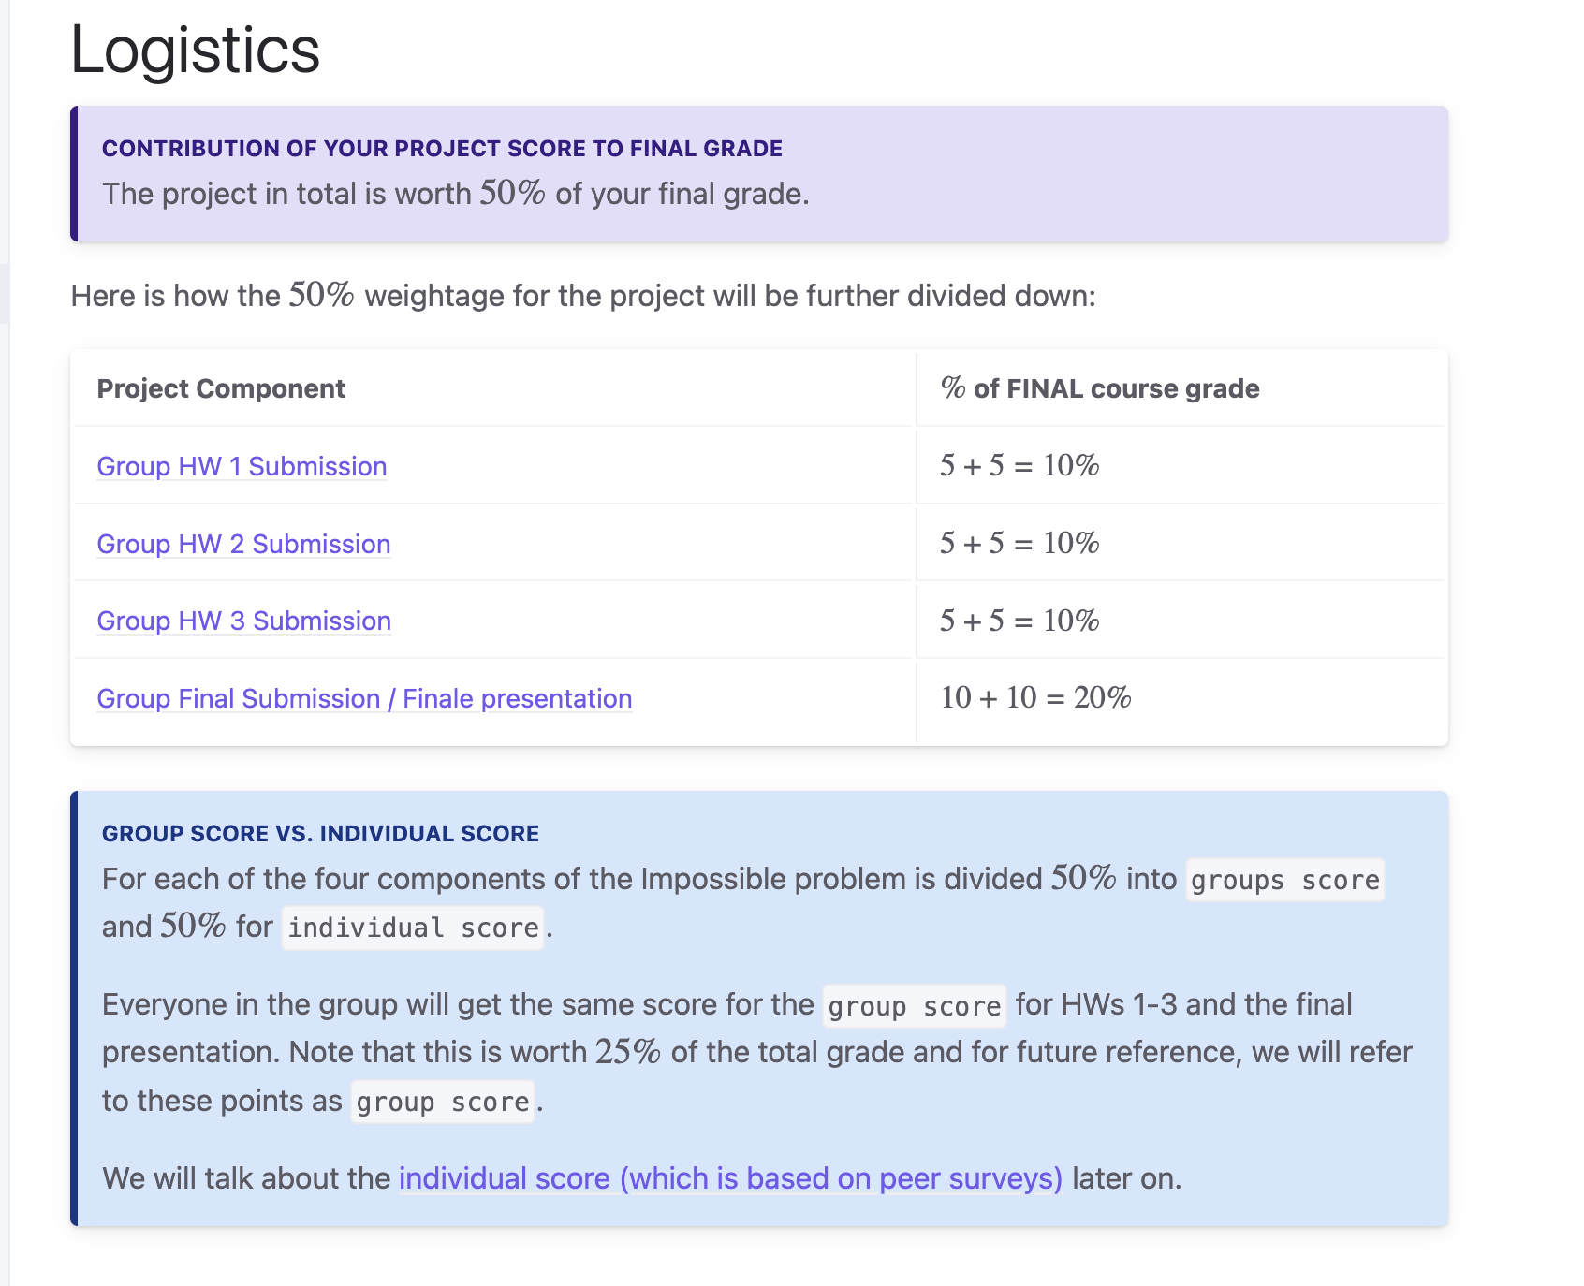
Project Logistics

Slide 35
Gen AI
[Safe space]
•How do you use GenAI right now?
What's the most "out there" use of generative AI by someone that you know?
•What are some uses of generative AI that might actually benefit society?
•What are some uses of generative AI that might harm society?
•What are some creepy uses of generative AI?
•How is “generative AI” different from “AI”? From “ML”?
•Where will we be in 5 years? 10 years? 100 years?

Slide 36
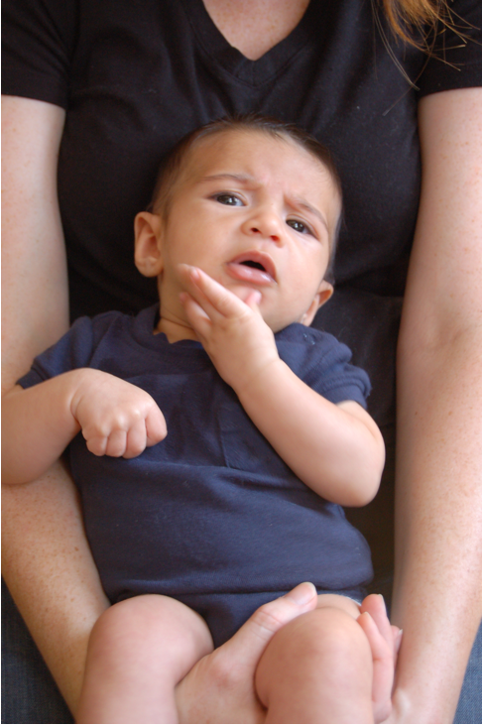
Questions/Comments?

Slide 37
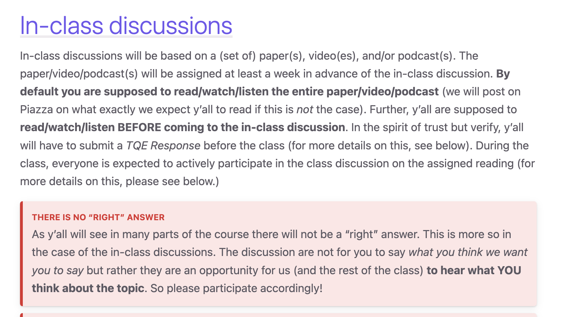
TQEs and Discussions

Slide 38
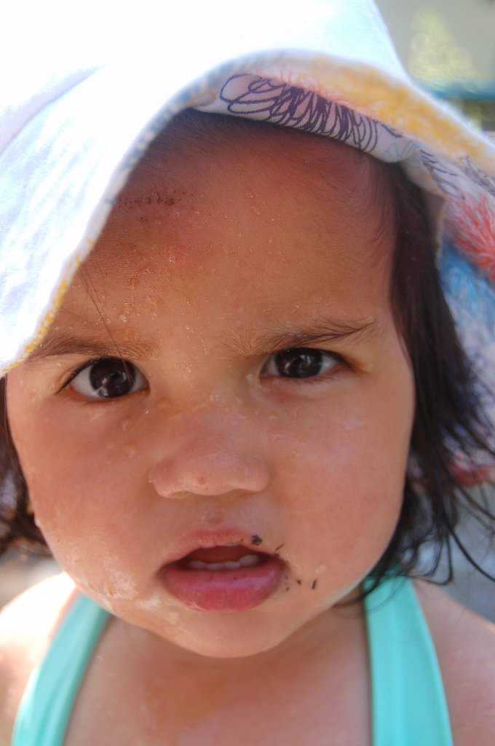
Why this course?

Slide 39
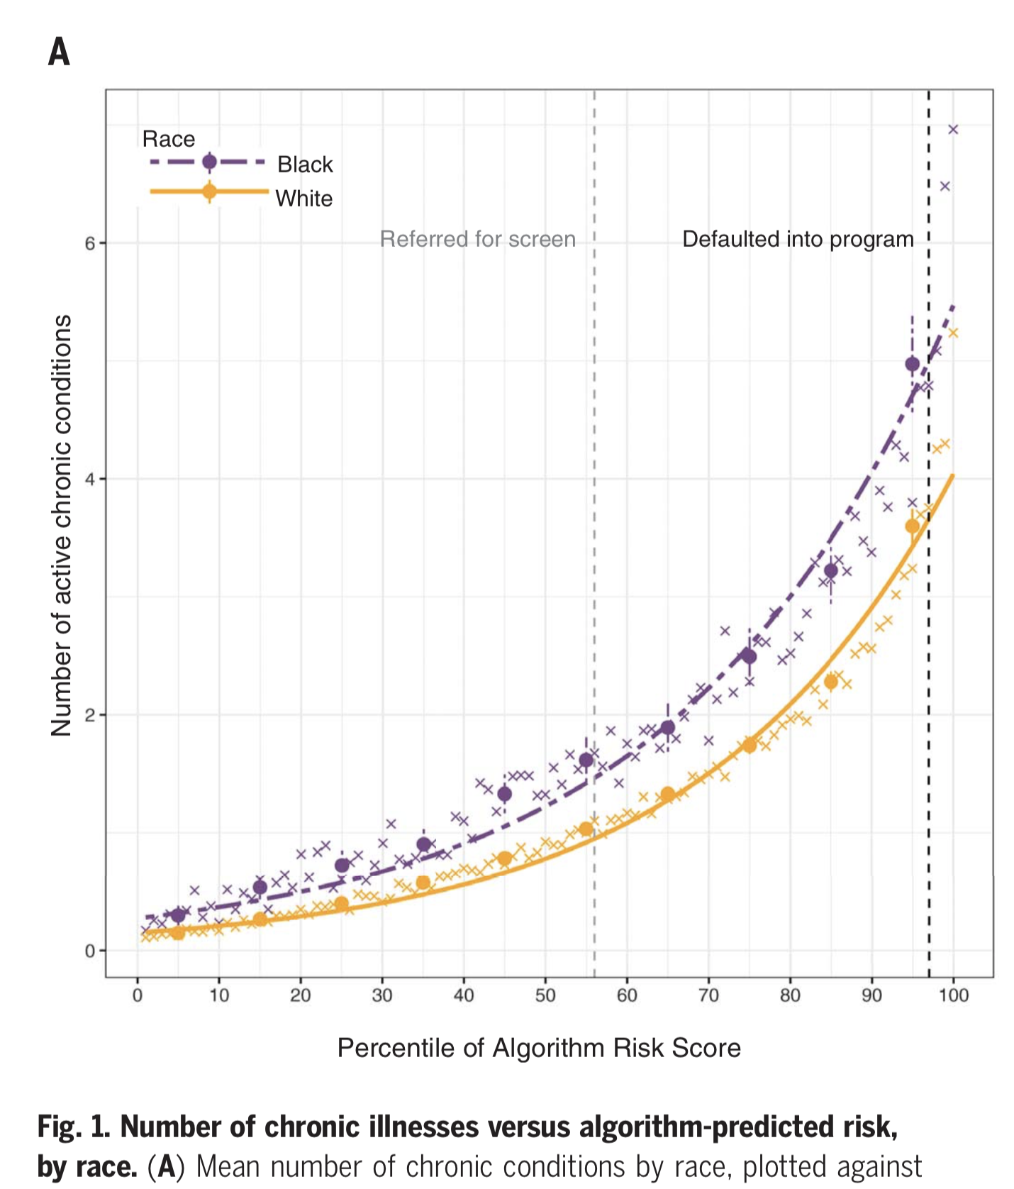
Obermeyer, Z., Powers, B., Vogeli, C., & Mullainathan, S. (2019). Dissecting racial bias in an algorithm used to manage the health of populations. Science, 366(6464), 447–453. https://doi.org/10.1126/science.aax2342

Slide 40
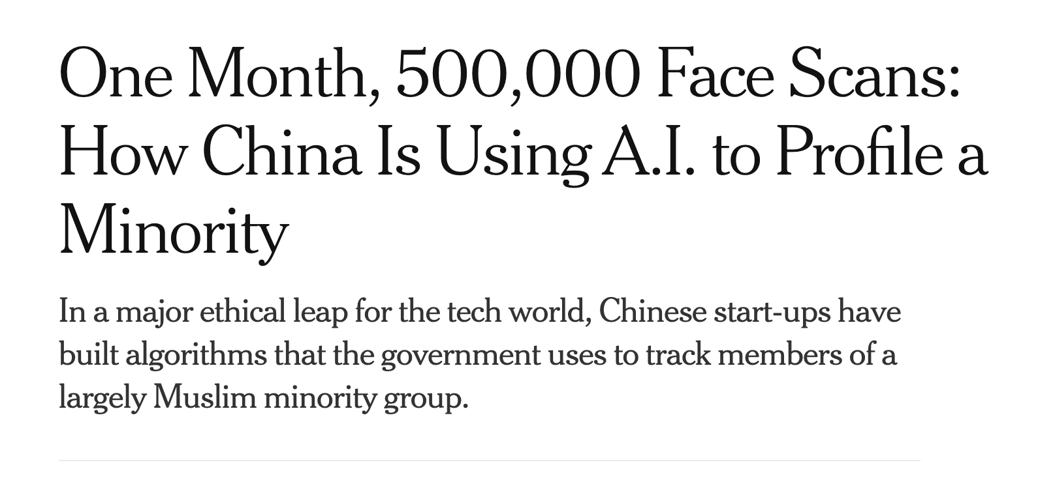

Slide 41
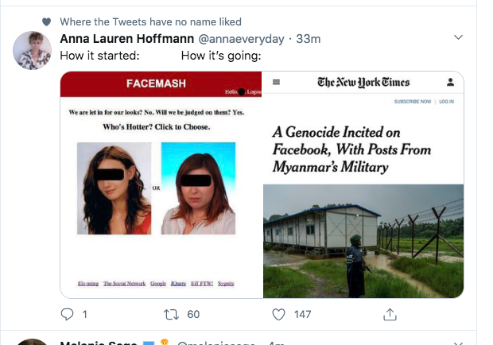

Slide 42
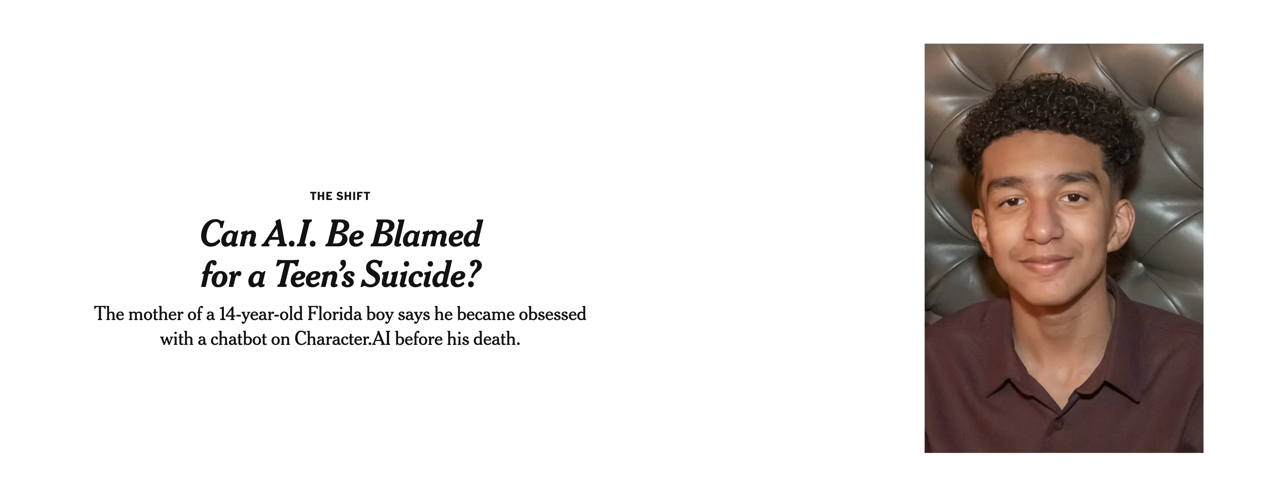

Slide 43

Uncomfortable discussions…
Disagree with what someone SAID NOT who you think they ARE

Slide 44
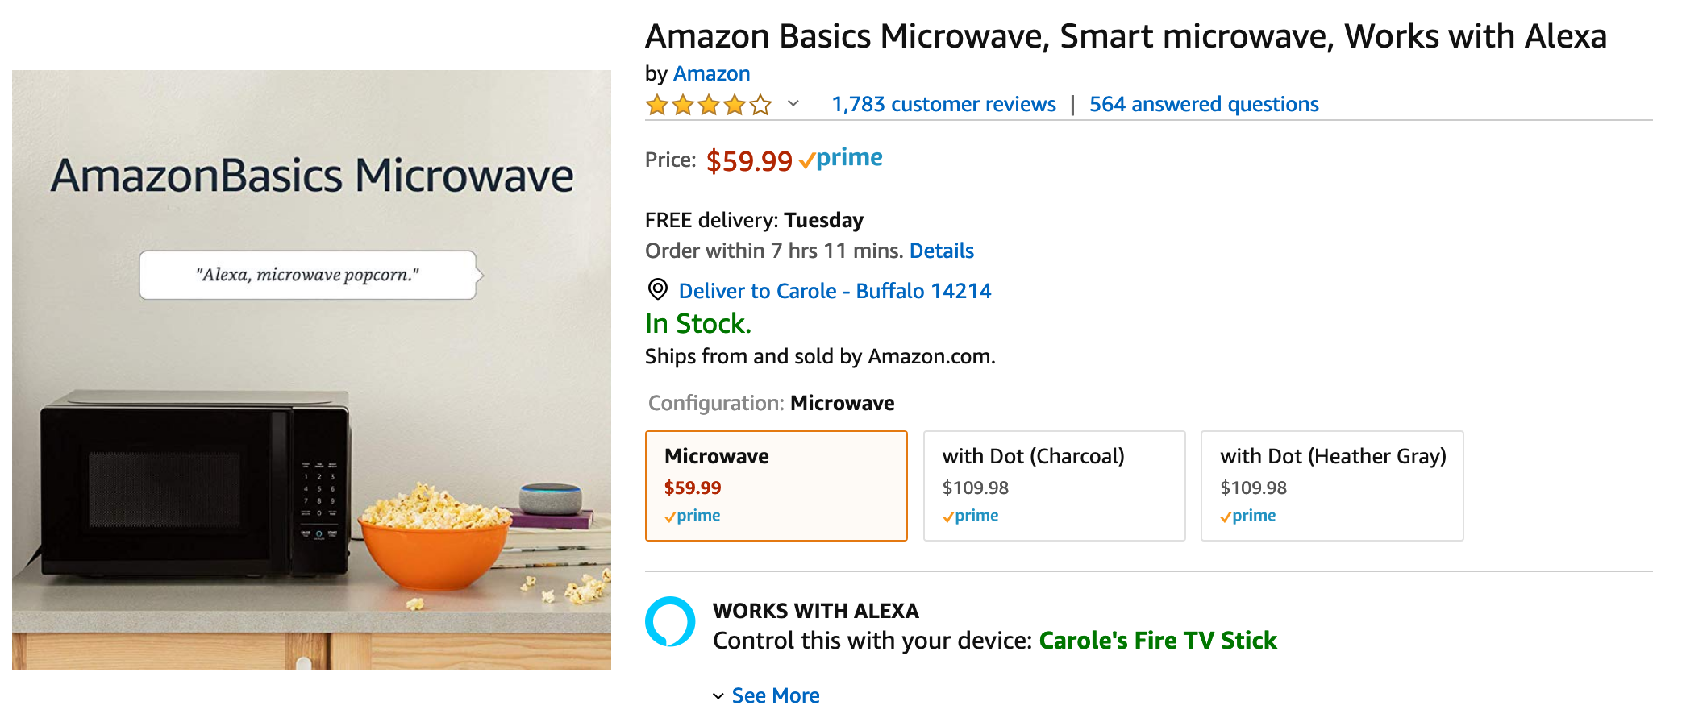
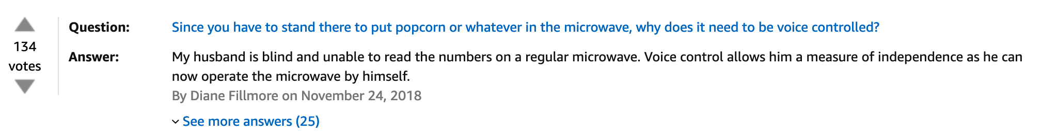
Same principle replace “race” by other topic

