Slide 1
Lecture 10
Social Media
Kenneth (Kenny) Joseph

Slide 2
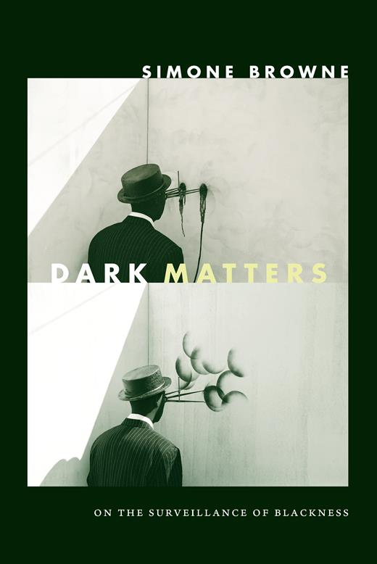
Simone Browne

Slide 3
Announcements
Wed – peer review
Break!
I’ll be pushing back HW3 ~1 week (so, same with the midpoint presentations)
More details soon

Slide 4
Today: social media
Lol you’re gonna tell us about social media?
  Well, kind of
Intro to social media
  What is social media?
  Where did it come from?
  History
  The 2016 U.S. Election as a case study
Throughout: A collective updating of my slides.

Slide 5
Social media is a whole bunch of things
There are many kinds of social media sites
Social networking sites (SNSs) – sites where you can:
  construct a profile
  articulate a list of other users with whom you share a connection
  view and traverse your connections and those made by others
User-generated content sites (UGCSs) - are sites that promote the exchange of amateur or professional content
Trading and Marketing Sites (TMSs) – for trading & selling goods
Play and game sites (PGS) – games where you can interact w/ ppl
...
We only have one lecture, so we will focus on SNSs and UGCS
Notes:
Examples…

Slide 6
People were originally super excited about social media
https://opentextbc.ca/mediastudies101/chapter/two-step-flow-of-communication/
Katz and Braly’s 2 Step Flow Model
Said content originated with mass media,
then moved to opinion leaders,
then to everybody else

Slide 7
People were originally super excited about social media
Katz and Braly’s 2 Step Flow Model
Said content originated with mass media,
then moved to opinion leaders,
then to everybody else
!!!!!!

Slide 8
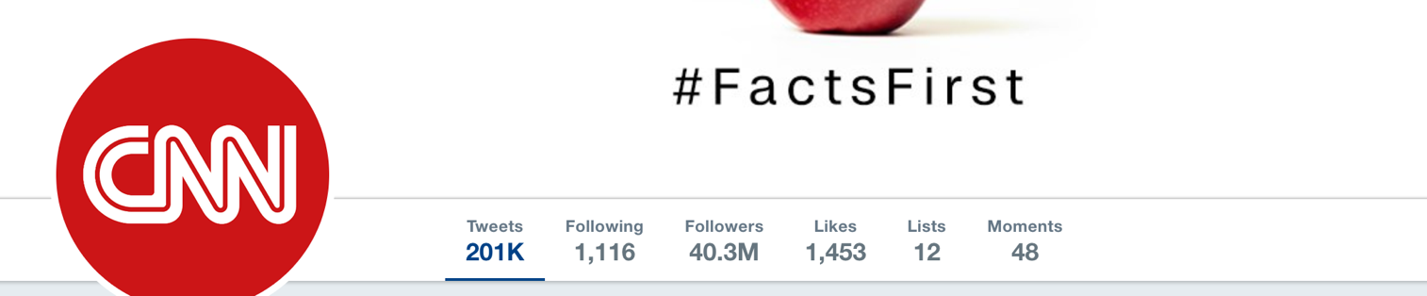
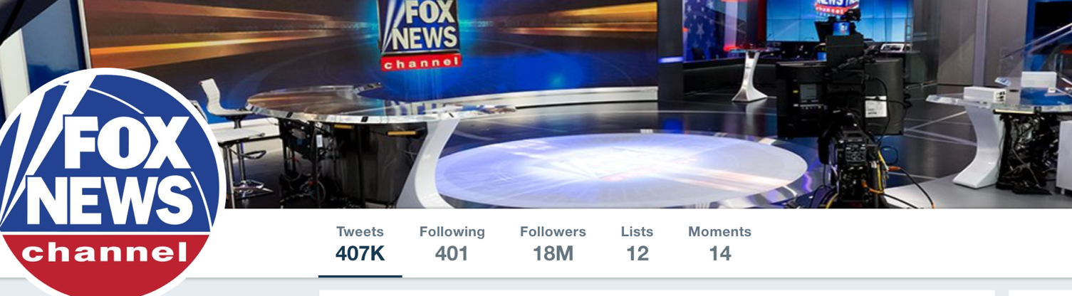
But…

Slide 9
But…
https://www.nytimes.com/2013/09/14/us/suicide-of-girl-after-bullying-raises-worries-on-web-sites.html

Slide 10
  What happened (anything)?

Slide 11
Update 1
What has happened since?
  The “central hubs” have shifted away from mainstream news
  Platform ownership has changed [Instagram, Twitter, TikTok]
  Jan 6th – More visceral/physical manifestation of the online environment
  Exacerbation of political polarization
  Influencer culture – the media mogul has been reshaped
  Transparency has decreased
  TOS have changed and so has their enforcement [shadow banning]
  COVID
  Screen time has increased
  Algorithm-first social media
  Cultural homogenization
  Identity niches have increased
  Platforms that are just AI
  Automated [or mostly automated] content
  Democratization of audiences/capital for businesses
  Multi-modal content
Later, to keep in mind… what might be done about it?

Slide 12
  What is it & where did it come from?
  Detailed case study:
    2016 U.S. Election
  The upsides of social media
  The downsides of social media
Notes:
We will not discuss any of those things
You guys know them better than I do
I’m not that old, I wasn’t on Myspace

Slide 13
Web 1.0
The original focus of the web was to connect users to information
https://sites.google.com/site/hciisocialweb/syllabus
Notes:
Unlike Web 1.0, Web 2.0 facilitates interaction between web users and sites, so it allows users to interact more freely with each other. Web 2.0 encourages participation, collaboration, and information sharing.

Slide 14
The move from Web 1.0 – 2.0
Web 2.0 was a shift to connecting users to other users ... And then great information followed!
https://sites.google.com/site/hciisocialweb/syllabus
Notes:
Unlike Web 1.0, Web 2.0 facilitates interaction between web users and sites, so it allows users to interact more freely with each other. Web 2.0 encourages participation, collaboration, and information sharing.

Slide 15
Wikipedia – moving from Web 1.0 - 2.0
https://www.youtube.com/watch?v=oVFPW0r4jWk

Slide 16
From Web 2.0 to Social Networking Sites
As the goal of the web shifted to connecting users, social networking sites naturally arose
In the beginning, there was Six Degrees.com
  Why do you think a SNS in ‘97 ultimately failed?
Slowly, all kinds of social media sites grew
  Ryze – precursor to LinkedIn
  LiveJournal – for blogging
  …
https://onlinelibrary.wiley.com/doi/full/10.1111/j.1083-6101.2007.00393.x

Slide 17
Why did some succeed where others failed?
Social factors
Technological Factors
Also
  Timing
  $$
  …
Notes:
Timing
Friendster may have just been before its time
Response to users
Twitter built out things users had developed
Technology
Twitter tech scaled, Friendster’s didn’t
Marketing
“The Twitter people cleverly placed two 60-inch plasma screens in the conference hallways, exclusively streaming Twitter messages,”
Endorsements
Celebrities endorsed Twitter rapidly
$$
Twitter raised a lot of money
Chance
Twitter happened to be “in the right place, at the right time”
Network externalities

Slide 18
Bringing us to the present
There have been many, many failed social networking sites
  These failures are due to a lot of things – chance, technology, …
But there have also been many successes
  Any many different kinds of successes
With all of this, social media has become a central part of our daily lives.

Slide 19
Summary and moving on
What is social media?
  Social media isn’t just FB, Twitter & Snapchat
Where did social media come from?
  Web 1.0 -> Web 2.0 -> Social Networking Sites -> All kinds of social media
Why did some platforms succeed and others fail
  Right place, right time, good tech, a lot of luck
Is social media just Snapchat Instagram stories or (? TikTok? Myspace?)
  NO! Social media is a lot more than that.

Slide 20
  What is it & where did it come from?
  Detailed case study:
    2016 U.S. Election
  The upsides of social media
  The downsides of social media
Notes:
We will not discuss any of those things
You guys know them better than I do
I’m not that old, I wasn’t on Myspace

Slide 21
Case Study: the 2016 US Election

Slide 22
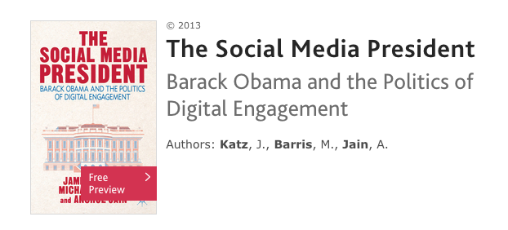
The Social Media President

Slide 23
Did social media analytics get Obama elected?
“Nah. We didn’t really use any social media data. Other kinds of data we had access to were much better”
Rayid Ghani, director of Obama’s data science team in 2012, now professor at CMU

Slide 24
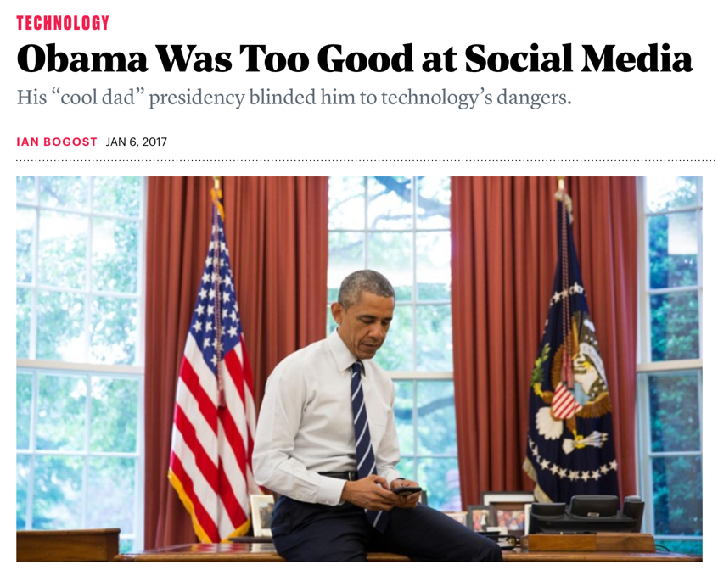
But, that’s not the whole story
Barack Obama understood that you could use the Web to lower the cost of building a political brand,
Create a sense of connection and engagement to increase support, excitement
Obama supporters who traded their personal information for a ticket to a rally …, or opted in on Facebook … can now be mass e-mailed at a cost of close to zero.
https://www.nytimes.com/2008/11/10/business/media/10carr.html
https://www.theatlantic.com/technology/archive/2017/01/did-america-need-a-social-media-president/512405/

Slide 25
Obama & Social Media
Obama’s campaign was one of the first indicators that politicians could use the power of social media to:
  Organize and excite supporters
  Collect personal information to leverage for, e.g., sending emails
  Build a desirable brand
What wasn’t a *big* thing, even in 2012, at least as far as we know, was:
  Leveraging social media and ad targeting effectively
  Turning to social media for policy statements
  Fake news
  (Russian) Bots

Slide 26
Social Media and the 2016 Election
What we will talk about (briefly)
  Political ad targeting
  Manipulation – bots, trolls, fake accounts
  Fake News
Did social media cause Trump to be elected?
What we won’t talk about
  Trump’s tweets
  Hate speech/harassment

Slide 27
  Political ad targeting
https://www.dailykos.com/stories/2017/8/4/1686913/--The-Cambridge-Analytica-Psyops-that-made-both-Trump-and-Brexit-Winners

Slide 28
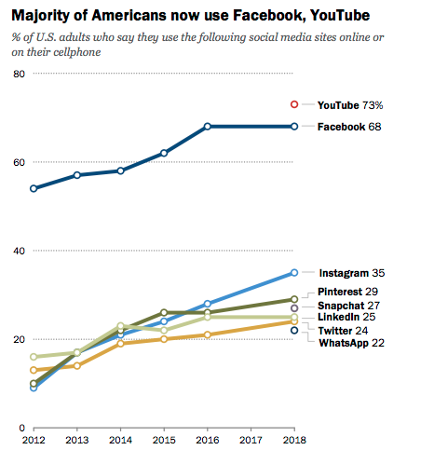
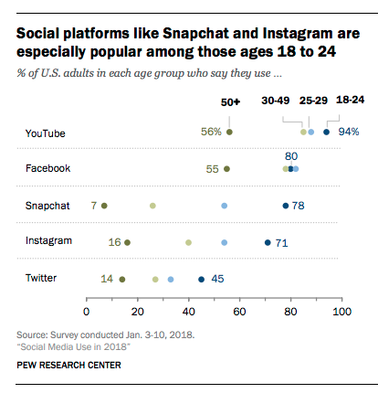

Slide 29
Social Media and the 2016 Election
What we will talk about (briefly)
  Political ad targeting
  Manipulation – bots, trolls, fake accounts
  Fake News
Did social media cause Trump to be elected?
What we won’t talk about
  Trump’s tweets
  Hate speech/harassment

Slide 30
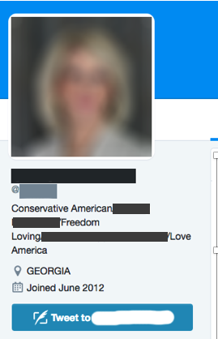
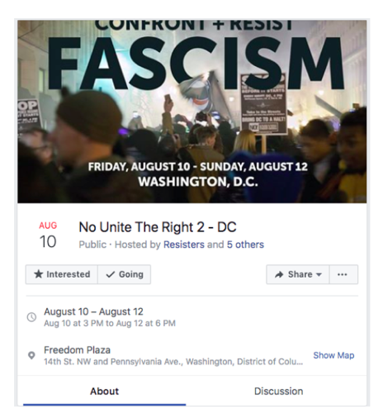
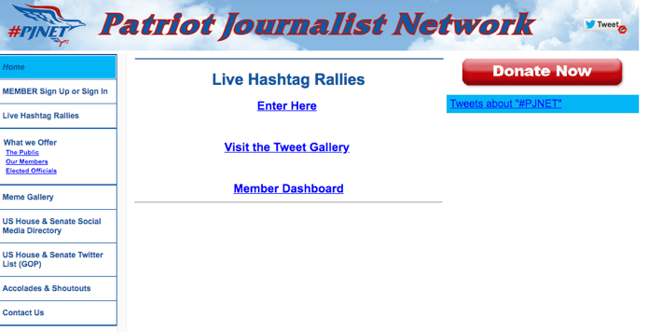
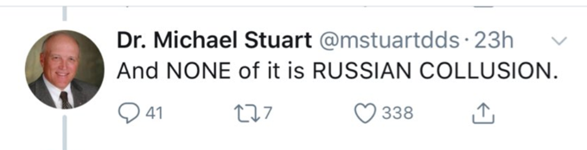
Manipulation – How?
Coordinated Campaigns
Bots
Cyborgs
Fake pages
Manipulation of the 2016 election came from a variety of sources
Hijacked accounts

Slide 31
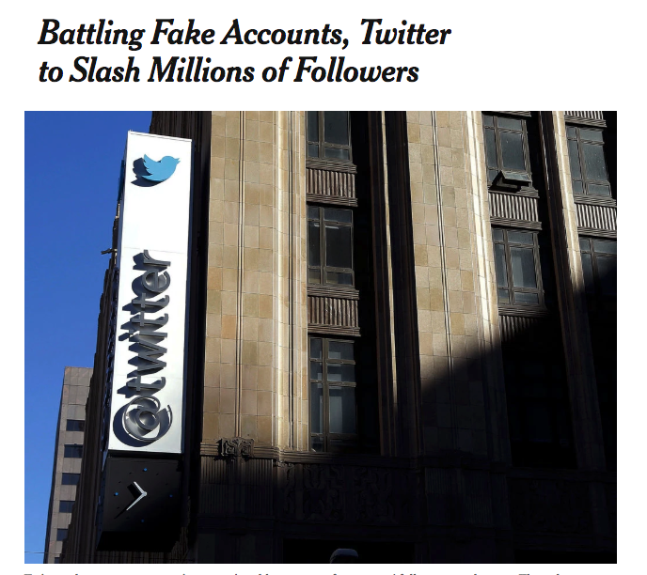
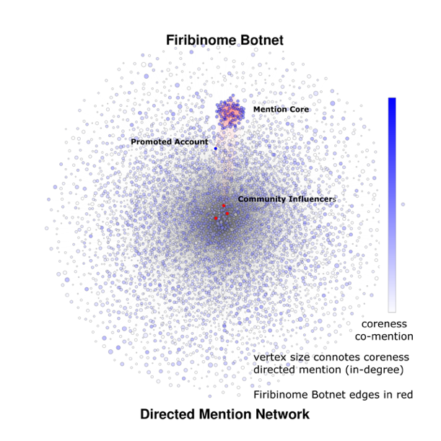
What do today’s bots tend to do?
Manipulate social signals
Of RTs/Mentions
Of support for candidates
Of follower counts
https://link.springer.com/article/10.1007/s10588-017-9255-3
https://www.nytimes.com/2018/07/11/technology/twitter-fake-followers.html
https://papers.ssrn.com/sol3/papers.cfm?abstract_id=2982233

Slide 32
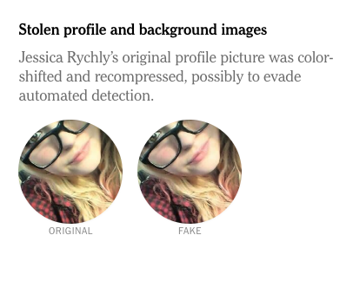
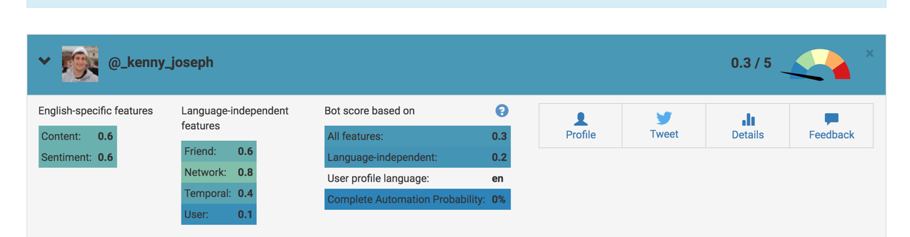
Bots are increasingly sophisticated, but detectable in some cases
https://botometer.iuni.iu.edu/#!/
http://delivery.acm.org/10.1145/2820000/2818717/p96-ferrara.pdf

Slide 33
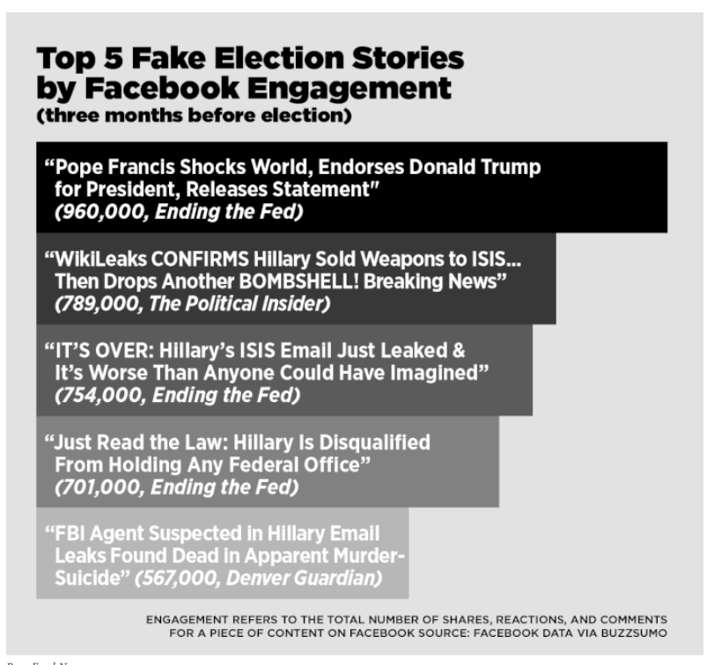
Fake News
https://www.buzzfeednews.com/article/craigsilverman/viral-fake-election-news-outperformed-real-news-on-facebook#.jepaXOx1m

Slide 34
What is fake news?
What do you think?
One increasingly accepted definition:
  Fake news is content produced with all the trappings of a legitimate news organization but without any of the actual journalistic scrutiny
Can you spot fake news?
  http://factitious.augamestudio.com/#/
http://science.sciencemag.org/content/359/6380/1094

Slide 35
Why did fake news come about?
Thoughts?

Slide 36
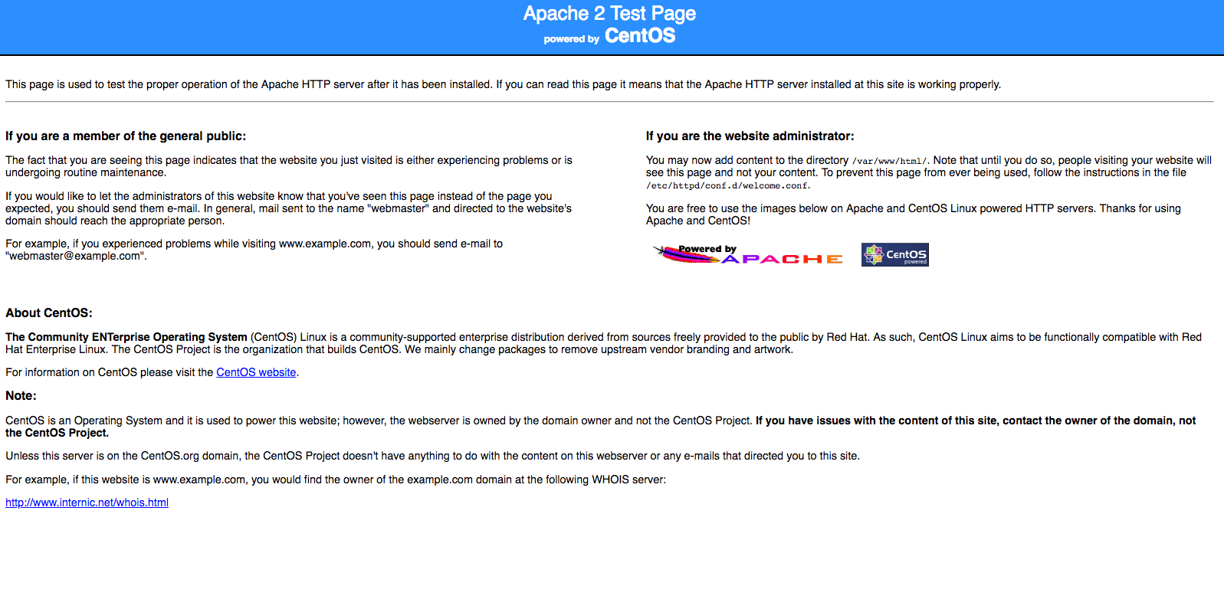

Slide 38
Why did fake news come about?
Why was/is there fake news?
  Money and power!
    Imagine that…
Who saw fake news in 2016?
  What percent of timelines do you think contained link to fake news?
  What percent of people saw fake news?

Slide 39
5.1%
of political content in voters’ Timelines was fake news
Notes:
DL: just to make sure I have this right: on average, each person in our panel was exposed to FN once per day? again need to be clear on what an impression is.
NG: no, sorry for the confusion. 5.1% is the aggregate of all FN exposures divided by the total number of political exposures across people (I.e. fraction of total volume flowing to all panel members). One fake news impression per person per day would have been the rate had this volume been evenly distributed among people. However, as the next slides would show, fake news is not, by any means, evenly distributed.
== 3.3M fake news exposures / 64.8M political exposures during Aug 1 - Dec 6 for our panel of 16.5K people.
That’s equivalent of 200 potential exposures per person, or roughly speaking 100 impressions per person over the course of four months (~1 impression of FN per day).
Caveat: this is just sheer volume, not how it is distributed over time or among people.

Slide 40
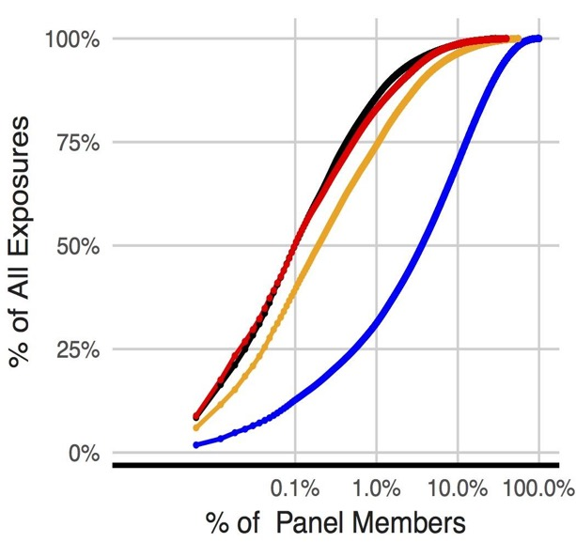
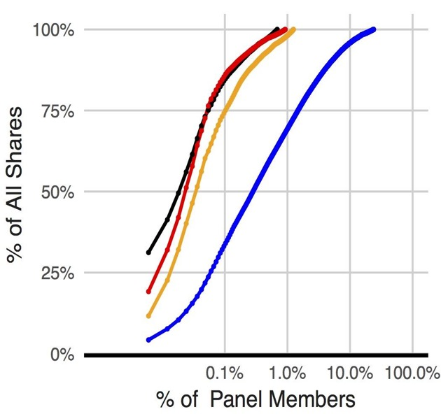
Fake news is highly concentrated!
Exposures
Sharing
16 accounts (of 16,442) responsible for 80% of fake news
Notes:
DL: figure on right is messed up. Or there should just be flat lines at 100%. Also, should we use a log scale on X axis, since so much action is in the first .1%? Let’s label in big letters the first one Exposure and the second Sharing, and use animation to have the second appear after the first.
KJ: I guess I actually prefer it without the line across at 100% because this way to can see very clearly where 100% is reached (otherwise you’re likely assuming that there’s some small percentage spread throughout the tail because its hard to differentiate between 98% and 100% unless there’s no line. Having said that, whatever you prefer is easy enough to produce. Here’s w/ the log-linear axes, in any case
DL: agree re 100%. we should add key.

Slide 41
Did you see fake news?

Slide 42
Summarizing
For Political Ad targeting, Bots, & Fake News, we see the same story:
  It’s not new
    Ad targeting existed for centuries
    Bots were impacted elections at least as early as 2010
    Fake news has been around since the Romans
  But, it came into focus because of new/increased use in 2016
    Ad targeting – via FB and semi-private data
    Bots – because there were so many, and because we know Russia was behind some of them
    Fake news - a vast increase in its spread
And they likely had an impact
But…

Slide 43
Would Trump have been elected without social media?
Its quite likely…
  The demographics most likely to vote for Trump were the least likely to be online
  Fake news was very concentrated
  Best estimates are that targeted ads would have had to be tens of times more effective than TV ads to have swayed enough voters
But, we don’t really don’t know!
  some academics disagree with this
  and it is likely impossible for us to ever figure it out

Slide 44
Update 2
What’s changed?
  Ad targeting is going to be more important
  Voters’ use and understanding of social media has shifted
  AI-generated content
  The platforms politicians are using have changed
  ”filter bubbles” are maybe more of a thing now
  The definition and regulation of misinformation has shifted
  Clip culture

Slide 45
  What is it & where did it come from?
  Detailed case study:
    2016 U.S. Election
  The upsides of social media
  The downsides of social media
Notes:
We will not discuss any of those things
You guys know them better than I do
I’m not that old, I wasn’t on Myspace

Slide 46
Is there anything good about social media?

Slide 47
Connecting us internationally

Slide 48
Encouraging political change

Slide 49
A Short Timeline of the Arab Spring
12/10 - Mohamed Bouazizi immolated himself in Sidi Bouzid, Tunisia in response to harassment from both a local policewoman and local municipality officers.
Rest of 12/10 – Tunisians take to the streets in protest, civil rights abuses captured & shared on FB, Twitter, Youtube
1/11 – Protests erupt in Oman, Yemen, Egypt, Syria, Morocco, in part in response to videos. Tunisian gov’t overthrown
2/11 – Mubarak resigns in Egypt, Libyan civil was begins
8/11 – Gaddafi overthrown in Libya
2/12 – Saleh, in Yemen, resigns
5/12 – First presidential election in 7 years in Egypt
…
Notes:
Early protests were relatively small and were met with violence from government forces
But, social media sites like Twitter, Facebook and YouTube were used to record these events and display them to the broader public.

Slide 50
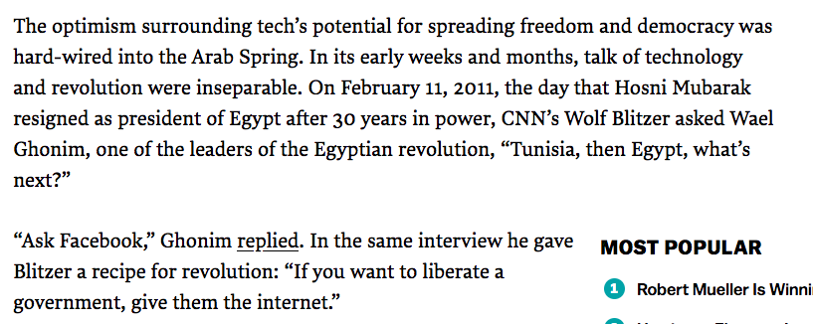

Slide 51
Assisting the creation of social movements

Slide 52
Giving voice to networked counterpublics

Slide 53
Helping us find relevant news

Slide 54
The upside of social media
Reasons to be positive about social media
  Connectivity
  Aides in the creation of social movements, here and abroad
  A new source for immediate news

Slide 55
Update 3
What’s changed?

Slide 56
  What is it & where did it come from?
  Detailed case study:
    2016 U.S. Election
  The upsides of social media
  The downsides of social media
Notes:
We will not discuss any of those things
You guys know them better than I do
I’m not that old, I wasn’t on Myspace

Slide 57
Social media is the worst thing in the world

Slide 58
Facebook friendships in space
NYT map of county-county friendships
Which counties do you think had the most absolute friendships in common with Erie county?
But that’s not that interesting! We want to look at the relative likelihood that any two people living in two different counties are connected on Facebook, controlling for population size
What about on this relative scale

Slide 59
A Short Timeline of the Arab Spring
12/10 - Mohamed Bouazizi immolated himself in Sidi Bouzid, Tunisia in response to harassment from both a local policewoman and local municipality officers.
Rest of 12/10 – Tunisians take to the streets in protest, civil rights abuses captured & shared on FB, Twitter, Youtube
1/11 – Protests erupt in Oman, Yemen, Egypt, Syria, Morocco, in part in response to videos. Tunisian gov’t overthrown
2/11 – Mubarak resigns in Egypt, Libyan civil was begins
8/11 – Gaddafi overthrown in Libya
2/12 – Saleh, in Yemen, resigns
5/12 – First presidential election in 7 years in Egypt
…
Notes:
Early protests were relatively small and were met with violence from government forces
But, social media sites like Twitter, Facebook and YouTube were used to record these events and display them to the broader public.

Slide 60
Was it really a Facebook revolution?
Economic problems caused by ineffective, corrupt and state-run economies.
Led to high levels of:
  Unemployment
  Inflation
  Food shortages
  Hikes in food prices
Unemployment particularly impacted well-educated youth populations
Combined with a “youth bulge” in which a disproportionate percentage of the population was between the ages of 15-29

Slide 61
Was it a Facebook Revolution (cont.)?
Other factors meant the Arab region was ripe for a spark.
Bouazizi was the spark
But its likely that social media spread the flame
So, at best, kinda?

Slide 62
Did the change last?
In short, no.
  Civil war has broken out in Syria, Libya, and Yemen
  Egypt has largely returned to pre-Arab Spring dictatorship and corruption
Arguably, had other negative impacts
  Created space for the rise of ISIS
  Led other countries to step up their attempts to censor and manipulate social media

Slide 63
Facebook and Myanmar
Nearly 700K Rohingya have become refugees in Myanmar
False information spread on Facebook was a critical part of this
https://www.nytimes.com/2018/10/15/technology/myanmar-facebook-genocide.html
Notes:
The Facebook posts were not from everyday internet users. Instead, they were from Myanmar military personnel who turned the social network into a tool for ethnic cleansing, according to former military officials, researchers and civilian officials in the country.
Members of the Myanmar military were the prime operatives behind a systematic campaign on Facebook that stretched back half a decade and that targeted the country’s mostly Muslim Rohingya minority group, the people said. The military exploited Facebook’s wide reach in Myanmar, where it is so broadly used that many of the country’s 18 million internet users confuse the Silicon Valley social media platform with the internet.
In Mayanmar, a country with a population of 53 million, 20 million people use Facebook. Facebook is such a big ordeal that some products, especially mobile devices already come with Facebook installed. Their Facebook campaign was a “success” as far as spreading hatred and fake news goes.
In an attempt to prevent more hate from spreading, Facebook removed the accounts of the political/military personnel responsible for leading the campaign. However, many troll accounts created for the purpose of backing this propaganda campaign, went completely undetected. Facebook’s inability to flag and remove these accounts resulted in more violence against the Rohingya.
Still, the company continued its work with seemingly little local input. One of its most public stumbles came four months after the meeting in May, when it began to remove posts and suspend users for posts including the term “kalar,” a Burmese word often used as a slur for people of South Asian origin. The word, however, is also used in other non-offensive phrases like “kalar pae,” lentil beans, or “kala-awe thee” a type of particularly spicy chili.
MISLEADING FACEBOOK POSTS continue to trigger confusion, threats of violence, and government overreach in Myanmar. Consider the case of journalist and translator Aung Naing Soe, who in November 2016 was targeted online after users began circulating a picture they claimed showed him standing with members of the Arakan Rohingya Salvation Army. The militant group attacked police posts in October 2016 and again in August 2017, sparking the massive campaign against the Rohingya that has driven hundreds of thousands to neighboring Bangladesh. (Disclosure: Aung Naing Soe was my translator for an article I wrote, which was published by the NewYorker.com in April.)
Aung Naing Soe was not in the photo, and it took several attempts and flags for Facebook to finally remove the post. Copies of it still circulate on the platform. Other posts targeted his religion and work as a journalist.
https://www.wired.com/story/how-facebooks-rise-fueled-chaos-and-confusion-in-myanmar/

Slide 64
Facebook and the Philippines
Rodrigo Dutere, even more so than Obama, came to power on a wave of support generate from Facebook
He has since used the platform to crush his enemies, with misinformation and threats
In response, Facebook has…
collaborated with his government to, e.g., build better access to Facebook across the country
Notes:
97 percent of Filipinos who are online have Facebook accounts.
After Duterte won, Facebook did what it does for governments all over the world—it began deepening its partnership with the new administration, offering white-glove services to help it maximize the platform’s potential and use best practices.

Slide 65
Bullying and Instagram
A survey done by the Pew Research Center shows that 59% of teens have been bullied online.
Cyber bullying doubles the chance of attempted suicide and has resulted in the development of low self-esteem, depression, academic difficulties, and school violence

Slide 66
Abuse of female journalists on Twitter
Study of tweets @ 778 Journalists in the US and UK
  A female journalist or politician harassed every 30 seconds
  7.1% of tweets sent to the women in the study were problematic or abusive.
  Online abuse against women cuts across the political spectrum. Politicians and journalists faced similar levels of online abuse and we observed both liberals and conservatives alike

Slide 67
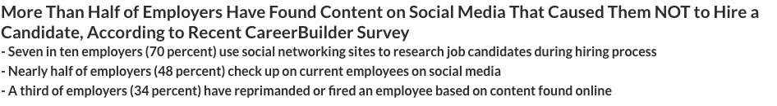

Privacy concerns
Think of the last time you did something you didn’t want people to know about
Now, think about what would happen if everybody in the world could access that fact about you, forever.

Slide 68
Update 4
What’s changed?
  Influencers aren’t all bad
  Social media addiction has increased
  Increased capacity for independent/civil journalism
  Stay up to date! The speed of news has increased
  Role of the web in mental health?
  Rate of exposure and connected has increased

Slide 69
Some final thoughts on social media

Slide 70
Summarizing – 3 Key Points
By and large social media companies have not taken responsibility for their actions, many of which have negative consequences
But, social media still has the potential to aid social movements (E.g. #MeToo, #BlackLivesMatter, #TransLivesMatter, …)
Open question as to how
  …what do you think?

Slide 71
News, Truth and Bias
Bias exists everywhere in the media, but in two forms
  Reporting bias – media organizations can be biased in the news that they produce
  Content bias – media organizations can be biased in the way that they cover
Bias is different than falsification, or “fake news”
But
  Who gets to decide what is worth covering, and what isn’t?
  Is it even possible to cover “everything”? Would anyone come to your site?
  Who gets to be the arbitrator of truth? The platform?
Also – the idea of “unbiased news” is relatively new
Notes:
he notion that reporters should possess Olympian objectivity is relatively recent. In the nineteenth century, most newspapers were explicitly linked to a particular political party and the economic interests of the publisher. In California during the Gold Rush, for example, the San Francisco Alta California was the enemy of Democratic governor John Bigler, whose press champion was the Stockton Republican.

Slide 72
My Take
Many benefits
  Connecting people to new friends, opportunities
  Spreading great things to millions of people (Ice Bucket Challenge, #MeToo, #Blacklivesmatter)
  Some democratization of information
  Wikipedia - I mean, come on.
  Cancer survivor sites
  … I think non-dominant sites show great promise
Many, many drawbacks, esp. from the big sites
  For you (privacy, cyberbullying, hate speech)
  For our country (fake news, a potential increase in polarization)
  Internationally (Genocide, Censorship)
We need you all to do better, to think bigger and brighter

Slide 73
https://www.axios.com/america-sours-on-social-media-giants-1542234046-c48fb55b-48d6-4c96-9ea9-a36e80ab5deb.html

Slide 74
Update 5
What’s changed?

