Slide 1
The “Technical” of Social Media Systems
Kenneth (Kenny) Joseph

Slide 2
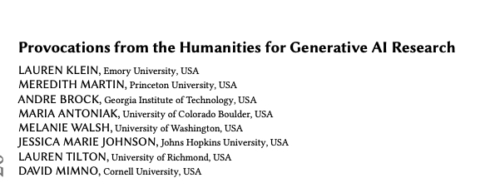
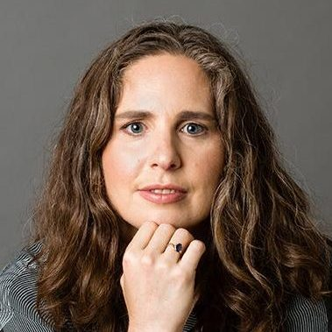
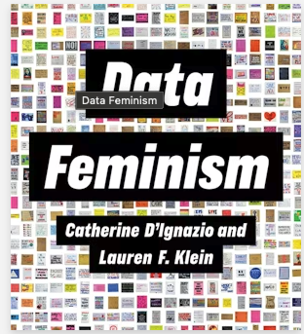
Lauren Klein

Slide 3
Annoucements
HW2 Grades out
HW3 Out
Schedule changes

Slide 4
HW 2 Reflections
Overall … OK job!
Superficial engagement with
  The idea of community, if at all, in most proposals
  Who your actual stakeholders are
  The actual hard parts of the project [not your fault, here!]
    HW2, Part C forced you to think about the narrow part of the “funnel”… now we need to zoom back out.

Slide 5
HW 2 (cont.)
A globally thriving community does not necessarily mean a single community, but it probably means communities living in some kind of harmony
  You may have to refine your definition of community or the underlying concepts to relate
We’re going to touch more on this moving forward, but we have some time

Slide 6
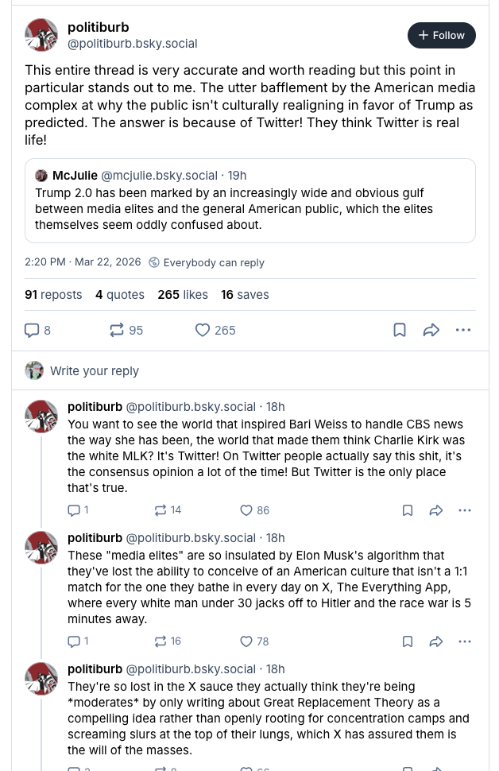

Slide 7
Overview - Today
Do recommendation algorithms cause polarization?
Types of recommender systems
Quick examples of these different types of recommender systems
A quick touch onto state of the art systems
Main sources (where not directly referenced)
  https://towardsdatascience.com/introduction-to-recommender-systems-6c66cf15ada
  Jure Leskovec’s slides
    http://snap.stanford.edu/class/cs246-2015/slides/07-recsys1.pdf
    http://snap.stanford.edu/class/cs246-2015/slides/08-recsys2.pdf

Slide 8
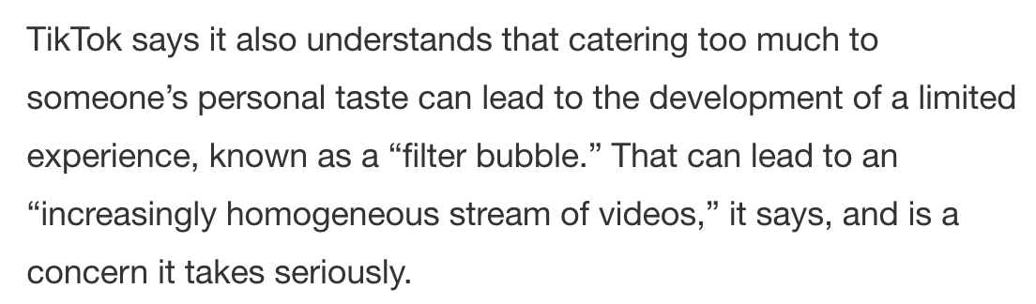
The “Filter Bubble”
https://newsroom.tiktok.com/en-us/how-tiktok-recommends-videos-for-you

Slide 9
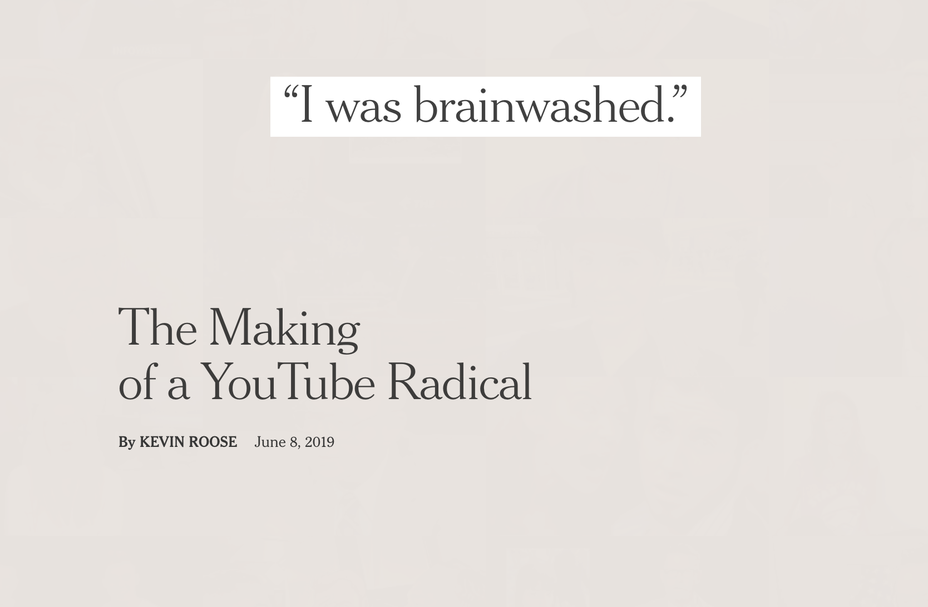
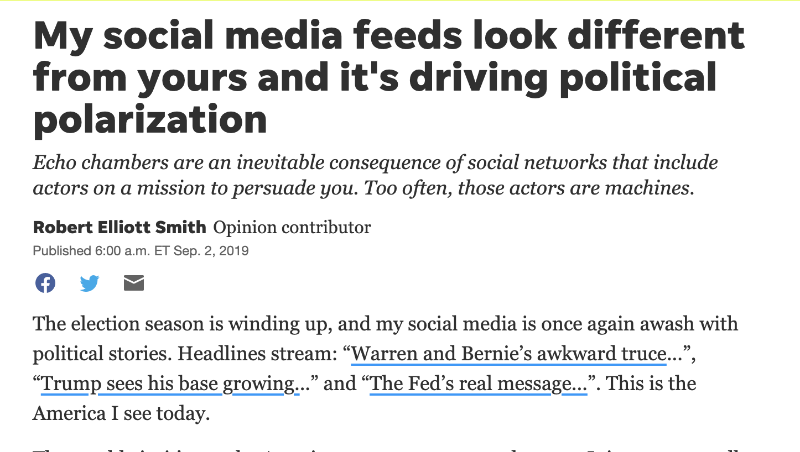

Slide 10
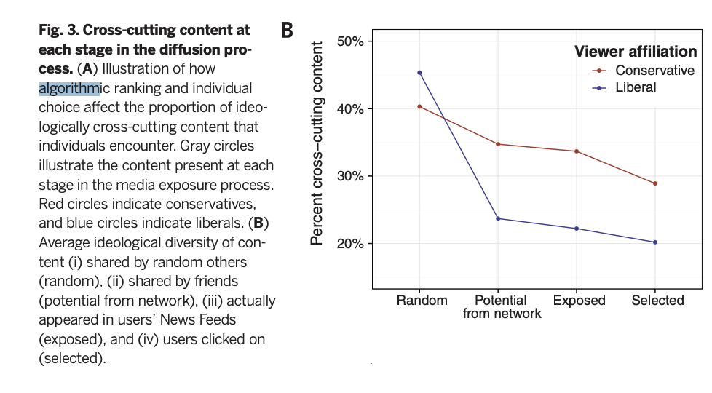
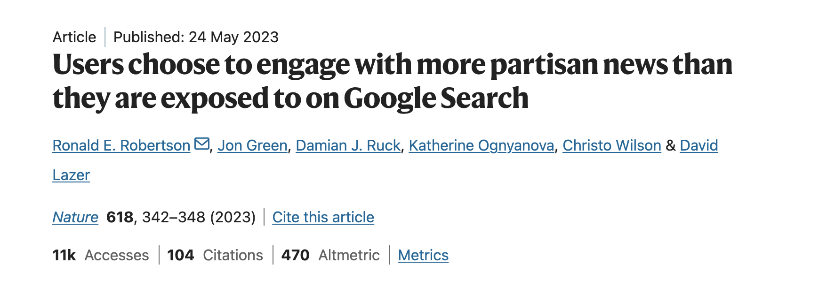
Is it really the algorithm?
Maybe not?

Slide 11
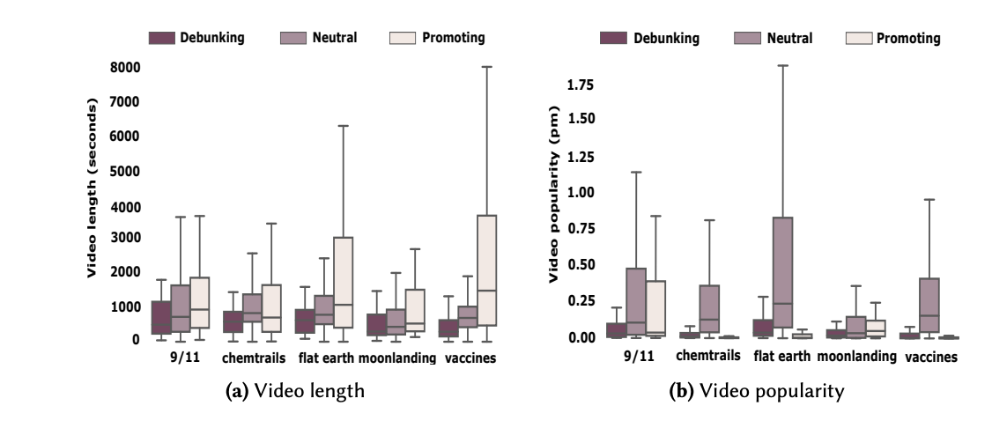
Is it really the algorithm?
Maybe?
http://faculty.washington.edu/tmitra/public/papers/cscw2020-YouTube_Audit.pdf

Slide 12
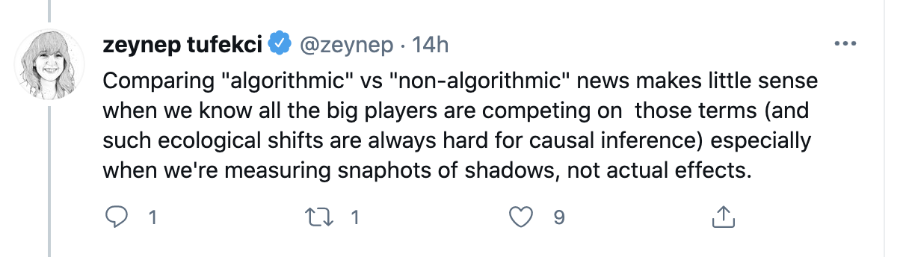
Better question – does it matter?
https://twitter.com/BrendanNyhan/status/1377600139200761863
https://www.nytimes.com/interactive/2019/06/08/technology/youtube-radical.html

Slide 13
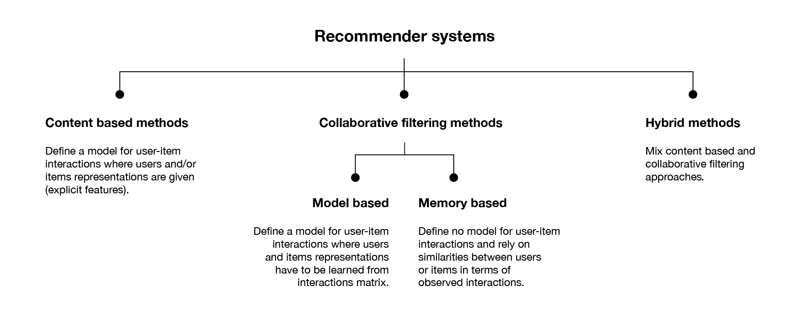

Slide 14
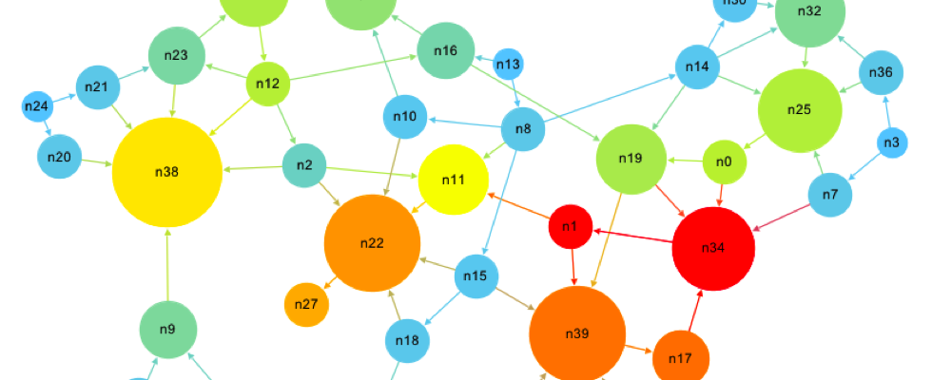
The original content-based model: PageRank
https://www.youtube.com/watch?v=qxEkY8OScYY&ab_channel=ZachStar

Slide 15
A simple content-based example for Netflix – Item-based

Slide 16
A simple content-based example for Netflix – User-based

Slide 17
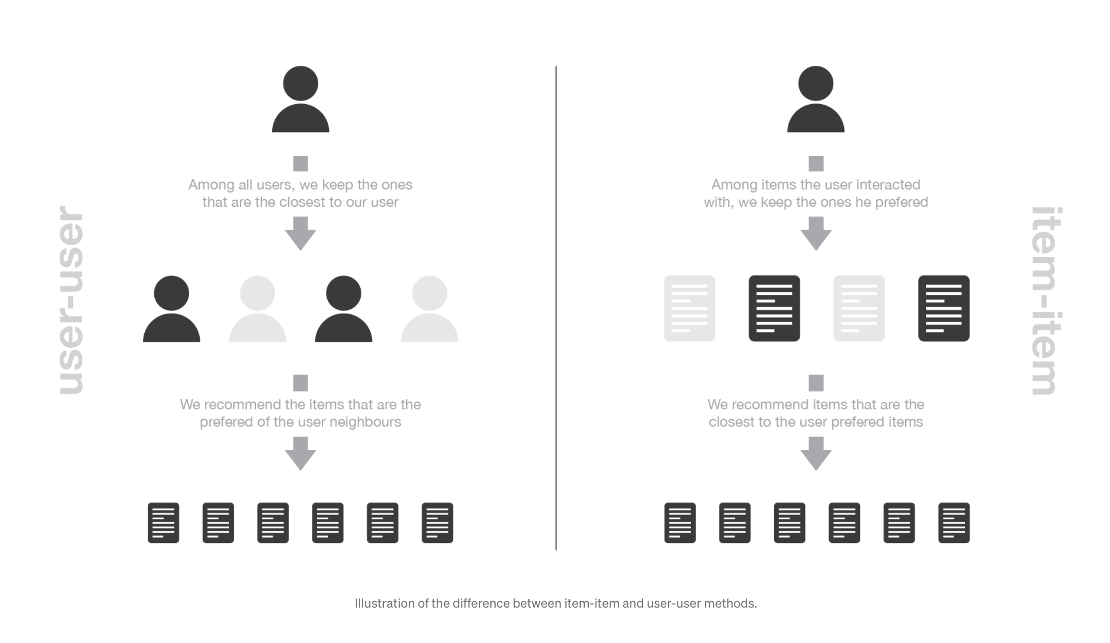

Slide 19
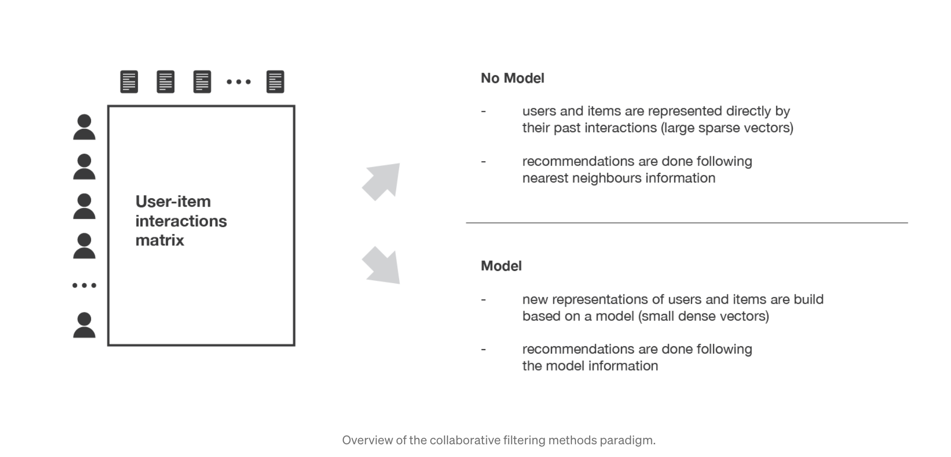
Collaborative Filtering

Slide 20
Simple model and item-based Collaborative Filtering

Slide 22
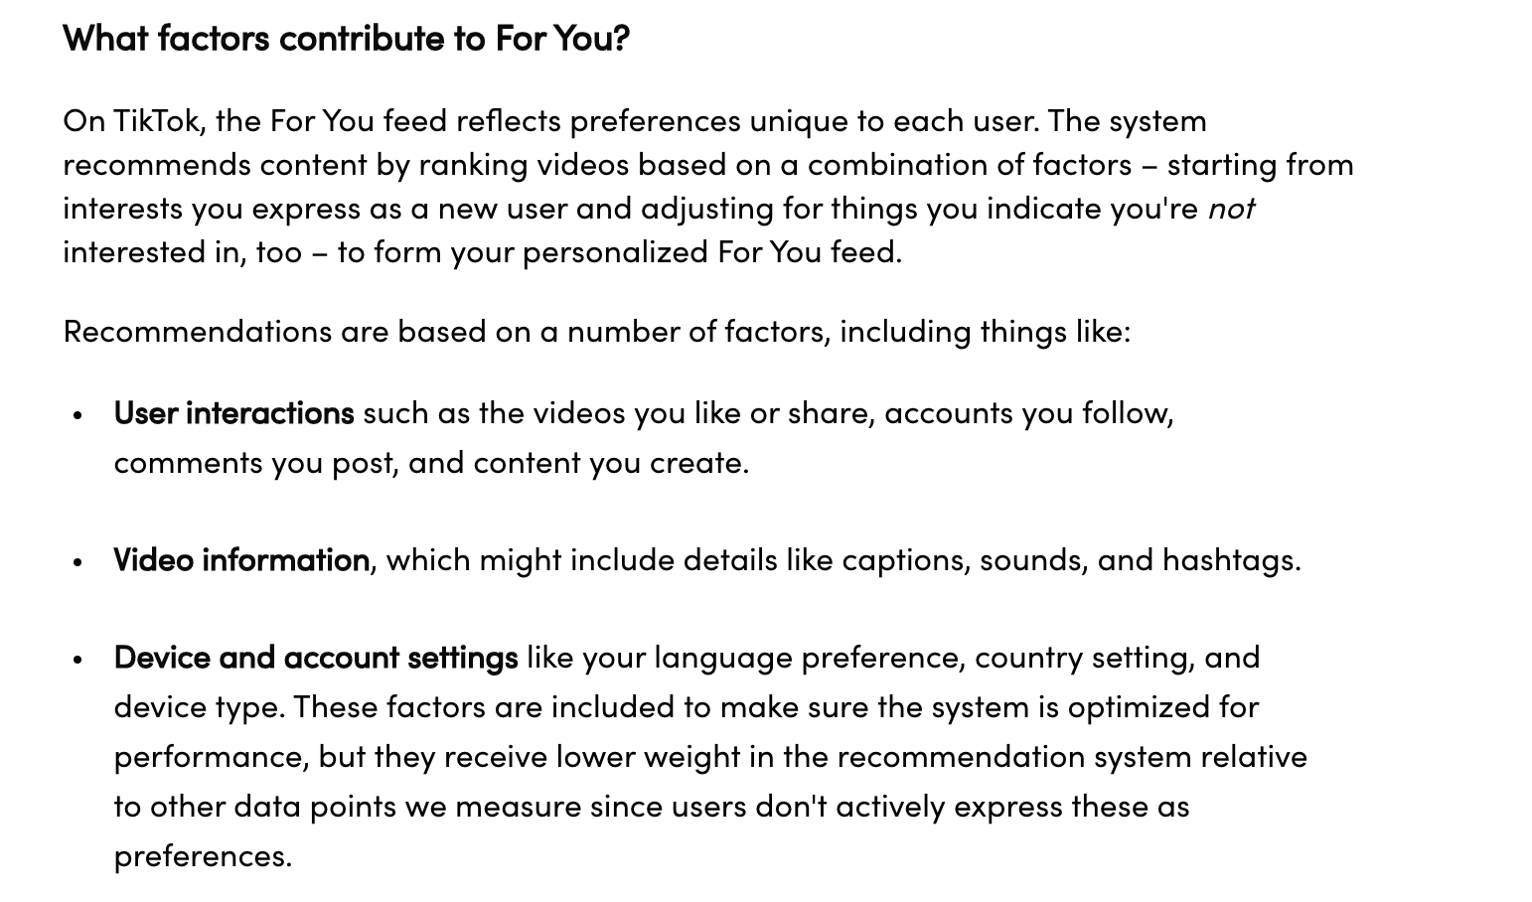
A modern hybrid approach
https://newsroom.tiktok.com/en-us/how-tiktok-recommends-videos-for-you

Slide 23
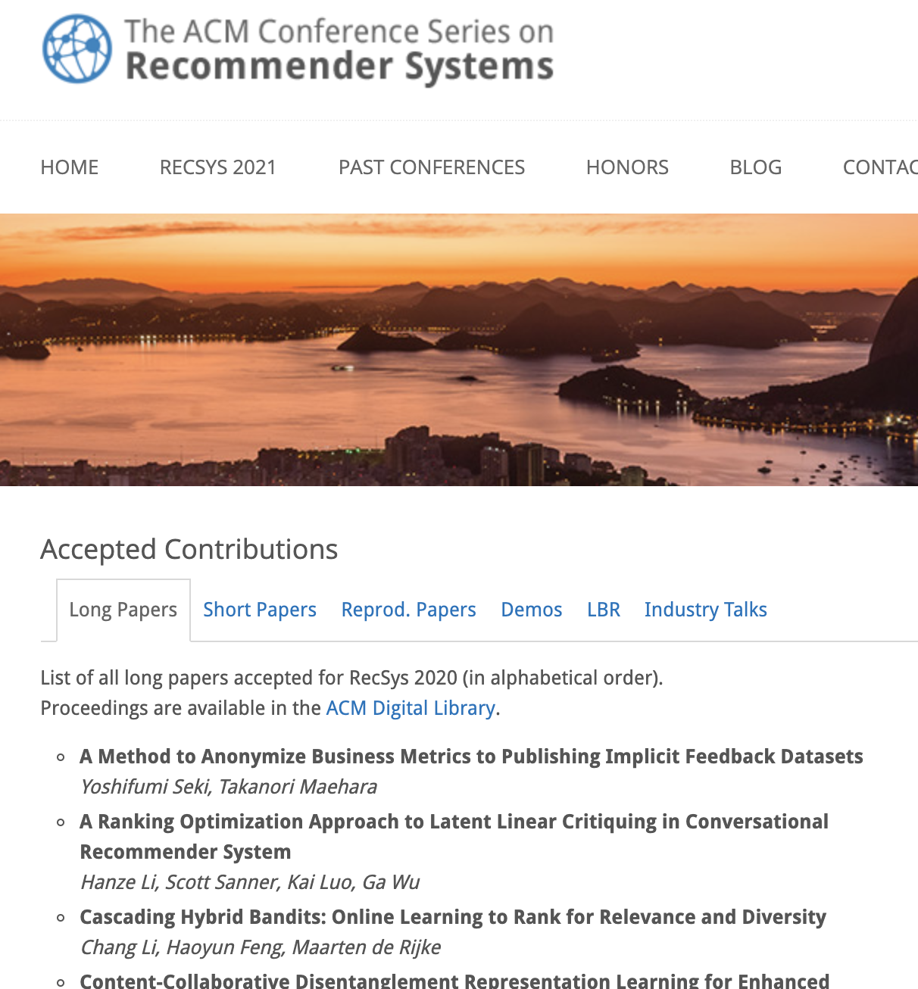
State of the art research – a quick glance
RecSeats: A Hybrid Convolutional Neural Network Choice Model for Seat Recommendations at Reserved Seating Venues
SSE-PT: Sequential Recommendation Via Personalized Transformer
KRED: Knowledge-Aware Document Representation for News Recommendations
Deconstructing the Filter Bubble: User Decision-Making and Recommender Systems

Slide 24
Now what?

Slide 25
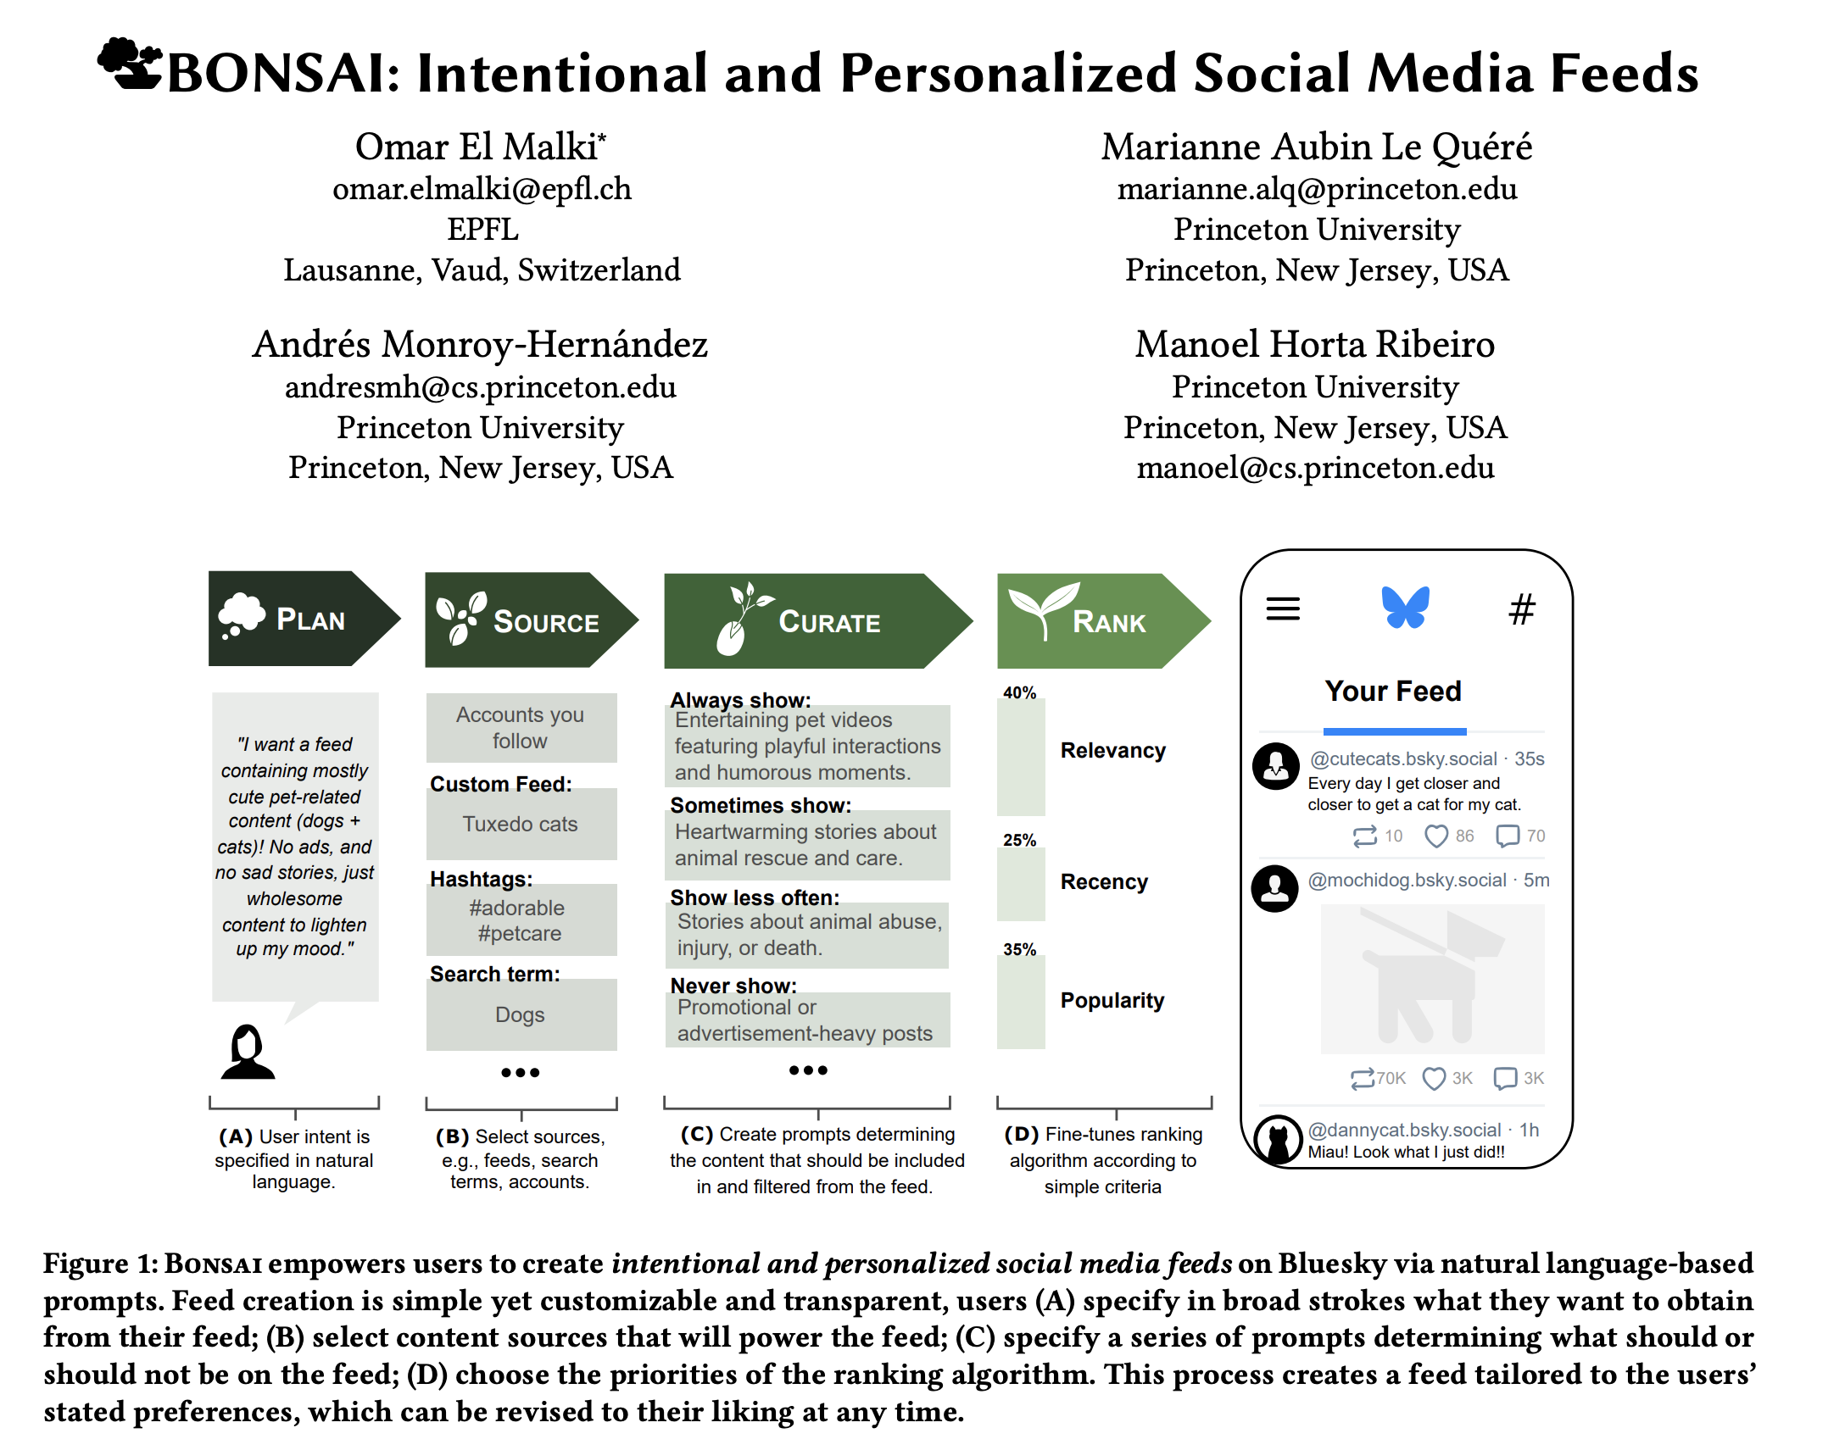

Slide 26
Will it solve the problem?

Slide 27
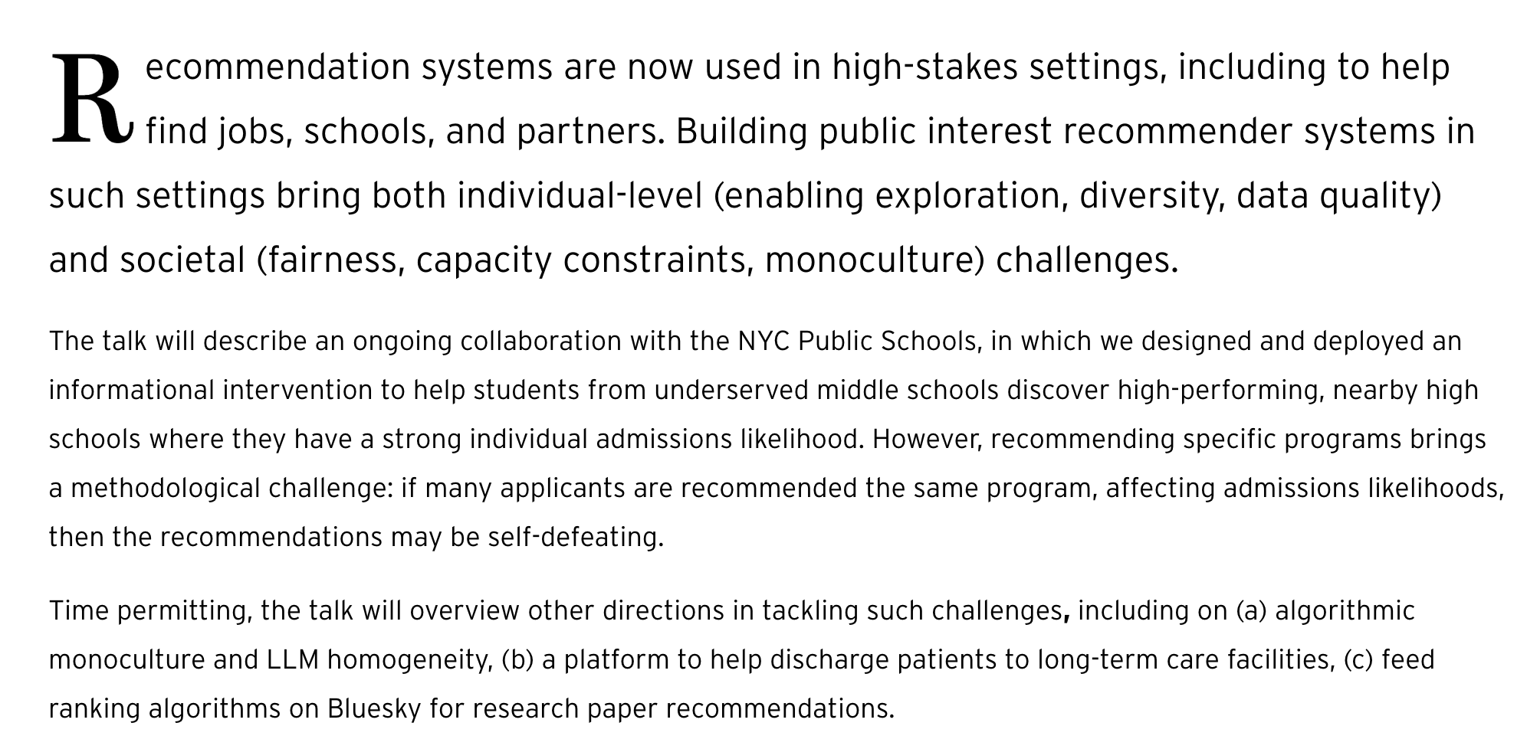
Does it only apply to social media?

Slide 28

Can we solve that problem?

Slide 29
Turtles, all the way down, always.
You can’t escape people and the sociotechnical systems in which they are embedded

