Slide 1
Multiple Stakeholders, Pt. 1
Kenneth (Kenny) Joseph

Slide 2


Slide 3



Slide 4
[True] Participatory Work
On Monday, I mentioned that your solutions somewhat superficially involved the actual stakeholders
OK, well, what do we do about that?
(At least) two ways of thinking about this:
  Participatory Design – Out of HCI, how do we incorporate stakeholders into the design process
  Participatory Action Research – Out of social work, how do we incorporate stakeholders into the process of research

Slide 5
PD
PAR
Social science focused
Origin in anticolonial practice
Research
output
Stronger
background
Engineering focused
Origins in labor organizing
Technology output
Stronger execution
Vivencia (whole process approach)
Constraints created by academic settings
Antagonism / challenge to power and hierarchy

Slide 6
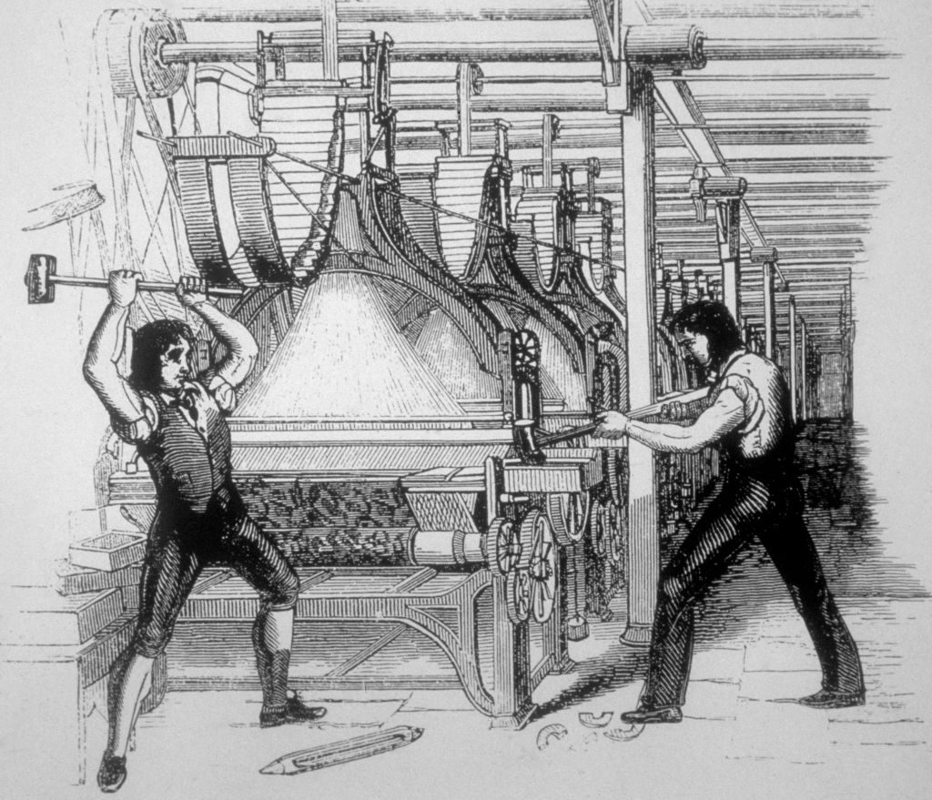
Participatory Design originated, in some sense, with Luddites…
Notes:
An early expression of this feeling was the Luddite movement, still used in modern language to describe people with a “small minded opposition to new technology”
However, the real Luddites weren’t superstitious or small minded, but realized that new technology entering the workplace in the early 19th century was a real threat to their rights in the workplace and greatly shifted bargaining power in favor of management
They also rallied against the increasingly unsafe and squalid working conditions of the early Industrial Revolution

Slide 7
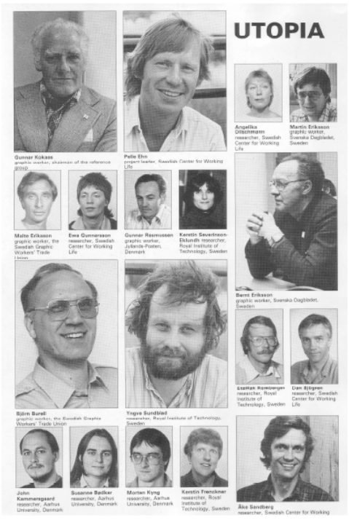
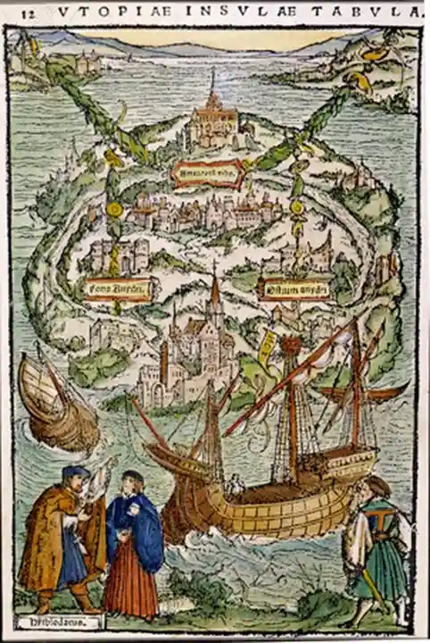
The Scandinavian Approach
1970’s Scandinavia
  Growing concerns of deskilling and shift in workplace dynamics due to computerization
  Foundational work by Kristen Nygaard and the Norwegian Iron and Metal Workers Union
UTOPIA
  Utbildning, Teknik Och Produkt I Arbetskvalitetsperspektiv
    Training, Technology and Product in Work Quality Perspective
  Ambitious attempt at direct participation in development of computerized systems in the workplace
  Nordic Graphic Union – newspaper graphic designers

Slide 8
UTOPIA Project
Objective of UTOPIA: contribute to the development of methods for involving end users in all phases of design and development of IT support for their activities
Goals:
  Mutual learning: Collaboration between graphic workers, computer scientists, and social researchers
  Study tours: Visits to industry exhibitions and leading U.S. labs (e.g., Xerox PARC, Stanford)
  System design: Developed requirements for a newspaper text & image prepress system
  Real-world testing: Studied pilot use at Aftonbladet newspaper
  Dissemination: Shared findings with graphic workers and the research community
  Publications: Produced ~20 UTOPIA reports on technology, work organization, and environment
  Broad outreach: Final Graffiti newsletter (48 pages) distributed to ~50,000 NGU members in multiple languages
  New tools: Tools and methods were new and impactful!
https://inria.hal.science/hal-01564650v1/document

Slide 9
UTOPIA Project - Results
“The main results were not so much the pilot computer tool built and used at Aftonbladet as compared to the experience and methods”
  “for the Nordic Graphic Union members…, the pros and cons of the emerging technology and what to require from it, for functionally and socially acceptable tools and systems in their work”
  “for the researchers, the challenging insight that the human interface is very important for how useful a computer based tool will be”
  “for [both], Cooperative Design / Participatory Design”
https://inria.hal.science/hal-01564650v1/document

Slide 10
PD summary
Real participatory design is challenging!
    Uncertain outcomes
    Long timelines
    Interpersonal dynamics of participation
    Buy-in from investors
Real participatory design is important!
    Democratic development of public good – rather than tech for tech’s sake
    Not just inclusion – empowerment
    Genuinely novel design insight generated by jumping far out of the box
    Projects with longevity that can thrive well after you have left the space

Slide 11
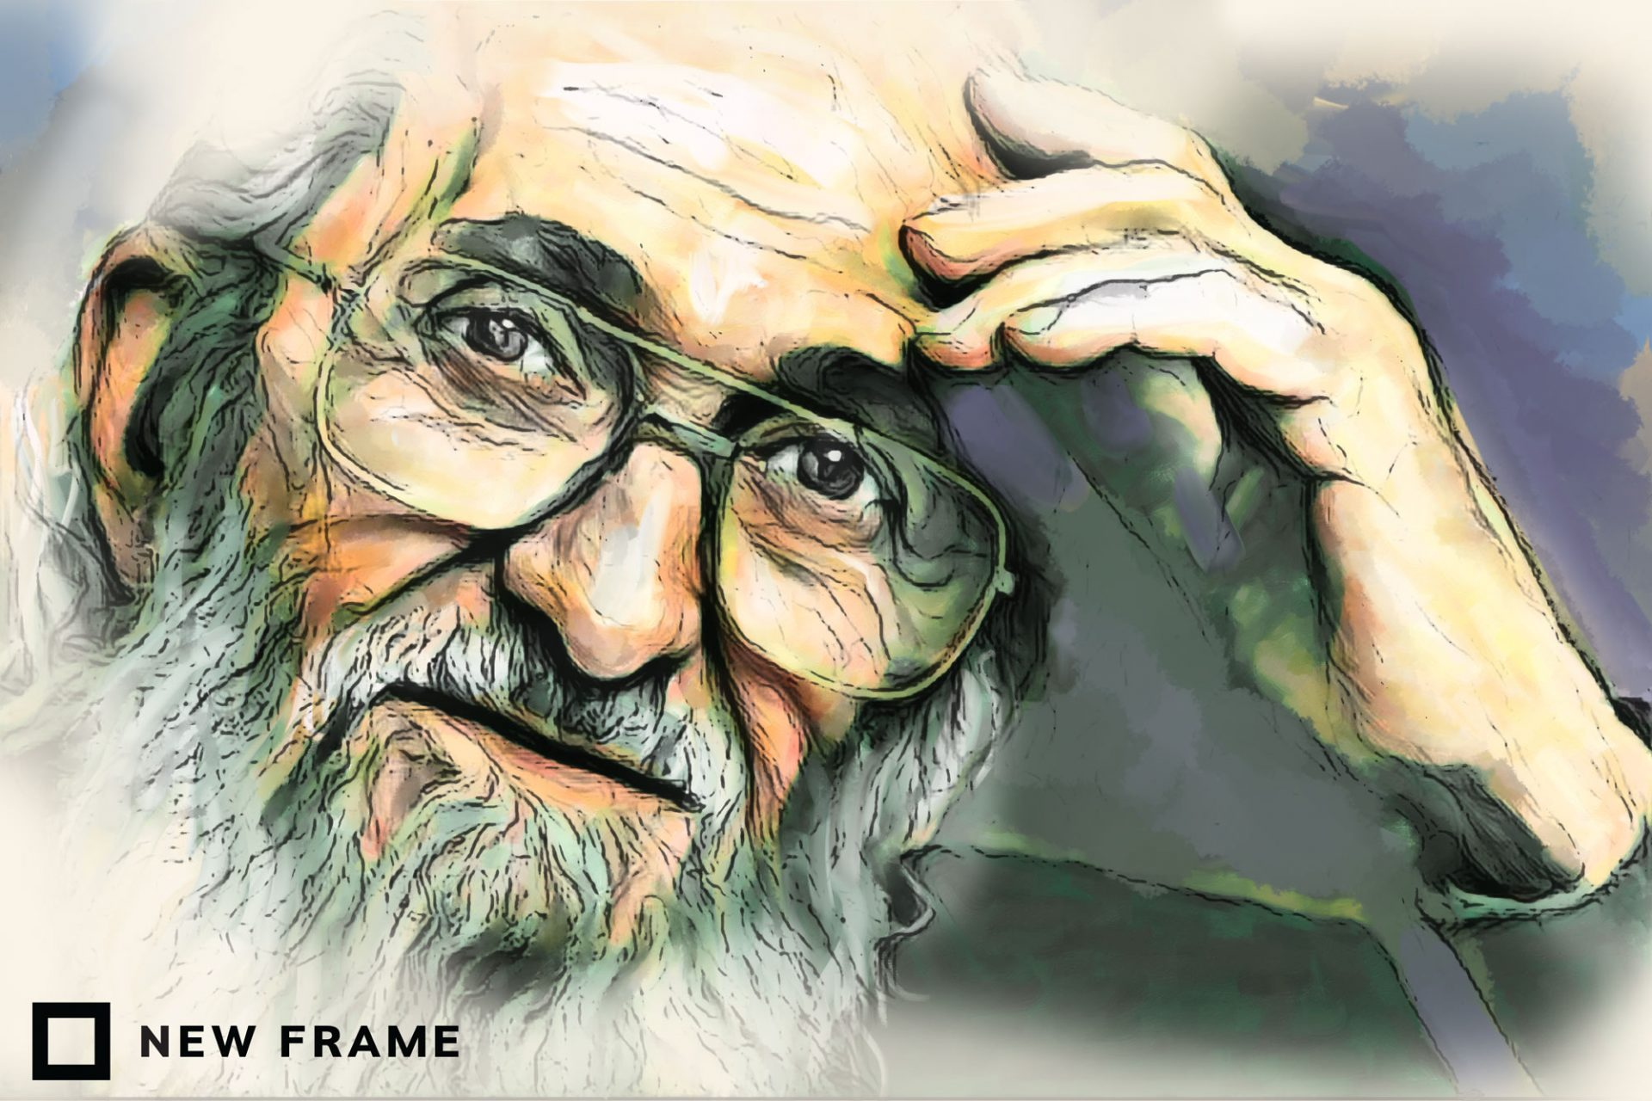
Participatory Action Research: Origins
1982: International Participatory Research Network
  1960s and 70s, India: Anti-colonialist lens, inspired by social movements
  1970s-1980s
    Tanzania (Hall and Swantz) and Chile (Vio Grossi): restructuring life around new economic policies (e.g., land redistribution) necessitated an understanding of citizens’ experiences (e.g., obstacles to subsistence farming on newly held land)
    Paulo Freire tied it altogether: Adult (popular) education, democratization of research
(Glassman & Erdem, 2014)
Notes:
Participatory action research developed in different places around the world, including Tanzania, India, Brazil, Peru, Columbia, etc. These separate projects emerged almost simultaneously, between the 50s and 70s, but it was not until 1982 that connections between them were drawn. Paulo Freire, who was primarily responsible for popularizing the movement, gave a speech at the International Participatory Research Network that tied these threads together.

Slide 12
Participatory Action Research: Components
Participation (Vivencia): Central to components 2 and 3 below and meant to represent the importance of lived experience as a driving, transformative force
Action (Praxis): The act of transforming one’s current lived experience to one that is more collectively just based on a critique of social conditions (see component 3); the focus is on changing structural power relations, both through the research process and the actions driven by the data.
Research (Conscientization): The point at which the oppressed “begin to question and critique actions they may have once believed were critical to their survival . . . [Conscientization involves] creating new community-based problem-solving processes” through research
Notes:
ELEMENTS OF PAR
Participation/Vivencia (Fals Borda, but adapted from Gasset, a Spanish philosopher): “a full experience of an event with its all possibilities, lived through direct participation” (p. 212): This is where the idea of participatory research came from, i.e., either recruiting co-researchers with lived experience or conducting research on one’s own lived experience in partnership with others. But vivencia is meant to be a transformative via “participation, sharing, sensing, feeling, and thinking” (p. 212)
Action/Praxis: “The transformation of vivencia . . . to a different collectively defined lived experience happens through action - praxis . . . Praxis implies a critical reflection, awareness of the process, and its aim . . . it must reach beyond abstract ideas about what you (must) do to improve your community and/or what you do to produce material goods, to what you do on a day-to-day basis to survive . . . Action as praxis . . . requires constant reflection and dialogue during the change process . . . The goal of PAR is . . . [to] give the oppressed members of a community or social group the capabilities of critiquing their own praxis of the immediate” (p. 212). The focus is particularly on changing power relations here - not simply including those who are marginalized in existing process (which would reflect a more positivist view where researchers are essentially “data owners” and participants are exploited for their knowledge by others who accumulate it in the form of wealth and expertise).

Slide 13
PAR Case Study: Youth Participatory Action Research (YPAR) 2.0
Institute for Sustainable and Economic Educational and Environmental Design (ISEEED) in Oakland, CA: iseeed
Aim: ‘Ground-truth’ the County health department’s official database on food outlets, which had labeled East Oakland as a food oasis
Youth and adults worked together to create an app that young people could use to capture information about locations in their environment and conduct interviews and surveys with store owners and residents: streetwyze
Findings: The county claimed there were 50 grocery stores, but there were only 3. The rest were liquor or corner stores.
Action: Made recommendations to decision makers and convinced them to add a farmers market, food commissary, and urban farm to local school districts
Youth outcomes: Newfound of their social locations within systems of race and class
(Akom et al., 2016)

Slide 14
PD
PAR
Engineering focused
Origins in labor organizing
Technology output
Stronger execution
Vivencia (whole process approach)
Constraints created by academic settings
Antagonism / challenge to power and hierarchy
Social science focused
Origin in anticolonial practice
Research
output
Stronger
background

Slide 15
Pause for a second
What is different here between how PD / PAR think about participatory work and

Slide 16
Wayy Back to Our Toy example
Imagine you are a new company tasked with designing an AI tutor for first-year college students. Do the following [thinking about the why for each]:
Explain, at a high level, why we might need AI tutors in the first place (why is this a problem, what are the causes?)
Outline a population you want to target (e.g. “students who are good at math”) (why?)
Define a way you’ll build the model, using the ideas from the ”two pipelines” in class
Define your “secret sauce” … why should I use your tool instead of others?
Explain how you’ll evaluate the effectiveness of your approach Describe one group of people that are not likely to benefit from your tool, and why that is(n’t) OK

Slide 17
Extension
Define the set of stakeholders who should have a say in this system, and why
Describe a participatory process by which you will design the system. Determine who will have “final say” on what, and how “final say” will be determined
Describe any feedback mechanisms that will be put into place for future changes to the system.

Slide 18
Presentations! 3 minutes this time.

Slide 19
Thoughts from previous years…

Slide 20
Stakeholders
Professors
  The ones teaching the students
  More experience in engaging with students
  Guides the student and grades the students
  Interview the students
  Professors understand the curriculum
  Spread the word equally
Students
  They’re the ones who actually do the application, it’s a cost to their time
  Concerns about fairness
  Understand their strengths and weaknesses
  Most affected community
  We want specific students…
Demographically diverse set of students
  Accommodate different perspectives / experiences
  Demographic representation based on applicant pool

Slide 21
Stakeholders
Job recruiters / industry experts
  Give a sense of what they’re looking for; what skills should be sought out
The lawyers
  Address concerns about biases in automation
Alumni
  They have a connection to and have a stake in success
  Form of engagement
Grad Office / Staff
  The people who actually do the stuff and want the automation

Slide 22
Stakeholders
Sponsors
  Who is going to pay for the thing to be built
Developers
  They need to say what can actually technically be built

Slide 23
Design Process
Mission committee - set of people who dictate the mission
  Do a survey
  Ensure everything goes through legal first
  Define success criteria as outcomes from the first year using an Randomized Control Trial
Stakeholders get a final say in the actual decisions being made by the algorithm
Define potential design capacities from what has been done previously
  Put the professors and admins in charge
  Look to existing spaces where people are expressing themselves
Repetitive iteration through the design process with a new and diverse set of stakeholders each semester
  Does this group of people involve affected individuals from prior semesters … who is the most affected? False negatives? How do we incentivize false negatives to participate?
  Drive system development by acknowledging impact and providing genuine use of feedback

Slide 24
Feedback Mechanisms
Analytics to see if the algorithm is biased in certain ways and if so, try to remove those biases

Slide 25
Is participatory design just a feel good exercise?
It makes things harder
It makes things costlier
Is it worth it?
  Yes, you need a diverse set of voices, you restrict us to the status quo
  No, nothing is actually going to get done and nothing is worse than something imperfect
  Yes – things change, you constantly need new voices
  No, it complicates it and creates increasingly likely that things break or stagnate or cease to be effective

Slide 26
Implications for your project
Careful of assuming you’ll get free labor
How can people in your situation have a final say even if they’re not in the design process?
How will you manage long term governance of your project
Does that group of people you’re assuming all have one view actually have one view?
Treat lived experience as real expertise

Slide 27
ML and News and Elon Musk and who owns our public spaces
Kenneth (Kenny) Joseph
Notes:
as no one has ever said before, if you want to get out of the cold, come on down to Buffalo

Slide 28
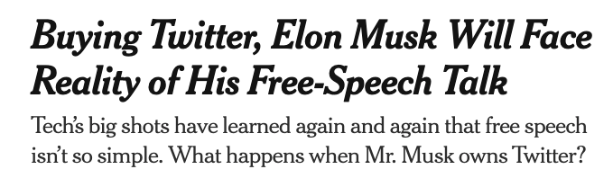

Slide 29

Task #1 today
I am a startup tycoon. I therefore know everything and can solve all problems with the maths and VC funding
Someone has told me that news is biased
I have decided to solve this problem.
I hire your team to build an unbiased news site (“Elon Twitter”)

Slide 30
Task (cont.)
Create a process (maybe including ML) that determines whether or not a particular piece of news is biased (or how it is biased, or how biased it is)
Determine how to use that process to produce a set of 15 news articles that are shared via a list-serv to paying customers every morning
Develop a 1-3 minute pitch for your approach and why it will work
Some examples you might think about
  https://knowherenews.com/

Slide 31
Task (cont.)
Create a process (maybe/hopefully including ML) that identifies a set of fake news domains
Determine how to use that process to curate news feeds on Twitter to paying customers (Twitter blueeee)
Develop a 1-3 minute pitch for your approach and why it will work
Some examples you might think about
  Newsguard
  https://arxiv.org/abs/1708.07104

Slide 32
Some considerations
I’m being deliberately vague about what “bias” is. But you may want to consider:
  Political leaning
  Spatial distribution
  Gender
  Topical content
  Source of the article
  Content of the article
  …
Not restricted to the US!
Some examples you might think about
  https://knowherenews.com/
  Post.news
  The Catalyst
  …

Slide 33


Slide 34
News, Truth and Bias
Bias exists everywhere in the media, but in two forms
  Reporting bias – media organizations can be biased in the news that they produce
  Content bias – media organizations can be biased in the way that they cover
Bias is different than falsification, or “fake news”
But
  Who gets to decide what is worth covering, and what isn’t?
  Is it even possible to cover “everything”? Would anyone come to your site?
  Who gets to be the arbitrator of truth? The platform?
Also – the idea of “unbiased news” is relatively new
Notes:
he notion that reporters should possess Olympian objectivity is relatively recent. In the nineteenth century, most newspapers were explicitly linked to a particular political party and the economic interests of the publisher. In California during the Gold Rush, for example, the San Francisco Alta California was the enemy of Democratic governor John Bigler, whose press champion was the Stockton Republican.

Slide 35


Slide 36
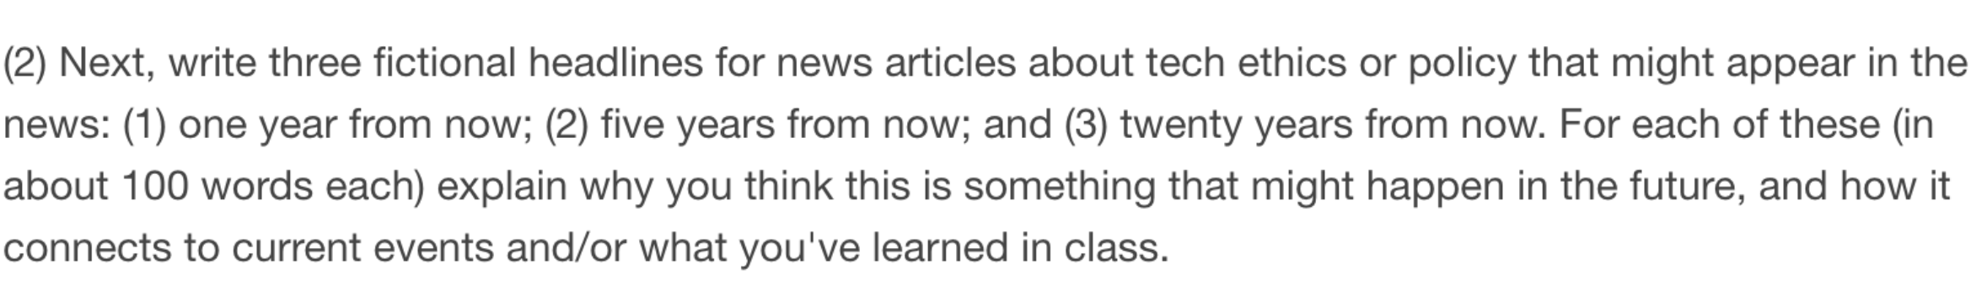
Task #2 – Future thinking on News Media Tech

Slide 37
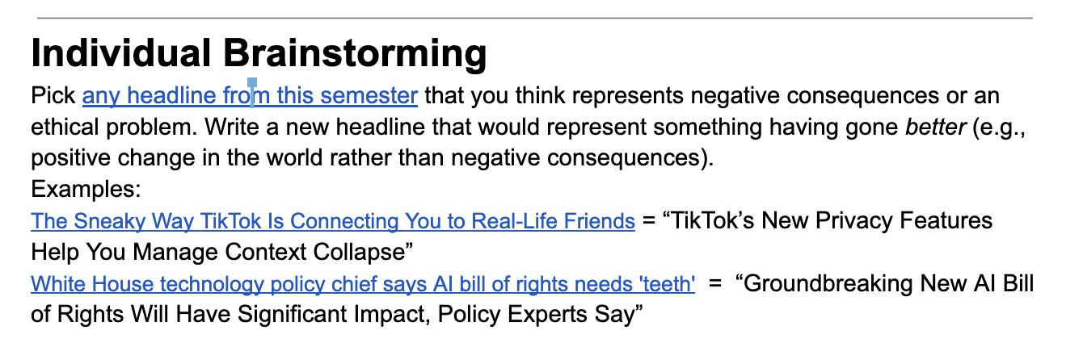
Task #2 (cont.)
What needs to happen for this to change?

