Slide 1
ML and News and Elon Musk and who owns our public spaces
Kenneth (Kenny) Joseph
Notes:
as no one has ever said before, if you want to get out of the cold, come on down to Buffalo

Slide 2
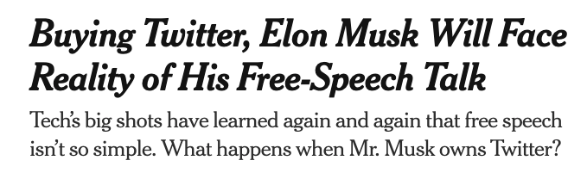

Slide 3
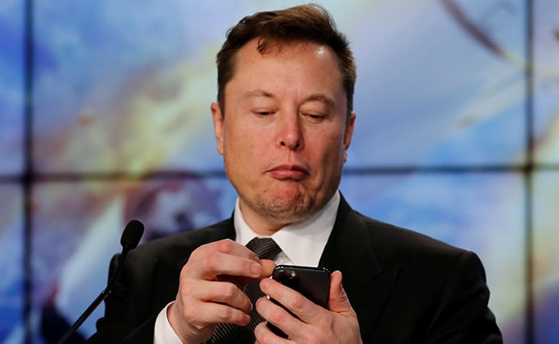
Task #1 today
I am a startup tycoon. I therefore know everything and can solve all problems with the maths and VC funding
Someone has told me that news is biased
I have decided to solve this problem.
I hire your team to build an unbiased news site (“Elon Twitter”)

Slide 4
Task (cont.)
Create a process (maybe including ML) that determines whether or not a particular piece of news is biased (or how it is biased, or how biased it is)
Determine how to use that process to produce a set of 15 news articles that are shared via a list-serv to paying customers every morning
Develop a 1-3 minute pitch for your approach and why it will work
Some examples you might think about
  https://knowherenews.com/

Slide 5
Task (cont.)
Create a process (maybe/hopefully including ML) that identifies a set of fake news domains
Determine how to use that process to curate news feeds on Twitter to paying customers (Twitter blueeee)
Develop a 1-3 minute pitch for your approach and why it will work
Some examples you might think about
  Newsguard
  https://arxiv.org/abs/1708.07104

Slide 6
Some considerations
I’m being deliberately vague about what “bias” is. But you may want to consider:
  Political leaning
  Spatial distribution
  Gender
  Topical content
  Source of the article
  Content of the article
  …
Not restricted to the US!
Some examples you might think about
  https://knowherenews.com/
  Post.news
  The Catalyst
  …

Slide 7
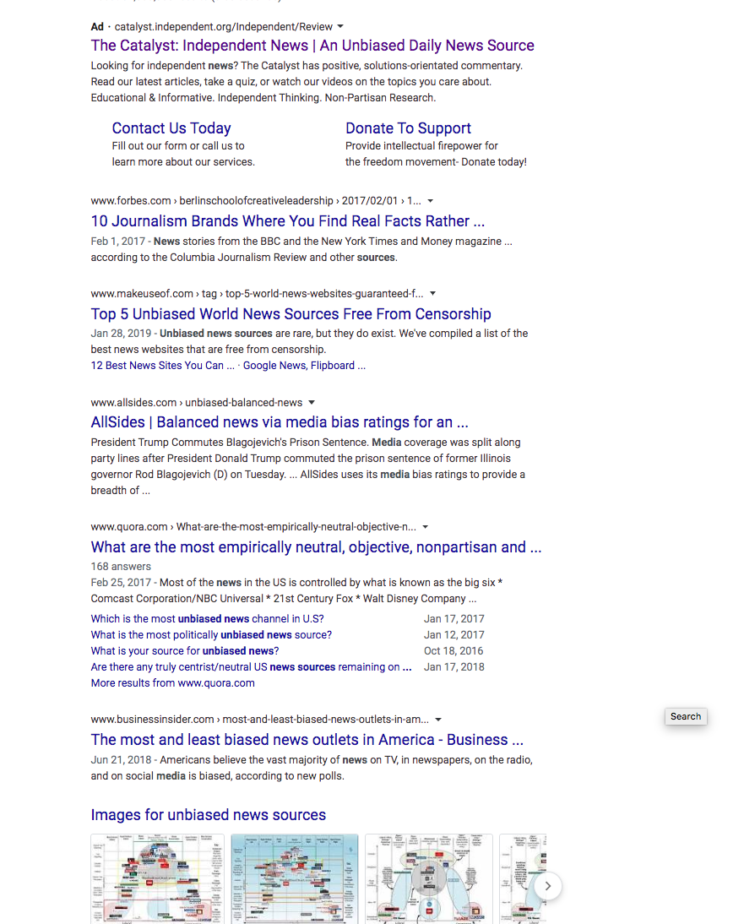

Slide 8
News, Truth and Bias
Bias exists everywhere in the media, but in two forms
  Reporting bias – media organizations can be biased in the news that they produce
  Content bias – media organizations can be biased in the way that they cover
Bias is different than falsification, or “fake news”
But
  Who gets to decide what is worth covering, and what isn’t?
  Is it even possible to cover “everything”? Would anyone come to your site?
  Who gets to be the arbitrator of truth? The platform?
Also – the idea of “unbiased news” is relatively new
Notes:
he notion that reporters should possess Olympian objectivity is relatively recent. In the nineteenth century, most newspapers were explicitly linked to a particular political party and the economic interests of the publisher. In California during the Gold Rush, for example, the San Francisco Alta California was the enemy of Democratic governor John Bigler, whose press champion was the Stockton Republican.

Slide 9
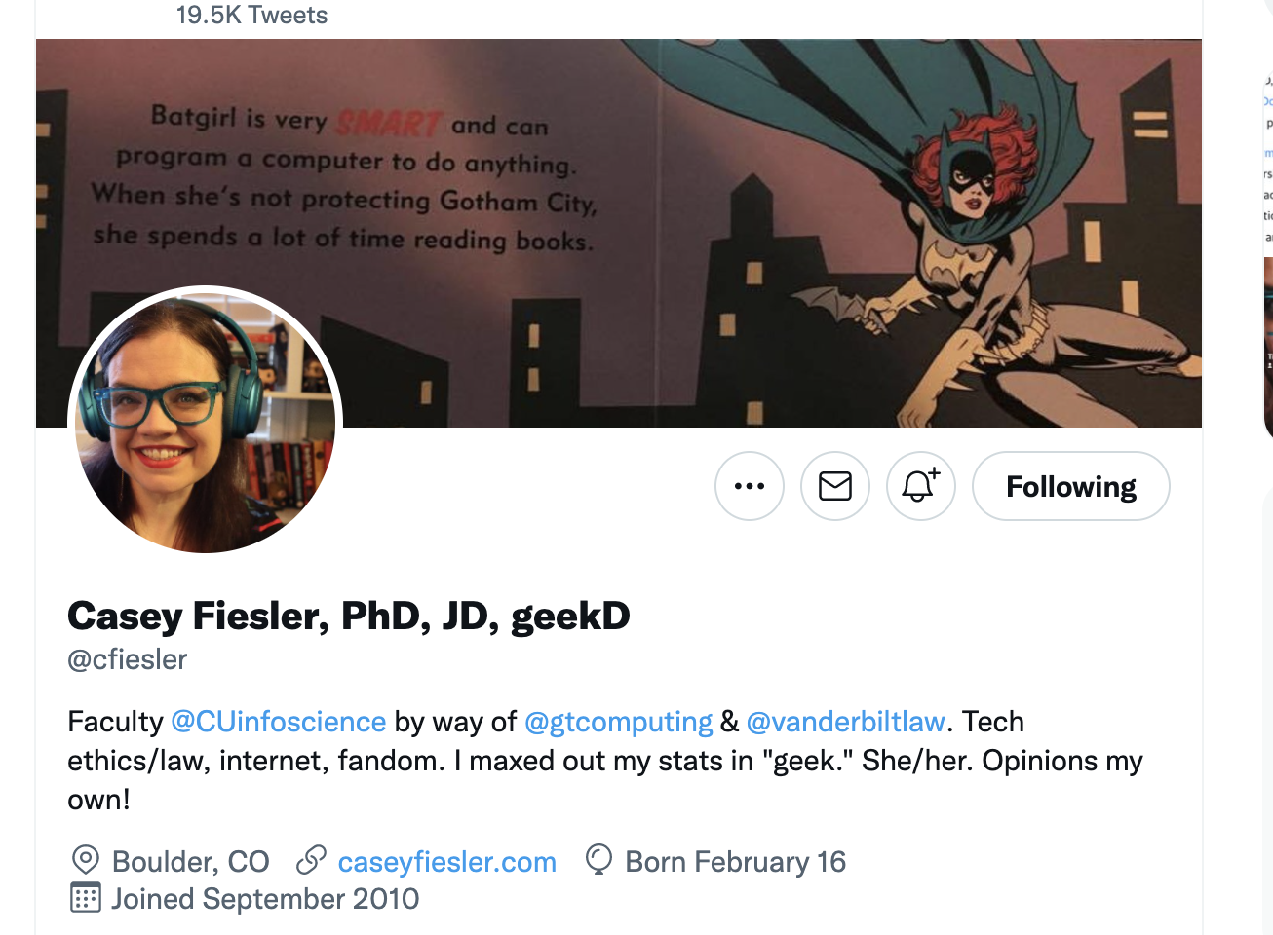

Slide 10
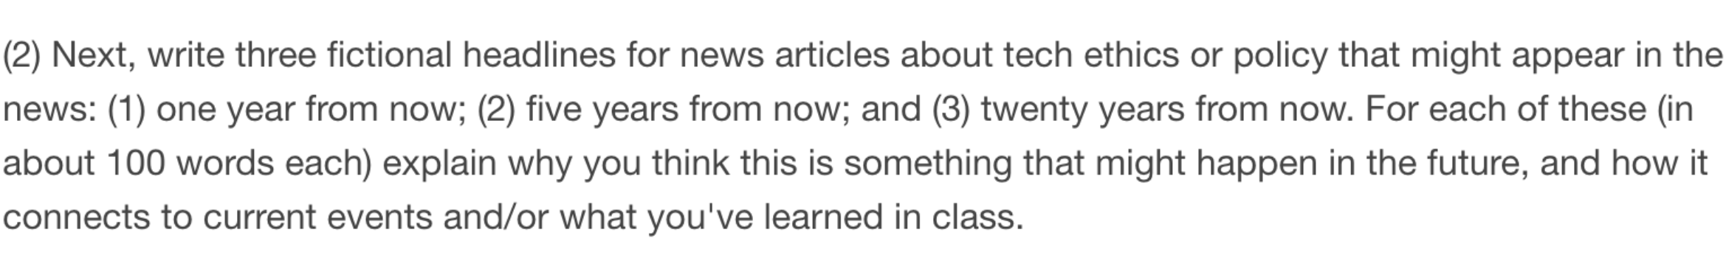
Task #2 – Future thinking on News Media Tech

Slide 11
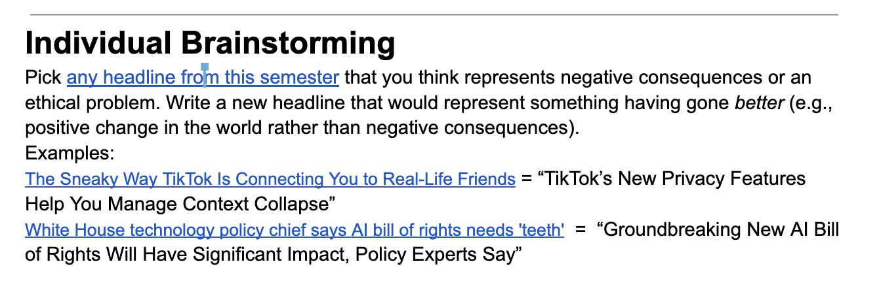
Task #2 (cont.)
What needs to happen for this to change?

