Slide 1
Causal Inference
Kenneth (Kenny) Joseph

Slide 2
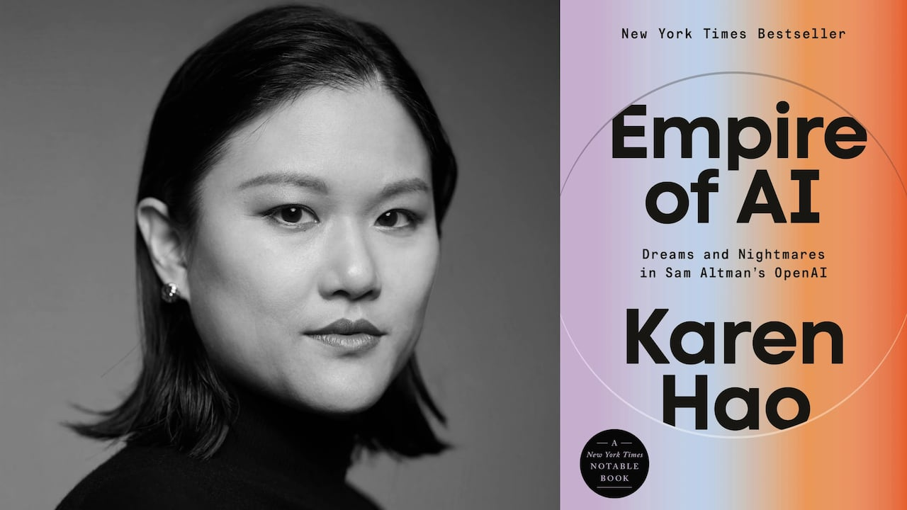
Karen Hao

Slide 3
Overview
Three things you need for your project [and to do good [computational social science]] (IMO)
The ability to understand/reason about the social world
The ability to use that understanding to design interventions on the world
The ability to conduct measurements that assess the [potential] effect of that intervention

Slide 4
Overview
Three things you need for your project/to do good [computational social] science (IMO)
The ability to understand/reason about the social world
The ability to use that understanding to design interventions on the world
The ability to conduct measurements that assess the [potential] effect of that intervention
To help us with this, I’m going to talk, at a very high level, about causation today

Slide 5
Overview of this lecture
Three things you need for your project/to do good [computational social] science (IMO)
The ability to understand/reason about the social world
The ability to use that understanding to design interventions on the world
The ability to conduct measurements that assess the [potential] effect of that intervention
Note: we’re going to do this through the use of diagrams, or, less fancy – pictures, one of which we’ve already drawn.

Slide 7
Overview of this lecture
Three things you need for your project/to do good [computational social] science (IMO)
The ability to understand/reason about the social world
The ability to use that understanding to design interventions on the world
The ability to conduct measurements that assess the [potential] effect of that intervention
Note: we’re going to do this through the use of diagrams, or, less fancy – pictures, one of which we’ve already drawn.
But first!

Slide 8
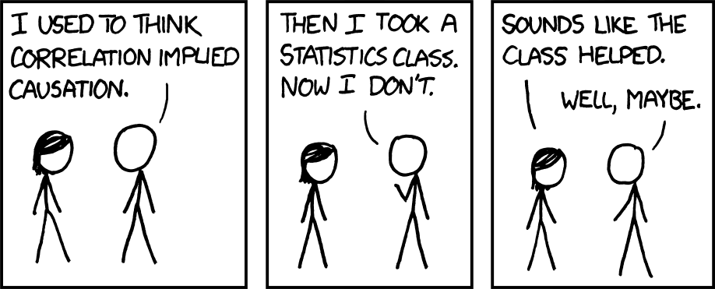

Slide 9
Correlation vs. Causation
Correlation: A measure of the relationship between two variables
Causation
  Informally: “if I change A, then B will also change”
  Formally, two ways to think about this:
    “Do calculus”
    Potential outcomes
    People argue about which of these is better. Irrelevant for our purposes

Slide 10
Correlation vs causation
https://tylervigen.com/spurious-scholar
Can you summarize the difference between correlation and causation?
Why do we care about causation and not correlation?
Does correlation always mean causation?
Does no correlation always mean no causation?

Slide 11

No correlation != No causation
What does pressing down the gas pedal do to speed?
What does going up/down a hill do to speed?
If we didn’t know that, what conclusions might we draw from a skilled driver?
https://goodauthority.org/news/milton-friedmans-thermostat/

Slide 12
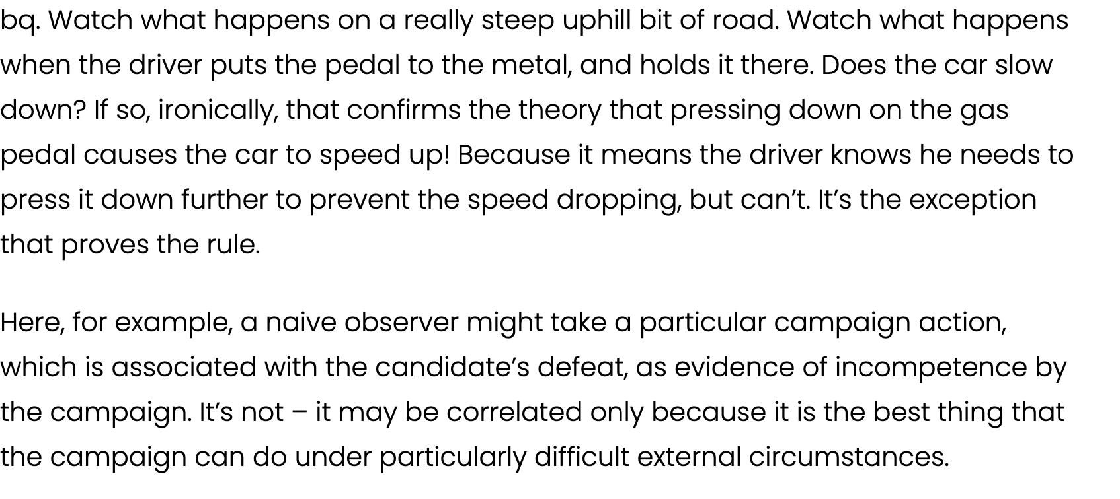

Slide 13
In general, correlations are fragile beings
https://www.youtube.com/watch?v=DbJyPELmhJc&ab_channel=AutodeskResearch

Slide 14
Why might we see a correlation where there is no (direct) causation?
Assumed causal relationship:
Rich people tend to get into ”better schools,” because they are smarter than people who are not rich

Slide 15
What did we just do?
We drew an assumed causal graph
This diagram we drew is reminiscent of two things
  Probabilistic graphical models/directed acyclic graphs (or in a restricted setting, causal graphical models)
  System dynamics models
But first – how do we move from assumed to known?

Slide 16
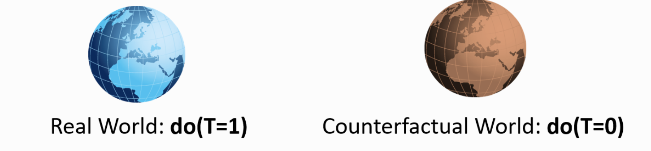
Introducing causal inference
What if we had a method that could explicitly account for these challenges and help us think through real causation?
Enter causal inference!
https://microsoft.github.io/dowhy/example_notebooks/tutorial-causalinference-machinelearning-using-dowhy-econml.html

Slide 17
Sounds great! But there’s a catch…
I want to know if telling Alvin he is going to get an A no matter what will make his participation better or worse
I can’t both give {friend} an A AND not give it to them!
This is the Fundamental Problem of Causal Inference
https://microsoft.github.io/dowhy/example_notebooks/tutorial-causalinference-machinelearning-using-dowhy-econml.html

Slide 18
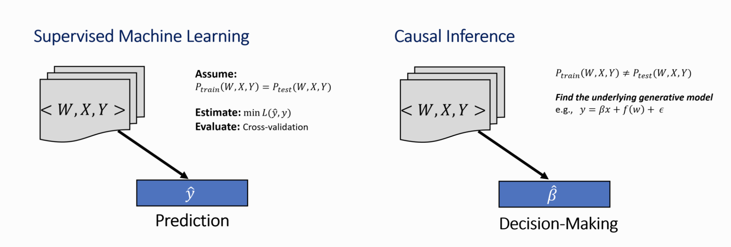
Aside: Causal inference vs. ML

Slide 19
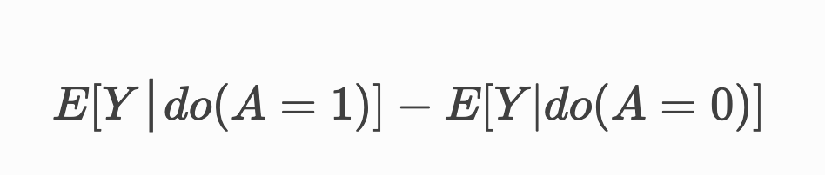
What can we do, then?
Target averages/expectations instead of an individualized effect
Experiment!
Note: do operator indicates an intervention, in an RCT we intervene by randomly assigning treatment and control to comparable groups.

Slide 20
Problems with the simple story
Sometimes, experimentation is unethical
  I suspect half of you would be very angry if I gave you a placebo study guide ☺
Other times, we might have wanted to experiment but simply couldn’t, and are left with a bunch of observational data
Since we do not always have access to experimental data, we rely on observational data for estimating causal effect

Slide 21
Uh-oh
Now:
  We have an idea how to evaluate an intervention, but when we can’t experiment, we have to control for factors associated with both the intervention and the outcome
  Related: how do we decide on a treatment in the first place?
Enter DAGs [and then, causal graphical models]. Informally, there are two “kinds” of probabilistic DAGs
  Bayes Nets encode the factorizations of any joint probability distribution
  Causal Graphical Models put explicit assumptions about causation into DAGs.
  We’ll focus on the latter

Slide 22
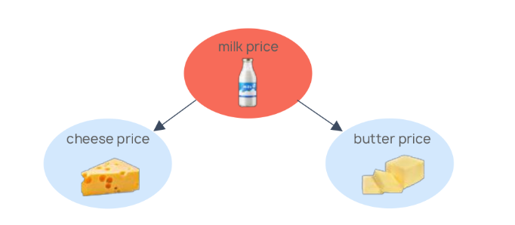

Causal DAGs– a tool to explain causal reasoning
https://causalens.com/resources/white-papers/why-correlation-based-machine-learning-leads-to-bad-predictions/

Slide 23
What is a causal graphical model?
A diagram that helps us explain our assumed causal relationships between two things
  Nodes are random variables
  Edges are causal relationships between RVs
Let’s practice!
Draw a DAG that represents the immigration and crime example.

Slide 24
Problems with DAGs
Not everything is a directed and acyclic graph
We don’t know probabilistic distributions for everything, sometimes we just know high-level relationships
The real world is messy and complex
… enter simulation

Slide 25
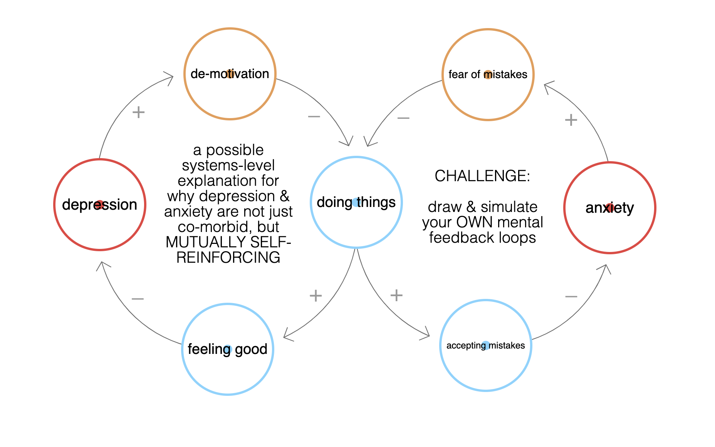
https://ncase.me/loopy/

