Slide 1
Feedback Loops
ML and Society
April 20, 2026

Slide 2
Different biases
Real world goal
Real world mechanism
Learning problem
Data collection mechanism
Which data to collect?
Data representation
Measurement
bias
Historical
Representation bias
Measurement
Historical
Representation bias
Measurement
Measurement bias
Society
Target class/model
Aggregation bias
Historical bias
Deployment bias
Evaluation bias
Evaluation bias
Representation bias
Deploy!
Evaluate error
Predict on test data
Model training
Training data set

Slide 3
Let us assume…
Real world goal
Real world mechanism
Learning problem
Data collection mechanism
Which data to collect?
Data representation
Measurement
bias
Historical bias
Measurement
Historical bias
Measurement
Measurement bias
Society
Target class/model
Historical bias
Representation bias
Deploy!
Evaluate error
Predict on test data
Model training
Training data set

Slide 4
What is a feedback loop
Real world goal
Real world mechanism
Learning problem
Data collection mechanism
Which data to collect?
Data representation
Measurement
bias
Historical bias
Measurement
Historical bias
Measurement
Measurement bias
Society
Target class/model
Historical bias
Representation bias
Deploy!
Evaluate error
Predict on test data
Model training
Training data set

Slide 5
The “loop” in feedback loop
Real world goal
Real world mechanism
Learning problem
Data collection mechanism
Which data to collect?
Data representation
Measurement
bias
Historical bias
Measurement
Historical bias
Measurement
Measurement bias
Society
Target class/model
Historical bias
Representation bias
Deploy!
Evaluate error
Predict on test data
Model training
Training data set

Slide 6
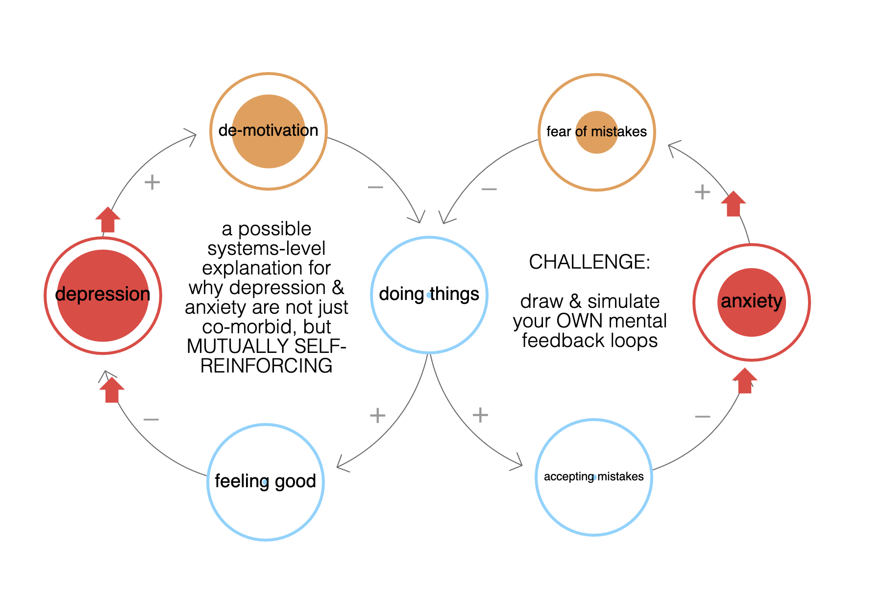
Loopy feedback loop example (from SP 25)

Slide 7
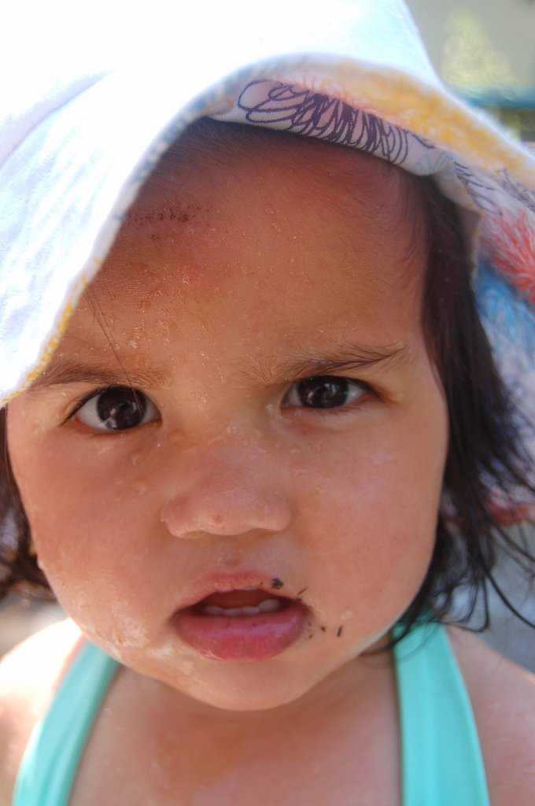
?

Slide 8
The “loop” in feedback loop
Real world goal
Real world mechanism
Learning problem
Data collection mechanism
Which data to collect?
Data representation
Measurement
bias
Historical bias
Measurement
Historical bias
Measurement
Measurement bias
Society
Target class/model
Historical bias
Representation bias
Deploy!
Evaluate error
Predict on test data
Model training
Training data set

Slide 9

Predictive policing

Slide 10
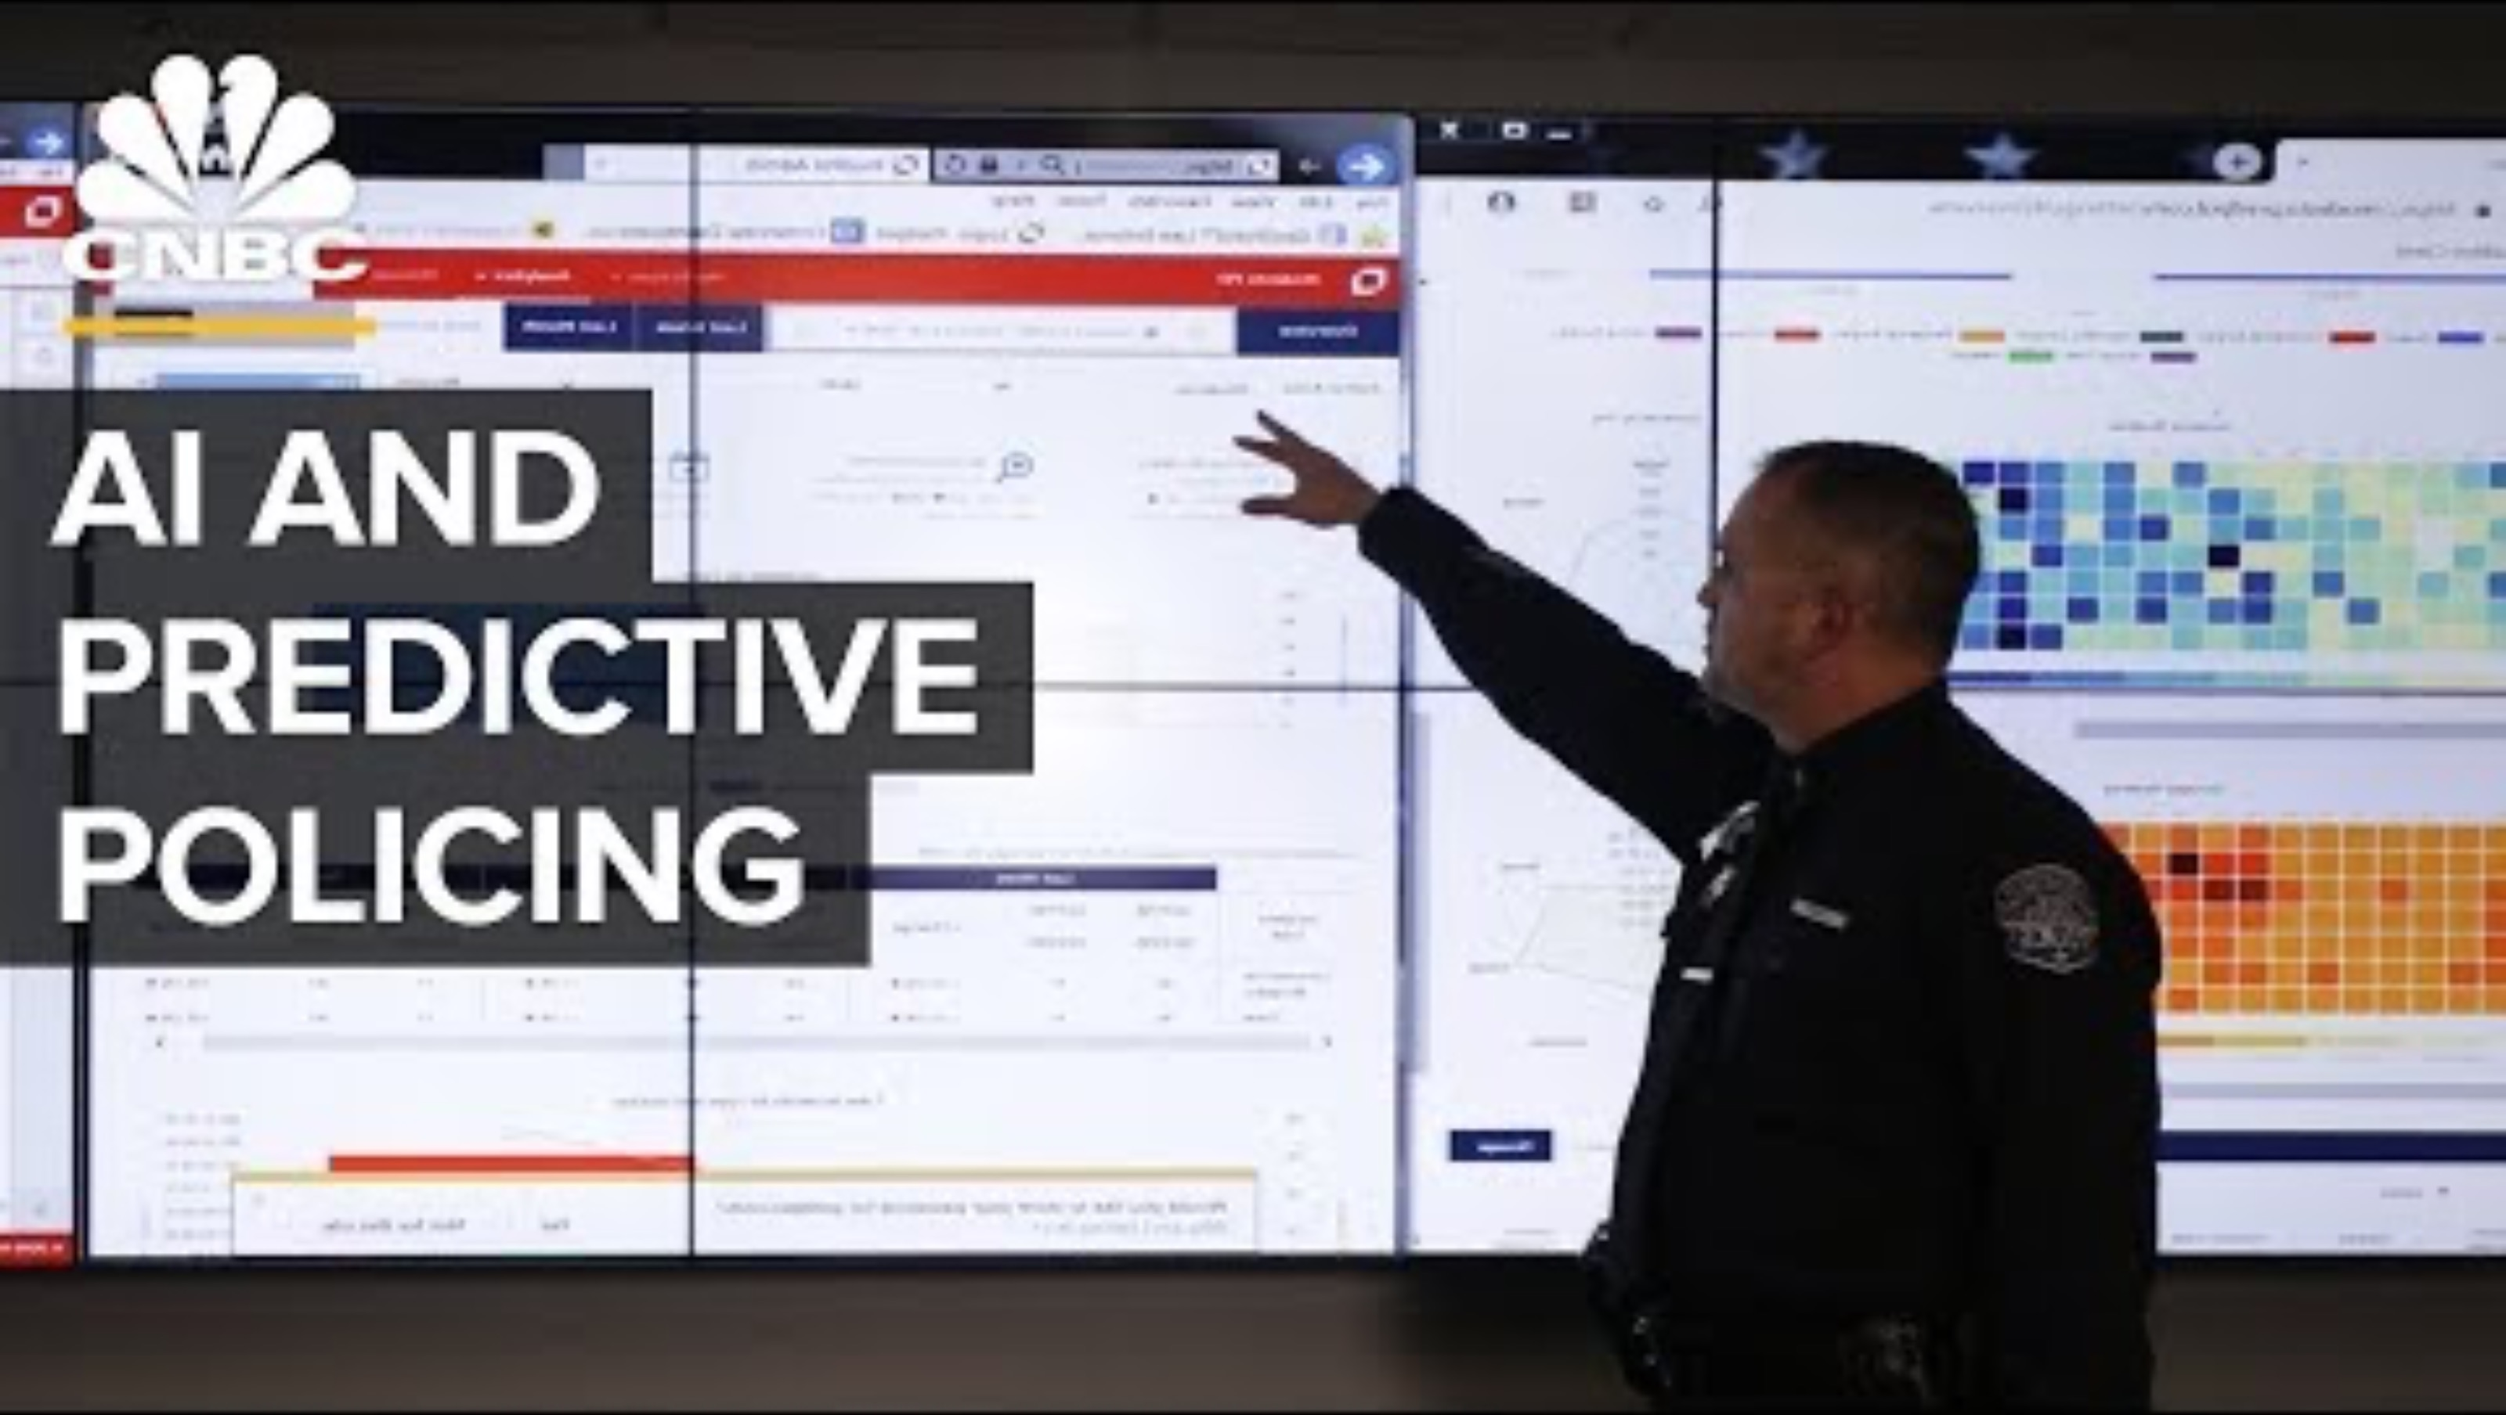
Potential biases in predictive policing

Slide 11
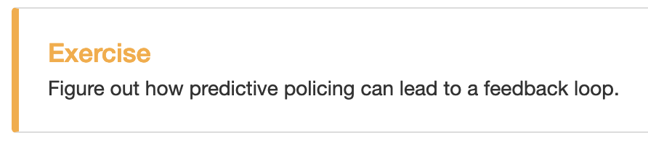
Exercise

Slide 12
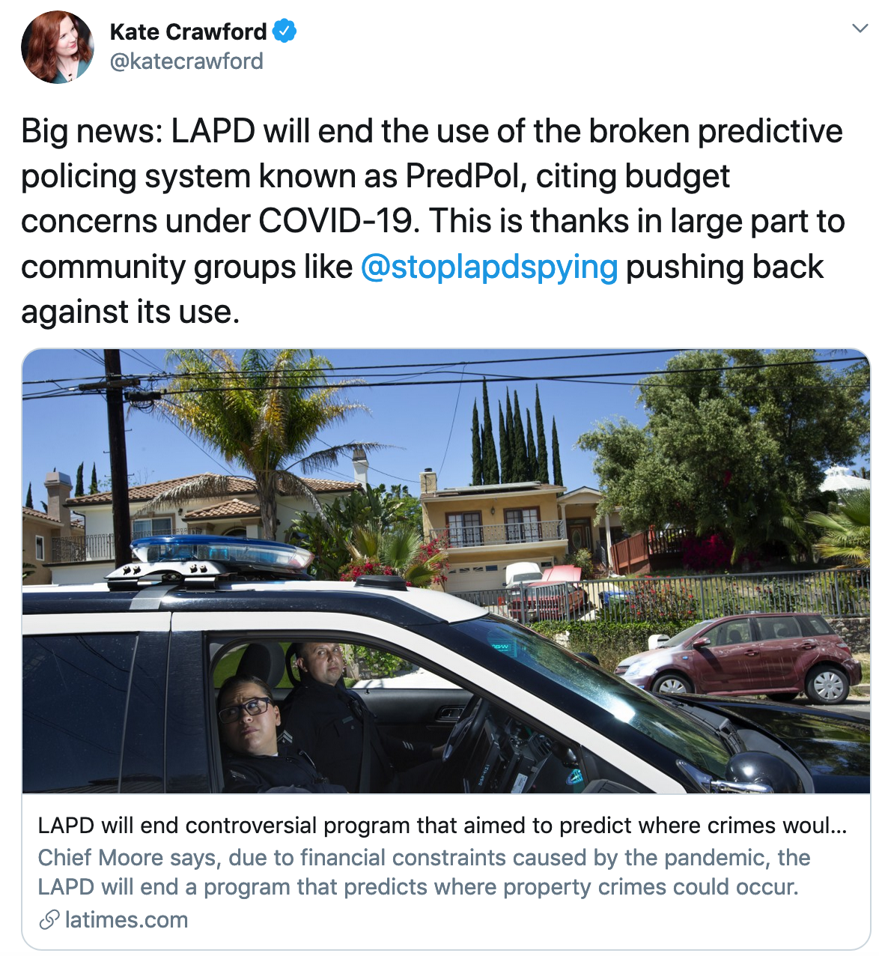
Community organization can get results!

Slide 13
?

Slide 14
Can we formalize this intuition?
How do we “prove” that feedback loops can exist in predictive policing?
Simulation results
Theoretical modeling results

Slide 15
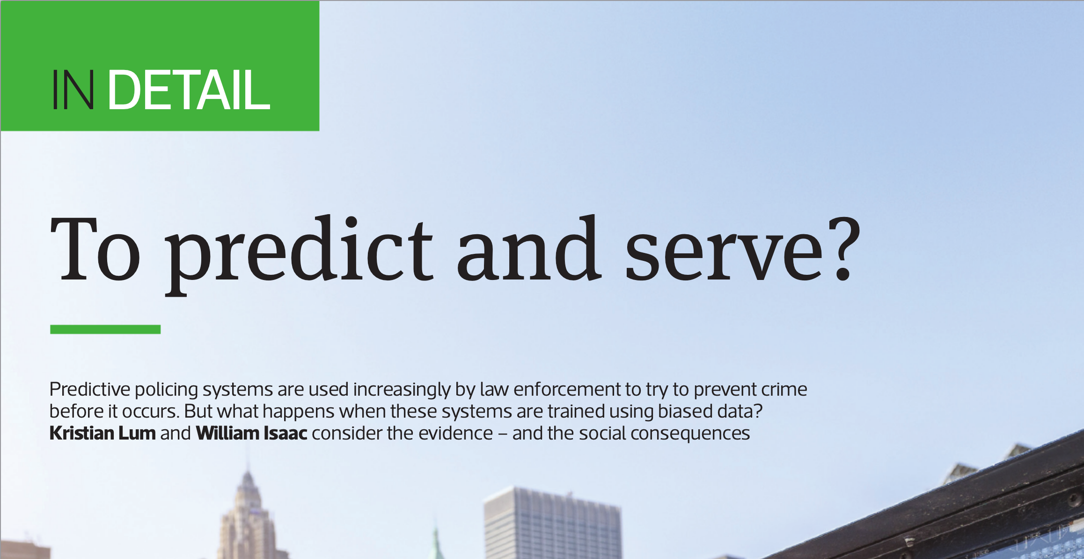
A simulation result

Slide 16
?

Slide 17
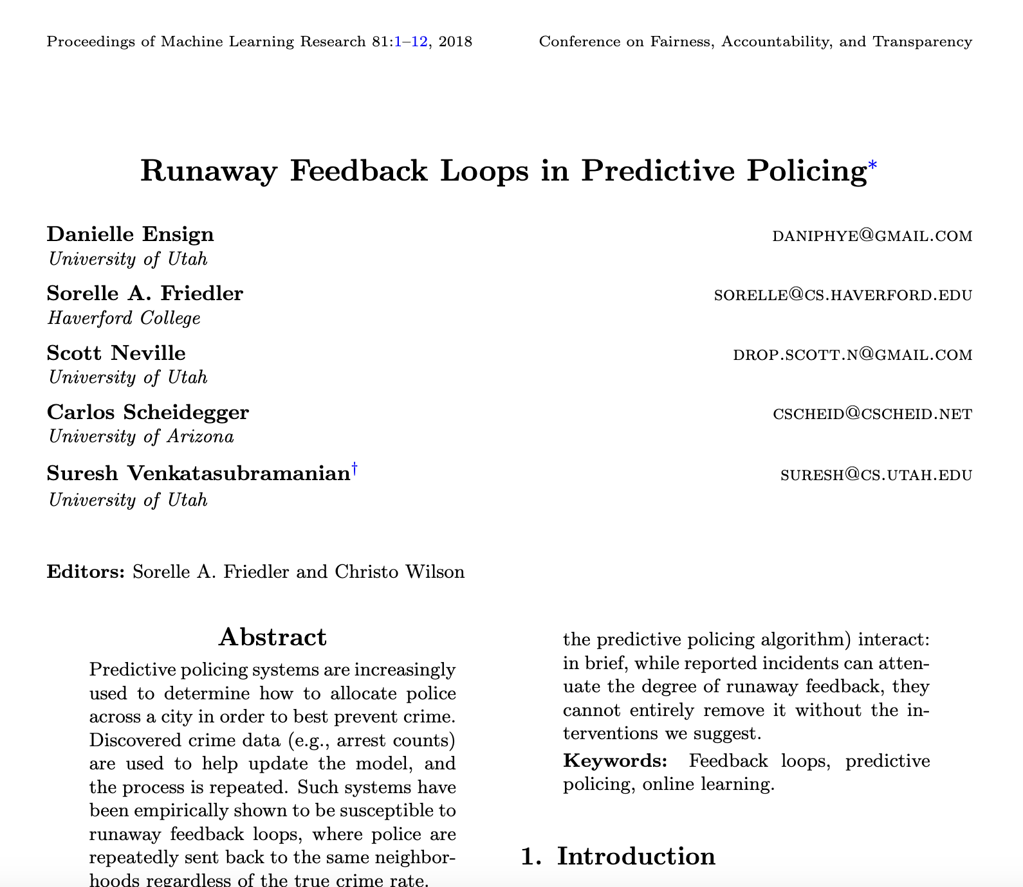
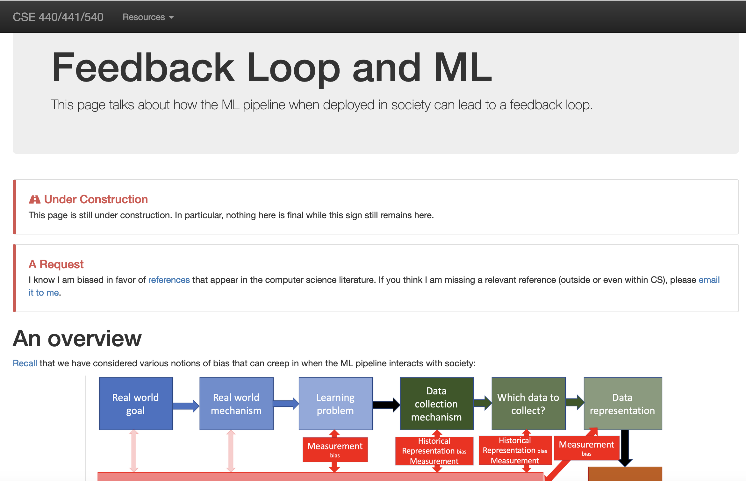
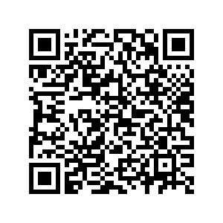
Theoretical modeling: Ensign et al.
A LOT of simplifications!

Slide 18
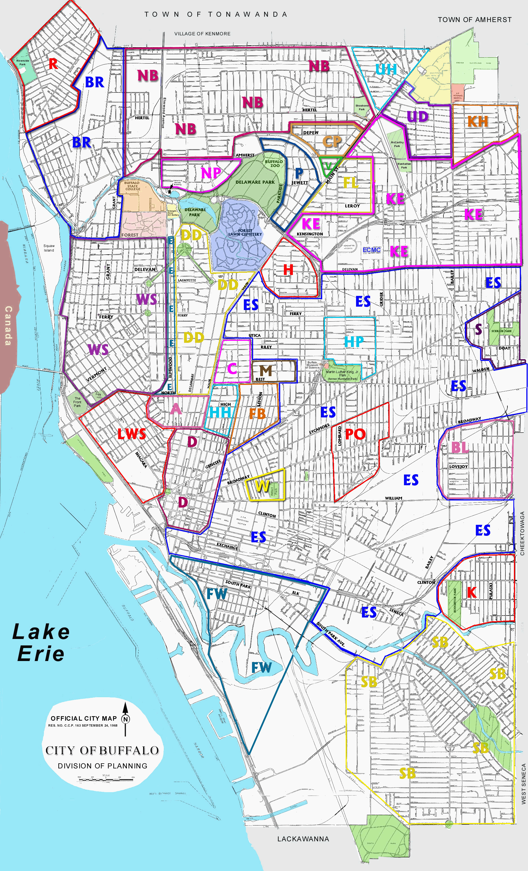
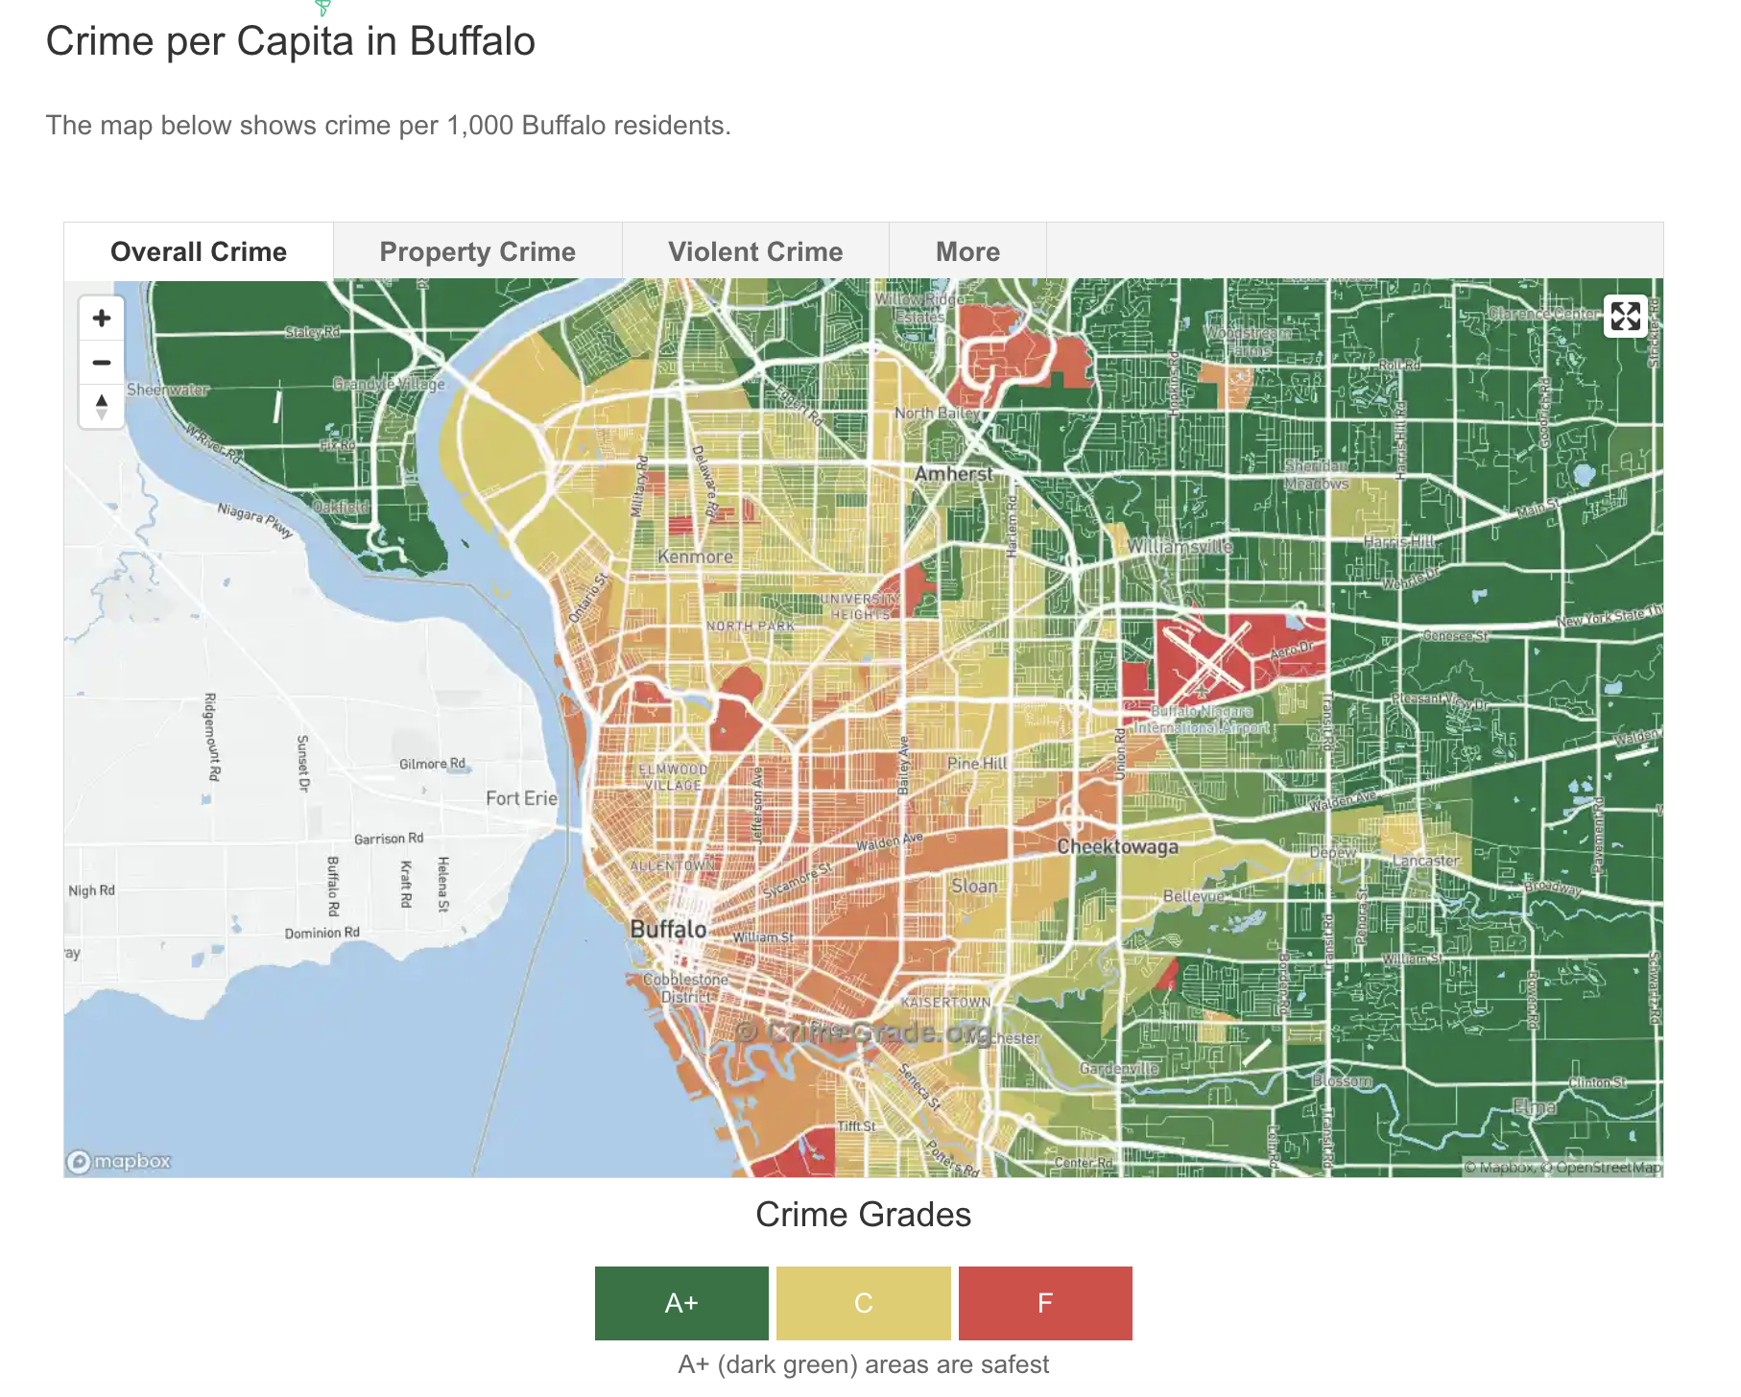
Basic Setup
Only ONE cop patrol E and W
W
E
https://crimegrade.org/safest-places-in-buffalo-ny/
https://library.buffalo.edu/maps/buffalo-wnymaps/buffalo-neighborhoods.html

Slide 19
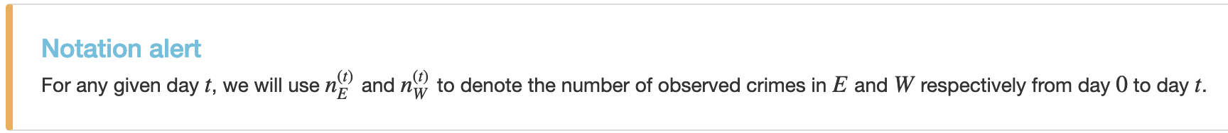
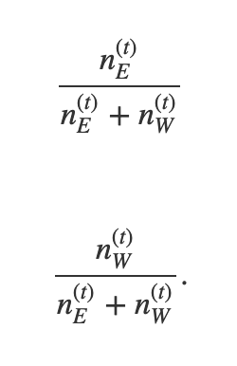
Assumption 1: One region/day
Cop can only go to one of E or W region per day
Cop will go to E or W with probability proportional to the number of crimes reported in that region
Cop will visit E on t+1 with probability
Cop will visit W on t+1 with probability

Slide 20
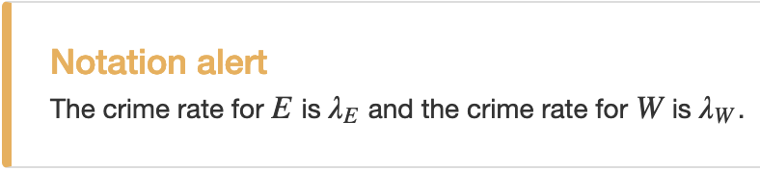



Assumption 2: Unequal crime rates
E and W unequal crime rates (which are known)
Mathematically:
Do NOT need $λ$_{E} and $λ$_{W} to be far apart

Slide 21
Assumption 3: Observed = actual crime rate
Cop discovers crime at exactly the same rate as the actual crime rate in either region
Is this a reasonable assumption?
If cop goes to E:
Discovers one crime with probability $λ$_{E} and no crime with probability 1- $λ$_{E}
If cop goes to W:
Discovers one crime with probability $λW$ and no crime with probability 1- $λW$

Slide 22
An exercise
If cop goes to E:
Discovers one crime with probability $λ$_{E} and no crime with probability 1- $λ$_{E}
If cop goes to W:
Discovers one crime with probability $λW$ and no crime with probability 1- $λW$

Slide 23
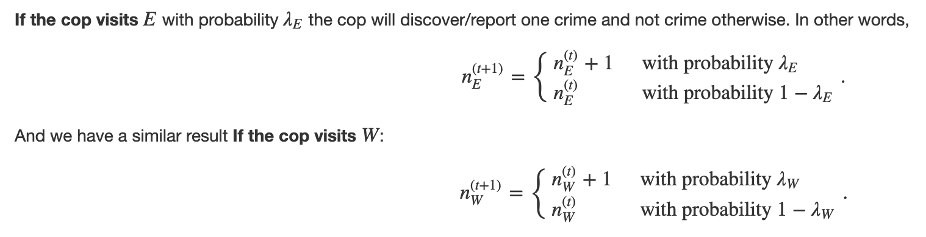
Solution to exercise

Slide 24
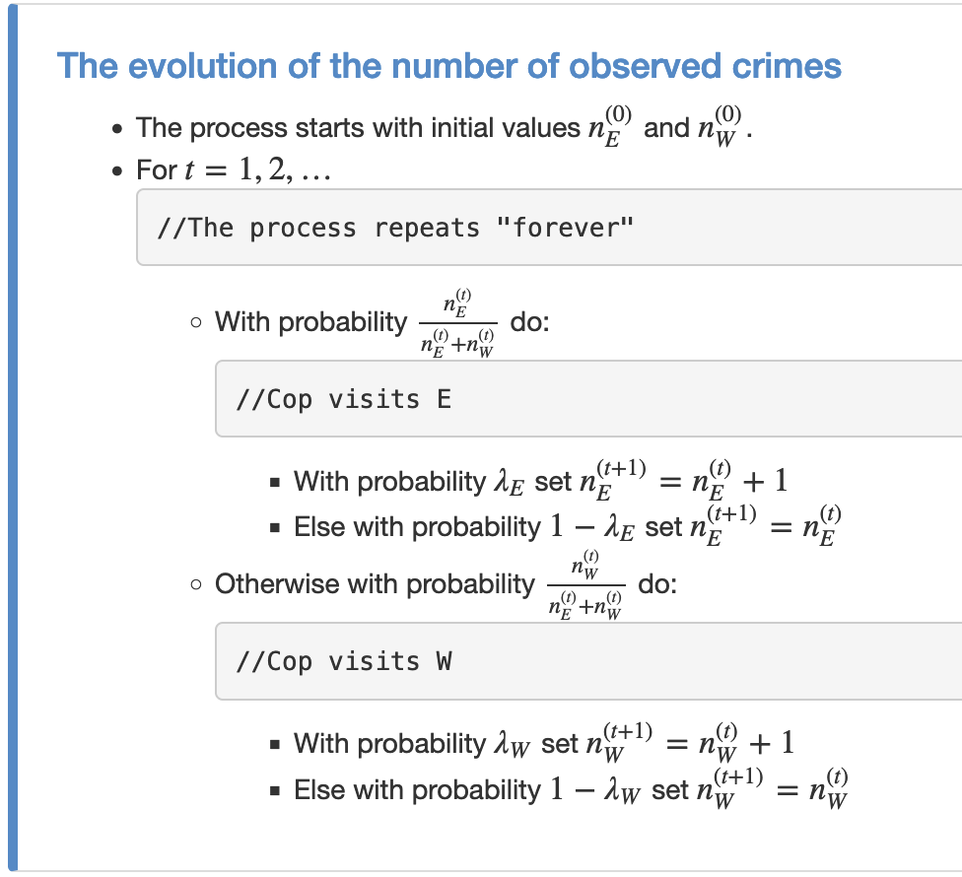
Finally, we have our model…

Slide 25
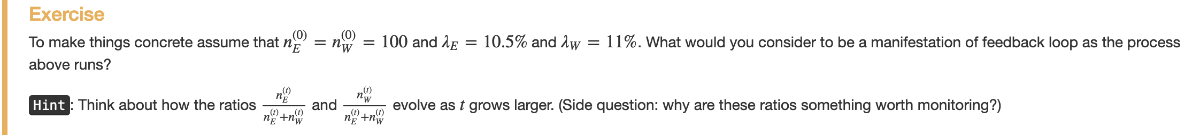
Next exercise…
Cop will visit E with probability
Cop will visit W with probability

Slide 26






Solution to exercise
Cop will visit E with probability
$$≈λ\text{E}$$
$$≪λ\text{E}$$
$$≫λ\text{E}$$
Cop will visit W with probability
$$≈λ\text{W}$$
$$≫λ\text{W}$$
$$≪ λ\text{W}$$

Slide 27
Does this model have a feedback loop?

Slide 28




What do you think will happen?
Answer is yes and in the most extreme sense.
$λ\text{E}$> $λ\text{W}$
$λ\text{E}<$ $λ\text{W}$
Cop will visit E with probability
$$≈λ\text{E}$$
= 1
= 0
Cop will visit W with probability
$$≈λ\text{W}$$
= 0
= 1

Slide 29
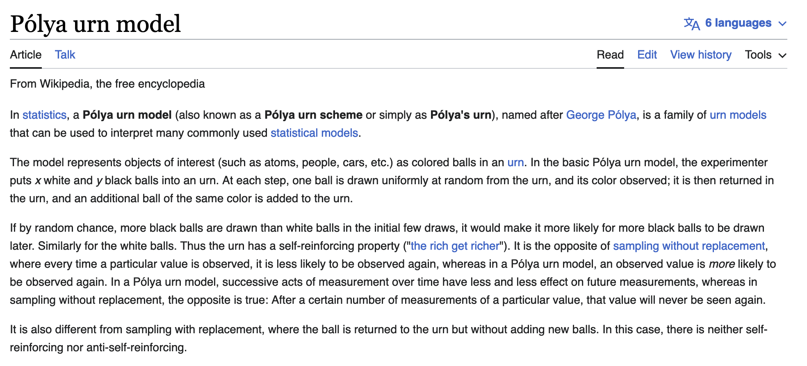
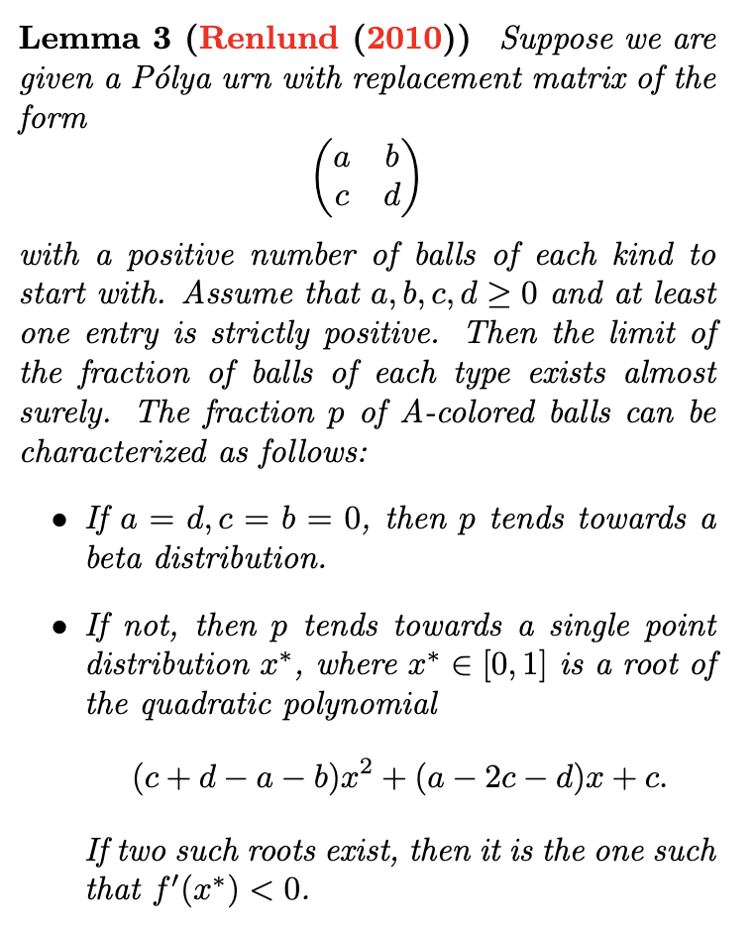
How the heck do you prove such a thing?

Slide 30
Now let’s prove this “lemma 3”!
Just kidding ☺

Slide 31

Now let’s prove this “lemma 3”!
Just kidding ☺

Slide 32
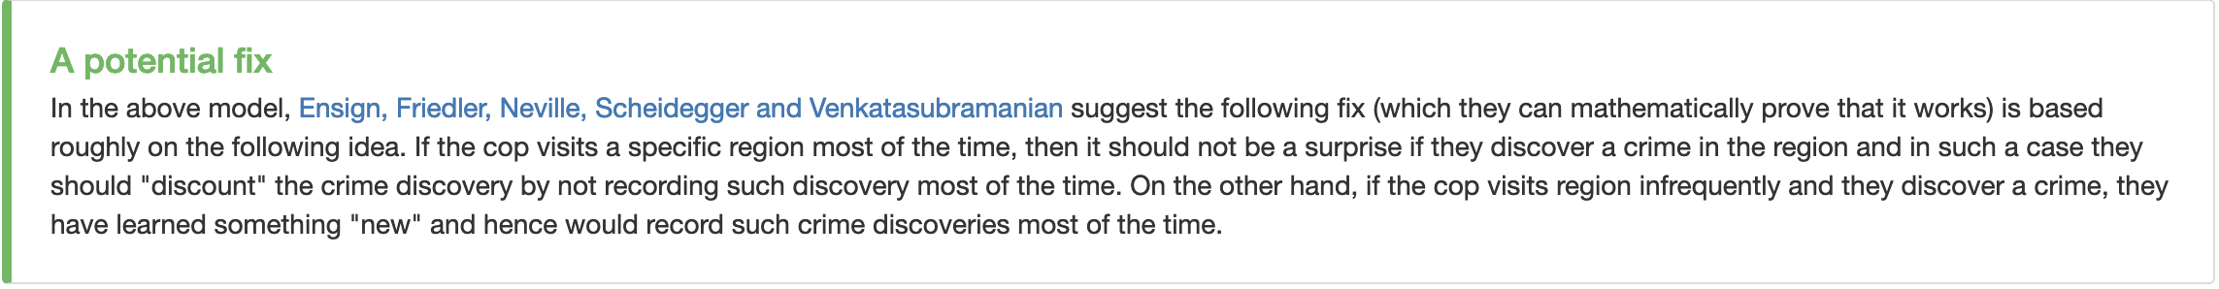
Is there a (mathematical) “fix”?

