Slide 1
Lecture 2
AI & Society

Slide 2
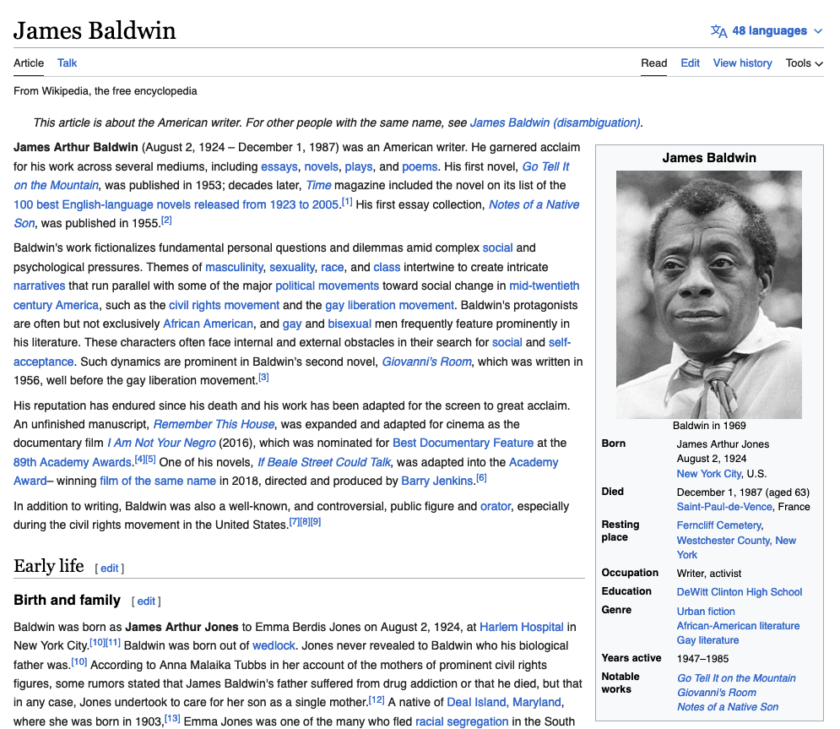
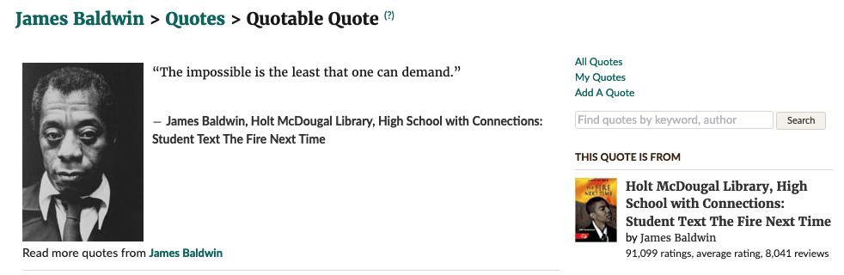
James Baldwin

Slide 3
Today
Reminders/Notes
  If you missed Wednesday, slides are up on course website, and make sure you read the syllabus carefully
  Happy snow day [we’ll make up the time over the next few lectures]
  TQE due next Monday… details next.
Today
  Questions?
  Icebreaker
  Four ways to help activity

Slide 4
TQE

Slide 5
Get up and move time
10 minutes
Fill the entire board! Anyone who does gets 10 bonus points
Each person can initial up to 3 squares

Slide 6
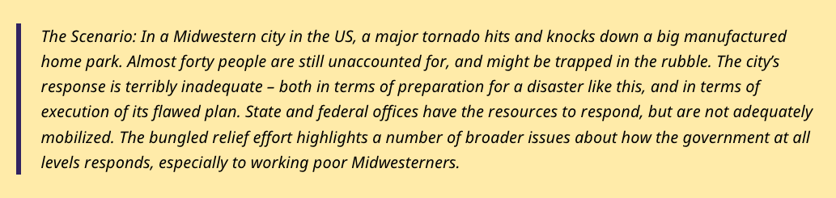
https://www.trainingforchange.org/training_tools/tornado-warning-four-roles-of-social-change/

Slide 7
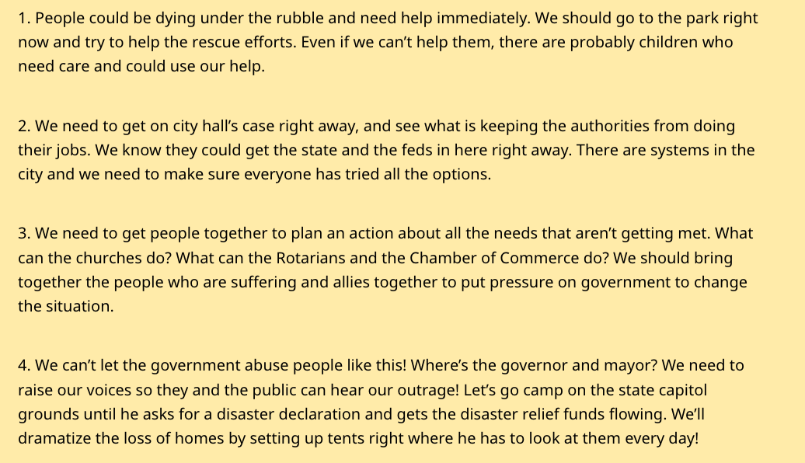

Slide 8

Uncomfortable discussions…
Disagree with what someone SAID NOT who you think they ARE

Slide 9
Your task
Choose a corner of the room
With others in that corner, discuss and answer [3 different people, if possible] the following:
  Why did you pick this corner?
  Why didn’t you pick the other corners?

Slide 10
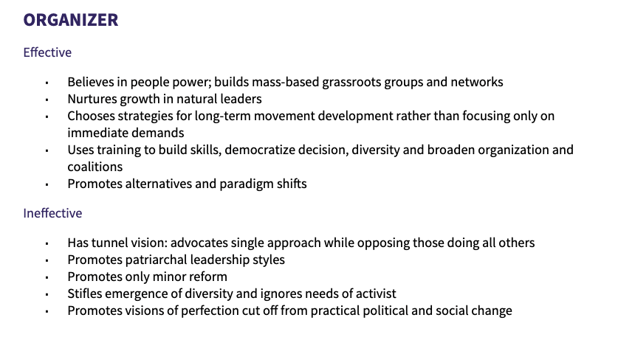
https://show.pics.io/preview/6216524c711cbf00123fbffb

Slide 11
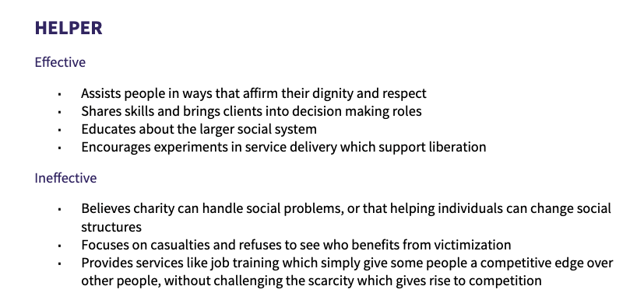
https://show.pics.io/preview/6216524c711cbf00123fbffb

Slide 12
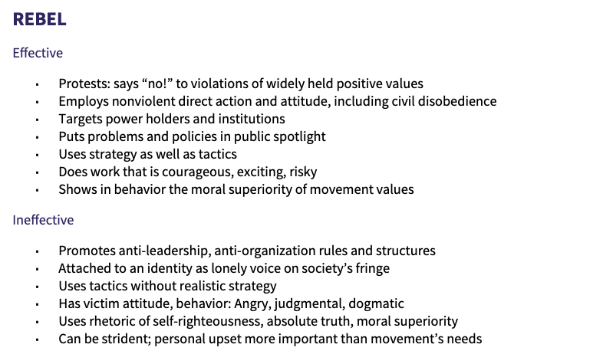
https://show.pics.io/preview/6216524c711cbf00123fbffb

Slide 13
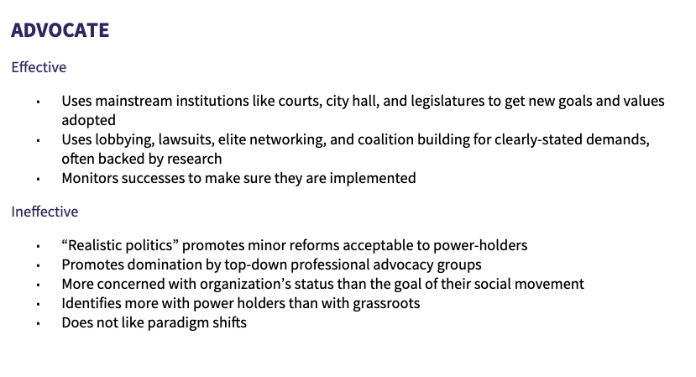
https://show.pics.io/preview/6216524c711cbf00123fbffb

Slide 14
Argue for why a different corner is important for social change

Slide 15
Which corner is your semester-long project in?

Slide 16
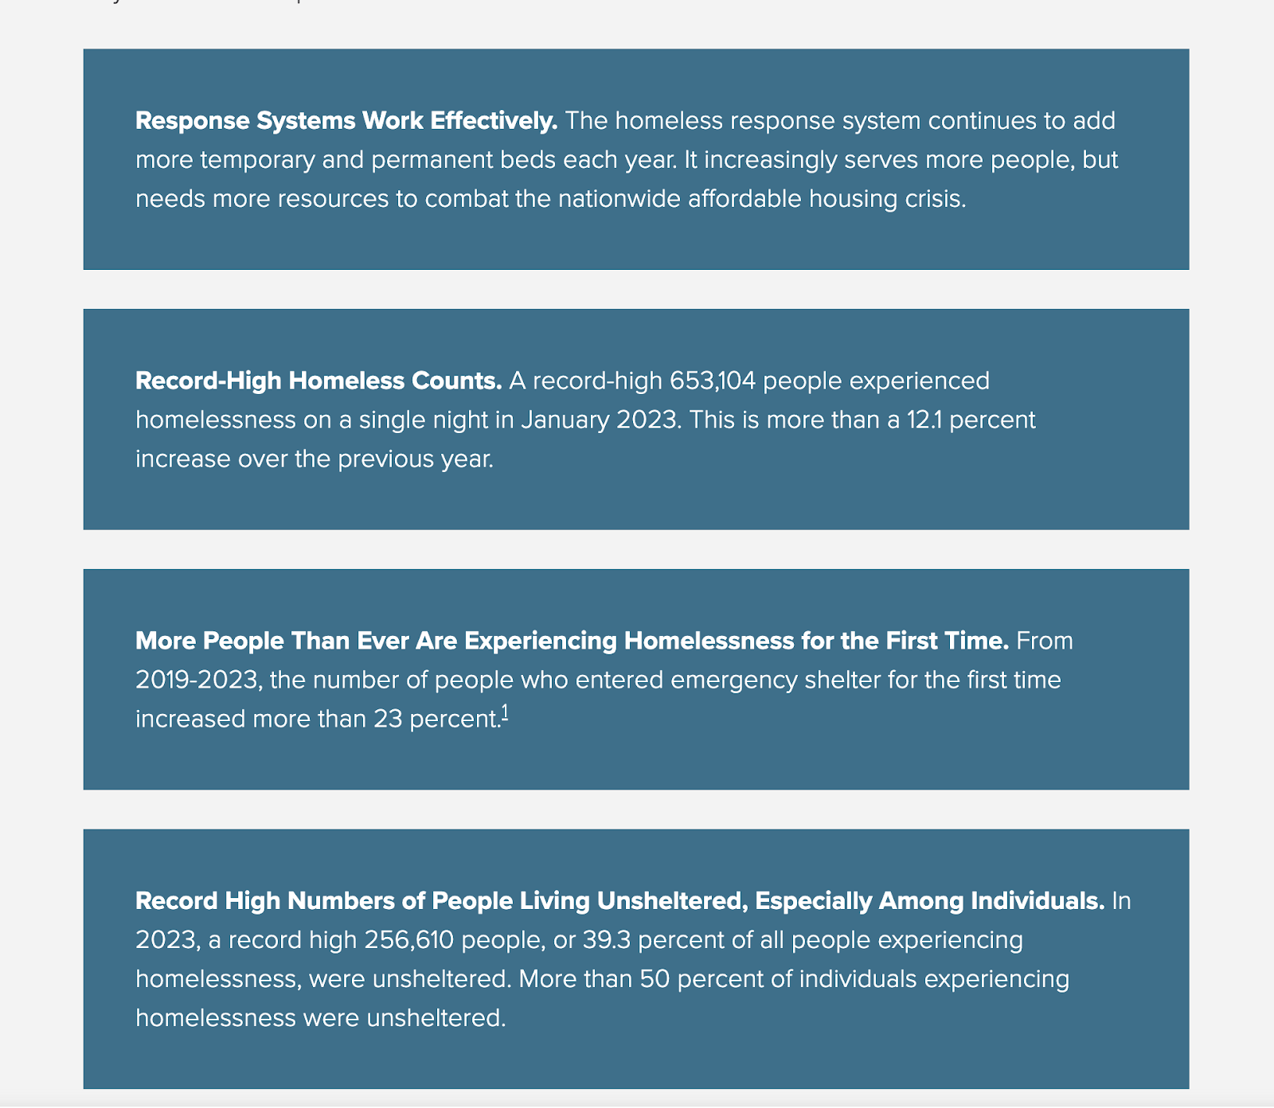
https://endhomelessness.org/homelessness-in-america/homelessness-statistics/state-of-homelessness/

Slide 17
