Slide 1
Discussion follow-up, Intro to GenAI
Kenneth (Kenny) Joseph

Slide 2
Attendance
Maria Rodriguez

Slide 3
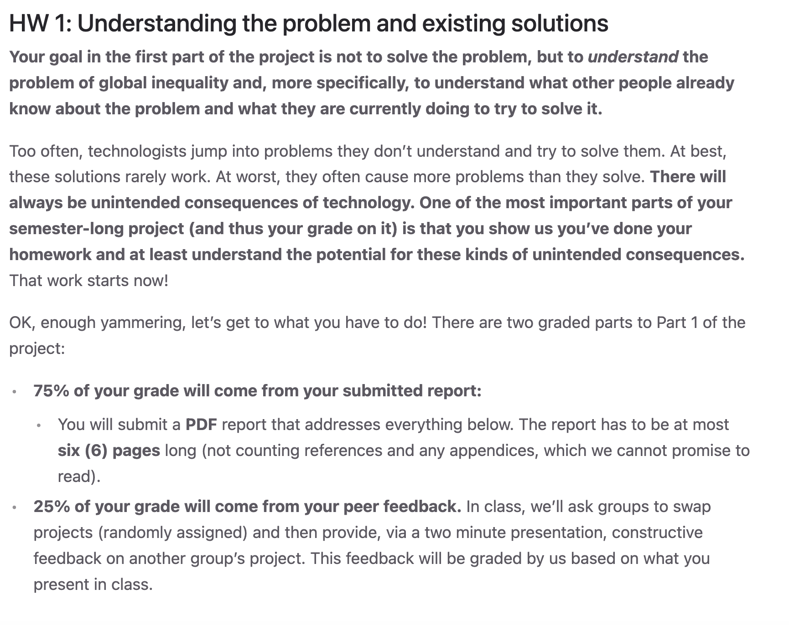
Project groups created / HW 1 Up
Check your email for the composition of your group
Group HW 1 due on Tues, Feb 17
Submission will open some time next week

Slide 4
Today
Project 1 Discussion / What is community
(Mostly) Project-related Discussion 1 Follow up
Break
Intro to GenAI
Break ~7 minutes early to find your team and make a plan

Slide 5
Why and how to (not) read/find academic papers?
How to find
  Google Scholar
  Open Scholar (neat! From last week!)
How to not find
  Pick the first paper you see
  What makes a good paper to read?
How to not read
  Just copy/paste a summary (reminder of the academic integrity policy)
  Just skim the introduction
How to read
  Settle in, find the good stuff, and enjoy ☺

Slide 6
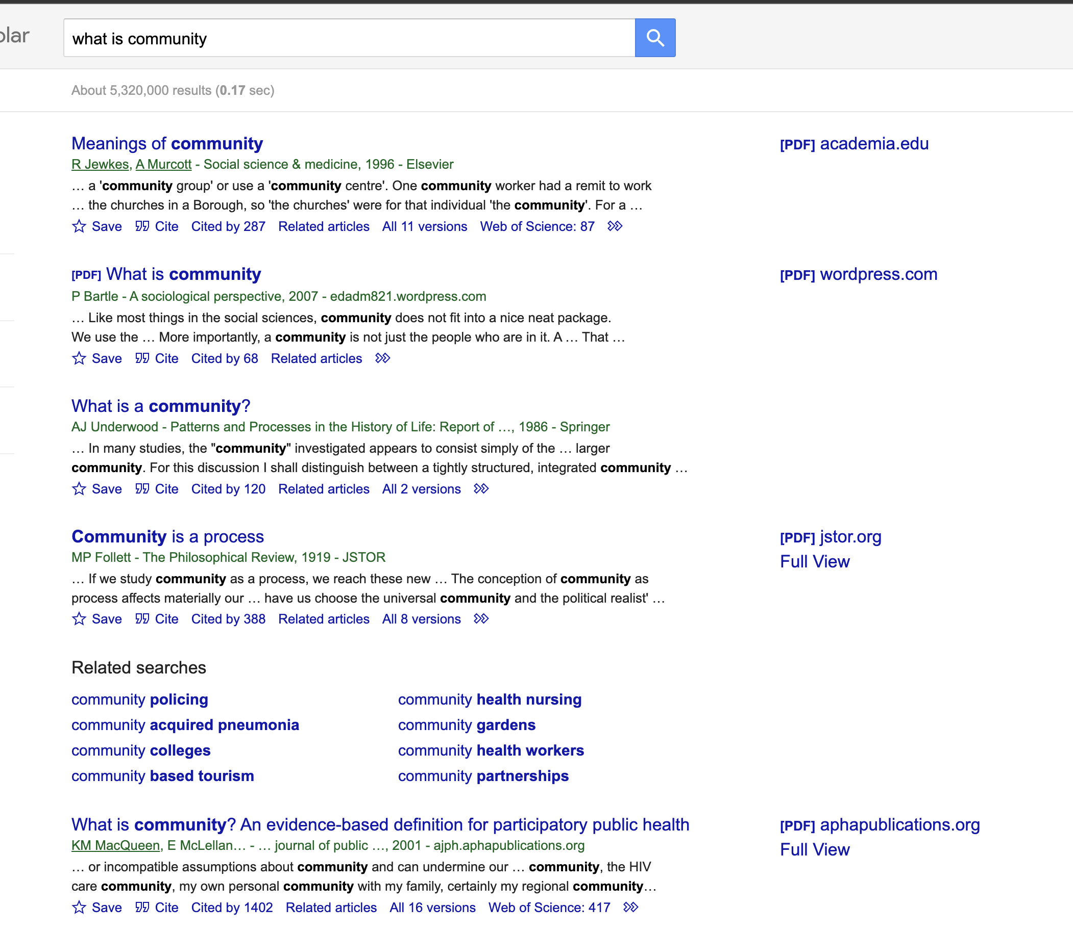
An example

Slide 7
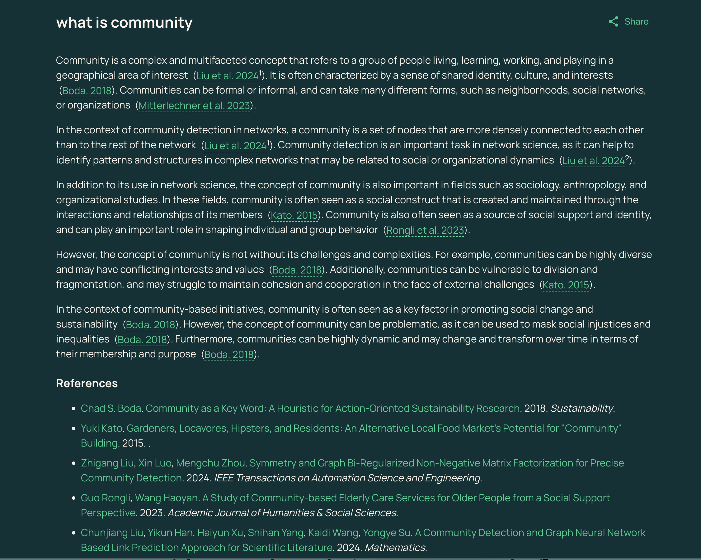
An example

Slide 8
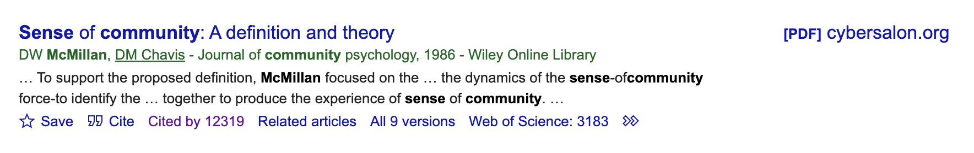
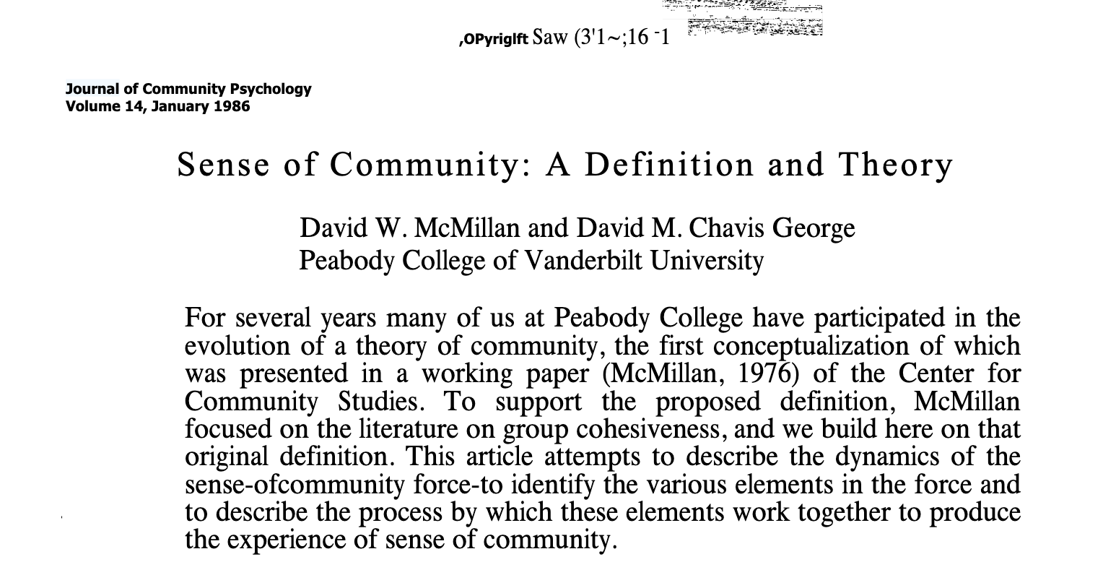
Membership is … a feeling of belonging, of being apart (Backman & Secord, 1959). Membership has boundaries; this means that there are people who belong and people who do not.

Slide 9
Other project questions?

Slide 10
(Mostly) Project-related Discussion 1 Follow-up
Short/Medium/Long-term thinking for your project
  Connections to “zooming in and out” while maintaining a common thread
Getting specific on definitions, goals
Some project gotchas to look out for
Two less project-related things. Assumptions about
  The “who”
  The importance of AI

Slide 11
Short, Medium, and Long-term
Are temporary short term solutions that actually work bad?
  Not necessarily. Band-aids work, for a while!
But eventually we need to tackle the hard stuff
Doing so requires pushing beyond what is “realistic”
  What do I mean by that?

Slide 12
Short, Medium, Long-Term
We’ll ask you to do all of these in your project
By “short term” … within 2-3 years (roughly)
By “medium term” … within a decade (roughly)
By “long term” …open-ended
To determine, ask yourself:
  How does change happen?
  What is stopping this change?
    Or, who is stopping this change, and what are their incentives for doing so?
  How long will it take to overcome those barriers?

Slide 13
Short, Medium, and Long-Term
Example: sexist speech on social media…
  Short term solution?
  Medium term?
  Long-term?

Slide 14
Zooming in and Zooming out
Short term solutions likely solve narrow problems
  Can you relate this back to the previous example?
Long term solutions solve big problems
  What does “big” mean?
Your project needs both
But they need to be connected…

Slide 15
…with a common thread
Bad project: “We solved sexist speech by implementing an AI algorithm for the short term and then eliminating gendered differences in access to capital”
Better project: “We implemented an AI to stop sexist speech on existing platforms, which informed a new social media platform that we build to improve access to capital, which …”
What is the difference?

Slide 16
Getting Specific - Definitions
What is a relationship?
  Is a connection with Replika a relationship? Why or why not?
What is a community?
  Is a subreddit a community? Why or why not?
  Do we need better relationships to build better communities?
Until you answer these (and related), it’s unlikely you’ll be able to build much
Your answers should not just be, as the youths say, vibes. People have thought about this stuff!

Slide 17
Getting Specific – Goals
So you changed policy. What now?
What was the goal of this policy change?
How do you know whether or not it worked?

Slide 18
Project gotchas
If you are going to focus (only) on education, be prepared for me to ask you the following:
  What evidence do you have that changing early education impacts adult behavior?
  How will you address the fact that these things you want to teach aren’t being taught now?
  Why not make change now, instead of hoping for change in the future through education?
If you are assuming you can change policy, you need to go look at how policy has been changed in the past
  A core component of this is organizing

Slide 19
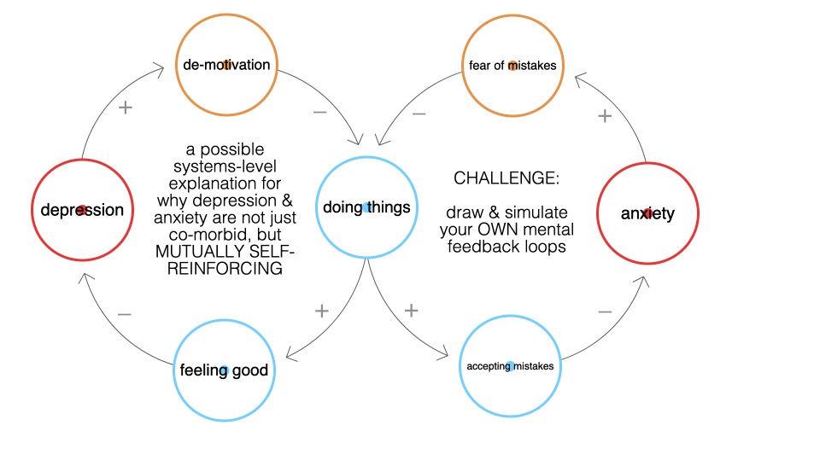
Project gotchas (cont.)
You should make sure you’re accounting for feedback effects and unintended consequences/side effects
Feedback effects – sociotechnical systems are complex systems, in that a small or linear change in one thing might have drastic or non-linear impacts on other things via feedback processes

Slide 20
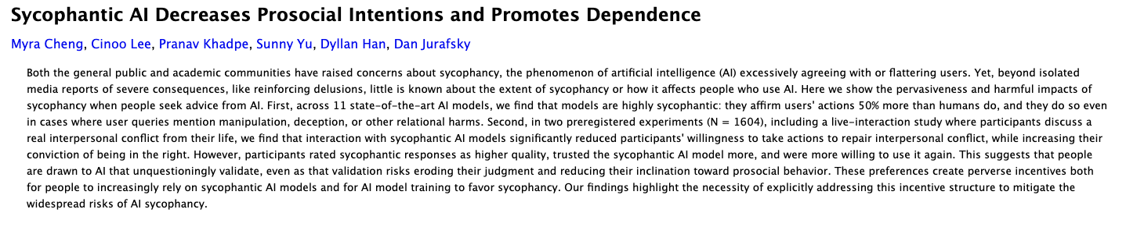
Project gotchas (cont.)
My favorite example of an unintended consequence/side effect from Monday:
https://arxiv.org/abs/2510.01395

Slide 21
(Mostly) Project-related Discussion 1 Follow-up
Short/Medium/Long-term thinking for your project
  Connections to “zooming in and out” while maintaining a common thread
Getting specific on definitions, goals
Some project gotchas to look out for
Two non-project-related things
  Assumptions about the “who”
  Assumptions about the importance of AI

Slide 22
Who gets to decide…
What a Turkish AI looks like/does?
What counts as a fix?
When everything has been fixed?
Who gets banned from AI use, and how?
We’ll touch on this in Discussion 3 and later in the semester, but keep it in mind

Slide 23
And, who should be blamed for societal ills?
Broadly, this question is the structure/agency debate
Who should we blame, e.g., for the dead of a child who uses character.ai?
  The child?
  Their parents?
  Character.ai?
  Regulators?
  The child’s bully at school?
  …
Does it even matter who we blame?

Slide 24
What about AI, does AI matter?
Is AI that much better or worse than…
  A piece of paper?
  An uninterested friend?
  A racist person-made policy?
Is AI actually going to change much?

Slide 25

The STS/Media Studies Lens on this
Science and Technology Studies (STS) and Media Studies have asked this question for a long time
Tech shapes people
People shape tech
Constructivism / Social Construction of Technology
Technological Determinism

Slide 26
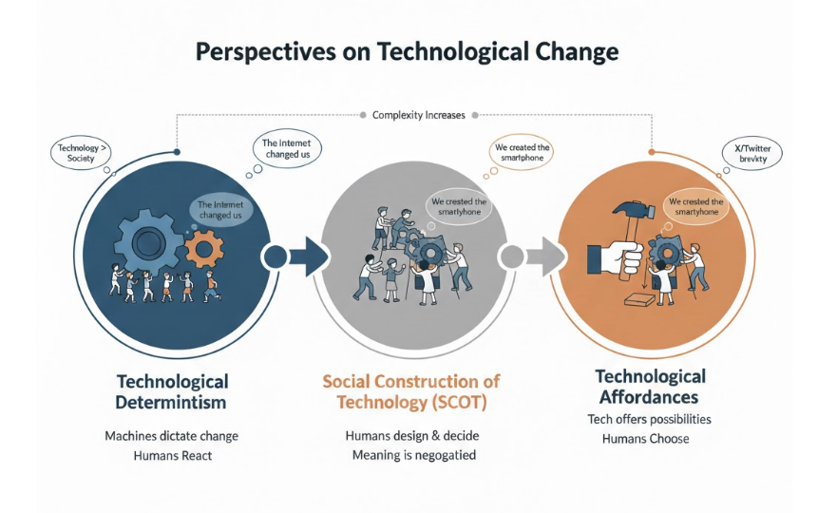
The STS/Media Studies Lens on this
Science and Technology Studies (STS) and Media Studies have asked this question for a long time
(bummer)

Slide 27
Today
(Mostly) Project-related Discussion 1 Follow up
Break
Intro to GenAI
Break ~7 minutes early to find your team and make a plan

Slide 28
Brain Break
What is one movie you’d recommend that has some kind of AI-related theme (can be tangential)?

Slide 29
Today’s one thing
Throughout the generative AI pipeline, there are many places where we make decisions, implicitly and explicitly, about who, what, and when we are optimizing for.

Slide 30
Follow-ups to that
There is no technology or AI model that does not need to make such decisions.
Where are those decision points and how can we do better?

Slide 31
How does ChatGPT work?
What do you think?

Slide 32
Today – the sociocultural part
Where do we get data?
  Where we used to get it -> where we get it now
How do we evaluate the quality of our model?
If time… some bonus topics
  Explanation
  Emotion recognition
Goal: Jumpstart you on ways of thinking about how AI is (in)adequate for particular ways of solving global inequality

Slide 33
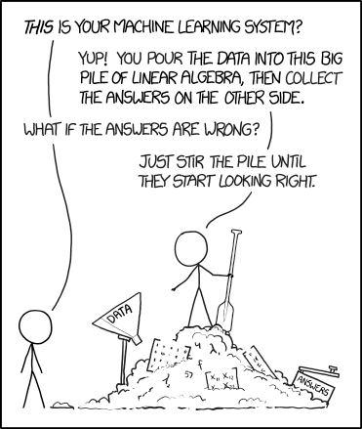
https://xkcd.com/1838/

Slide 34
A not-too-over-simplified definition of LLMs
Find as much data as you can
Find as many computers as you can
Use those computers to build a program that can predict the next word in a document, given all previous words.
If desired, add some additional stuff on top (like what?)
Rinse and repeat until the model is “good”

Slide 35
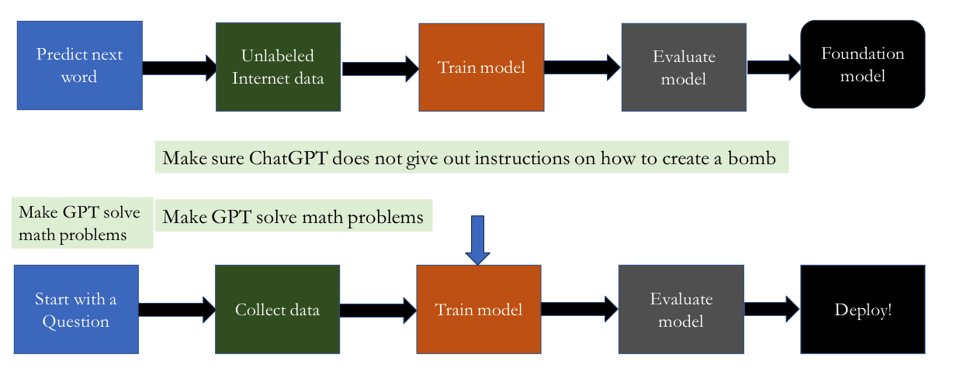
The [new] [simplified] ML pipeline

Slide 36
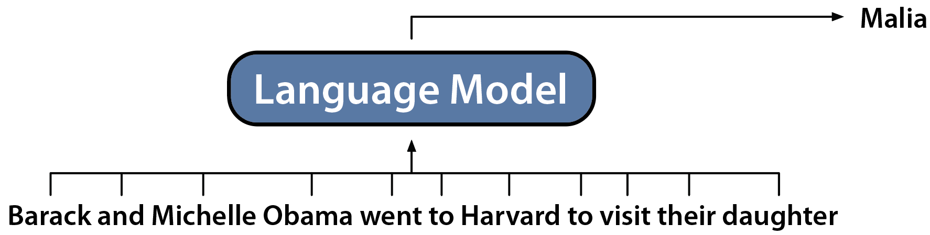
1 slide summary: Generative Language Models
Generative Language Models: Generate the Next Token
Slide by: Dan Fu

