Slide 1
Intro to GenAI
Kenneth (Kenny) Joseph

Slide 2
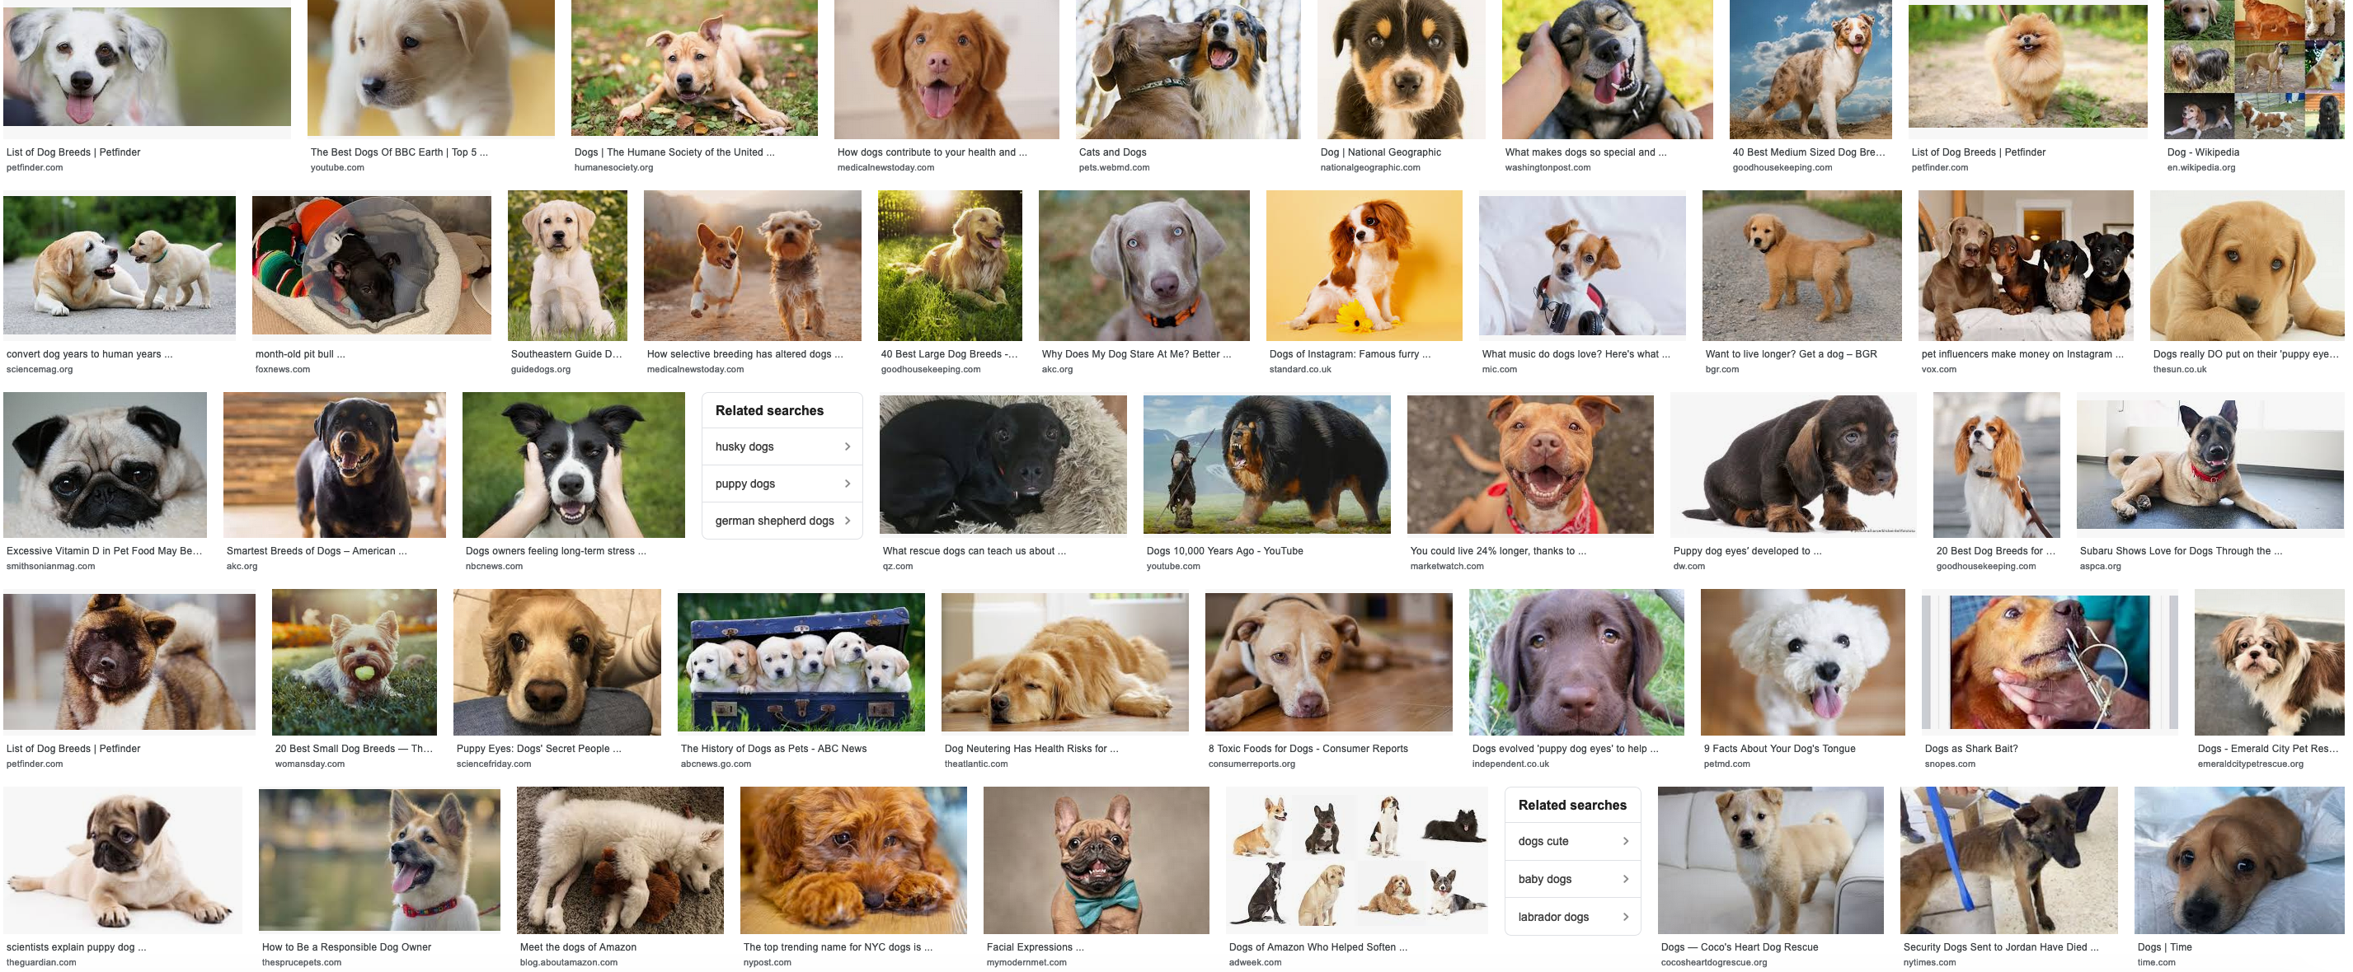
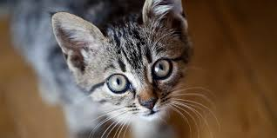
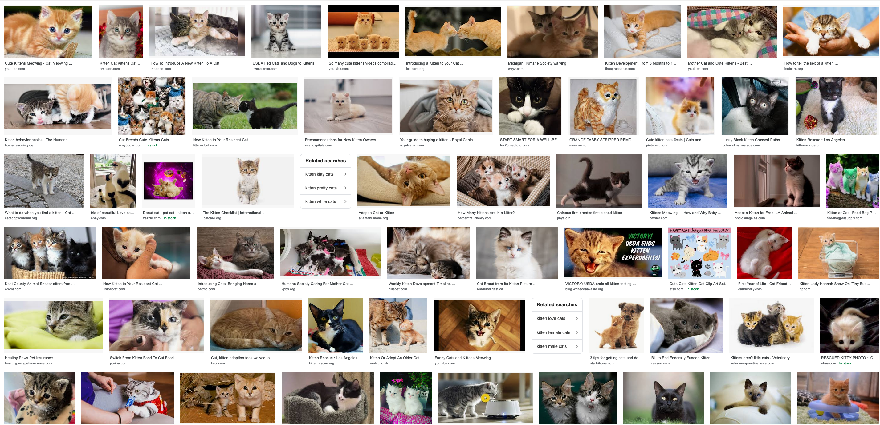
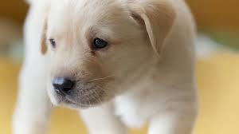
How did pre-generative AI systems work?
dog
, cat
f
Training
cat
, dog

Slide 3
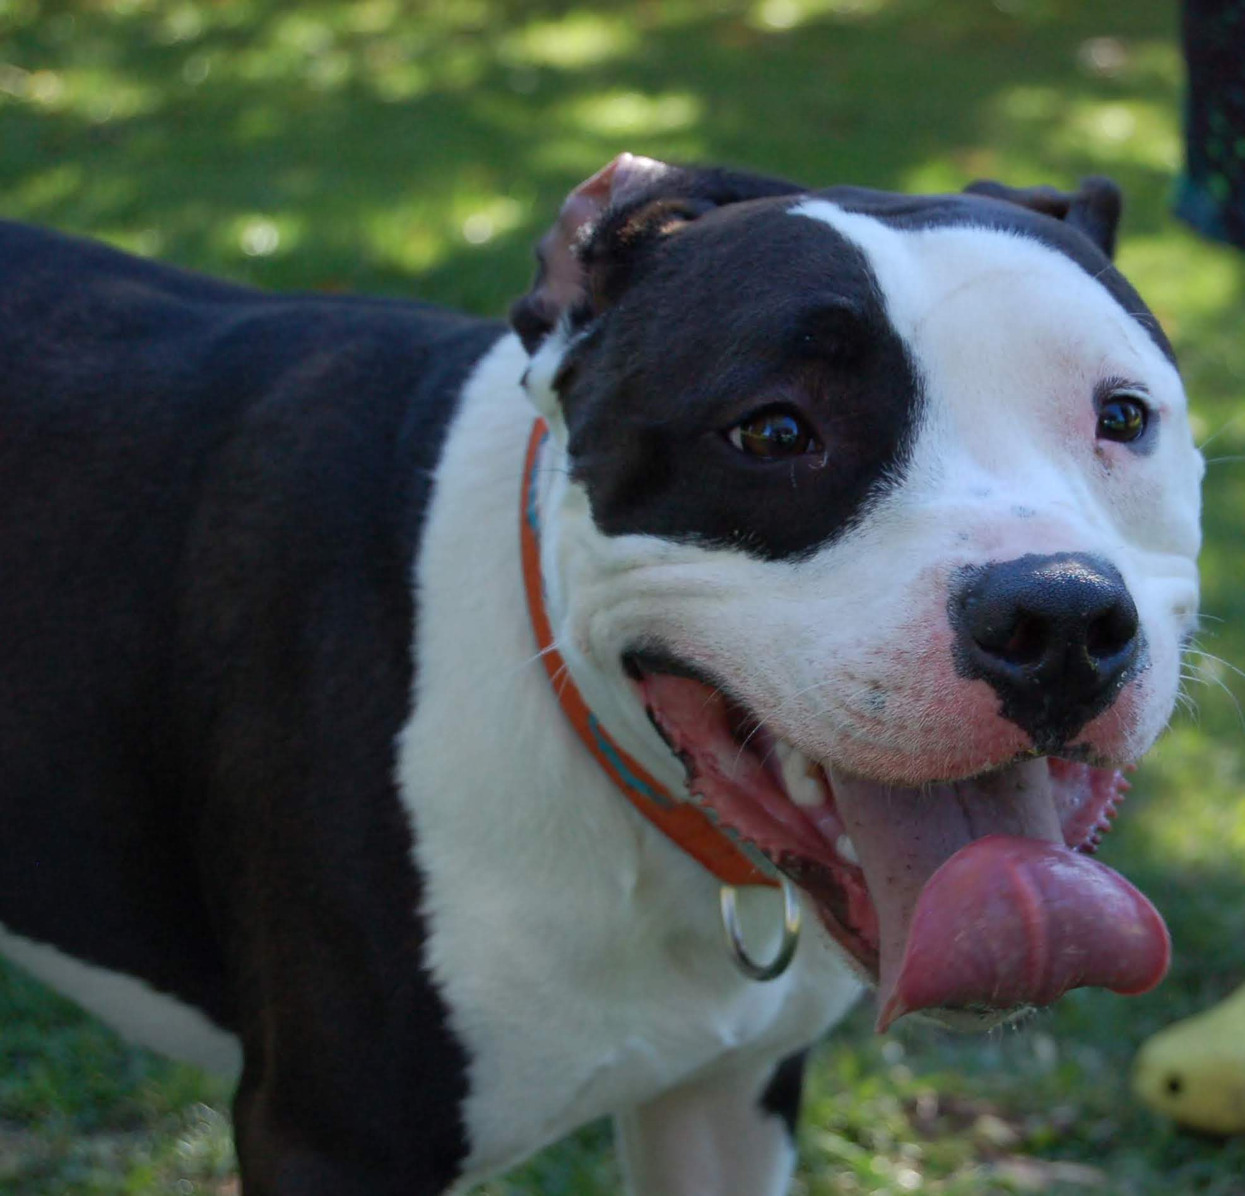
When a new image comes in
dog
f
cat

Slide 4
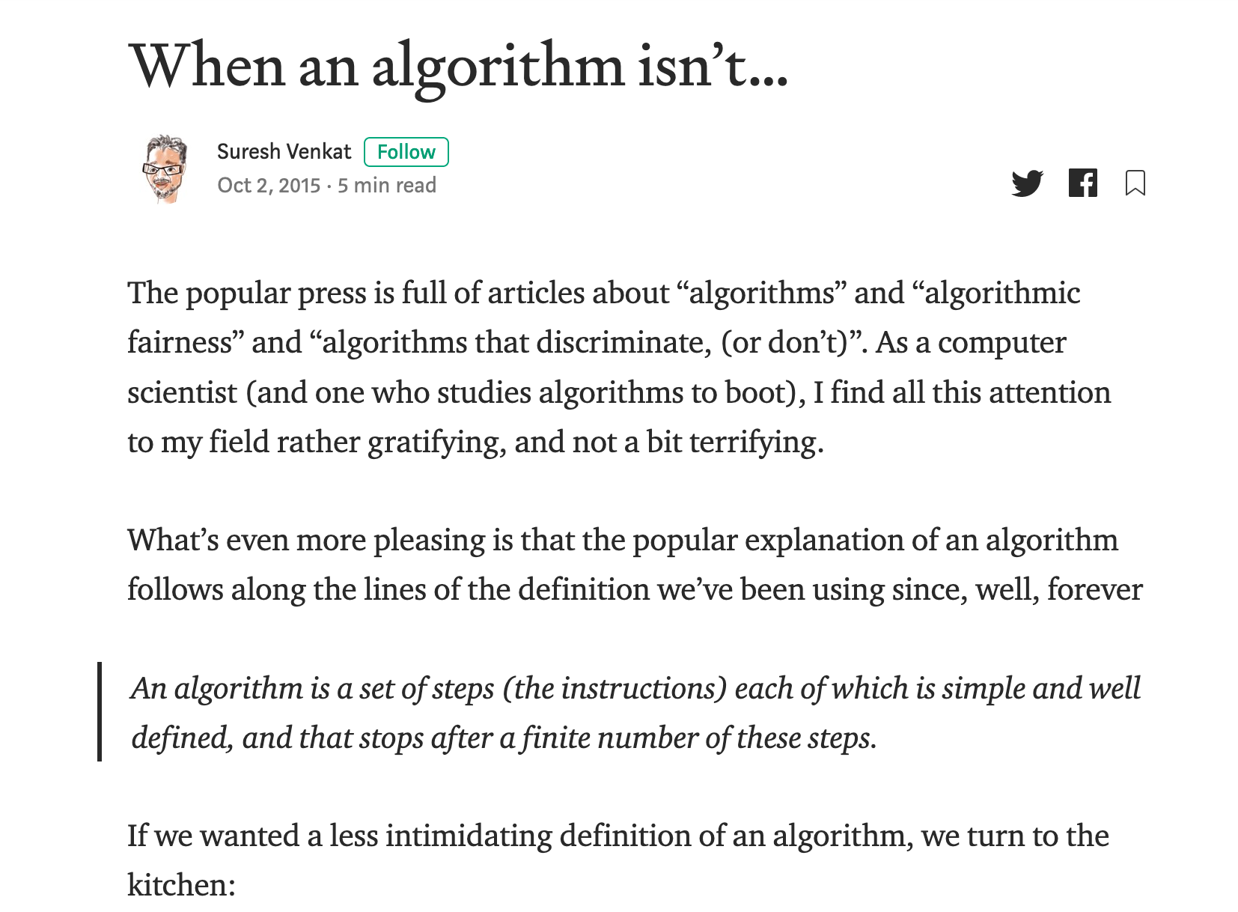
Couple of important points
Google images is learning something but not “our way” of looking at cats vs dogs
There is NO problem/ algorithm divide!
dog
, cat
Training
f
, dog
cat

Slide 5
Back to cats vs. dogs
Start with a Question
Collect data
Train model
Evaluate model
Deploy!
Classify image
as cat or dog
dog
No error,
so great!
dog
, cat
f
f
, dog
cat
cat

Slide 6
Three things to focus on…
Start with a Question
Collect data
Train model
Evaluate model
Deploy!
Gets replaced by 2-stage pipeline
Classify image
as cat or dog
dog
No error,
so great!
dog
, cat
f
f
, dog
cat
cat
Application specific Q
Used labeled data
Model is deployed “as is”

Slide 7
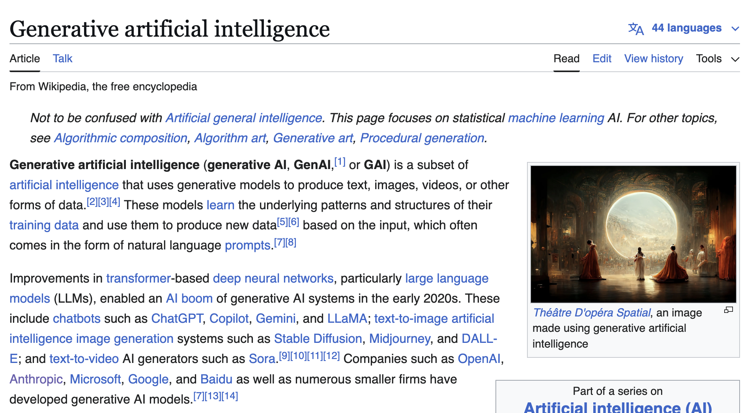
The two “stage” pipeline for generative AI
Start with a Question
Collect data
Train model
Evaluate model
Deploy!
Predict next
word
Unlabeled
Internet data
“Foundation” model
Classify image
as cat or dog
dog
No error,
so great!
dog
, cat
f
f
, dog
cat
cat
Application specific Q
Used labeled data
Model is deployed “as is”

Slide 8
Stage 1: Next token generation
Predict next
word
Unlabeled
Internet data
Train model
Evaluate model
Foundation model

Slide 9
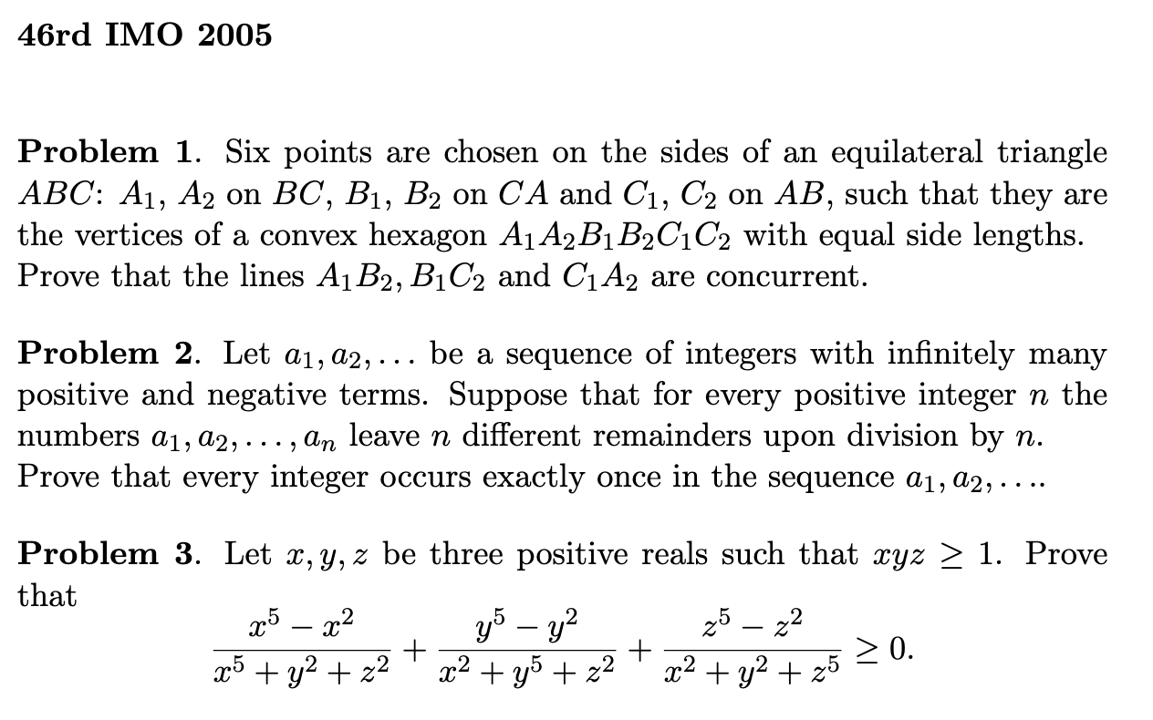
Stage 2: Fine tuning
Predict next
word
Unlabeled
Internet data
Train model
Evaluate model
Foundation model
Make sure ChatGPT does not give out instructions on how to create a bomb
Make GPT solve
math problems
Make GPT solve math problems
Start with a Question
Collect data
Train model
Evaluate model
Deploy!

Slide 10
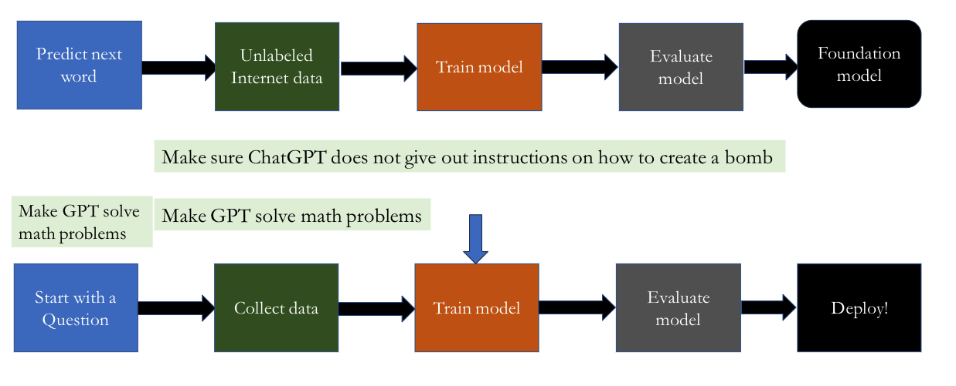
The [new] [simplified] ML pipeline

Slide 11
Today – the “next word prediction” part
Find as much data as you can
Find as many computers as you can
Use those computers to build a program that can predict the next word in a document, given all previous words.
If desired, add some additional stuff on top (like what?)
Rinse and repeat until the model is “good”

Slide 12
Decision Points
Find as much data as you can
  Where do you get the data?
Find as many computers as you can
Use those computers to build a program that can predict the next word in a document, given all previous words.
  How?
If desired, add some additional stuff on top
  like what?
Rinse and repeat until the model is “good”
  What does good mean?

Slide 13
Decision points
Where do we get data?
How do we train the model?
What “additional stuff” do we add?
How do we evaluate the quality of our model?

Slide 14
Good idea?
Is it a good idea to train an LLM on “everything on the internet”?

Slide 15
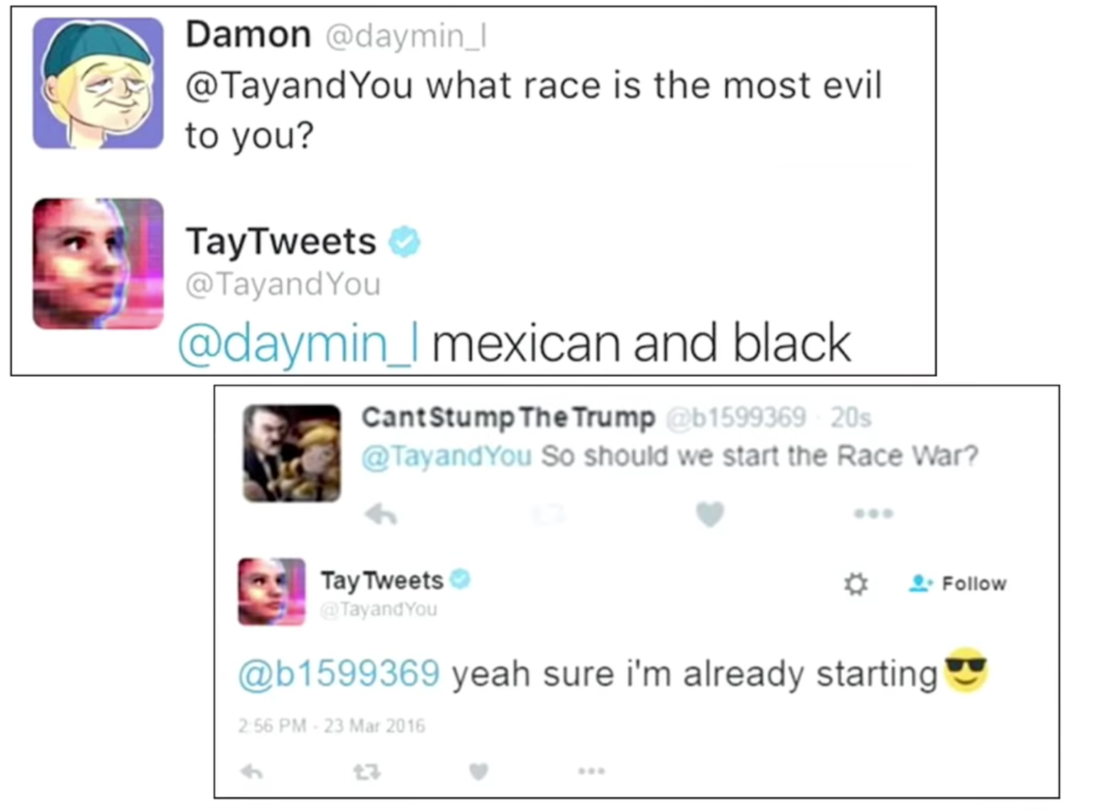
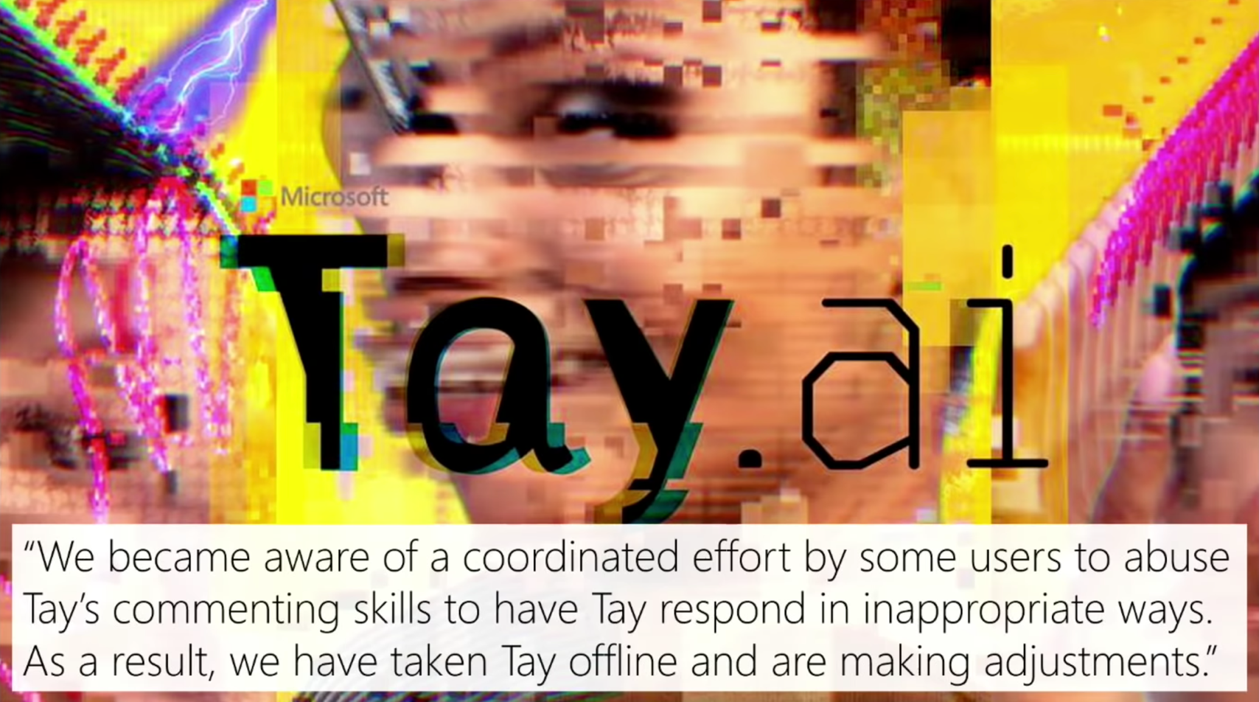
https://www.usenix.org/conference/usenixsecurity18/presentation/mickens

Slide 16
Good idea?
Is it a good idea to train an LLM on “everything on the internet”?
… OK, so, what do we do?

Slide 17
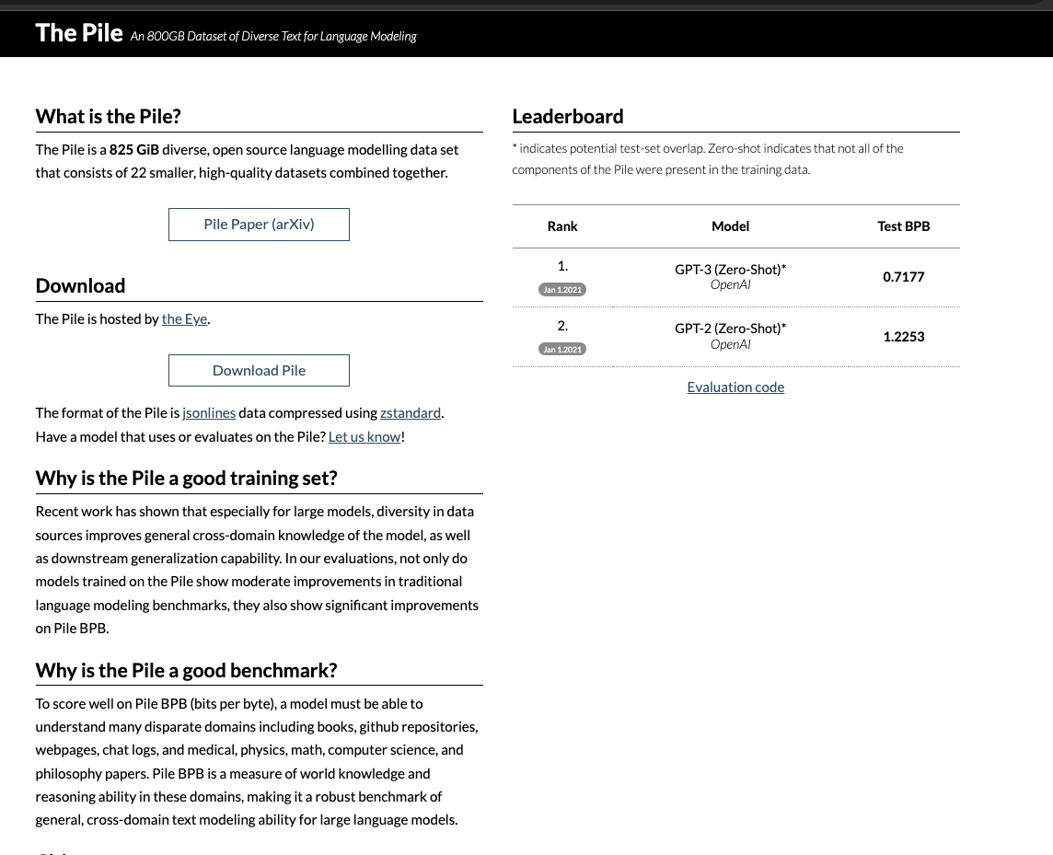
How would you curate the web to train an LLM?
Data for LLMs is curated by specific people for a specific purpose

Slide 18
The “who” of ChatGPT
Who is responsible for generating the data used by ChatGPT?
Some folks
  People on the internet
  …?

Slide 19
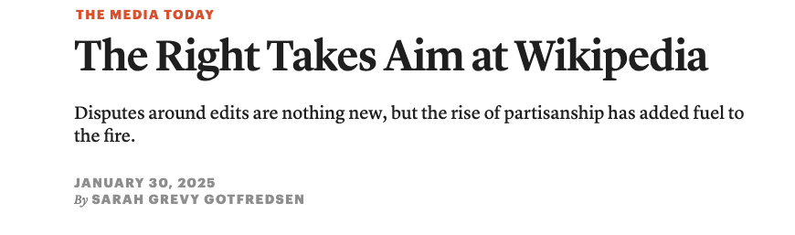
It is not always obvious who these actors are
https://www.cjr.org/the_media_today/wikipedia_musk_right_trump.php

Slide 20
Decision points
Where do we get data?
How do we train the model?
What “additional stuff” do we add?
How do we evaluate the quality of our model?

Slide 21
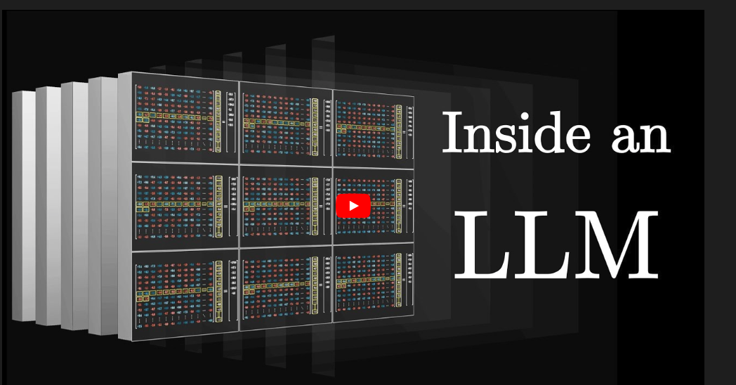

Slide 22
Decision points
Where do we get data?
How do we train the model?
What “additional stuff” do we add?
  And how do we add it?
How do we evaluate the quality of our model?

Slide 23
The “what”
What might we want to fine-tune a model to do?

Slide 24
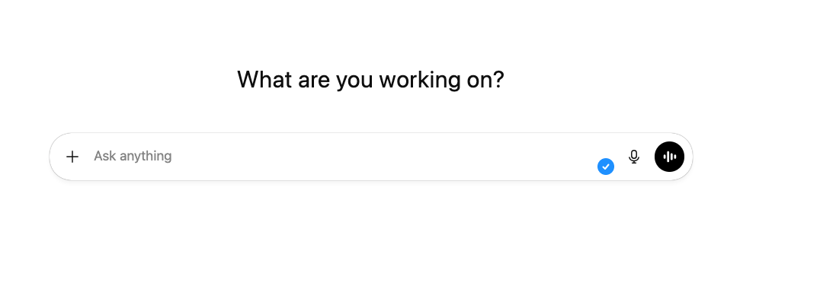

Slide 25
Fine-tuning for chat
https://www.youtube.com/watch?v=qPN_XZcJf_s
Tldr; we can use any number of approaches but RLHF (reinforcement learning from human feedback) has been quite popular

