Slide 1
(Somewhat) Technical AI Details
Kenneth (Kenny) Joseph

Slide 2
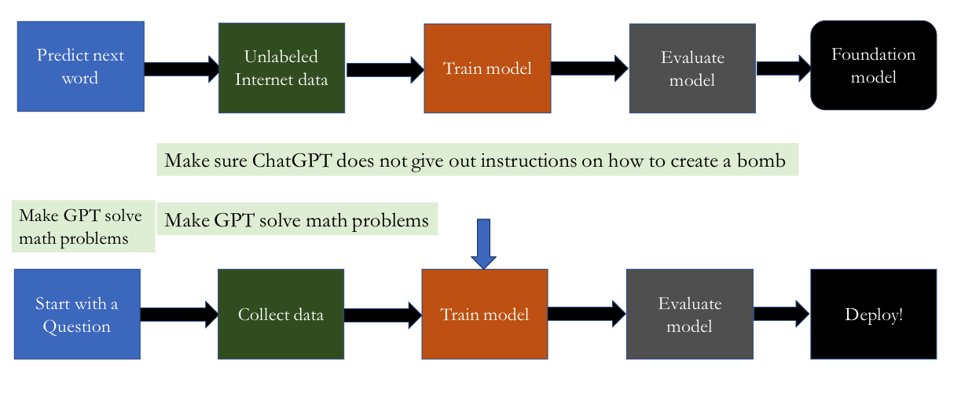
The [new] [simplified] ML pipeline

Slide 3
Returning to “Pipeline 1”
Things we’ve discussed
  What is the task?
  Where does the data come from?
Today, a bit
  How do we train the model?
  How does the model actually make predictions?
  How do we evaluate the model?
  How do we deploy these models?
  I’ll lump these last two in with “Pipeline 2”, since we never really use these models anymore

Slide 4
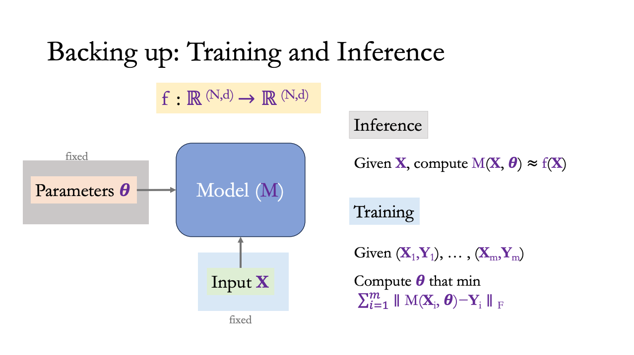
What do we actually try to do when “training a model”
https://colab.research.google.com/drive/1GWKkpW2SlXdFYlvUTpxcOojowHejq5jk?usp=sharing

Slide 5
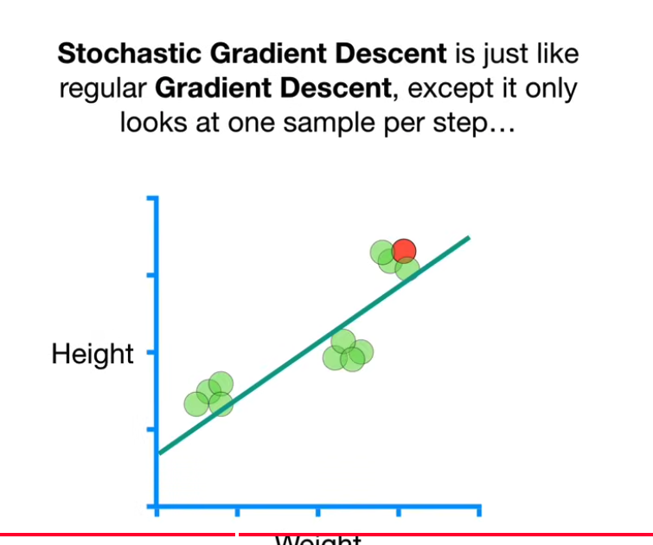
How does training work?
Remember the 3blue1brown “dials” example
  That’s mostly it!
More technically, we use some form of (stochastic) gradient descent
  There’s always a StatsQuest for it…
https://www.youtube.com/watch?v=vMh0zPT0tLI

Slide 6
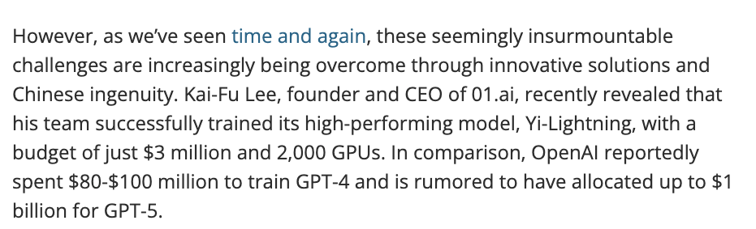
How does training work (cont.)
https://www.techradar.com/pro/openai-spent-usd80m-to-usd100m-training-gpt-4-chinese-firm-claims-it-trained-its-rival-ai-model-for-usd3-million-using-just-2-000-gpus

Slide 7
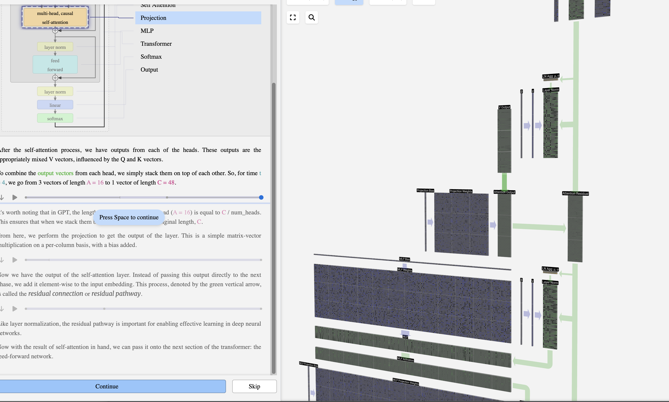
How does the model make predictions?
https://bbycroft.net/llm
Other resources
  https://jalammar.github.io/illustrated-transformer/
  https://nlp.seas.harvard.edu/2018/04/03/attention.html

Slide 8
Returning to “Pipeline 1”
Things we’ve discussed
  What is the task?
  Where does the data come from?
  How do we train the model?
  How does the model actually make predictions?
  How do we evaluate the model?
  How do we deploy these models?

Slide 9
The [new] [simplified] ML pipeline

Slide 10
Returning to “Pipeline 2”
Things we’ve discussed
  Not all “foundation models” are generative!
  And perhaps not even the most useful ones are!
Things we haven’t discussed:
  What do you mean “not all foundation models are generative”?
  Where does the data come from?
  How do we train (“train”) the model?
  How does the model actually make predictions?
  How do we evaluate the model?
  How do we deploy these models?

Slide 11
Not all LLMs are generative
There are many tasks that one might be interested in that don’t require text generation. Can you think of a few?
The details here are geared towards generative models, but there are strong similarities to the other types of LLMs

Slide 12
One high-level typology of LLMs
Architecture | Attention pattern | Generates text? | Training objective | Typical tasks
Encoder-only | Bidirectional self-attention | ❌ No | Masked Language Modeling (MLM): predict randomly masked tokens using full context | Classification, NER, similarity, retrieval
Decoder-only | Causal (left-to-right) self-attention | ✅ Yes | Autoregressive / Next-token prediction: predict token (x_t) given (x_{<t}) | Chat, open-ended generation, code
Encoder–decoder | Encoder: bidirectionalDecoder: causal + cross-attention | ✅ Yes | Conditional language modeling (seq2seq): predict output sequence given full input sequence | Translation, summarization, structured generation
This was quite clearly generated using Chat ☺

Slide 13
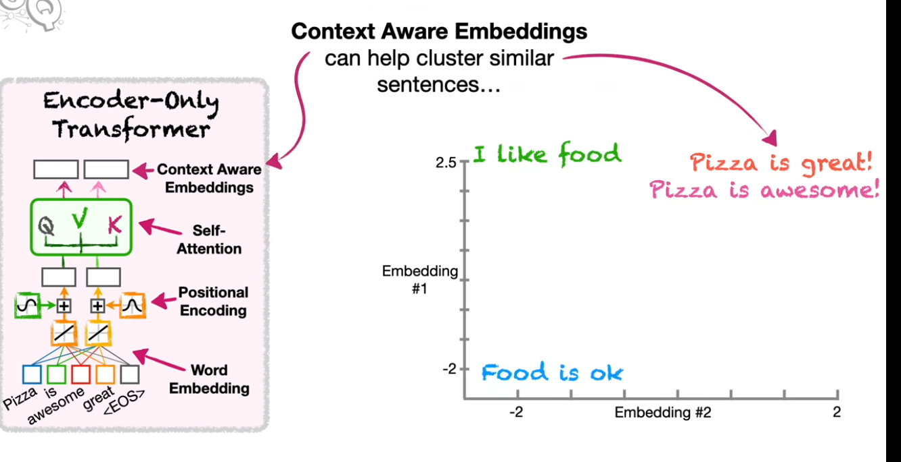
Encoder-only models
https://www.youtube.com/watch?v=GDN649X_acE

Slide 14
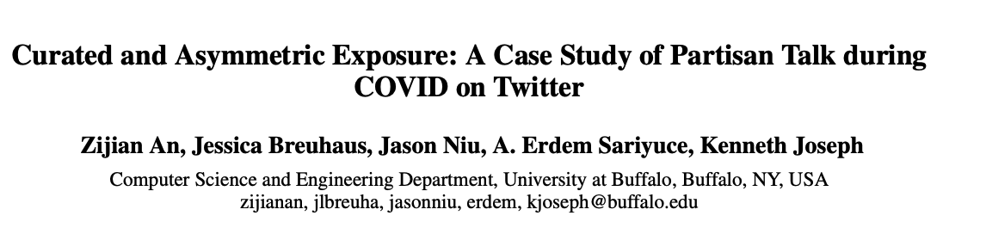
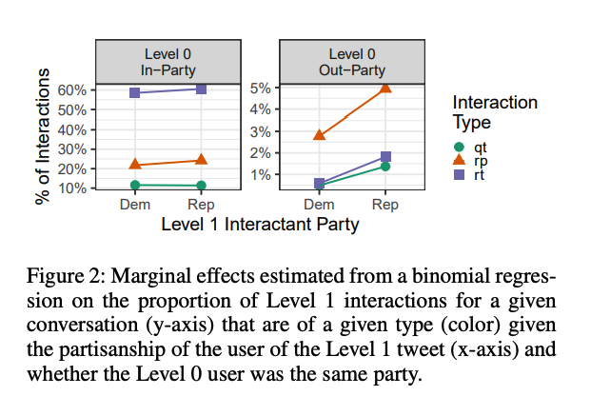
Fine-tuning an encoder-only model

Slide 15
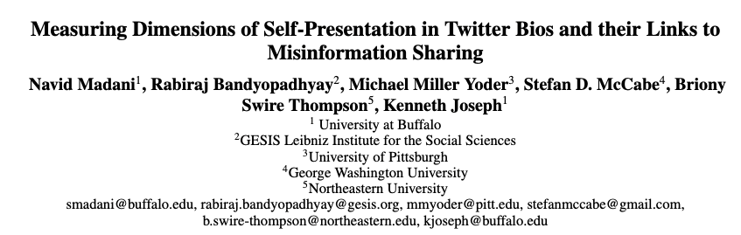
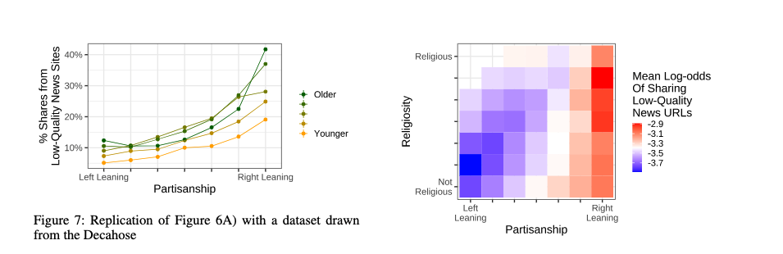
Using encoder-only embeddings

Slide 16
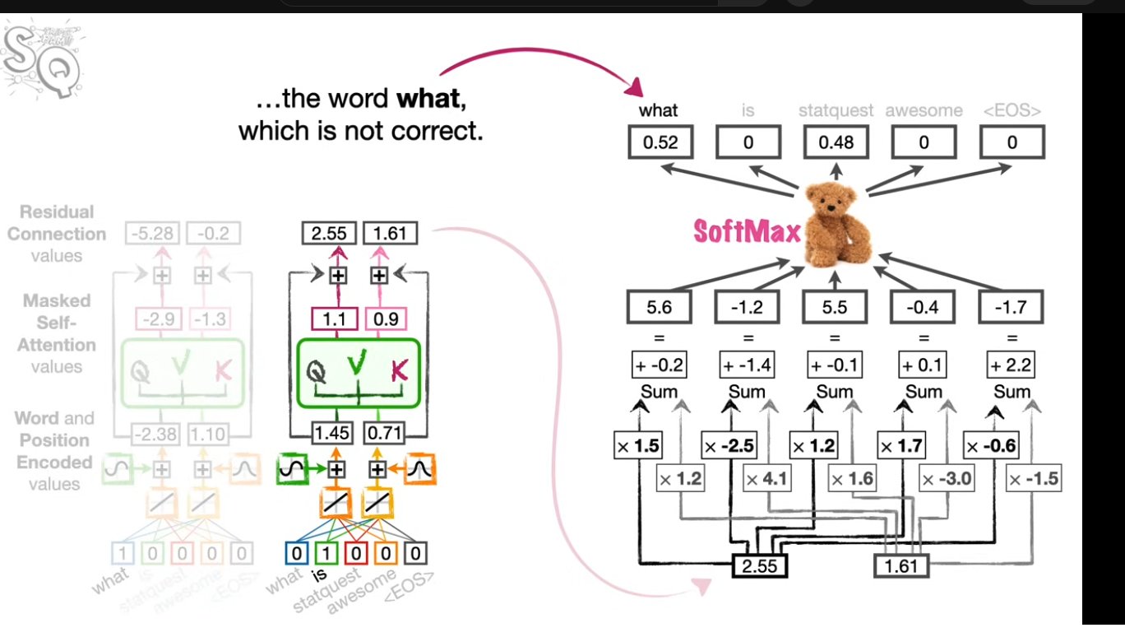
Decoder-only models
https://www.youtube.com/watch?v=bQ5BoolX9Ag&t=10s

Slide 17

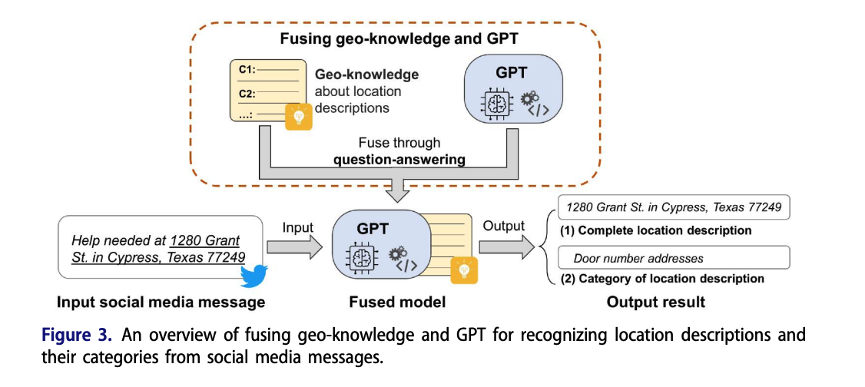
“Finetuning” a decoder-only model

Slide 18
Classification with all kinds of LLMs

Slide 19
Let’s try it!
Is this [text/image] AI-generated or not?

Slide 20
Summary of this tangent
Generation is not the only task, and arguably not the most useful
In any case, to generate well, especially in a chat context, we need to fine-tune
  But in practice, that means a lot of things, from prompt-tuning through full-weight tuning
And to do other things, we almost certainly need to fine-tune
This is another place in which decisions about data enter our model
Now, back to the chat context. What else might we want to do besides fine-tune to be better at chatting?

Slide 21

https://www.anthropic.com/research/constitutional-ai-harmlessness-from-ai-feedback

Slide 22
Guard-rails – Hard Questions
What should the guard-rails be?
Who gets to decide what the guard-rails are?

