Slide 1
(Somewhat) Technical AI Details (cont.)
Kenneth (Kenny) Joseph

Slide 2
Returning to “Pipeline 2”
Things we’ve discussed
  Not all “foundation models” are generative!
  And perhaps not even the most useful ones are!
  What do you mean “not all foundation models are generative”?
  How do we train (“train”) the model?
Things to discuss
  Where does the data come from?
  How do we deploy these models?
  How do we evaluate the model?

Slide 3
Where does “preference” or “fine-tuning” data come from?
Thoughts?

Slide 4
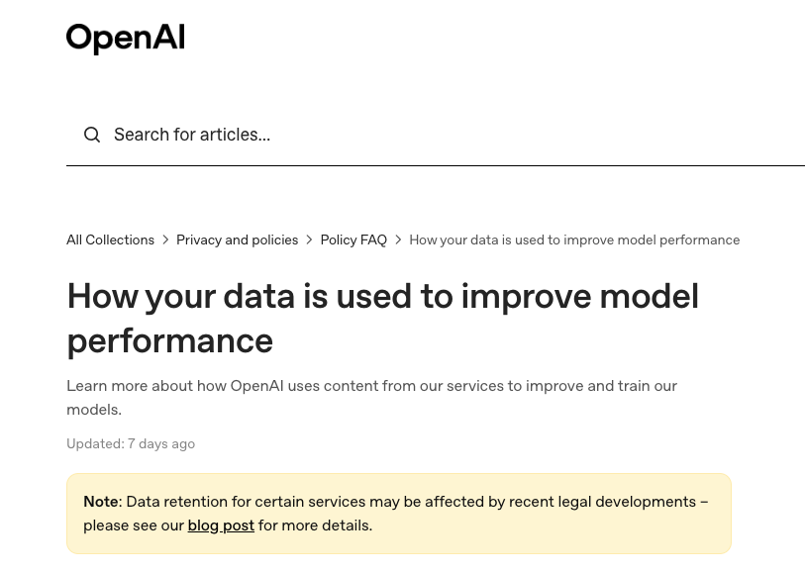
(cont.)

Slide 5
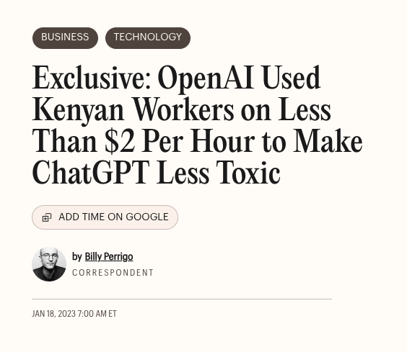
(cont.)
https://time.com/6247678/openai-chatgpt-kenya-workers/

Slide 6
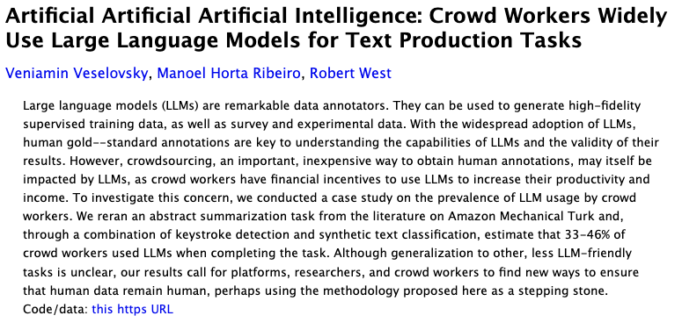
(cont.)
https://arxiv.org/abs/2306.07899

Slide 7
How about deployment
Who remembers how expensive it was to train these models?
What about deployment? Is that the same?!

Slide 8
Zooming back out
Things we’ve discussed
  Pipeline 1 technical details
  Pipeline 2 technical details
  … both of these are optimization machines that predict text (or video, or images) – given a bunch of data and something to optimize, they do their best.
Why give the technical details?
  Not that scary
  Places where your project can think beyond “how do we use chatgpt”?
What’s left
  … how do we know our model is good?
  That’s two questions – what do we want out of our model, and how do we know it achieved it?

Slide 9
What do we want out of our models?
What are we optimizing for?
Who are we optimizing for?
When are we optimizing for?
… your data and your optimization algorithm encode your answers to these questions

Slide 10
Some warm up
What is ChatGPT optimizing for?
Who is ChatGPT optimizing for?
When is ChatGPT optimizing for?

Slide 11
Evaluation is key
What are we optimizing for
Who are we optimizing for
When are we optimizing for
… your data and your optimization algorithm and how you evaluate your work encode your answers to these questions

Slide 12
Evaluation is key
What is ChatGPT optimizing for?
Who is ChatGPT optimizing for?
When is ChatGPT optimizing for?
How is ChatGPT evaluated?

Slide 13
The bigger question…
What does it mean for a model to “work”? Or to “be good”?

Slide 14
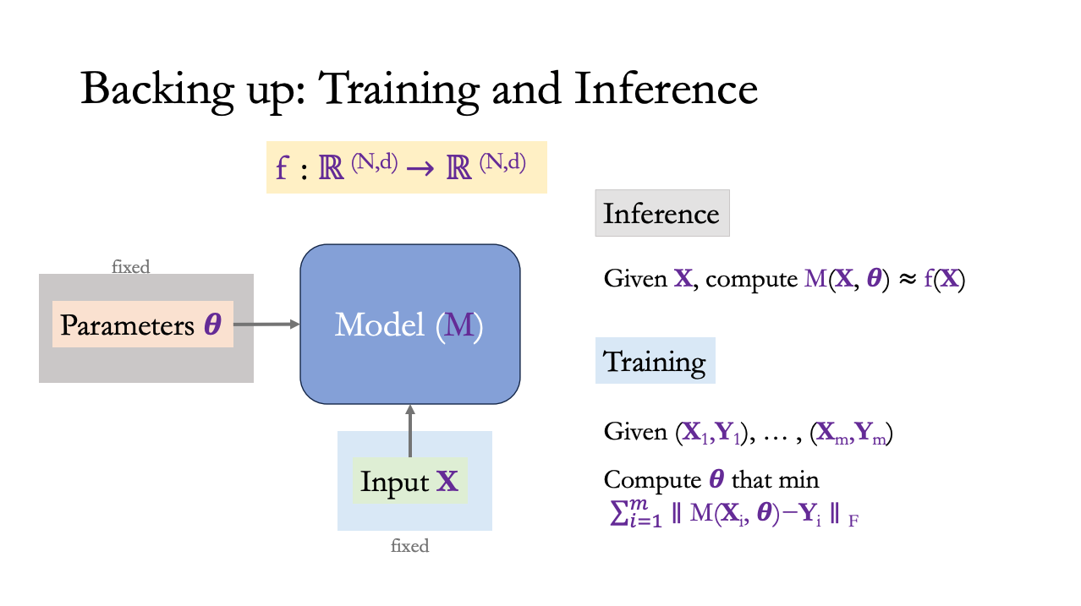
The Technical Answer [sort of]
Any caveats to this technical answer?

Slide 15
What about some non-technical answers [or other technical answers]?

Slide 16
How could we evaluate it differently?
We’re going to give you some tools to think through this throughout the course. Here’s one
https://designjustice.org/read-the-principles
Activity: You will be assigned one principle. Answer two questions
  Do you think ChatGPT as-is encompasses this principle?
    What is one way you might evaluate that (if only partially)?
  If so, why? If not, what could you change to make it that way?

