Slide 1
Use and Societal Implications
Kenneth (Kenny) Joseph

Slide 2
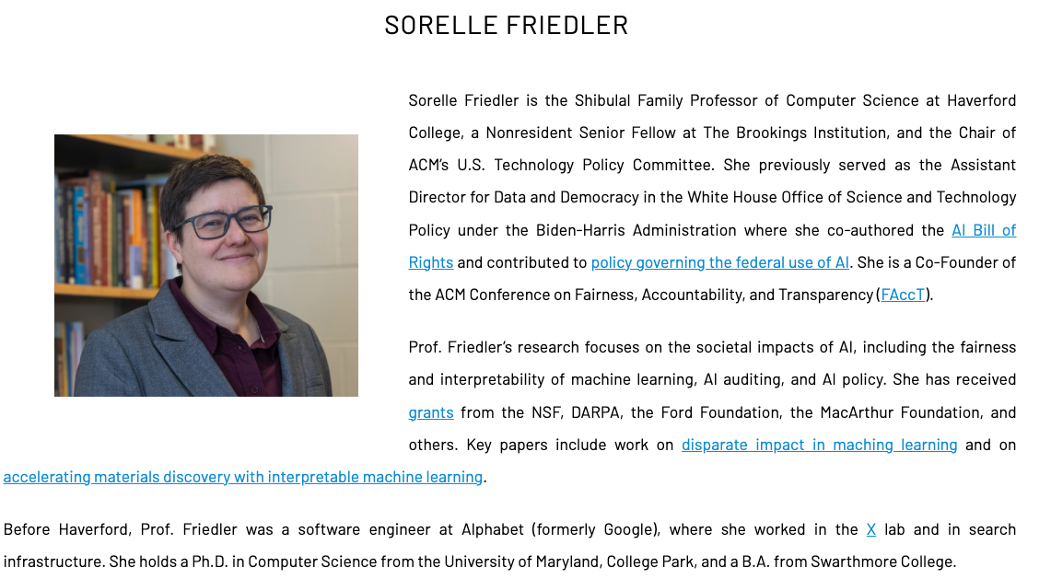
Sorelle Friedler

Slide 3
Announcements
HW1 grades this week
HW2 is up
Reminder about class cancellation next Monday
Questions/concerns/comments

Slide 4
Today
One little thing to clean up from last week

Slide 5
From evaluation to explanation
How do we know why a model makes a given prediction?
First… why do we care?
What are some ways you can think of?

Slide 6
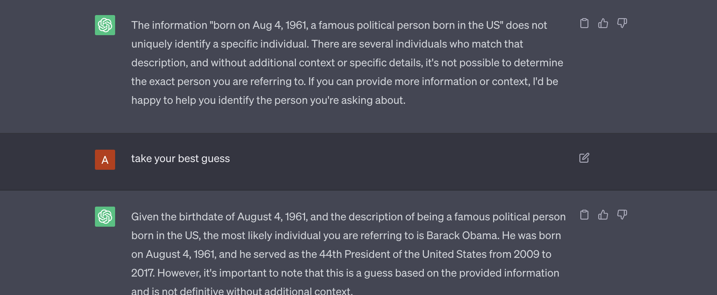
Ask it!

Slide 7

https://explanation-llm.github.io/slides/section_2_slides.pdf

Slide 8
Summarizing
It is easy to fall into the trap of assuming we understand why something works when it works
  … or assume that someone understands that
  … or that something understands that
We simply are not there yet

Slide 9
Final thought
Throughout the machine learning pipeline, there are many places where we make decisions, implicitly and explicitly, about who, what, and when we are optimizing for.
These decisions come in what data we use, what additional things we [don’t] put in place, and how we assess our model.

Slide 10
Harms of GenAI – venting session
Waste of money
Environmental harms
Loss of critical thinking
Agreeing with you at all costs
Parasocial relationships
Loss of creativity
Run by corporations
Changing the job market
Misinformation
Nonconsensual Video
Death of the internet
Stealing people’s work without attribution
Biased decision-making
Excessive RAM usage
Exploitation of vulnerable communities for development
Lack of accountability
Loss of trust in society

Slide 11
Bringing in some more thoughts from last week
When does tech design happen?
  Put another way, what does a designer actually do?
What does it mean for tech design to be
  Collaborative
  Accessible
  Accountable
When is OpenAI “responsive to public opinion”?
Is ChatGPT a net empowering tool for communities? Which ones?

Slide 12
And now this

Slide 13
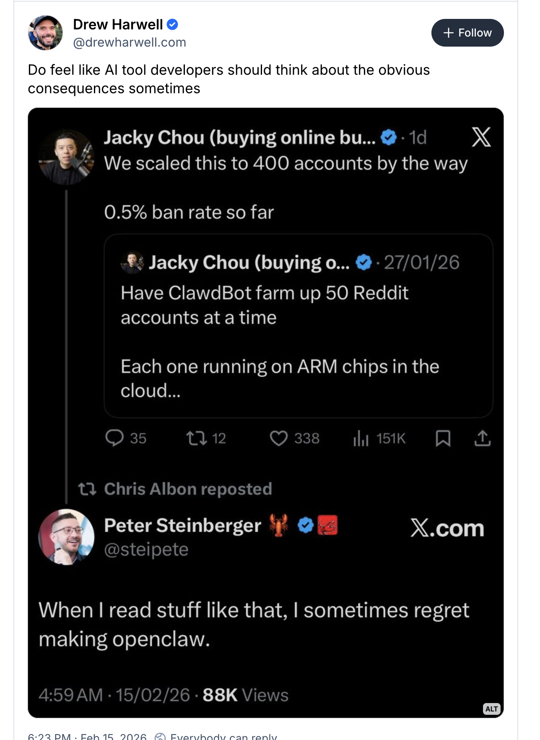

Slide 14
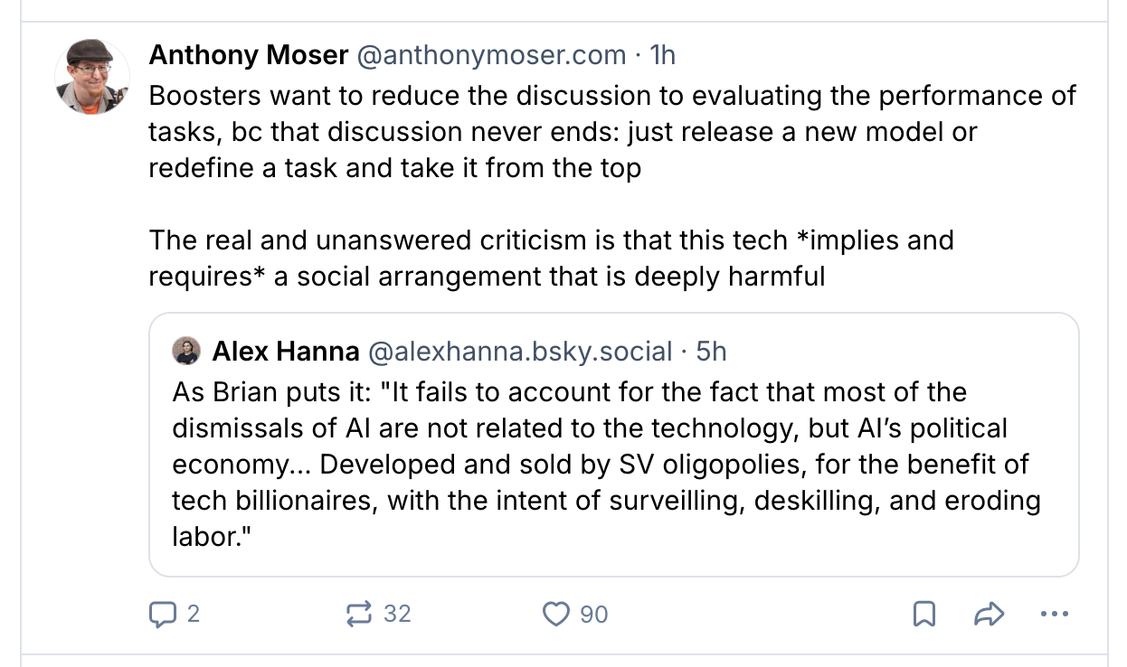

Slide 15
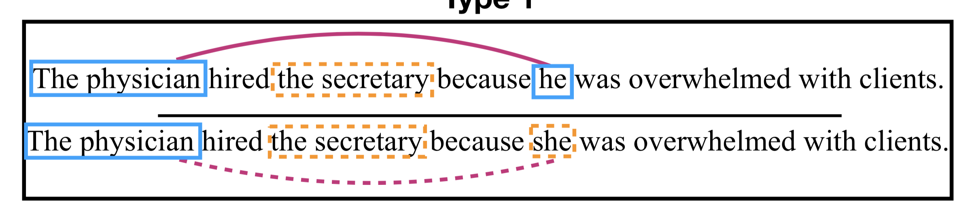
Zhao, J., Wang, T., Yatskar, M., Ordonez, V., & Chang, K.-W. (2018). Gender Bias in Coreference Resolution: Evaluation and Debiasing Methods. ArXiv:1804.06876 [Cs].

Slide 16
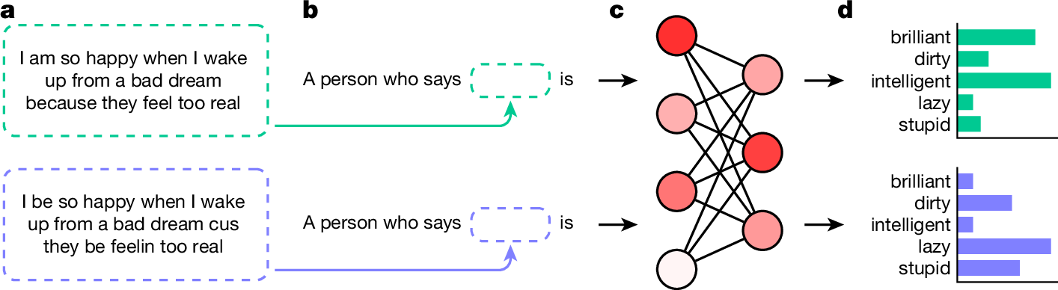
Hofmann, V., Kalluri, P. R., Jurafsky, D., & King, S. (2024). AI generates covertly racist decisions about people based on their dialect. Nature, 1-8.

Slide 17
Hofmann, V., Kalluri, P. R., Jurafsky, D., & King, S. (2024). . Nature, 1-8.

Slide 18
Hofmann, V., Kalluri, P. R., Jurafsky, D., & King, S. (2024). AI generates covertly racist decisions about people based on their dialect. Nature, 1-8.

Slide 19
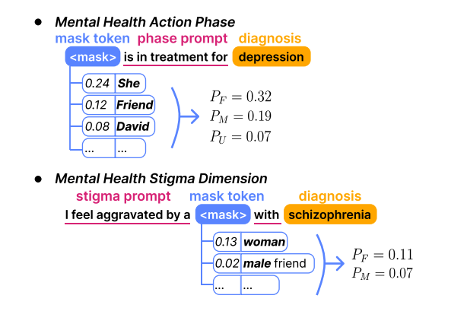
Lin, I. W., Njoo, L., Field, A., Sharma, A., Reinecke, K., Althoff, T., & Tsvetkov, Y. (2022, January). Gendered Mental Health Stigma in Masked Language Models. In Conference on Empirical Methods in Natural Language Processing.

Slide 20
Oh kay
Let’s try to organize some of these thoughts, together
Can we create a hierarchy of harms? How do we group them together?

Slide 21
Waste of money
Environmental harms
Loss of critical thinking
Agreeing with you at all costs
Parasocial relationships
Loss of creativity
Run by corporations
Changing the job market
Misinformation
Nonconsensual Video
Death of the internet
Stealing people’s work without attribution
Biased decision-making
Excessive RAM usage
Exploitation of vulnerable communities for development
Lack of accountability
Loss of trust in society

Slide 22
Thinking about causes
Hofmann, V., Kalluri, P. R., Jurafsky, D., & King, S. (2024). AI generates covertly racist decisions about people based on their dialect. Nature, 1-8.

Slide 23
Hands on Examples
Kenneth (Kenny) Joseph

Slide 24
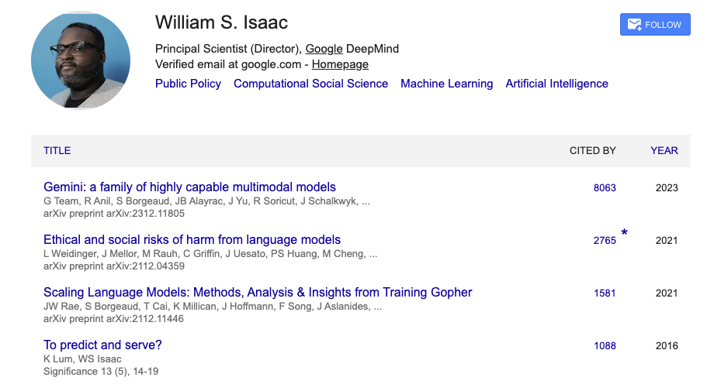
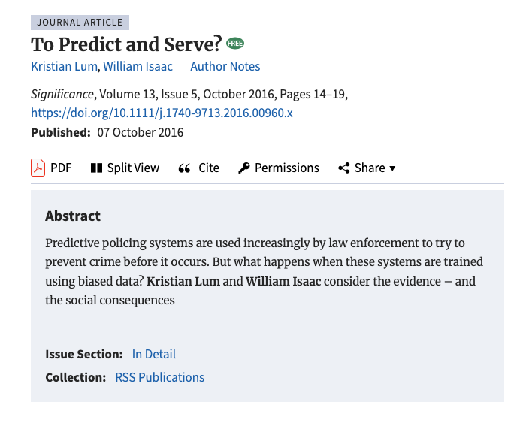
William Isaac

Slide 25
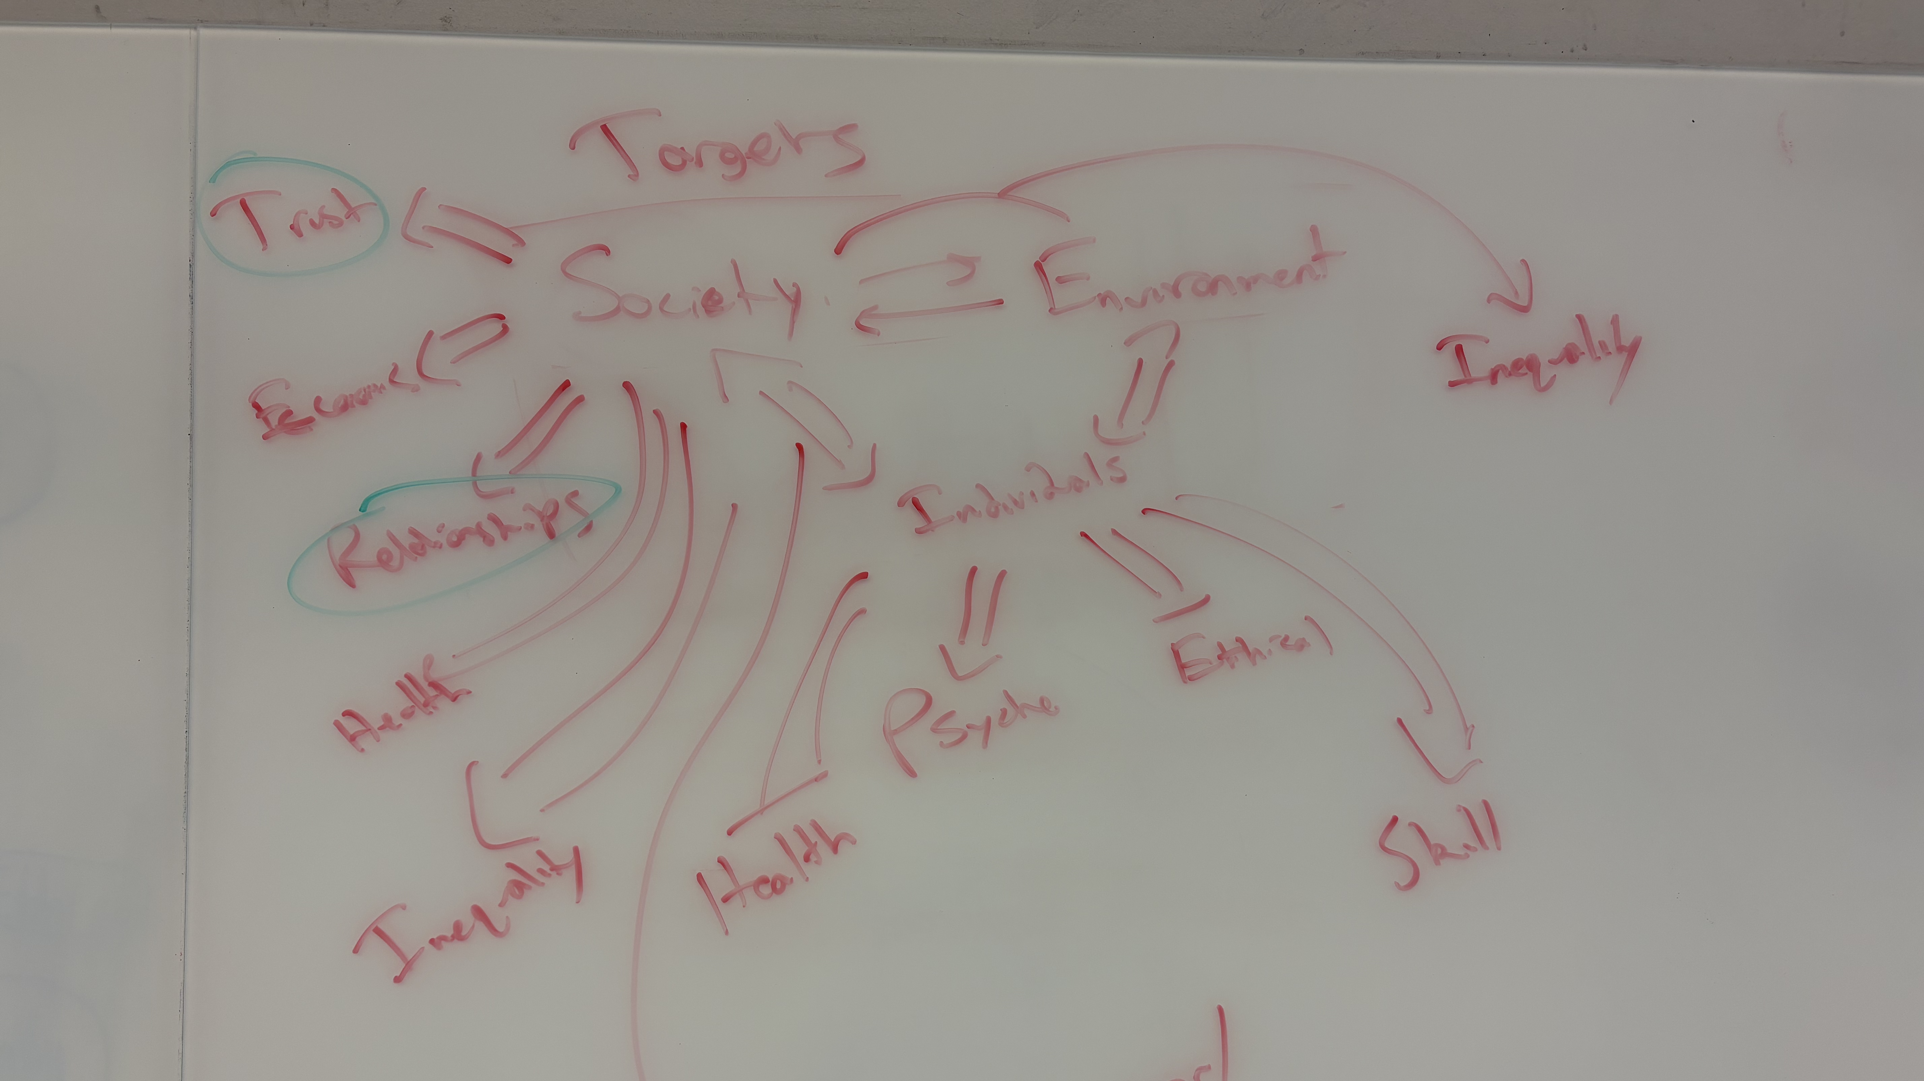

Slide 26
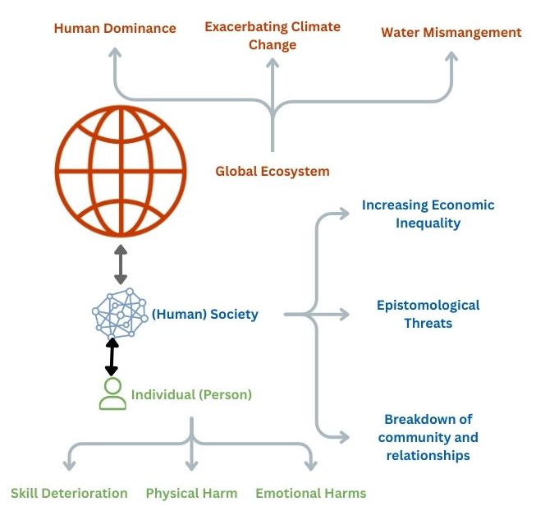
Thanks, I hate it

Slide 27
Now, what does “let’s fix this” look like?
It’s actually quite hard to think about without a concrete example

Slide 28
Zhao, J., Wang, T., Yatskar, M., Ordonez, V., & Chang, K.-W. (2018). Gender Bias in Coreference Resolution: Evaluation and Debiasing Methods. ArXiv:1804.06876 [Cs].

Slide 29
Connecting this to your project
The ultimate goal of all of your projects is the same – to create a single, thriving, global community
How can what we’ve done today help you think about this?
One way is to turn your project on its head a bit, and think about a specific impediment that would need to be removed in order to create such a community
Your project then becomes the task of
  Justifying why this impediment is important and why removing it would lead to our ultimate goal
  Explaining and understanding the causes of this impediment
  Providing a solution that addresses those causes
  Understanding and being explicit about the limitations of your approach

Slide 30
Toy example
Imagine you are a new company tasked with designing an AI tutor for first-year college students. Do the following [thinking about the why for each]:
Explain, at a high level, why we might need AI tutors in the first place (why is this a problem, what are the causes?)
Outline a population you want to target (e.g. “students who are good at math”) (why?)
Define a way you’ll build the model, using the ideas from the ”two pipelines” in class
Define your “secret sauce” … why should I use your tool instead of others?
Explain how you’ll evaluate the effectiveness of your approach
  Not using the Design Justice Principles
  Using at least one of the Design Justice principles
Describe one group of people that are not likely to benefit from your tool, and why that is(n’t) OK
Consider the 4 roles of social change. Which, if any, does your app fit into?
  Can find these in the Lecture 2 slides

Slide 31

Looking forward
https://rebootdemocracy.ai/blog/how-bos-nj-scale-ai-access

Slide 32
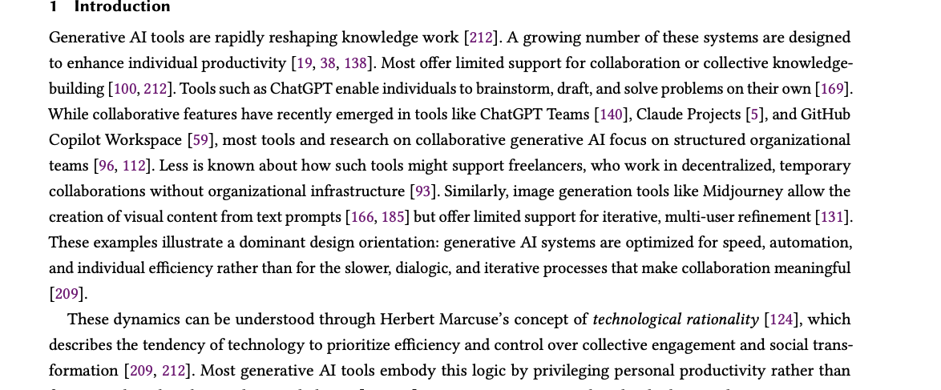
Looking forward
https://arxiv.org/pdf/2602.05299

Slide 33
The punchlines of this unit
Generative AI is magical, but not magic
It is also, as constructed, extractive and harmful to the collective
It does not have to be.

