Slide 1
Set, Block, and Byte in Cache

Slide 2
Block and Byte
Goal: take advantage of spatial locality.
Organize memory and cache in blocks
Each block contains multiple bytes
So how to figure out where data should be placed in the cache? We use block address and block index.
Byte
Address
Block
Address
0000
0001
0010
0011
0100
0101
0110
0111
1000
1001
1010
1011
1100
1101
1110
1111
000
001
010
011
100
101
110
111
Block
Index
00
01
10
11

Slide 3
Locating block and byte in the cache
Assume a cache with 2^{k} blocks, each containing 2^{n} bytes.
For a byte of data, we utilize its address in main memory to locate its position in cache
-- k bits of the block index selects one of the 2^{k} cache blocks.
-- The lowest n bits are now a block offset that decides which of the 2^{n} bytes in the cache block will store the data.
Prior example used a 2²-block cache with 2¹ bytes per block. Thus, memory address 13 (1101) would be stored in byte 1 of cache block 2.
(m-k-n) bits
k bits
Block Index
n-bit Block
Offset
m-bit Address
Tag
block address: (m-n) bits
1 bit
2 bits
1-bit Block
Offset
4-bit Address
1
10
1

Slide 4
Example
Tag
Index (2 bits)
Address (4 bits)
1
10
1
Block offset
2
Index
Valid
Tag
Data
0
1
2
3
8
8
=
Mux
8
Hit
Data

Slide 5
Set and Block
In a set-associative cache
-- The cache is divided into groups of blocks, called sets.
-- Each memory address maps to exactly one set in the cache, but data may be placed in any block within that set.
If each set has 2^{x} blocks, cache is an 2^{x}-way associative cache.
Several possible organizations of an eight-block cache.
1-way associativity
8 sets, 1 block each
2-way associativity
4 sets, 2 blocks each
4-way associativity
2 sets, 4 blocks each
Set
Set
Set
0
1
2
3
4
5
6
7
0
1
2
3
0
1

Slide 6
Locating a set associative block
How to determine where a memory address belongs in an associative cache?
If a cache has 2^{s} sets and each block has 2^{n} bytes, the memory address can be partitioned as follows.
Block Offset= Memory Address mod 2^{n}
Block Address = Memory Address / 2^{n}
Set Index = Block Address mod 2^{s}
t=(m-s-n)
s
n
Address (m bits)
Tag
Set Index
Block
offset
block address: (m-n) bits

Slide 7
Generality of set associative
1-way set associative cache is the same as a direct-mapped cache.
If a cache has 2^{k} blocks, a 2^{k}-way set associative cache would be the same as fully-associative cache.
x = k - s
1-way
8 sets,
1 block each
2-way
4 sets,
2 blocks each
4-way
2 sets,
4 blocks each
8-way
1 set,
8 blocks
Set
Set
Set
Set
0
1
2
3
4
5
6
7
0
1
2
3
0
1
0
direct mapped
fully associative

Slide 8
1-Way Set-Associative Cache
Byte
Address
Block
Address
0000
0001
0010
0011
0100
0101
0110
0111
1000
1001
1010
1011
1100
1101
1110
1111
000
001
010
011
100
101
110
111
Set
Block
Index
00
01
10
11

Slide 9
2-Way Set-Associative Cache
t=(m-s-n)
s
n
Address (m bits)
Tag
Set Index
Block
offset
block address: (m-n) bits
Byte
Address
Block
Address
0000
0001
0010
0011
0100
0101
0110
0111
1000
1001
1010
1011
1100
1101
1110
1111
000
001
010
011
100
101
110
111
Set
Index
0
1

Slide 10
2-Way Set-Associative Cache
Block
Offset
Tag
Set Index
11
0
1
n
t
s
V
Tag
Data Block
V
Tag
Data Block
10
11
t
=
=
Data
Word
or Byte
HIT

Slide 11
Fully Associative Cache
Byte
Address
Block
Address
0000
0001
0010
0011
0100
0101
0110
0111
1000
1001
1010
1011
1100
1101
1110
1111
000
001
010
011
100
101
110
111

Slide 12
Fully Associative Cache
V
Tag
Data Block
110
t
=
Tag
110
010
t
=
HIT
100
Block
Offset
1
Data
Word
or Byte
=
n

Slide 13
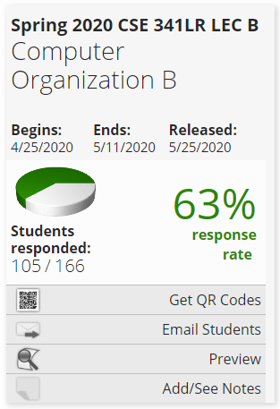
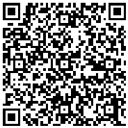
Course Evaluation Incentive
I will reveal one question of the final exam (5-10 points) as an incentive, if (and when) the response rate of the course evaluation reaches 80% !!!
https://sunyub.smartevals.com/

Slide 14
Thank You!

