Slide 1
CSE 341 Computer Organization Lecture 10 Processor : Single-Cycle Implementation 1
Prof. Lu Su
Compute Science & Engineering
Slides adapted from Raheel Ahmad, Luis Ceze , Sangyeun Cho,
Howard Huang, Bruce Kim, Josep Torrellas, Bo Yuan, and Craig Zilles

Slide 2
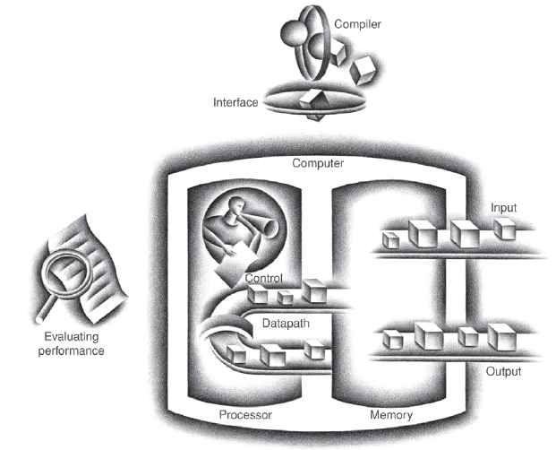
Today’s Content in Big Picture
SW
Part-I Ch2
Part-II Ch3,4
Part-III Ch1,5,6
ch2
ch1
I/O device
Ch6
Ch3,4
Ch5
Computer Organization and Design (5th edition) by Patterson and Hennessy

Slide 3
Goal of this Part
Implement hardware to execute instructions
-- ISA defines the hardware operations which are available to software.
-- Instruction set can be implemented in different ways.

Slide 4
RISC Instruction Execution
Instruction fetch cycle (IF)
Send the program counter (PC) to memory
Fetch the instruction from memory
Update the next sequential PC
Instruction decode/register fetch cycle (ID)
Decode the instruction
Read the registers corresponding to register source specifiers
Execution/effective address cycle (EX)
Memory reference (calculate effective address)
Register-register ALU instruction
Register-immediate ALU instruction
Memory access (MEM)
Load/store
Write-back cycle (WB)

Slide 5
Outline of this Part
Single-cycle implementation:
-- All operations takes in one clock cycle
Multi-cycle implementation:
-- Fast operations take less time than slower ones
Pipelining
-- Overlap the execution of several instructions

Slide 6
Task I
Single-cycle implementation:
-- All operations takes in one clock cycle
Multi-cycle implementation:
-- Fast operations take less time than slower ones
Pipelining
-- Overlap the execution of several instructions

Slide 7
Functions of Simple Processor
A simple MIPS processor can support a small
instruction set:
-- Memory-related instructions
lw (load word) and sw (store word)
-- Arithmetic/logic instructions
add, sub, and, or, slt, etc.
-- Control/transfer instructions
beq (branch if equal)
j (unconditional jump)

Slide 8
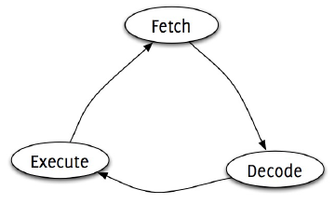
Generic Implementation
The CPU is in an infinite loop, fetching
instructions from memory, decode them, and executing them.

Slide 9
Fetching Instruction
Instructions are stored in Instructions Memory(IM)
-- Assume IM cannot be written or changed during running.
Program Counter (PC) register holds the address of current instruction.
-- MIPS instructions are 32 bits (4bytes)
-- MIPS memory is byte addressable
-- PC should be incremented by 32/8=4
Add
4
PC
Read
address
Instruction
[31-0]
Instruction
memory

Slide 10
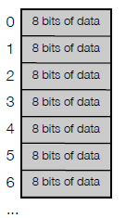
Byte-addressable Memory
Memory is byte-addressable.
A 32-bit word occupies four contiguous locations (bytes) of memory
The data output of instruction memory is still 32.
Read
address
Instruction
[31-0]
Instruction
memory

Slide 11
Decode
Some fields of instructions (binary form) are the number of registers and the address of memory.
-- rs
-- rt
-- rd
-- address
Other fields are used to generate the control signals. (We will discuss control unit later).
-- op
-- func

Slide 12
Review of R-type Instruction
Register-to-register instructions:
-- op: opcode
-- func: specifies a particular arithmetic operation
-- rs, rt and rd: source and destination registers
-- shamt: shift
op | rs | rt | rd | shamt | func
6 bits | 5 bits | 5 bits | 5 bits | 5 bits | 6 bits

Slide 13
Register File for R-type
R-type instructions need to access registers and an arithmetic logic unit (ALU).
MIPS register file stores 32 32-bit values.
-- Each register specifier is 5 bits long.
-- Two registers can be read at a time.
-- RegWrite is 1 to write register.
RegWrite
Read
register 1
Read
data 1
Read
register 2
Read
data 2
Write
register
Registers
Write
data

Slide 14
Boolean Algebra
In Boolean algebra, all the variables have the values 0 or 1 and, in typical formulations, there are three operators:
The OR operator is written as +, as in A + B. The OR operation is also called a logical sum, since its result is 1 if either operand is 1.
The AND operator is written as · , as in A· B. The AND operator is also called logical product, since its result is 1 only if both operands are 1.
The unary operator NOT is written as Ā. Applying the operator NOT to a logical value results in an inversion or negation of the value (i.e., if the input is 0 the output is 1, and vice versa).
14

Slide 15
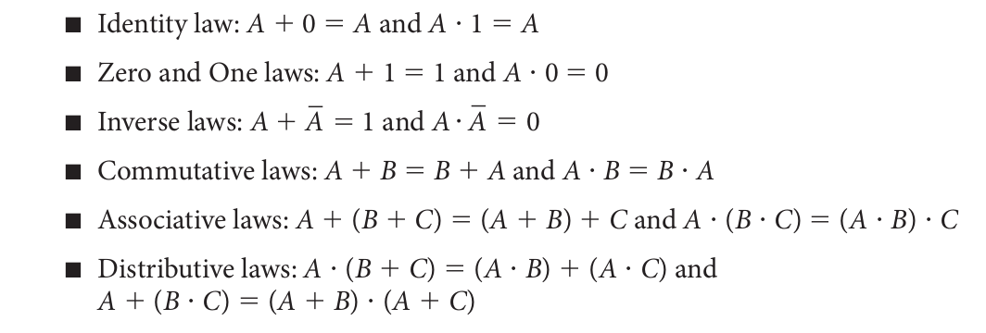
Boolean Algebra
Laws of Boolean algebra
15

Slide 16
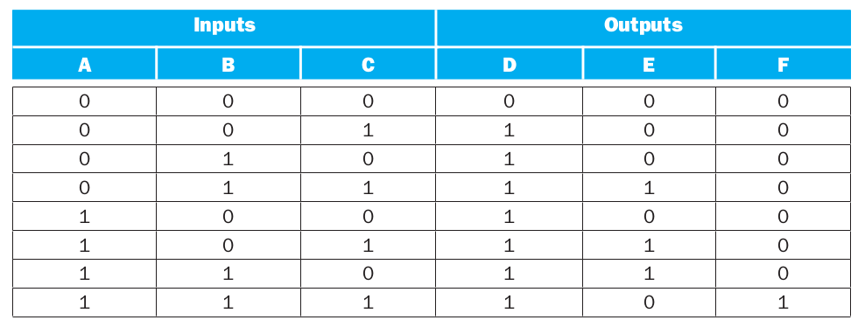
Truth Tables
A combinational logic block contains no memory can be completely specified by defining the values of the outputs for each possible set of input values. Such a description is normally given as a truth table.
For a logic block with n inputs, there are 2^{n} entries in the truth table.
Example: D is true if at least one input is true, E is true if exactly two inputs are true, and F is true only if all three inputs are true.
16

Slide 17
Logic Equations
Show the logic equations for the logic functions, D, E, and F, described in the previous example.
Think of E in two parts: what must be true for E to be true (two of the three inputs must be true), and what cannot be true (all three cannot be true). Thus we can write E as:
E is true only if exactly two of the inputs are true. Then we can also write E as an OR of the three possible terms that have two true inputs and one false input:
17

Slide 18
Gate

Slide 19
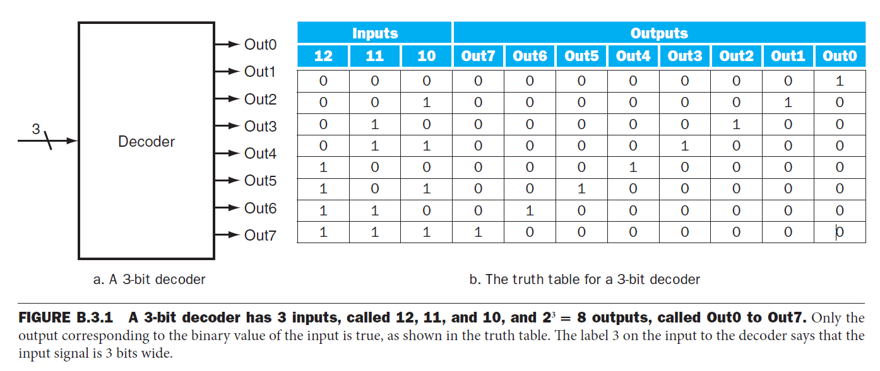
Combinational Logic
Decoders: n-bit input, 2^{n} outputs, where only one output is asserted for each input combination.
3-to-8 decoder
Notes:
In this section, we look at a couple of larger logic building blocks that we use
heavily, and we discuss the design of structured logic that can be automatically
implemented from a logic equation or truth table by a translation program. Last,
we discuss the notion of an array of logic blocks.

Slide 20
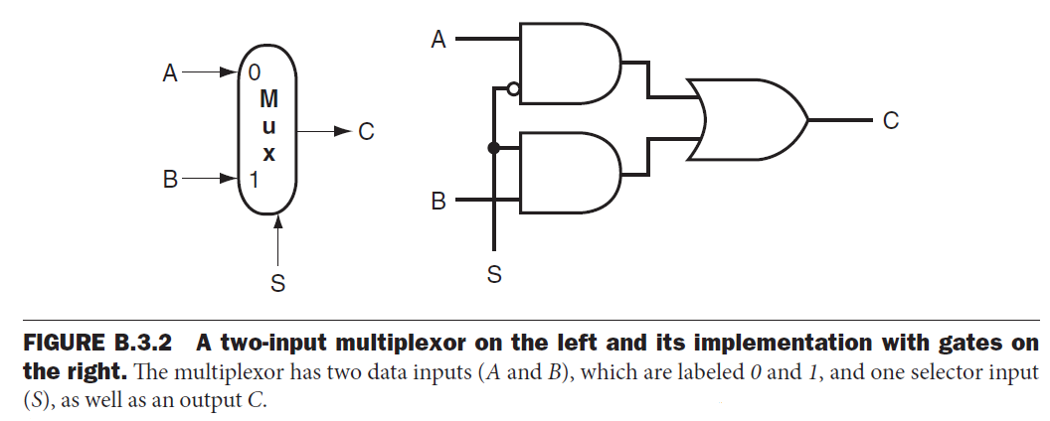
Multiplexors (Selector)
Inputs: data values and selector (or control) values.
Output: one of the inputs that is selected by a control.
Notes:
Hollow circle
Solid circle

Slide 21
Arithmetic Logic Unit (ALU)
The device that performs the arithmetic operations like addition and subtraction or logical operations like AND and OR.
This section constructs an ALU from four hardware building blocks (AND and OR gates, inverters, and multiplexors) and illustrates how combinational logic works.

Slide 22
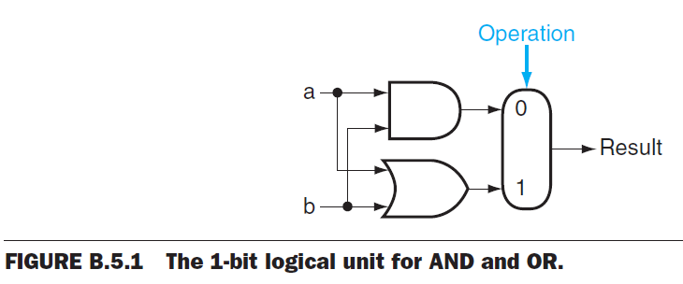
A 1-Bit ALU

Slide 23
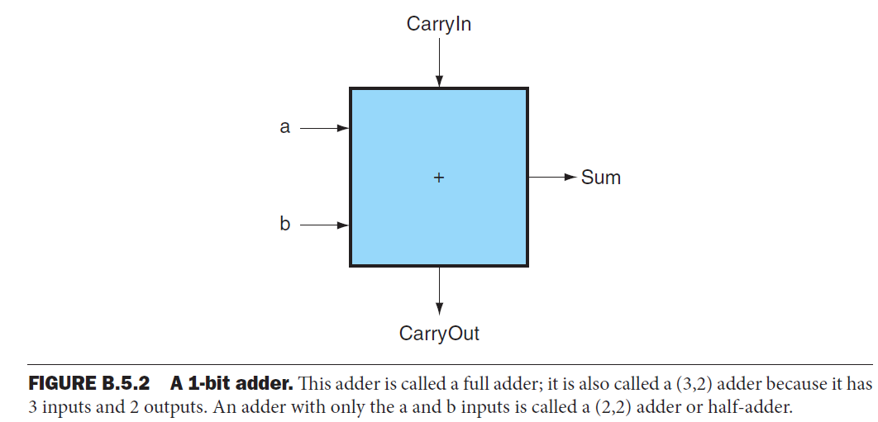
Addition
An adder must have two inputs for the operands and a single-bit output for the sum.
There must be a second output to pass on the carry, called CarryOut.
Since the CarryOut from the neighbor adder must be included as an input, we need a third input. This input is called CarryIn.

Slide 24
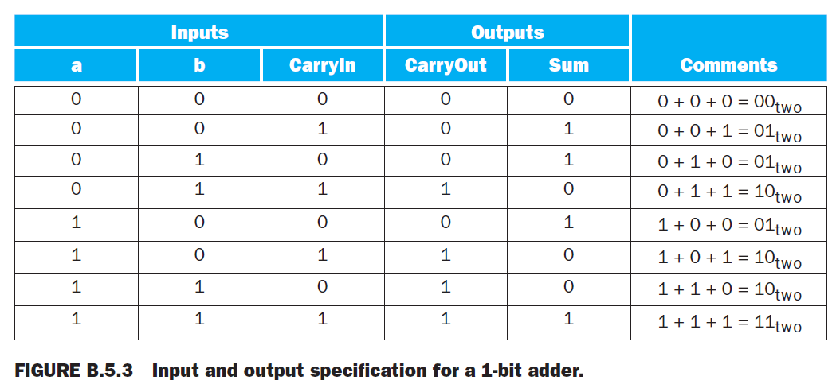
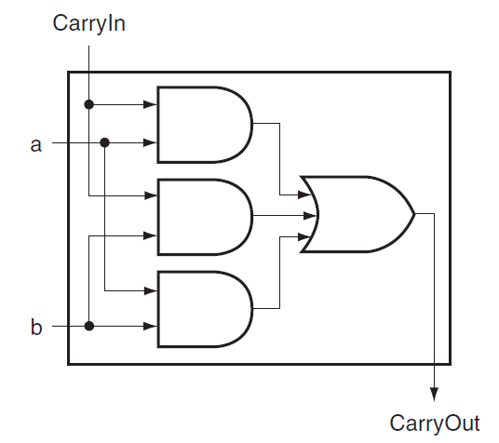
Addition

