Slide 1
CSE 341 Computer Organization Lecture 11 QtSpim Simulator
Wei Wang
Computer Science Engineering, UB

Slide 2
What is SPIM
SPIM is a self-contained simulator that runs MIPS32 programs. It reads and executes assembly language programs written for this processor.
-- James Larus (previously a Professor at WISC, now at Microsoft Research)
SPIM does NOT execute binary (compiled) programs.
Download webpage:
-- http://spimsimulator.sourceforge.net/
-- Versions for Windows, Linux, and Mac OS X are all available

Slide 3
Important Documents
James Larus, “Assemblers, Linkers, and the SPIM Simulator,” available on Piazza/Resources/HP_AppA.pdf.
More reference and documents can be referred
-- http://spimsimulator.sourceforge.net/further.html

Slide 4
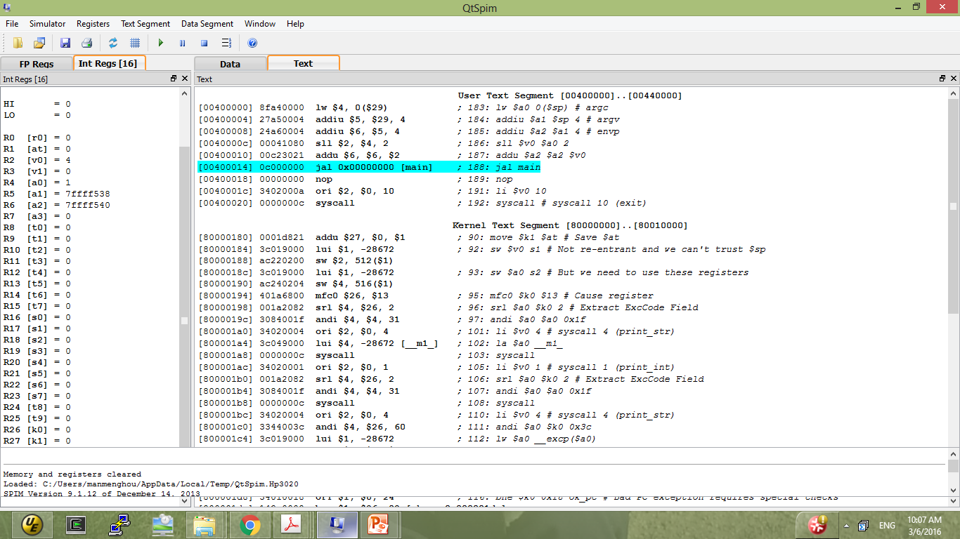
Layout of QtSPIM

Slide 5
A Simple Example
Write a simple MIPS code to add two numbers 5, -3 stored in registers t0, t1, and store the result in register t2.
addi $8, $0, 5
addi $9, $0, -3
add $10, $8, $9

Slide 6
Real MIPS Program
main:
addi $8, $0, 5
addi $9, $0, -3
add $10, $8, $9
jr $ra

Slide 7
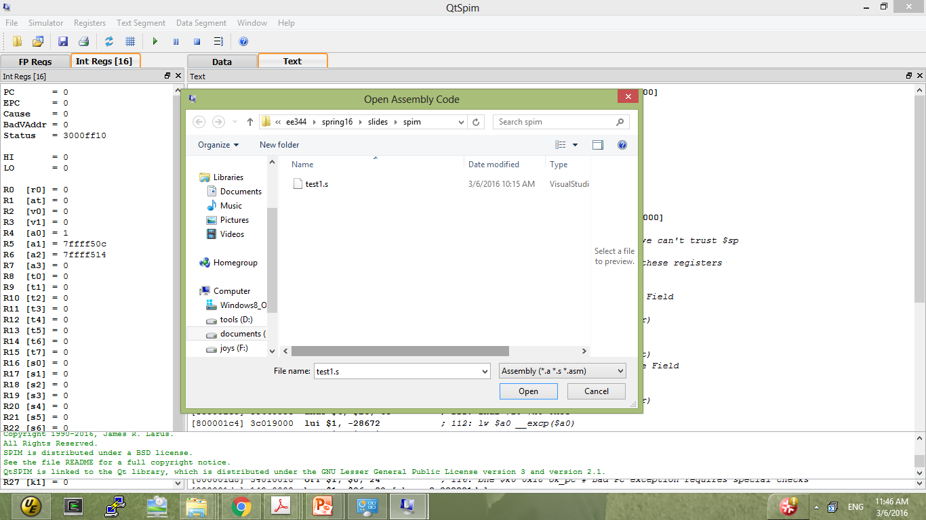
Load File

Slide 8
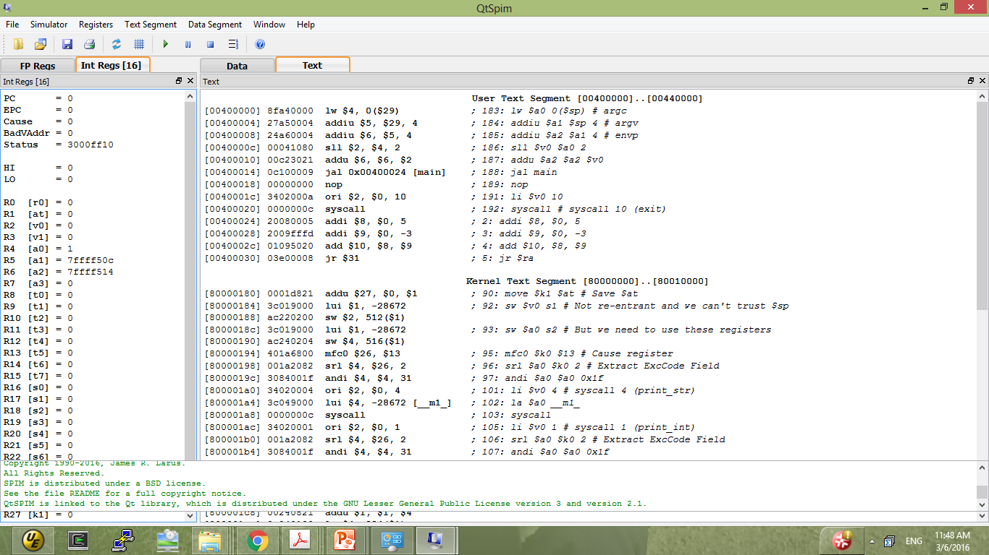
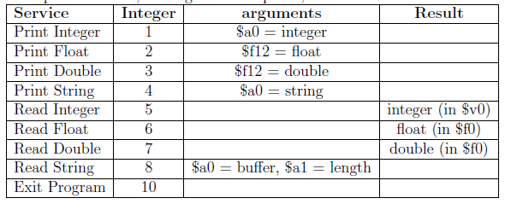
Program Counter
Initial Code - header files, argument definition and main statement call and program end
program codes
Uncleared Reg
Address
Hex format
Instruction
Pseudo-Instruction

Slide 9
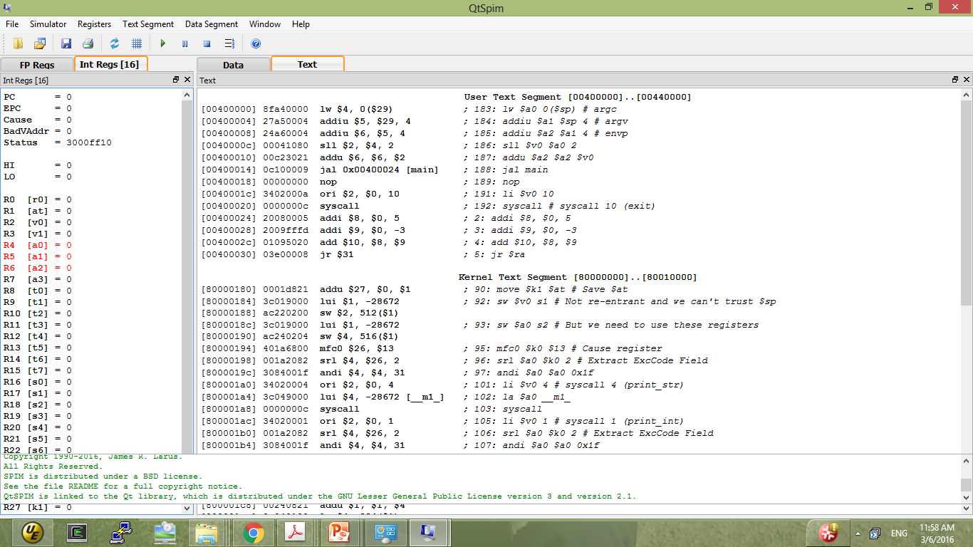
Clear Register
Simulator → Clear Registers

Slide 10
Setting Program Breakpoint
QtSpim has the option for single-step execution (F10), to simulate each instruction line by line.
To start the line-by-line execution from the program code, we set breakpoints in the program.
Select main in the user text section, right click and select “set bookmark”.
Once bookmark is set, you can see a halt symbol to the left of the instruction address.

Slide 11
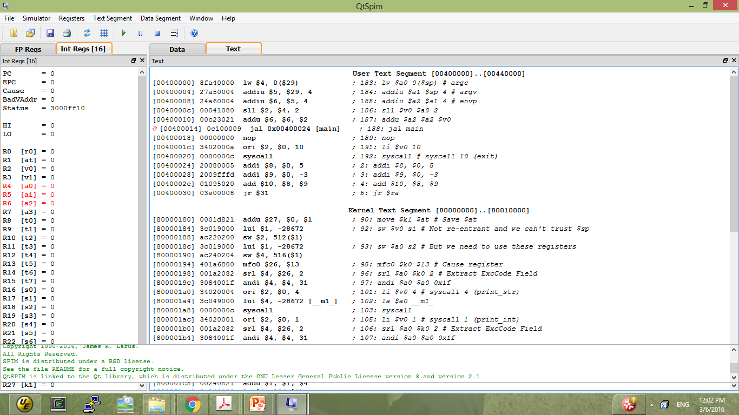
Breakpoint

Slide 12
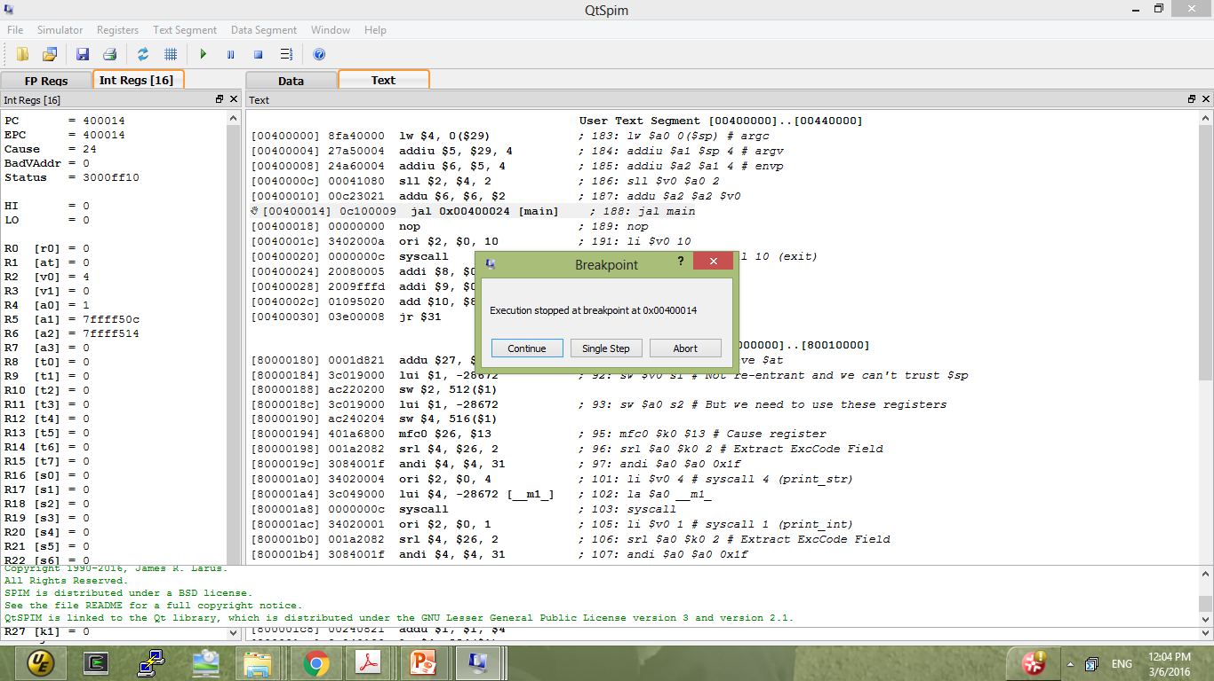
Simulation
Simulator → Run/Continue (F5)
Execution will start from the first line and continue till the break-point.
After encountering the breakpoint, select single-step execution, to observe line-by-line program execution.

Slide 13
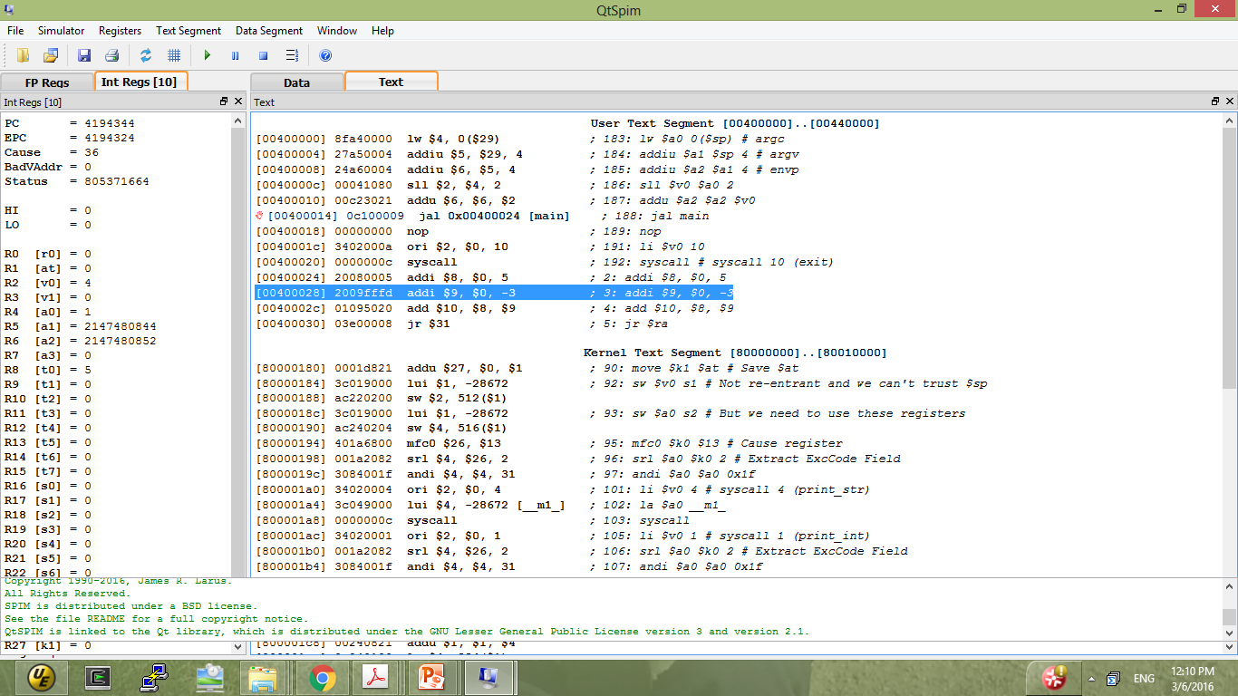
Execution (1)

Slide 14
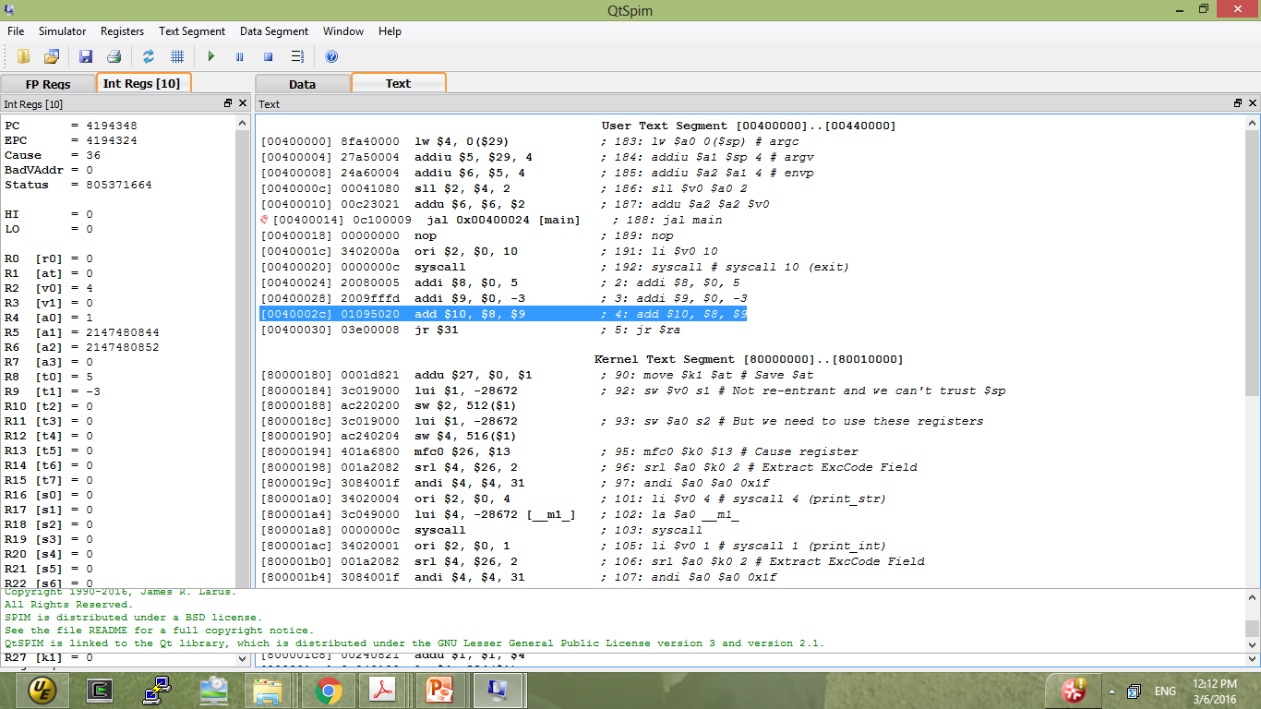
Execution (2)

Slide 15
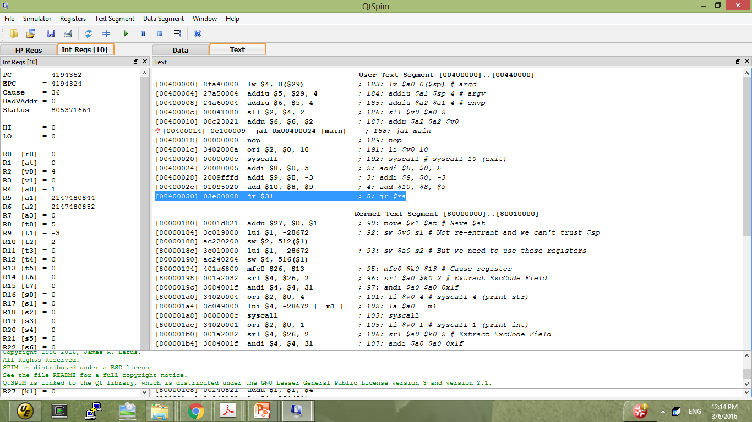
Execution (3)

Slide 16
Assembler Directives (1)
Top-level Directives:
.text
-- indicates that following items are stored in the user text segment, typically instructions
.data
-- indicates that following data items are stored in the data segment
.globl sym
-- declare that symbol sym is global and can be referenced from other files

Slide 17
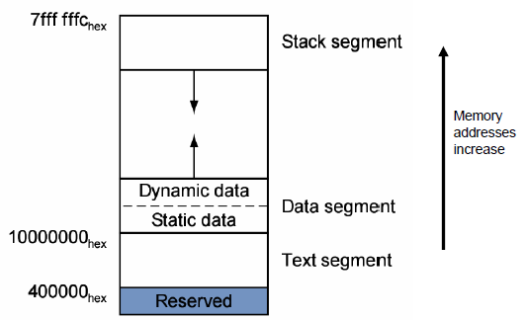
Review of Memory Layout

Slide 18
Assembler Directives (2)
Common Data Definitions under .data
.word w1, …, wn
-- store n 32-bit quantities in successive memory words
.half h1, …, hn
-- store n 16-bit quantities in successive memory halfwords
.byte b1, …, bn
-- store n 8-bit quantities in successive memory bytes
.ascii str
-- store the string in memory but do not null-terminate it
-- strings are represented in double-quotes “str”
-- special characters, eg. \n, \t, follow C convention
.asciiz str
-- store the string in memory and null-terminate it

Slide 19
Assembler Directives (3)
Common Data Definitions:
.float f₁, …, f_{n}
-- store n floating point single precision numbers in successive memory locations
.double d₁, …, d_{n}
-- store n floating point double precision numbers in successive memory locations
.space n
-- reserves n successive bytes of space
.align n
-- align the next data on a 2^{n} byte boundary.
-- For example, .align 2 aligns next value on a word boundary.

Slide 20
Example
.data # Put Global Data here
N: .word 5 # loop count
X: .word 2,4,6,8,10 # array of numbers to be added
SUM: .word 0 # location of the final sum
str: .asciiz "The sum of the array is = "
.text # Put program here
.globl main # globally define main
main: // your program codes here

Slide 21
Some useful pseudo-instructions
move $t0, $t1
-- Copy contents of register t1 to register t0.
li $s0, immediate
-- Load immediate into to register s0.
la $s0, addr
-- Load address into to register s0.

Slide 22
Addressing Mode
How to load/store between memory and $t0?
Imm+Register: (Only mode in bare machine, suggested)
la $t1, label # load address of label to $t1
lw $t0, 8($t1) # address: address of label + 2
Immediate:
lw $t0, 0x000AE430 # address: address 0x000AE430
Symbol:
lw $t0, label # address: address of label
Register:
la $t1, label # load address of label to $t1
lw $t0, $t1 # address: address in $t1
Symbol±Imm:
lw $t0, label+2 # address: address of label + 2
Symbol±Imm+Register:
lw $t0, label+8($t1) # address: address of label + 2 + $t1

Slide 23
Example
.data # Put Global Data here
N: .word 5 # loop count
X: .word 2, 4, 6, 8, 10 # array of numbers to be added
SUM: .word 0 # location of the final sum
.text # Put program here
.globl main # globally define main
main: lw $s0, N # load loop counter into $s0
la $t0, X # load the address of X into $t0
…..
sw $s1, SUM # store the final total

Slide 24
System Call
System Calls (syscall)
-- OS-like services
-- Very useful for I/O operation
Method
-- load system call code into register $v0
-- load arguments into registers $a0…$a3
-- call system with SPIM instruction syscall
-- After call, return value is in register $v0
Frequently used system calls

Slide 25
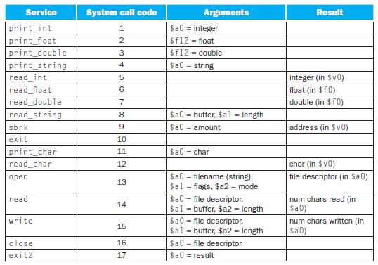
List of System Call

Slide 26
Wrap up
.data # Put Global Data here
N: .word 5 # loop count
X: .word 2, 4, 6, 8, 10 # array of numbers to be added
SUM: .word 0 # location of the final sum
str: .asciiz "The sum of the array is = "
.text # Put program here
.globl main # globally define main
main: lw $s0, N # load loop counter into $s0
la $t0, X # load the address of X into $t0
and $s1, $s1, $zero # clear $s1 aka temp sum
loop: lw $t1, 0($t0) # load the next value of x
add $s1, $s1, $t1 # add it to the running sum
addi $t0, $t0, 4 # increment to the next address
addi $s0, $s0, -1 # decrement the loop counter
bne $0, $s0, loop # loop back until complete
sw $s1, SUM # store the final total
li $v0, 4 # 4 is system call code for print_str
la $a0, str
syscall # system call for print_str
li $v0, 1 # 1 is system call code for print_int
move $a0, $s1
syscall # system call for print_int
li $v0, 10 # 10 is system call code for exit
syscall # system call for exit

