Slide 1
CSE 341 Computer Organization Lecture 12 Processor : Single-Cycle Implementation 2
Prof. Lu Su
Compute Science & Engineering
Slides adapted from Raheel Ahmad, Luis Ceze , Sangyeun Cho,
Howard Huang, Bruce Kim, Josep Torrellas, Bo Yuan, and Craig Zilles

Slide 2
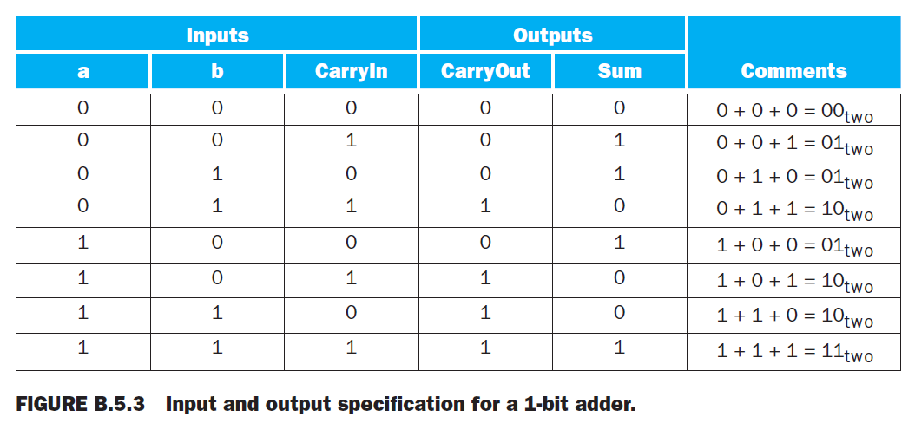
Addition
The Sum bit is set when
exactly one input is 1.
or when all three inputs are 1.

Slide 3
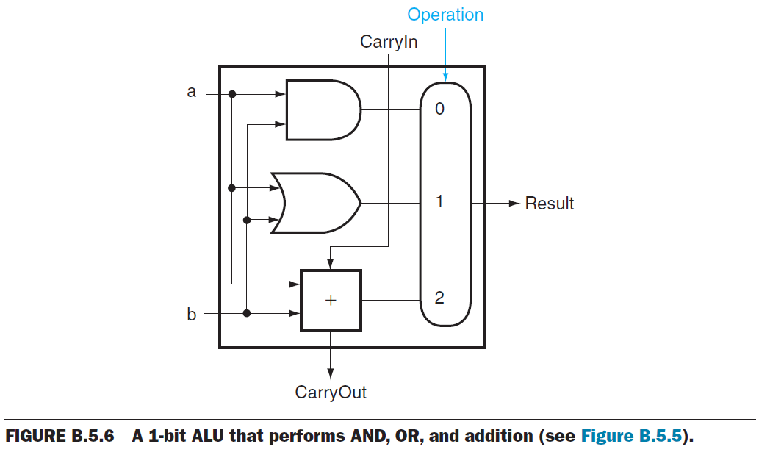
A 1-Bit ALU

Slide 4
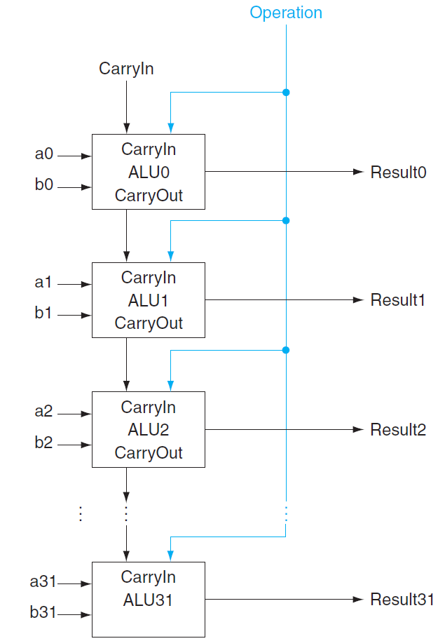
A 32-Bit ALU

Slide 5
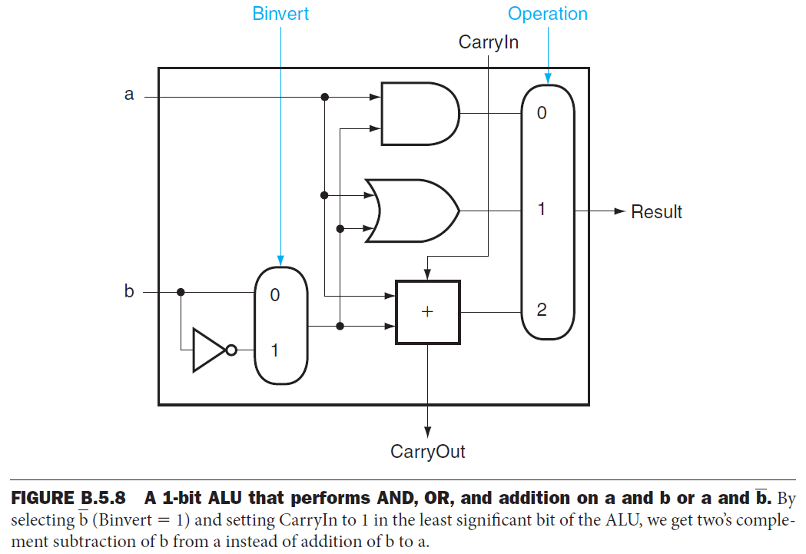
Subtraction
Subtraction is the same as adding the negative version of an operand.

Slide 6
Useful shortuts
A quick way to negate a two’s complement binary
number:
Simply invert every 0 to 1 and every 1 to 0,
then add one to the result. This shortcut is based
on the observation that the sum of a number and its
inverted representation must be 111 . . . 111_{two},
which represents 1.
x + $\overline{x}$ = -1 → $\overline{x}$ +1 = -x

Slide 8
Subtraction
Set this CarryIn to 1 instead of 0.
The adder will then calculate a+b+1.
Select the inverted version of b.

Slide 9
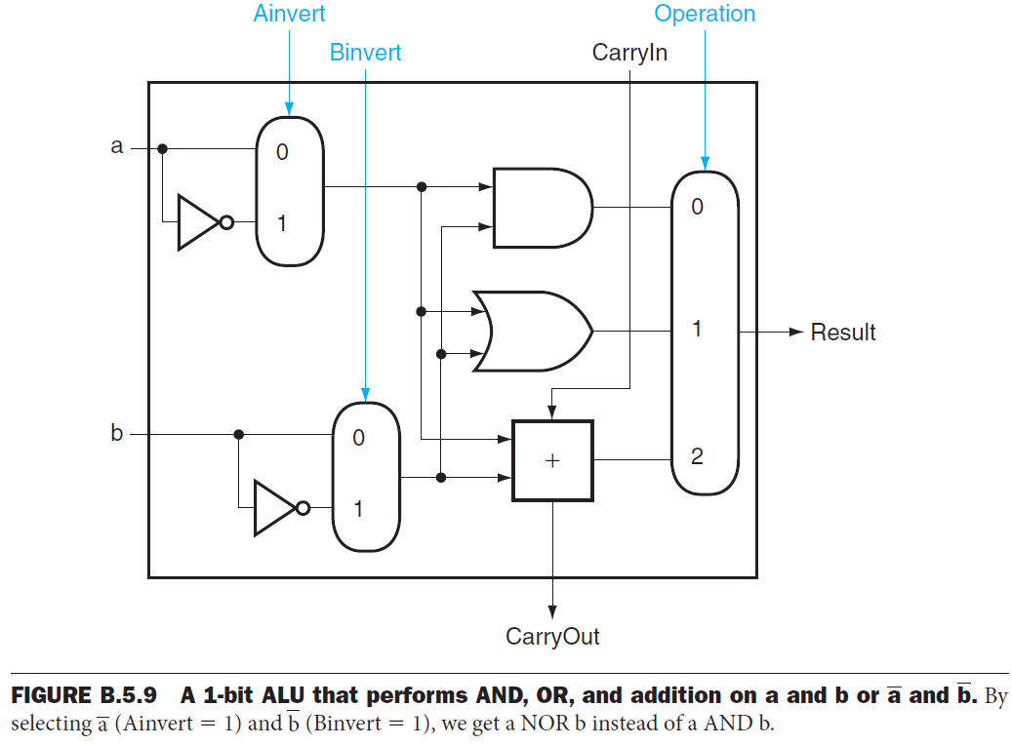
NOR function
Instead of adding a separate gate for NOR, we can reuse much of the hardware already in the ALU.
DeMorgan’s theorem: NOT (a OR b) is equivalent to NOT a AND NOT b.

Slide 10
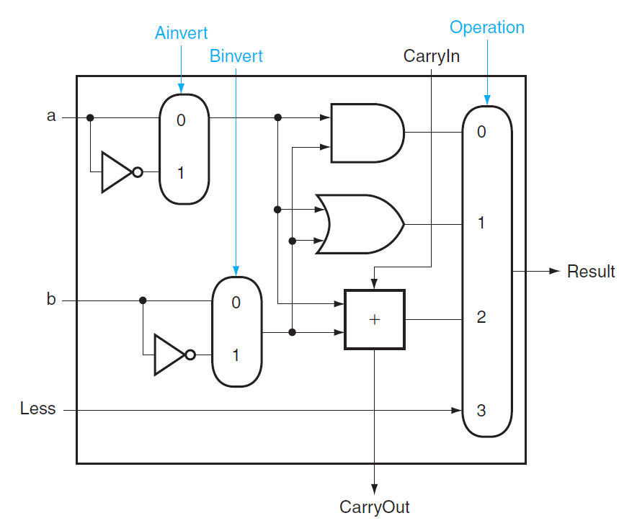
slt operation

Slide 11
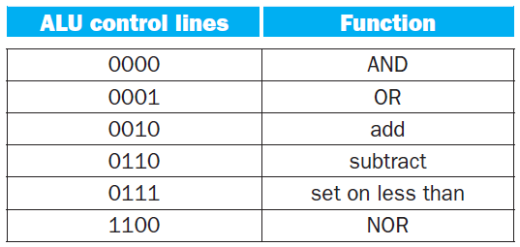
Inner arch. of ALU
ALU = arithmetic unit + logic unit
ALUOp bits: Ainvert, Binvert, Operation

