Slide 1
CSE 341 Computer Organization Lecture 14 Processor : Single-Cycle Implementation 3
Prof. Lu Su
Compute Science & Engineering
Slides adapted from Raheel Ahmad, Luis Ceze , Sangyeun Cho,
Howard Huang, Bruce Kim, Josep Torrellas, Bo Yuan, and Craig Zilles

Slide 2
Building a Datapath
§4.3 Building a Datapath
Datapath
Elements that process data and addresses in the CPU
Registers, ALUs, mux’s, memories, …
We will build a MIPS datapath incrementally
Refining the overview design

Slide 3
Review of R-type Instruction
Register-to-register instructions:
-- op: opcode
-- func: specifies a particular arithmetic operation
-- rs, rt and rd: source and destination registers
-- shamt: shift
op | rs | rt | rd | shamt | func
6 bits | 5 bits | 5 bits | 5 bits | 5 bits | 6 bits

Slide 4
Fetching Instruction
Instructions are stored in Instructions Memory(IM)
-- Assume IM cannot be written or changed during running.
Program Counter (PC) register holds the address of current instruction.
-- MIPS instructions are 32 bits (4bytes)
-- MIPS memory is byte addressable
-- PC should be incremented by 32/8=4
Add
4
PC
Read
address
Instruction
[31-0]
Instruction
memory

Slide 5
Executing R-type instruction
Step1. Read an instruction from IM.
Step2. Specify source registers using rs and rt.
Step3. ALU performs desired operations.
Step4. Store output of ALU to designation register (specified by rd).
RegWrite
Read
address
Instruction
[31-0]
I [25 - 21]
Read
register 1
Read
data 1
ALU
Zero
I [20 - 16]
Read
register 2
Result
Instruction
memory
Read
data 2
I [15 - 11]
Write
register
Registers
ALUOp
Write
data
op | rs | rt | rd | shamt | func
31 26 | 21 | 16 | 11 | 6 | 5 0

Slide 6
Review of I-type Instruction
I-type instructions: lw, sw and beq etc.
-- rt: destination for lw, source for beq and sw.
-- address :16-bit signed constant.
lw $t0, –4($sp)
sw $a0, 16($sp)
op | rs | rt | address
6 bits | 5 bits | 5 bits | 16 bits
100011 | 11101 | 01000 | 1111 1111 1111 1100
101011 | 11101 | 00100 | 0000 0000 0001 0000

Slide 7
Data Memory for I-type
I-type instruction needs to access data memory
Two control signals (1 for enable):
-- MemRead: read data from memory
-- MemWrite: write data to memory
32-bit width for address bus and data bus
MemWrite
Read
address
Read
data
Write
address
Write
data
Data
memory
MemRead

Slide 8
Modification for lw/sw(1)
Because R-type and I-type are executed on the same hardware, some modification is required.
Example instruction: lw $t0, –4($sp).
$sp (32-bit) is added to -4 (16-bit)
-- a sign-extension block is required
RegWrite
Read
address
Instruction
[31-0]
I [25 - 21]
MemWrite
MemToReg
Read
register 1
Read
data 1
I [20 - 16]
ALU
Read
address
Read
data
1
M
u
x
0
Instruction
memory
Read
register 2
Zero
0
M
u
x
1
Read
data 2
0
M
u
x
1
Result
Write
address
Write
register
Write
data
Data
memory
I [15 - 11]
Write
data
Registers
ALUOp
ALUSrc
MemRead
RegDst
I [15 - 0]
Sign
extend

Slide 9
Sign-Extension Shortcut
How to convert a binary number represented in n bits to a number represented with more than n bits:
To add the 16-bit number to a 32-bit register, the
computer must convert that 16-bit number to its
32-bit equivalent.
Take the most significant bit from the smaller quantity—the sign bit—and replicate it to fill the new bits of the larger quantity. The old nonsign bits are simply copied into the right portion of the new word.

Slide 11
Modification for lw/sw(2)
Example instruction: lw $t0, –4($sp).
For instructions like add/sub, inputs of ALU are from two registers; for lw/sw, inputs of ALU are from one register and one immediate value
-- a multiplexer controlled by ALUSrc is needed.
RegWrite
Read
address
Instruction
[31-0]
I [25 - 21]
MemWrite
MemToReg
Read
register 1
Read
data 1
I [20 - 16]
ALU
Read
address
Read
data
1
M
u
x
0
Instruction
memory
Read
register 2
Zero
0
M
u
x
1
Read
data 2
0
M
u
x
1
Result
Write
address
Write
register
Write
data
Data
memory
I [15 - 11]
Write
data
Registers
ALUOp
ALUSrc
MemRead
RegDst
I [15 - 0]
Sign
extend

Slide 12
Modification for lw/sw(3)
Example instruction: lw $t0, –4($sp).
Register file’s “Write data” input can store either the ALU output for instructions like add, or the data memory output for lw.
-- A mux controlled by MemToReg is needed.
RegWrite
Read
address
Instruction
[31-0]
I [25 - 21]
MemWrite
MemToReg
Read
register 1
Read
data 1
I [20 - 16]
ALU
Read
address
Read
data
1
M
u
x
0
Instruction
memory
Read
register 2
Zero
0
M
u
x
1
Read
data 2
0
M
u
x
1
Result
Write
address
Write
register
Write
data
Data
memory
I [15 - 11]
Write
data
Registers
ALUOp
ALUSrc
MemRead
RegDst
I [15 - 0]
Sign
extend

Slide 13
Modification for lw/sw(4)
Example instruction: lw $t0, –4($sp).
Destination register of lw is in rt ; destination register for instructions like add is rd.
-- Another mux controlled by RegDst is needed to select the destination register from either rt or rd.
RegWrite
Read
address
Instruction
[31-0]
I [25 - 21]
MemWrite
MemToReg
Read
register 1
Read
data 1
I [20 - 16]
ALU
Read
address
Read
data
1
M
u
x
0
Instruction
memory
Read
register 2
Zero
0
M
u
x
1
Read
data 2
0
M
u
x
1
Result
Write
address
Write
register
Write
data
Data
memory
I [15 - 11]
Write
data
Registers
ALUOp
ALUSrc
MemRead
RegDst
I [15 - 0]
Sign
extend

Slide 14
Offset for branch instruction
Constant in branch instructions is not an address but an instruction offset from the current program counter to the desired address.
beq $at, $0, L
add $v1, $v0, $0
add $v1, $v1, $v1
j Somewhere
L: add $v1, $v0, $v0
Target address L is three instructions past the beq
-- address field is 0000 0000 0000 0011.
-- Actual memory offset is 4*3=12 bytes.
000100 | 00001 | 00000 | 0000 0000 0000 0011
op | rs | rt | address

Slide 15
Executing branch instruction
Step1. Fetch the instruction, e.g. beq $at, $0, offset, from IM.
Step2. Read the source registers, $at and $0, from the register file.
Step3. Compare the values in $at and $0 by subtracting them in ALU
Step4. If the subtraction result is 0, PC is loaded with the target address as PC + 4 + (offset x 4); otherwise PC is incremented to PC + 4 to fetch the next instruction sequentially.

Slide 16
Modification for branch instructions
0
M
u
x
1
Add
PC
4
Add
Shift
left 2
PCSrc
RegWrite
Read
address
Instruction
[31-0]
I [25 - 21]
MemWrite
MemToReg
Read
register 1
Read
data 1
I [20 - 16]
ALU
Read
address
Read
data
1
M
u
x
0
Instruction
memory
Read
register 2
Zero
0
M
u
x
1
Read
data 2
0
M
u
x
1
Result
Write
address
Write
register
Write
data
Data
memory
I [15 - 11]
Write
data
Registers
ALUOp
ALUSrc
MemRead
RegDst
I [15 - 0]
Sign
extend

Slide 17
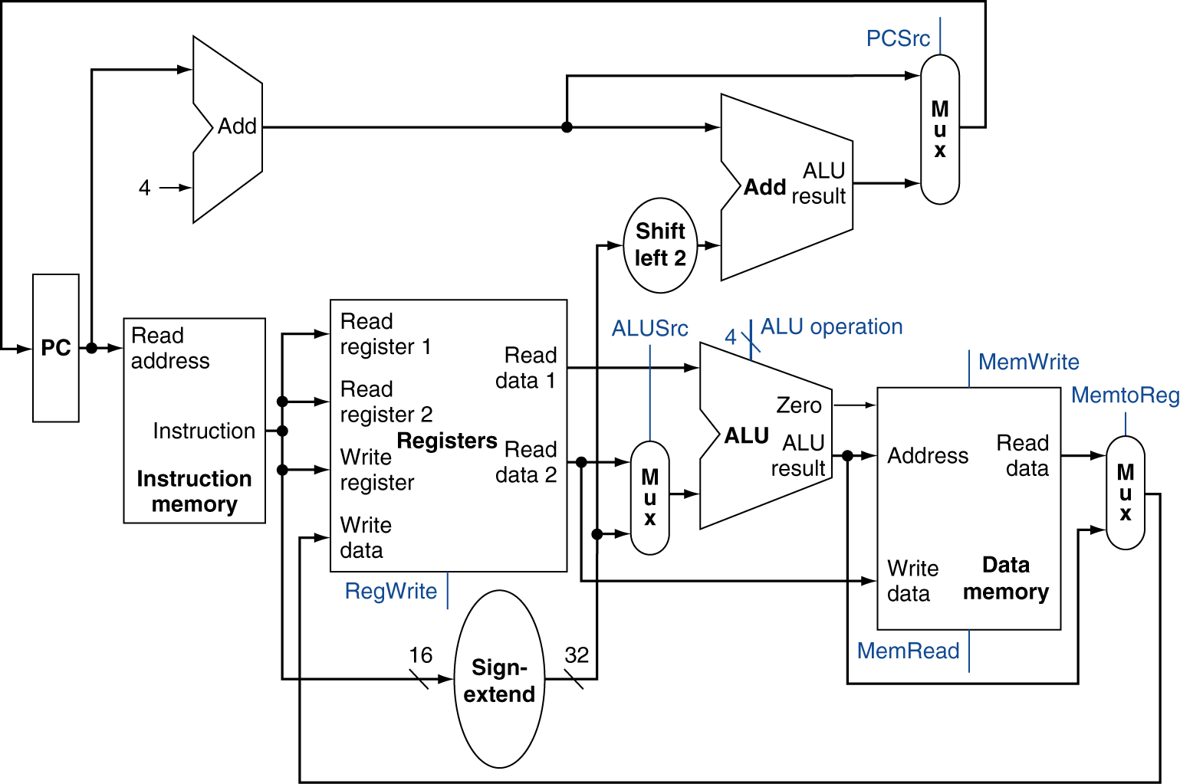
Full Datapath

