Slide 1
CSE 341 Computer Organization Lecture 15 Processor : Single-Cycle Implementation 4
Prof. Lu Su
Compute Science & Engineering
Slides adapted from Raheel Ahmad, Luis Ceze , Sangyeun Cho,
Howard Huang, Bruce Kim, Josep Torrellas, Bo Yuan, and Craig Zilles

Slide 2
Control Unit Design
Right now we have not considered how to generate control signal.
A control unit is responsible for setting all the control signals
-- Its input is the 32-bit instruction word
-- Its outputs are the control signals for data path
Most of the control signals can be generated from op field in the binary encoding instruction.
Next we show the generating mechanism of control signals for different types of instructions.

Slide 3
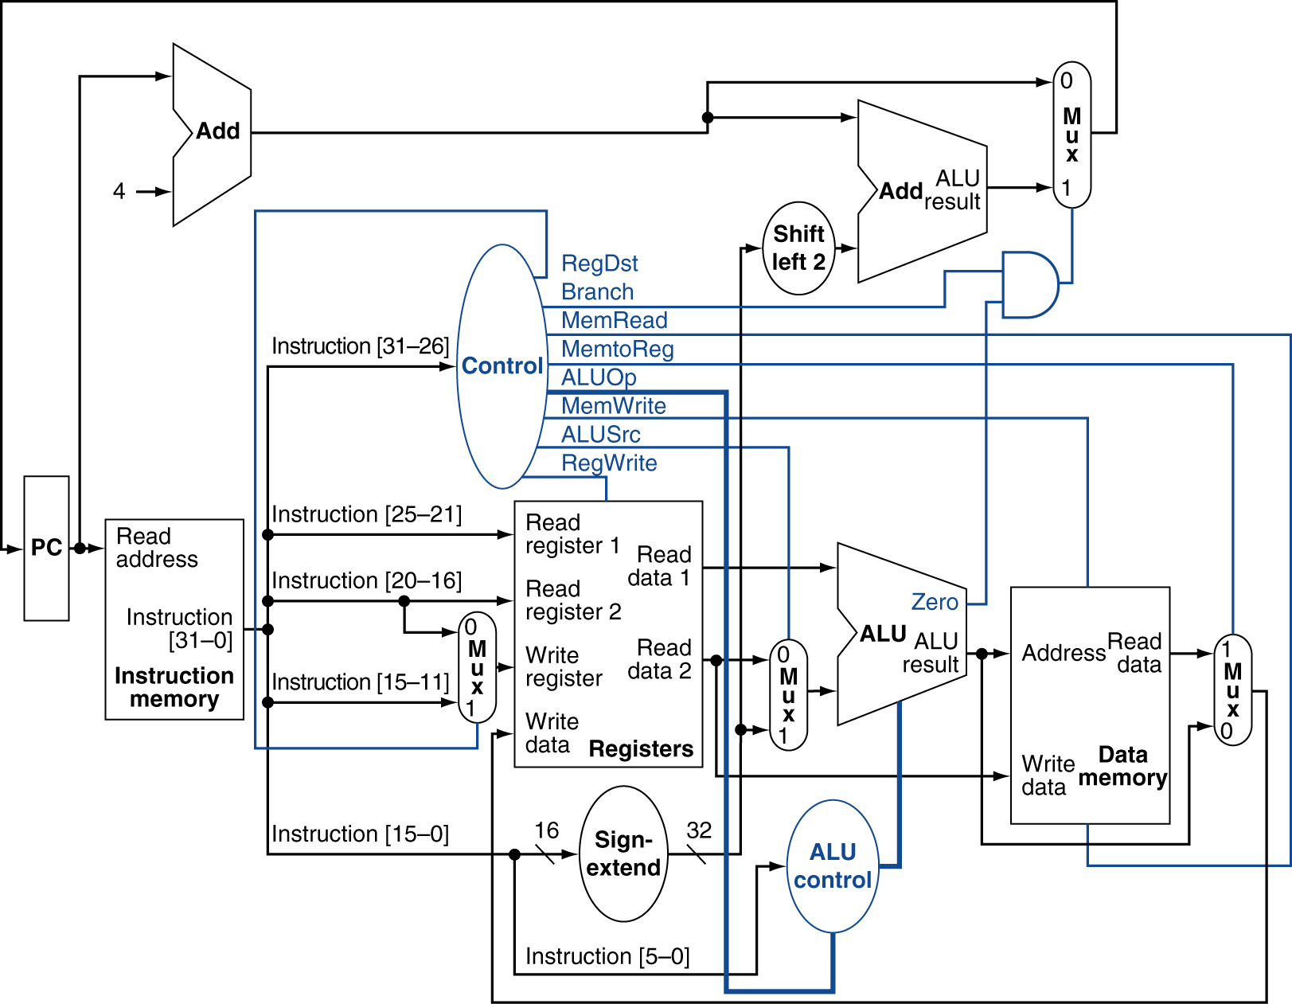
Datapath With Control

Slide 4
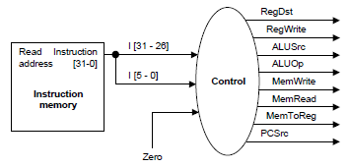
Virtual Control Unit
Combine two control units into a virtual control unit.
--needs 13 bits of inputs.
--6 bits from op field, 6 bits from func field, 1 bit from zero output of the ALU.
Control unit has 10 bits of output (including the control signal for jump)
A little different from textbook

Slide 5
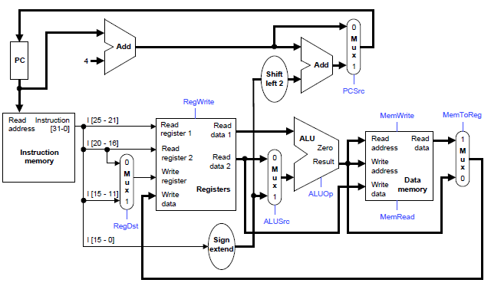
R-type Instruction Path
R-type instructions include add, sub, and, or, and slt.
ALUOp is determined by instruction’s func field.

Slide 6
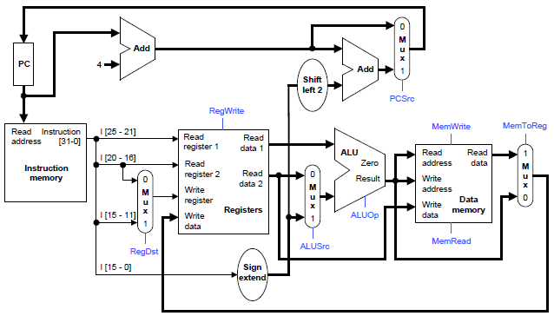
lw Instruction Path
Example load instruction is lw $t0, –4($sp)
ALUOp is 010 (add) to compute the address

Slide 7
sw Instruction Path
Example store instruction: sw $a0, 16($sp)
ALUOp is 010 (add) to compute the address

Slide 8
beq Instruction Path
Example branch instruction: beq $at, $0, offset
ALUOp is 110 (subtract), to test for equality
0
M
u
x
1
ALU’s Zero output indicates the equality
Add
PC
4
Add
Shift
left 2
PCSrc
RegWrite
Read
address
Instruction
[31-0]
I [25 - 21]
MemWrite
MemToReg
Read
register 1
Read
data 1
I [20 - 16]
ALU
Read
address
Read
data
1
M
u
x
0
Instruction
memory
Read
register 2
Zero
0
M
u
x
1
Read
data 2
0
M
u
x
1
Result
Write
address
Write
register
Write
data
Data
memory
I [15 - 11]
Write
data
Registers
ALUOp
ALUSrc
MemRead
RegDst
I [15 - 0]
Sign
extend

Slide 9
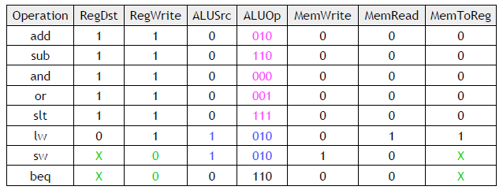
Control Signal Table
ALUOp for R-type instructions depends on the instructions’ func field.
PCSrc should be set as 1 when the instruction is beq and the zero output of ALU is 1.

Slide 10
J-type Format
J-type format: jump instruction.
Unlike branch instruction, the last field of jump instruction contains a word address instead of offset.
A 26-bit address field allows jump to any address from 0 to 2²⁸.
Word Address !
Byte Address !

Slide 11
Implementing Jumps
Jump
000010
address
31:26
25:0
Jump uses word address
Update PC with concatenation of
Top 4 bits of old PC
26-bit jump address
00
Need an extra control signal decoded from opcode

Slide 12
Pseudodirect Addressing
The jump address is the 26 bits of the instruction concatenated with the upper 4 bits of the PC, followed by 00.
0000 0000 0000 0000 0000 0000 11
1001 0000 0000 0000 0000 0000 0000 0000
PC31...PC28 AD26...AD01 0 0
1001 0000 0000 0000 0000 0000 0000 1100

Slide 13
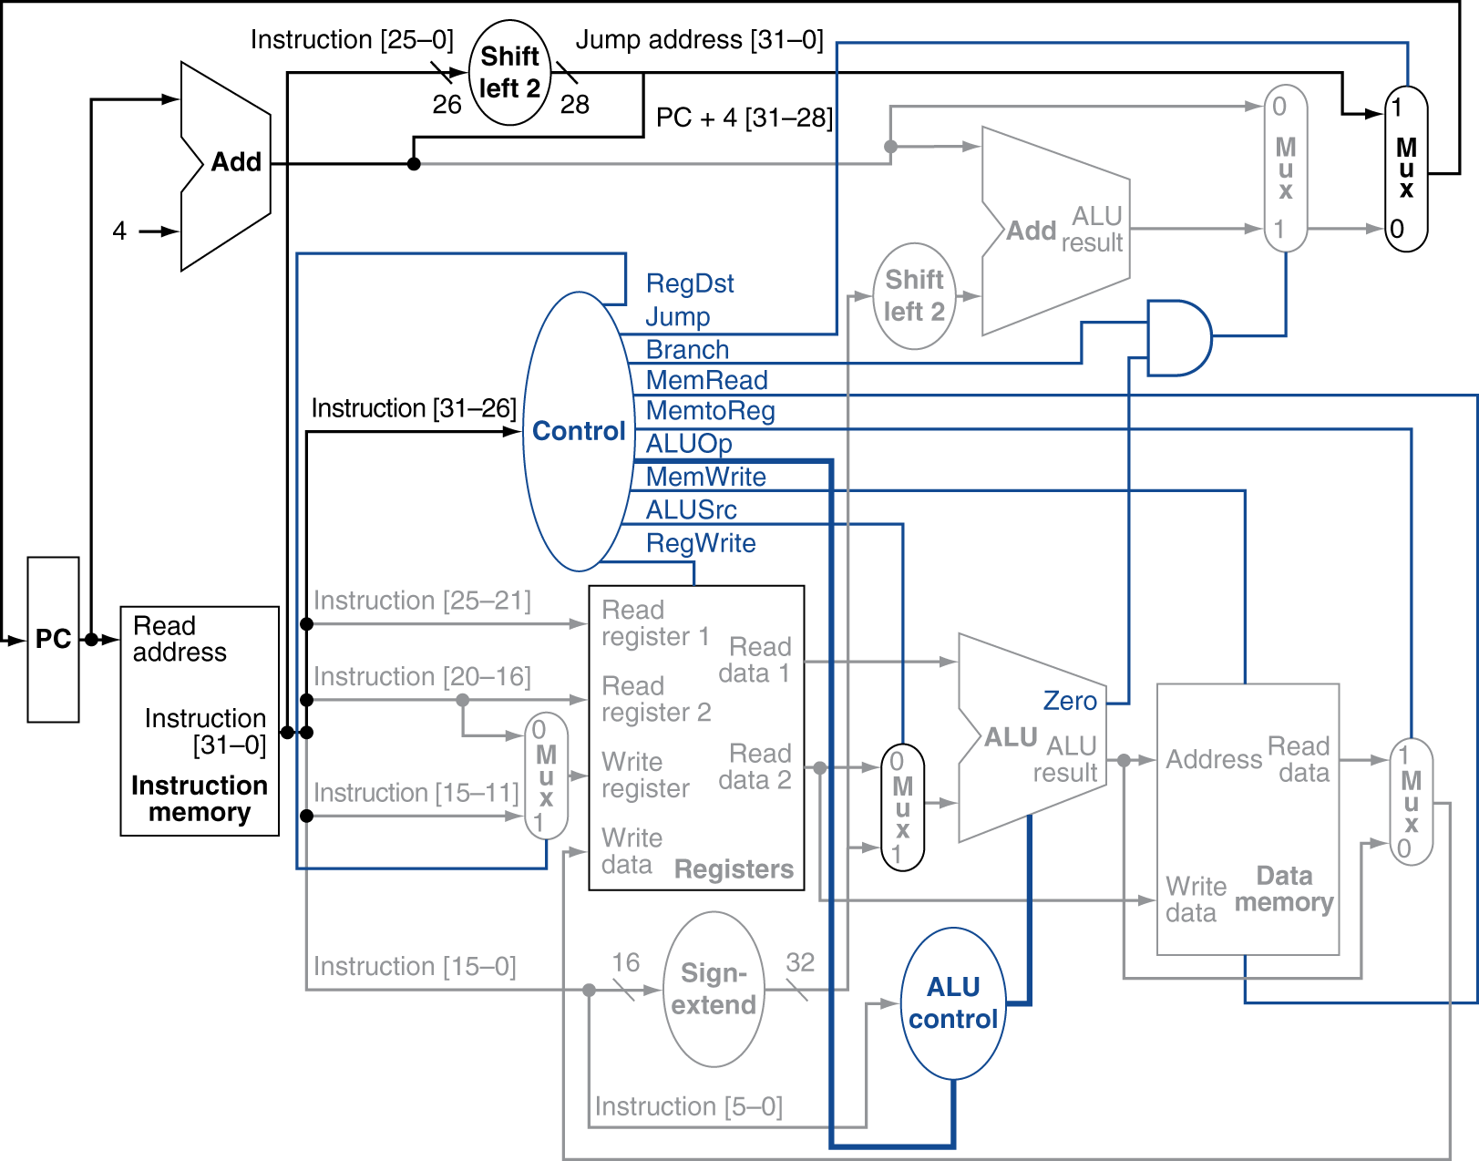
Jump instructions
Jump
000010
address
31:26
25:0

