Slide 1
CSE 341 Computer Organization Lecture 17 Processor : Pipelining 1
Prof. Lu Su
Computer Science Engineering, UB
Slides adapted from Raheel Ahmad, Luis Ceze , Sangyeun Cho,
Howard Huang, Bruce Kim, Josep Torrellas, Bo Yuan, and Craig Zilles

Slide 2
Task III
Single-cycle implementation:
-- All operations takes in one clock cycle
Multi-cycle implementation:
-- Fast operations take less time than slower ones
Pipelining
-- Overlap the execution of several instructions

Slide 3
Example from Laundry
Three steps for one load of laundry
-- One washer (takes 30 minutes)
-- One drier (takes 40 minutes)
-- One “folder” (takes 20 minutes)
Totally 20+30+40=90 minutes for one load of laundry

Slide 4
Sequential Way
A sequential way for 4 loads need 6 hours.
6 PM
7
8
9
10
11
Midnight
Time
30
40
20
30
40
20
30
40
20
30
40
20

Slide 5
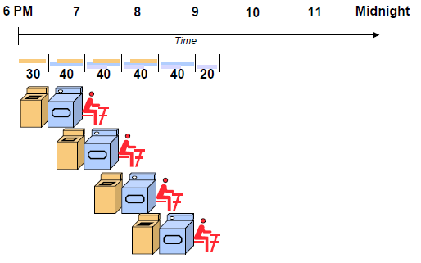
Pipelining Way
Each load is started as soon as possible (overlap)
Such pipelining strategy leads to take 3.5 hours

Slide 6
Some Observations on Pipelining
Pipelining doesn’t reduce latency of single load
Pipelining increase throughput of entire workload
Multiple tasks are operated simultaneously via the use of different resources
The speedup achieved by pipeline is reduced by extra time to “fill” and to “drain” the pipeline.
6 PM
7
8
9
Time
30
40
40
40
40
20

Slide 7
Pipelining
A general-purpose optimization technique
Analogous to daily lives
-- Assembly lines
-- Fast food restaurants
Rely on utilizing idle resource
Can be used to accelerate instruction execution (processors)

Slide 8
Instruction Execution Review
At most 5 steps for executing MIPS instruction
Not all instructions need all five steps.
Step | Name | Description
Instruction Fetch | IF | Read an instruction from memory.
Instruction Decode | ID | Read source registers and generate control signals.
Execute | EX | Compute an R-type result or a branch outcome.
Memory | MEM | Read or write the data memory.
Writeback | WB | Store a result in the destination register.
Instruction | Steps required
beq | IF | ID | EX
R-type | IF | ID | EX |  | WB
sw | IF | ID | EX | MEM
lw | IF | ID | EX | MEM | WB

Slide 9
Single-Cycle Datapath
0
M
u
x
1
Add
PC
4
Add
Shift
left 2
1ns
PCSrc
RegWrite
2ns
Read
address
Instruction
[31-0]
I [25 - 21]
2ns
MemWrite
MemToReg
Read
register 1
Read
data 1
I [20 - 16]
ALU
Read
address
Read
data
1
M
u
x
0
Instruction
memory
Read
register 2
Zero
0
M
u
x
1
Read
data 2
0
M
u
x
1
Result
Write
address
Write
register
Write
data
Data
memory
2ns
I [15 - 11]
Write
data
Registers
ALUOp
ALUSrc
MemRead
RegDst
I [15 - 0]
Sign
extend
1ns

Slide 10
Single-cycle Review
All five steps occur in one clock cycle.
-- “lw” in the instruction set has five steps
-- Cycle time must be long to accommodate it
-- In prior examples, all instructions needs 8ns.
Each hardware element can only be used once per cycle
-- Separate memory and data memory for “lw” or “sw” (need to access memory twice)
-- Multiple adders are required. One for instruction increments (PC) in the IF. Another for computation (EX). Additionally, an extra adder is needed for branches

Slide 11
Instruction Fetch (IF)
Example instruction: lw (ignore PC incrementing and branching).
In the IF step, instruction is read from memory.
RegWrite
Read
address
Instruction
[31-0]
I [25 - 21]
MemWrite
MemToReg
Read
register 1
Read
data 1
I [20 - 16]
ALU
Read
address
Read
data
1
M
u
x
0
Instruction
memory
Read
register 2
Zero
0
M
u
x
1
Read
data 2
0
M
u
x
1
Result
Write
address
Write
register
Write
data
Data
memory
I [15 - 11]
Write
data
Registers
ALUOp
ALUSrc
MemRead
RegDst
I [15 - 0]
Sign
extend

Slide 12
Instruction Decode (ID)
In the ID step, source register is read from the register file.
RegWrite
Read
address
Instruction
[31-0]
I [25 - 21]
MemWrite
MemToReg
Read
register 1
Read
data 1
I [20 - 16]
ALU
Read
address
Read
data
1
M
u
x
0
Instruction
memory
Read
register 2
Zero
0
M
u
x
1
Read
data 2
0
M
u
x
1
Result
Write
address
Write
register
Write
data
Data
memory
I [15 - 11]
Write
data
Registers
ALUOp
ALUSrc
MemRead
RegDst
I [15 - 0]
Sign
extend

Slide 13
Execute (EX)
In the EX step, effective memory address is computed by using the source register and the instruction’s constant field.
RegWrite
Read
address
Instruction
[31-0]
I [25 - 21]
MemWrite
MemToReg
Read
register 1
Read
data 1
I [20 - 16]
ALU
Read
address
Read
data
1
M
u
x
0
Instruction
memory
Read
register 2
Zero
0
M
u
x
1
Read
data 2
0
M
u
x
1
Result
Write
address
Write
register
Write
data
Data
memory
I [15 - 11]
Write
data
Registers
ALUOp
ALUSrc
MemRead
RegDst
I [15 - 0]
Sign
extend

Slide 14
Memory (MEM)
In the MEM step, the data memory is read via the address computed by the ALU.
RegWrite
Read
address
Instruction
[31-0]
I [25 - 21]
MemWrite
MemToReg
Read
register 1
Read
data 1
I [20 - 16]
ALU
Read
address
Read
data
1
M
u
x
0
Instruction
memory
Read
register 2
Zero
0
M
u
x
1
Read
data 2
0
M
u
x
1
Result
Write
address
Write
register
Write
data
Data
memory
I [15 - 11]
Write
data
Registers
ALUOp
ALUSrc
MemRead
RegDst
I [15 - 0]
Sign
extend

Slide 15
Writeback (WB)
In the WB step, the memory value is stored into the destination register.
RegWrite
Read
address
Instruction
[31-0]
I [25 - 21]
MemWrite
MemToReg
Read
register 1
Read
data 1
I [20 - 16]
ALU
Read
address
Read
data
1
M
u
x
0
Instruction
memory
Read
register 2
Zero
0
M
u
x
1
Read
data 2
0
M
u
x
1
Result
Write
address
Write
register
Write
data
Data
memory
I [15 - 11]
Write
data
Registers
ALUOp
ALUSrc
MemRead
RegDst
I [15 - 0]
Sign
extend

Slide 16
What we can find…
Each execution step uses a different functional unit.
That means, the main units are idle for most of the 8ns cycle!
-- Instruction memory is used for just 2ns at the start of the cycle.
-- Registers are read once in ID (1ns), and written once in WB (1ns).
-- ALU is used for 2ns near the middle of the cycle.
-- Reading the data memory only takes 2ns.
A lot of idle hardware!

Slide 17
Make those idle units work
We do not have to wait for the entire instruction to complete before we can re-use the functional units.
An example: Instruction memory is free in ID step
Idle
Instruction Decode (ID)
RegWrite
Read
address
Instruction
[31-0]
I [25 - 21]
MemWrite
MemToReg
Read
register 1
Read
data 1
I [20 - 16]
ALU
Read
address
Read
data
1
M
u
x
0
Instruction
memory
Read
register 2
Zero
0
M
u
x
1
Read
data 2
0
M
u
x
1
Result
Write
address
Write
register
Write
data
Data
memory
I [15 - 11]
Write
data
Registers
ALUOp
ALUSrc
MemRead
RegDst
I [15 - 0]
Sign
extend

Slide 18
Decoding and Fetching Together
In that case, we can let processor fetch the next instruction while we’re decoding the first one.
Fetch 2nd
Decode 1st instruction
RegWrite
Read
address
Instruction
[31-0]
I [25 - 21]
MemWrite
MemToReg
Read
register 1
Read
data 1
I [20 - 16]
ALU
Read
address
Read
data
1
M
u
x
0
Instruction
memory
Read
register 2
Zero
0
M
u
x
1
Read
data 2
0
M
u
x
1
Result
Write
address
Write
register
Write
data
Data
memory
I [15 - 11]
Write
data
Registers
ALUOp
ALUSrc
MemRead
RegDst
I [15 - 0]
Sign
extend

Slide 19
Executing, Decoding and Fetching
Once the first instruction enters its Execute stage, we can go ahead and decode the second instruction.
And since the instruction memory is free again, so we can fetch the third instruction…
Fetch 3rd
Decode 2nd
Execute 1st
RegWrite
Read
address
Instruction
[31-0]
I [25 - 21]
MemWrite
MemToReg
Read
register 1
Read
data 1
I [20 - 16]
ALU
Read
address
Read
data
1
M
u
x
0
Instruction
memory
Read
register 2
Zero
0
M
u
x
1
Read
data 2
0
M
u
x
1
Result
Write
address
Write
register
Write
data
Data
memory
I [15 - 11]
Write
data
Registers
ALUOp
ALUSrc
MemRead
RegDst
I [15 - 0]
Sign
extend

Slide 20
Making Pipelining Work
Based on this idea, the lw instructions can be pipelined via 5 stages.
-- Stages are: IF, ID, EX, MEM, and WB
-- Such arrangement can support executing 5 instructions simultaneously: one in each stage.
-- Each stage has its own functional units.
-- Each stage can execute in 2ns, similar to multi-cycle implementation

Slide 21
5-Stage Pipeline
IF
ID
EXE
MEM
WB
RegWrite
Read
address
Instruction
[31-0]
I [25 - 21]
MemWrite
MemToReg
Read
register 1
Read
data 1
I [20 - 16]
ALU
Read
address
Read
data
1
M
u
x
0
Instruction
memory
Read
register 2
Zero
0
M
u
x
1
Read
data 2
0
M
u
x
1
Result
Write
address
Write
register
Write
data
Data
memory
I [15 - 11]
Write
data
Registers
ALUOp
ALUSrc
MemRead
RegDst
I [15 - 0]
Sign
extend
2ns
2ns
2ns
2ns

Slide 22
Pipelining Loads
 | Clock cycle
 | 1 | 2 | 3 | 4 | 5 | 6 | 7 | 8 | 9
lw $t0, 4($sp) | IF | ID | EX | MEM | WB
lw $t1, 8($sp) |  | IF | ID | EX | MEM | WB
lw $t2, 12($sp) |  |  | IF | ID | EX | MEM | WB
lw $t3, 16($sp) |  |  |  | IF | ID | EX | MEM | WB
lw $t4, 20($sp) |  |  |  |  | IF | ID | EX | MEM | WB
6 PM
7
8
9
Time
30
40
40
40
40
20

Slide 23
Pipeline Diagram
Pipeline diagram shows the execution of a series of instructions.
-- Instruction sequence is shown vertically (top to bottom)
-- Clock cycles are shown horizontally (left to right)
-- Each instruction is divided into its component stages.
Overlapping of instructions is shown in the diagram.
 | Clock cycle
 | 1 | 2 | 3 | 4 | 5 | 6 | 7 | 8 | 9
lw $t0, 4($sp) | IF | ID | EX | MEM | WB
sub $v0, $a0, $a1 |  | IF | ID | EX | MEM | WB
and $t1, $t2, $t3 |  |  | IF | ID | EX | MEM | WB
or $s0, $s1, $s2 |  |  |  | IF | ID | EX | MEM | WB
add $sp, $sp, -4 |  |  |  |  | IF | ID | EX | MEM | WB

Slide 24
Some Terminology
The pipeline depth is the number of stages: 5 in this case
In the first 4 cycles here, the pipeline is filling, since there are idle functional units.
In cycle 5, the pipeline is full. Five instructions are being executed simultaneously, no idle functional units.
In cycles 6-9, the pipeline is emptying.
 | Clock cycle
 | 1 | 2 | 3 | 4 | 5 | 6 | 7 | 8 | 9
lw $t0, 4($sp) | IF | ID | EX | MEM | WB
sub $v0, $a0, $a1 |  | IF | ID | EX | MEM | WB
and $t1, $t2, $t3 |  |  | IF | ID | EX | MEM | WB
or $s0, $s1, $s2 |  |  |  | IF | ID | EX | MEM | WB
add $sp, $sp, -4 |  |  |  |  | IF | ID | EX | MEM | WB
filling
full
emptying

Slide 25
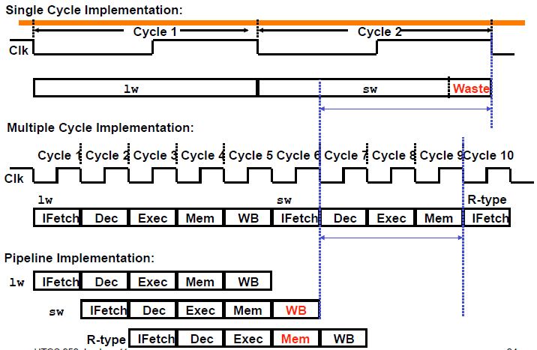
Single vs Multiple vs Pipelining

Slide 26
Pipelining Performance
Execution time on ideal pipeline:
--Time to fill the pipeline + one cycle per instruction
--What is the execution time for N instructions?
Compare with other implementations:
-- eg. Single Cycle with 8ns clock period ?
How much faster is pipelining for N=1000 ?

Slide 27
Pipelining other instruction types
For other types of instructions, eg. R-type instructions, it only require 4 stages: IF, ID, EX, and WB
-- MEM stage is not needed.
Some problems when we try to pipeline loads with R-type instructions…
 | Clock cycle
 | 1 | 2 | 3 | 4 | 5 | 6 | 7 | 8 | 9
add $sp, $sp, -4 | IF | ID | EX | WB
sub $v0, $a0, $a1 |  | IF | ID | EX | WB
lw $t0, 4($sp) |  |  | IF | ID | EX | MEM | WB
or $s0, $s1, $s2 |  |  |  | IF | ID | EX | WB
lw $t1, 8($sp) |  |  |  |  | IF | ID | EX | MEM | WB

Slide 28
A Solution: Insert NOP Stages
Enforce uniformity
-- Make all instructions take 5 cycles with the same stages in the same order
-- Some stages will do nothing for some instructions
R-type | IF | ID | EX | NOP | WB
 | Clock cycle
 | 1 | 2 | 3 | 4 | 5 | 6 | 7 | 8 | 9
add $sp, $sp, -4 | IF | ID | EX | NOP | WB
sub $v0, $a0, $a1 |  | IF | ID | EX | NOP | WB
lw $t0, 4($sp) |  |  | IF | ID | EX | MEM | WB
or $s0, $s1, $s2 |  |  |  | IF | ID | EX | NOP | WB
lw $t1, 8($sp) |  |  |  |  | IF | ID | EX | MEM | WB
store | IF | ID | EX | MEM | NOP
branch | IF | ID | EX | NOP | NOP

