Slide 1
CSE 341 Computer Organization Lecture 18 Processor : Pipelining 2
Prof. Lu Su
Computer Science Engineering, UB
Slides adapted from Raheel Ahmad, Luis Ceze , Sangyeun Cho,
Howard Huang, Bruce Kim, Josep Torrellas, Bo Yuan, and Craig Zilles

Slide 2
Task III
Single-cycle implementation:
-- All operations takes in one clock cycle
Multi-cycle implementation:
-- Fast operations take less time than slower ones
Pipelining
-- Overlap the execution of several instructions

Slide 3
5-Stage Pipeline
IF
ID
EXE
MEM
WB
RegWrite
Read
address
Instruction
[31-0]
I [25 - 21]
MemWrite
MemToReg
Read
register 1
Read
data 1
I [20 - 16]
ALU
Read
address
Read
data
1
M
u
x
0
Instruction
memory
Read
register 2
Zero
0
M
u
x
1
Read
data 2
0
M
u
x
1
Result
Write
address
Write
register
Write
data
Data
memory
I [15 - 11]
Write
data
Registers
ALUOp
ALUSrc
MemRead
RegDst
I [15 - 0]
Sign
extend
2ns
2ns
2ns
2ns

Slide 4
Pipelining Loads
 | Clock cycle
 | 1 | 2 | 3 | 4 | 5 | 6 | 7 | 8 | 9
lw $t0, 4($sp) | IF | ID | EX | MEM | WB
lw $t1, 8($sp) |  | IF | ID | EX | MEM | WB
lw $t2, 12($sp) |  |  | IF | ID | EX | MEM | WB
lw $t3, 16($sp) |  |  |  | IF | ID | EX | MEM | WB
lw $t4, 20($sp) |  |  |  |  | IF | ID | EX | MEM | WB
6 PM
7
8
9
Time
30
40
40
40
40
20

Slide 5
Pipeline Diagram
Pipeline diagram shows the execution of a series of instructions.
-- Instruction sequence is shown vertically (top to bottom)
-- Clock cycles are shown horizontally (left to right)
-- Each instruction is divided into its component stages.
Overlapping of instructions is shown in the diagram.
 | Clock cycle
 | 1 | 2 | 3 | 4 | 5 | 6 | 7 | 8 | 9
lw $t0, 4($sp) | IF | ID | EX | MEM | WB
sub $v0, $a0, $a1 |  | IF | ID | EX | MEM | WB
and $t1, $t2, $t3 |  |  | IF | ID | EX | MEM | WB
or $s0, $s1, $s2 |  |  |  | IF | ID | EX | MEM | WB
add $sp, $sp, -4 |  |  |  |  | IF | ID | EX | MEM | WB

Slide 6
Some Terminology
The pipeline depth is the number of stages: 5 in this case
In the first 4 cycles here, the pipeline is filling, since there are idle functional units.
In cycle 5, the pipeline is full. Five instructions are being executed simultaneously, no idle functional units.
In cycles 6-9, the pipeline is emptying.
 | Clock cycle
 | 1 | 2 | 3 | 4 | 5 | 6 | 7 | 8 | 9
lw $t0, 4($sp) | IF | ID | EX | MEM | WB
sub $v0, $a0, $a1 |  | IF | ID | EX | MEM | WB
and $t1, $t2, $t3 |  |  | IF | ID | EX | MEM | WB
or $s0, $s1, $s2 |  |  |  | IF | ID | EX | MEM | WB
add $sp, $sp, -4 |  |  |  |  | IF | ID | EX | MEM | WB
filling
full
emptying

Slide 7
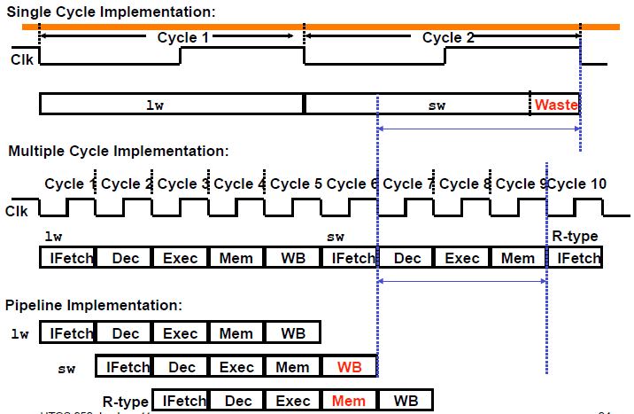
Single vs Multiple vs Pipelining

Slide 8
Pipelining Performance
Execution time on ideal pipeline:
--Time to fill the pipeline + one cycle per instruction
--What is the execution time for N instructions?
Compare with other implementations:
-- eg. Single Cycle with 8ns clock period ?
How much faster is pipelining for N=1000 ?

Slide 9
Pipelining other instruction types
For other types of instructions, eg. R-type instructions, it only require 4 stages: IF, ID, EX, and WB
-- MEM stage is not needed.
Some problems when we try to pipeline loads with R-type instructions…
 | Clock cycle
 | 1 | 2 | 3 | 4 | 5 | 6 | 7 | 8 | 9
add $sp, $sp, -4 | IF | ID | EX | WB
sub $v0, $a0, $a1 |  | IF | ID | EX | WB
lw $t0, 4($sp) |  |  | IF | ID | EX | MEM | WB
or $s0, $s1, $s2 |  |  |  | IF | ID | EX | WB
lw $t1, 8($sp) |  |  |  |  | IF | ID | EX | MEM | WB

Slide 10
A solution: Insert NOP stages
Enforce uniformity
-- Make all instructions take 5 cycles with the same stages in the same order
-- Some stages will do nothing for some instructions
R-type | IF | ID | EX | NOP | WB
 | Clock cycle
 | 1 | 2 | 3 | 4 | 5 | 6 | 7 | 8 | 9
add $sp, $sp, -4 | IF | ID | EX | NOP | WB
sub $v0, $a0, $a1 |  | IF | ID | EX | NOP | WB
lw $t0, 4($sp) |  |  | IF | ID | EX | MEM | WB
or $s0, $s1, $s2 |  |  |  | IF | ID | EX | NOP | WB
lw $t1, 8($sp) |  |  |  |  | IF | ID | EX | MEM | WB
store | IF | ID | EX | MEM | NOP
branch | IF | ID | EX | NOP | NOP

Slide 11
Review of Pipelining
Pipelined processor allows multiple instructions to execute simultaneously. Each instruction uses a different functional unit in the datapath.
Increased throughput and faster program
-- Simpler stages also lead to shorter cycle times.
 | Clock cycle
 | 1 | 2 | 3 | 4 | 5 | 6 | 7 | 8 | 9
lw $t0, 4($sp) | IF | ID | EX | MEM | WB
sub $v0, $a0, $a1 |  | IF | ID | EX | MEM | WB
and $t1, $t2, $t3 |  |  | IF | ID | EX | MEM | WB
or $s0, $s1, $s2 |  |  |  | IF | ID | EX | MEM | WB
add $t5, $t6, $0 |  |  |  |  | IF | ID | EX | MEM | WB

Slide 12
Datapath in Pipelining
The key idea of pipelining is to allow multiple instructions to execute at the same time.
So several operations are needed to be performed in the same cycle.
-- Increment the PC and add registers
-- Fetch one instruction and access data memory
Similar to single-cycle datapath, datapath of pipelined processor need duplicate hardware units
 | Clock cycle
 | 1 | 2 | 3 | 4 | 5 | 6 | 7 | 8 | 9
lw $t0, 4($sp) | IF | ID | EX | MEM | WB
sub $v0, $a0, $a1 |  | IF | ID | EX | MEM | WB
and $t1, $t2, $t3 |  |  | IF | ID | EX | MEM | WB
or $s0, $s1, $s2 |  |  |  | IF | ID | EX | MEM | WB
add $t5, $t6, $0 |  |  |  |  | IF | ID | EX | MEM | WB

Slide 13
One register file is enough
Only one register file is enough to support both the ID and WB stages.
-- Reads and writes go to separate ports on the register file.
-- Writes occur in the first half of the cycle, reads occur in the second half.
Read
register 1
Read
data 1
Read
register 2
Read
data 2
Write
register
Write
data
Registers

Slide 14
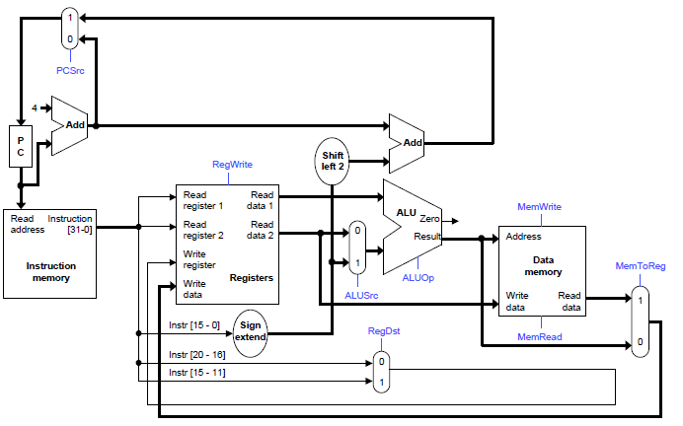
Review of Single-cycle Datapath (slightly rearranged)

Slide 15
Recall of Intermediate registers in Multi-Cycle Design
Some outputs of a functional unit in multi-cycle design need to be used in later cycle, for example:
-- The instruction word fetched in stage 1 determines the destination of the register write in stage 5
These outputs need to be stored in intermediate registers
-- Save the instruction read in stage 1 in Instruction register
-- Save Register file outputs from stage 2 in registers A and B
-- Save the ALU output in register ALUOut
-- Save the data fetched from memory in stage 4 in the Memory data register(MDR)

Slide 16
The Final Multi-cycle Datapath
PCWrite
PC
ALUSrcA
IorD
0
M
u
x
1
RegDst
RegWrite
0
M
u
x
1
MemRead
0
M
u
x
1
Read
register 1
Read
data 1
A
ALU
Address
Zero
IRWrite
Read
register 2
Result
ALU
Out
Memory
0
M
u
x
1
Read
data 2
B
0
1
2
3
[31-26]
[25-21]
[20-16]
[15-11]
[15-0]
Write
register
4
PCSource
Write
data
Mem
Data
ALUOp
Write
data
Registers
MemWrite
Instruction
register
0
M
u
x
1
ALUSrcB
Sign
extend
Shift
left 2
Memory
data
register
MemToReg

Slide 17
Pipeline Registers
Intermediate registers are needed to guarantee functional validity.
-- Drawing one big pipeline register between each stage to simplify drawing.
The registers are named for the stages they connect.
-- IF/ID ID/EX EX/MEM MEM/WB
No register is needed after the WB stage since at that time the instruction has been done.

Slide 18
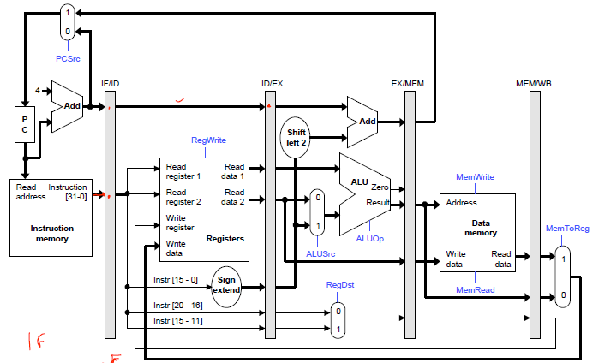
Pipelined datapath

Slide 19
Pipelining
Similarly to datapath, some control signals must be propagated through the pipeline until they reach the appropriate stage.
--Just pass them in the pipeline registers, along with the other data.
Control signals can be categorized by the pipeline stage that uses them.

Slide 20
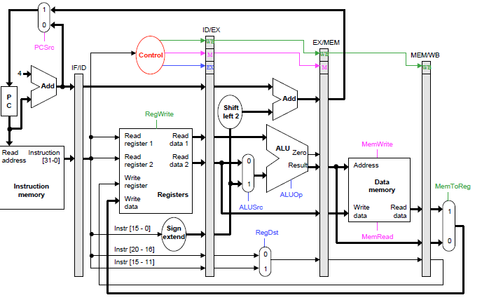
Pipelined Datapath and Control

Slide 21
Example
An example
Some assumptions:
-- Each register contains its number plus 100. For instance, register $8 contains 108
-- Every data memory location contains 99.
Our pipeline diagrams will follow some conventions.
-- X indicates values that aren’t important
-- ??? indicate values we don’t know

Slide 22
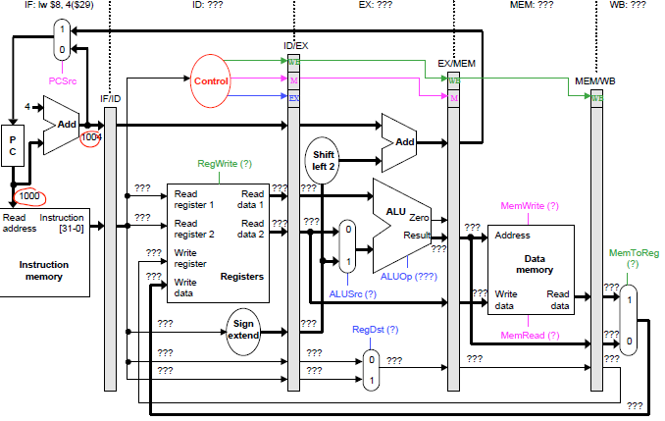
Cycle 1 (filling)

Slide 23
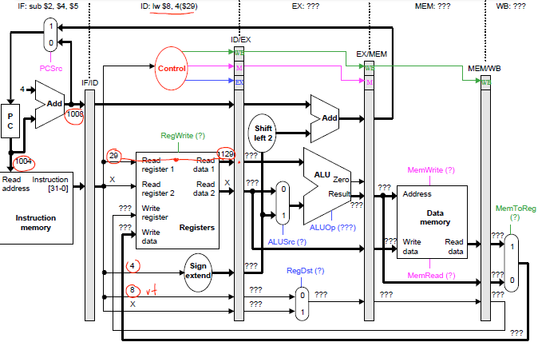
Cycle 2

Slide 24
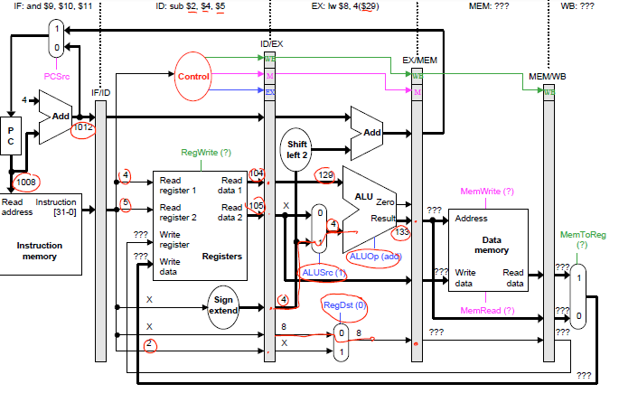
Cycle 3

Slide 25
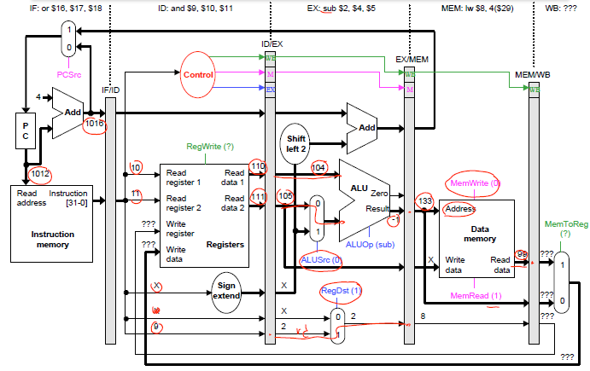
Cycle 4

Slide 26
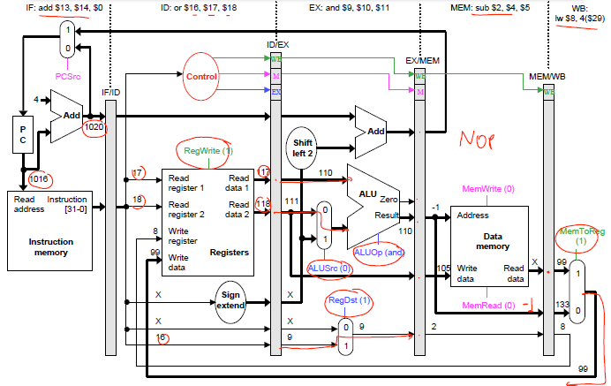
Cycle 5

Slide 27
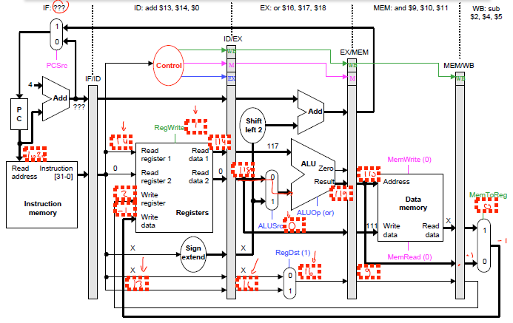
Cycle 6

Slide 28
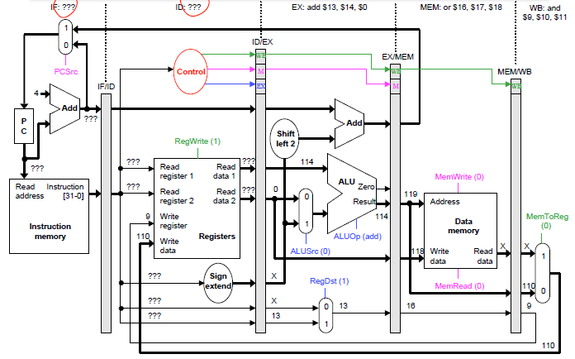
Cycle 7

Slide 29
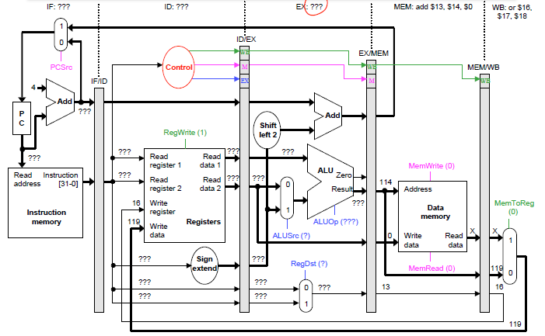
Cycle 8

Slide 30
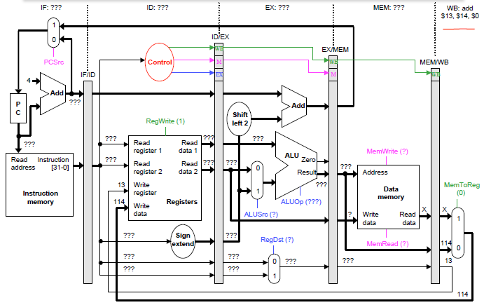
Cycle 9

Slide 31
Some Conclusions
Using the prior pipeline, up to five instructions can be executed simultaneously.
-- Implies that the maximum speedup is 5 times.
-- In general, the ideal speedup equals the pipeline depth.
Pipelining does not improve the execution time of any single instruction.
Some times pipeline even makes instruction actually takes longer to execute than in a single-cycle datapath
Instead, pipelining increases the throughput, or the amount of work done per unit time. Here, several instructions are executed together in each clock cycle.
The result is improved execution time for a sequence of instructions, such as an entire program.

