Slide 1
CSE 341 Computer Organization Lecture 19 Processor : Pipelining 3
Prof. Lu Su
Computer Science Engineering, UB
Slides adapted from Raheel Ahmad, Luis Ceze , Sangyeun Cho,
Howard Huang, Bruce Kim, Josep Torrellas, Bo Yuan, and Craig Zilles

Slide 2
Task III
Single-cycle implementation:
-- All operations takes in one clock cycle
Multi-cycle implementation:
-- Fast operations take less time than slower ones
Pipelining
-- Overlap the execution of several instructions

Slide 3
Review of pipeline diagram
Above is an ideal code fragment.
-- Each instruction needs a total of five cycles for execution.
-- One instruction begins on every clock cycle for first five cycles.
-- One instruction completes on each cycle from that time on.
-- Each instruction is independent (completely operates on different registers).
 | Clock cycle
 | 1 | 2 | 3 | 4 | 5 | 6 | 7 | 8 | 9
lw $8, 4($29) | IF | ID | EX | MEM | WB
sub $2, $4, $5 |  | IF | ID | EX | MEM | WB
and $9, $10, $11 |  |  | IF | ID | EX | MEM | WB
or $16, $17, $18 |  |  |  | IF | ID | EX | MEM | WB
add $13, $14, $0 |  |  |  |  | IF | ID | EX | MEM | WB

Slide 4
Example with dependencies
sub $2, $1, $3
and $12, $2, $5
or $13, $6, $2
add $14, $2, $2
sw $15, 100($2)
Several dependencies in this code fragment.
-- The first instruction, SUB, stores a value into $2.
-- $2 is used as a source in the rest of the instructions.
Not a problem for the single/multi cycle datapaths.
-- Each instruction is executed completely before the next one begins.

Slide 5
Data Hazards (1)
 | Clock cycle
 | 1 | 2 | 3 | 4 | 5 | 6 | 7 | 8 | 9
sub $2, $1, $3 | IF | ID | EX | MEM | WB
and $12, $2, $5 |  | IF | ID | EX | MEM | WB
or $13, $6, $2 |  |  | IF | ID | EX | MEM | WB
add $14, $2, $2 |  |  |  | IF | ID | EX | MEM | WB
sw $15, 100($2) |  |  |  |  | IF | ID | EX | MEM | WB
Two data hazards in the pipelined datapath.
-- The AND reads register $2 in cycle 3. Since SUB hasn’t modified the register yet, this will be the old value of $2, not the new one.
-- The OR instruction uses register $2 in cycle 4, again before it’s actually updated by SUB.

Slide 6
Data Hazards (2)
 | Clock cycle
 | 1 | 2 | 3 | 4 | 5 | 6 | 7 | 8 | 9
sub $2, $1, $3 | IF | ID | EX | MEM | WB
and $12, $2, $5 |  | IF | ID | EX | MEM | WB
or $13, $6, $2 |  |  | IF | ID | EX | MEM | WB
add $14, $2, $2 |  |  |  | IF | ID | EX | MEM | WB
sw $15, 100($2) |  |  |  |  | IF | ID | EX | MEM | WB
The ADD instruction is okay, because of the design of register file:
-- Registers are written at the beginning of a clock cycle.
-- The new value will be available by the end of that cycle.
The SW is no problem at all, since it reads $2 after the SUB finishes.

Slide 7
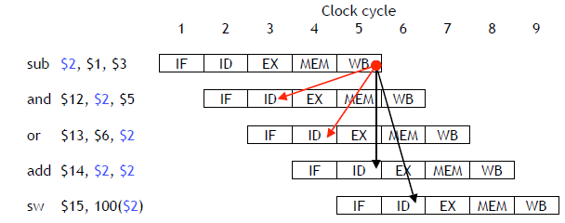
Dependency Arrows(1)
Arrows indicate the flow of data between instructions.
-- The tails of the arrows show when register $2 is written.
-- The heads of the arrows show when $2 is read.
Any arrow that points backwards in time represents a data hazard in our basic pipelined datapath. Here, hazards exist between instructions 1 & 2 and 1 & 3.

Slide 8
Dependency Arrows(2)
Clock cycle
1 2 3 4 5 6 7 8 9
sub $2, $1, $3
and $12, $2, $5
or $13, $6, $2
add $14, $2, $2
sw $15, 100($2)
IM
Reg
DM
Reg
IM
Reg
DM
Reg
IM
Reg
DM
Reg
IM
Reg
DM
Reg
IM
Reg
DM
Reg

Slide 9
Resolving Data Hazards (1)
Strategy 1:
Wait for the result to be available by stalling earlier pipeline stages

Slide 10
Stalled Stages and Pipeline Bubbles
time
t0 t1 t2 t3 t4 t5 t6 t7 . . . .
(I₁) r1 ← (r0) + 10 IF₁ ID₁ EX₁ MA₁ WB₁
(I₂) r4 ← (r1) + 17 IF₂ ID₂ ID₂ ID₂ ID₂ EX₂ MA₂ WB₂
(I₃) IF₃ IF₃ IF₃ IF₃ ID₃ EX₃ MA₃ WB₃
(I₄) IF₄ ID₄ EX₄ MA₄ WB₄
(I₅) IF₅ ID₅ EX₅ MA₅ WB₅
stalled stages
time
t0 t1 t2 t3 t4 t5 t6 t7 . . . .
IF I₁ I₂ I₃ I₃ I₃ I₃ I₄ I₅
ID I₁ I₂ I₂ I₂ I₂ I₃ I₄ I₅
EX I₁ nop nop nop I₂ I₃ I₄ I₅
MA I₁ nop nop nop I₂ I₃ I₄ I₅
WB I₁ nop nop nop I₂ I₃ I₄ I₅
Resource
Usage
nop ⇒ pipeline bubble

Slide 11
Resolving Data Hazards (2)
Strategy 2:
Forward data as soon as possible after it is calculated to the earlier pipeline stage

Slide 12
How to eliminate hazards(1)
In the example AND and OR instructions in the example should use the correct value for $2.
When is the data is actually produced and consumed?
-- SUB instruction produces its result in its EX stage, during cycle 3 in the diagram below.
-- AND and OR need the new value of $2 in their EX stages, during clock cycles 4-5 here.
 | Clock cycle
 | 1 | 2 | 3 | 4 | 5 | 6 | 7
sub $2, $1, $3 | IF | ID | EX | MEM | WB
and $12, $2, $5 |  | IF | ID | EX | MEM | WB
or $13, $6, $2 |  |  | IF | ID | EX | MEM | WB

Slide 13
How to eliminate hazards(2)
The actual result $1 - $3 is computed in clock cycle 3, before it’s needed in cycles 4 and 5.
-- In general, we need to somehow bypass the writeback and register read stages when needed.
-- More specifically, We need to pass the ALU output from SUB directly to the AND and OR instructions, without going through the register file.
 | Clock cycle
 | 1 | 2 | 3 | 4 | 5 | 6 | 7
sub $2, $1, $3 | IF | ID | EX | MEM | WB
and $12, $2, $5 |  | IF | ID | EX | MEM | WB
or $13, $6, $2 |  |  | IF | ID | EX | MEM | WB

Slide 14
Forwarding
The ALU result generated in the EX stage is normally passed through the pipeline registers to the MEM and WB stages, before it is finally written to the register file.
Hence, we could just forward that value to subsequent instructions, to prevent data hazards.
Clock cycle
1 2 3 4 5 6 7
sub $2, $1, $3
and $12, $2, $5
or $13, $6, $2
IM
Reg
DM
Reg
IM
Reg
DM
Reg
IM
Reg
DM
Reg

Slide 15
Outline of forwarding hardware
Forwarding unit selects correct ALU inputs for EX.
-- If there is no hazard, the ALU’s operands will come from the register file, just like before.
-- If there is a hazard, the operands will come from either the EX/MEM or MEM/WB pipeline registers.
ALU sources will be selected by two new multiplexers, with control signals ForwardA and ForwardB.
sub $2, $1, $3
and $12, $2, $5
or $13, $6, $2
IM
Reg
DM
Reg
IM
Reg
DM
Reg
IM
Reg
DM
Reg

Slide 16
Datapath with Forwarding Muxes
IF/ID
ID/EX
EX/MEM
MEM/WB
PC
0
1
2
Instruction
memory
Registers
ForwardA
ALU
0
1
2
Data
memory
1
0
Rt
ForwardB
0
1
Rd

Slide 17
How to Detect EX/MEM Hazard(1)
An EX/MEM hazard occurs between the instruction currently in its EX stage and the previous instruction if:
The previous instruction will write to the register file, and
The destination is one of the ALU source registers in the EX stage.
Data in a pipeline register can be referenced using a class-like syntax. For example, ID/EX.RegisterRt refers to the rt field stored in the ID/EX pipeline.
sub $2, $1, $3
and $12, $2, $5
IM
Reg
DM
Reg
IM
Reg
DM
Reg

Slide 18
How to Detect EX/MEM Hazard (2)
First ALU source comes from pipeline register when necessary.
if (EX/MEM.RegWrite = 1
and EX/MEM.RegisterRd = ID/EX.RegisterRs)
then ForwardA = 2
The second ALU source is similar.
if (EX/MEM.RegWrite = 1
and EX/MEM.RegisterRd = ID/EX.RegisterRt)
then ForwardB = 2
sub $2, $1, $3
and $12, $2, $5
IM
Reg
DM
Reg
IM
Reg
DM
Reg

Slide 19
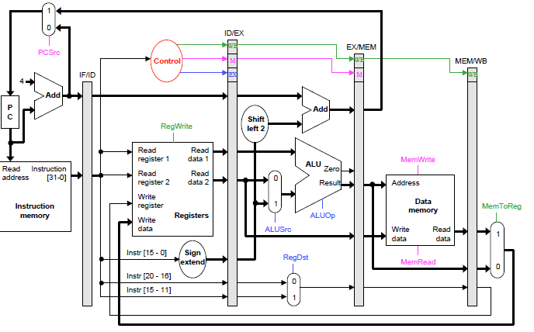
Pipelined Datapath and Control

Slide 20
How to Detect MEM/WB Hazard(1)
A MEM/WB hazard may occur between an instruction in the EX stage and the instruction from two cycles ago.
sub $2, $1, $3
and $12, $2, $5
or $13, $6, $2
IM
Reg
DM
Reg
IM
Reg
DM
Reg
IM
Reg
DM
Reg

Slide 21
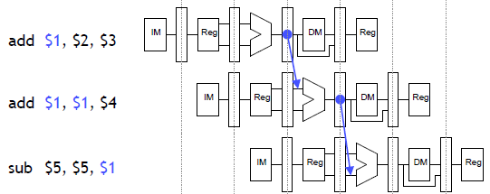
How to Detect MEM/WB Hazard(2)
A MEM/WB hazard may occur between an instruction in the EX stage and the instruction from two cycles ago.
Counter example: a register is updated twice in a row.
add $1, $2, $3
add $1, $1, $4
sub $5, $5, $1
Register $1 is written by both of the previous instructions, but only the most recent result (from the second ADD) should be forwarded.
EX/MEM Hazard

Slide 22
How to Detect MEM/WB Hazard (2)
Here is an equation for detecting and handling MEM/WB hazards for the first ALU source.
if (MEM/WB.RegWrite = 1
and MEM/WB.RegisterRd = ID/EX.RegisterRs
and (EX/MEM.RegisterRd ≠ ID/EX.RegisterRs or EX/MEM.RegWrite = 0)
then ForwardA = 1
The second ALU operand is handled similarly.
if (MEM/WB.RegWrite = 1
and MEM/WB.RegisterRd = ID/EX.RegisterRt
and (EX/MEM.RegisterRd ≠ ID/EX.RegisterRt or EX/MEM.RegWrite = 0)
then ForwardB = 1

Slide 23
Forwarding Unit
The forwarding unit has several control signals as inputs.
ID/EX.RegisterRs EX/MEM.RegisterRd MEM/WB.RegisterRd
ID/EX.RegisterRt EX/MEM.RegWrite MEM/WB.RegWrite
The fowarding unit outputs are selectors for the ForwardA and ForwardB multiplexers attached to the ALU. These outputs are generated from the inputs using the equations on the previous pages.

Slide 24
Datapath with Forwarding Unit
IF/ID
ID/EX
EX/MEM
MEM/WB
PC
0
1
2
Registers
ForwardA
Instruction
memory
ALU
0
1
2
Data
memory
1
0
Rt
ForwardB
0
1
Rd
Rs
ID/EX.
RegisterRt
EX/MEM.RegisterRd
Forwarding
Unit
MEM/WB.RegisterRd
ID/EX.
RegisterRs

Slide 25
Data hazards for store(1)
Two “easy” cases.
1
2
3
4
5
6
add $1, $2, $3
sw $4, 0($1)
IM
Reg
DM
Reg
IM
Reg
DM
Reg
1
2
3
4
5
6
add $1, $2, $3
sw $1, 0($4)
IM
Reg
DM
Reg
IM
Reg
DM
Reg

Slide 26
Data hazards for store(2)
A harder case
In which cycle is
-- The load value available?
-- The store value needed?
1
2
3
4
5
6
lw $1, 0($2)
sw $1, 0($4)
IM
Reg
DM
Reg
IM
Reg
DM
Reg

Slide 27
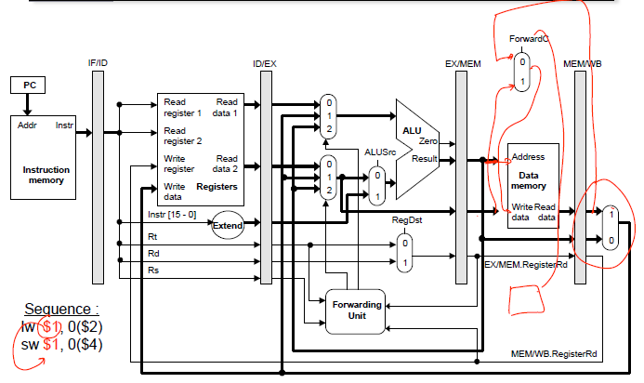
Extended Datapath for Load/Store Bypassing

Slide 28
Summary
Most instructions of real codes are dependent upon others.
-- This can lead to data hazards in our original pipelined datapath.
-- Instructions can’t write back to the register file soon enough for the next two instructions to read.
Forwarding eliminates data hazards involving arithmetic instructions.
-- The forwarding unit detects hazards by comparing the destination registers of previous instructions to the source registers of the current instruction.
-- Hazards are avoided by grabbing results from the pipeline registers before they are written back to the register file.

