Slide 1
CSE 341 Computer Organization Lecture 1: Overview & Logistics
Prof. Lu Su
Computer Science & Engineering, UB
Slides adapted from Raheel Ahmad, Luis Ceze , Sangyeun Cho,
Howard Huang, Bruce Kim, Josep Torrellas, Bo Yuan, and Craig Zilles

Slide 2
Agenda
Course Info. and Admin.
Information;
Administration.
Course Content
Definition;
Content.
Why we need to learn this course?
Motivation;
Learning Outcomes.

Slide 3
Time and Location
Lectures
Tuesday/Thursday, 2:00 PM - 3:20 PM, Davis101
Recitation
5 recitation sessions
Homework, Quiz, Course project

Slide 4
Instructor
Instructor: Prof. Lu Su
Associate Professor, Computer Science and Engineering
Email: lusu@buffalo.edu
Office location: Davis 321
Office hour: 3:20pm-4:20pm Tuesday/Thursday (or appointment)
Research interests: Internet of Things, Cyber-Physical Systems, Wireless, Mobile, and Crowd Sensing Systems.
Website: www.cse.buffalo.edu/~lusu/

Slide 5
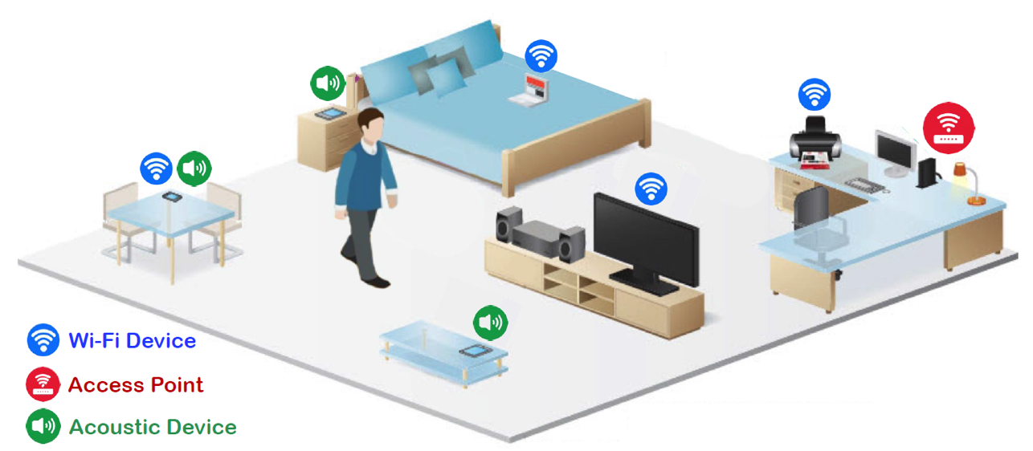
Hiring: UG research assistants Wireless and Mobile Human Sensing

Slide 6
Hiring: UG research assistants Wireless and Mobile Human Sensing
Only US citizens and permanent residents are eligible
Send me email with your CV/resume
Include your name, and the words “CSE 341” and “REU” in the title.

Slide 7
TAs
Name: Shiyang Wang
Email: shiyangw@buffalo.edu
Office hour: TBD
Name: Wei Wang
Email: wwang49@buffalo.edu
Office hour: TBD
Name: Yi Zhu
Email: yzhu39@buffalo.edu
Office hour: TBD

Slide 8
UTAs

Slide 9
Course Materials
Course Website
Lecture notes
Homework & solutions
Course project
Reading materials & handouts
Piazza (questions, discussions)
Make sure you receive email notifications for every new post/comment
Post in the right category
Mark a questions as “Resolved” when it is resolved

Slide 10
Text
Textbook
Computer Organization and Design: The Hardware/Software Interface
5th edition, revised printing
By Patterson and Hennessy
Other materials
Handouts
Reading materials

Slide 11
Prerequisites
This class will need a background in digital logic and systems.
CSE 241 Digital Systems
EE 178 Digital Principles
CSE 220 Systems Programming
Basic Knowledge on assembly language.
Basic Knowledge on high-level programming language (C/Java).

Slide 12
Class Make-up
Time conflict with the class schedule may occurs when I attend technical or research conferences etc.
Manners to resolve the potential conflicts:
--Reschedule class to other date and time
--Adjusting the date of midterm exam
--Compensate by substitute instructor
Any class conflicts due to my travel will be announced both in class and on Piazza.

Slide 13
Grading
4 Homework 0%
Quizzes* 20% (10%/each)
(2 highest out of 4 random)
In-class Midterm 20% (5% bonus)
Final (May 12) 35% (5% bonus)
Project 25%
*Course participation will be evaluated as part of the random quizzes.

Slide 14
Quiz Policy
Quiz will be provided randomly, There may be NO pre-announcements.
In-class 30-minute short quizzes
Closed book, non-programmable calculator is allowed
NO makeup quizzes for any reason.

Slide 15
Exam Policy
Closed book (note) for all exams
No makeup exams will be given except in provably extreme circumstances:
-- Notify me 24 hours prior to the exam via e-mail
-- For medical-related reasons, a note from a physician is a must.

Slide 16
Agenda
Course Info. and Admin.
Information;
Administration.
Course Content
Definition;
Content.
Why we need to learn this course?
Motivation;
Learning Outcomes.

Slide 17
Computer Organization
CSE 341 is about “Computer Organization”
-- “Hardcore” of Computer Engineering program
-- Fundamental for many graduate-level courses
Different names in different colleges
-- Computer & Machine Organization
-- Machine Organization & Assembly Language
-- Hardware & Software Interface
-- Computer Design
…

Slide 18
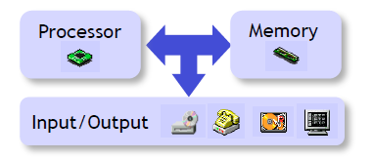
What is Comp. Org. About?
Computer organization is the study of building computer systems.
More specifically, it studies:
- Design principle of each component
- Interaction among components
- Interaction between HW and SW
- Analysis and evaluation of performance

Slide 19
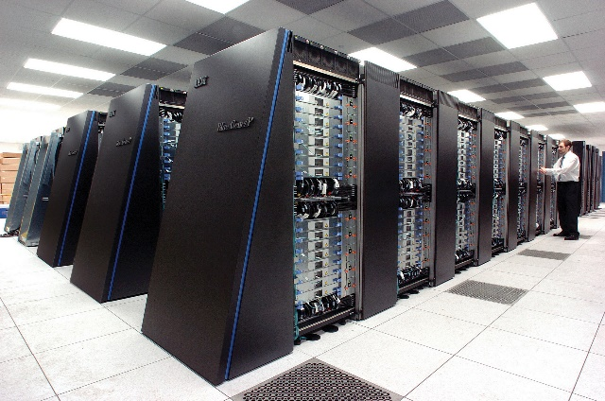
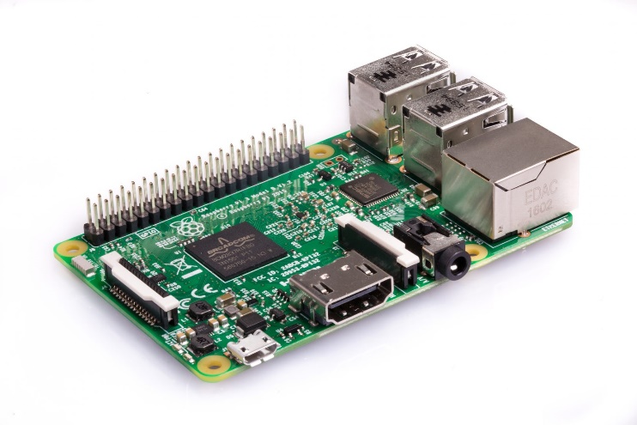
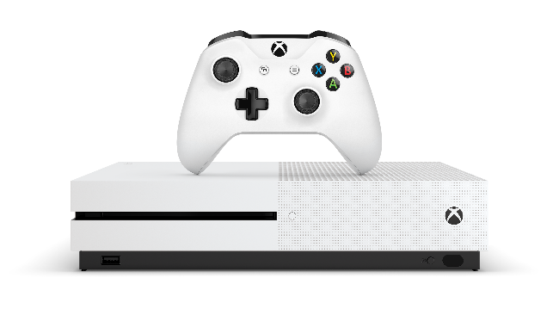
Computer System

Slide 20
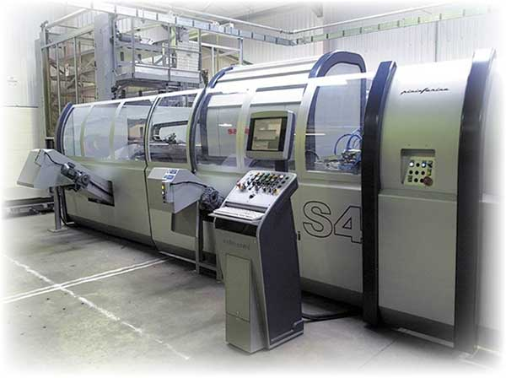
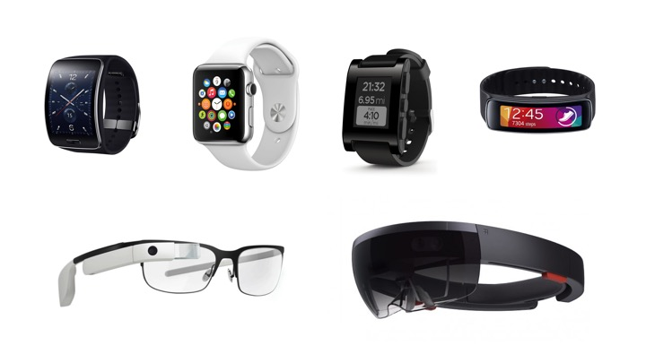
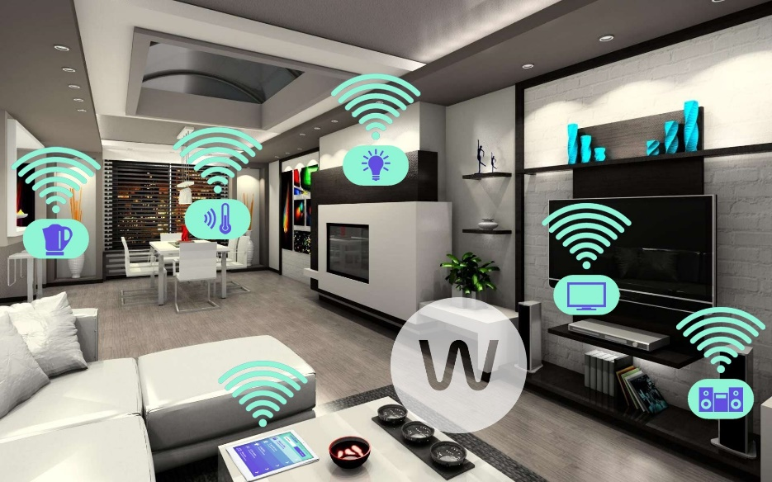
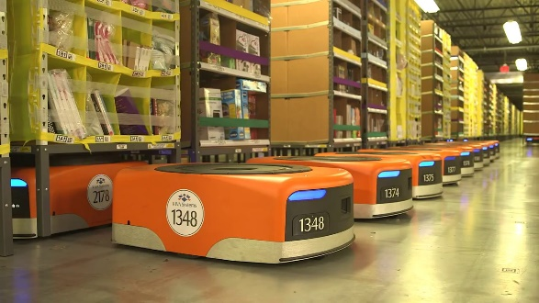
What Else?

Slide 21
What is Comp. Org. About?
Computer organization is the study of building computer systems.
More specifically, it studies:
- Design principle of each component
- Interaction among components
- Interaction between HW and SW
- Analysis and evaluation of performance

Slide 22
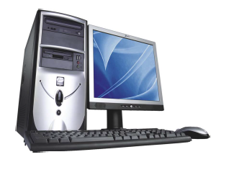
HW in Computer System

Slide 23
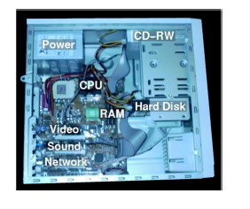
Inside the computer

Slide 24
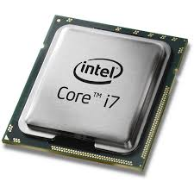
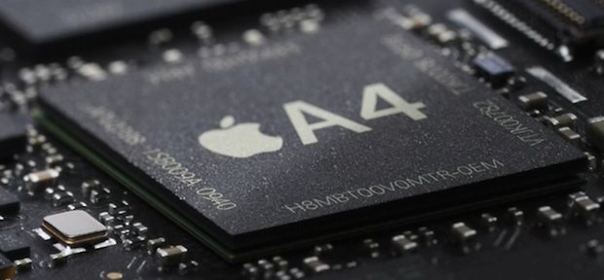
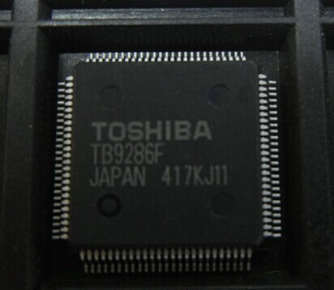
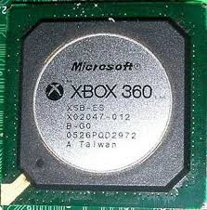
Processor
In courtesy of www. feelgrafix.com; www.osxdaily.com
www. semiaccurate.com; www.vipprogrammer.com

Slide 25
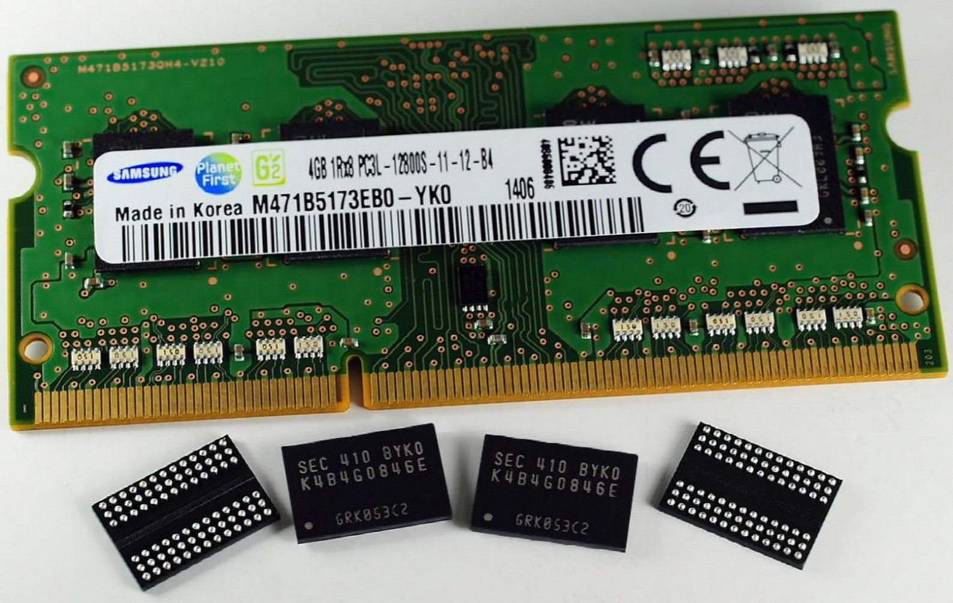
Memory
In courtesy of wccftech.com

Slide 26
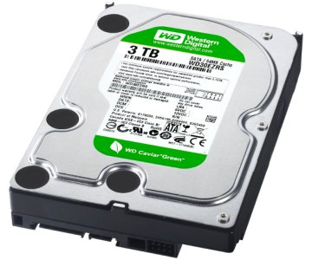
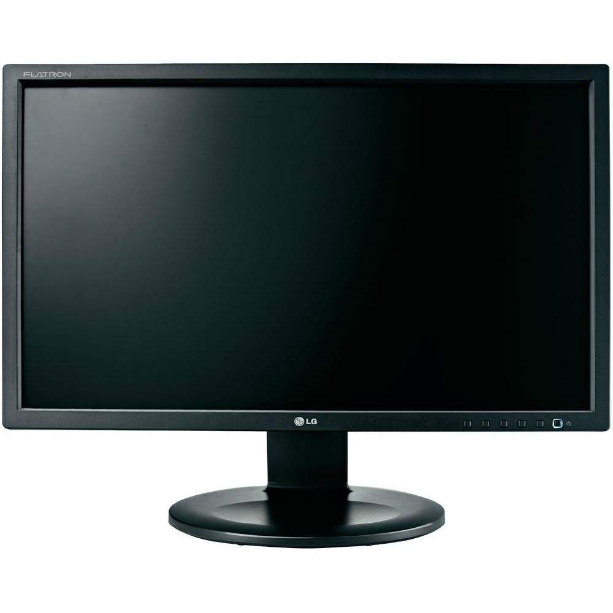
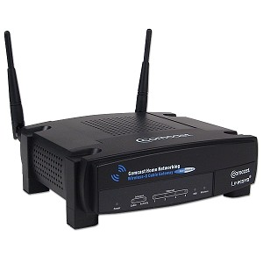
I/O Devices
In courtesy of www.technologyuk.net; www.omgchrome.com www.conrad.com; www-mp3.us

Slide 27
What is Comp. Org. About?
Computer organization is the study of building computer systems.
More specifically, it studies:
- Behavior-level design of components
- Interaction among component
- Interaction between HW and SW
- Analysis and evaluation of performance

Slide 28
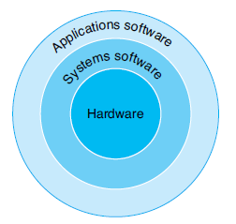
SW in Computer System
App SW:
Word,
Adobe Reader
Photoshop
…
Syst. SW:
Win8,
Linux,
MacOS

Slide 29
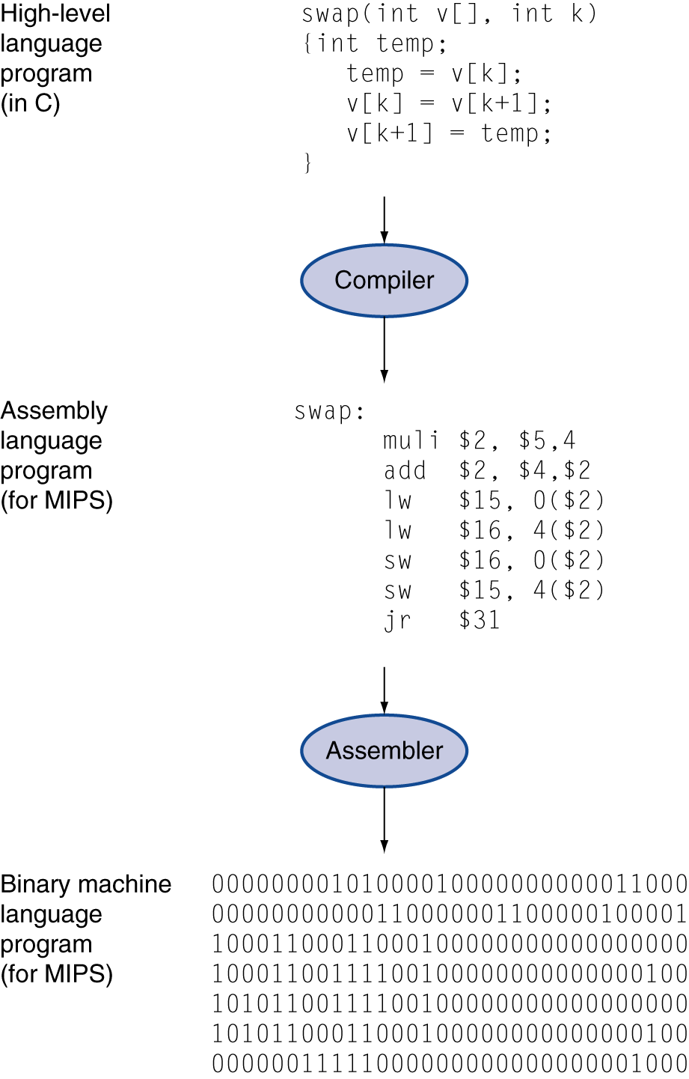
Levels of Program Code
High-level language
Level of abstraction closer to problem domain
Provides for productivity and portability
Assembly language
Textual representation of instructions
Machine language
Hardware representation
Binary digits (bits)
Encoded instructions and data

Slide 30
What is Comp. Org. About?
Computer organization is the study of building computer systems.
More specifically, it studies:
- Design principle of each component
- Interaction among component
- Interaction between HW and SW
- Analysis and evaluation of performance

Slide 31
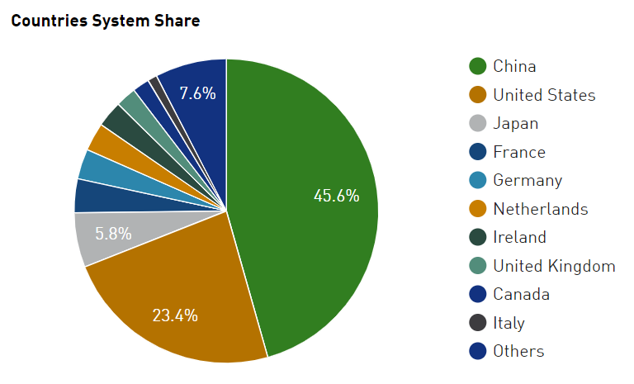
Top 500 Computers
Floating point operations per second (FLOPS, flops or flop/s)

Slide 32
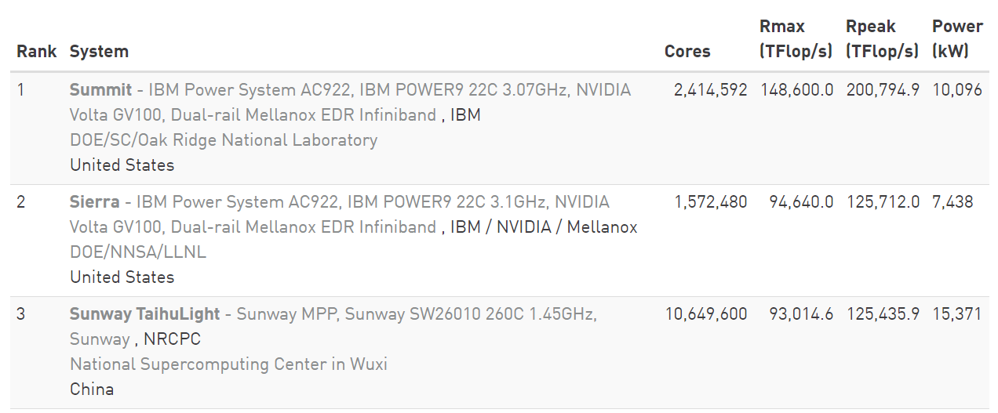
Top 500 Computers
Floating point operations per second (FLOPS, flops or flop/s)

Slide 33
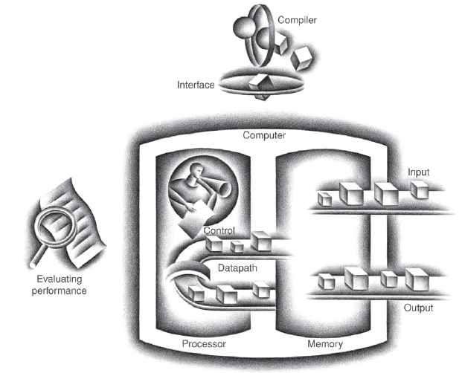
Big Picture for Computer System
SW
I/O device
Computer Organization and Design (5th edition) by Patterson and Hennessy

Slide 34
Outline of the Course
SW
Part-I Ch2
Part-II Ch3,4
Part-III Ch1,5,6
Ch2
I/O device
Ch6
Ch3,4
Ch5
Computer Organization and Design (5th edition) by Patterson and Hennessy

Slide 35
Agenda
Course Info. and Admin.
Information;
Administration.
Course Content
Definition;
Content.
Why we need to learn this course?
Motivation;
Learning Outcomes.

Slide 36
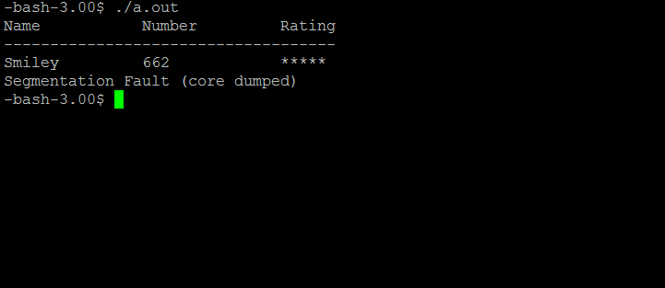
Why we need to learn this course (Know-how)
You will know how computer works
--HW: Know the behavior of CPU memory
--SW: Benefit for your programming
C/Java codes-> machine codes
Track and identify the error in coding

Slide 37
Why we need to learn this course (Academia)
“Hardcore” of comp. engineering track
Basis for many advanced courses/topics
-- Computer Architecture
-- Digital VLSI system design
-- Operating Systems
-- Embedded Systems
-- Computer Networks
…

Slide 38
Learning Outcomes
Understand how computer works
Understand important concepts (abstraction, pipeline, cache etc.)
Understand the relationship among high-level (C/Java), assembly and machine languages.
……

Slide 39
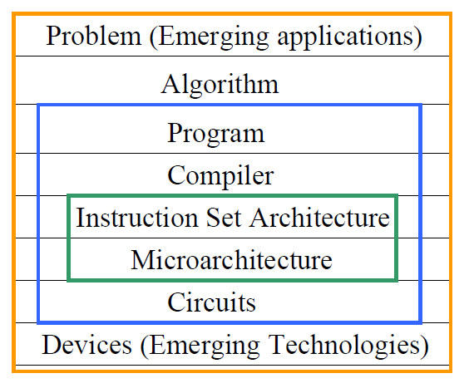
Big Picture of Computer Architecture

