Slide 1
CSE 341 Computer Organization Lecture 20 Processor : Pipelining 4
Prof. Lu Su
Computer Science Engineering, UB
Slides adapted from Raheel Ahmad, Luis Ceze , Sangyeun Cho,
Howard Huang, Bruce Kim, Josep Torrellas, Bo Yuan, and Craig Zilles

Slide 2
Task III
Single-cycle implementation:
-- All operations takes in one clock cycle
Multi-cycle implementation:
-- Fast operations take less time than slower ones
Pipelining
-- Overlap the execution of several instructions

Slide 3
Example with dependencies
sub $2, $1, $3
and $12, $2, $5
or $13, $6, $2
add $14, $2, $2
sw $15, 100($2)
Several dependencies in this code fragment.
-- The first instruction, SUB, stores a value into $2.
-- $2 is used as a source in the rest of the instructions.
Not a problem for the single/multi cycle datapaths.
-- Each instruction is executed completely before the next one begins.

Slide 4
Dependency Arrows
Clock cycle
1 2 3 4 5 6 7 8 9
sub $2, $1, $3
and $12, $2, $5
or $13, $6, $2
add $14, $2, $2
sw $15, 100($2)
IM
Reg
DM
Reg
IM
Reg
DM
Reg
IM
Reg
DM
Reg
IM
Reg
DM
Reg
IM
Reg
DM
Reg

Slide 5
Review of Forwarding
Forwarding allows other instructions to read ALU results directly from the pipeline registers, without going through the register file.
Clock cycle
1 2 3 4 5 6 7
sub $2, $1, $3
and $12, $2, $5
or $13, $6, $2
IM
Reg
DM
Reg
IM
Reg
DM
Reg
IM
Reg
DM
Reg

Slide 6
Limitation of Pipelining
Some real limitations of pipelining.
-- Forwarding may not work for data hazards from load instructions.
-- Branches affect the instruction fetch for the next clock cycle.
In both of these cases, we may need to slow down, or stall, the pipeline.

Slide 7
An Example for load
For the following example
-- The load data doesn’t come from memory until the end of cycle 4.
-- But the AND needs that value at the beginning of the same cycle!
This is a “true” data hazard—the data is not available when we need it.
Clock cycle
1 2 3 4 5 6
lw $2, 20($3)
and $12, $2, $5
IM
Reg
DM
Reg
IM
Reg
DM
Reg

Slide 8
Stalling
The easiest solution is to stall the pipeline.
We could delay the AND instruction by introducing a one-cycle delay into the pipeline, sometimes called a bubble.
Notice that we’re still using forwarding in cycle 5, to get data from the MEM/WB pipeline register to the ALU.
Clock cycle
1 2 3 4 5 6 7
lw $2, 20($3)
and $12, $2, $5
IM
Reg
DM
Reg
IM
Reg
DM
Reg

Slide 9
Stalling and Forwarding
Without forwarding, we’d have to stall for two cycles to wait for the LW instruction’s writeback stage.
In general, you can always stall to avoid hazards—but dependencies are very common in real code, and stalling often can reduce performance by a significant amount.
Clock cycle
1 2 3 4 5 6 7 8
lw $2, 20($3)
and $12, $2, $5
IM
Reg
DM
Reg
IM
Reg
DM
Reg

Slide 10
Stalling Delays the Entire Pipeline
If we delay the second instruction, we’ll have to delay the third one too.
-- To make forwarding work between AND and OR.
-- Also prevents problems such as two instructions trying to write to the same register in the same cycle.
Clock cycle
1 2 3 4 5 6 7 8
lw $2, 20($3)
and $12, $2, $5
or $13, $12, $2
IM
Reg
DM
Reg
IM
Reg
DM
Reg
IM
Reg
DM
Reg

Slide 11
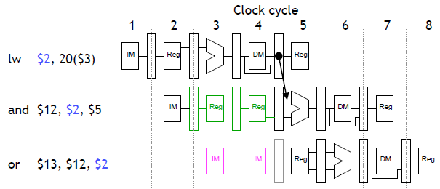
Implementing Stalls
One way to implement a stall is to force the two instructions after LW to pause and remain in their ID and IF stages for one extra cycle.
This is easily accomplished via:
-- Don’t update PC, so current IF stage is repeated.
-- Don’t update IF/ID register, so ID stage is repeated.

Slide 12
Implement Stalling for EXE, MEM, WB
Those units aren’t used in those cycles because of the stall, so the control signals of EX, MEM and WB can be set to all 0s.

Slide 13
Stall = Nop conversion
In fact, the effect of a load stall is to insert an empty or nop instruction into the pipeline
Clock cycle
1 2 3 4 5 6 7 8
lw $2, 20($3)
and -> nop
and $12, $2, $5
or $13, $12, $2
IM
Reg
DM
Reg
IM
Reg
DM
Reg
IM
Reg
DM
Reg
IM
Reg
DM
Reg

Slide 14
Stall Control
Stall is needed when load hazard happens.
We can detect a load hazard between the current instruction in its ID stage and the previous instruction in the EX stage.
A hazard occurs if the previous instruction was LW...
ID/EX.MemRead = 1
...and the LW destination is one of the current source registers.
ID/EX.RegisterRt = IF/ID.RegisterRs
or ID/EX.RegisterRt = IF/ID.RegisterRt
Complete test for stalling:
if (ID/EX.MemRead = 1 and
( ID/EX.RegisterRt = IF/ID.RegisterRs or
ID/EX.RegisterRt = IF/ID.RegisterRt))
then stall

Slide 15
Unified Hazard Detection Unit
The hazard detection unit’s inputs are as follows.
-- IF/ID.RegisterRs and IF/ID.RegisterRt, the source registers for the current instruction.
-- ID/EX.MemRead and ID/EX.RegisterRt, to determine if the previous instruction is LW and, if so, which register it will write to.
By inspecting these values, the detection unit generates three outputs.
-- Two new control signals PCWrite and IF/ID Write, which determine whether the pipeline stalls or continues.
-- A mux select for a new multiplexer, which forces control signals for the current EX and future MEM/WB stages to 0 in case of a stall.

Slide 16
Datapath with Unified Hazard Unit
ID/EX.MemRead
Hazard
Unit
ID/EX.RegisterRt
ID/EX
PC Write
IF/ID Write
Rs
Rt
0
0
1
WB
EX/MEM
M
WB
MEM/WB
Control
EX
M
WB
PC
IF/ID
Read
register 1
Read
data 1
0
1
2
Addr
Instr
Read
register 2
ALU
Zero
Write
register
Read
data 2
ALUSrc
Result
Address
Instruction
memory
0
1
2
0
1
Data
memory
Write
data
Registers
Instr [15 - 0]
Write
data
Read
data
1
0
Extend
RegDst
Rt
0
1
Rd
Rs
EX/MEM.RegisterRd
Forwarding
Unit
MEM/WB.RegisterRd

Slide 17
Control Hazard in Branch
Most of work for a branch computation is done in EX stage.
-- The branch target address is computed.
-- The source registers are compared by the ALU, and the Zero flag is set or cleared accordingly.
The branch decision cannot be made until end of EX stage.
-- But we need to know which instruction to fetch next, in order to keep the pipeline running.
-- This leads to what’s called a control hazard.
Clock cycle
1 2 3 4 5 6 7 8
beq $2, $3, Label
? ? ?
IM
Reg
DM
Reg
IM

Slide 18
Stalling for Control Hazard
Stalling is one possible solution for control hazard.
-- In the following example we just stall until cycle 4, after we do make the branch decision.
Clock cycle
1 2 3 4 5 6 7 8
beq $2, $3, Label
? ? ?
IM
Reg
DM
Reg
IM
IM
Reg
DM
Reg

Slide 19
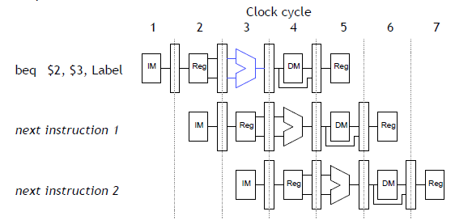
Branch Prediction
Prediction is another approach!
-- To guess whether or not the branch is taken.
-- Usually it’s easier to assume the branch is not taken.
-- In this case we just increment the PC and continue execution, as for normal instructions.
If we’re correct, then there is no problem and the pipeline keeps going at full speed.

Slide 20
Branch Misprediction
If our guess is wrong, then we would have already started executing two instructions incorrectly. We’ll have to discard, or flush, those instructions and begin executing the right ones from the labeled instructions.
Clock cycle
1 2 3 4 5 6 7 8
beq $2, $3, Label
next instruction 1
next instruction 2
Label: . . .
IM
Reg
DM
Reg
IM
Reg
flush
IM
flush
IM
Reg
DM
Reg

Slide 21
Gains and Losses for Brach Prediction
Overall, branch prediction is worth it.
-- Mispredicting means that two clock cycles are wasted.
-- But if our predictions are even just occasionally correct, then this is preferable to stalling and wasting two cycles for every branch.
All modern CPUs use branch prediction.
-- Accurate predictions are important for optimal performance.
-- Most CPUs predict branches dynamically—statistics are kept at run-time to determine likelihood of a branch being taken.
Pipeline structure also has big impact on branch prediction.
-- Longer pipeline may require more instructions to be flushed for a misprediction, resulting in lower performance.
-- Also be careful that instructions do not modify registers or memory before they get flushed.

Slide 22
Dynamic Branch Prediction 1-bit Predictor
Branch prediction buffer: a small memory indexed by the lower portion of the address of the branch instruction.
The memory contains a bit that says whether the branch was recently taken or not.
T
NT
NT
1
0
Predict not
taken
Predict Taken
T

Slide 23
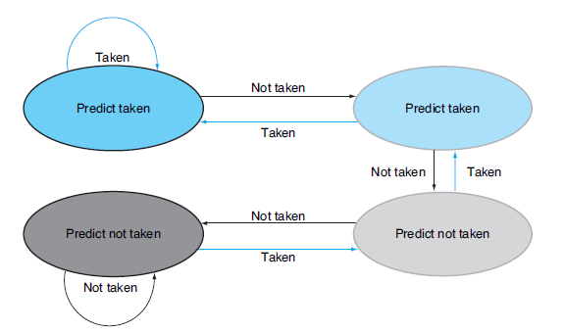
Dynamic Branch Prediction 2-bit Predictor
In a 2-bit scheme, a prediction must be wrong twice before it is changed.

Slide 24
Summary
Three kinds of hazards when pipelining.
Structural hazards result from not having enough hardware available to execute multiple instructions simultaneously.
-- Solution: adding more functional units or by redesigning the pipeline stages.
Data hazards can occur when instructions need to access registers that haven’t been updated yet.
-- Solution: Forwarding for R-type instructions
-- Stalling for Loads instructions
Control hazards arise when the CPU cannot determine which instruction to fetch next.
-- Solution: Minimize delays by doing branch tests earlier in the pipeline.
-- Predict branch direction to make the most of a bad situation.

