Slide 1
CSE 341 Computer Organization Lecture 21 Performance
Prof. Lu Su
Computer Science Engineering, UB
Slides adapted from Raheel Ahmad, Luis Ceze , Sangyeun Cho,
Howard Huang, Bruce Kim, Josep Torrellas, Bo Yuan, and Craig Zilles

Slide 2
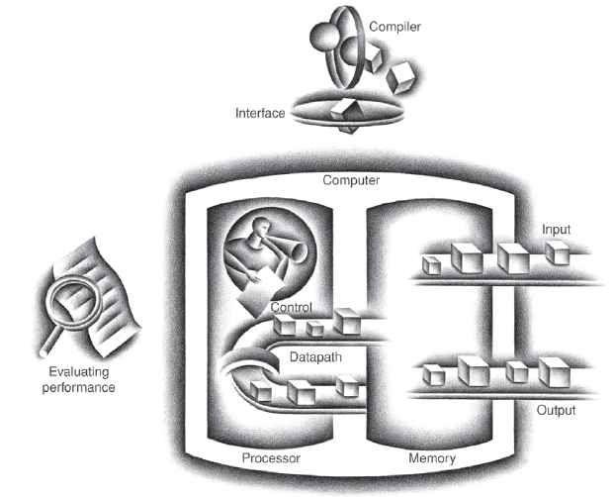
Today’s Content in Big Picture
SW
Part-I Ch2
Part-II Ch3,4
Part-III Ch1,5,6
ch2
ch1
I/O device
Ch6
Ch3,4
Ch5

Slide 3
Motivation
Purchasing Perspective: In a collection of computers, which has the best performance?
-- Lowest Price?
-- Best Performance/Price?
Design Perspective: Faced with different design options, which has the best performance improvement?
-- Lowest Cost?
-- Best Performance/Cost ?
We need
-- Basis for comparison
-- Metric for evaluation

Slide 4
Venders’ “Tricks”…
Computer vendor selects the metrics that can make their products look good. Hence there are many possible “definitions” of performances.
Q: Why do end users need a new performance metric? A: End users who rely only on megahertz as an indicator for performance do not have a complete picture of PC processor performance and may pay the price of missed expectations.

Slide 5
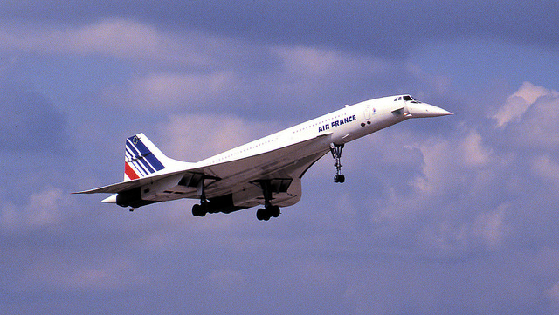
An Example from Plane
Which plane has better performance?
-- Time to do the task (Execution Time, Latency, Response Time): more for desktop PCs
-- Tasks per unit time (Throughput, Bandwidth): more for servers
Plane | DC to Paris | Speed | Passengers | Throughput (pmph)
747 | 6.5 hours | 610 mph | 470 | 286,700
Concorde | 3 hours | 1350 mph | 132 | 178,200

Slide 6
Definition
Performance is in units of things-per-second
-- bigger is better
Response time of a system Y running program Z
Throughput of system Y running many programs
" System X is n times faster than Y" means

Slide 7
Measuring Performance
Time is the measure of computer performance
-- The one performs the same amount of work in the least time is the fastest.
Execution time is measured in seconds per program.
-- Different definitions
-- Wall Clock Time, or elapsed time: the total time
to complete a task, including disk accesses, memory accesses, input/output (I/O) etc.
-- CPU execution time or simply CPU time: the time the CPU spends computing for this task. It contains user CPU time and system CPU time.
User CPU Time The CPU time spent in the program
System CPU Time The CPU time spent in the operating system performing tasks on behalf of the program.

Slide 8
CPU Clocking
Operation of digital hardware governed by a constant-rate clock
Clock period
Clock (cycles)
Data transfer and computation
Update state
Clock period: duration of a clock cycle
e.g., 250ps = 0.25ns = 250×10^{–12}s
Clock frequency (rate): cycles per second
e.g., 4.0GHz = 4000MHz = 4.0×10⁹Hz

Slide 9
Clock Time and Clock Rate
One “cycle”: the minimum time it takes the CPU to do any work.
-- Clock cycle time or clock period is just the length of a cycle.
-- Clock rate, or frequency, is the reciprocal of the cycle time.
-- Generally, higher frequency is better.
Some examples:
-- A 500MHz processor has a cycle time of 2ns.
-- A 2GHz CPU has a cycle time of 0.5ns (500ps).

Slide 10
CPU Performance
For one program
Clock Cycles per Instruction (CPI)
-- Recall some instructions costlier than some others
-- Average for all instructions
-- Good measure of implementations of same architecture

Slide 11
Instructions Executed
Instructions executed:
-- Not interested in the static instruction count, or how many lines of code are in a program.
-- Care about the dynamic instruction count, or how many instructions are actually executed.
li $a0, 1000
L1: sub $a0, $a0, 1
bne $a0, $0, L1

Slide 12
CPI
CPI: The average number of clock cycles per instruction
-- Function of the machine and program.
-- Depends on the actual instructions appearing in the program, e.g., a floating-point intensive application may have higher CPI than an integer-based program.
-- Depends on the CPU implementation. Pentium can have lower CPI than old 80486, though both of them execute the same instructions.

Slide 13
Same ISA, Different Implementation
Two 8086-based processors.
-- An 800MHz AMD Duron, with a CPI of 1.2 for an MP3 compressor.
-- A 1GHz Pentium III with a CPI of 1.5 for the same program.
CPU time_{AMD,P} = Instructions_{P} * CPI_{AMD,P} * Cycle time_{AMD}
=
=
CPU time_{P3,P} = Instructions_{P} * CPI_{P3,P} * Cycle time_{P3}
=
=

Slide 14
CPI in More Detail
If different instruction classes take different numbers of cycles
Weighted average CPI
Relative frequency

Slide 15
CPI Example
Alternative compiled code sequences using instructions in classes A, B, C
Class | A | B | C
CPI for class | 1 | 2 | 3
IC in sequence 1 | 2 | 1 | 2
IC in sequence 2 | 4 | 1 | 1
Sequence 1: IC = 5
Clock Cycles = 2×1 + 1×2 + 2×3 = 10
Avg. CPI = 10/5 = 2.0
Sequence 2: IC = 6
Clock Cycles = 4×1 + 1×2 + 1×3 = 9
Avg. CPI = 9/6 = 1.5

Slide 16
Performance Summary
The BIG Picture
Performance depends on
Algorithm: affects IC, possibly CPI
Programming language: affects IC, CPI
Compiler: affects IC, CPI
Instruction set architecture: affects IC, CPI, T_{c}

Slide 17
Performance Improvement Amdahl’s Law
Amdahl’s Law states that improving an aspect of a computer and expecting a proportional improvement in overall performance.
Example, 10% of the program execution time involves floating-point code, how faster if we double the speed of floating-point operations?

Slide 18
Exercise (1)
New CPU (40%) 10X faster
I/O bound server, so 60% time waiting for I/O
Q1: what is the max speedup in this machine?
Q2: if we need to speedup by 2X, what can we do?

Slide 19
Exercise (2)
Q1:
CPU 50% -> 3X
I/O 10%
Memory 40% -> 4X
Q2:
CPU 40% -> 0.5X
I/O 20%
Memory 40% -> 2X

