Slide 1
CSE 341 Computer Organization Lecture 22 Memory (1)
Prof. Lu Su
Computer Science Engineering, UB
Slides adapted from Raheel Ahmad, Luis Ceze , Sangyeun Cho,
Howard Huang, Bruce Kim, Josep Torrellas, Bo Yuan, and Craig Zilles

Slide 2
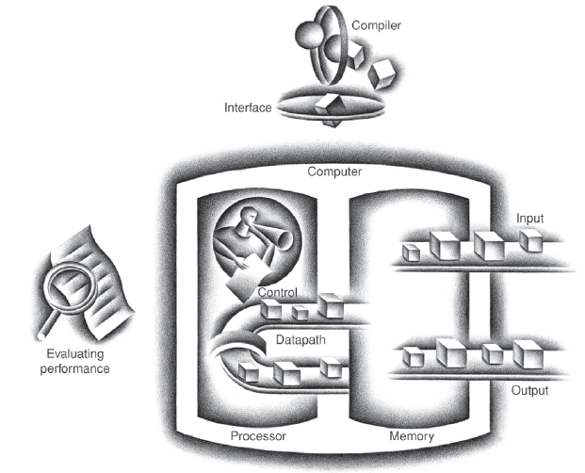
Today’s Content in Big Picture
SW
Part-I Ch2
Part-II Ch3,4
Part-III Ch1,5,6
ch2
ch1
I/O device
Ch6
Ch3,4
Ch5

Slide 3
Course Evaluation Incentive
Course evaluation ends on May 11.
Your suggestions and comments are important!
Everyone is busy in the final weeks, so…
I will reveal one question of the final exam (5-10 points) as an incentive, if (and when) the response rate of the course evaluation reaches 80% !!!

Slide 4
Memory
We have shown how to make a fast processor.
Now we will learn how to supply the processor with enough data to keep it busy
-- Memory
Memory
CPU

Slide 5
Fast and Large Memory?
Modern computers depend upon large and fast storage systems.
-- Large capacities for many applications: datacenter, mobile devices
-- Fast speed to keep up with pipelined CPUs
From the perspective of technology, system designer can get both fast and large storage systems; however, you also need to consider the budget.

Slide 6
In Real World…
Random Access Memory (RAM)
allows data items to be read or written in almost the same amount of time irrespective of the physical location of data inside the memory.
Storage | Speed | Cost | Capacity
Static RAM | Fastest | Expensive | Smallest
Dynamic RAM | Slow | Cheap | Large
Hard disks | Slowest | Cheapest | Largest
Storage | Delay | Cost/MB | Capacity
Static RAM | 1-10 cycles | ~$5 | 128KB-2MB
Dynamic RAM | 100-200 cycles | ~$0.10 | 128MB-4GB
Hard disks | 10,000,000 cycles | ~$0.0005 | 20GB-400GB

Slide 7
CPU-Memory Bottleneck
Memory
CPU
Performance of high-speed computers is usually
limited by memory bandwidth & latency
Latency (time for a single access)
Memory access time >> Processor cycle time
Problematic
Bandwidth (number of accesses per unit time)
Increase the bus size, etc.
Usually OK

Slide 8
Processor-DRAM Gap (latency)
µProc 60%/year
1000
CPU
Processor-Memory
Performance Gap: (grows 50% / year)
100
Performance
10
DRAM
7%/year
DRAM
1
1986
1988
1987
1989
1990
1991
1992
1993
1994
1995
1980
1996
1981
1982
1983
1984
1985
1997
1998
1999
2000
Time

Slide 9
Memory Hierarchy
Big, Slow Memory
(DRAM)
A
Small,
Fast Memory
(RF, SRAM)
B
CPU
holds frequently used data
capacity: Register << SRAM << DRAM
latency: Register << SRAM << DRAM
bandwidth: on-chip >> off-chip
On a data access:
if data ∈ fast memory ⇒ low latency access (SRAM)
If data ∉ fast memory ⇒ long latency access (DRAM)

Slide 10
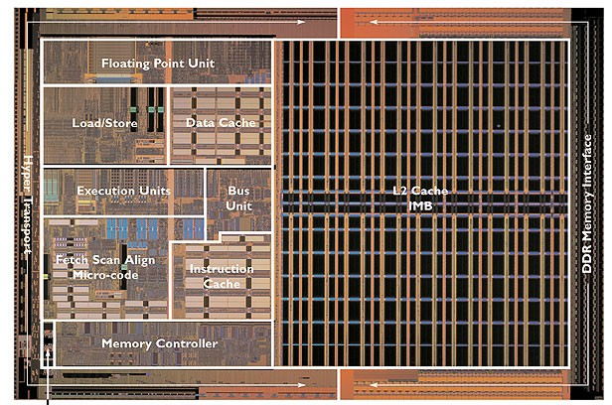
Cache

Slide 11
Levels of Memory Hierarchy
Capacity
Access Time
Cost
Upper Level
Staging
Xfer Unit
faster
CPU Registers
100s Bytes
<10s ns
Registers
Instr. Operands
prog./compiler
1-8 bytes
Cache
K Bytes
10-100 ns
1-0.1 cents/bit
Cache
Blocks
cache cntl
8-128 bytes
Main Memory
M Bytes
200ns- 500ns
$.0001-.00001 cents /bit
Memory
Pages
OS
512-4K bytes
Disk
G Bytes, 10 ms (10,000,000 ns)
10 - 10 cents/bit
Disk
-5
-6
Files
user/operator
Mbytes
Tape
infinite
sec-min
10
Larger
Tape
Lower Level
-8

Slide 12
Memory Hierarchy: Intel Haswell Mobile Processor (2013)
Storage Components | Size | Latency
Registers | 1 KB | 1 cycle
L0 cache | 6 KB
L1 Instr/Data cache | 128 KB | 700 GB/sec
L2 cache | 1 MB | 200 GB/sec
L3 cache | 6 MB | 100 GB/sec
L4 cache | 128 MB | 40 GB/sec
Main memory | 1~16 GB | 10 GB/sec
Disk | 1~4 TB | 2000 MB/sec (SSD)
Nearline storage | Up to exabytes | 160 MB/sec
Goal: Illusion of large, fast, cheap memory
Let programs address a memory space that scales to the disk size, at a speed that is usually as fast as register access

Slide 13
Management of Memory Hierarchy
Small/fast storage, e.g., registers
Address usually specified in instruction
Generally implemented directly as a register file
but hardware might do things behind software’s back, e.g., stack management, register renaming
Larger/slower storage, e.g., main memory
Address usually computed from values in register
Generally implemented as a hardware-managed cache hierarchy
hardware decides what is kept in fast memory
but software may provide “hints”, e.g., don’t cache or prefetch

Slide 14
Cache
How to find a balance between fast and cheap memory?
Cache, a small amount of fast, expensive memory.
-- Between the processor and main memory
-- Keeps a copy of the most frequently used data
from the main memory.
In overall, cache increases memory access speed
-- Cache for the access to the most frequently used
data
-- Main memory for the access to the less frequently used data.

Slide 15
Role of Cache
CPU
A little static
RAM (cache)
Lots of
dynamic RAM

Slide 16
Locality
In practice, it is hard to figure out what data will be “most frequently accessed” before a program actually runs,
-- It is hard to know what to store into the cache
Fortunately , most programs exhibit locality,
-- Temporal locality: If a program accesses one memory address, it is likely that it will access the same address again.
-- Spatial locality: If a program accesses one memory address, it is likely that it will also access other nearby addresses.

Slide 17
Temporal Locality for Instruction Access
An example of temporal locality is loop.
-- The loop body will be executed many times.
-- Computer will need to access those same few locations of the instruction memory repeatedly.
Loop: lw $t0, 0($s1)
add $t0, $t0, $s2
sw $t0, 0($s1)
addi $s1, $s1, -4
bne $s1, $0, Loop

Slide 18
Temporal Locality for Data Access
Programs often access the same variables over and over, especially within loops.
We can keep those commonly-accessed variable in the registers, but in many cases it is not possible.
-- Limited number of registers.
-- Sometimes data must be kept in memory
sum = 0;
for (i = 0; i < MAX; i++)
sum = sum + f(i);

Slide 19
Spatial Locality for Instruction Access
Nearly every program exhibits spatial locality
-- Instructions are usually executed in sequence
If an instruction at memory location i is executed then the instruction, at memory location i+4 may also be executed in a high chance.
sub $sp, $sp, 16
sw $ra, 0($sp)
sw $s0, 4($sp)
sw $a0, 8($sp)
sw $a1, 12($sp)

Slide 20
Spatial Locality for Data Access
Programs often access data that is stored contiguously.
-- A good example is arrays
-- Another example is the individual fields of a record or object
sum = 0;
for (i = 0; i < MAX; i++)
sum = sum + a[i];
employee.name = “Homer Simpson”;
employee.boss = “Mr. Burns”;
employee.age = 45;

Slide 21
How Cache Utilizes Temporal Locality
The first time the processor reads from an address in main memory, as well as storing that data to the cache.
-- The next time that same address is read, the copy of the data in the cache is used
-- First read is a little slower than before (why?), but subsequent reads are much faster.
CPU
A little static
RAM (cache)
Lots of
dynamic RAM

Slide 22
How Cache Utilizes Spatial Locality
When the CPU reads location i from main memory, a copy of that data is placed in the cache.
Instead of just copying the contents of location i, several values are copied into the cache at once, such as from locations i through i + 3.
-- If the CPU later does need to read from locations i + 1, i + 2 or i + 3, it can access that data from the cache and not the main memory.
The initial load is slow, but we’re gambling on spatial locality and the chance that CPU will need the extra data.

Slide 23
Cache Hit and Miss
Cache Hit: The cache contains the data that we’re looking for.
Cache Miss: The cache does not contain the requested data.
Two basic measurements of cache performance.
-- Hit rate is the percentage of memory accesses that are handled by the cache.
-- Miss rate (1 - hit rate)
Typical caches have a hit rate of 95% or higher

Slide 24
A Simple Cache Design
Caches are divided into blocks.
-- Number of blocks is usually a power of 2.
-- Assume each block contains one byte.
Block
index
8-bit data
000
001
010
011
100
101
110
111

Slide 25
Four Questions on Cache Design
1. When copying a block of data from main memory to
the cache, where exactly should we put it?
2. How can we tell if a word is already in the cache, or if
it has to be fetched from main memory first?
3. When the small cache memory fill up. How to replace
one of the existing blocks in the cache by a new block from main RAM?
4. How can write operations be handled by the memory
system?

Slide 26
1. When copying a block of data from main memory to
the cache, where exactly should we put it?
2. How can we tell if a word is already in the cache, or if
it has to be fetched from main memory first?
3. When the small cache memory fill up. How to replace
one of the existing blocks in the cache by a new block from main RAM?
4. How can write operations be handled by the memory
system?

Slide 27
Where Should We Put Data in the Cache? (1)
Direct-mapped: each main memory address maps to exactly one cache block.
If the cache contains 2^{k} blocks, then the data at memory address i go to cache block index
i mod 2^{k}
Memory
Address
0
1
2
3
4
5
6
7
8
9
10
11
12
13
14
15
Index
0
1
2
3

Slide 28
Where Should We Put Data in the Cache? (2)
An equivalent way is to look at the least significant k bits of the address.
Taking the least k bits of a binary value is the same as computing that value mod 2^{k}.
Memory
Address
0000
0001
0010
0011
0100
0101
0110
0111
1000
1001
1010
1011
1100
1101
1110
1111
Index
00
01
10
11

Slide 29
1. When copying a block of data from main memory to
the cache, where exactly should we put it?
2. How can we tell if a word is already in the cache, or if
it has to be fetched from main memory first?
3. When the small cache memory fill up. How to replace
one of the existing blocks in the cache by a new block from main RAM?
4. How can write operations be handled by the memory
system?

Slide 30
Adding Tags
Sometimes multiple addresses of main memory map to the same cache block.
We need to add tags to the cache, which supply the rest of the address bits to distinguish.
0000
0001
0010
0011
0100
0101
0110
0111
1000
1001
1010
1011
1100
1101
1110
1111
Index
Tag
Data
00
01
10
11
00
11
01
01

Slide 31
Valid Bit
When started, the cache is empty, so adding a valid bit is required for each cache block.
-- When the system is initialized, all the valid bits are set to 0.
-- When data is loaded into a particular cache block, the corresponding valid bit is set to 1.
Valid
Bit
Main memory
address in cache block
Index
Tag
Data
00
01
10
11
1
0
0
1
00
11
01
01
00 + 00 = 0000
Invalid
Invalid
01 + 11 = 0111

Slide 32
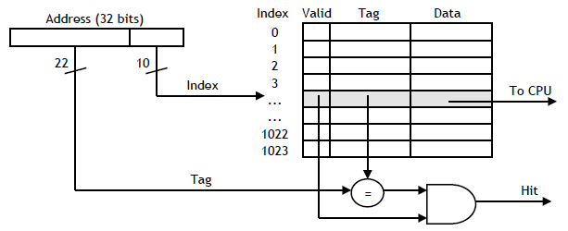
A Cache Hit
When the CPU tries to read from memory, the address will be sent to a cache controller.
-- The lowest k bits of the address will index a block in the cache.
-- If the block is valid and the tag matches the upper (m - k) bits of the m-bit address, then that data will be sent to the CPU.

Slide 33
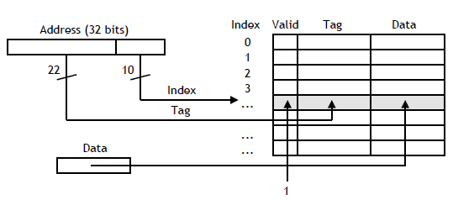
A Cache Miss
Slower main memory access is needed for cache miss.
-- Stalling pipeline until data from main memory is fetched.
After reading data from main memory, copy it to cache
-- Lowest k bits of the address specify a cache block
-- Upper (m - k) address bits are stored as tag
-- Data from main memory is stored in the block’s data field.
-- Valid bit is set to 1.

Slide 34
1. When copying a block of data from main memory to
the cache, where exactly should we put it?
2. How can we tell if a word is already in the cache, or if
it has to be fetched from main memory first?
3. When the small cache memory fill up. How to replace
one of the existing blocks in the cache by a new block from main RAM?
4. How can write operations be handled by the memory
system?

Slide 35
What if the caches fills up
Least recently used replacement policy
-- Assumes that older data is less likely to be requested than newer data.
Already implicitly solved in previous slides
-- A miss causes a new block to be loaded into the cache, automatically overwriting any previously stored data.

