Slide 1
CSE 341 Computer Organization Lecture 23 Memory (2)
Prof. Lu Su
Computer Science Engineering, UB
Slides adapted from Raheel Ahmad, Luis Ceze , Sangyeun Cho,
Howard Huang, Bruce Kim, Josep Torrellas, Bo Yuan, and Craig Zilles

Slide 2
Cache Organization

Slide 3
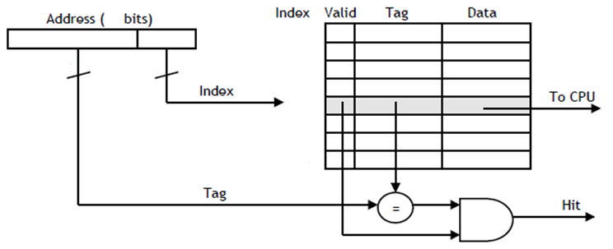
How big is the cache
For a byte-addressable machine with 16-bit addresses with a cache with the following characteristics:
-- It is direct-mapped
-- Each block holds one byte
-- The cache index is the four least significant bits
How many blocks does the cache hold?
4-bit index -> 2⁴ = 16 blocks
How many bits of storage are required to build the cache?
tag size = 12 bits (16 bit address - 4 bit index)
(12 tag bits + 1 valid bit + 8 data bits) x 16 blocks = 21 bits x 16 = 336 bits

Slide 4
Motivation
We want to explore some alternate cache organizations.
-- How can we take advantage of spatial locality too?
-- How can we reduce the number of potential conflicts?
First, we need to discuss about cache performance.

Slide 5
Memory System Performance
To examine the performance of a memory system, we need to focus on important factors.
-- How long does it take to send data from cache to CPU?
-- How long does it take to copy data from memory into cache?
-- How often do we have to access main memory?
There are names for all of these variables.
-- The hit time is how long it takes data to be sent from the cache to the processor. This is usually fast, on the order of 1-3 clock cycles.
-- The miss penalty is the time to copy data from main memory to the cache. This often requires dozens of clock cycles (at least).
-- The miss rate is the percentage of misses.
CPU
A little static
RAM (cache)
Lots of
dynamic RAM

Slide 6
AMAT
The average memory access time, or AMAT, can be computed.
AMAT = Hit time + (Miss rate x Miss penalty)
Averaging the amount of time for cache hits and the amount of time for cache misses.
How to improve the AMAT time of a system?
-- A lower AMAT is better.
-- Miss penalties are usually much greater than hit times, so the best way to lower AMAT is to reduce the miss penalty or the miss rate.

Slide 7
Example
Assume data accesses only. The cache hit ratio is 97% and the hit time is one cycle, but the miss penalty is 20 cycles.
AMAT = Hit time + (Miss rate x Miss penalty)
= 1 cycle + (3% x 20 cycles)
= 1.6 cycles
If the cache was perfect and never missed, the AMAT would be one cycle. But even with just a 3% miss rate, the AMAT here increases 1.6 times!
Reduce miss rate is very important!

Slide 8
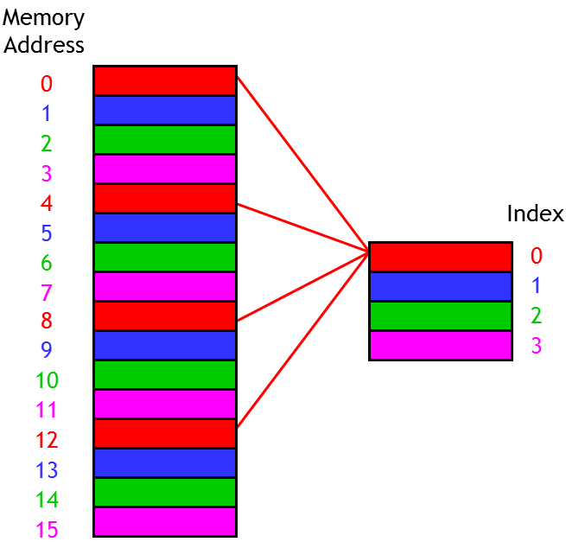
Explore spatial locality
One-byte cache blocks don’t take advantage of spatial locality, which predicts that an access to one address will be followed by an access to a nearby address.
What we can do is make the cache block size larger than one byte.
Here we use two-byte blocks, so we can load the cache with two bytes at a time.
If we read from address 12, the data in addresses 12 and 13 would both be copied to cache block 2

Slide 9
Explore spatial locality
One-byte cache blocks don’t take advantage of spatial locality, which predicts that an access to one address will be followed by an access to a nearby address.
What we can do is make the cache block size larger than one byte.
Here we use two-byte blocks, so we can load the cache with two bytes at a time.
If we read from address 12, the data in addresses 12 and 13 would both be copied to cache block 2
Memory
Address
0
1
2
3
4
5
6
7
8
9
10
11
12
13
14
15
Index
0
1
2
3

Slide 10
Block address of main memory
So how to figure out where data should be placed in the cache? We use block addresses.
The prior example has two-byte cache blocks, so we can think of a 16-byte main memory as
an “8-block” main memory instead.
For instance, memory addresses 12 and 13 both correspond to block address 6.
Byte
Address
Block
Address
0
1
2
3
4
5
6
7
8
9
10
11
12
13
14
15
0
1
2
3
4
5
6
7

Slide 11
Cache mapping
Once we know the block address, we can map it to the cache: find the remainder when the block address is divided by the number of cache blocks.
In prior example, memory block 6 belongs in cache block 2, since 6 mod 4 = 2.
This corresponds to placing data from memory byte addresses 12 and 13 into cache block 2.
Byte
Address
Block
Address
0
1
2
3
4
5
6
7
8
9
10
11
12
13
14
15
0
1
2
3
4
5
6
7
Index
0
1
2
3

Slide 12
Data placement within a block
When we access one byte of data in memory, we copy its entire block into the cache, to hopefully take advantage of spatial locality.
In our example, if a program reads from byte address 12 we’ll load all of memory block 6 (both addresses 12 and 13) into cache block 2.
Byte
Address
Cache
Block
Byte 0
Byte 1
12
13
2

Slide 13
Locating data in the cache
Assume a cache with 2^{k} blocks, each containing 2^{n} bytes.
For a byte of data, we utilize its address in main memory to locate its position in cache
-- k bits of the address will select one of the 2^{k} cache blocks.
-- The lowest n bits are now a block offset that decides which of the 2^{n} bytes in the cache block will store the data.
Prior example used a 2²-block cache with 2¹ bytes per block. Thus, memory address 13 (1101) would be stored in byte 1 of cache block 2.
(m-k-n) bits
k bits
n-bit Block
Offset
m-bit Address
Tag
Index
1 bit
2 bits
1-bit Block
Offset
4-bit Address
1
10
1

Slide 14
Example
Tag
Index (2 bits)
Address (4 bits)
1
10
1
Block offset
2
Index
Valid
Tag
Data
0
1
2
3
8
8
=
Mux
8
Hit
Data

Slide 15
Example
Address (32 bits)
2 bits
0000 .... 0001
1000000000
10
20
10
Index
Valid
Tag
Data
0
1
2
...
512
...
1022
1023
Tag
8
8
8
8
=
Mux
8
Hit
Data

Slide 16
Disadvantage of direct mapping
Till now we talked about direct mapping. Direct-mapped cache is easy, but not really flexible.
If a program uses addresses 2, 6, 2, 6, 2, ..., then each access will result in a cache miss and a load into cache block 2.
This cache has four blocks, but direct mapping might not let us use all of them. This can result in more misses than we might like.
Memory
Address
0000
0001
0010
0011
0100
0101
0110
0111
1000
1001
1010
1011
1100
1101
1110
1111
Index
00
01
10
11

Slide 17
Fully associative cache
A fully associative cache permits data to be stored in any cache block, instead of forcing each memory address into one particular block.
-- When data is fetched from memory, it can be placed in any unused block of the cache.
-- This way we’ll never have a conflict between two or more memory addresses which map to a single cache block.
In the previous example, we might put memory address 2 in cache block 2, and address 6 in block 3. Then subsequent repeated accesses to 2 and 6 would all be hits instead of misses.
If all the blocks are already in use, it’s usually best to replace the least recently used one, assuming that if it hasn’t used it in a while, it won’t be needed again anytime soon.

Slide 18
Price of full associativity
However, a fully associative cache is expensive.
-- There is no index field in the address anymore, the entire address must be used as the tag, increasing the total cache size.
-- Data could be anywhere in the cache, so we must check tag of every cache block → a lot of comparators
Address (32 bits)
Index
Valid
Tag (32 bits)
Data
...
...
...
32
Tag
=
=
Hit
=

Slide 19
Set associativity
An intermediate possibility is a set-associative cache.
-- The cache is divided into groups of blocks, called sets.
-- Each memory address maps to exactly one set in the cache, but data may be placed in any block within that set.
If each set has 2^{x} blocks, cache is an 2^{x}-way associative cache.
Several possible organizations of an eight-block cache.
1-way associativity
8 sets, 1 block each
2-way associativity
4 sets, 2 blocks each
4-way associativity
2 sets, 4 blocks each
Set
Set
Set
0
1
2
3
4
5
6
7
0
1
2
3
0
1

Slide 20
Locating a set associative block
How to determine where a memory address belongs in an associative cache?
If a cache has 2^{s} sets and each block has 2^{n} bytes, the memory address can be partitioned as follows.
Block Offset= Memory Address mod 2^{n}
Block Address = Memory Address / 2^{n}
Set Index = Block Address mod 2^{s}
(m-s-n)
s
n
Address (m bits)
Tag
Index
Block
offset

Slide 21
Example
Where would data from memory byte address 6195 be placed, assuming the eight-block cache designs below, with 16 bytes per block?
-- 6195 in binary is 00...0110000 011 0011.
-- Each block has 16 bytes, so the lowest 4 bits are the block offset.
For 1-way cache, next three bits (011) are the set index.
For 2-way cache, next two bits (11) are the set index.
For 4-way cache, next one bit (1) is the set index.
The data may go in any block, shown in green, within correct set.
1-way associativity
8 sets, 1 block each
2-way associativity
4 sets, 2 blocks each
4-way associativity
2 sets, 4 blocks each
Set
Set
Set
0
1
2
3
4
5
6
7
0
1
2
3
0
1

Slide 22
Block replacement
Any empty block in the correct set may be used for storing data.
If there are no empty blocks, the cache controller will attempt to replace the least recently used (LRU) block.
For highly associative caches, it’s expensive to keep track of what’s really the least recently used block, so some approximations are used.

Slide 23
Simple LRU example
Assume a fully-associative cache with two blocks, which of the following memory references miss in the cache.
addresses
0
Tags
1
LRU
--
--
0
miss
A
On a miss, we replace the LRU.
On a hit, we just update the LRU.
A
--
1
miss
B
A
B
0
A
A
B
1
miss
C
A
C
0
miss
B
B
C
1
miss
A
B
A
0
B
B
A
1

Slide 24
Generality of set associative
1-way set associative cache is the same as a direct-mapped cache.
If a cache has 2^{k} blocks, a 2^{k}-way set associative cache would be the same as fully-associative cache.
1-way
8 sets,
1 block each
2-way
4 sets,
2 blocks each
4-way
2 sets,
4 blocks each
8-way
1 set,
8 blocks
Set
Set
Set
Set
0
1
2
3
4
5
6
7
0
1
2
3
0
1
0
direct mapped
fully associative

