Slide 1
CSE 341 Computer Organization Lecture 24 Memory (3)
Prof. Lu Su
Computer Science Engineering, UB
Slides adapted from Raheel Ahmad, Luis Ceze , Sangyeun Cho,
Howard Huang, Bruce Kim, Josep Torrellas, Bo Yuan, and Craig Zilles

Slide 2
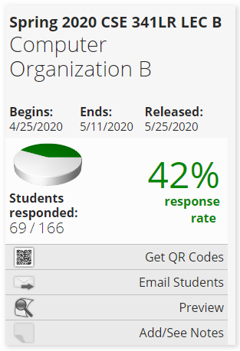
Course Evaluation Incentive
I will reveal one question of the final exam (5-10 points) as an incentive, if (and when) the response rate of the course evaluation reaches 80% !!!
https://sunyub.smartevals.com/

Slide 3
Generality of set associative
1-way set associative cache is the same as a direct-mapped cache.
If a cache has 2^{k} blocks, a 2^{k}-way set associative cache would be the same as fully-associative cache.
1-way
8 sets,
1 block each
2-way
4 sets,
2 blocks each
4-way
2 sets,
4 blocks each
8-way
1 set,
8 blocks
Set
Set
Set
Set
0
1
2
3
4
5
6
7
0
1
2
3
0
1
0
direct mapped
fully associative

Slide 4
Direct-Mapped Cache
Tag
Index
Block
Offset
t
k
b
V
Tag
Data Block
2^{k}
lines
t
=
HIT
Data Word or Byte

Slide 5
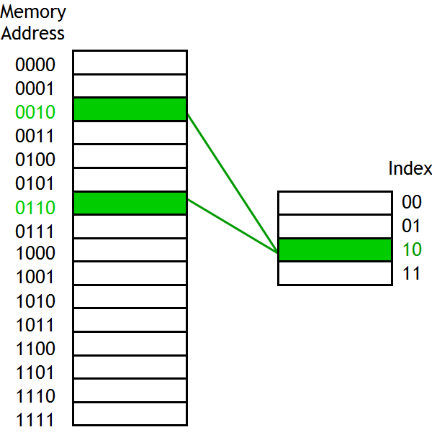
Direct-Mapped Cache
Direct-mapped cache: Blocks in memory that map to the same index in the cache cannot be present in the cache at the same time
One index → one entry
Can lead to 0% hit rate if more than one block accessed in an interleaved manner map to the same index
Assume addresses A and B have the same index bits but different tag bits
A, B, A, B, A, B, A, B, … → conflict in the cache index
All accesses are conflict misses

Slide 6
2-Way Set-Associative Cache
Tag
Index
Block
Offset
b
t
k
V
Tag
Data Block
V
Tag
Data Block
t
=
=
Data
Word
or Byte
HIT

Slide 7
Fully Associative Cache
V
Tag
Data Block
t
=
Tag
t
=
HIT
Block
Offset
Data
Word
or Byte
=
b

Slide 8
Replacement Policy
In an associative cache, which block from a set should be evicted when the set becomes full?
Random
Least Recently Used (LRU)
LRU cache state must be updated on every access
true implementation only feasible for small sets (2-way)
pseudo-LRU binary tree often used for 4-8 way
First In, First Out (FIFO) a.k.a. Round-Robin
used in highly associative caches
Not Most Recently Used (NMRU)
FIFO with exception for most recently used block or blocks
Replacement only happens on misses

Slide 9
Simple LRU example
Assume a fully-associative cache with two blocks, which of the following memory references miss in the cache.
addresses
0
Tags
1
LRU
--
--
0
miss
A
On a miss, we 1) replace the block indicated by LRU, 2) update the LRU.
On a hit, we only update the LRU.
A
--
1
miss
B
A
B
0
A
A
B
1
miss
C
A
C
0
miss
B
B
C
1
miss
A
B
A
0
B
B
A
1

Slide 10
Improving Cache Performance
Average memory access time =
Hit time + Miss rate x Miss penalty
To improve performance:
reduce the hit time
reduce the miss rate
reduce the miss penalty
How to improve Cache Performance?
Cache Size;
Cache Block;
Cache Associativity;
Replacement Policy;
Parallelism;
Many other known and unknown techniques…..

Slide 11
1. When copying a block of data from main memory to
the cache, where exactly should we put it?
2. How can we tell if a word is already in the cache, or if
it has to be fetched from main memory first?
3. When the small cache memory fill up. How to replace
one of the existing blocks in the cache by a new block from main RAM?
4. How can write operations be handled by the memory
system?

Slide 12
Cache Writing & Performance
We’ll explore:
-- Writing to caches: keeping memory consistent & write-allocation.
-- Quantify the benefits of different cache designs, and see how caches affect overall performance.
-- Some main memory organizations that can help increase memory system performance.

Slide 13
Writing to a cache
Writing to cache raises several issues.
First, assume that the address we want to write to is already loaded in the cache. Also assume simple direct-mapped cache.
If we write a new value to that address, we can store the new data in the cache, and avoid expensive main memory access.
Index
V
Tag
Data
Address
Data
...
110
...
...
1101 0110
...
1
11010
42803
42803
Mem[214] = 21763
Index
V
Tag
Data
Address
Data
...
110
...
...
1101 0110
...
1
11010
21763
42803

Slide 14
Inconsistent memory
However, now the cache and memory contain different, inconsistent data
How can we ensure that subsequent loads will return the right value?
This is also problematic if other devices are sharing the main memory, as in a multiprocessor system.
Index
V
Tag
Data
Address
Data
...
110
...
...
1101 0110
...
1
11010
21763
42803

Slide 15
Write-through caches
A write-through cache solves the inconsistency problem by forcing all writes to update both the cache and the main memory.
This is simple to implement and keeps the cache and memory consistent, but this is not so good.
The bad thing is that forcing every write to go to main memory, we use up bandwidth between the cache and the memory.
Mem[214] = 21763
Index
V
Tag
Data
Address
Data
...
110
...
...
1101 0110
...
1
11010
21763
21763

Slide 16
Write Buffers
Write-through caches can result in slow writes, so CPU typically include a write buffer, which queues pending writes to main memory and permits CPU to continue.
Buffers are used when two devices run at different speeds.
-- If a producer generates data too quickly for a consumer to handle, the extra data is stored in a buffer and producer can continue with other tasks, without waiting for consumer.
-- Conversely, if the producer slows down, the consumer can continue running at full speed as long as there is excess data in the buffer.
Here the producer is the CPU and the consumer is the main memory.
Producer
Buffer
Consumer

Slide 17
Write-back caches
In a write-back cache, the memory is not updated until the cache block needs to be replaced
For example, we might write some data to cache at first, leaving it inconsistent with main memory as shown before.
-- The cache block is marked “dirty” to indicate this inconsistency
Subsequent reads to the same memory address will be serviced by cache, which contains the correct, updated data.
Mem[214] = 21763
Index
V
Dirty
Tag
Data
Address
Data
...
110
...
1000 1110
1101 0110
...
1225
1
1
11010
21763
42803

Slide 18
Finishing the write back
We don’t need to store the new value back to main memory unless the cache block gets replaced.
For example, on a read from Mem[142], which maps to the same cache block, the modified cache contents will first be written to main memory.
Only then can the cache block be replaced with data from address 142.
Index
Tag
Data
Address
Data
...
110
...
1000 1110
1101 0110
...
1225
11010
21763
21763
Index
Tag
Data
Address
Data
...
110
...
1000 1110
1101 0110
...
1225
10001
1225
21763

Slide 19
Write misses
Another scenario is if we try to write to an address that is not already contained in the cache; this is called a write miss.
Let’s say we want to store 21763 into Mem[1101 0110] but we find that address is not currently in the cache.
When we update Mem[1101 0110], should we also load it into the cache?
Index
V
Tag
Data
Address
Data
...
110
...
...
1101 0110
...
1
00010
123456
6378

Slide 20
Write around caches (write-no-allocate)
With a write around policy, the write operation goes directly to main memory without affecting the cache.
This is good when data is written but not immediately used again, in which case there’s no point to load it into the cache yet. for (int i = 0; i < SIZE; i++)
a[i] = i;
Mem[214] = 21763
Index
V
Tag
Data
...
110
...
Address
Data
1
00010
123456
...
1101 0110
...
21763

Slide 21
Cache Writing & Performance
We’ll explore:
-- Writing to caches: keeping memory consistent & write-allocation.
-- Quantify the benefits of different cache designs, and see how caches affect overall performance.
-- Some main memory organizations that can help increase memory system performance.

Slide 22
Cache Hierarchies
Trade-off between access time & hit rate
L1 cache can focus on fast access time (okay hit rate)
L2 cache can focus on good hit rate (okay access time)
Such hierarchical design is another “big idea”
Main
Memory
L2 cache
CPU
L1 cache

Slide 23
Example
L1 Caches: Instruction & Data
-- 64 kB, 64 byte blocks
-- 2-way set associative, 2 cycle access time
L2 Cache:
-- 1 MB, 64 byte blocks
-- 4-way set associative, 16 cycle access time
Memory
-- 200+ cycle access time
Main
Memory
L2 cache
CPU
L1 cache

Slide 24
Associativity and miss rates
Higher associativity means more complex hardware.
Highly-associative cache will also exhibit a lower miss rate.
-- Each set has more blocks, so there’s less chance of a conflict between two addresses which both belong in the same set.
-- Overall, this will reduce AMAT and memory stall cycles.
12%
9%
Miss rate
6%
3%
0%
One-way
Two-way
Four-way
Eight-way
Associativity

Slide 25
Cache size and miss rates
The cache size also has a significant impact on performance.
-- The larger a cache is, the less chance there will be of a conflict.
-- Again this means the miss rate decreases, so the AMAT and number of memory stall cycles also decrease.
The Figure depicts the miss rate as a function of both the cache size and its associativity.
15%
12%
9%
Miss rate
1 KB
2 KB
6%
4 KB
8 KB
3%
0%
One-way
Two-way
Four-way
Eight-way
Associativity

Slide 26
Block size and miss rates
Miss rates are also related to the block size and overall cache size.
-- Smaller blocks do not take maximum advantage of spatial locality.
-- But if blocks are too large, there will be fewer blocks available, and more potential misses due to conflicts.
40%
35%
30%
25%
1 KB
8 KB
Miss rate
20%
16 KB
15%
64 KB
10%
5%
0%
4
16
64
256
Block size (bytes)

Slide 27
Cache Writing & Performance
We’ll explore:
-- Writing to caches: keeping memory consistent & write-allocation.
-- Quantify the benefits of different cache designs, and see how caches affect overall performance.
-- Some main memory organizations that can help increase memory system performance.

Slide 28
Memory and overall performance
How do cache hits and misses affect overall system performance?
-- Assuming a hit time of one CPU clock cycle, program execution will continue normally on a cache hit.
-- For cache misses, we’ll assume the CPU must stall to wait for a load from main memory.
The total number of stall cycles depends on the number of cache misses and the miss penalty.
Memory stall cycles = Memory accesses x miss rate x miss penalty
To include stalls due to cache misses in CPU performance equations:
CPU time = (CPU execution cycles + Memory stall cycles) x Cycle time

Slide 29
Example
Assume that 33% of the instructions in a program are data accesses. The cache hit ratio is 97% and the hit time is one cycle, but the miss penalty is 20 cycles.
Memory stall cycles = Memory accesses x Miss rate x Miss penalty
= 0.33 I x 0.03 x 20 cycles
= 0.2 I cycles
Processor performance traditionally outpaces memory performance, so the memory system is often the system bottleneck.
In this example, with a base CPI of 1, the CPU time is:
CPU time = (I + 0.2 I) x Cycle time
What if we could double the CPU performance so the CPI becomes 0.5, but memory performance remained the same?
CPU time = (0.5 I + 0.2 I) x Cycle time
The overall CPU time improves by just 1.2/0.7 = 1.7 times!

Slide 30
Basic main memory design
There are some ways the main memory can be organized to reduce miss penalties and help with caching.
For examples assume the following
three steps are taken when a cache needs to load data
from the main memory.
It takes 1 cycle to send an address to the RAM.
There is a 15-cycle latency for each RAM access.
It takes 1 cycle to return data from the RAM.
In the setup shown here, the buses from the CPU to the
cache and from the cache to RAM are all one word wide.
If the cache has one-word blocks, then filling a block
from RAM (i.e., the miss penalty) would take 17 cycles.
1 + 15 + 1 = 17 clock cycles
The cache controller has to send the desired address to
the RAM, wait and receive the data.
CPU
Cache
Main
Memory

Slide 31
Miss penalties for larger cache blocks
If the cache has four-word blocks, then loading a single block would need four individual main memory accesses, and a miss penalty of 68 cycles.
CPU
Cache
Main
Memory

Slide 32
A wider memory
A simple way to decrease the miss penalty is to widen memory and its interface to cache for multiple words from RAM.
If four words are read from the memory at once, a four-word cache load would need just 17 cycles.
1 + 15 + 1 = 17 cycles
The disadvantage is the cost of the wider buses—each additional bit of memory width requires another connection to the cache.
CPU
Cache
Main
Memory

Slide 33
An interleaved memory
Another approach is to interleave the memory, or split it into “banks” that can be accessed individually.
The main benefit is overlapping the latencies of accessing each word.
For example, if our main memory has four banks, each one word wide, then we could load four words into a cache block in just 20 cycles.
1 + 15 + (4 x 1) = 20 cycles
Our buses are still one word wide here, so four cycles are needed to transfer data to the caches.
CPU
Cache
Main Memory
Bank 0
Bank 1
Bank 2
Bank 3

Slide 34
Example
Each memory bank has a 15-cycle latency, and it takes another cycle (shown in blue) to return data from the memory.
The same basic idea as pipelining.
As soon as we request data from one memory bank, we can go ahead and request data from another bank as well.
Each individual load takes 17 clock cycles, but four overlapped loads require just 20 cycles.
Clock cycles
Load word 1
Load word 2
Load word 3
Load word 4
15 cycles

Slide 35
End of Lectures

