Slide 1
CSE 341 Computer Organization Lecture 2 ISA : Assembly Language 1
Prof. Lu Su
Computer Science & Engineering
Slides adapted from Raheel Ahmad, Luis Ceze , Sangyeun Cho,
Howard Huang, Bruce Kim, Josep Torrellas, Bo Yuan, and Craig Zilles

Slide 2
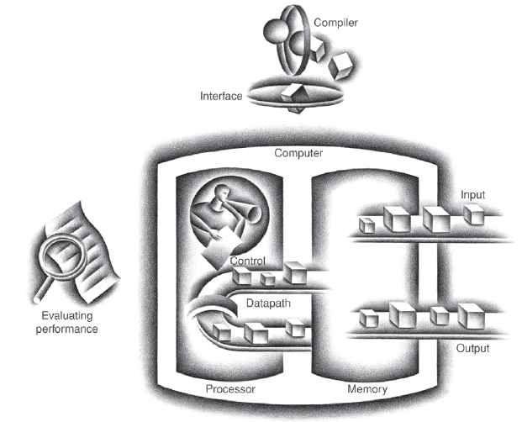
Today’s Content in Big Picture
SW
Part-I Ch2
Part-II Ch3,4
Part-III Ch1,5,6
ch2
I/O device
Ch6
Ch3,4
Ch5
Computer Organization and Design (5th edition) by Patterson and Hennessy

Slide 3
Instruction Set Arch. (ISA)
The first part of this course is all about ISA.
ISA is a central topic in Comp. Org.
---In old days, CO= ISA design
Why ISA is so important?
--- To command computer, we need a “language”
--- Instruction: “Word” of the language
--- Instruction Set Arch. : “Vocabulary”

Slide 4
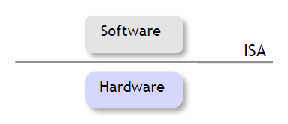
ISA: Interface between HW and SW
Abstraction: Hide HW complexity from the software through a set of simple operations and devices: add, mul…
Provides a mechanism by which the software tells the hardware what should be done.

Slide 5
A “Medium” Pic. For ISA
High-level Language(C/Java)
A=B+C
Compiler
Assembly language
add $t0, $s1, $s2
Assembler
Machine language
000010001100100100000000100000
HW-level operation

Slide 6
Machine language
Binary representation of instruction
Physically store in the memory
Directly executed by the processor
In courtesy of www.proactiveinvestors.com.au
We will re-visit machine language later

Slide 7
Assembly (ASM) language
For programmer, directly uses machine language to command CPU is too tedious
High-level language (HLL) cannot perform directly on hardware (register-level)
ASM provides good tradeoff between “readability” to programmer and “accessibility” to hardware

Slide 8
First Glance to Instruction in MIPS ASM
add $t0, $s1, $s2
Operation
Reg1
Reg2
Reg3
Reg: Register
MIPS ASM language directly operates on Register
It is readable to programmer
We will talk about Register later

Slide 9
HLL vs ASM vs Machine
Readability:
HLL > ASM > Machine
Executing speed:
Machine > ASM > HLL

Slide 10
Task 1: From HLL to ASM
High-level Language(C/Java)
A=B+C
Compiler
Assembly language
add $t0, $s1, $s2
Assembler
Machine language
000010001100100100000000100000
HW-level operation

Slide 11
In this task, you will learn…
Fundamental knowledge of Assembly language
How to Translate from C/Java to Assembly language
How to program Assembly in simulator

Slide 12
MIPS ISA
In CSE 341 we will learn MIPS ISA.
MIPS: Microprocessor without interlocked pipeline stages
There are many other ISAs:
Intel x86, ARM, IBM power
They are quite similar, like “dialects”

Slide 13
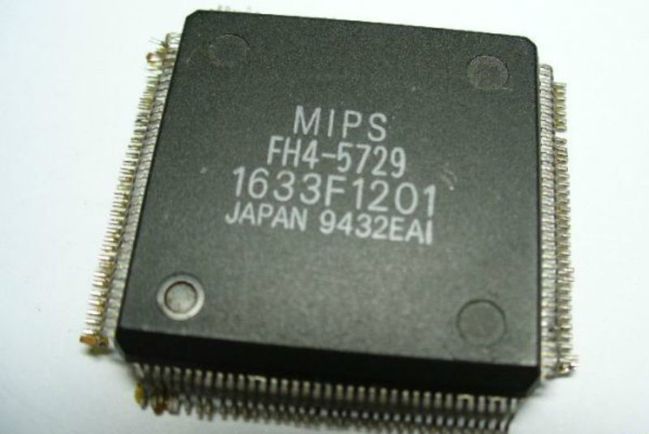
Why we choose MIPS
It is simple, RISC pioneer
--RISC (reduced instruction set computer)
--CISC (complex instruction set computer)
It is still used in commercial products
In courtesy of vr-zone.com

Slide 14
Register to Register
MIPS is a register-to-register architecture
-- The destination and source of most instructions must be registers.
-- Special instructions are provided to access to memory.
-- CISC is memory-to-memory architecture
add $t0, $s1, $s2

Slide 15
Register vs Memory
Both of them are used for data storage
Register
Pros: Faster access (read and write)
Cons: Higher unit cost
Memory
Pros: Lower unit cost
Cons: Slower access

Slide 16
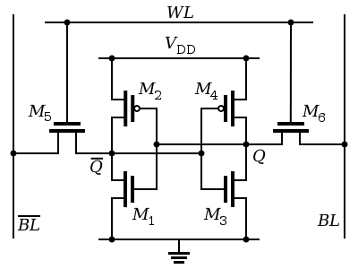
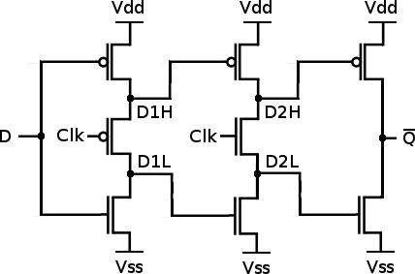
1-bit Reg and Mem
1-bit Register (D Flip-flop)
8 transistors
1-bit SRAM cell
6 transistors

Slide 17
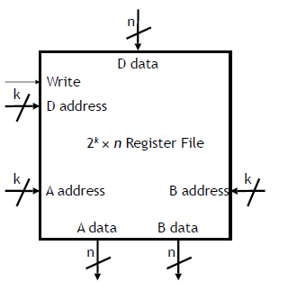
Register File
A combination of multiple registers
2^{k} x n Register file
-- Contains 2^{k} n-bit Registers
-- Write=1, D data stored into D address
-- No enable signal for read
-- When supplying the inputs of A address and B address, output appears as A data and B data

Slide 18
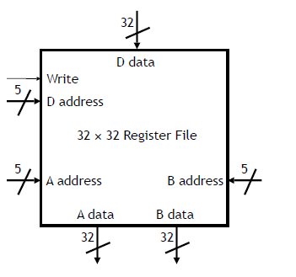
MIPS Register File
32 x 32 Register file
-- Contains 32 32-bit registers
-- More register is “expensive” due to
area budget
-- Register is for most frequently used data and operation (instruction)
-- Memory is for less frequently used and large-size (>32-bit) data.

Slide 19
Register Name
In MIPS, register names begin with $
Two types of naming conventions:
-- $0 $1 $2 … $31
-- (mostly used) $a0-$a3 $s0-$s7 … (see “MIPS Reference Data” in textbook)
Some registers have special uses by convention
-- $0 or $zero always contain 0
-- see textbook for other conventions
Follow those conventions to maintain readability

Slide 20
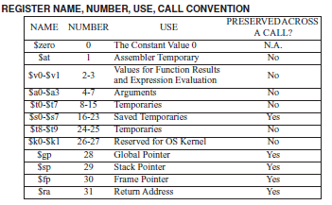
Naming Conventions

Slide 21
MIPS ASM Instructions (Arithmetic)
Three-address (operands) instructions for arithmetic instructions
Each arithmetic instruction contains a destination and two sources (destination first)
Operation
destination
source
add $t0, $s1, $s2

Slide 22
Some Arithmetic and Logical Operations
integer arithmetic operation
add sub mul div
logical operation
and or nor
All above require three register operands
add $t0, $t1, $t2 # $t0= $t1 + $t2
mul $t0, $t1, $t2 # $t0= $t1 x $t2
Read “MIPS Reference Data” in textbook for full lists

Slide 23
Larger Expression
For more complex arithmetic expressions, multiple operations are required.
How to perform t0 = (t1 + t2) x (t3 - t4)?
add $t0, $t1, $t2 # $t0 = $t1 + $t2
sub $s0, $t3, $t4 # $s0 = $t3 - $t4
mul $t0, $t0, $s0 # update $t0

Slide 24
Immediate Operations
Immediate operations are used to perform operations involve with constant
addi $t0, $t1, 4 # $t0= $t1 + 4
A important use of the immediate operations is to write constants into registers
addi $t0, $0, 4 # $t0= 4
Read “MIPS Reference Data” in textbook for full lists

Slide 25
Question
Write ASM instructions for the following operation
2+4+6+8

Slide 26
Question
Write ASM instructions for the following operation
2+4+6+8
addi $t0, $0, 2 # $t0= 2
addi $t0, $t0, 4 # $t0= 2+4
addi $t0, $t0, 6 # $t0= (2+4)+6
addi $t0, $t0, 8 # $t0= (2+4+6)+8

Slide 27
The Need of Memory
Fact1: MIPS is a register-to-register arch.
Fact2: Register file of MIPS is 32x32
-- Only 32 register is available
They are not enough for real applications
-- More data needs to be stored
-- A lot of data is beyond 32-bit width
Memory is a good solution
-- Denser and cheaper
-- Larger width of data bus

Slide 28
The Need of Memory
Fact1: MIPS is a register-to-register arch.
Fact2: Register file of MIPS is 32x32
-- Only 32 register is available
They are not enough for real applications
-- More data needs to be stored
-- A lot of data is beyond 32-bit width
How to compile this C code?
A[64] = h + A[8]
Memory is a good solution
-- Denser and cheaper
-- Larger width of data bus

Slide 29
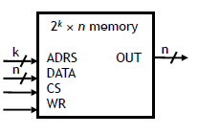
Review of Memory
CS: chip select, enable/disable signal (CS=1/0)
ADRS: The address of memory being accessed
WR=0, read phase,
OUT=data stored in the
address (ADRS)
WR=1, write phase, data
stored in the ADRS is replaced
by DATA

Slide 30
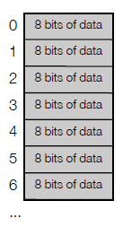
Memory in the MIPS
Byte-addressable, each data entry is 8-bit
Width of address bus is k=32
- totally 2³² entries
- total volume can reach 4GB

