Slide 1
CSE 341 Computer Organization Lecture 5 ISA : Assembly Language 4
Prof. Lu Su
Computer Science & Engineering
Slides adapted from Raheel Ahmad, Luis Ceze , Sangyeun Cho,
Howard Huang, Bruce Kim, Josep Torrellas, Bo Yuan, and Craig Zilles

Slide 2
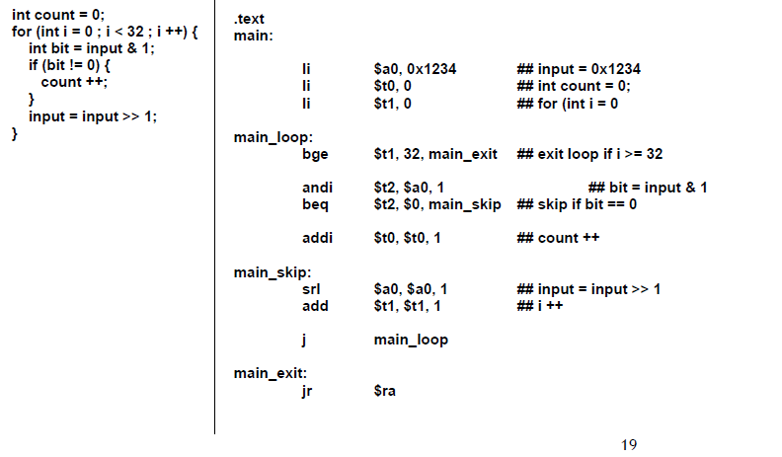
More Complex Example

Slide 3
More Complex Example
0000 0000 0000 0000 0000 0000 0000 1101
AND
0000 0000 0000 0000 0000 0000 0000 0001

Slide 4
Function (Procedure)
Function (Procedure) structures the code
int main() {
t1 = sum(5, 7);
}
int sum(int a, int b) {
int c=0; c=a+b;
return c;
}

Slide 5
How to Translate Function Call in MIPS ASM
Three necessary steps:
--1. Change the control flow
--2. Pass the arguments and return values
--3. Allocate and destroy the local variables
Approaches in MIPS:
-- Special instructions for calling functions.
-- Conventions for sharing registers
-- Use of stack

Slide 6
How to Translate Function Call in MIPS ASM
Three necessary steps:
--1. Change the control flow
--2. Pass the arguments and return values
--3. Allocate and destroy the local variables
Approaches in MIPS:
-- Special instructions for calling functions.
-- Conventions for sharing registers
-- Use of stack

Slide 7
Control Flow
When calls a function, the control flow of the main program changes twice
-- Call the function
-- Return from the function
Each time function is called, CPU needs to remember the correct return address

Slide 8
Control Flow in MIPS
Call function: jal (jump-and-link)
jal sum # call function sum
-- jal saves the return address (address of the next instruction) in the $ra before jump to function.
-- PC (Program Counter) register contains the address of the current executing instruction.
-- jal actually save PC+4 in $ra
Return: jr (jump return)
jr $ra # return to main program
- jr jumps to the address stored in $ra

Slide 9
Control Flow in MIPS
sum
main
call sum
PC
1100
1110
$ra

Slide 10
How to Translate Function Call in MIPS ASM
Three necessary steps:
--1. Change the control flow
--2. Pass the arguments and return values
--3. Allocate and destroy the local variables
Approaches in MIPS:
-- Special instructions for calling functions.
-- Conventions for sharing registers
-- Use of stack

Slide 11
Data Flow
int main() {
t1 = sum(5, 7);
}
int sum(int a, int b) {
int c=0; c=a+b;
return c;
}
Function accepts
arguments from the main program
Function produces return results

Slide 12
Data Flow in MIPS
$a0 - $a3 store arguments
$v0 and $v1 store return results
$ra stores returned address
No “type-check” in MIPS
--Be careful on consistent type

Slide 13
How to Translate Function Call in MIPS ASM
Three necessary steps:
--1. Change the control flow
--2. Pass the arguments and return values
--3. Allocate and destroy the local variables
Approaches in MIPS:
-- Special instructions for calling functions.
-- Conventions for sharing registers
-- Use of stack

Slide 14
A Problem on Register
In MIPS, registers for function are limited
-$a0~$a3 for storing arguments
-$v0 and $v1 for storing return results
What can we do to store more values?
In addition, more registers are needed for multiple calling the same function to reserve and destroy the local variables.

Slide 15
Spilling Registers
We can spill register to memory.
Stack is an ideal data structure
-- Reserved in main memory
-- Last-in-first-out queue
-- Address of top element is stored in $sp
-- The stack grows downward in terms of memory address

Slide 16
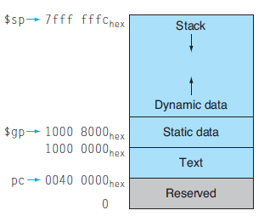
Breakdown of Main Memory

Slide 17
Example
//main.cpp int a = 0;
char *p1;
main() { int b; char s[] = “abc”; char *p2; char *p3 = “123456”; static int c =0; p1 = (char *)malloc(10); p2 = (char *)malloc(20); strcpy(p1, "123456"); }

Slide 18
Example
//main.cpp int a = 0; // Static
char *p1; // an area adjacent to Static
main() { int b; // Stack char s[] = “abc”; // “abc” in Text char *p2; // Stack char *p3 = “123456”; //“123456” in the Text static int c =0； // Static p1 = (char *)malloc(10); // Heap (Dynamic) p2 = (char *)malloc(20); // Heap (Dynamic) strcpy(p1, "123456"); // “123456” in Text }
p3 and s are in the stack

Slide 19
Example
s
p3
abc
123456

Slide 20
Stack and Heap
Stack: -- Downward Addressing, last-in-first out
-- Continuous area in the main memory
-- Top of stack and maximum size is pre-defined
-- Overflow may occur
Heap: -- Upward Addressing
-- Discontinuous area in the memory (linked list),
-- Flexible, large size
Malloc/New: --Request space from heap
-- Free/Delete is a must
--memory leak

Slide 21
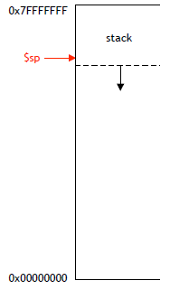
Downward Addressing of Stack

Slide 22
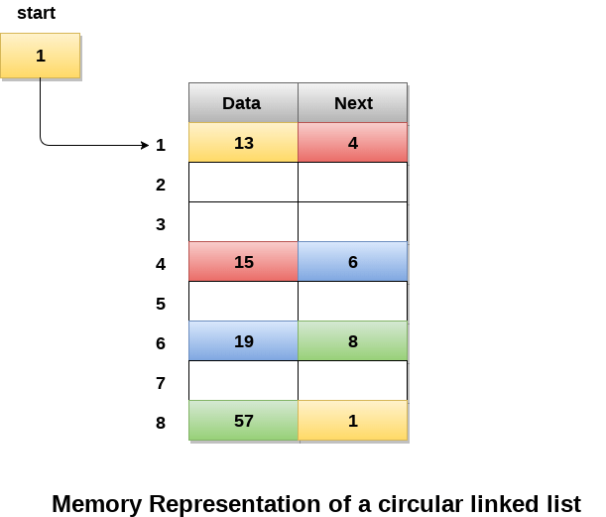
Heap

Slide 23
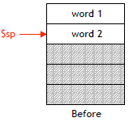
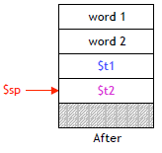
Pushing (store local variables)
To push elements onto the stack:
-- Move $sp down to make room
-- Store the elements into stack
For example:
addi $sp, $sp, -8 # make room
sw $t1, 4($sp) # push data
sw $t2, 0($sp) # push data

Slide 24
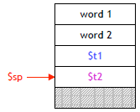
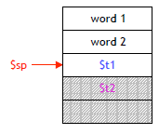
Accessing and Popping (destroying local variables)
Access the element in stack
lw $s0, 4($sp) # retrieve $t1
Pop (erase) the element in stack
addi $sp, $sp, 4 # pop $t2
Note that the popped data is
still in the memory.

Slide 25
Convention for Caller and Callee
Stack can also be used to
-- save the value of registers before overwritten by a function call,
-- then restore them after the function completes.
By convention, caller is responsible for saving and restoring the following registers
$t0 ~ $t9, $a0~$a3, $v0~$v1
Callee is responsible for saving and restoring registers
$s0 ~ $s7, $ra

Slide 26
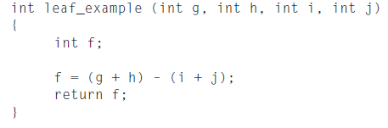




Example

Slide 27
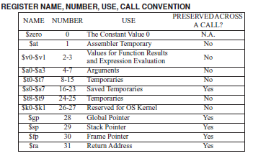
Naming Conventions

