Slide 1
CSE 341 Computer Organization Lecture 6: Signed and Unsigned Numbers
Prof. Lu Su
Computer Science & Engineering, UB
Slides adapted from Raheel Ahmad, Luis Ceze , Sangyeun Cho,
Howard Huang, Bruce Kim, Josep Torrellas, Bo Yuan, and Craig Zilles

Slide 2
Binary Numbers
In any number base, the value of ith digit d is:
d × Base^{i}
Numbers are kept in computer hardware as a series of high and low electronic signals, and so they are considered base 2 numbers.(binary numbers)
A single digit of a binary number is called binary digits or bits.

Slide 3
Numbering of Bits within a MIPS Word
Least significant bit: the rightmost bit in a MIPS word.
Most significant bit: the leftmost bit in a MIPS word.
Can represent 2³² different 32-bit patterns.

Slide 4
Unsigned Numbers
Let a word represent the numbers from 0 to 2³²-1(4,294,967,295_{ten}):
32-bit binary numbers can be represented in terms of the bit value times a power of 2:
These positive numbers are called unsigned numbers.

Slide 5
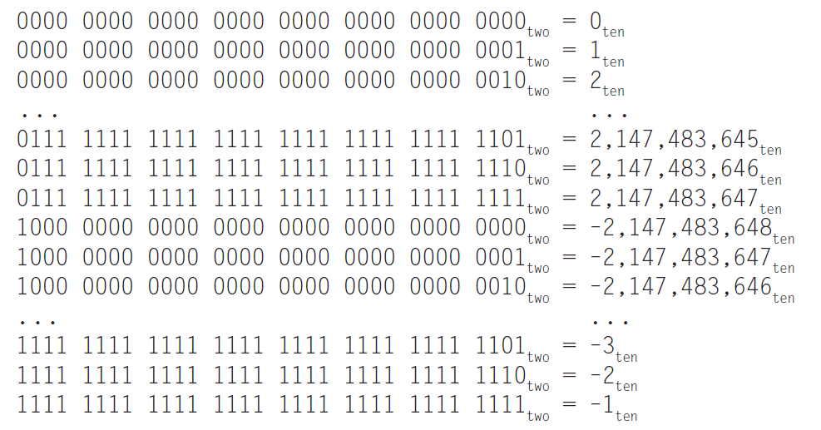
Signed Numbers
Two’s complement representation: leading 0s mean positive, and leading 1s mean negative.

Slide 6
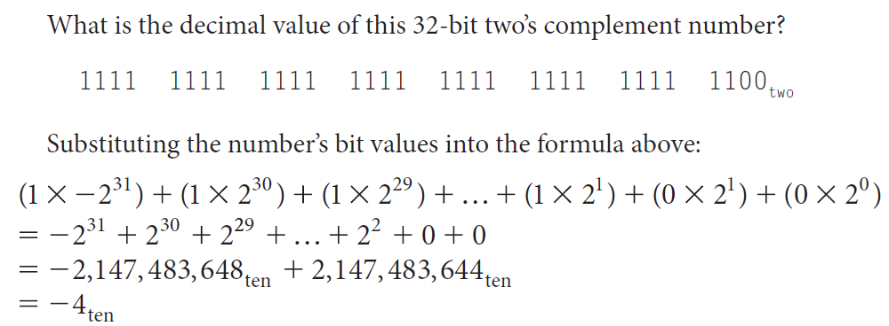
Binary to Decimal Conversion
Represent positive and negative 32-bit numbers:
Example:

Slide 7
Useful shortuts
A quick way to negate a two’s complement binary
number:
Simply invert every 0 to 1 and every 1 to 0,
then add one to the result. This shortcut is based
on the observation that the sum of a number and its
inverted representation must be 111 . . . 111_{two},
which represents 1.
x + $\overline{x}$ = -1 → $\overline{x}$ +1 = -x

Slide 9
Decimal to Binary Conversion
First consider the general case of binary to decimal conversion. (no sign bits but may have fraction part)
For the integral part, assume there are n bits: x_{n-1},
x_{n-2},…, x₁,x₀(from left to right), we have:
D_{I} = x_{n-1}·2^{n-1} + … + x₁·2¹+ x₀·2⁰
For the fractional part, assume there are n bits: x₁,
x₂,…, x_{n}(from left to right), we have:
D_{f} = x₁·2⁻¹ + x₂·2⁻²+… +x_{n}·2^{-n}

Slide 10
Decimal to Binary Conversion
Convert the integral part of decimal to binary equivalent : ( )
1. Divide the decimal number by 2 and store
remainders in array.
2. Divide the quotient by 2.
3. Repeat step 2 until we get the quotient equal to
zero.
4. Equivalent binary number would be reverse of all
remainders of step 1.
(Adapted from https://www.geeksforgeeks.org/convert-decimal-fraction-binary-number/)

Slide 11
Decimal to Binary Conversion
Convert the fractional part of decimal to binary equivalent : ( )
Assume the
1. Multiply the fractional decimal number by 2.
2. Integral part of resultant decimal number will be
first digit of fraction binary number.
3. Repeat step 1 using only fractional part of decimal
number and then step 2.
Combine both integral and fractional part of binary number.

Slide 12
Decimal to Binary Conversion
Example: Convert 4.3125 to binary. (3 precision after decimal point)
Step1: Conversion of 4 to binary.
1. 4/2: remainder = 0; quotient = 2;
2. 2/2: remainder = 0; quotient = 1;
3. 1/2: remainder = 1; quotient = 0;
So integral part is 100.

Slide 13
Decimal to Binary Conversion
Step2: Conversion of .3125 to binary.
1. 0.3125 * 2 = 0.625, integral part: 0;
2. 0.625 * 2 = 1.25, integral part: 1;
3. 0.25 * 2 = 0.5, integral part: 0;
4. 0.5 * 2 = 1, integral part: 1;
So fractional part is 0.0101.
Step3: 100 + 0.0101 = 100.0101.

Slide 14
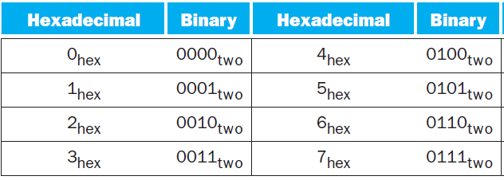
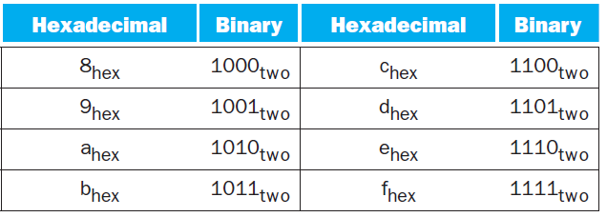
Binary to Hexadecimal and Back
Since base 16 is a power of 2, we can trivially convert by replacing each group of four binary digits by a single hexadecimal digit, and vice versa.

Slide 15
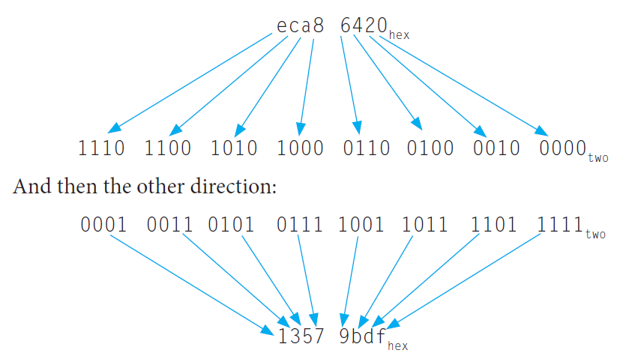
Binary to Hexadecimal and Back
Example:

Slide 16
Notation in C
Binary: C doesn’t support binary literals, but we can use ‘0b’ before the binary number in C++ 14.
Octal: ‘0’ before octal number.
Hexadecimal: ‘0x’ before hex number.
Decimal: no other notation.

