Slide 1
CSE 341
Computer Organization
Lecture 7
ISA : Machine Language 1
Prof. Lu Su
Computer Science & Engineering

Slide 2
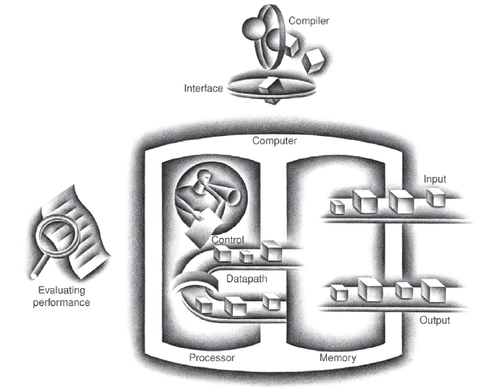
Today’s Content in Big Picture
SW
Part-I Ch2
Part-II Ch3,4
Part-III Ch1,5,6
ch2
ch1
I/O device
Ch6
Ch3,4
Ch5
Computer Organization and Design (5th edition) by Patterson and Hennessy

Slide 3
Task 2: From ASM to Machine
High-level Language(C/Java)
A=B+C
Compiler
Assembly language
add $t0, $s1, $s2
Assembler
Machine language
000010001100100100000000100000
HW-level operation

Slide 4
ASM vs Machine Language
So far we’ve been using assembly language, some readability
-- Operations (e.g., add) and operands (e.g., $t0).
-- Branches/jumps use labels instead of addresses.
-- Many pseudo-instructions.
Programs must eventually be translated into machine language
-- Binary format, stored in memory and decoded by CPU.

Slide 5
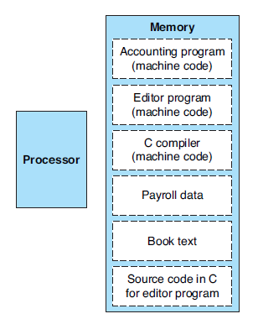
Stored-Program Concept
The words of a computer’s language are called instructions, and its vocabulary is called an instruction set.
Today’s computers are built on two key principles:
  1. Instructions are represented as numbers.
  2. Programs are stored in memory to be read or written, just like data.

Slide 6
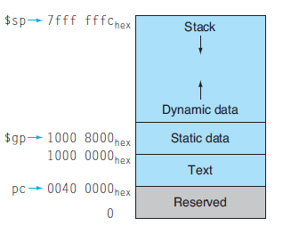
Breakdown of Main Memory

Slide 7
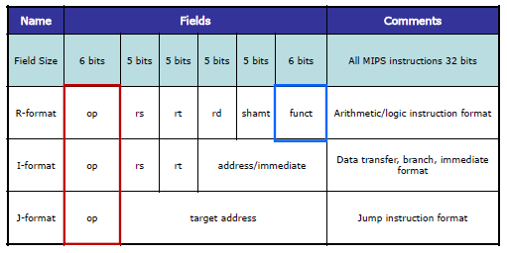
MIPS Machine Language
MIPS machine language: is designed for easily decode.
-- Each instruction has the same 32-bits length
-- Only three different instruction formats

Slide 8
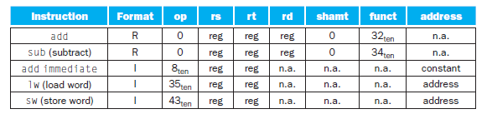
Instruction Encoding Example

Slide 9

R-type Format
R-type format: design for register-to-register arithmetic/logic instructions, like add, and
-- op: operation code (opcode)
-- rs, rt: 1st and 2nd source register
-- rd: destination register
-- shamt: for shift instruction
-- func: used with op to select functions

Slide 10
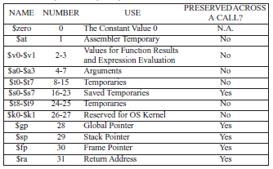
Number for Register
Recall that register can be represented by decimal number: eg. $t8 is $24
In MIPS machine language, register name is encoded by 5-bit binary number: eg.11000 represents $t8

Slide 11
Example for Add
add $t0, $s1, $s2
0 17 18 8 0 32
000000 10001 10010 01000 00000 100000

Slide 12
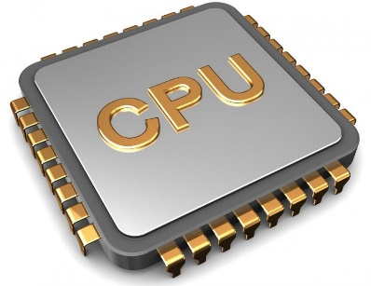
Example for Add
s2
18
s1
17
t0
8
add $t0, $s1, $s2
Register File
Memory

Slide 13
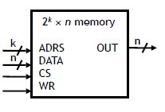
Review of Memory
CS: chip select, enable/disable signal (CS=1/0)
ADRS: The address of memory being accessed
WR=0, read phase,
OUT=data stored in the
address (ADRS)
WR=1, write phase, data
stored in the ADRS is replaced
by DATA

Slide 14
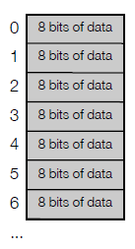
Memory in the MIPS
Byte-addressable, each data entry is 8-bit
Width of address bus is k=32
- totally 2³² entries
- total volume can reach 4GB

Slide 15
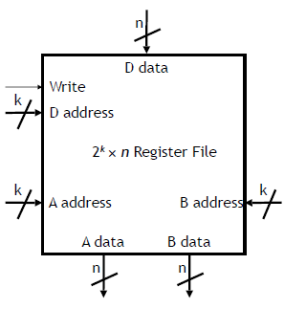
Register File
A combination of multiple registers
2^{k} x n Register file
-- Contains 2^{k} n-bit Registers
-- Write=1, D data stored into D address
-- No enable signal for read
-- When supplying the inputs of A address and B address, output appears as A data and B data

Slide 16
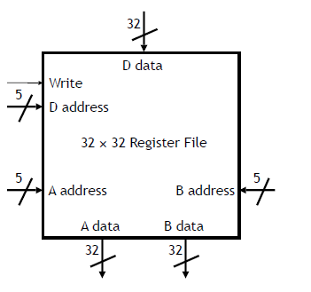
MIPS Register File
32 x 32 Register file
-- Contains 32 32-bit registers
-- More register is “expensive” due to
area budget
-- Register is for most frequently used data and operation (instruction)
-- Memory is for less frequently used and large-size (>32-bit) data.

Slide 17
Example for Sub
sub $t0, $s1, $s2
0 17 18 8 0 34
000000 10001 10010 01000 00000 100010

Slide 18
Example for And
and $t0, $s1, $s2

Slide 19
Example for And
and $t0, $s1, $s2
0 17 18 8 0 24_{hex}
000000 10001 10010 01000 00000 100100

Slide 20
R-type Format for Shift
Shift instruction is slightly different
-- rs is always 0₁₀
-- rt: source register
-- rd: destination registe
-- shamt: for shift instruction
-- func: used with op to select functions

Slide 21
Example for Shift
sll $t2, $s0, 4
0 0 16 10 4 0_{hex}
000000 00000 10000 01010 00100 000000

Slide 22
Example for Shift
srl $t2, $s0, 4

Slide 23
Example for Shift
srl $t2, $s0, 4
0 0 16 10 4 02_{hex}
000000 00000 10000 01010 00100 000010

