Slide 1
CSE 341 Computer Organization Lecture 8 ISA : Machine Language 2
Prof. Lu Su
Computer Science & Engineering

Slide 2
I-type Format
I-type format: designed for load/store, branch and immediate instruction.
- rs: source register for load/store; for branch or immediate instruction, it is operand.
- rt: for branches, it is source register; for other three cases, it is destination register
- address: 16-bit, from (-32768)₁₀ to (32767)₁₀

Slide 3
Example for load
lw $s1, 100($s2)
23_{hex} 18 17 100
100011 10010 10001 00000 00001100100

Slide 4
Example for store
sw $s1, 100($s2)

Slide 5
Example for store
sw $s1, 100($s2)
2b_{hex} 18 17 100
101011 10010 10001 00000 00001100100

Slide 6
Example for addi
addi $s1, $s2, 100
8_{hex} 18 17 100
001000 10010 10001 00000 00001100100

Slide 7
Branch
For branch instruction, the last field (16-bit) is not address
Since all the instructions are stored in the memory, the last field of branch instruction is the offset from the address of current instruction (program counter (PC)) to the address of the targeted instruction.
PC-relative addressing: The MIPS address is actually relative to the address of the following instruction (PC+4) as opposed to the current instruction (PC).

Slide 8
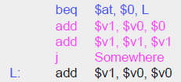
Example for branch
Word Offset !
(not byte offset)

Slide 9
J-type Format
J-type format: jump instruction.
Unlike branch instruction, the last field of jump instruction contains a word address instead of offset.
A 26-bit address field allows jump to any address from 0 to 2²⁸.
Word Address !
Byte Address !

Slide 10
Example for jump
j 100

Slide 11
Example for jump
j 100
2_{hex} 25₁₀
000010 00000 00000 00000 00000 011001

Slide 12
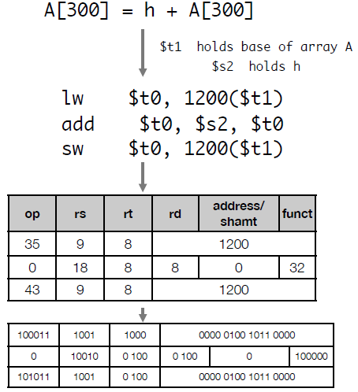
From Program to Computer Example 1

Slide 13
From Program to Computer Example 2

Slide 14
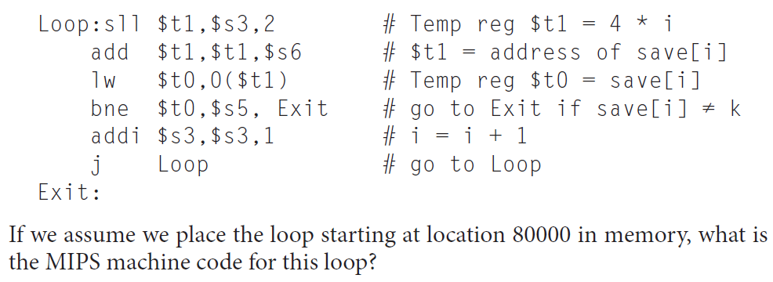
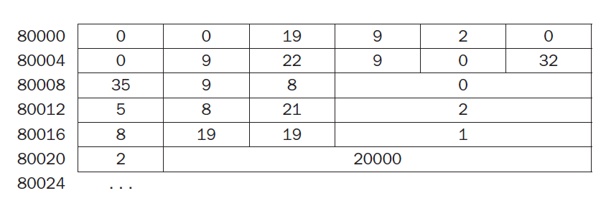
From Program to Computer Example 2

Slide 15
MIPS Addressing Mode Summary
Multiple forms of addressing are generically called addressing modes.
The MIPS addressing modes are the following:
1. Immediate addressing
2. Register addressing
3. Base or displacement addressing
4. PC-relative addressing
5. Pseudodirect addressing

Slide 16
Immediate Addressing
The operand is a constant within the instruction itself

Slide 17
Example for addi
addi $s1, $s2, 100
8_{hex} 18 17 100
001000 10010 10001 00000 00001100100

Slide 18
Register Addressing
The operand is a register

Slide 19
Base or Displacement Addressing
The operand is at the memory location

Slide 20
Example for store
sw $s1, 100($s2)
2b_{hex} 18 17 100
101011 10010 10001 00000 00001100100
00000 10001000111

Slide 21
PC-relative Addressing
The branch address is the sum of the PC and a constant in the instruction.

Slide 22
Pseudodirect Addressing
The jump address is the 26 bits of the instruction concatenated with the upper bits of the PC

Slide 23
Short Summary
Machine language: Binary representation of instr.:
--The format in which the machine actually executes them
MIPS machine language is designed to simplify processor implementation
-- Fixed length instructions
-- 3 instruction encodings: R-type, I-type, and J-type
-- Common operations fit in one instruction
-- Uncommon (e.g., long immediate) require more than one

