Slide 1
CSE 341 Computer Organization Lecture 9 ISA : Assembly Language 5
Prof. Lu Su
Computer Science & Engineering
Slides adapted from Raheel Ahmad, Luis Ceze , Sangyeun Cho,
Howard Huang, Bruce Kim, Josep Torrellas, Bo Yuan, and Craig Zilles

Slide 2
Nested Procedures
Procedures that do not call others are called leaf procedures.
In practice, procedures may invoke other procedures, sometimes even themselves.
Nested Procedures: push all the other registers that must be preserved onto the stack.
The caller pushes any argument registers ($a0–$a3) or temporary registers ($t0–$t9) that are needed after the call.
The callee pushes the return address register $ra and any saved registers ($s0–$s7) used by the callee.
Upon the return, the registers are restored from memory and the stack pointer is readjusted.

Slide 3
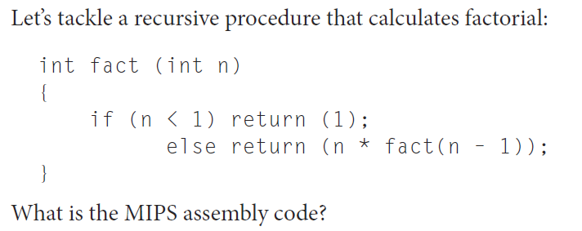
Example

Slide 5
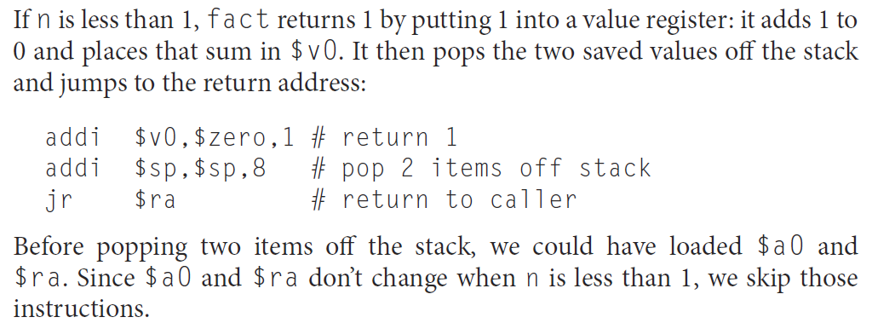

Slide 7
Example (n=3)

Slide 8
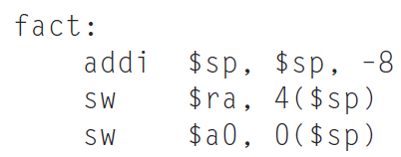
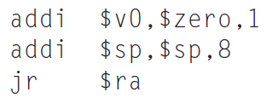
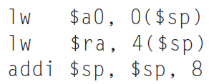
SP
ra(n=3)
a0=3

Slide 9
ra(n=3)
SP
a0=3
ra(n=2)
a0=2

Slide 10
ra(n=3)
a0=3
ra(n=2)
SP
a0=2
ra(n=1)
a0=1

Slide 11
ra(n=3)
a0=3
ra(n=2)
a0=2
ra(n=1)
SP
a0=1
ra(n=0)
a0=0

Slide 12
CSE 341 Computer Organization Lecture 9 ISA : Machine Language 3
Prof. Lu Su
Computer Science & Engineering
Slides adapted from Raheel Ahmad, Luis Ceze , Sangyeun Cho,
Howard Huang, Bruce Kim, Josep Torrellas, Bo Yuan, and Craig Zilles

Slide 13
PC-relative Addressing
The branch address is the sum of the PC and a constant in the instruction.
0000 0000 0000 0000 0000 0000 0000 0010
1001 0000 0000 0000 0000 0000 0000 0000

Slide 14
Pseudodirect Addressing
The jump address is the 26 bits of the instruction concatenated with the upper 4 bits of the PC, followed by 00.
0000 0000 0000 0000 0000 0000 11
1001 0000 0000 0000 0000 0000 0000 0000
PC31...PC28 AD26...AD01 0 0

Slide 15
Short Summary
Machine language: Binary representation of instr.:
--The format in which the machine actually executes them
MIPS machine language is designed to simplify processor implementation
-- Fixed length instructions
-- 3 instruction encodings: R-type, I-type, and J-type
-- Common operations fit in one instruction
-- Uncommon (e.g., long immediate) require more than one

Slide 16
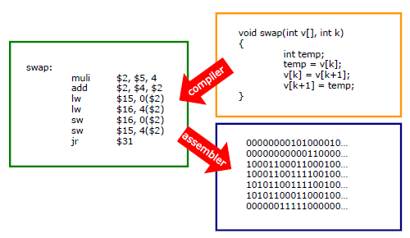
“C” Program to Number

Slide 17
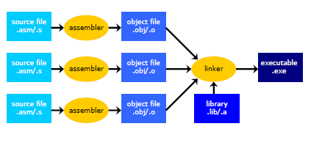
A combination of machine language instructions, data, and information needed to place instructions properly in memory

Slide 18
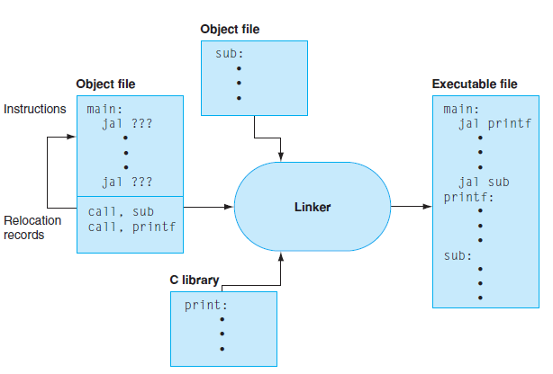
Linker

Slide 19
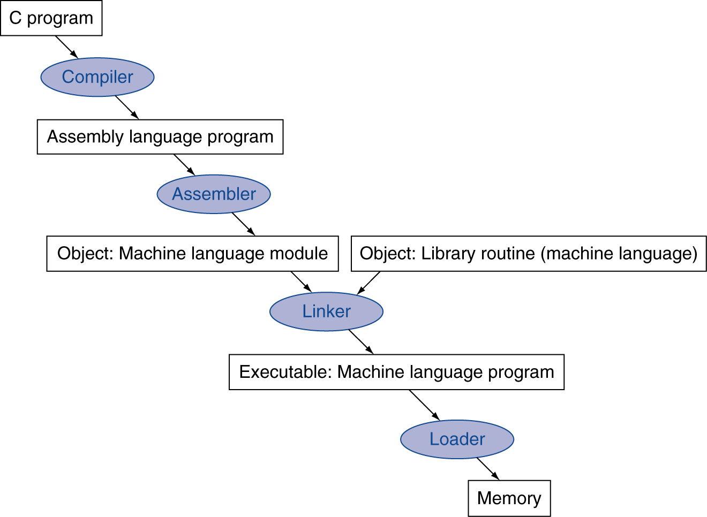
Translation and Startup
Many compilers produce object modules directly
Static linking

Slide 20
Assembler Pseudoinstructions
Most assembler instructions represent machine instructions one-to-one
Pseudoinstructions: figments of the assembler’s imagination
move $t0, $t1 → add $t0, $zero, $t1
blt $t0, $t1, L → slt $at, $t0, $t1 bne $at, $zero, L
$at (register 1): assembler temporary

Slide 21
Producing an Object File
Assembler (or compiler) translates program into machine instructions
Provides information for building a complete program from the pieces
Header: describes the size and position of the other pieces of the object file.
Text segment: translated machine language code.
Static data segment: data allocated for the life of the program.
Relocation info: for contents that depend on absolute location of loaded program
Symbol table: global definitions and external refs
Debug info: for associating with source code

Slide 22
Linking Object Files
Produces an executable file
Merges segments
Determine the addresses of data and instruction labels.
Patch location-dependent and external refs
Could leave location dependencies for fixing by a relocating loader
But with virtual memory, no need to do this
Program can be loaded into absolute location in virtual memory space

Slide 23
Loading a Program
Load from executable file on disk into memory
1. Read header to determine segment sizes
2. Create virtual address space
3. Copy text and initialized data into memory
Or set page table entries so they can be faulted in
4. Set up arguments on stack
5. Initialize registers (including $sp, $fp, $gp)
6. Jump to startup routine
Copies arguments to $a0, … and calls main
When main returns, do exit syscall

Slide 24
Dynamic Linking
Only link/load library procedure when it is called
Requires procedure code to be relocatable
Avoids image bloat caused by static linking of all (transitively) referenced libraries
Automatically picks up new library versions

