Slide 1
Project Example

Slide 2
Web-based travel planner
Client Side:
User registration and login
Ability to coordinate flights, hotels, and tours & excursions through multiple countries and locations
Create itineraries (consolidation of flights, hotels, tours)
Server Side:
Databases of users, airline, hotel, and tour information
Site Administration (dashboard)

Slide 3
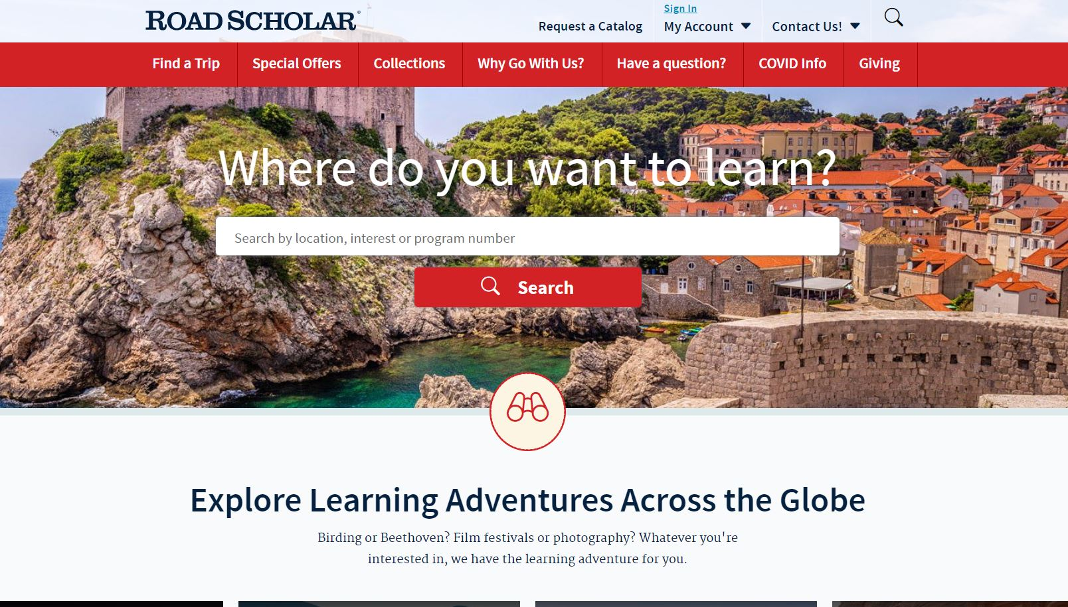

Slide 4
Major Modules
Client Side:
User registration and login
flights, hotels, and tours/excursions user screens
consolidation (of flights, hotels, tours) user screen
Server Side:
Databases of users, airline, hotel, and tour information
Site Administration (dashboard)
Server / Client Interfaces

Slide 5
typical - done once
Customer meetings
System Spec
Review
SRS
Review
Top Level Design
Test Plan
Review
Integration
Documentation
Customer Site Deployment

Slide 6
typical - done for each module
Detailed Design
Code
Walk-thru / Review
Unit Test

