Slide 1
An Interactive Clustering-based Approach to Integrating Source Query Interfaces on the Deep Web
Wensheng Wu
Clement Yu
AnHai Doan
Weiyi Meng
Presented By :
Manas Pradhan
Database Seminar March 21, 2008

Slide 2
OUTLINE
Background
Hierarchical Modeling of Query Interface
Interface Matching
Field Mapping via Clustering
User Interactions
Experiments
Related Work and Future Work

Slide 3
Background
For a domain of interest, there exist numerous data sources.
Different data sources can be accessed individually by their query interfaces (web forms, web services).

Slide 4
Background
To integrate the data sources, their query interfaces need to be integrated.
Integration has 2 steps :
Semantic field mapping over different interfaces.
Interface integration based on identified mapping.
Accuracy of mapping majorly depends on output of 1st step.

Slide 5
Current limitations
Non- hierarchical modeling
1:1 mapping assumption
Black Box Operation
Laborious Parameter Tuning

Slide 6
Clustering-based approach
Hierarchical Modeling
Structure of interface exploited.
Clustering
Helps to indentify 1:1 mapping.
Complex Mapping
Approaches to find complex mappings by exploiting hierarchical nature of interfaces
User Interaction and Parameter Learning
Active learning of parameters by asking questions to the human integrator

Slide 7
OUTLINE
Background
Hierarchical Modeling of Query Interface
Interface Matching
Field Mapping via Clustering
User Interactions
Experiments
Related Work and Future Work

Slide 8
Hierarchical modeling of query interfaces
Basic building block of query interface: Field
Properties of a field ‘ f ’:
Name (f)
Label (f)
Domain (f)
Model interface with a hierarchical schema which is ordered tree of elements.
Leaf elements of the tree are fields.
Internal elements correspond to groups or super-groups

Slide 9
Example of a query interface and its mapping into hierarchical model

Slide 10
OUTLINE
Background
Hierarchical Modeling of Query Interface
Interface Matching
Field Mapping via Clustering
User Interactions
Experiments
Related Work and Future Work

Slide 11
Interface matching
Two types of Mapping
Simple Mapping
1:1 semantic correspondence between 2 fields in different interfaces
Major Challenge : Label mismatch problem.
Example: class of service, class of ticket, cabin, preferred cabin flight service etc. imply the same label.
Complex Mapping
1:m semantic correspondence between more than 2 fields in different interfaces
Aggregate and is-a types of 1:m mapping
More challenging than simple mapping

Slide 12
Handling Mappings
Handling 1:1 mappings
Done by using the bridging effect achieved by matching all interfaces at once.
Similar to reusing existing mappings.
Handling 1:m mappings
Using following observations to identify 1:m mappings
Value Correspondence
Field Proximity
Label Similarity
User Interactions

Slide 13
OUTLINE
Background
Hierarchical Modeling of Query Interface
Interface Matching
Field Mapping via Clustering
User Interactions
Experiments
Related Work and Future Work

Slide 14
Field Matching via Clustering
Field Similarity Function
Aggregate Similarity AS(e, f ) is
where Linguistic Similarity lingSim(e, f ) is
after normalization (next slide )
and where domSim is Domain Similarity (to follow )
λs are weight coefficients
nSim, lSim and nlSim calculated using cosine similarity

Slide 15
Normalization
Tokenization
Used to cope with concatenated words
For example departcity is tokenized into depart city and first_name into first name.
Transformation
Used to expand abbreviations
For example dept is transformed into departure.
To avoid false expansion, word should not be in dictionary and to be more than 3 words long and having the same first letter as expanding word

Slide 16
Domain Similarity
Simple Domain types like money, string, int, time, real, area …
typeSim is 1 if same domain type and 0 otherwise
valueSim(d, d’) is evaluated as follows when type int :
min{ max(d), max(d’) } – max{ min(d), min(d’) }
max{ max(d), max(d’) } – min{ min(d), min(d’) }
where min(d) and max(d) give the minimum and maximum values in the domain d
In case of strings valueSim is evaluated using Dice’s function 2 * |C|
|d| + |d’|
where C is the set of similar string pairs calculated using cosine similarities.

Slide 17
Finding 1:1 Mappings
A hierarchical agglomerative clustering algorithm used to find 1:1 mappings
It takes as input 3 elements :
Set of Interfaces S
Similarity Matrix M of fields in S
Stopping Threshold τ_{c} ≥ 0
Algorithm employs greedy matching
Output of the algorithm is partition over fields such that similar fields are in same partitions.

Slide 18
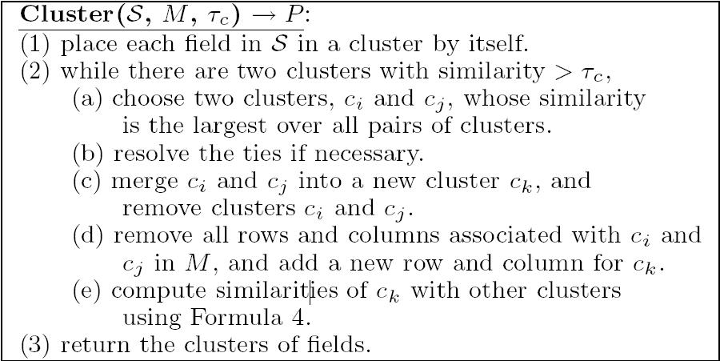
Clustering Algorithm

Slide 19
Ordering Based Tie Resolution
Occurs when more than 1 pair of clusters with the same maximum similarity.
Resolved by using order semantics of fields in the involved clusters.

Slide 20
Finding Complex Mappings
2 phases introduced to handle 1:m mappings
Preliminary 1-m matching phase
Final 1-m matching phase
Involves considering composite domain and composite field
Similarity of Composite vs. Simple/Composite Domains to be handled.

Slide 21
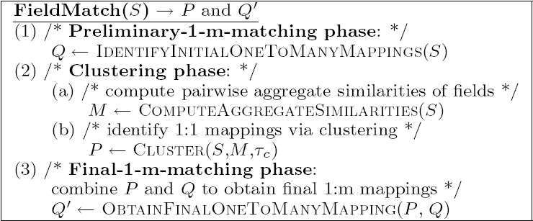
Field Matching Algorithm

Slide 22
Finding Complex Mappings
Identifying a Preliminary Set of 1:m Mappings
Aggregate Type
If a field e in an interface S is composite then we check every other interface denoted as X and look for set of fields f = (f₁,f₂,….f_{n}) where n>1 satisfying following conditions :
f_{i}'s are siblings of same parent p, but the set of f_{i}'s might also be a proper subset of the set of all children of p.
The label of the parent of f_{i}'s is highly similar to the label of e.
There is a subset s of sub-domains of domain of e such that there is a 1:1 correspondence between each sub-domain in s and the domain of some field f_{j} (or sub-domain if f_{j} is composite) in f in the sense that they have high similarity

Slide 23
Finding Complex Mappings
Identifying a Preliminary Set of 1:m Mappings
Is-a Type
For each non-composite field ‘e’ in interface S, we check if there exists a set of fields f = (f₁.f₂,…,f_{n}) where n > 1, in another interface X, which meets the following conditions:
All fi's are siblings and their parent does not have any children other than fi's.
The label of the parent of fi's is highly similar to the label of e.
The domain of each f is highly similar to the domain of e.

Slide 24
Finding Complex Mappings
Dealing with Infinite Domains
Some fields whose domain type cannot be inferred
We assume the domain type to be string and the cardinality to be infinite.
Similarity of such domains with any other domains is 0
Such cases we utilize the label information of the fields
For all such fields not identified as 1:m mappings, we seek a set of sibling fields f = { f1,f2, … , fn) n> 0 such that one of the conditions is satisfied
fii's are the only children of their parent, p, and the label of g is identical to the label of p.
The label of g can be decomposed into several component terms with `,', `/', `or' as delimiters, and the label of each fi is one of the component terms in the label of g

Slide 25
Finding Complex Mappings
Obtaining Final 1:m Mappings of fields.
Inference Process is applied
1:m mappings combined with 1:1 mappings to infer additional 1:m mappings
Example: If previous steps give us a mapping a {b1,b2}
and we have 1:1 mappings b1 c1 and b2 c2 then we can infer a mapping a { c1, c2 } given that c1 and c2 both belong to interface C .

Slide 26
Outline
Background
Hierarchical Modeling of Query Interface
Interface Matching
Field Mapping via Clustering
User Interactions
Experiments
Related Work and Future Work

Slide 27
User Interactions
Algorithm requires set of parameters to be manually set.
The field matching algorithm made interactive by putting the human integrator back in loop.
This interaction is achieved in the following 2 ways :
Parameter Learning
Resolving the Uncertainties

Slide 28
Parameter Learning
Field Similarity (fs) is a linear combination of component similarities (cs).
fs = a₁ * cs₁ + a₂ *cs₂ + …… + a_{n}*cs_{n}
a_{i}’s are weight coefficients
Field Matching Algorithm acts as thresholding function.
Depending upon threshold, fields judged if similar.
Critical factor is learning the threshold.

Slide 29
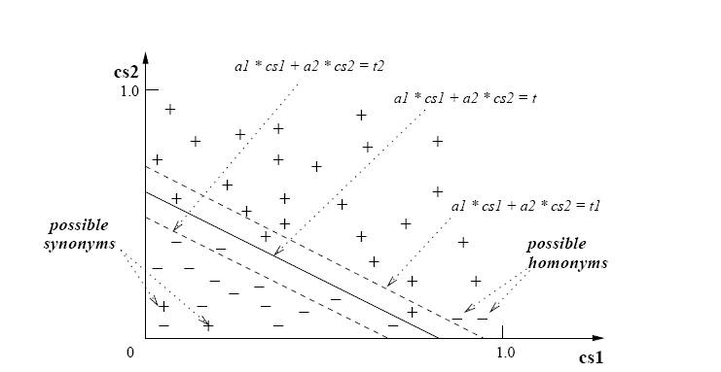
Thresholding Function

Slide 30
Resolving The Uncertainties
Analysis shows errors due to
False positives due to homonyms
Example: type of job can mean part time/ fulltime or accountant / engineer
To determine possible homonyms, user asked to confirm when very low domain similarity but very high linguistic similarity.
Since it can confuse the clustering process they are resolved before the learning starts
False negative due to synonyms
Words which do not hav similar labels and domains are semantically similar but do not have enough common values to be similar.
To determine possible synonyms, additional Check – Ask – Merge Procedure introduced after resolving the ties step in the clustering process.

Slide 31
Resolving The Uncertainties
False negative 1:m mappings
Some potential 1:m mappings that may be left out due to follwing reasons :
Field e could intuitively map to fields f and g if
Similarity between e and f is close to that between e and g.
f and g are very close to each other in the interface
No other field in the interface containing e which satisfies conditions 1 and 2. Also f and g should be adjacent in the interface. ( Essential because there might be multiple 1:1 mappings instead of a single 1:m mapping )
Applied after preliminary 1:m mapping phase.

Slide 32
Outline
Background
Hierarchical Modeling of Query Interface
Interface Matching
Field Mapping via Clustering
User Interactions
Experiments
Related Work and Future Work

Slide 33
Experiments

Slide 34
Experiments
Data Set
Query interfaces to sources in 5 domains
20 query interfaces to each domain by utilizing 2 online directories
Searched sources in invisibleweb.com and yahoo.com
Performance Metrics
Performance measured using precision, recall and F- measure.
F measure incorporates both precision and recall.
F = 2PR / (P+R)

Slide 35
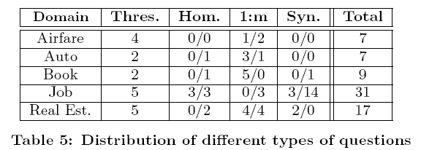
Experiments with Accuracy measurements

Slide 36
Observations on Component Contribution

Slide 37
Outline
Background
Hierarchical Modeling of Query Interface
Interface Matching
Field Mapping via Clustering
User Interactions
Experiments
Related Work and Future Work

Slide 38
Related Work
Schema and Interface Matching
User Interaction & Parameter Learning
Bridging Effect vs. Mapping Reusing

Slide 39
Conclusions
High Accuracy yielding approach to interface matching
Captures hierarchical nature of interfaces, handles simple and complex mappings of fields
Incorporates user interactions to learn parameters and resolve the uncertainties
Results conclude that approach is highly effective

Slide 40
Conclusions
Approach can be extended to general schema problem.
Large set of schemas can be matched at once instead of 2 to identify mappings.
User interactions introduced during the matching process complementing approaches used at the end.
Both the structural and instance level information of schemas can be used
Active learning of parameters important step towards systematic tuning of parameters in schema matching algorithms.

Slide 41
Future Work
Possibility of user interactions in resolving other uncertainties in the matching process
Better methods to break ties when the ordering based strategies fail
Incorporate an automatic interface modeling procedure into our approach
Further evaluate the approach on automatically generated schema trees.

