Slide 1
Welcome
to
CSE 331

Slide 2
Please follow COVID-19 policies

Slide 3
Let’s do some introductions

Slide 4
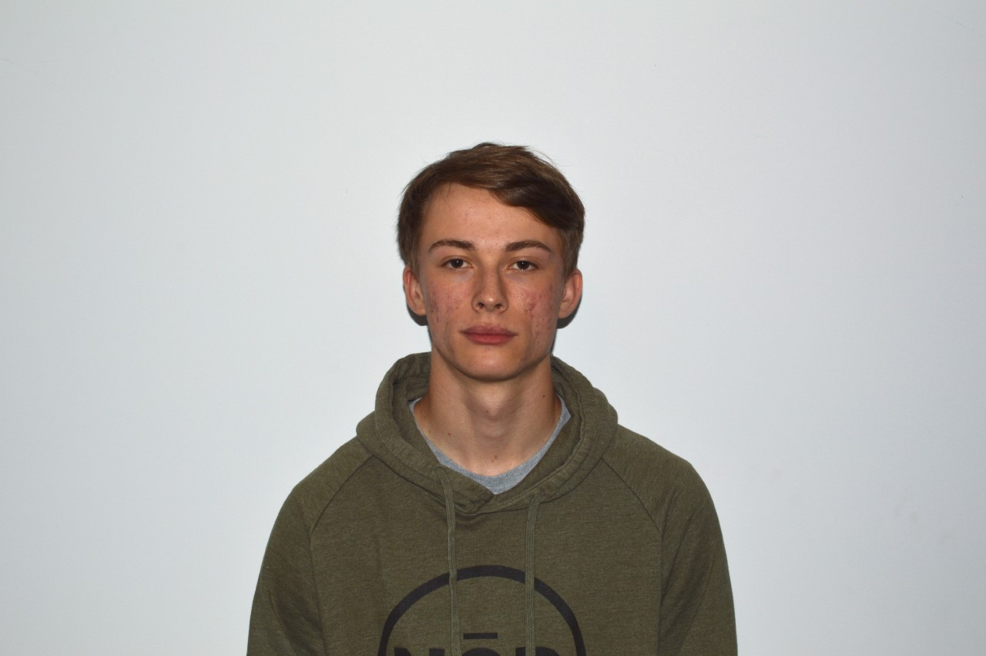
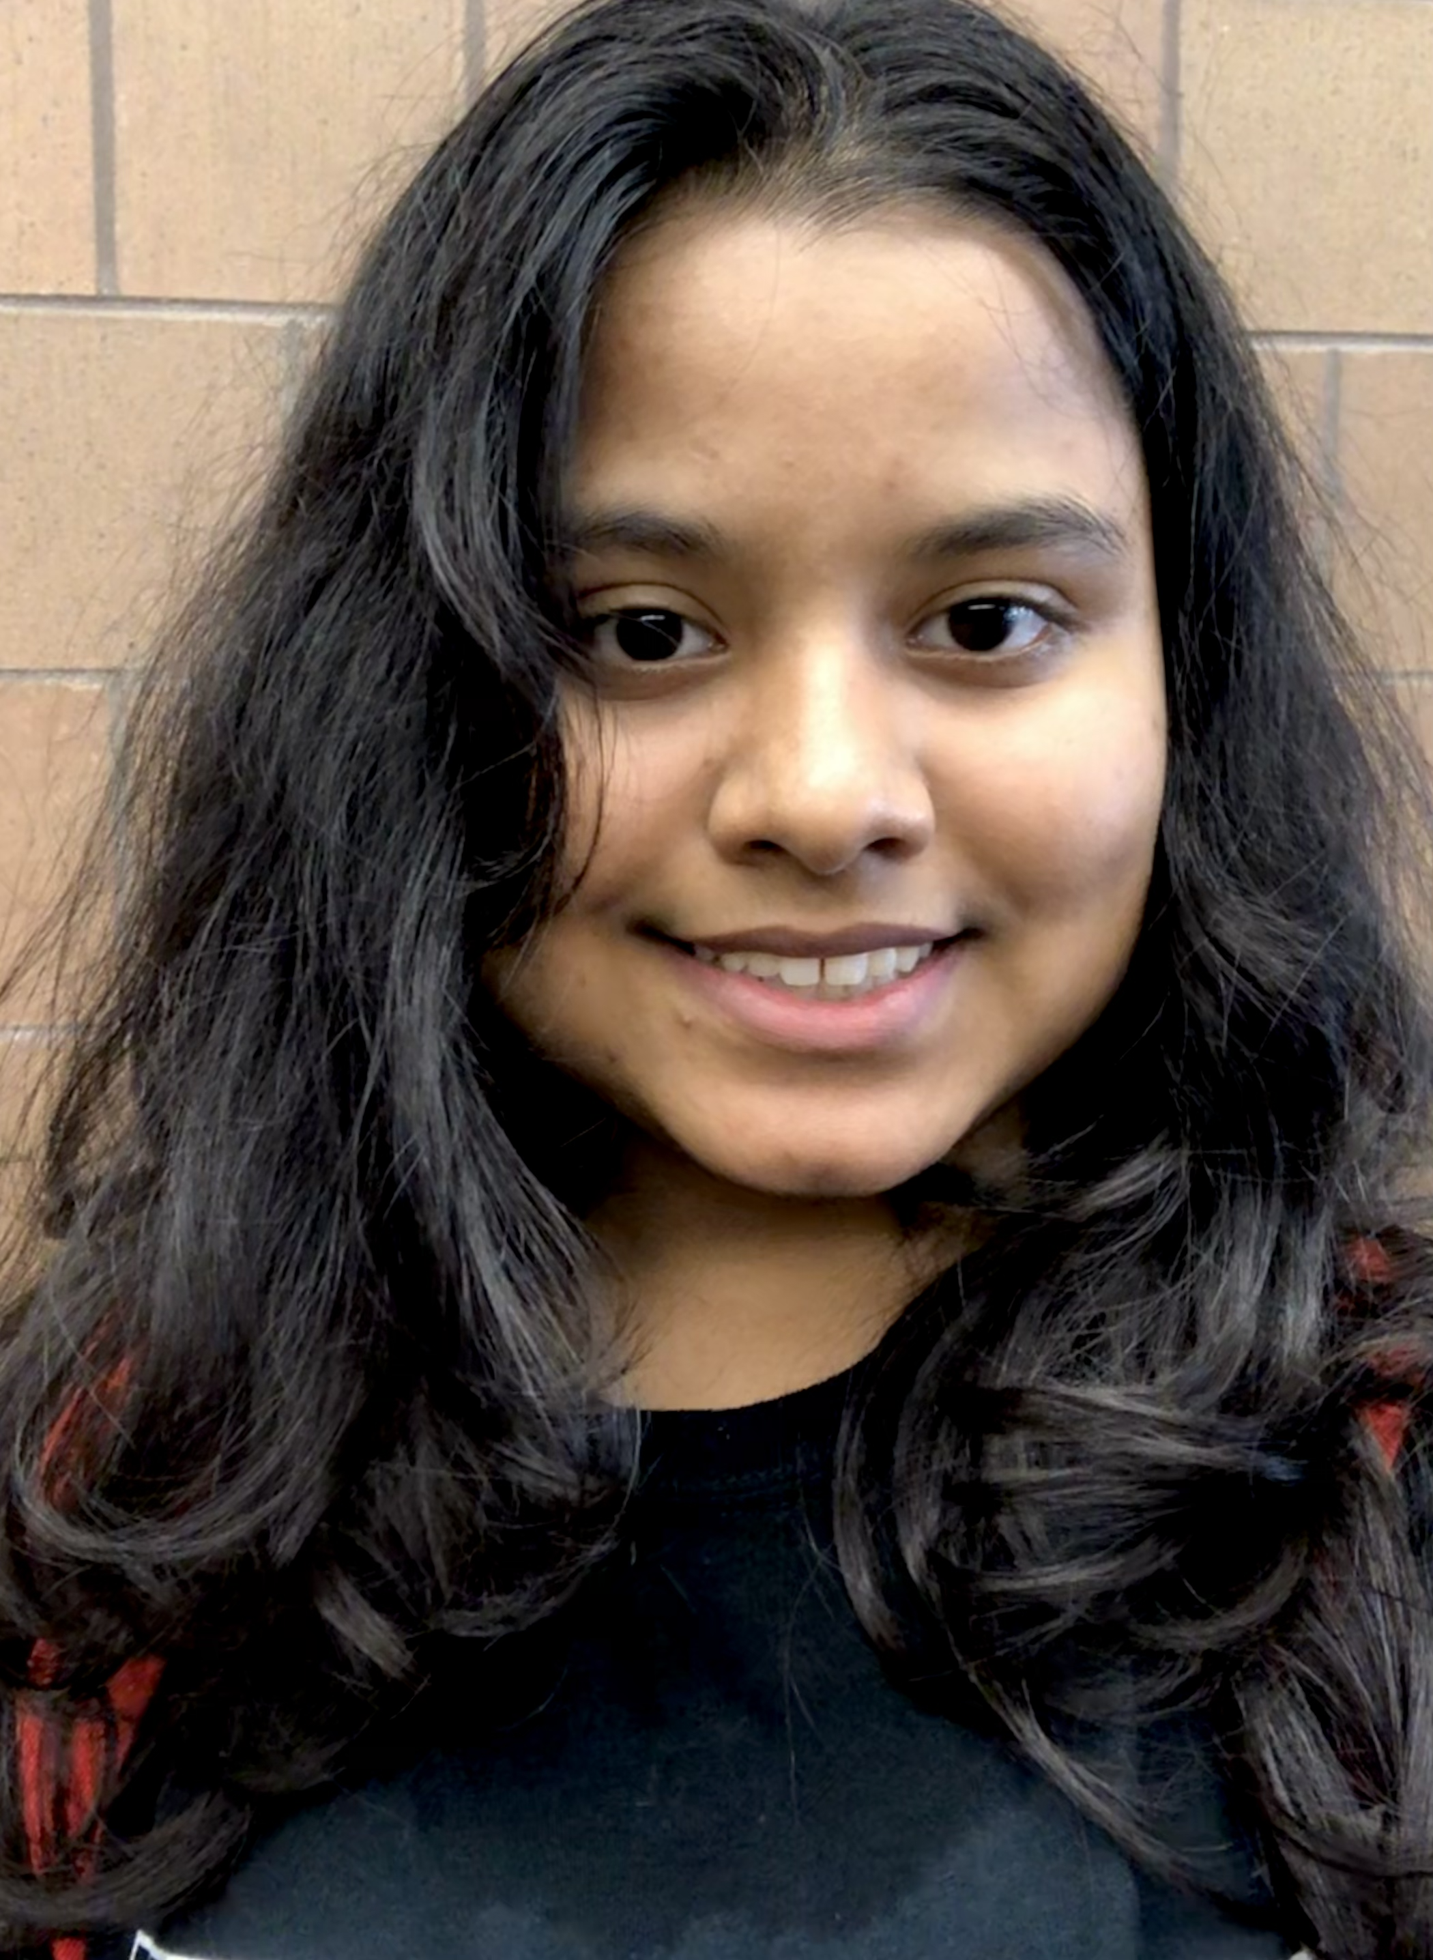
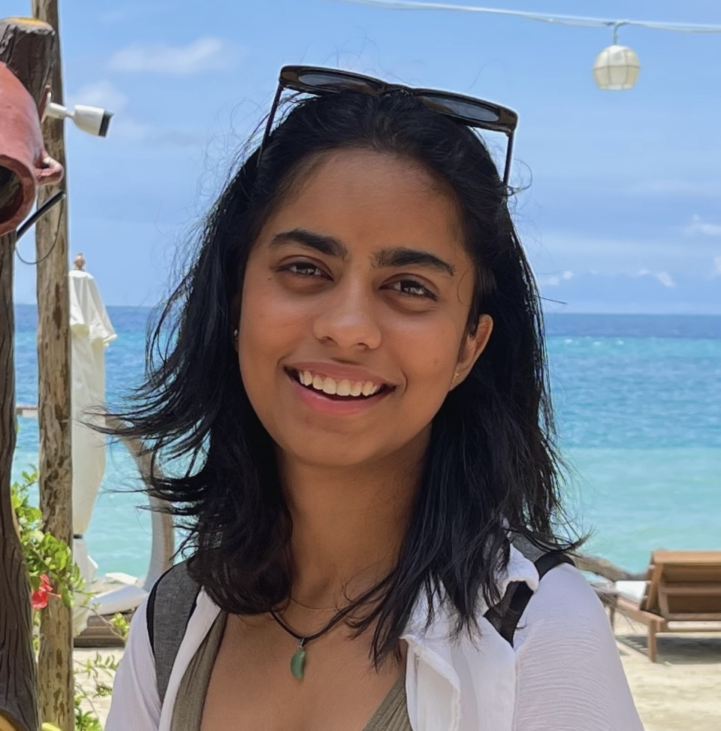
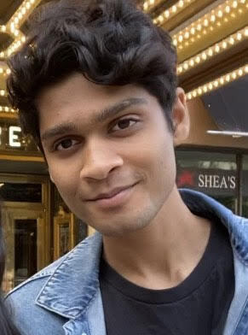
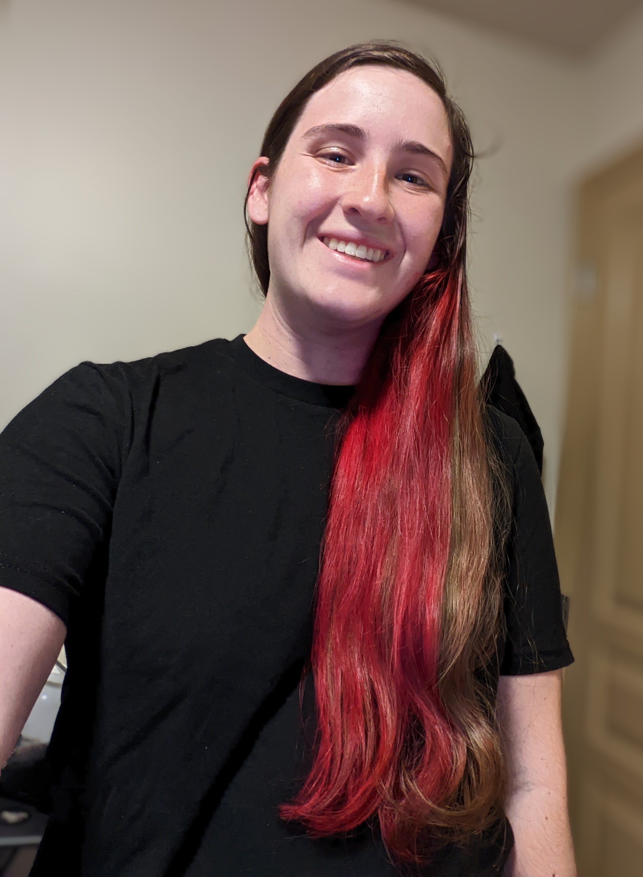
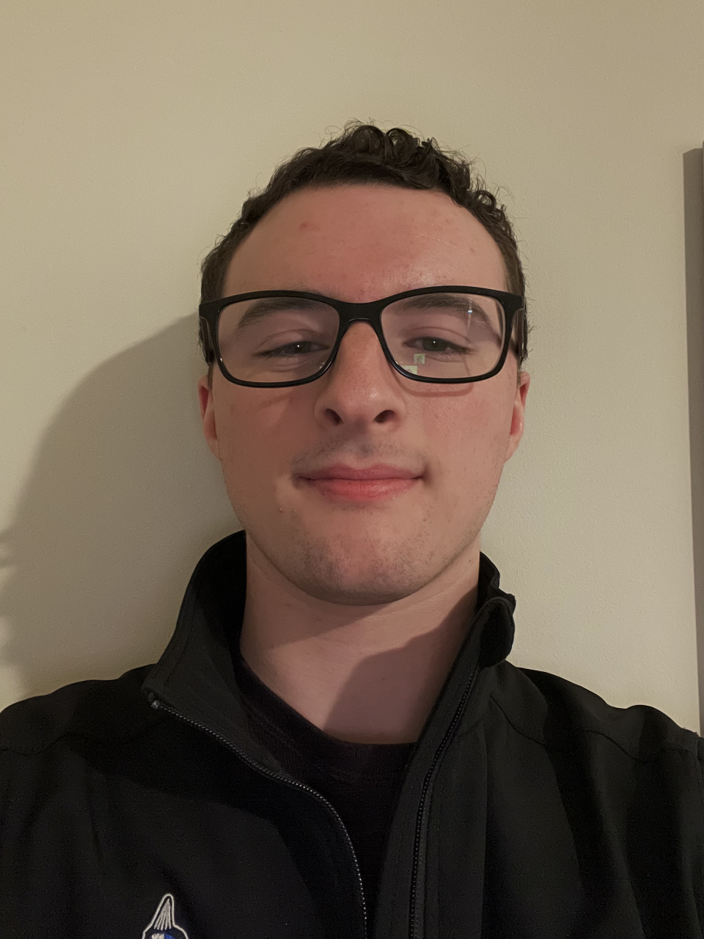
TAs first
Trevor
James
Hunter
Zachary
Sebastian
Caleb
Richard
Rrucha
Ahana
Nishanth
Lizzy
Harrison

Slide 5
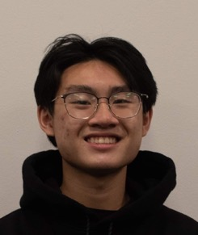
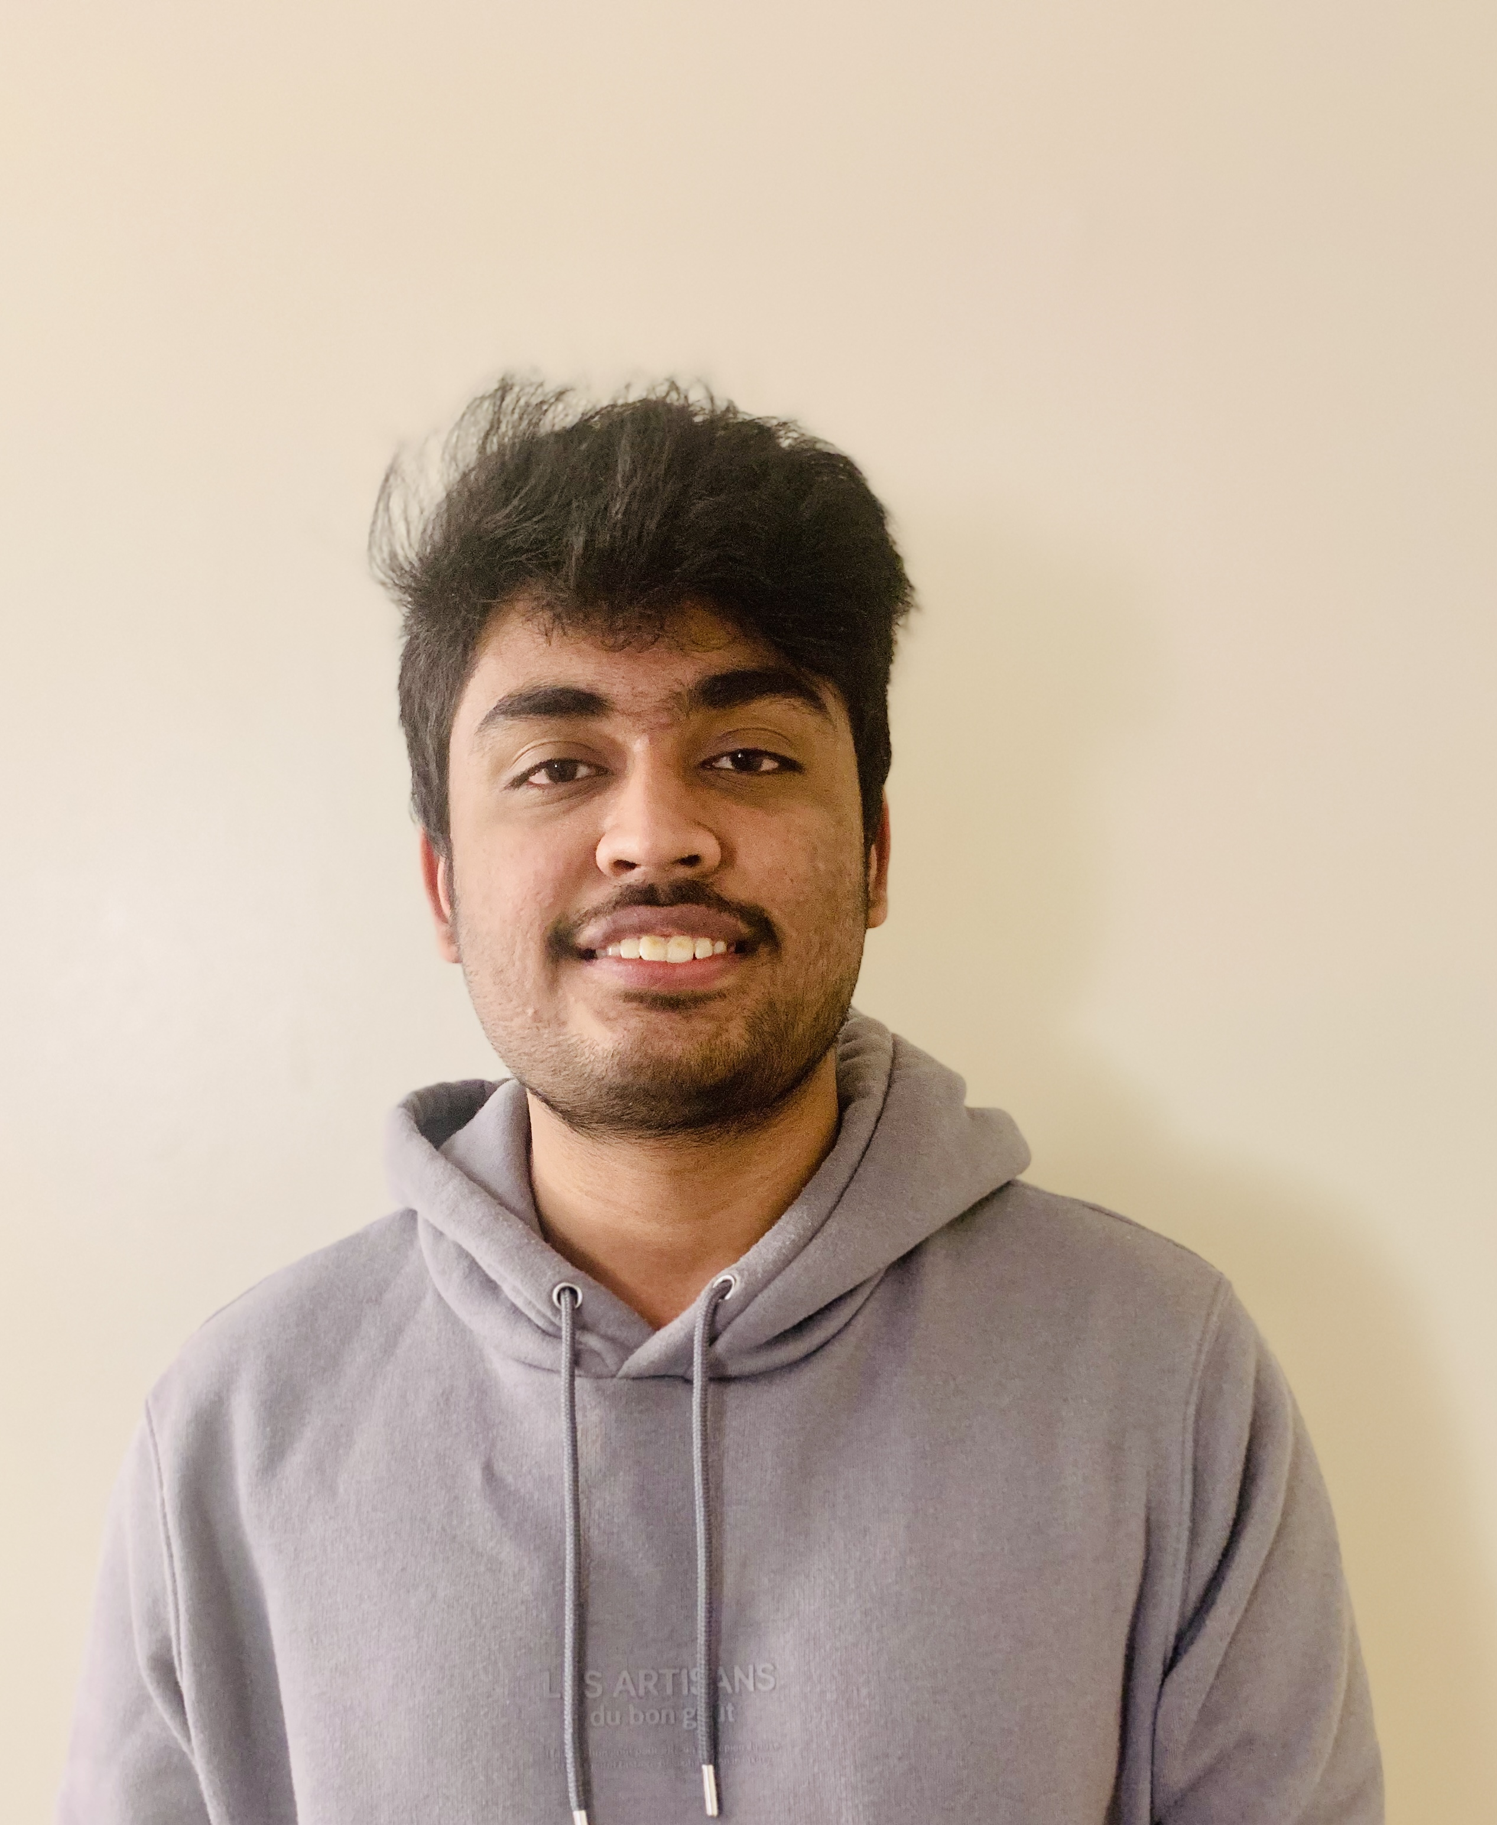
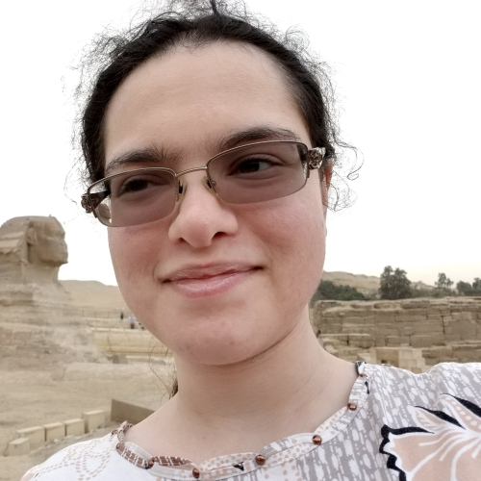
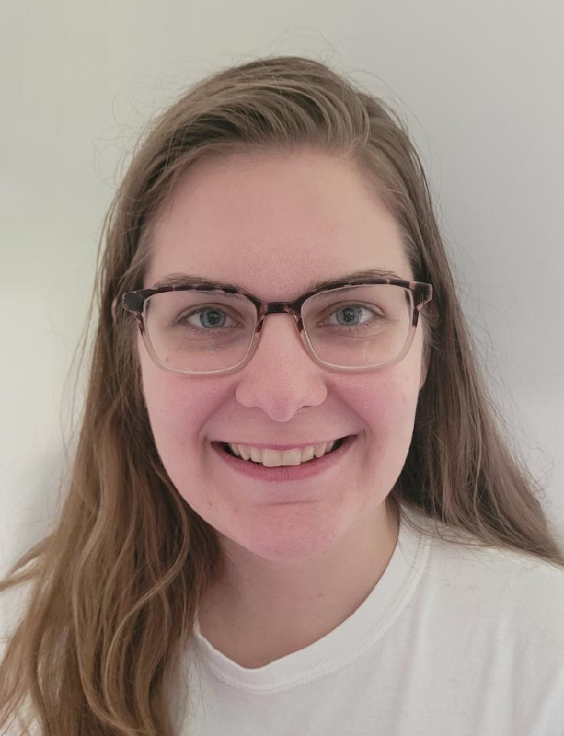
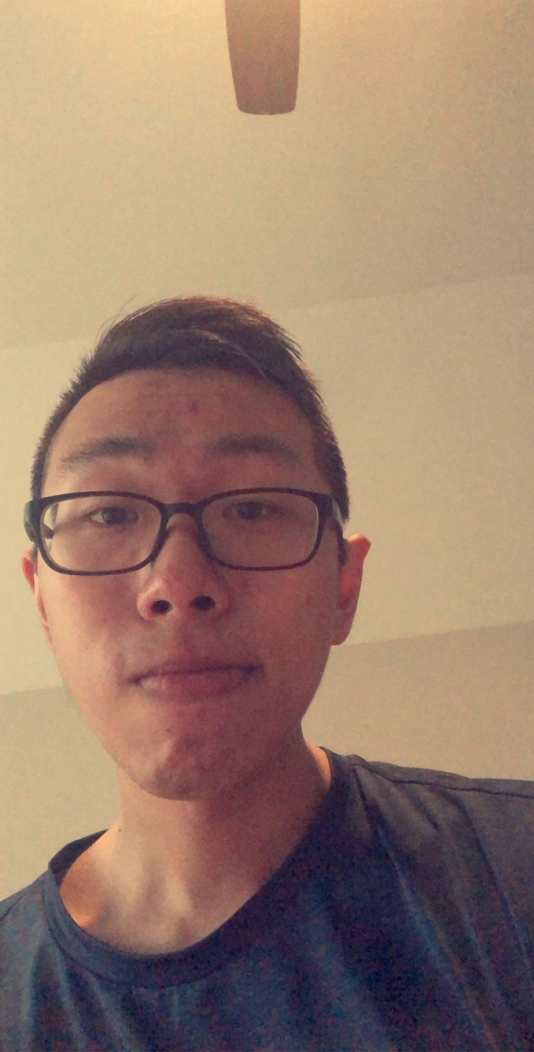
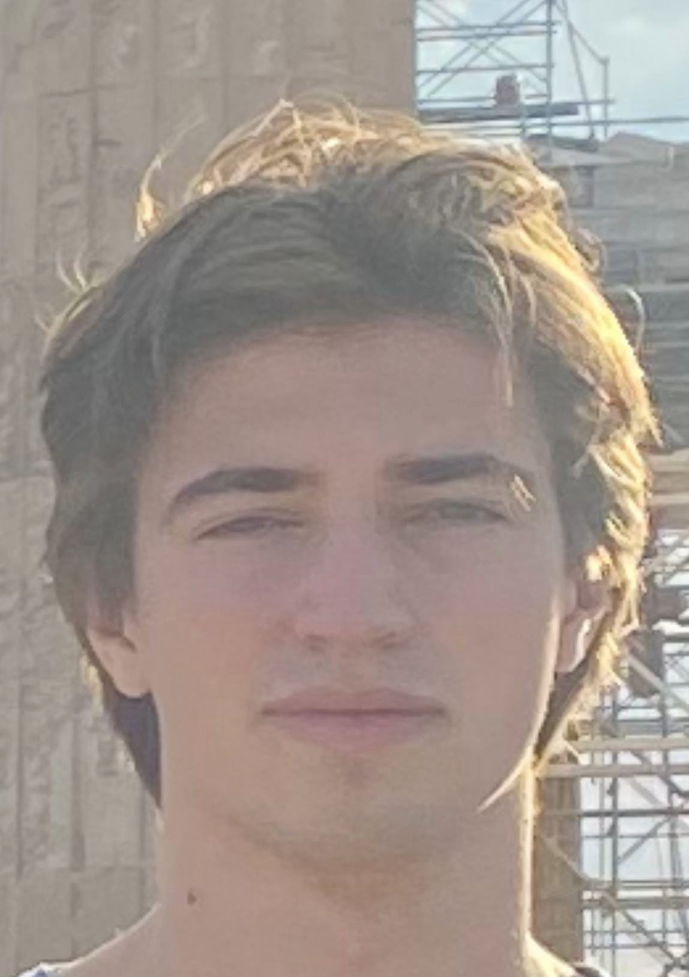
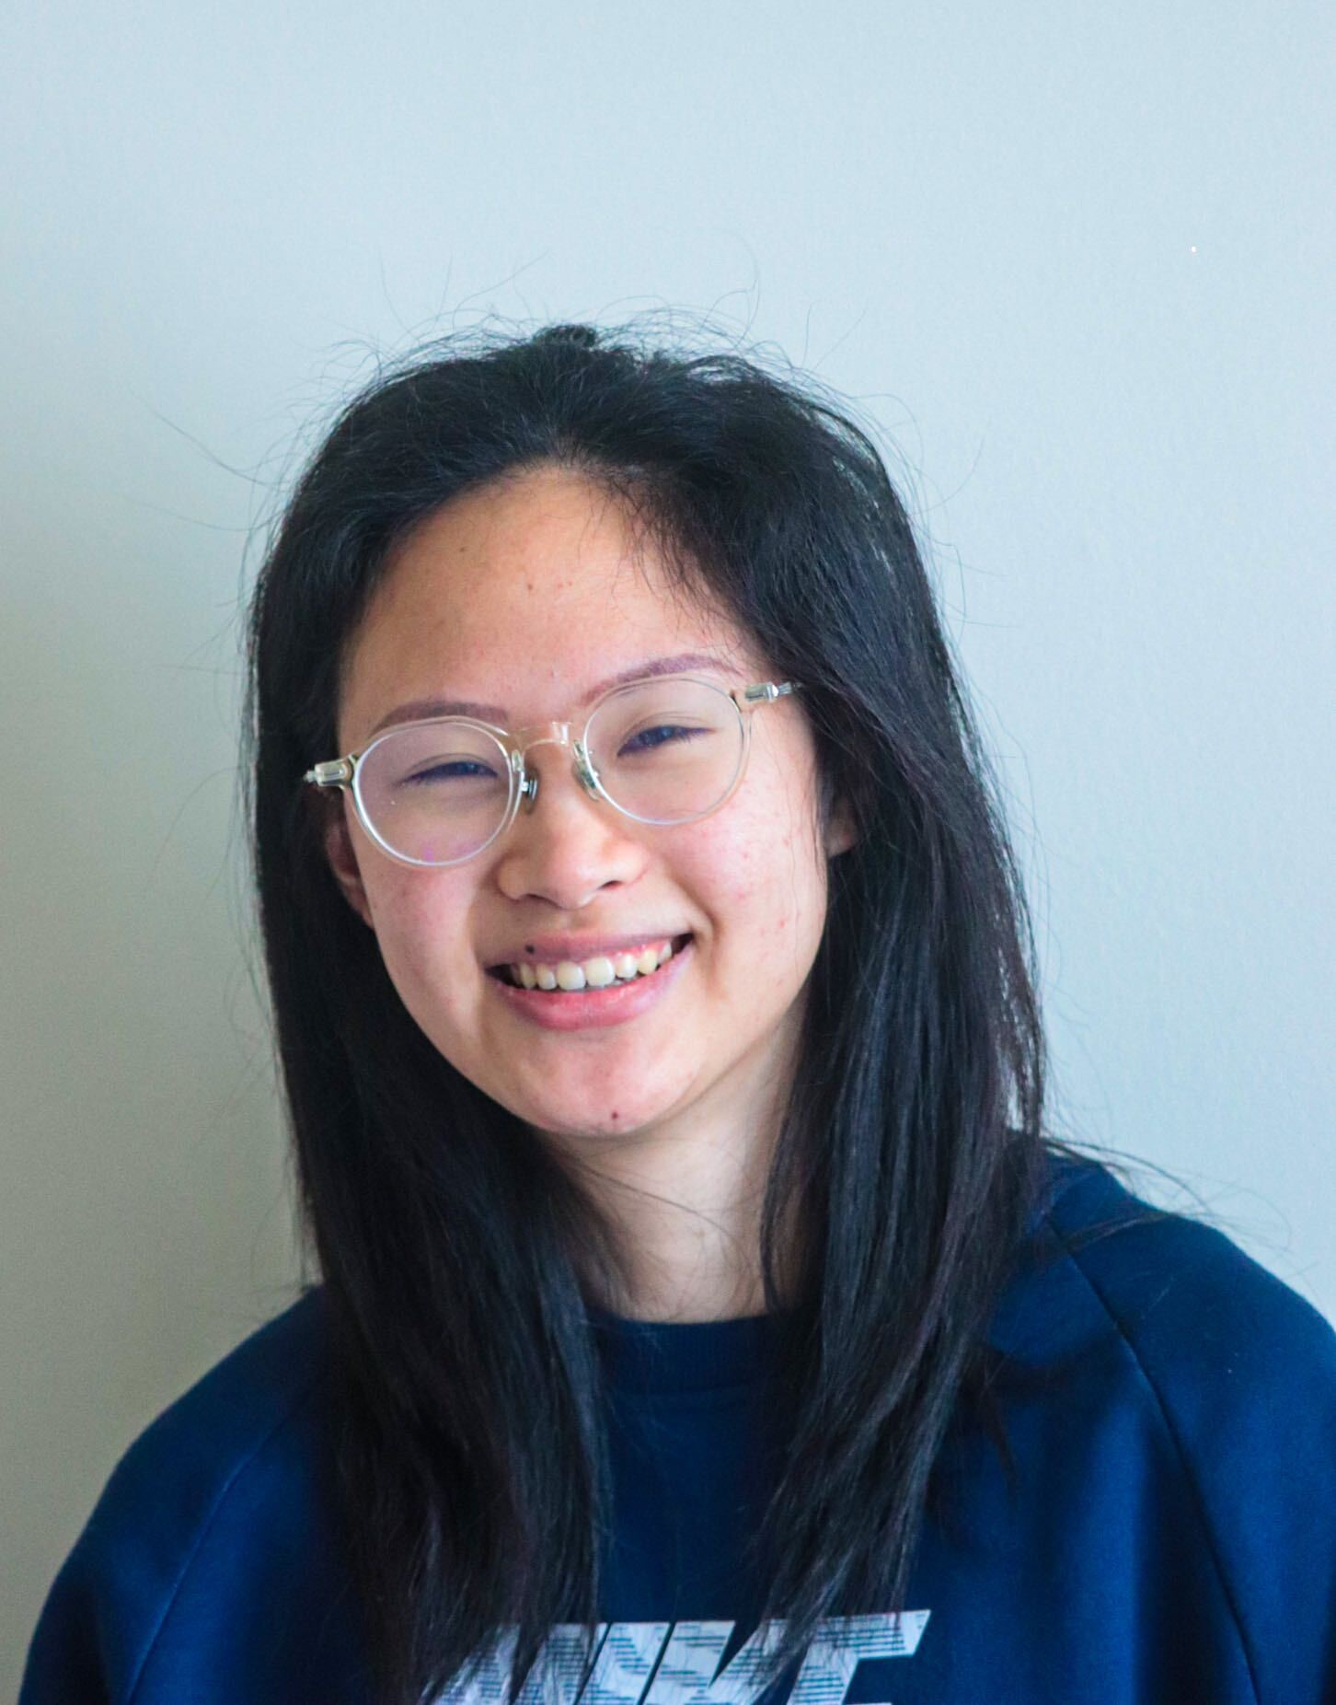
TAs first
Korey
Heba
Sujal
John
Jessica
Billy
Dylan
Kelly

Slide 6
Lectures will be videotaped
http://www.imdb.com/title/tt0363510/mediaviewer/rm2499681792

Slide 7
About Me
Nasrin Akhter
nasrinak@buffalo.edu
Office: Davis 303
Office hours: M W 3:30-4:30PM ET

Slide 8
Contact us all at
Or use piazza!
cse-331-staff@buffalo.edu
TAs will not respond to individual emails (except for re-grading requests)

Slide 9
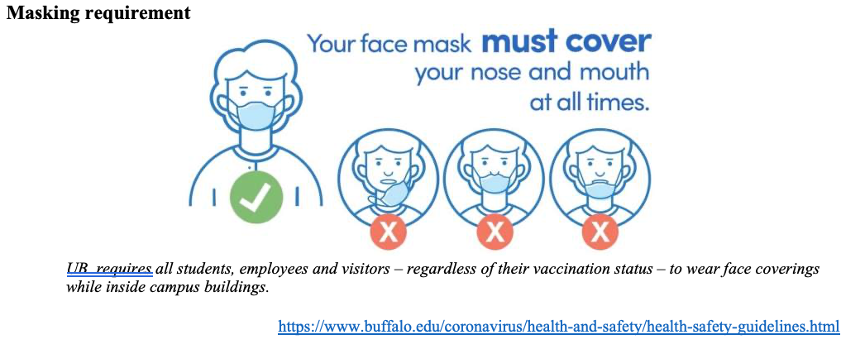
CSE 331 in times of COVID
Lectures and recitations will be in-person
Office hours will be a mix of in-person and virtual locations
Exams and Quizzes will be in-person

Slide 10
Questions/Comments?

Slide 11
Handouts for today
Syllabus (online)
Homework Policy document (online)

Slide 12
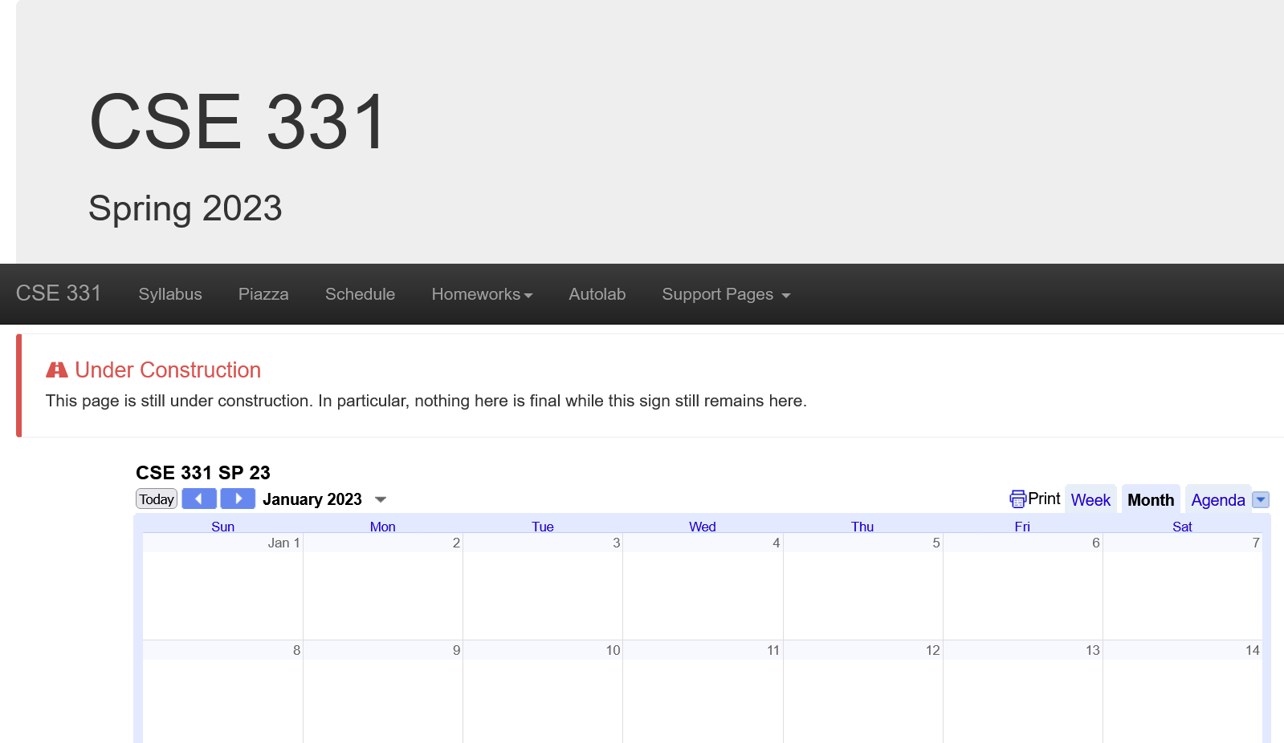
One Stop Shop for the Course
Piazza Access Code: CSE331SP23
https://cse.buffalo.edu/~nasrinak/cse331/SP23/index.html

Slide 13
Three things to remember
WORK HARD!
DO NOT CHEAT!
READ CAREFULLY!

Slide 14
Wait.. What???
Make sure you follow submission instructions.
Two most common ways of losing points
Make sure you read problem statements carefully.

Slide 15
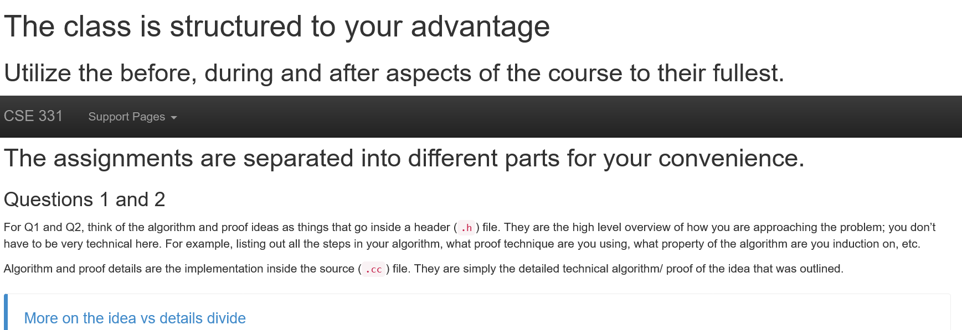
Advice from 331 TAs
https://cse.buffalo.edu/~nasrinak/cse331/support/advice/index.html

Slide 16
Academic Dishonesty
All your submissions must be your own work
Penalty:
Minimum: A grade reduction in course
Possible: F (or higher penalty) if warranted
YOUR responsibility to know what is cheating, plagiarism etc.
If not sure, come talk to me
Excuses like “I have a job,” “This was OK earlier/in my country,” “This course is hard,” etc. WON’T WORK.
IN FACT, NO EXCUSE OR NO AMOUNT OF ARGUMENT WILL WORK:
YOU WILL GET A GRADE REDUCTION IN THE COURSE
FOR YOUR FIRST MISTAKE

Slide 17
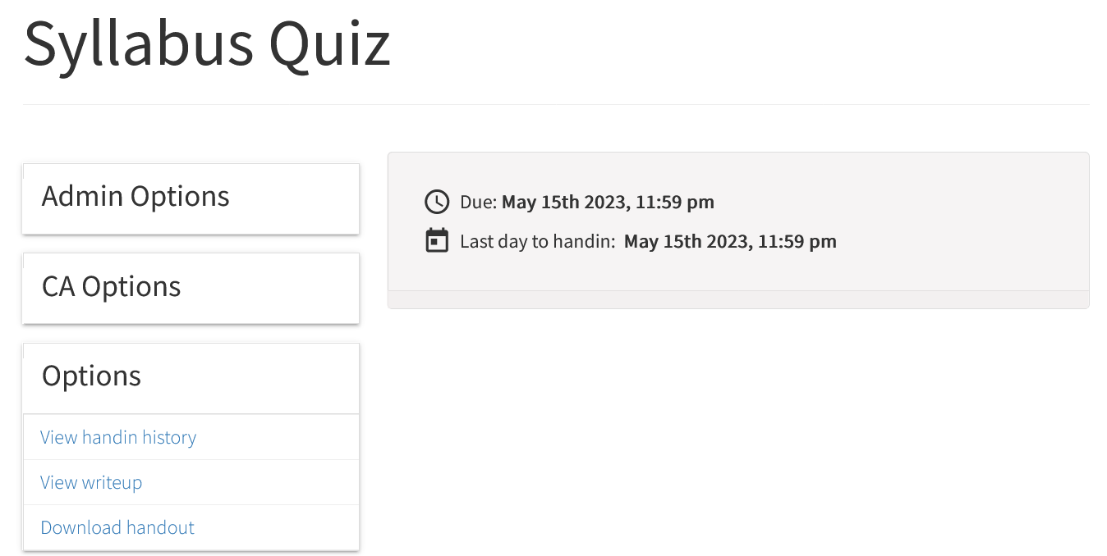
Read the syllabus CAREFULLY!
No graded material will be handed back till you pass the syllabus quiz!

Slide 18
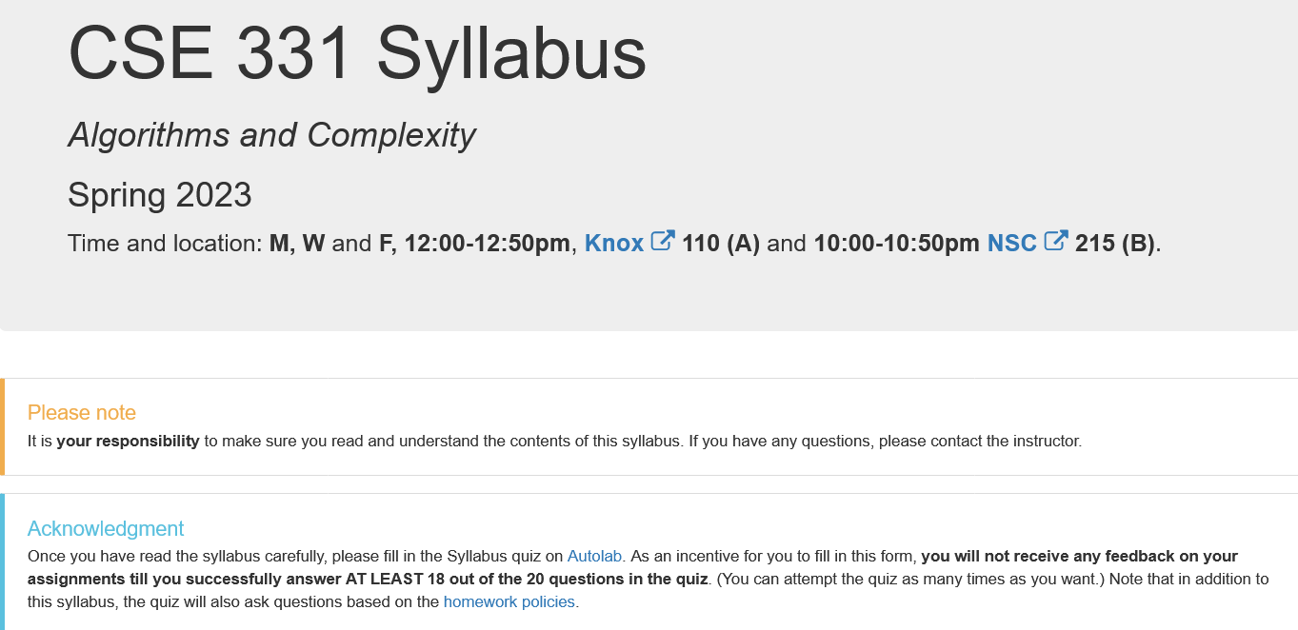
More information on the quiz

Slide 19
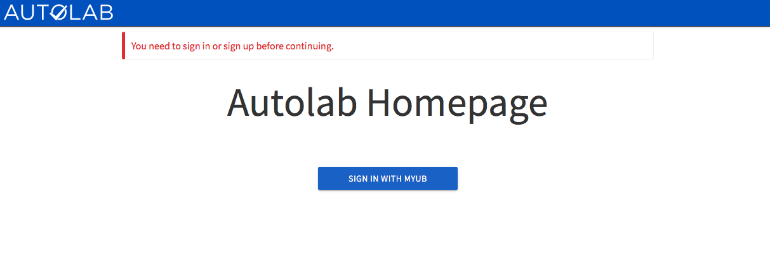
Autolab
https://autograder.cse.buffalo.edu/

Slide 20
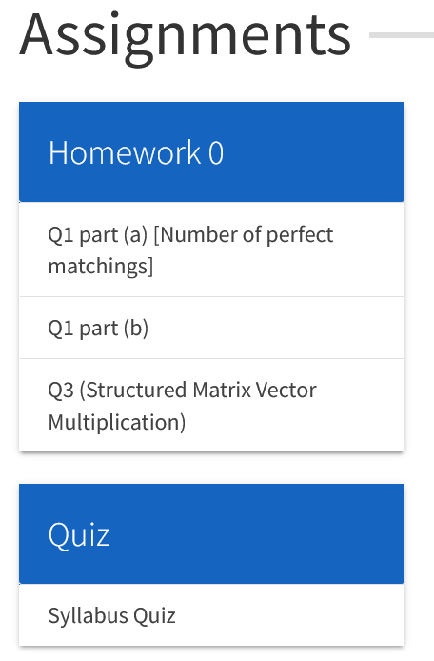
You can submit the following now
HW0 is out!

Slide 21
Grading break-down

Slide 22
Questions/Comments?

Slide 23
Pre-requisites
Required (officially)
CSE 250, [CSE 191 or MTH 311] and MTH 142
At least a C- (this is recommended)
Required (for practical purposes)
Comfort with proofs
Willingness to work hard!

Slide 24
Accessibility Resources
Information included in the syllabus
In short, let me know and consult with Accessibility Resources.

Slide 25
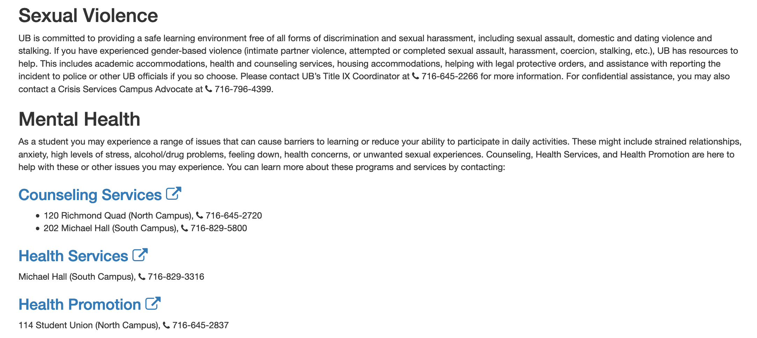
Critical Campus Resources

Slide 26
TA Office hours
YOU decide!

Slide 27
Recitations
Are on for this week!
RECITATIONS

Slide 28
Please stick to your recitation section

Slide 29
Exams
Mid term (two parts)
Tentative dates:
Mon, March 13 and Wed, March 15, 2023. Usual place and time.
Final exam
Wed, May 17, 2023. Usual place and time.
Section A: NSC 201, Section B: NSC 215

Slide 30
The HW structure
DROP lowest 2 HW scores
Three questions
Q1 and Q2 are proof based while Q3 is programming
Q1 worth 50 points
The hard proof based Q2 and programming Q3 worth 25 points each
HWs due by 8:00pm on Fridays
A few exceptional cases: HW0, HW8
Please keep an eye on the schedule

Slide 31
Project

Slide 32
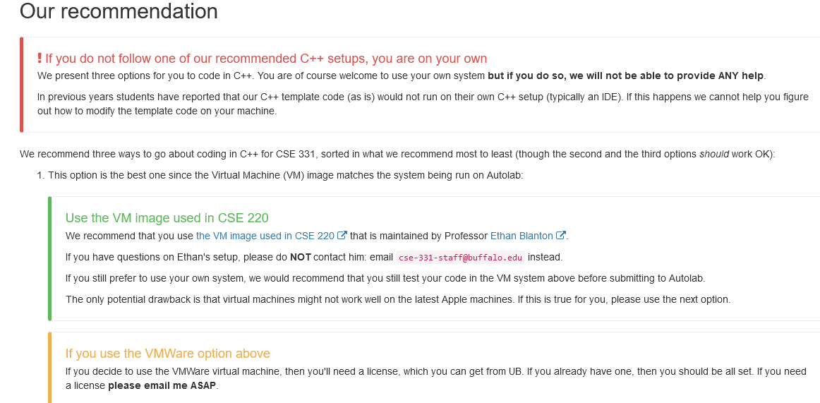
C++ vs Java/Python
Use Java/Python if as you just as comfortable with as C++

Slide 33
C++ vs Java/Python
Use Java/Python if as you just as comfortable with as C++

Slide 34
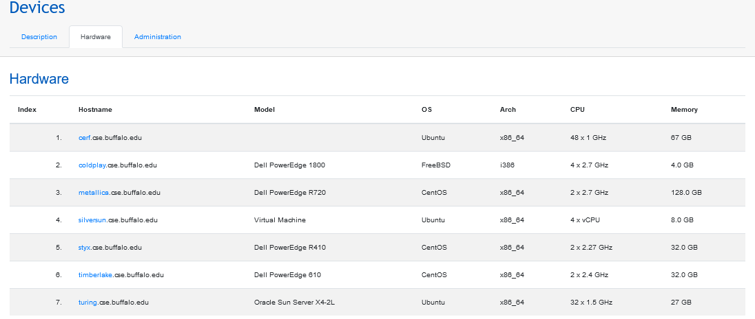
C++ vs Java/Python
Use Java/Python if as you just as comfortable with as C++
https://cse.buffalo.edu/apps/devices/

Slide 35
C++ vs Java/Python
Use Java/Python if as you just as comfortable with as C++

Slide 36
Questions/Comments?

