Slide 1
Lecture 15
CSE 331

Slide 2
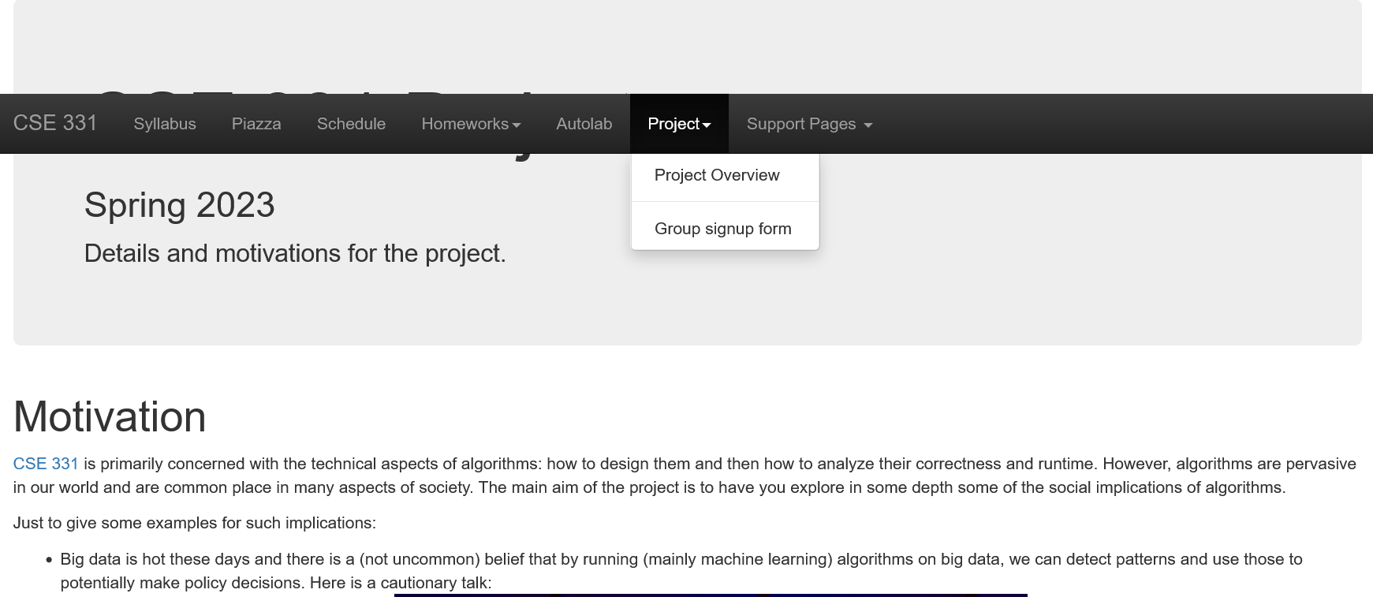
Project groups due Friday!
Deadline: Tonight (Friday, March 3), 11:59pm

Slide 3
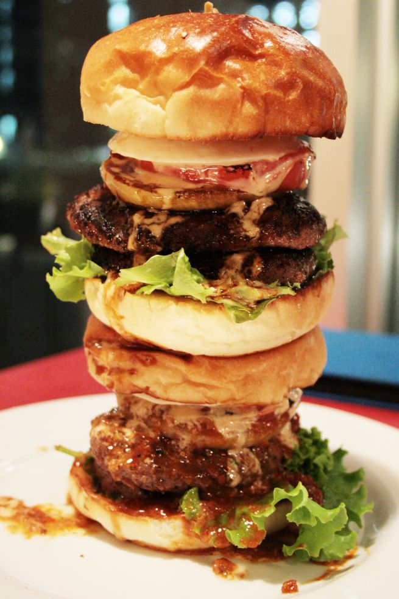
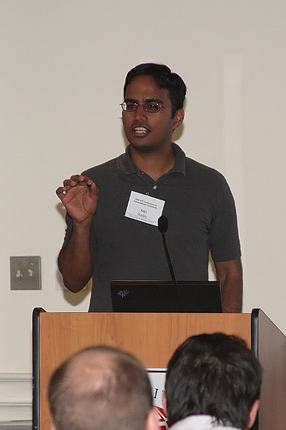
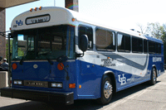
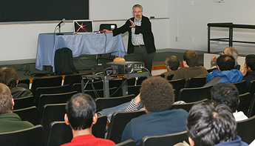
Directed graphs
Model asymmetric relationships
Precedence relationships
CSE 331 CLASS
u needs to be done before w means (u,w) edge

Slide 4
Directed graphs
Adjacency matrix is not symmetric
CSE 331 CLASS

Slide 5
Directed Acyclic Graph (DAG)
No directed cycles
Precedence relationships are consistent
CSE 331 CLASS

Slide 6
Topological Sorting of a DAG
Order the vertices so that all edges go “forward”
CSE 331 CLASS
CSE 331 CLASS

Slide 7
More details on Topological sort

Slide 8
Mid-term material until here

Slide 9
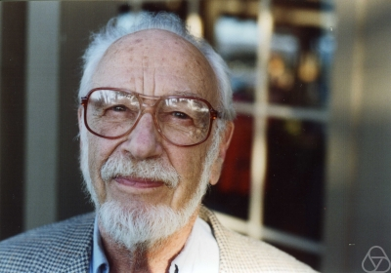
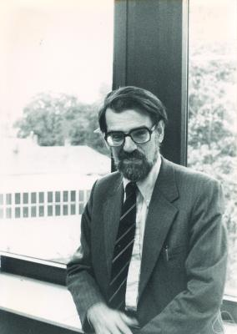
Main Steps in Algorithm Design
Problem Statement
Problem Definition
Algorithm
n!
“Implementation”
Data Structures
Analysis
Correctness+Runtime Analysis

Slide 10
Where do graphs fit in?
Problem Statement
A tool to define problems
Problem Definition
Algorithm
“Implementation”
Data Structures
Analysis
Correctness+Runtime Analysis

Slide 11
Rest of the course*
Problem Statement
Problem Definition
Three general techniques
Algorithm
“Implementation”
Data Structures
Analysis
Correctness+Runtime Analysis

Slide 12
Greedy algorithms
Build the final solution piece by piece
Being short sighted on each piece
Never undo a decision
Know when you see it

Slide 13
End of Semester blues
Can only do one thing at any day: what is the maximum number of tasks that you can do?
Write up a term paper
Party!
Exam study
331 homework
331 HW
Project
Saturday
Sunday
Monday
Tuesday
Wednesday

Slide 14
The optimal solution
Can only do one thing at any day: what is the maximum number of tasks that you can do?
Party!
Exam study
331 HW
Saturday
Sunday
Monday
Tuesday
Wednesday

Slide 15
Interval Scheduling Problem
Input: n intervals [s(i), f(i)) for 1≤ i ≤ n
{ s(i), … ,f(i)-1 }
Output: A schedule S of the n intervals
No two intervals in S conflict
|S| is maximized

Slide 16
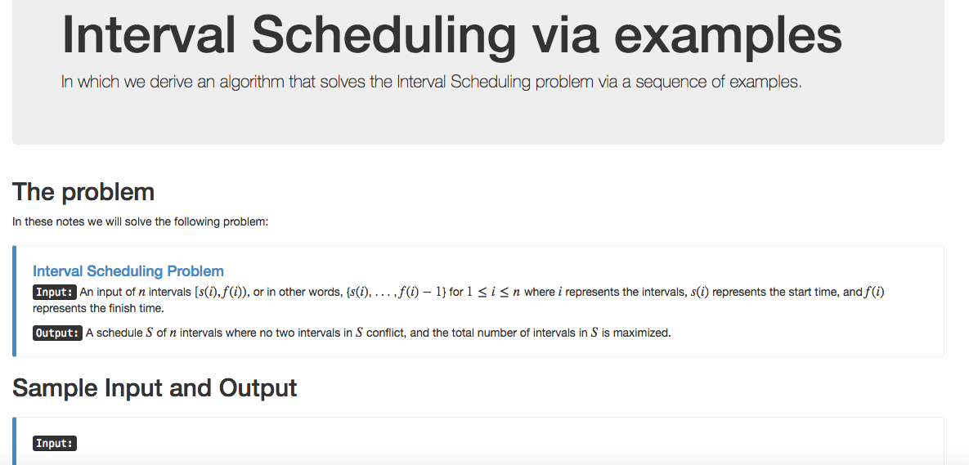
Algorithm with examples

Slide 17
Interval Scheduling Problem
Input: n intervals; ith interval: [s(i), f(i)).
Output: A valid schedule with maximum number of intervals in it (over all valid schedules).
Def: A schedule S ⊆ [n] ([n] = {1, 2, …, n})
Def: A valid schedule S has no conflicts.
Def: intervals i and j conflict if they overlap.

Slide 18
Interval Scheduling Problem
Conflicts:
i
j
No conflicts:
i
j

Slide 19
Example 1
No intervals overlap

Slide 20
Algorithm?
No intervals overlap
R: set of requests
Set S to be the empty set
While R is not empty
Choose i in R
Add i to S
Remove i from R
Return S*= S

Slide 21
Example 2
At most one overlap/task

Slide 22
Algorithm?
At most one overlap
R: set of requests
Set S to be the empty set
While R is not empty
Choose i in R
Add i to S
Remove i from R
Return S*= S

Slide 23
Algorithm?
At most one overlap
R: set of requests
Set S to be the empty set
While R is not empty
Choose i in R
Add i to S
Remove all tasks that conflict with i from R
Return S*= S

